Slide 1
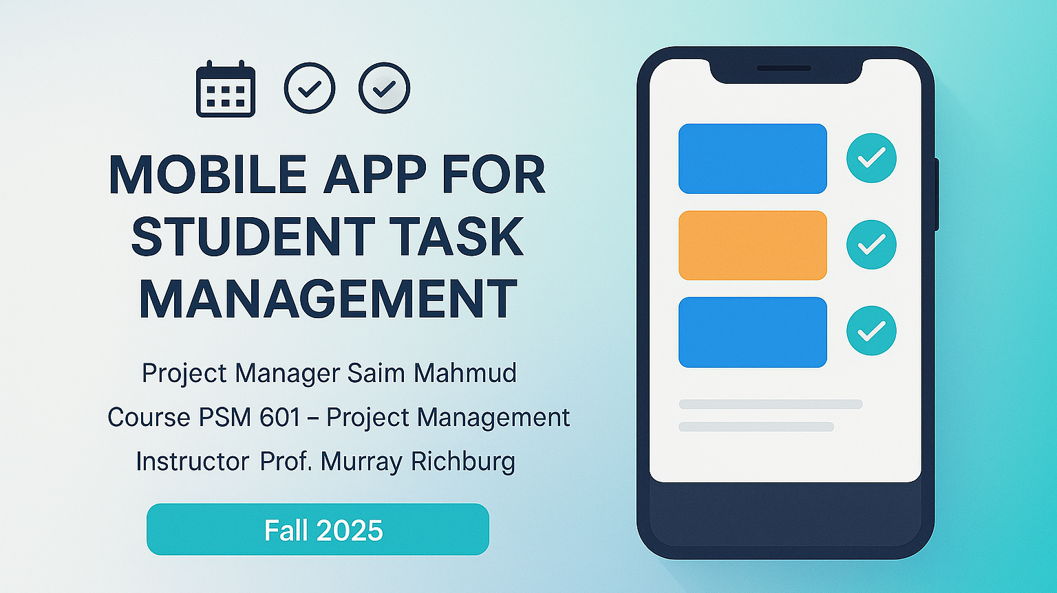

Slide 2
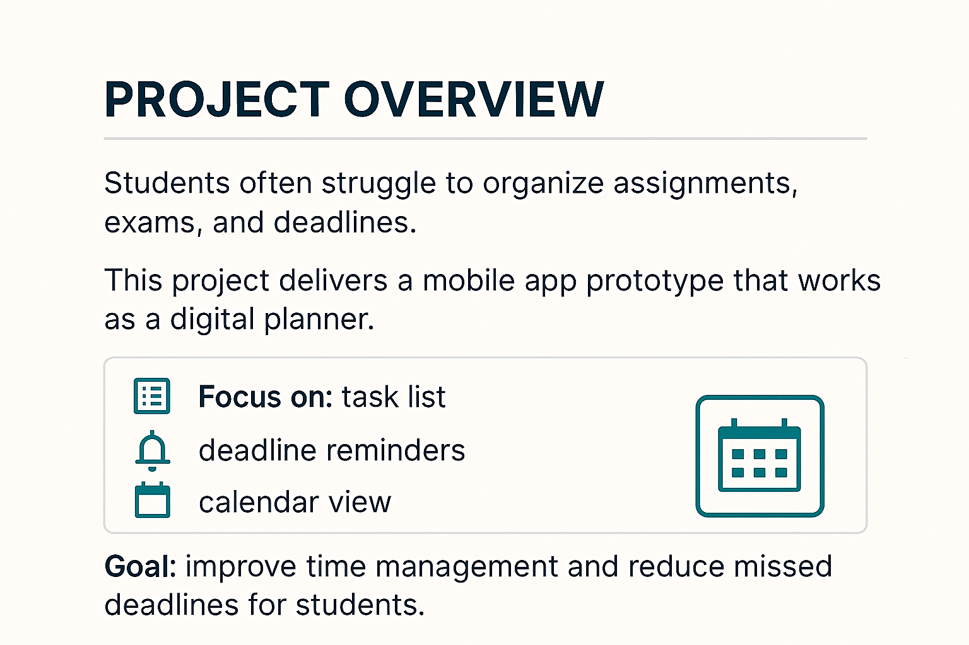

Slide 3
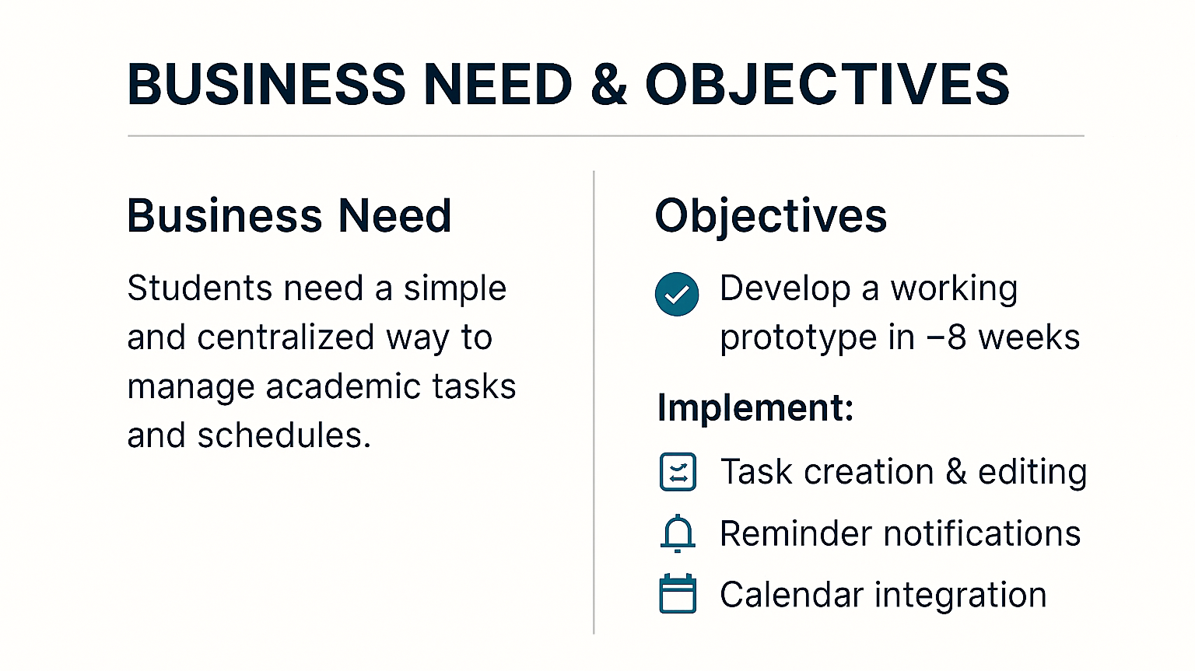
Notes:
.So the need here is a simple and centralized way for students to manage their academic tasks more efficiently.

Slide 4
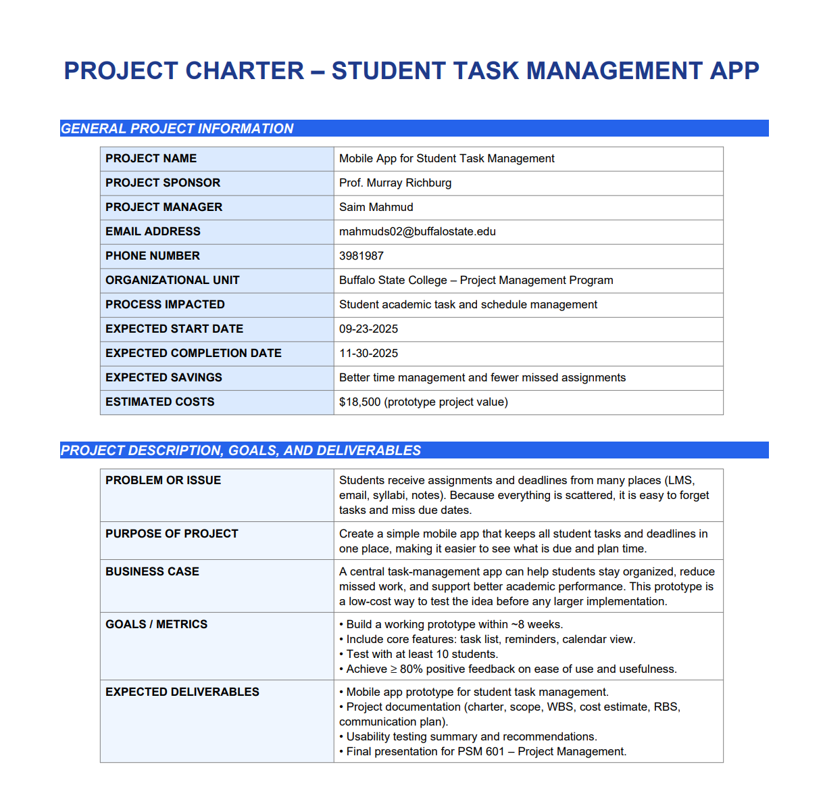
Notes:
The problem is that student deadlines come from many places.
The purpose is to create one simple app that keeps all tasks together.
The business case is that this app can help students stay organized and miss fewer assignments.
The goals are to build a working prototype in about eight weeks, include core features, test with ten students, and get at least eighty percent positive feedback
The deliverables are the app prototype, all documents, the usability testing summary, and the final presentation.”

Slide 5
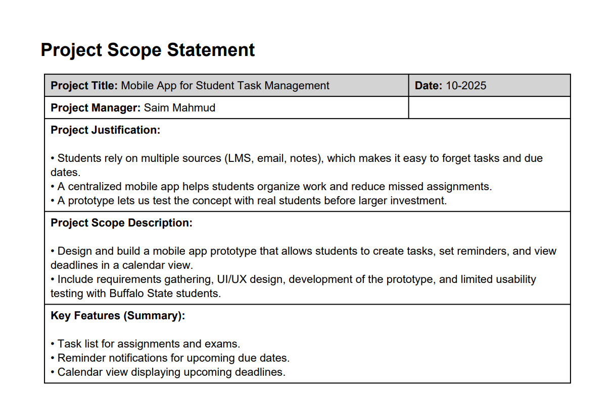
Notes:
The justification is simple: students use many different sources for deadlines, so things get lost.
A single app can help them stay organized, and the prototype lets us test the idea with real students.
The scope is to design and build a mobile prototype where students can create tasks, set reminders, and see deadlines on a calendar

Slide 6
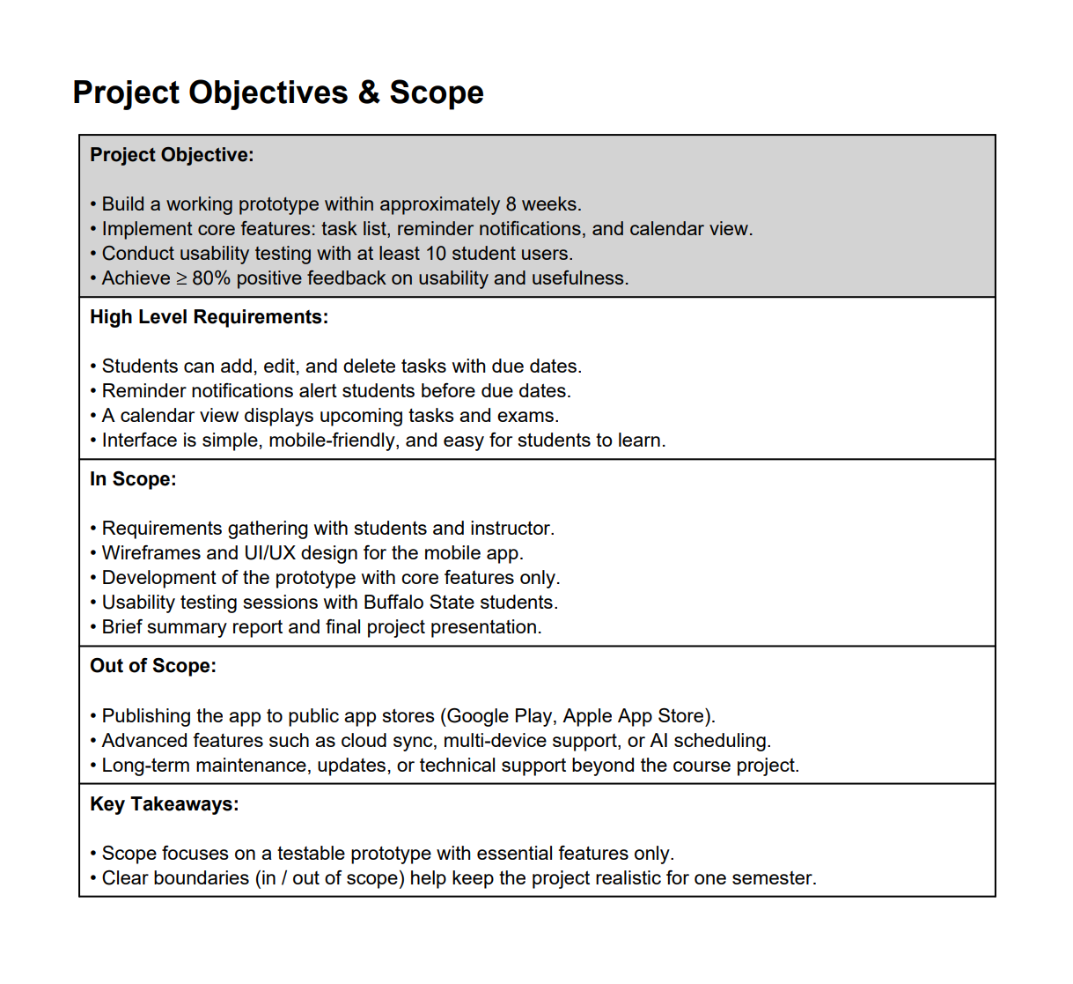
Notes:
The main objectives are to build a working prototype in about eight weeks, include the core features like task list, reminders, and calendar view, test with at least ten students, and try to get over eighty percent positive feedback.
The high-level requirements include adding tasks, editing and deleting tasks, sending reminders, and showing deadlines on a simple calendar view.
Out of scope are things like publishing the app to app stores, adding advanced features, or doing long-term maintenance.

Slide 7
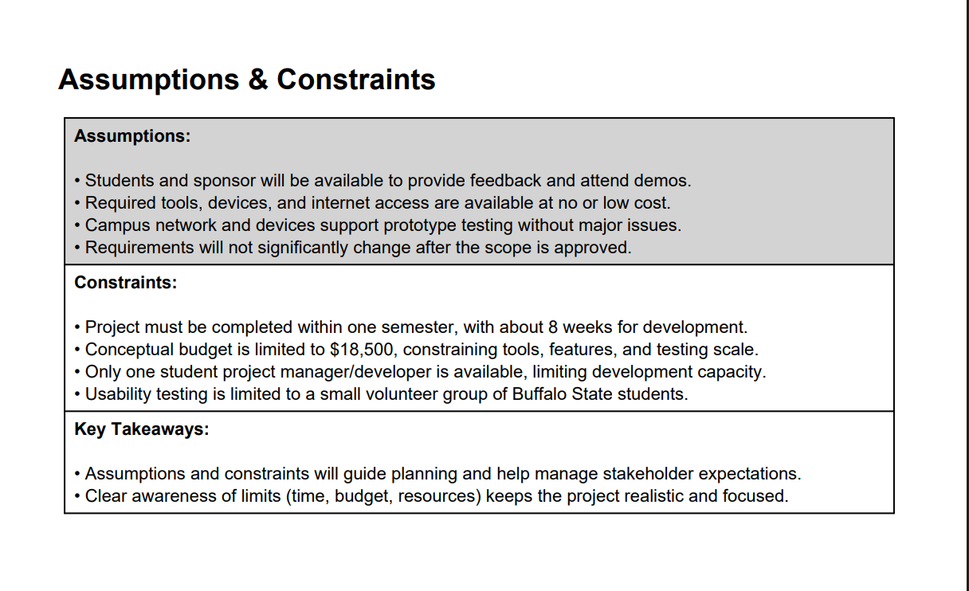
Notes:
The assumptions are that students and the sponsor can give feedback, the needed tools and internet are available, campus systems support testing, and requirements won’t change much.
The constraints are the one-semester timeline, the budget limit of eighteen-thousand five-hundred dollars, only one student developer, and testing limited to a small student group.

Slide 8
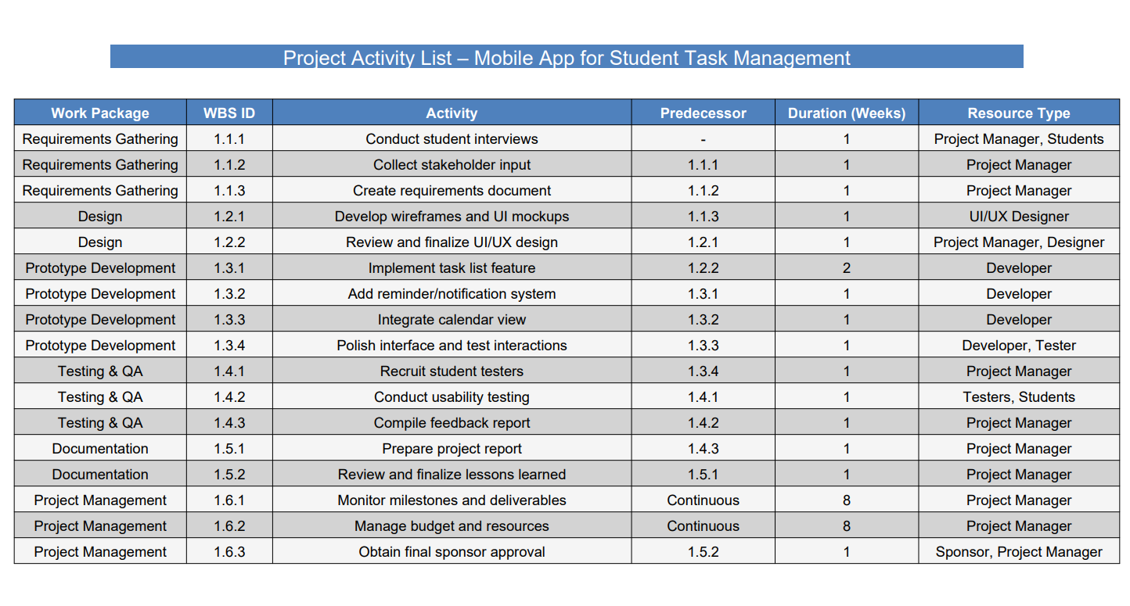
1
2
3
4
5

Slide 9
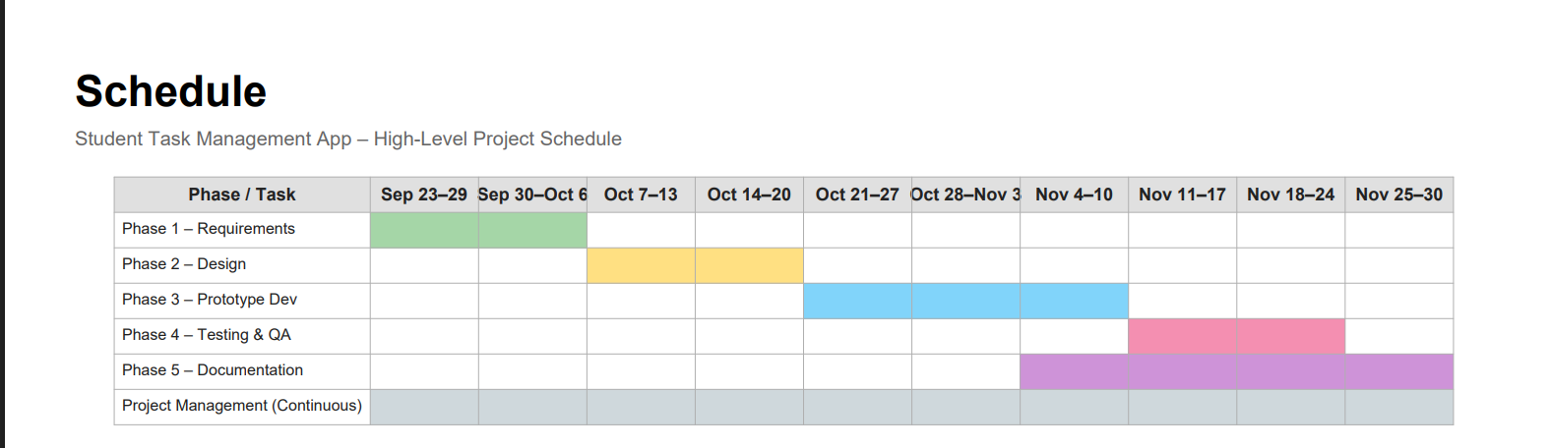

Slide 10
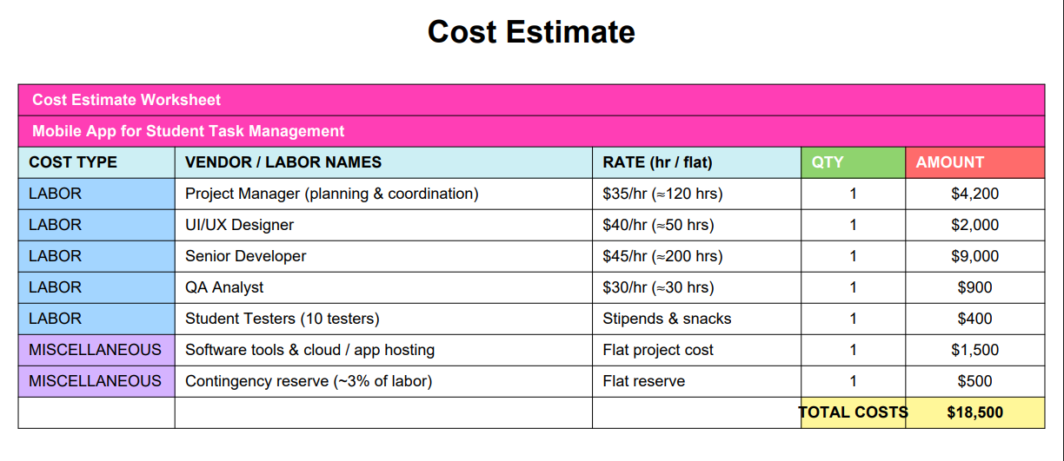

Slide 11
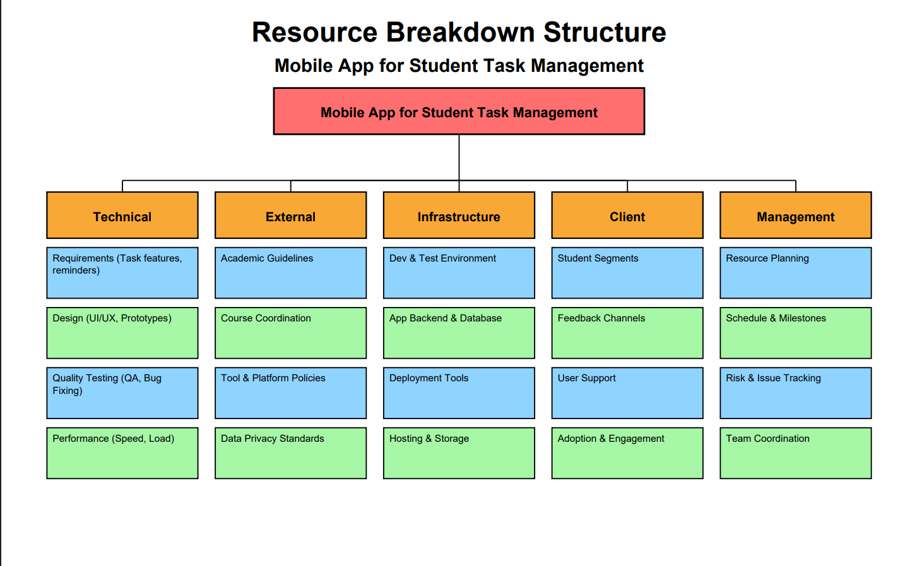
Notes:
The technical resources include requirements for the app features, UI and UX design, quality testing, and performance needs.
The external resources include academic guidelines, course coordination, tool and platform policies, and data privacy standards.
The infrastructure resources include the development and testing environment, the backend and database, deployment tools, and hosting and storage.
The client resources include understanding student segments, feedback channels, user support, and adoption and engagement.
And the management resources cover resource planning, the schedule and milestones, risk and issue tracking, and team coordination.
Overall, this structure helps organize everything the project needs to run smoothly.”

Slide 12
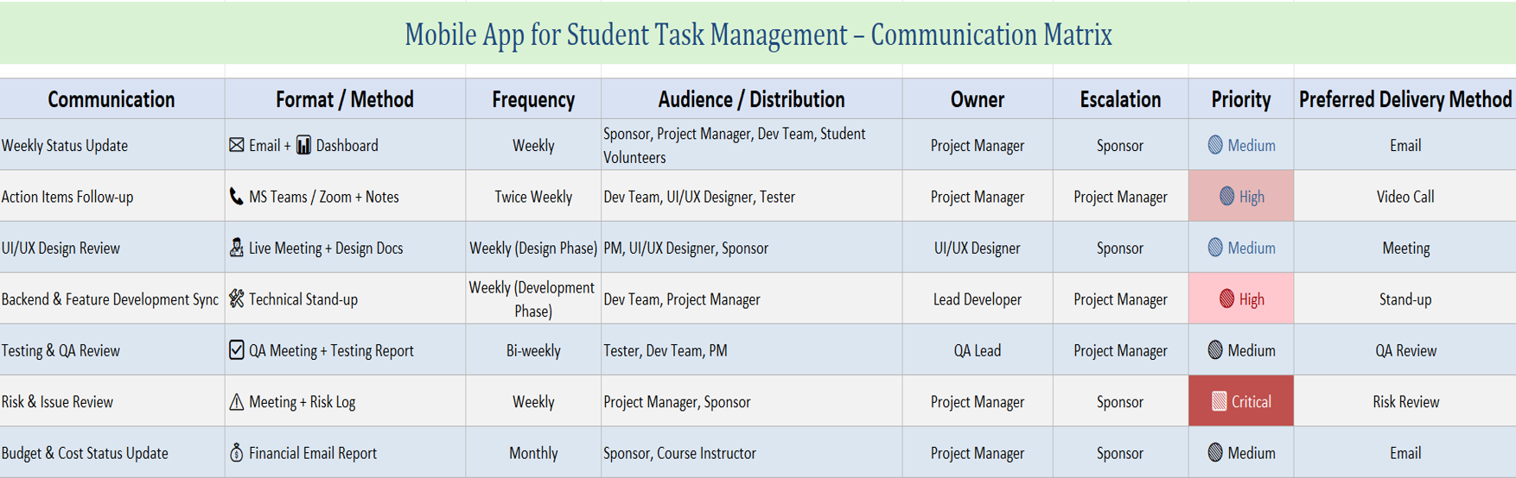
Notes:
Weekly status updates are shared by email and dashboard, and they go to the sponsor, project manager, and development team.
Action items are followed up twice a week using MS Teams or Zoom, mainly for the dev team and the designer.
UI/UX design reviews happen weekly during the design phase through live meetings with the project manager, designer, and sponsor.
Backend and feature development syncs take place weekly during development through technical stand-ups.
Testing and QA reviews happen bi-weekly using QA meetings and testing reports.
Risk and issue reviews are done weekly between the project manager and sponsor, and these are marked as critical.
Budget and cost status updates are sent monthly.
And finally, the project is submitted once through Brightspace along with the final presentation.
This matrix helps keep communication clear and consistent throughout the project.”

Slide 13
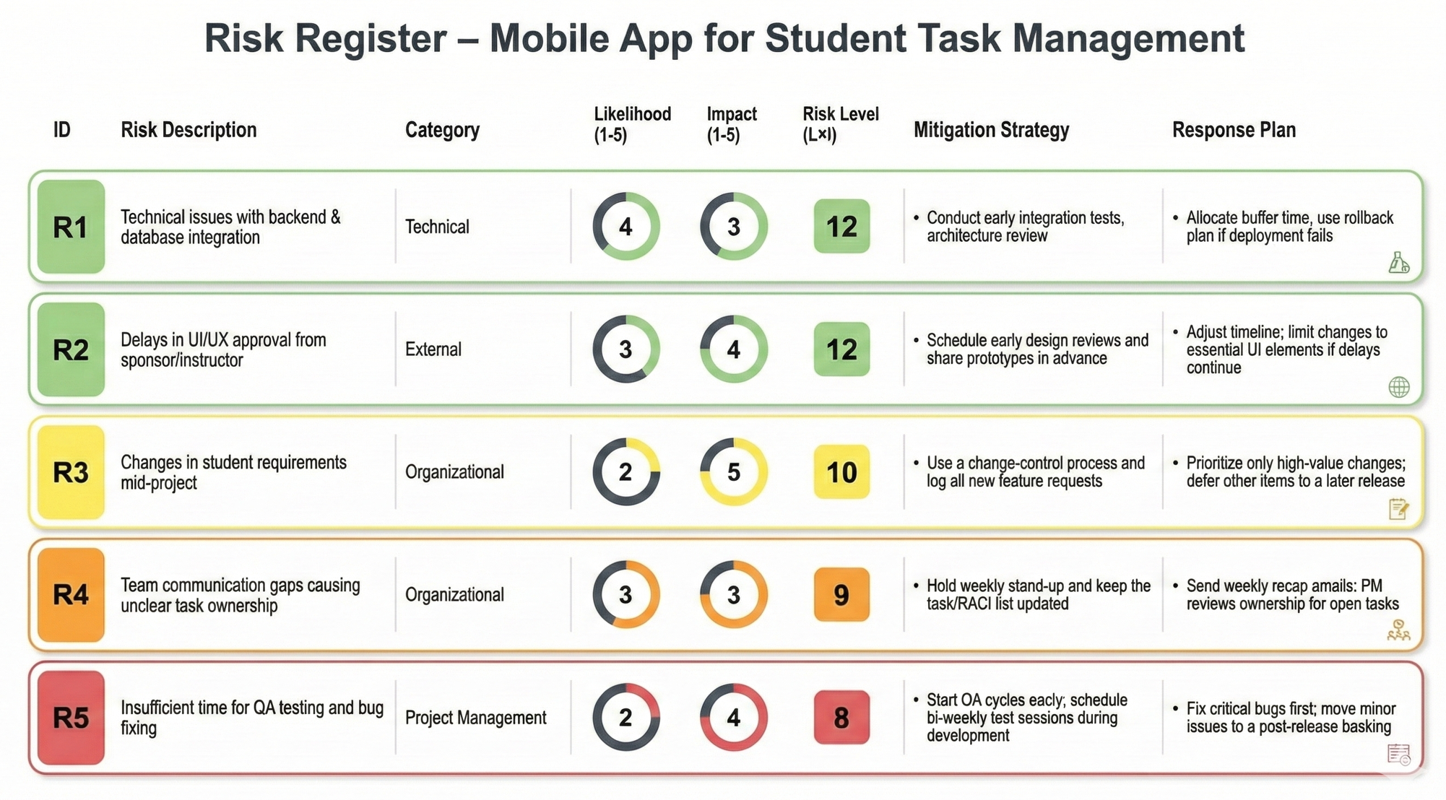
Notes:
R1 is technical issues with backend and database integration, with a risk level of 12.
I handle this by doing early integration tests and using buffer time and rollback plans.
R2 is delays in UI/UX approval, also with a risk level of 12.
To reduce this, I schedule early design reviews and share prototypes in advance.
R3 is changing student requirements mid-project, with a risk level of 10.
I manage this by using a change-control process and prioritizing only high-value changes.
R4 is communication gaps in the team, with a risk level of 9.
Weekly stand-ups and clear task ownership help prevent this.
R5 is not enough time for QA testing, with a risk level of 8.
I plan early QA cycles and fix critical bugs first.
Then I assigned the score based on how often that type of issue usually happens in similar projects.”
I rated the impact based on how much the risk could delay the schedule, increase cost, or damage the project quality.”

Slide 14
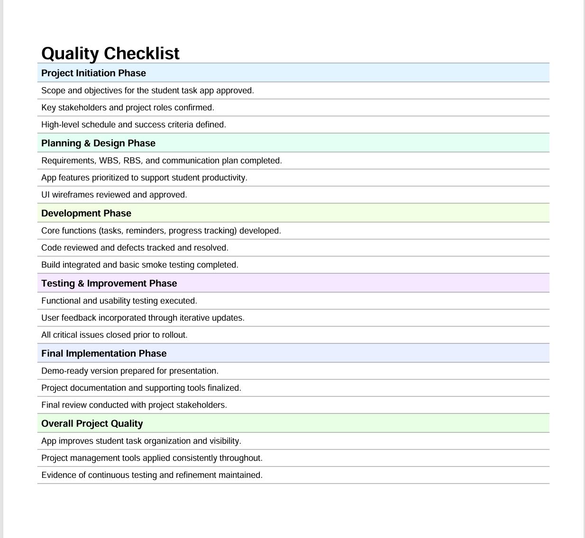

Slide 15

Conclusion
Successfully developed a functional mobile app that improves student task organization and productivity.
Applied key project management tools (WBS, RBS, Communication Matrix, Risk Planning) to guide development effectively.
Ensured quality through continuous testing, feedback, and iterative refinement.

Slide 16
