Slide 1

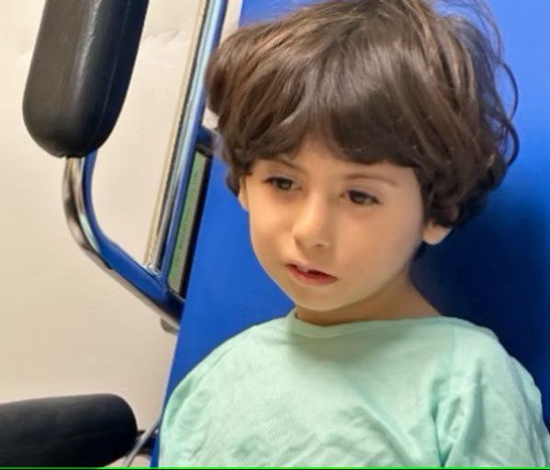
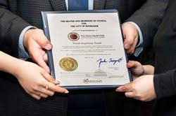

YOUTH Serving YOUTH
025 Sponsorship Package
Theme:
Lasting Impact
For more info: thevoicegavelclub.com

Slide 2
Sponsorship Invitation – Voice Gavel Club’s Annual Graduation Ceremony: "Lasting Impact"
Dear Esteemed Supporter,
With great excitement and purpose, the Voice Gavel Club warmly invites you to be part of our upcoming Annual Graduation Ceremony, held under the inspiring theme "Lasting Impact." This special evening is dedicated to raising crucial funds for War Orphans and Women and Child Victims of Domestic Abuse. Our graduating members stand united under the powerful mission: "Graduate with a Purpose."
The Voice Gavel Club is a youth-led organization committed to nurturing the next generation of confident public speakers and empathetic leaders. In partnership with the World Life Institute, we aim to create a global platform for youth empowerment through communication, leadership, and service.
Over the years, our club has continuously supported charitable causes, overcoming many challenges to ensure that our fundraising efforts benefit those most in need. This year, we are proud to continue this legacy.
Event Highlights:
  A vibrant dinner gala
  Art showcase featuring unique talent
  Live musical performances
  Our signature Awards Ceremony
  The Oath Ceremony for our future Gavel Club presidents
This meaningful event is only possible through the generous support of our sponsors and the encouragement of compassionate leaders like yourself. Your sponsorship will directly contribute to our fundraising goal of CAD $40,000, helping us continue to support Ahmed Cherif and expand our outreach to other vulnerable groups globally.
We invite you to review our Sponsorship Package and consider joining us as a valued partner. Your contribution will leave a lasting impact not only on the youth in our club but on countless lives around the world.
Thank you for your time, support, and belief in our cause. We look forward to the opportunity to collaborate with you.
Warm regards,
Shayan Khan and Peihao Wang

Slide 3

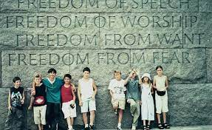
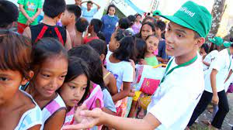
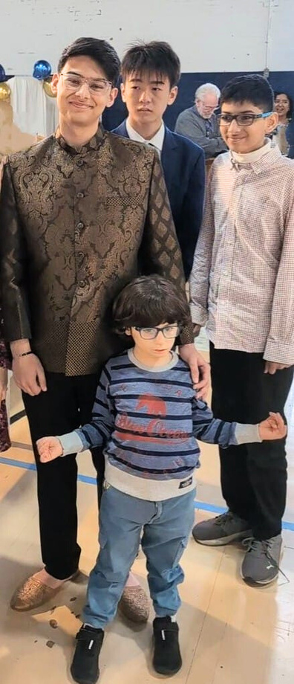
Our Ongoing Commitment: Supporting Project Life
For many years, the Voice Gavel Club has proudly supported Project Life, a transformative international initiative dedicated to helping child victims of injustice reintegrate into society and reclaim the childhoods they were denied.
Through Project Life, these young survivors are offered safe housing, high-quality care, and the emotional support needed to heal and grow. With time, they are able to rediscover joy, rebuild trust, and return to their home countries as confident, empowered individuals, ready to shape their own futures.
The Voice Gavel Club is deeply honored to be part of this journey. In just the last four years, our youth-led club has raised over $100,000 for Project Life. These funds have made a tangible impact on the lives of children around the world—proving that when young people lead with purpose, real change happens.
Looking Ahead to 2025: Greater Impact Through Partnership
In 2025, we are setting our sights even higher. With your sponsorship and support, we aim to expand our reach, increase our impact, and raise more than ever before for this vital cause.
Your partnership will not only strengthen Project Life—it will empower our youth leaders, amplify their voices, and help rewrite the stories of children in need across the globe.
Together, we can ensure that these young lives are not forgotten, and that hope, healing, and opportunity remain within reach.

Slide 4
Benefits W: thevoicegavelclub.com | Bronze $500 | Silver $1000 | Gold $1500 | Platinum $2500 | Diamond $4000+
Company advertisements distributed among VIPs and other attendees |  |  |  |  | 👑
Banner displayed at reception |  |  |  | 👑 | 👑
Interview with media |  |  | 👑 | 👑 | 👑
Table centerpiece |  | 👑 | 👑 | 👑 | 👑
Honorary mention by MC |  | 👑 | 👑 | 👑 | 👑
Free dinner |  | 👑 | 👑 | 👑 | 👑
Logo on the agenda | 👑 | 👑 | 👑 | 👑 | 👑
Mention on website | 👑 | 👑 | 👑 | 👑 | 👑

Slide 5
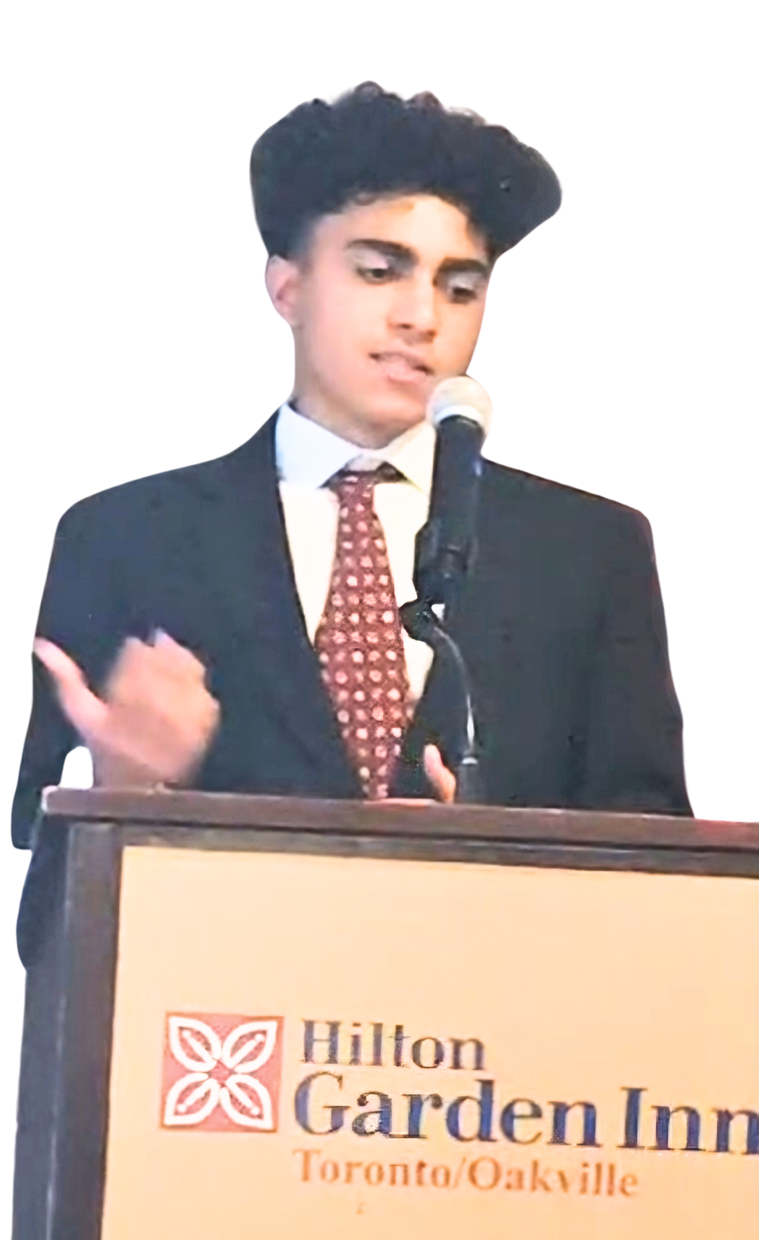
CONTACT US
Mentor: Lubna Zaidi: 416 219 4748
President: Shayan Khan
E: thevoicegavelclub09@gmail.com
E: shayan.n.khan13@gmail.com
W: thevoicegavelclub.com
Our Cause
Payment and Donations

