Slide 1


Nexl Projects and Applications
OVERVIEW

Slide 2
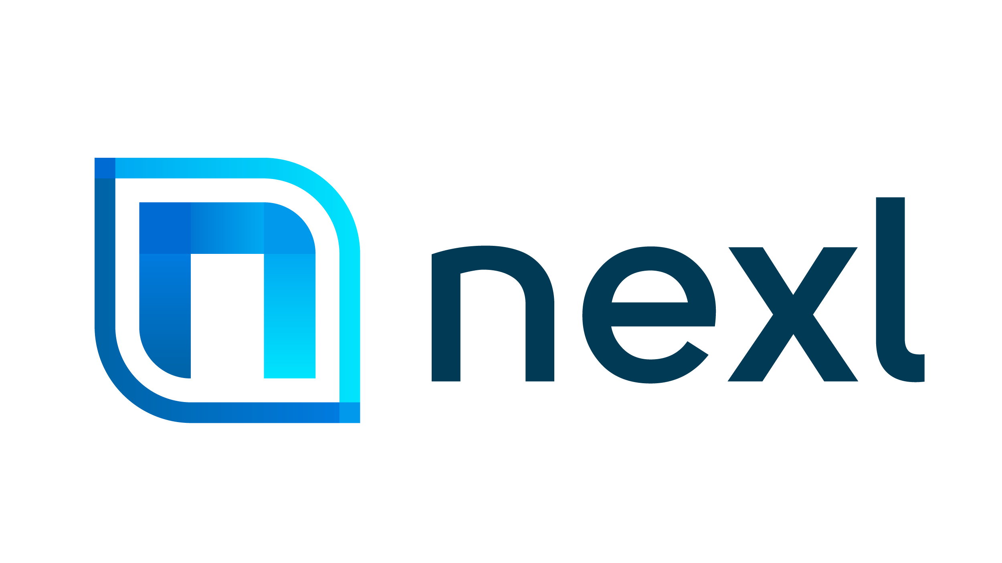

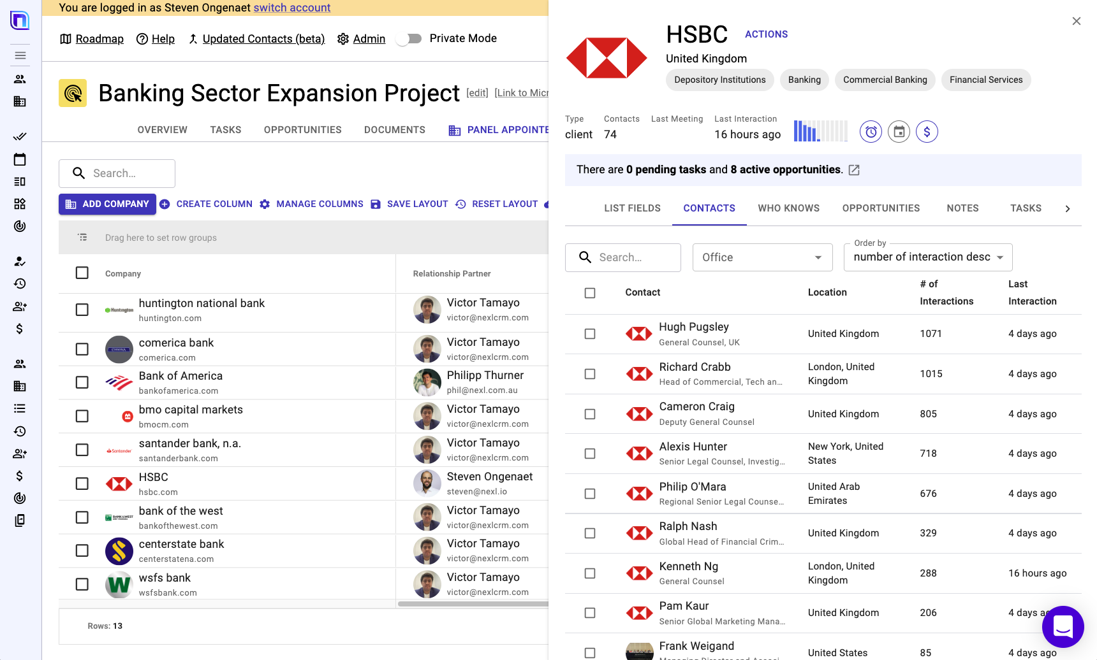
Operationalize your Marketing and BD
Nexl enables closer collaboration and coordination for cross practice and cross border BD
Combine the power of our automated relationship tracking with the flexibility of a project management tool to operationalize your growth initiatives.
With customizable company and contact lists, opportunity tracking, and client prospecting in a powerful collaboration space, Nexl helps you execute your business development projects and become smart collaboration champions.
Nexl’s Revenue Operations Cloud helps leadership and operation teams support revenue-generating initiatives forward, power client-centric delivery, and drive operational efficiency.

Slide 3

Project Use Cases
REFERRAL ACCELERATION PROJECT
CROSS-SELLING PROJECT
Managing referrals can be an important part of bringing in new business and enhancing client satisfaction. Inbound referrals in which your existing clients or other organizations direct business to your organization can be an excellent source of new business. Referring your clients to other organizations when yours does not offer the appropriate services can help improve your relationships with your clients and improve their satisfaction. It also has the added benefit of driving future inbound referrals to your organization.
The objective of cross-selling is increasing Share-of-Wallet (“SWO”), the percentage of the total legal spend of your client that goes to your firm, by convincing clients to start buying services from a different practice group or another office.
SECTOR EXPANSION PLAN
KEY CLIENT PROGRAM
A business development (“BD”) plan for a strategic sector invites team leaders to develop a vision on how to grow and build out the firm’s footprint in a specific sector or industry, and then create a process to execute on that vision.
Key Client Programs (“KCP”) are designed to keep a clear focus on the Firm’s most important clients. These can be both clients that are currently generating most revenues, or clients where there is strong growth potential.

Slide 4
Project Use Cases
PRACTICE GROUP BUSINESS PLAN
COUNTRY DESK
A business development (“BD”) plan for a practice group (“PG”) invites team leaders to develop a vision on how to grow and build out the practice, and then create a process to execute on that vision.
A Country Desk initiative at a law firm is a coordinated attempt at structuring and optimizing the relationships with stakeholders in a country or region where the Firm has no formal presence (and is usually not allowed to practice), but that is significant commercial interest. Country desks are especially relevant for law firms that have a high percentage of their revenue coming from cross border work.
ALUMNI PROGRAM
CLIENT RETENTION
Many organizations maintain information about former employees in the form of alumni directories. Former employees can be a good source of business as they often move on to work in the client and intermediary legal teams, so maintaining relationships through communications and other events is important.
Retaining your clients protects your organization’s current and future revenue. Numerous studies have shown that it is easier and less costly to keep existing clients than to win new ones. While providing valuable services is an important part of retaining clients, it is often only half the battle. Executing client retention programs can help ensure that clients are satisfied with the work your organization does for them and see their relationship with you as valuable.

Slide 5
Project Use Cases
MKT CREDENTIALS APPLICATION
EVENT MANAGEMENT
Managing expertise and experience gives your organization a valuable tool for presenting your organization to clients in pitches and RFP's. Tracking this information makes it easy to determine which professionals have particular expertise and which have experience working on particular types of engagements in the past.
If your law firm is investing time, energy and marketing dollars into an event, it is important to maximize its strategic value. Events generate lots of potential leads, which can and should be transitioned to new clients and work.
INTL BUSINESS TRIP MANAGEMENT
LATERAL ONBOARDING
Many firms invest significant resources in participation in International Conferences and visits to the main Referral Sources that can generate inbound work. These trips often involve significant amount of meetings that need to be prepared, planned and reported on. Nexl can provide the platform that allows for the efficient execution of these Projects, leveraging the underlying relationship intelligence.
Because acquiring novel talent and expertise is a critical component of any firm expansion strategy, many law firms have built robust lateral hiring programs to recruit experienced talent for highly specialized roles. Typically, this practice is part of a broader strategic plan to increase reach into certain market segments, including new industries, geographies, areas of expertise, and specializations.

Slide 6
Project Use Cases
SUCESSION PLANNING
PANEL MANAGEMENT
The potential loss of a leader or key rainmaker is a concerning but inevitable challenge for law firms. Without adequate measures to embed a succession strategy into the firm’s culture, client experience and loyalty suffer when a gap in leadership is created by the departure of a partner. A successful succession plan will enable future leaders to continue their predecessor’s legacy and support the future growth of the firm.
Law firm panels (legal panels) have long been selected and used by clients to manage the engagement of outside counsel. By using a consolidated panel, the idea is that both parties (the client and the panel of selected firms) get added value : the consolidated arrangement provides the firm added revenue, discounted rates for the client and improved work product—resulting from the firm having a better understanding of how the client operates.
THOUGHT LEADERSHIP TRACKER
COMPETITIVE INTELLIGENCE
Targeting engaging and authentic content is crucial to establishing your firm as a thought leader in your specific area of law. It takes time to produce and publish that type of content, so it is critical to have an audience in mind before starting. When using Nexl your firm can identify the relevant contacts who will be interested in trending topics, and it helps you focus content on the best audience.
Competitive intelligence is a crucial tool across a range of pillars for law firms – including, strategy, sales and business development, and operations. In the current market, it is possible to identify the key clients of your main competitors, and track a variety of data points (e.g., number of lawyers, service offering, rates, etc.) that can help you better understand your position in the market.

Slide 7
Project Use Cases
MANAGING DIRECTORY SUBMISSIONS
MEMBERSHIPS AND SPONSORSHIPS
Law firms all over the world make submissions to the key Legal Directories in order to boost their market credibility, attract new business, illustrate the breadth and depth of their skill set, and support the recruitment of talent. However, compiling, coordinating and submitting Legal Directory entries can be a very time-consuming, confusing and ultimately unsatisfactory process. Often a lack of in-house resources and/or experience means key information is not prepared, presented or submitted in the correct format, leading to missed opportunities for recognition and disappointing rankings.
Building relationships in the market can be boosted by becoming a member of relevant federations, associations, chambers of commerce, think tanks, and industry bodies. These organizations offer premium opportunities of connecting with clients and targets. Lawyers can play a vital role in such associations by sharing their know-how and updating its membership on relevant legislative developments. By sponsoring events firms can promote their brand directly to the right target audience.
NEW OFFICE LAUNCH
SUBSCRIPTION-BASED SERVICES
Opening a new office is a strategic project for any firm, especially when it concerns an office in a new jurisdiction. For the new office to be successful, there is a need to build a solid business development plan that will look at both expanding relationships with existing clients, as well as greenfield new client development. New relationships need to be forged with key players in the market and often there are delicate considerations to be made around relationships with previous referral sources from this new jurisdiction. Nexl is a great tool to manage these different aspects of the new office launch.
In an increasingly competitive market, law firms are exploring and experimenting with new business and service delivery models that can offer more value at a reduced cost. Many firms are embracing subscription-based services that offer customers light-touch, scalable, self-help services. Traditional billing and ERP systems, however, are not set up to handle these efficiently. Nexl can help you design a workflow that can help you stay on top of subscription-based service delivery models.

Slide 8
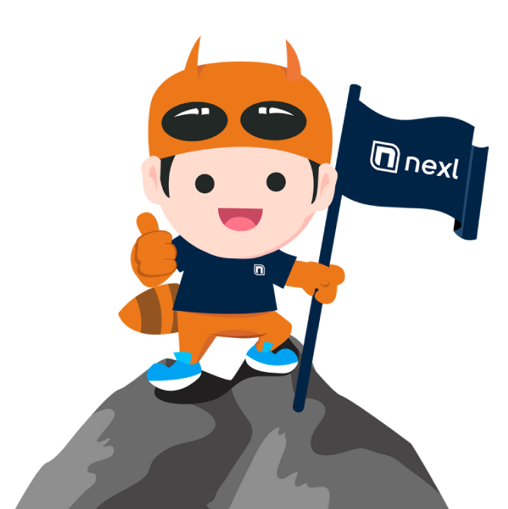
Project Use Cases
CLIENT FEEDBACK PROGRAM
SECONDMENT MANAGEMENT
A Client feedback program is the cornerstone of a client- and service-oriented culture and an institutional approach to service delivery and client satisfaction. It will also uncover unmet client needs and thus naturally lead to new business opportunities. Whether your client feedback program goes for electronic surveys, virtual call, or in-person, on-site visits, you will need a shared platform to plan and execute your program. As all accounts and client contacts, as well as all related underlying engagement is automatically captures, Nexl is the ideal platform that will facilitate and accelerate your client feedback program.
Secondments have long been used as effective means to both develop the careers of young professionals – particularly in terms of acquiring international experience – and to provide added value to important client relationships. Typically, a young professional is sent to work as part of the client team for a period of time at a particularly attractive fee rate from the client’s point of view. There is ample evidence that an early secondment at the right sort of client organization can have a far-reaching impact on the future positioning and work generation ability of a professional.
WHAT ARE YOUR GROWTH PLANS?
At Nexl we make sure our customers are trained to develop their own Projects and use Nexl exactly for what they need to accomplish. An experienced team will work with your team to make sure they are ready for your next challenge.
CONTACT US

Slide 9

BENEFITS OF USING NEXL
PARTNERS
BUSINESS DEVELOPMENT
MARKETING
Stay on top of your most valuable relationships
Win new business, retain clients and get more referrals
See who else is engaging with your clients so you look better informed when meeting them
Focus your BD efforts on the right clients and contacts
Win the right type of clients and work in strategic sectors
Give and get more introductions into existing clients of the firm
Execute your business plan easier
Focus BD activity on key relationships and existing panels
Focus efforts on key sectors
Optimization of commercial processes and improvement win rates pitches
Higher impact coaching work with detailed engagement data
Establish or strengthen international country desks
Create more focus in roadshows and international events
Develop and execute a data-driven international strategy
Eliminate burden of data stewardship, saving valuable time
Focused thought leadership on the right audience
Create meaningful and personalized experiences for your key contacts
Improve the ROI of your events
Higher engagement from your Marketing campaigns
Simplify Marketing segmentation
Easy process to gather contacts from partners

Slide 10
NEXL is a leading provider of innovative legal technology solutions aimed at creating efficiencies, accelerating growth and providing data-driven insights that drive smart decision making. We offer scalable solutions for law firms of all shapes and sizes
Founded by legal professionals with vast experience working within legal firms, NEXL grew out of a desire to fundamentally change the way that legal firms grow and engage with internal and external stakeholders. The existing way of managing these relationships doesn’t work. Today, we’re driving the delivery of smart, innovative and technology-driven services to clients worldwide.
Smart, insight-driven solutions underpin NEXL’s purpose. Drawing from our own practical experience working within the professional services industry, our purpose is to develop and deliver technology solutions that will drive positive change in how law firms manage their client relationships and grow their practice.
NEXL™ Pty Ltd 2022 All rights reserved.

