Slide 1


Our next-generation CRM platform to drive revenue growth

Slide 2
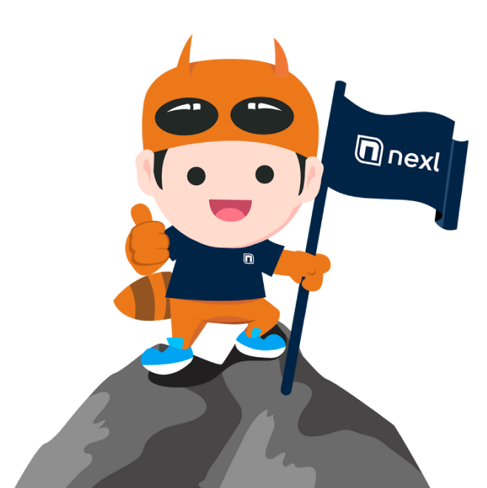

A Fresh Approach for a Strategic Challenge We move from a back-office CRM to front-office Revenue Operations
REVENUE ACCELERATION
FOR LAWYERS
Nexl automatically creates a 360° view of our all clients, prospects and partners, removing the need to manually enter data to track and understand relationships
Nexl overcomes adoption challenges by providing an intuitive no-data-entry platform specifically designed for lawyers
By moving CRM from a “back-office” contact database to a relationship-focused, “front-office” revenue operations platform, Nexl helps lawyers to turn our relationships into revenue
Nexl enables better collaboration and alignment between the lawyers and Marketing and Business Development, offering the data we need to accelerate revenue growth together.

Slide 3
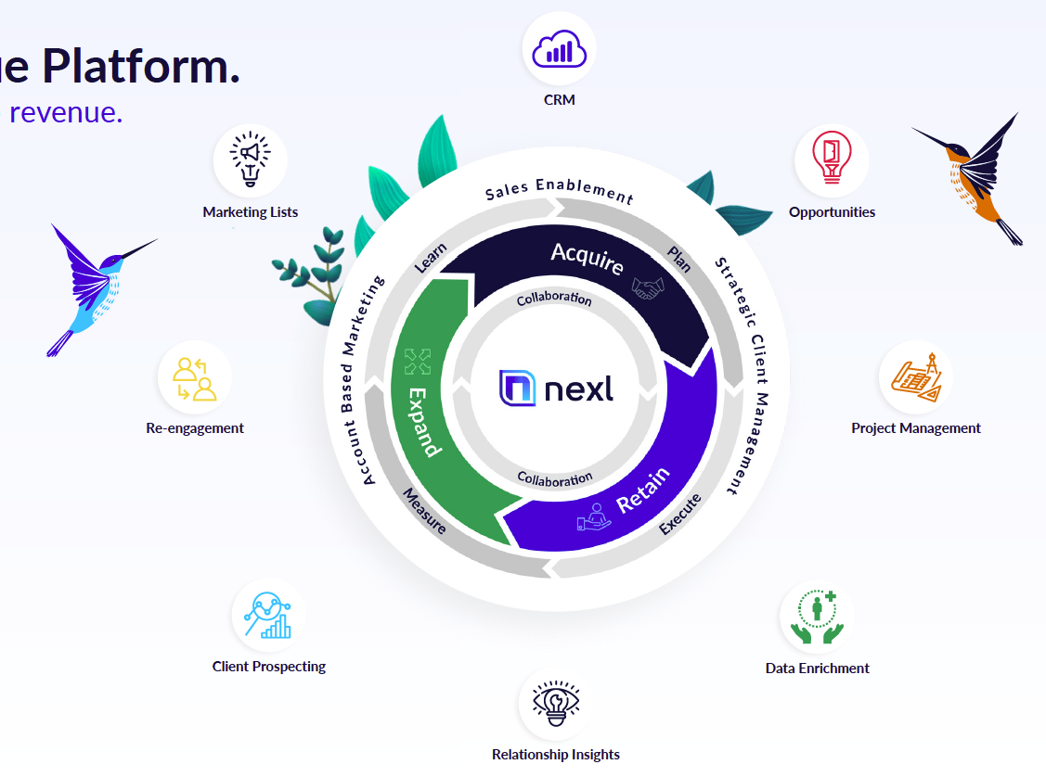
The legal market has changed
Law Firms now live in a competitive, data-driven business world – where any law firm can approach any client, anytime. In this competitive world, law firms can no longer work in silos and passively wait for clients to come to them.
To stay competitive, lawyers and law firms must break down knowledge barriers, share resources and go from passive to active and collaborative business development.
To help lawyers move from passive to active business development, Nexl enables improves client retention, expansion of existing client accounts and new client acquisition.

Slide 4
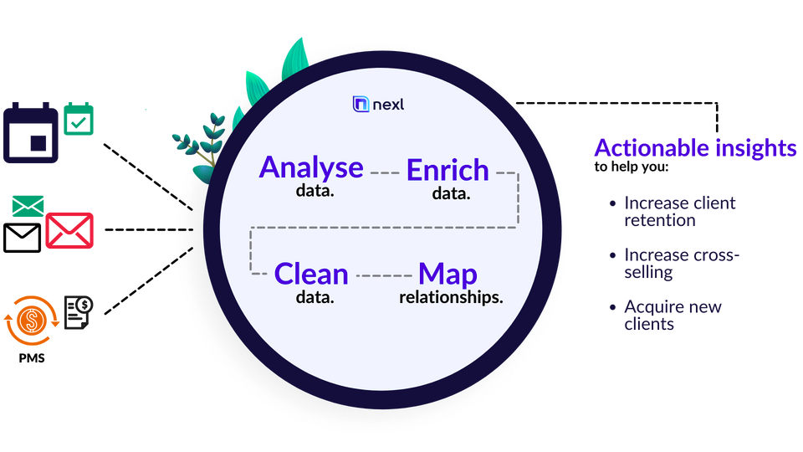
How does Nexl Work? Automated data capturing and enrichment for actionable insights
Nexl automatically captures all our contacts and interactions. As soon as you send an email or meet a contact, Nexl automatically creates a 360° view of the contact by combining all internal relationship data with external Data Enrichment sources
Nexl is a web-based SaaS platform, fully integrated with our Office 365 environment.
You can easily access your account by opening
360.nexl.io in your web browser, or through the add-in for Outlook.
360.nexl.io

Slide 5

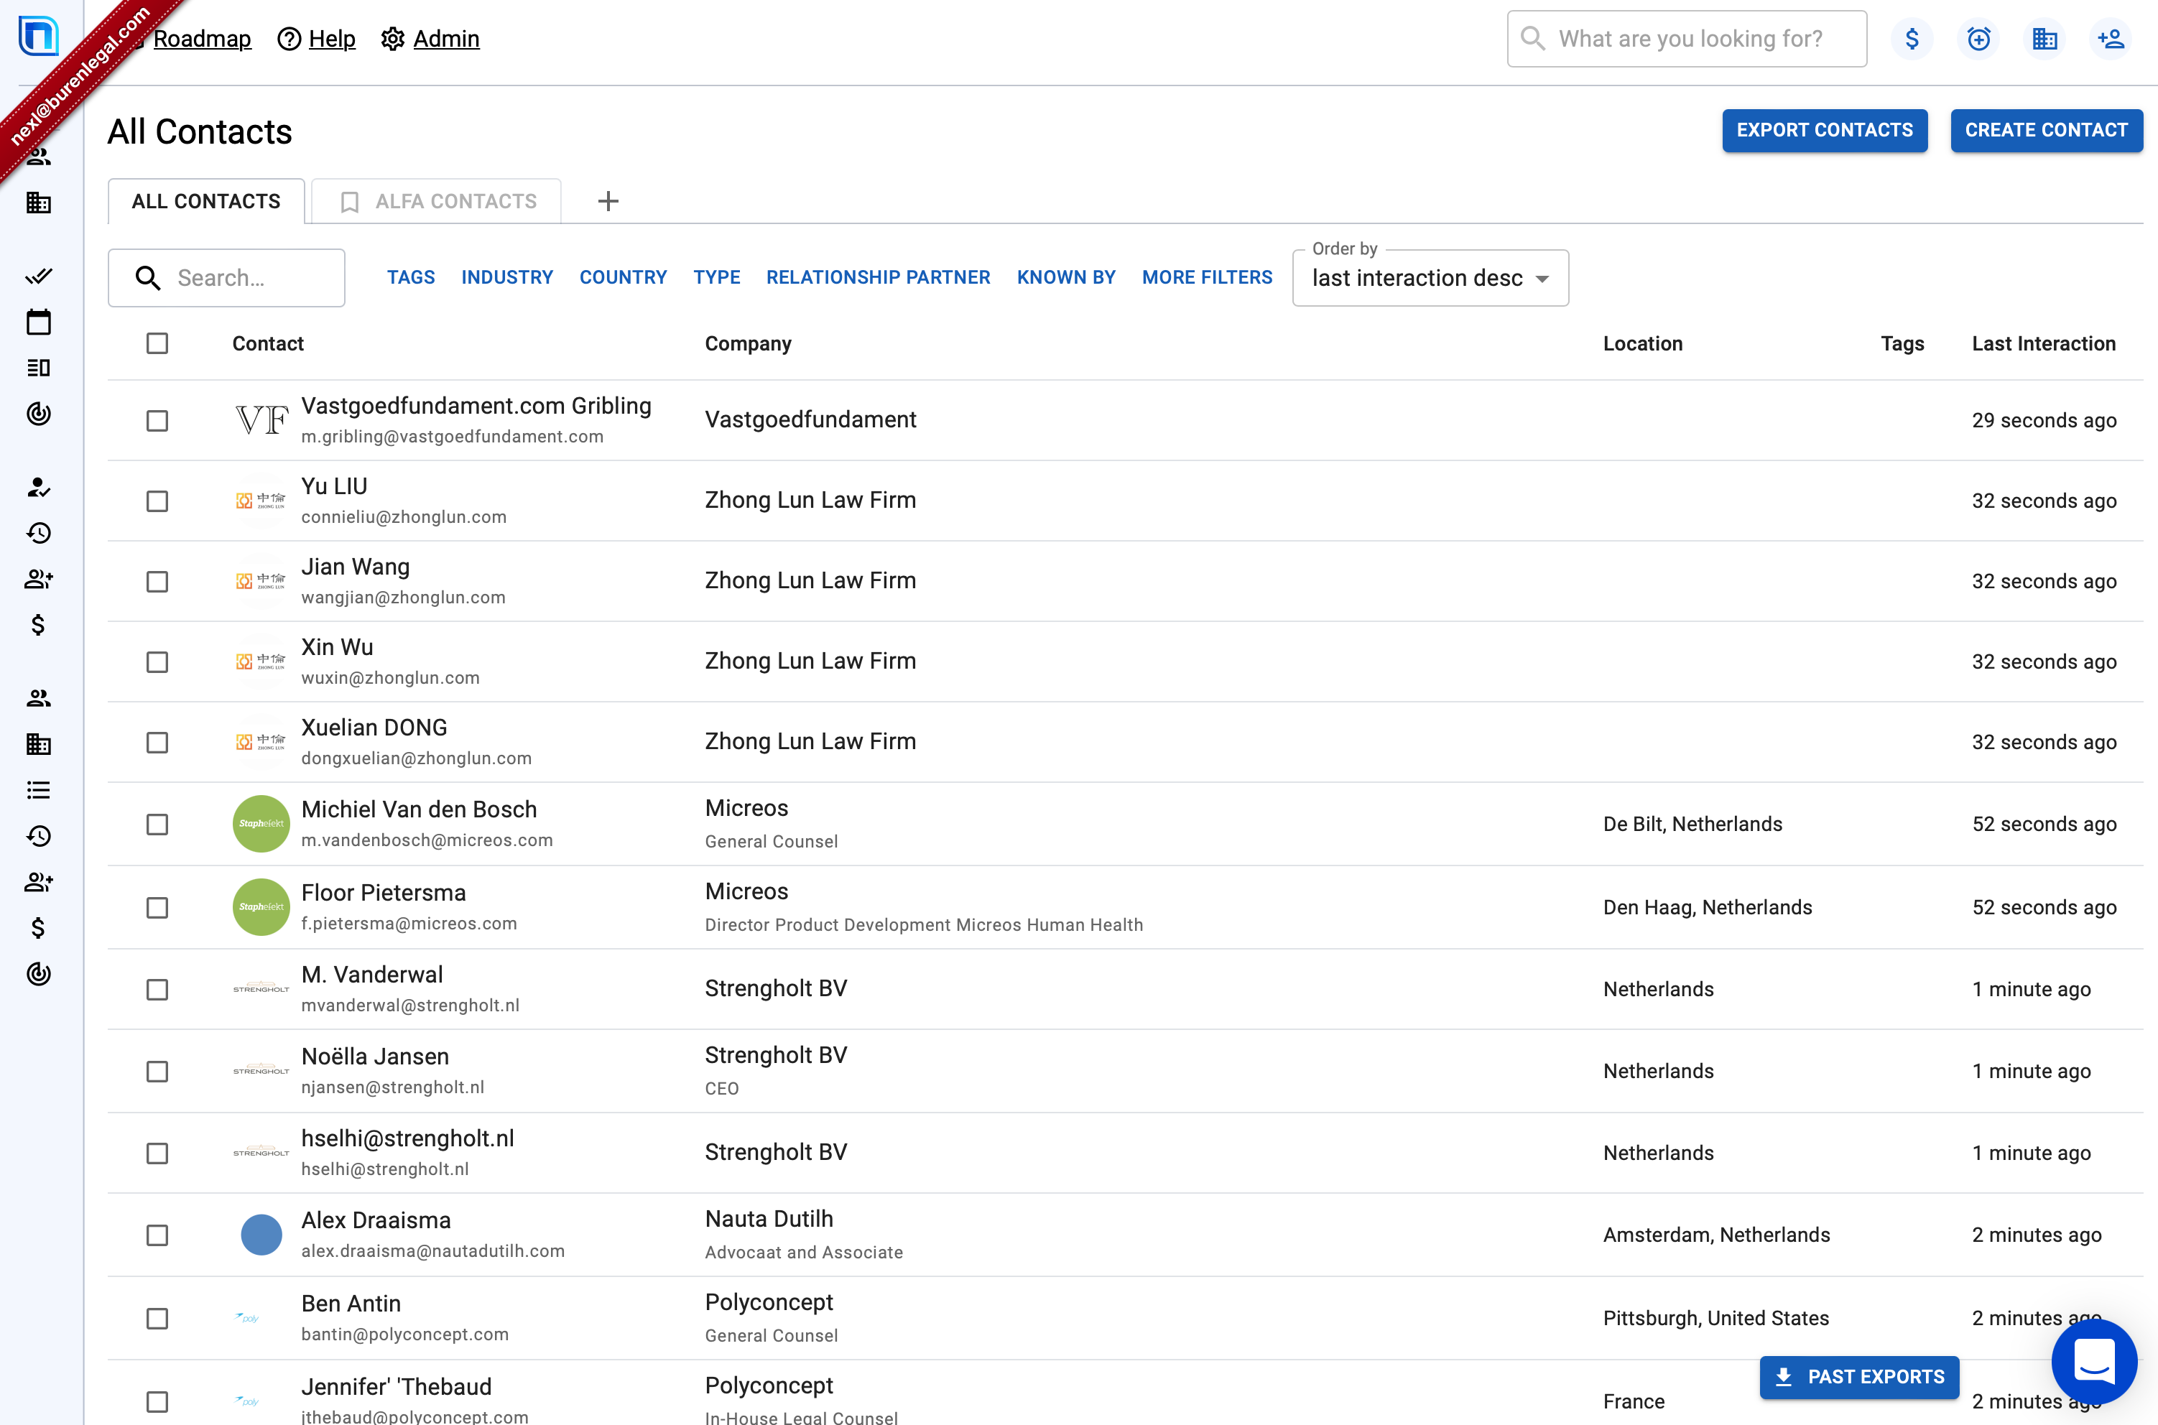
A fully automated and enriched personal address book for everyone
Each lawyer benefits from a personalised list of their Contacts and Companies in order of last Interaction.
Contacts and Companies can easily be filtered to find the most important relationships.
Stay on top of your VIP contacts with automated stay-in-touch reminder, tasks and notes.
Understand who else in the Firm engages with your contacts.

Slide 6
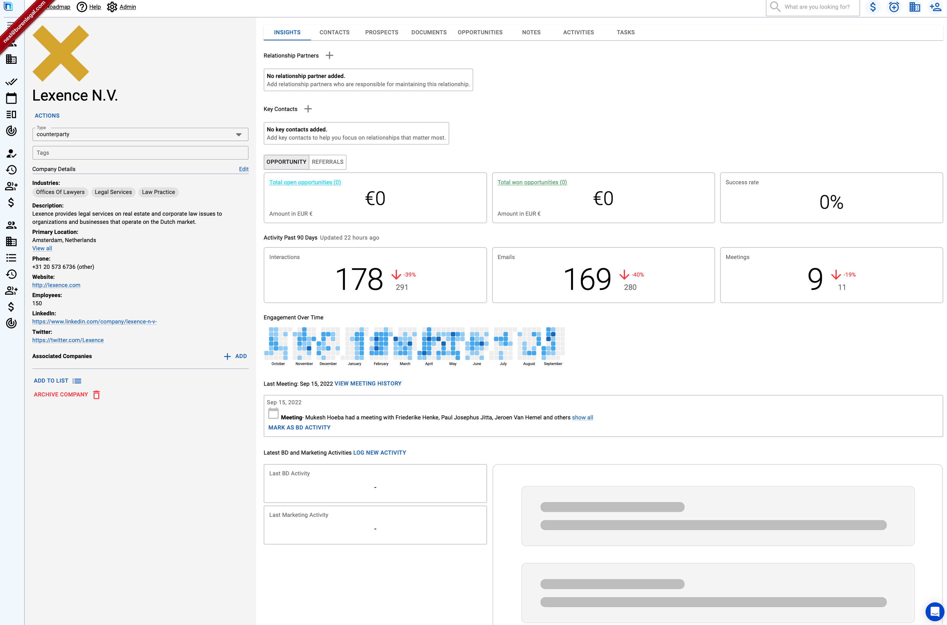
Detailed relationship intelligence, revealing strongest links and blind spots
Better understand the “who knows whom” across your entire firm. In modern B2B business development, lawyers must understand the entire relationship history of a prospective and existing clients.
Nexl shows you the who knows who across your firm and gives you deep relationship insights to better leverage your firm’s relationship to win more business – without the need of manual data entry.

Slide 7
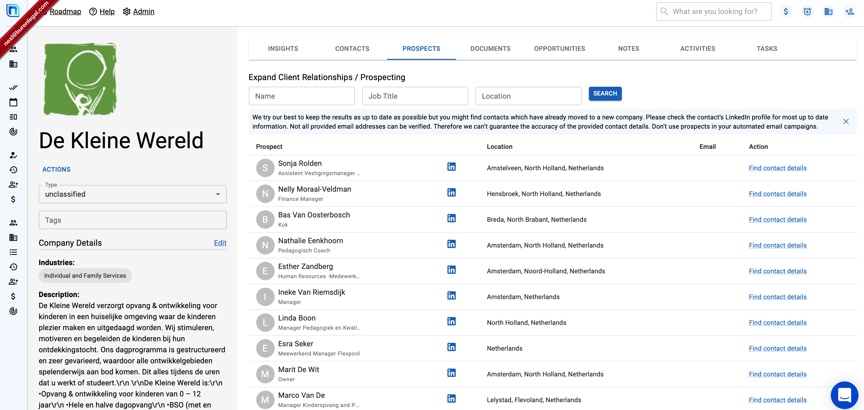
Activate your Business Plans Prospect into millions of profiles and companies, even if you have no pre-existing relationship
Nexl is the only legal CRM with built-in client prospecting tools.
You can now reach the right decisions makers directly, using the most accurate and up-to-date emails and social media links database in the world.
Leveraging our built-in data-enrichment, you can find verified emails on 450 million professionals across 15 million companies which sync right to your Nexl.

Slide 8
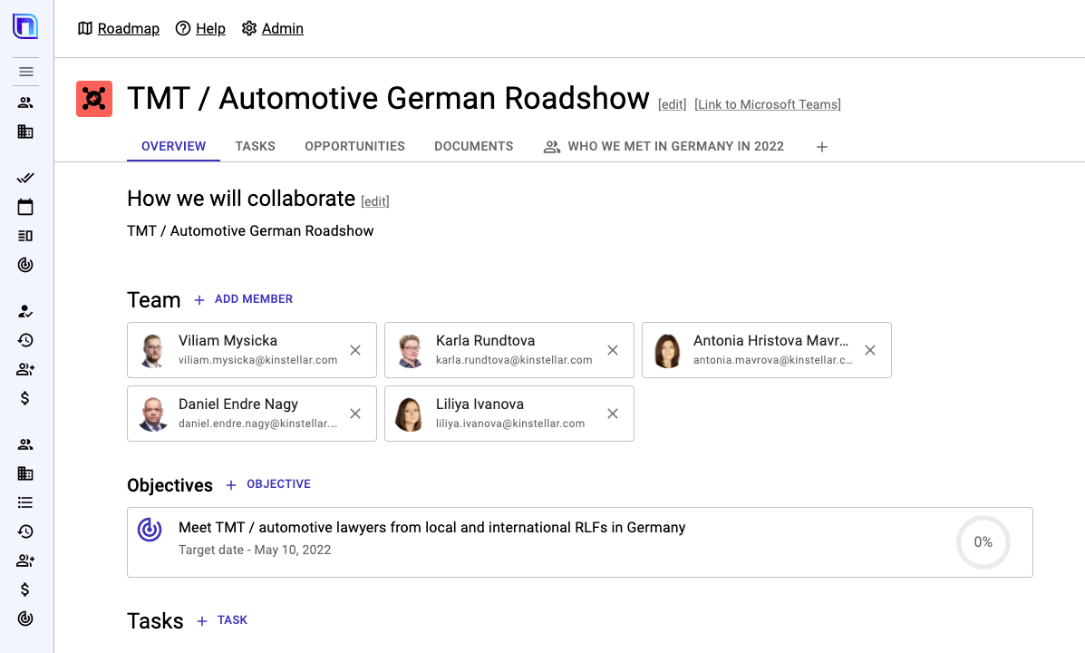
Aligning our offices and teams Nexl will enable closer collaboration and coordination for cross practice and cross border BD
Combine the power of customizable target and key client lists, opportunity tracking, and client prospecting in a powerful collaboration space, easily accessible through Microsoft Teams to help execute our business development and growth strategy and become smart collaboration champions.

Slide 9
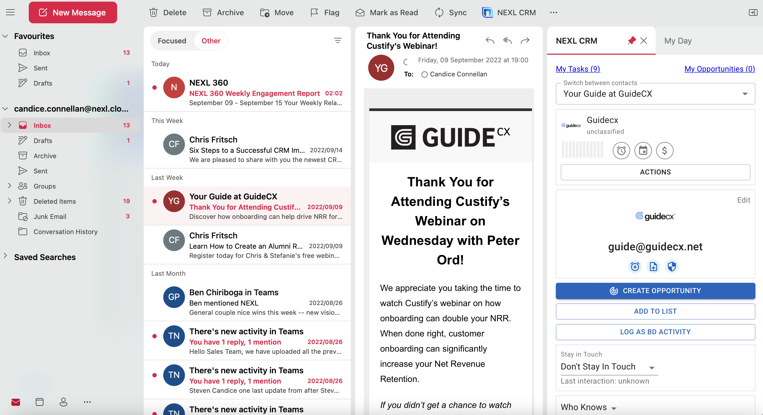
Grow revenues right from your inbox Nexl’s Outlook plug-in gives you all the data without leaving your inbox
Nexl facilitates pro-active business development, giving us access to +450 million company and individual profiles for one-to-one, personalized outreach.
The system will immediately show you is there are already relationships for any given company or individual.

Slide 10
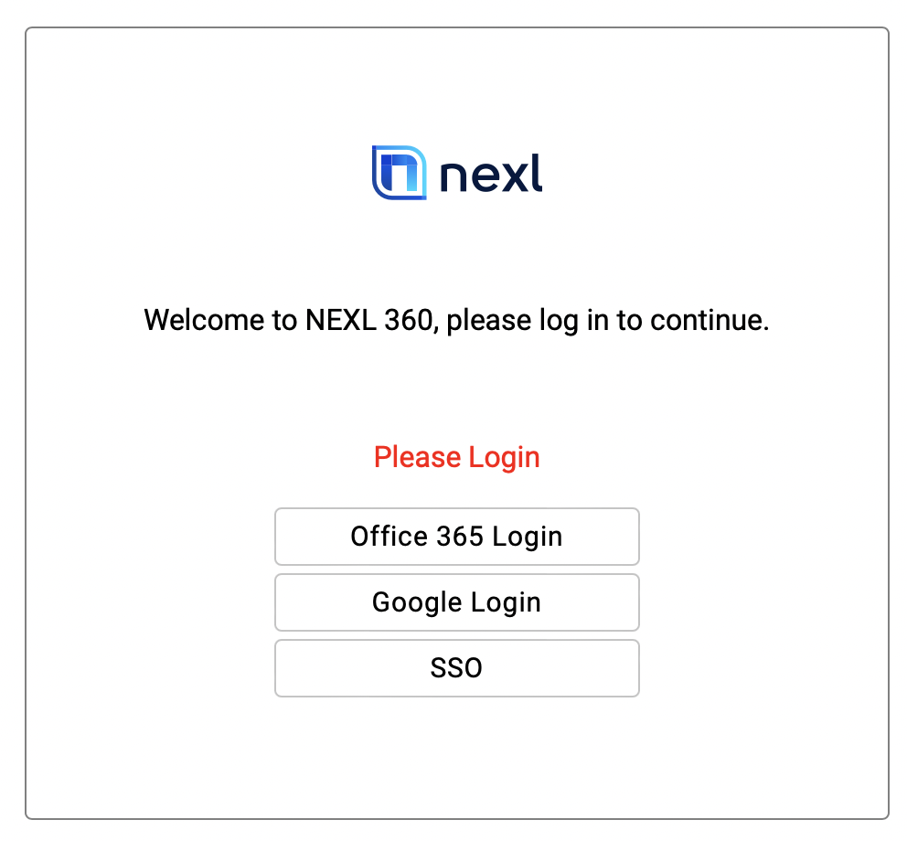
Getting Started : Web browser
Nexl automatically captures all our contacts and interactions. As soon as you send an email or meet a contact, Nexl automatically creates a 360° view of the contact by combining all internal relationship data with external Data Enrichment sources
Nexl is a web-based SaaS platform, fully integrated with our Office 365 environment.
You can easily access your account by opening
360.nexl.io in your web browser, or through the add-in for Outlook.
access your Nexl account by opening 360.nexl.io in your preferred web browser
you will be directed to a login screen and will need to select the option “Office 365 Login”
note your session will remain active for 8 hours (meaning you will not have to login again until then)
360.nexl.io

Slide 11
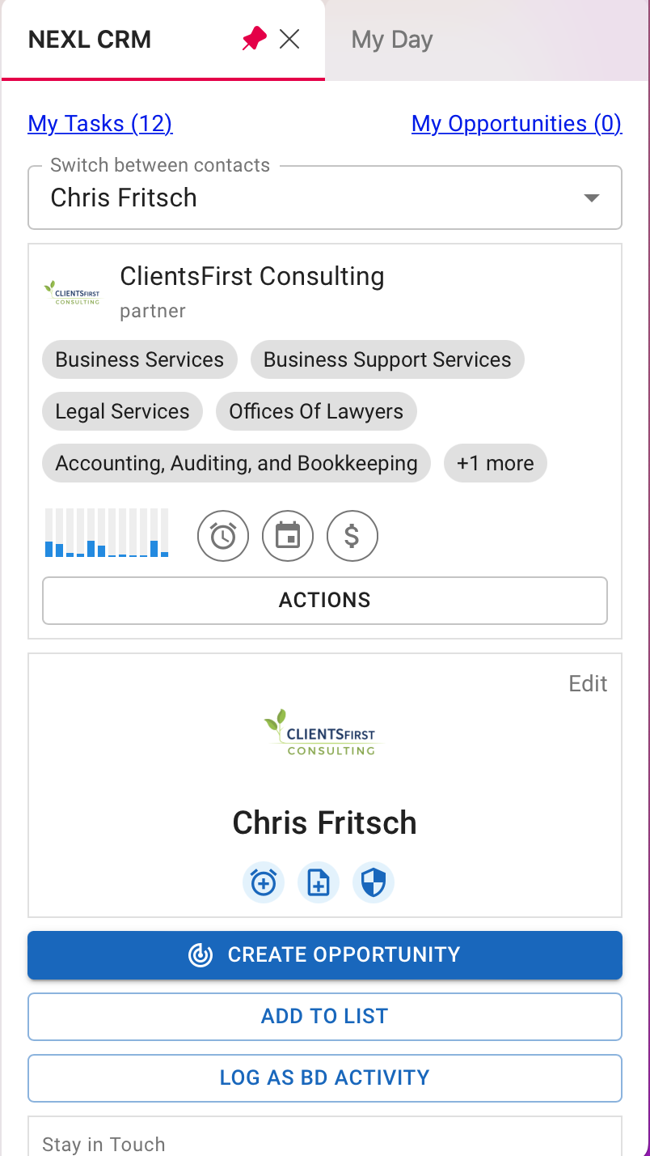
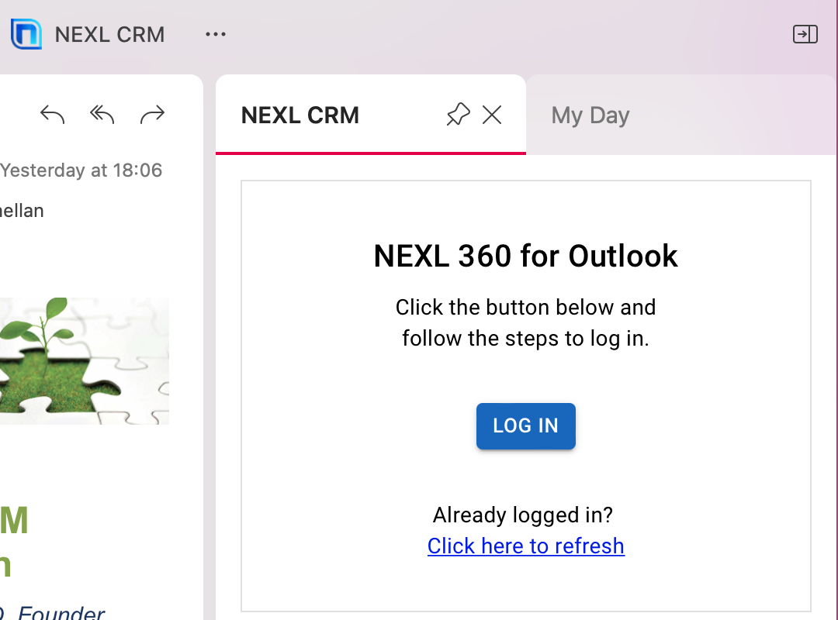
Getting Started : Nexl CRM Plugin for Outlook
Nexl automatically captures all our contacts and interactions. As soon as you send an email or meet a contact, Nexl automatically creates a 360° view of the contact by combining all internal relationship data with external Data Enrichment sources
Nexl is a web-based SaaS platform, fully integrated with our Office 365 environment.
You can easily access your account by opening
360.nexl.io in your web browser, or through the add-in for Outlook.
You now have the added benefit of leveraging all the benefits of Nexl right from your inbox through our custom Nexl CRM plugin, meaning you don’t have to switch applications to access your contact information.
Activating this feature is quick and easy:
click on the Nexl CRM icon on your toolbar and pin it so that it sticks
if your session has expired follow the login prompts (as you would do in the web browser)
just to note that you will need to be on a specific mail to create opportunities, log BD activity and more
360.nexl.io

Slide 12


Benefits of using Nexl
PARTNERS
BUSINESS DEVELOPMENT
MARKETING
Stay on top of your most valuable relationships
Win new business, retain clients and get more referrals
See who else is engaging with your clients so you look better informed when meeting them
Focus your BD efforts on the right clients and contacts
Win the right type of clients and work in strategic sectors
Give and get more introductions into existing clients of the firm
Execute your business plan easier
Focus BD activity on key relationships and existing panels
Focus efforts on key sectors
Optimization of commercial processes and improvement win rates pitches
Higher impact coaching work with detailed engagement data
Establish or strengthen international country desks
Create more focus in roadshows and international events
Develop and execute a data-driven international strategy
Eliminate burden of data stewardship, saving valuable time
Focused thought leadership on the right audience
Create meaningful and personalized experiences for your key contacts
Improve the ROI of your events
Higher engagement from your Marketing campaigns
Simplify Marketing segmentation
Easy process to gather contacts from partners

Slide 13
NEXL is a leading provider of innovative legal technology solutions aimed at creating efficiencies, accelerating growth and providing data-driven insights that drive smart decision making. We offer scalable solutions for law firms of all shapes and sizes
Founded by legal professionals with vast experience working within legal firms, NEXL grew out of a desire to fundamentally change the way that legal firms grow and engage with internal and external stakeholders. The existing way of managing these relationships doesn’t work. Today, we’re driving the delivery of smart, innovative and technology-driven services to clients worldwide.
Smart, insight-driven solutions underpin NEXL’s purpose. Drawing from our own practical experience working within the professional services industry, our purpose is to develop and deliver technology solutions that will drive positive change in how law firms manage their client relationships and grow their practice.
NEXL™ Pty Ltd 2022 All rights reserved.

