Slide 1

Trump 2.0 – New World Order
Overdue or Overblown?
“Known must be your fear before banish it you can.”
- Master Yoda, Star Wars
Photo Credit: FT
Feb 2025

Slide 2
1. Trumpflation May Not be as Reflationary as Currently Assumed
Inflationary
Stagflationary
Reflationary
Recessionary
“Goldilocks”
Trade Tariffs (30%)*
Tax Cuts (90%)*
“Trump Trades”
“Bessent Effect”
Real(ized) Trump Trades?
Trade, Immigration, uncertainty blow back amid Energy anchor.
Negative Growth Shock
Immigration
(15%)*
De-regulation (75%)*
Positive Growth Shock
* Subjective confidence around implementation/outcomes, not objective probabilities
Deflationary

Slide 3
1a-i. Energy/Oil: US Energy Dynamics & Posturing to Dis-inflate?
Global Demand-Supply to Buffer: For one, the bigger picture is for aggregate global supply dynamic to at least keep apace, if not comfortably outstrip, demand shifts.
Non-OPEC led Supply Offset: Second, the of Russia’s crude disruption is likely to be offset elsewhere. OPEC has compelling spare capacity poised for (delayed) output bump-up. Crucially, non-OPEC production outside of Russia has grown significantly, and is set to be flush.
“Leaky” Russian Oil Sanctions: Notably, the sanctions could still prove “leaky”. Russia’s oil leaching into global supplies is highly likely outcome (and the lived experience). And with Russian oil at an even deeper discount, perversely blunting price upside from sanctions.
US Energy Ascendancy: What’ more, US ambitions to materially lift energy output, inevitably deepening and solidifying its position as a net energy exporter is yet another critical dynamic to check unmitigated upside* in prices.
Beijing Buffer: On the demand-end, China’s inclination to stockpile during periods of softer prices, provides the strategic inventory buffer to dampen bullish oil impulses. Especially as onshore demand recovery remains subpar.
* Admittedly, US producers welcome price buoyancy, but the supply will subdue the extent of upside in prices, all else equal.
Higher Energy Prices
Extreme/Tail Geo-political Trigger
Sanctions (Russia/Iran)
Softer Energy Prices
Russia “Leakages”
Canada
“DBD” & US Energy Ambitions
China - Demand & “Green Supply”
OPEC+ Tightens Further

Slide 4
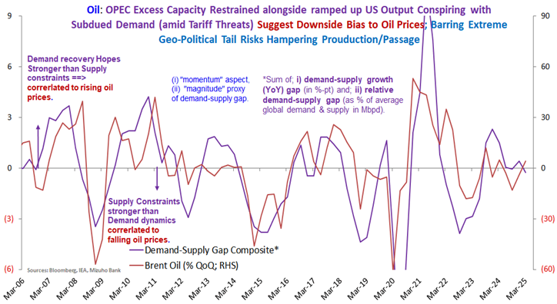
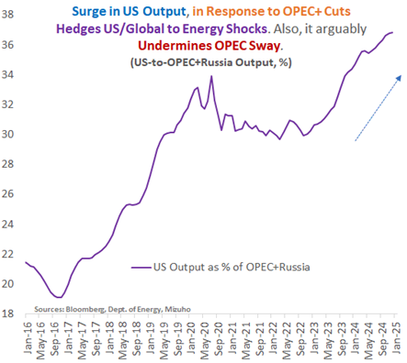
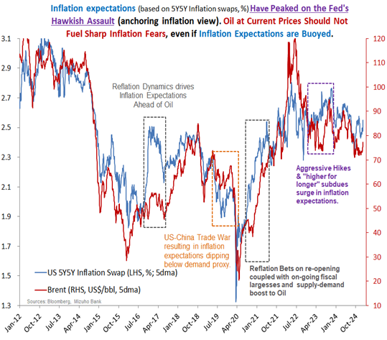
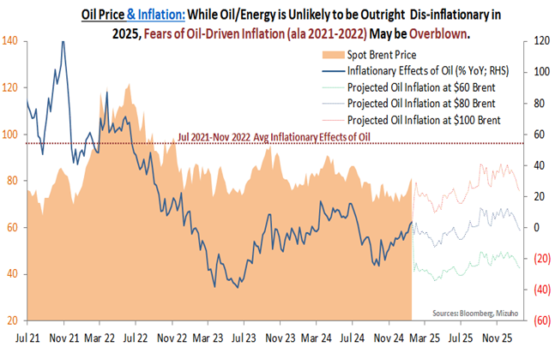
1a-ii. Oil: Despite Geopolitics, US Energy Ascendancy Ambitions may Overwhelm

Slide 5
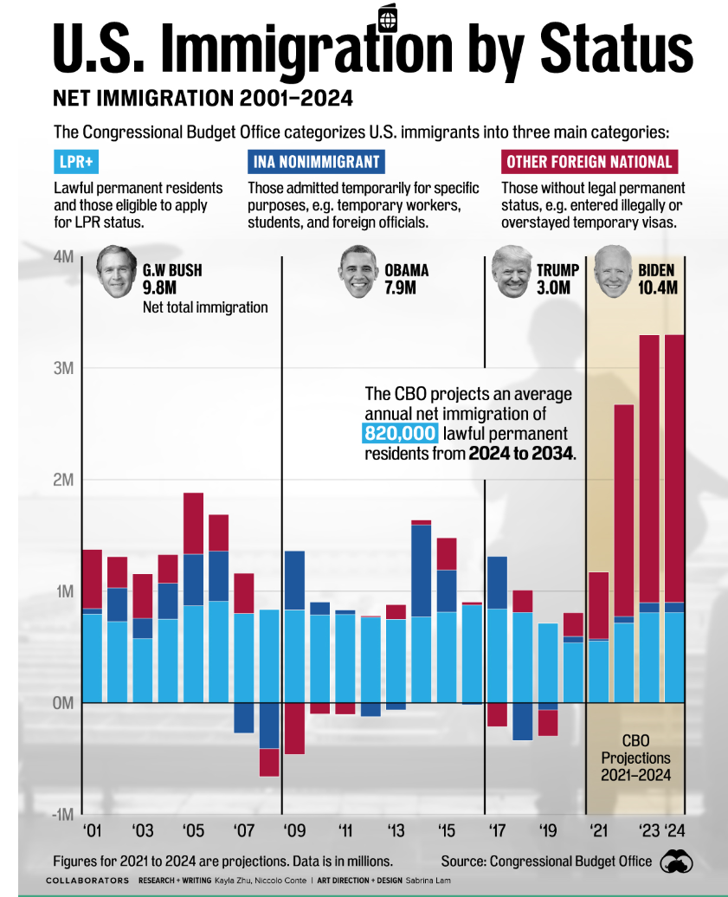
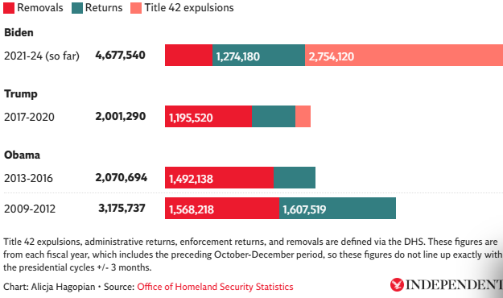
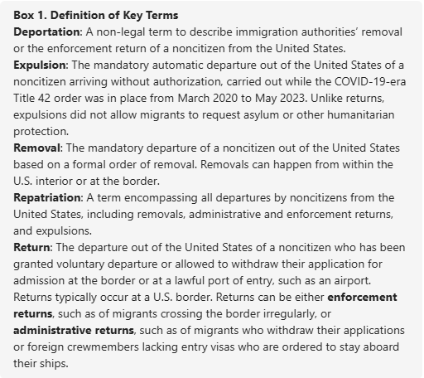
1b. Immigration ➔ Execution Matters. Ultimate Risks are Deflationary.
source: visualcapitalist.com

Slide 6
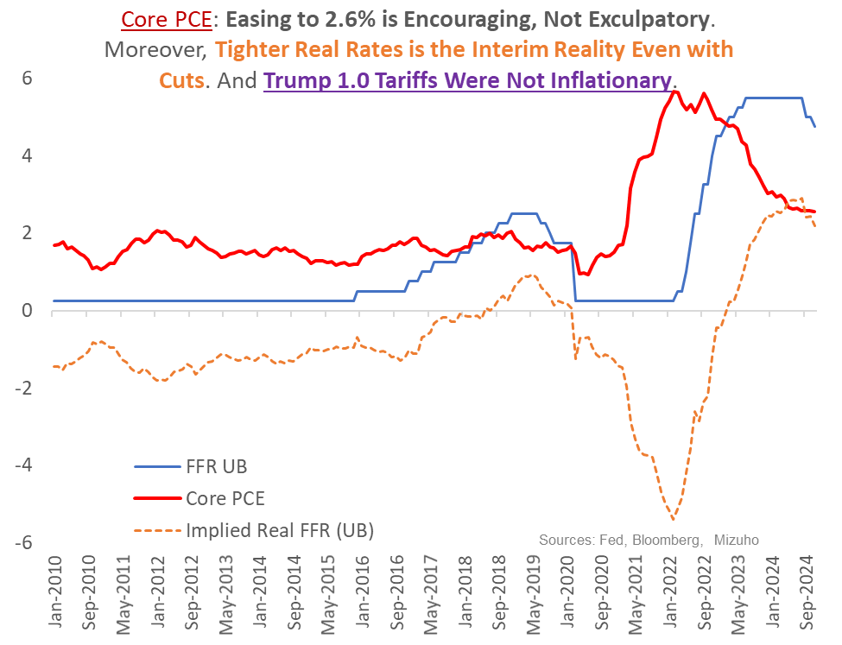
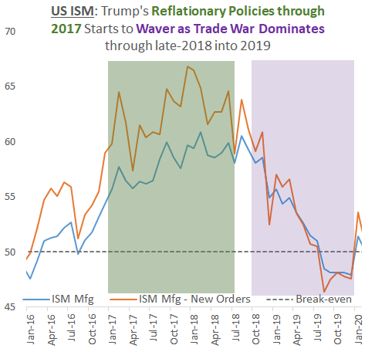
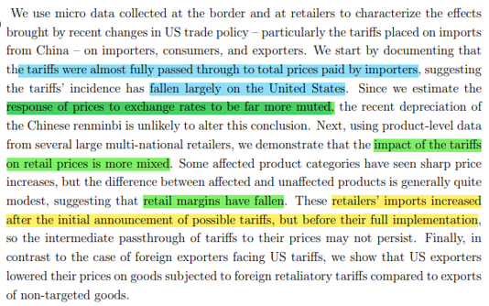
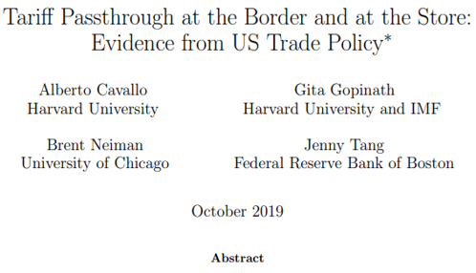
1c. In fact, Trump 1.0 Reveals Inflation Contained & Subsequent Demand Dent
Trump 1.0 tariffs not outright inflationary. Fed need not hastily reverse course.

Slide 7
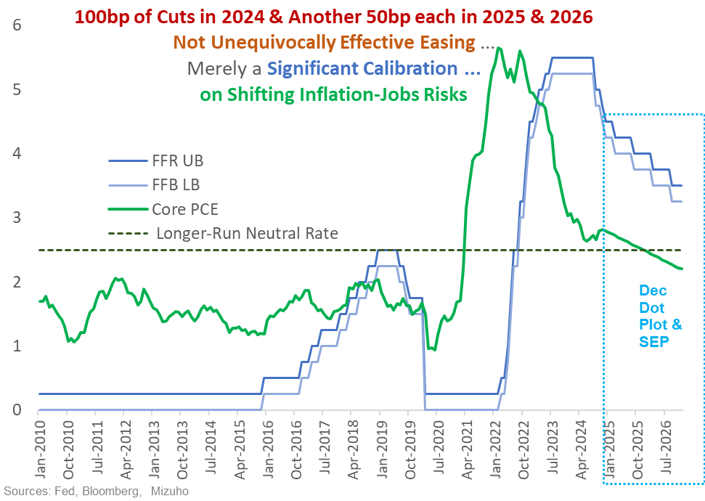
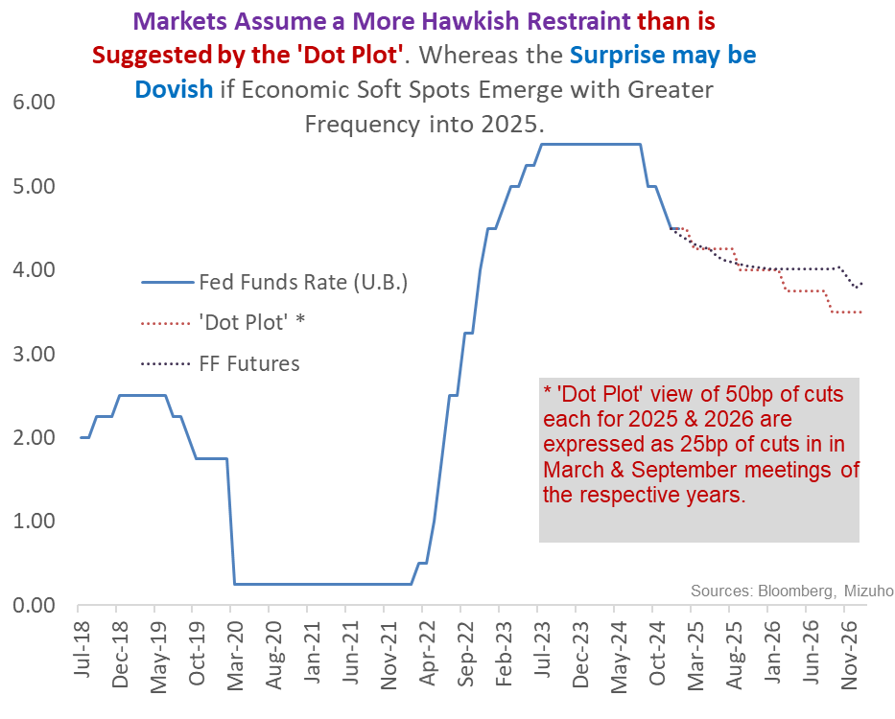
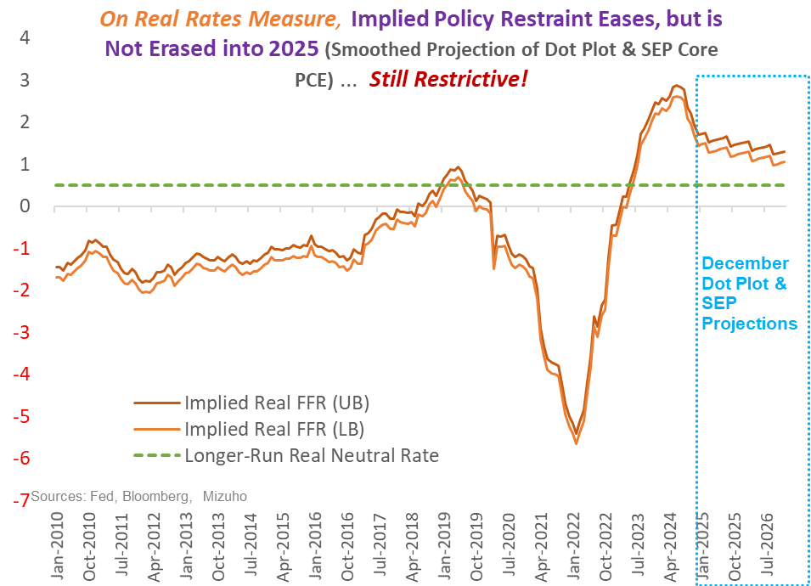
2a. Fed’s Restrictive Stance Leaves Scope for More Easing than the “Dot Plot” Suggests

Slide 8
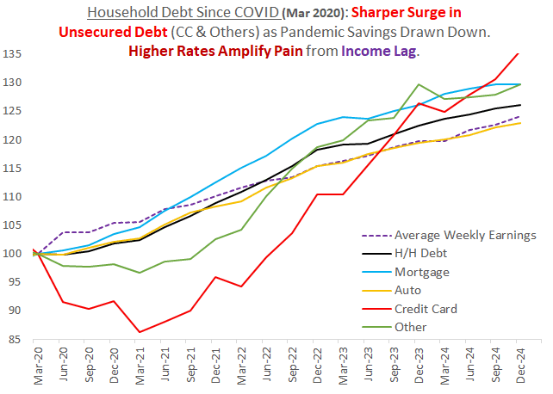
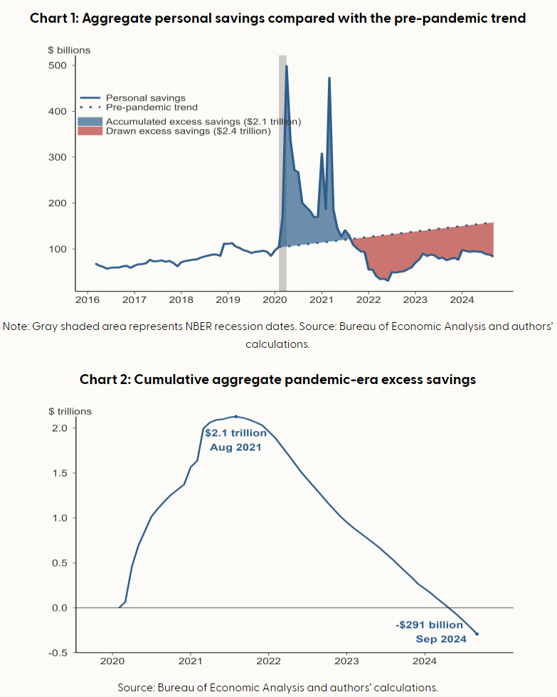
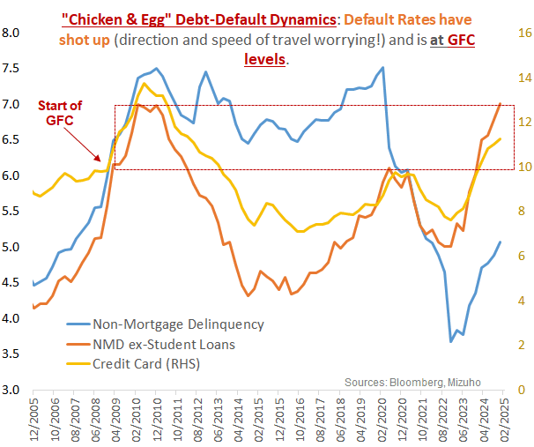
2b. Whereas US Household Cash-flow Constraints Threaten Demand Resilience
Chart from Bloomberg, San Francisco Fed,

Slide 9
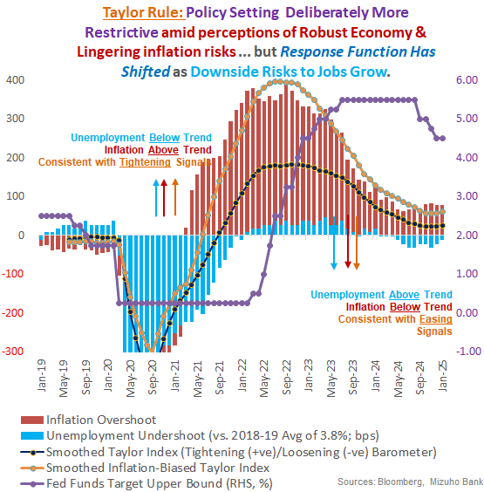
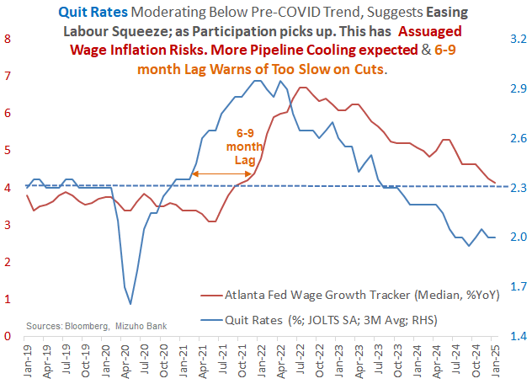
2c. Especially as Tight Conditions Preside Over Softer Jobs-Wage Confidence

Slide 10
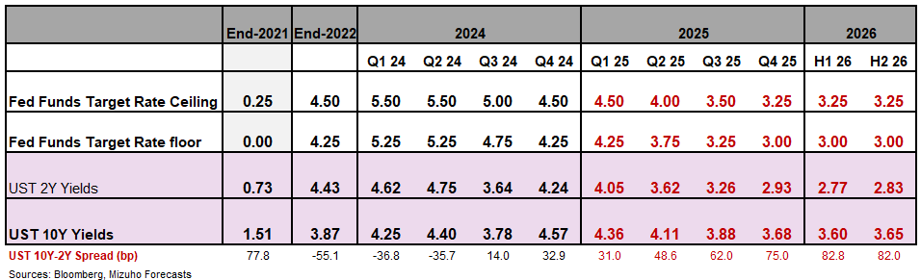
2d. Front-Loading Not Necessarily Forestalling “Too High for too Long”
Conditional
Pronounced Steepening
Front-Loaded 100bp in 2024 May Not Cut It
The Fed’s 100bp of cuts in 2024, initiated with 50bp Sep cut, signals front-loaded easing.
But real rates remain (too) elevated. So early-2025 policy is more “skip” not “pause”.
An Overly Hawkish (Dot) Plot for 2025-26
Barring significant inflationary shocks, 50bp each for 2025 and 2026 is too little to insure “Goldilocks”.
“Sticky” inflation merely tempers but doesn’t derail path back lower “neutral”.
Rate Cuts to Cluster Around Mid-2025
Expect faster cuts into late-2025, with some 75-100bp on the cards, to lower rates to ~3%.
And then, some more by ~50bp later in 2025 if as risks to soft-landing re-emerge amid elevated real rates.
More Distinctly Dovish Leg Not Ruled Out
Scope for distinctly dovish 2025 back-end if jobs/demand deteriorate too sharp for a“controlled landing”.
Premise: Consumer Slowdown, Not Crisis
Deeper cuts are premised on sharper consumption slowdown as cash-flows tighten ➔ a not-so-soft landing.
And not a crisis from a balance sheet shock – for which far deeper and larger rate slashing will be required.
Outcomes: Lower Yields + Distinctly Steeper Curve + Long-end Fiscal Volatility

Slide 11
3a. The “Bessent Effect”: A Dis-inflationary, Lower Yield Path to Higher Growth?
The “Three ‘3’s”
3% Growth
3% Fiscal Deficit
3MBpD Additional Oil Equivalent
~80bp higher than CBO estimates of 2.1-2.2%
Estimated to lower crude prices $3-4/bbl
At least 50% reduction in deficit!
Dis-inflationary

Slide 12
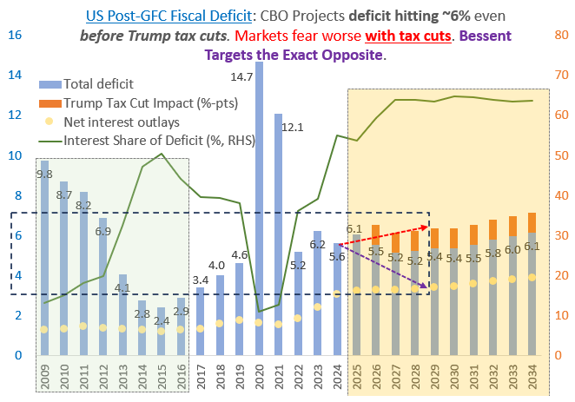
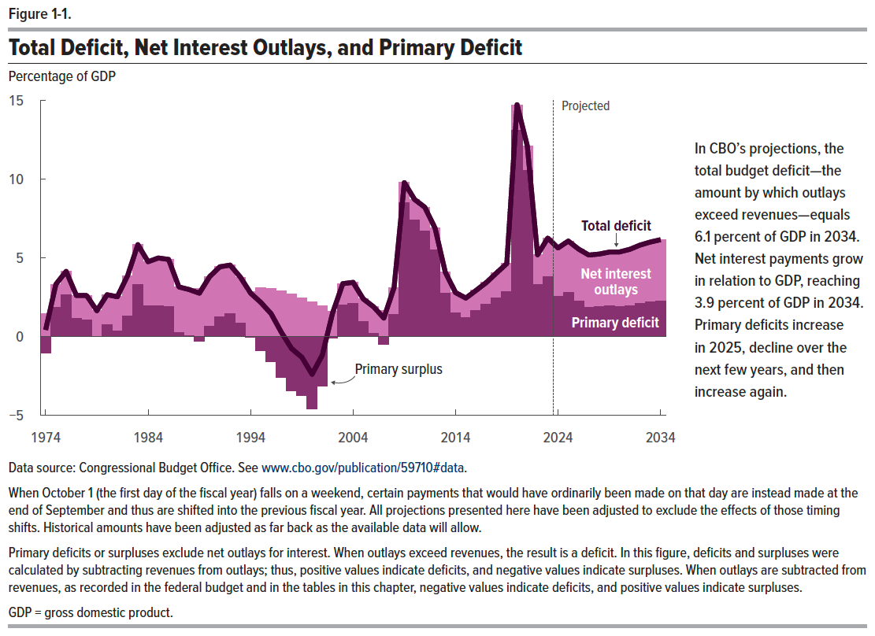
3b. Enough for Direction of Travel to Surprise … But Interest Rates Must Be Part of the Answer!

Slide 13
4a. Lower Rates as the “Bridge” to (& From) Three-3s ➔ The One Ring!
Lower Interest Rates
Interest Burden
Bond Supply
Lower (3%) Fiscal Deficit
Tax Revenues
Higher (by 3MBpD) Oil Pdtn
Dis-inflation
Financing Boost
“Goldilocks” USD Policy
Pumping
Demand-Price
Higher (3%) Growth
Tax Revenues

Slide 14
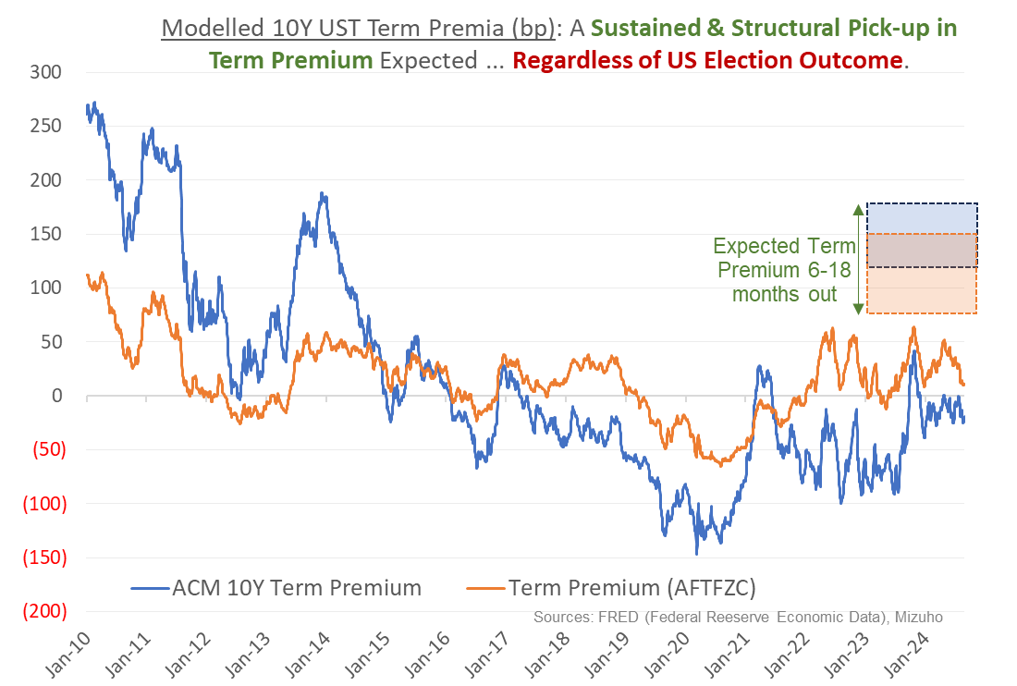
4b. Caveat is that the Structural View is for Higher Term Premium Beyond Cyclical Forces
Significant & Structural lift in term premium, accentuating the policy cycle buoyancy expected in longer-end yields (in re-steepening), a key macro risk
i) Inflation Expectations: Up & Uncertain?
First, structurally higher inflation, associated with de-globalization threats that feature antagonistic US-China geo-politics*** colliding with “green-flation”.
ii) Geo-Political/Social Costs Termed Out
Moreover, conflict/geo-political tensions raising longer-end bond supply globally, exacerbated by a more isolationist and less predictable US, feature in the term structure via higher volatility expectations.
iii) Debt, Debasement & Dollar
Crucially, dramatically increased, but harder-to-time, USD debasement risks from burgeoning debt, may emerge as pronounced UST term premium.

Slide 15
USD Policy Tensions ➔ Soft-Landing for USD ➔ Cool, Not Crash
USD
Dominance
Reserve Currency
Financial Stability
Denomination
Competitiveness
Trade
Tail Risk:
Plaza Accord-Lite!
Sweet Spot may be for Controlled Soft Landing Backed by the “Three 3s”.

Slide 16
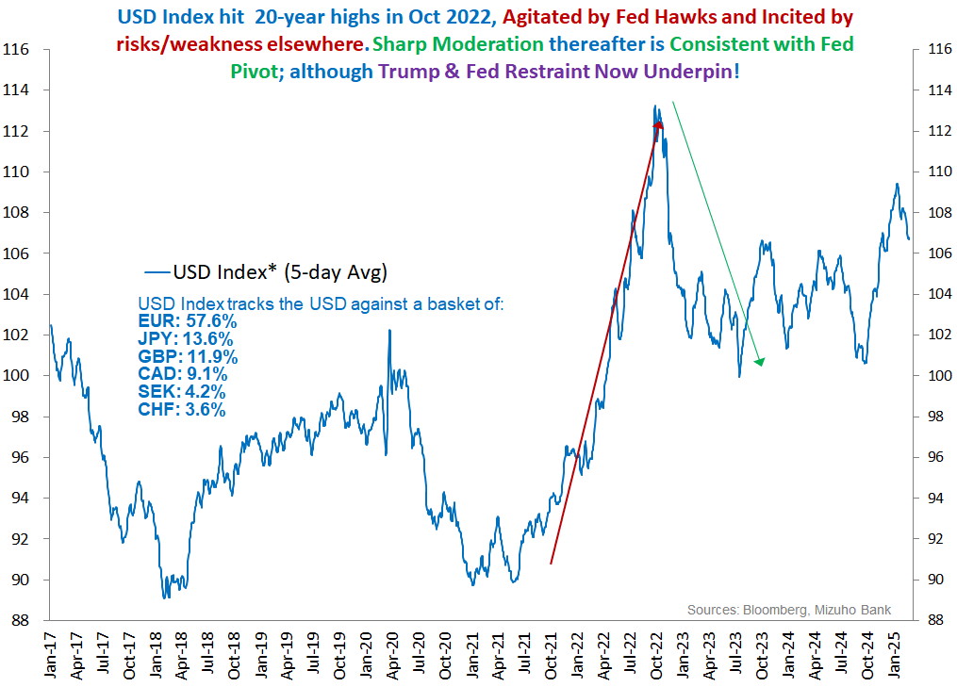
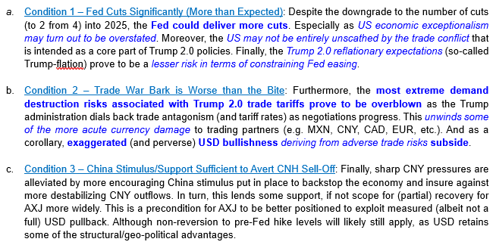
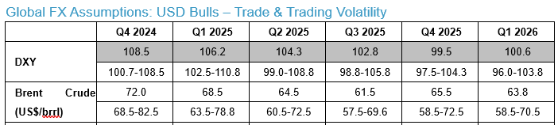
5a. USD to Mellow: As a Conspiracy of Fears Subside & Fed Relents

Slide 17
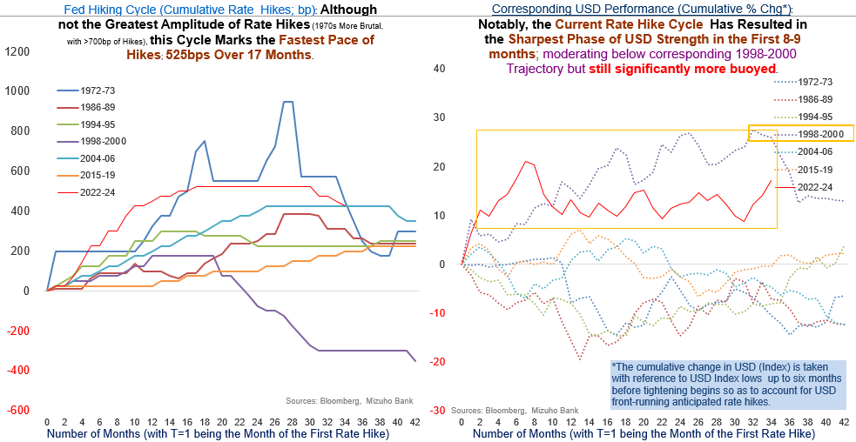
5b. USD: Atypical Late-Stage USD Strength

Slide 18
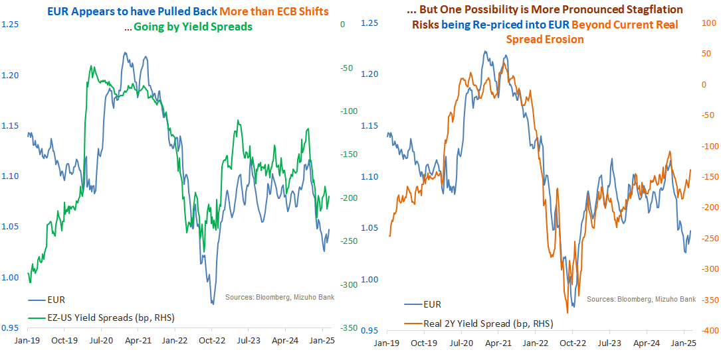
5c. Whereas, EUR is Compromised. So, USD May be Tempered

Slide 19
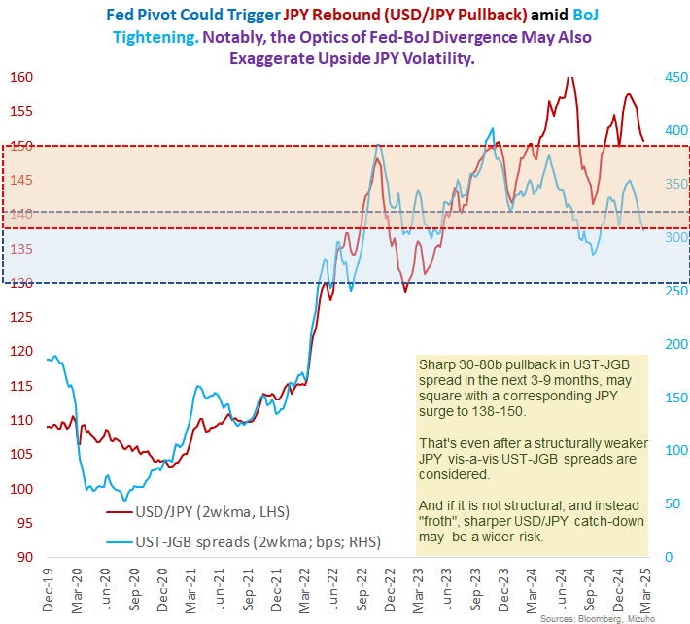
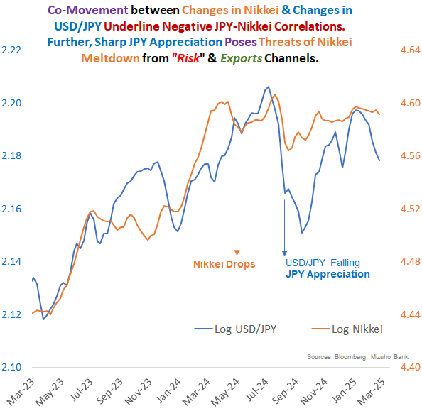
5d. FX - JPY-BoJ Risks: Trump 2.0 Heightens Inherent Volatility & Emboldens “Carry” for Now
“JPY Problem with a Fed Solution” Distorted by Trump 2.0 Disruptions
Fed Doubt & Trade pain may inflict bouts of JPY sell-off initially

Slide 20
6a. The Impossible Trinity of Trump Tariffs
Fiscal Revenues
Geo-political Leverage
Trade-Industrial Rebalancing
Broad-based
Certainty
Tariffs
Targeted/Strategic
Dispensability
Nuanced &
Calculated
Sweeping & Unfazed
One (Tariff) Tool, Many Objectives Apart from the obvious motivation to force trade/industrial re-balancing and attendant supply-chain relocation (to the US), tariffs also pursue geopolitical leverage and to raise fiscal revenues.
Conflicting Objectives: Trouble is, the obvious conflict in objectives. Fiscal revenues argue for steady, wide and steep tariffs. Leverage prioritizes non-trade deal-making (that entails rescinding on tariffs) and trade rebalancing requires strategic nuance.
Conflicting Objectives: Acute tariff uncertainty results from the one tariff tool is being exploited for multiple objectives. , undermines a path to quick resolution.

Slide 21
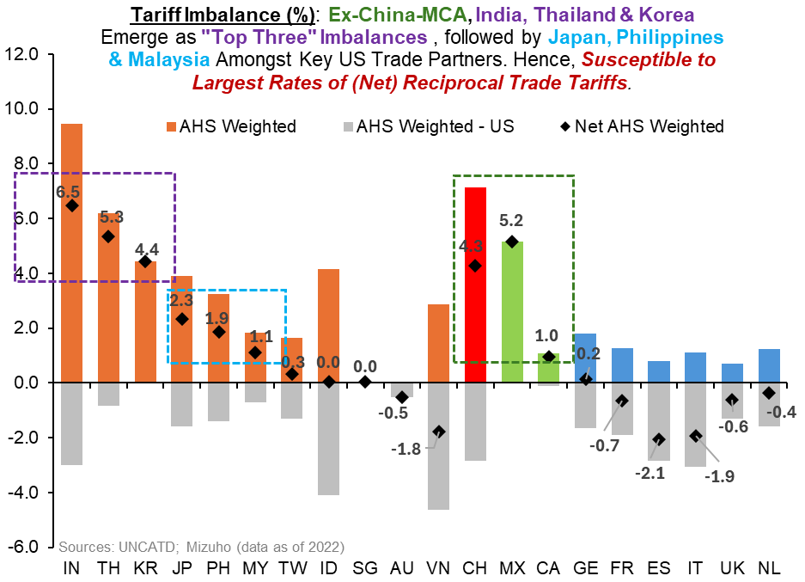
6b-i. Reciprocal Tariffs: Silver Linings (to Dial-Back) …

Slide 22
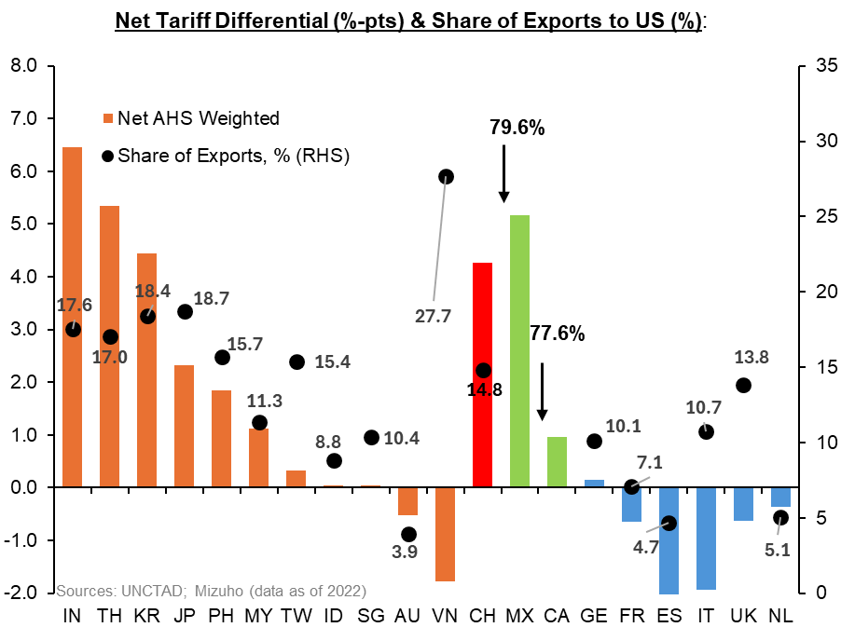
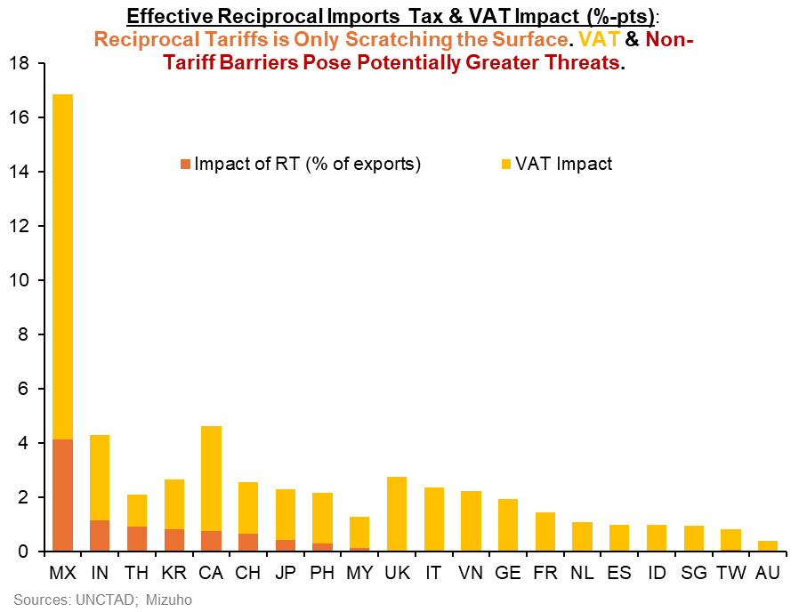
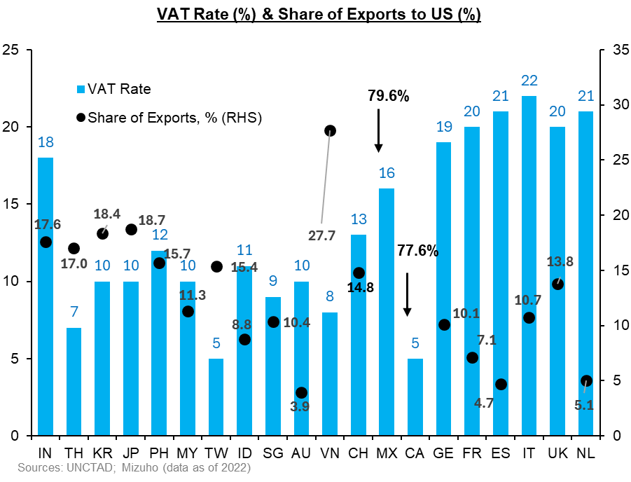
6b – ii. Reciprocal Tariffs: … or Spiral Risks From Escalation & Additivity

Slide 23
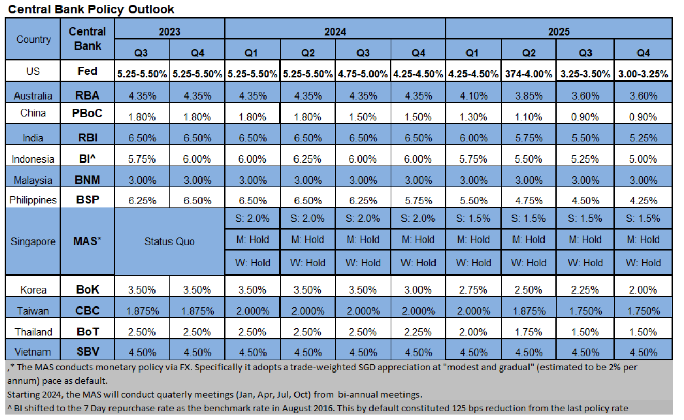
8. Policy Outlook
Notes:
i. Global Demand-Supply to Buffer: For one, the bigger picture is for aggregate global supply dynamic to at least keep apace, if not comfortably outstrip, demand shifts.
ii. Non-OPEC led Supply Offset: Second, the of Russia’s crude disruption is likely to be offset elsewhere. OPEC has compelling spare capacity poised for (delayed) output bump-up. Crucially, non-OPEC production outside of Russia has grown significantly, and is set to be flush.
iii. “Leaky” Russian Oil Sanctions: Notably, the sanctions could still prove “leaky”. Russia’s oil leaching into global supplies is highly likely outcome (and the lived experience). And with Russian oil at an even deeper discount, perversely blunting price upside from sanctions
iv. US Energy Ascendancy: What’ more, US ambitions to materially lift energy output, inevitably deepening and solidifying its position as a net energy exporter is yet another critical dynamic to check unmitigated upside* in prices.
v. Beijing Buffer: On the demand-end, China’s inclination to stockpile during periods of softer prices, provides the strategic inventory buffer to dampen bullish oil impulses. Especially as onshore demand recovery remains subpar.

Slide 24
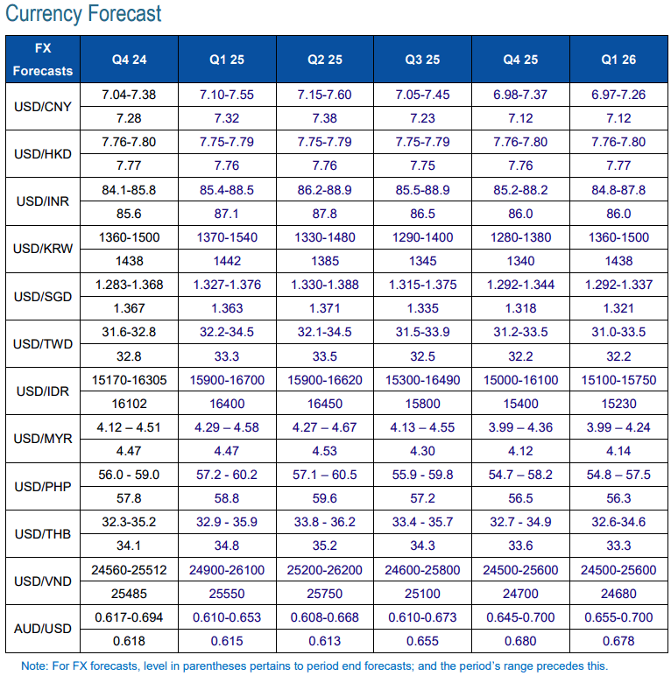
9. FX Outlook
Notes:
i. Global Demand-Supply to Buffer: For one, the bigger picture is for aggregate global supply dynamic to at least keep apace, if not comfortably outstrip, demand shifts.
ii. Non-OPEC led Supply Offset: Second, the of Russia’s crude disruption is likely to be offset elsewhere. OPEC has compelling spare capacity poised for (delayed) output bump-up. Crucially, non-OPEC production outside of Russia has grown significantly, and is set to be flush.
iii. “Leaky” Russian Oil Sanctions: Notably, the sanctions could still prove “leaky”. Russia’s oil leaching into global supplies is highly likely outcome (and the lived experience). And with Russian oil at an even deeper discount, perversely blunting price upside from sanctions
iv. US Energy Ascendancy: What’ more, US ambitions to materially lift energy output, inevitably deepening and solidifying its position as a net energy exporter is yet another critical dynamic to check unmitigated upside* in prices.
v. Beijing Buffer: On the demand-end, China’s inclination to stockpile during periods of softer prices, provides the strategic inventory buffer to dampen bullish oil impulses. Especially as onshore demand recovery remains subpar.

Slide 25
EM-Asia: Shoring Up Defences on Multiple Fronts
Photo Credits: Vector Stock
June 2024
Notes:
Thank you Boon Heng and hello everyone. We will now be turning to the EM Asia section, where the trickiness of navigating the current geo-political landscape mean EM Asia economies need to shore up their defences on multiple fronts.

Slide 26
Tariffs in Focus – Will EM Asia be Targeted?
Factors that US may look at include
whether economy has net goods trade surplus with the US?
net tariff differentials?
sensitive sectors?
Vietnam may be more at risk on its net goods trade balance.
India may also be more at risk given sizeable net goods trade surplus and relatively high net tariff differential.
Notes:
First of all, amid the flurry of headlines on US tariffs, a natural question is whether EM Asia will be targeted.
From tariffs headlines, we see that the US may target all imports from a specific countries, or selected goods.
There are several considerations for this.
To see if a country may be specifically targeted, one approach the US may undertake is to consider whether an economy has an overall net goods trade surplus with the US. This is because an outsized net goods trade surplus suggests trade imbalances, and the US may want to use tariffs as a tool to correct this imbalance.
The goods trade balance is also one of three criteria that the US looks at for its US Treasury report for suspected currency manipulation practices.
As of the latest report in November, China, Japan, Korea, Singapore, Taiwan and Vietnam are in the monitoring list, meriting closer monitoring, while Malaysia was removed from this list.
The top chart shows the exports, in blue, imports, in orange, and net goods balance, represented by the green dot, of EM Asia economies.
We can observe that Vietnam, Korea and India have a higher trade surplus against the US.
Notably, some of these countries have already announced some moves.
For example, Vietnam announced the imposition of anti-dumping duties on Chinese hot roll coil, which will be effective 8 March, signalling a pragmatic willingness to impose tariffs on Chinese goods should the need arise under Trump 2.0 threats. To be clear, the tariff was very self serving and not at request of the US but it tells us that there is an economic pragmatism that at times can override the image of close Vietnam-China relations.
Next, if the US wants to target this country, it could choose to impose tariffs on all goods or only specific goods.
On this, the US could look at net tariffs differentials to see if US is at an disadvantage.
In other words, whether a trade partner imposes higher tariffs on US goods compared to the tariff US imposes on the goods from this trade partner.
The bottom chart shows the variation in net tariff differentials across different goods categories, such as food and beverages, apparels etc.
This chart is a box and whiskers chart, so it shows the minimum, the first quartile, median, third quartile and maximum net differentials.
Taking India for example, across all the goods categories, the lowest tariff differential is -1, while the highest is about 22.6 percentage point. But a good 50% of goods around 0.5percentage points to 3 percentage points.
Over here, it is worth noting that India stands out in terms of overall net tariff differentials, and may be a potential target.
Already, we have seen news of India trying to pre-empt any tariffs by US.
It was reported last week that India officials were exploring ways to lower tariffs on a wide range of imports, including cars and chemicals, in a bid to evade Trump's threatened reciprocal levies. The proposals would go much further than previous tariff reductions, like on high-end motorcycles and bourbon whiskey.
Those in red boxes are countries who have signed free trade agreements, or FTAs with the US. For Australia and Singapore, the net tariff differential are almost zero across all goods categories.
Interestingly, for South Korea who has a FTA with the US, although most goods have zero net tariff differentials, there are still some goods with higher tariffs.
We would also like to highlight that FTA is no immunity card for tariffs.
For example, Australia is due to be hit with the 25% tariffs on steel and aluminium exports due to take effect on March 12, with authorities working for an exemption.
Meanwhile, under Trump 2.0, tariffs on Korea’s light trucks exports, which were initially scheduled to be phased out between 2019-2021, were also extended to 2041.
+++
For example, Trump 1.0 imposed 25% tariff on all steel imports in 2018, which hit Korea, which was in the top five supplies of US steel imports. After negotiations, US imports of South Korean steel are subject to an absolute quota equivalent to 70% of the average volume of South Korea steel imported between 2015-2017

Slide 27
Goods with Highest Weighted Net Tariffs
Goods with Highest Weighted Net Tariffs – Net tariffs (ppt), Export Share to US (%)
 | IN | ID | KR | MY | PH | TW | TH | VN
1 | Preparations of Meat, fish etc. (27.4pp / 82.6%) | Preparations of Meat, fish etc. (17.4pp / 56.8%) | Preparations of cereals (78.7pp / 17.1%) | Arms and Ammunition (16.2pp / 18.2%) | Preparations of Meat, fish etc. (36.9pp / 25.7%) | Preparations of cereals (15.0pp / 37.3%) | Arms and Ammunition (29.7pp / 45.3%) | Furniture (13.3pp / 66.8%)
2 | Miscellaneous edible preparations (70.3pp / 19.25) | Straw, basketware (22.9pp / 35.5%) | Cereals (59.1pp / 19.4%) | Explosives (22.2pp / 7.6%) | Straw, basketware (10.9pp / 82.3%) | Vehicles (14.6pp / 35.4%) | Oil seeds and fruits (79.0pp / 11.7%) | Tobacco (77.8pp / 10.4%)
3 | Dairy (42.0pp / 30.1%) | Feathers and down (11.2pp / 68.0%) | Cocoa (37.2pp / 17.5%) | Metals (13.1pp / 11.7%) | Articles of leather (8.8pp / 50.1%) | Explosives (4.9pp / 93.3%) | Dairy (123.1pp / 6.7%) | Umbrellas (22.0pp / 34.7%)
4 | Carpets (22.3pp / 53.7%) | Knitted apparel and clothing (10.4pp / 57.7%) | Vegetables and tubers (101.2pp / 5.2%) | Glass and glassware (17.2pp / 36.1%) | Arms and Ammunition (11.6pp / 31.2%) | Sugars and confectionery (7.2pp / 56.1%) | Knitted apparel and clothing (15.5pp / 29.4%) | Preparations of Meat, fish etc. (21.2pp / 25.8%)
5 | Gums and resins (29.8pp / 29.9%) | Articles of leather (14.2pp / 42.4%) | Fruits and Nuts (13.4pp / 33.2%) | Furniture (3.2pp / 36.1%) | Meat and edible offals (24.6pp / 13.3%) | Preparations of Meat, fish etc. . (20.3pp / 18.2%) | Explosives (19.9 pp / 22.9%) | Articles of leather (12.6pp / 38.8%)
*Australia and Singapore mostly has zero net tariff differentials. Highlighted cells means exports of that group is ≥2% of total exports to world.
Notes:
So now that we have a broad overview of distribution of net tariff differentials across all goods. There are even more questions.
For example, what exactly are these goods? Will specific sectors in a country will be hit hard if tariffs are imposed?
And also whether these goods are important to the economy from a more macro level?
So over here in this table, we have listed the top five goods categories which have the highest weighted net tariffs differentials. In other words, we ranked them based on the product of the net tariff differential and export share of that particular good to the US.
We excluded Australia and Singapore because these two economies mostly have zero net tariff differentials.
We see that for EM Asia economies, they are mostly agriculture and labour intensive sectors such as apparel.
It is certainly not too surprising to see that governments want to protect these industries considering that so many people are employed in these sectors.
Furthermore, domestic food security is also an important consideration
Interestingly, we also see arms and ammunition. This may be a consequence of defense cooperation with the US.
The cells in red means that exports of that goods category accounts for at least 2% of total exports to the world.
For example, Vietnam is a major furniture manufacturer.
Taiwan has a rich automotive industry chain, from parts manufacturing to vehicle assembly with considerable strength.
We think the higher weight is largely attributed to car parts as well as components, such as EV batteries.
So if tariffs are imposed on these goods, Vietnam and Taiwan may be hit harder.

Slide 28
By Goods – Key Sensitive areas?
Notes:
Next, the US may not want tackle specific countries but undertake a more sectoral perspective where specific sectors are targeted.
This may stem from sectors that are more sensitive to the US such as steel and aluminium, which the Trump administration has accused other countries of dumping practices – which is the practice that other countries’ steel and aluminum sectors benefiting from state subsidies to lower cost of these exports.
So over here, we show AHS, or effectively applied tariffs, on aluminium, autos, iron and steel, which are goods which US has announced tariffs on.
The blue columns indicates the tariffs an economy applies on US exports, while the orange column is the negative of the tariffs US applies on the economy’s exports.
The red dot indicates the net tariff differential, and the purple dot is the export share to the US of the particular good.
So for example, for aluminium, Vietnam has the highest net tariff differential of 9.5ppt, and export share about 9%. In contrast, while India has a net tariff differential of about 8%, it may be hit harder on any broad-based aluminium tariffs, given that its export share is higher at 14%.
For autos, we see that many economies have net tariffs differentials as Asian countries do want to protect the auto companies in their countries, and Taiwan and korea has a notably higher market share. So over here, we need to caveat that due to the way the goods are classified, car parts are included. So if the US targets more specific goods type, the impact may be bigger or smaller based on the specific good that have tariffs imposed on.
Moving on to iron & steel, India looks particularly vulnerable.
However, we also want to mention Australia specifically, even though it has zero net tariffs and have a relatively modest export share to the US.
This is because China is the destination of a large proportion of Australia’s aluminium (20%) and iron ore (80%) exports and Chinese production of steel has obviously not escaped the attention of White House officials.
So while Australia is negotiating an exemption to the imminent tariffs, it will need to convince the Whit House that it will fight Chinese subsidies while not overly subsidizing its own sectors.
We also included electrical machinery and parts given that Trump is also eyeing tariffs on semiconductors and associated devices, and the importance of this sector to the EM Asia economies.
From the chart, India, Indonesia, Thailand may be particularly impacted given higher net tariffs.
But given trade interlinkages for electronics cycle within the region, the region is likely to be adversely impact.
And we have seen some evidence of authorities wanting to pre-empt any actions by the US.
For example, Singapore has taken on a non-quantitative aspect by upping vigilance on reporting requirements, with authorities probing potential fraud in Nvidia AI chips shipments to China through shipments of servers to Malaysia.
Meanwhile, Vietnam has also appeared to be pre-empting any US’ targeted actions, imposing anti-dumping duties on Chinese hot roll coil effective 8 march had sent steel stocks soaring and at the margin, this perhaps signal a pragmatic willingness to impose tariffs on Chinese goods should the need arise under Trump 2.0 threats.
All in, the threat that EM Asia economies may be targeted by the US is a credible one.
Even if there are no direct threats, EM Asia economies are also susceptible to adverse trade headwinds, especially from US-China trade headwinds.
++++
Since 2018, the Trump Administration imposed a 25% tariff on all steel imports. South korea, typically among the top five supplies of US steel imports was one of the first countries to negotiate with the Trump Administration a quota in lieu of the tariff. As a result, US imports of South Korean steel are subject to an absolute quota equivalent to 70% of the average volume of South Korea steel imported between 2015-2017. South Korean officials have urged the Biden Adminstration to revisit the quota arrangement in light of less restrictive arrangements the Administration has negotiated with the EU and Japan.
Notably, the issue of global overcapacity in steel and aluminium, and the role state subsidies play, has been plaguing these sectors for more than a decade. The 2024 report of the Global Forum on Steel Excess Capacity – of which Ausralia is a member – states that significant over-investment by coutnries such as China, along with India, Indonesia, Malaysia and Vietnam, continues to ensure overcapacity in steel production. This has caused exports in steel and steel-intensive products to flood international markets, artificially reducing prices. Much of the blame has been laid at China’s door. China’s share of the aluminium market has increased from 8% to 58% in the past 20 years.
Donald Trump’s trade adviser Peter Navarrohad said over the weekend that “the US will no longer be a dumping ground for heavily subsidized and unfairly traded auminium”. Further state that it was not “just strategic competitors like China and Russia” that had exemptions, and specifically naming Australia.

Slide 29
FX Volatility – Forcing the Hands of EM Asia Central Banks?
Volatility remains elevated more generally.
Recent comments:
Bank Indonesia at Feb meeting (19 Feb) said they have been intervening “almost everyday” and on 28 Feb said they are intervening “boldly” to guard rupiah.
BNM said on 12 Feb its ready to manage excessive ringgit volatility
BOK, in 25 Feb decision, cautioned against high exchange rate volatility even as easing bias remained.
BSP on 13 Feb meeting said it was developing playbook for FX interventions.
Vietnam’s foreign reserves less than 3-month imports
Notes:
Apart from the economic implications of tariffs, another aspect is the impact of the current macro developments on EM Asia FX, not withstanding domestic factors.
EM Asia FX has been pretty volatile of late. And the two charts here show the 1-month at the money volatility of FX moves.
The top charts shows South east asia currencies, with JPY and CNH given the spillovers of JPY and CNH to these currencies.
For example, THB is more susceptible to spillovers from JPY.
The bottom chart shows Aussie dollar, Indian rupee, Korean won and Taiwan dollar, and we also observe volatility picking up.
That it may be becoming increasingly difficult to defend currencies can be found in some of the statements by central banks.
Notably, Bank Indonesia at their February meeting said that they have been intervening almost everyday, and last week said they are intervening “boldly” to guard the rupiah as the rupiah neared highs seen in 2020.
Meanwhile, BNM and BOK made remarks on the heightened FX volatility.
VND, in the green line is almost a straight line given its managed exchange rate system by SBV, but are facing problems with reduced FX reserves.

Slide 30
EM Asia Central Banks – Interventions Toolkit
Central Banks | Verbal Intervention style (language & tone) | Frequency & intensity of verbal intervention | Drivers of verbal intervention (level or volatility or both)
BoT | Via official channels espousing rate stability and framing THB movements in NEER terms | Not as frequent or as intense compared to regional counterparts. | Volatility
BoK | Espoused the need for stability. | Frequency increased recently due to domestic issues. | Both
RBI | Referring to fundamentals and avoiding excessive volatility | Intensity stepped up with greater frequency in recent months | Volatility
BNM | Relatively quiet on verbal intervention, but have made if clear that monetary policy will not be used to support MYR, although BNM may intervene when MYR moves are not orderly and to ensure enough liquidity in banking system | Reiterate their stance during times of excessive MYR weakness. Such comments are not frequent. | Excessive volatility or when MYR is excessively weak.
BI | Reiterate that BI is ready to intervene or is in the market to support the IDR. | Dependent on level of IDR and pace of depreciation. For past few quarters, comments are usually given when USD/IDR trade above 16,000 levels. | Both levels and volatility, but more on levels.
BSP | Governor Remolona states views on where he sees USD/PHP trading at or could move to. Occasions where BSP indicated it would intervene when markets are volatile. | Comments are given typically when USD/PHP is trading near key levels. In the past few quarters, 59 handle has been the key level to watch. If breached, 60 would be the next level. | Levels are often quoted by BSP Governors though smoothing volatility has been a motivation as well.
Notes:
This slide is more for information purposes. It details some stylized information on how different central banks may choose to conduct interventions. Some may choose to intervene but not announce, while others may opt to voice their interventions more openly.

Slide 31
Brief Recap Of Past Few Months – Surprises Underscore Tricky Balancing Act
RBA: Commenced easing cycle with a 25bps reduction; but hawkish cut as labour market still appears strong.
Bank Indonesia: Surprise cut in January, before returning to a hold in February as BI continues to look for room to ease while grappling with IDR-stability concerns.
BSP: Surprise hold at February meeting despite affirmations that BSP remained in an easing cycle. Inclinations to support growth has not faded with pipeline RRR cuts and plans to devise a playbook for FX interventions.
Bank of Korea: Cut rates at February meeting, amid downwardly revised 2025 GDP growth forecasts, but easing pace still dependent on any rebound in household debt and FX markets.
Bank of Thailand: Cut rates in February on growth concerns, but ought to see restraints from back-to-back cuts with BoT’s alluding to structural woes weighing on growth.
RBI: First cut of the cycle in February. More to come on growth woes, but cautious amid rupee pressures.
Notes:
So with that, we will be going through the individual economies one-by-one.
But I will first give a brief recap of the notable central bank decisions in the past few weeks, which underscore the tricky balancing act, as several surprises for the market means that things are not as clear-cut.
RBA commenced its easing cycle with a 25bps reduction, but hawkish cut as labour market still appears strong.
Bank Indonesia returned to a pause in February following a surprise cut in January. BI will continue to look for room to ease while grappling with IDR-stability concerns.
BSP had a surprise hold at February meeting despite affirmations that BSP remained in an easing cycle. Inclinations to support growth has not faded with pipeline RRR cuts and plans to devise a playbook for FX interventions.
Bank of Korea cut rates at February meeting, amid downwardly revised 2025 GDP growth forecasts, but easing pace still dependent on any rebound in household debt and FX markets.
Bank of Thailand: Cut rates in February on growth concerns, but ought to see restraints from back-to-back cuts with BoT’s alluding to structural woes weighing on growth.
RBI: First cut of the cycle in February. More to come on growth woes, but cautious amid rupee pressures.

Slide 32
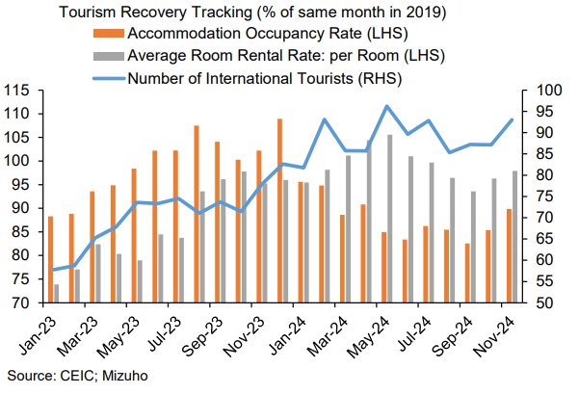
Thailand
External Risk assessment: Relatively higher net tariff differentials mean there are risks of being targeted, with some sectors (e.g. automobiles) more at vulnerable than others (semiconductors) given supply chain positioning. External economic interlinkages via Chinese tourist and export demand channels will also weigh on growth.
Domestic Risk Assessment: Thailand’s Q4 GDP disappointed on dire private investment spending growth and the services sector driving nearly the entirety of growth amid fiscal transfers and tourism boost. Decline in non-performing loans partly driven by restructuring measures enabling reclassification rather than economic upturn.
BoT: Recent cut should not be extrapolated to extend bets for an outright easing cycle as BoT alluded to structural woes weighing on growth.
Notes:
To start off, we have Thailand. Our tariff assessment is that there are certainly risks given relatively higher net tariff differentials, but will be differentiated across goods.
In particular, some sectors (e.g. automobiles) more at vulnerable than others (semiconductors) given supply chain positioning. While Thailand’s semiconductor supply chain positioning imply that they may be less threatened by direct tariffs relative to regional peers such as Vietnam, it is likely to get a hit on the automobiles front.
Meanwhile, their external economic interlinkages via Chinese tourist and export demand channels will weigh on growth.
Domestic indicators have been disappointing. Notably, Thailand’s Q4 GDP was significantly below expectations. In our view, it is not that the expected consumption boot from fiscal transfers did not come through, as private consumption grew 3.4% YoY with expansion across most categories. Disappointment though came from investment spending, where private investment spending was dire, contracting 2.1% on a year ago basis. An envisaged Q4 restocking of inventories also did not come through which reflects the soft business sentiments. As such, most of the growth support came from net exports, particularly services exports which is also evident in the services sector’s 3%-pts contribution to the 3.2% growth in Q4.
In addition, although non-performing loans declined in Q4, there is little comfort as the decline was partly driven by restructuring measures enabling reclassification rather than economic upturn.
Onto central banks, the BoT decision was in line with our call to ease policy rates by 25 bps. While growth concerns were ubiquitous, they should not be extrapolated to extend bets for an outright easing cycle. We refrain from calling for back to back cuts especially as the BoT's statement alludes to structural woes weighing on growth, and monetary easing may not be the right tool to use for structural factors.

Slide 33
Philippines
External Risk assessment: May not be prime target for US tariffs, but semiconductors sector could get a hit too; in addition, geo-political headlines with China presents some tail risk. Recovery of tourism also still have some way to go, which could support growth.
Domestic Risk Assessment: Heightened downside risks for domestic consumption amid poor sentiment. Domestic political woes also cast overhang.
BSP: Surprise hold in February. But easing bias will be retained, especially to support growth. See 60% probability of a cut at April’s meeting.
Notes:
Next, moving on to Philippines.
Overall, Philippines may not be prime target for US tariffs, but semiconductors sector could get a hit on tariffs imposition.
In addition, geo-political headlines with China in relation to disputed waters presents some tail risk.
Nonetheless, tourism growth has been supportive and should remain so, given that recovery of tourism also still have some way to go.
For Philippines, our sense is that there are greater risks on the domestic front, relative to external.
In particular, we see heightened downside risks for domestic consumption amid poor sentiment.
Downside risks for domestic consumption are increasingly worrying. Despite the holiday season, a survey conducted by Social Weather Stations (SWS) in December revealed that 63% of Filipinos saw themselves as poor, the highest self-rated poverty level in 21 years. This is shown in the right chart below.
A separate survey by the same organization indicated that the number of Filipino households experiencing involuntary hunger has jumped to 25.9%, the highest since the pandemic.
Accordingly, BSP’s easing bias will be retained, despite the surprise hold in February. We see 60% probability of a cut at April’s meeting, subject to overall USD conditions.

Slide 34
Indonesia
External Risk assessment: Not a prominent target for US tariffs, but other external risks are present as current account deficit widens. Expect elevated palm oil prices to be temporary and commodity prices to be broadly soft amid global demand woes; IDR vulnerable to USD moves.
Domestic Risk Assessment: Domestic risks arguably more accentuated than external risks. Shrinking middle class and difficulty to find higher-skilled jobs likely to cast a shadow on resiliency of household spending. Fiscal situation is a big bugbear; recent announcements do not impart confidence.
Bank Indonesia: Will continue to keep looking for room to ease, subject to IDR-stability concerns.
Notes:
On to Indonesia, we think that it is not a prominent target for US tariffs, but other external risks are present as current account deficit expected to widen further.
While palm oil prices have been higher in the past few months, this is in large part attributed to poor harvests in Malaysia due to bad weather and flooding. While higher palm oil prices could continue into Q1 on persistent bad weather conditions in Malaysia and higher demand going into/during Ramadan, demand for the whole year is unlikely to rise by much amid growth woes in China and Europe. In addition, bumper harvests for soy (a competing crop for food and fuel) would likely put a lid on price increases.
Overall, we expect commodity prices to be broadly soft amid global demand woes.
Meanwhile, IDR continues to be vulnerable to USD moves, especially as domestic risks have been heightened.
Similar to Philippines, we view domestic risks in Indonesia to be more accentuated than external risks.
Firstly, a report by University Indonesia showed that Indonesia’s middle class has been shrinking in the past decade.
In addition, the proportion of university graduates engaging in informal employment has seen a structural upward shift (as shown in the right chart) post-pandemic. This suggests that it is more difficult to find higher-skilled and better paying jobs.
This combined with a shrinking middle class cast a shadow on resiliency of household spending and presents downside risks to growth.
Meanwhile, fiscal situation is a big bugbear amid the slew of recent announcements.
Notably, "Dark Indonesia" protests in recent weeks week stemmed from dissatisfaction around Prabowo's call for ministries to lower the budget spending by Rp306.7tn (8.5% of approved budget) had seen the health, education and public works ministries announcing budget cuts of 19%, 24% and a whopping 73%, respectively.
Initially, these savings were thought to be re-allocated towards his flagship free lunch programmes and other policy priorities. Estimates had suggested an additional IDR100tn needed to fund Prabowo's intention to expand the free lunch program to included all 83m recipient by end-2025 on top of the current IDR71tn budget.
Last week's announcement of Danantara, Indonesia's new sovereign wealth fund, saw President Prabowo state that these budget savings will also be channelled to the fund alongside ownership transfer of SOEs to the fund.
On aggregate, given seemingly enlarged spending needs and clouded sight of the savings re-allocation, the fiscal deficit target will likely need to be lifted. Afterall, something got to give. On tail risks, extreme austerity could engender social unrest should the desired outcome of a managed fiscal deficit be realised through removal of on the ground programmes rather than trimming inefficiencies.
On Bank Indonesia, the desire to support growth will mean that BI will continue to keep looking for room to ease, but this will be subject to rupiah-stability concerns. Accordingly, it will be a bumpy pathway down.

Slide 35
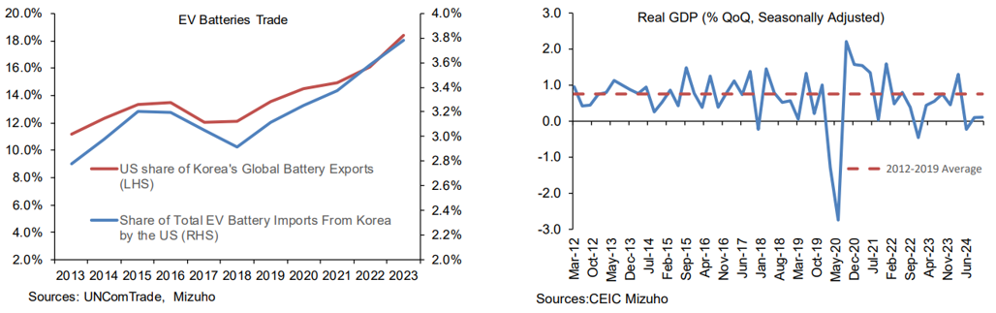
South Korea
External Risk assessment: Trump’s removal of incentive for EVs will be a setback for automobile and battery sectors with the latter taking a bigger brunt of the hit, given that EV batteries exports to the US taking up almost a fifth of total EV battery exports. External headwinds will drag on the industrial sector which is already at risk of stagnating, in addition to competition from Chinese automobile companies.
Domestic Risk Assessment: Political uncertainty persists amid weak growth. Overall 2024 growth printed at just 2% after two quarters of 0.1% QoQ expansion in the second half, likely meaning a negative output gap.
BoK: Bank of Korea cut rates in an unanimous decision amid downwardly revised 2025 GDP growth forecasts (1.5%, vs 1.6-1.7% in Jan), but hinted that easing pace was still dependent on any rebound in household debt rebound and FX markets. This was perhaps reflected by the (revelation?) that only 2 out of 6 members expressed openness to another rate cut in the next 3 months. We expect another cut in late Q2.
Notes:
Onto Korea, we expect korea to be more impacted on the tariffs front, both directly or indirectly, such as via impact of Trump’s executive orders such as EV credits and tariffs on China.
Notably, Trump’s removal of incentive for EVs will be a setback for automobile and battery sectors with the latter taking a bigger brunt of the hit given their reliance on supplying to American companies. While Korea has seen their small share of batteries imported by the US steadily increase over the year, the export demand is at risk of a sharp plunge in 2025 with EV batteries exports to the US taking up almost a fifth of total EV battery exports.
Meanwhile, external headwinds will drag on the industrial sector which is already at risk of stagnating. Competition from Chinese automobile companies also likely to add further strains.
On the domestic front, political uncertainty persists. Should President Yoon be removed from office or resign, snap elections will be held within 60 days. Nonetheless, the twist and turns in the investigation alongside domestic protests from both ends imply that there is considerable uncertainty over the timeline of the next elections though political pressures may push towards an election in H2 2025.
With overall 2024 growth at just 2% after two quarters of 0.1% QoQ expansion in the second half, the BoK is likely faced with a negative output gap which underpins their overall tendency towards easing. We expect another cut in late Q2.

Slide 36
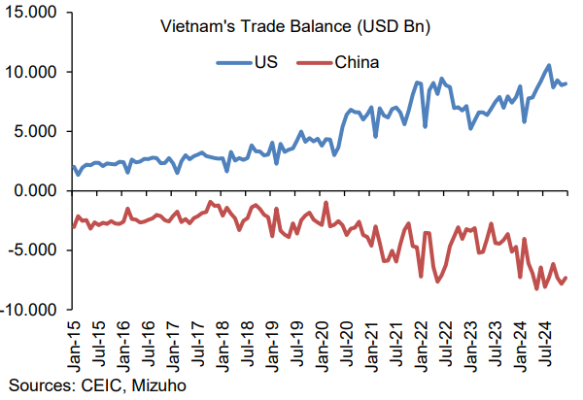
Vietnam
External Risk assessment: Gains from China+1 are likely to be more modest as the Trump administration may apply selected tariffs on Vietnam to protect their industries given that much of the supply chain would have already diversified. To look out for next edition of US Treasury report (exp. in April). Imposition of anti-dumping duties on Chinese hot roll coil (eff 8 March) signal a pragmatic willingness to impose tariffs on Chinese goods should the need arise under Trump 2.0 threats.
Domestic Risk Assessment: Economic indicators show that growth remain supported. But official GDP growth upgrade to above 8% in 2025 is really too high, even if SBV eases at the expense of higher price pressures (inflation targets upgraded to 4.5-5.0%).
SBV: We retain our base case that the SBV will keep rates on hold as the VND remains the overriding concern. Reserves are worrying.
Economic data release (due 6 Mar) may see a possibility of an upgrade by FTSE to be reclassified as an emerging market from their current frontier status under its equity country classification.
Notes:
Moving on to Vietnam, given the precedence from Trump 1.0, it is certainly tempting to suggest that Vietnam is set to gain on grounds that there may be an acceleration of the China+1 strategy as the US intensified its trade war with China. These gains are likely to be more modest as the Trump administration may apply selected tariffs on Vietnam to protect their industries given that much of the supply chain would have already diversified. The tariff threat is not a theoretical one given that prominent members of the incoming Trump administration such as Vice President Vance were part of the Senate who opposed Vietnam’s classification as market economy which leaves them subjected to more prohibitive trade barriers.
On the domestic front, economic indicators should continue to indicate supported growth, with its monthly industrial production and retail sales due on Thursday. However, official GDP growth upgrade to above 8% in 2025 is really too high a bar even as they appear to be accounting for it via an upgrade of inflation target to 4.5-5.0% signalling tolerance of higher price pressures alongside SBV’s willingness to adjust credit growth targets.
Relatedly, there also could be a possibility of an upgrade by FTSE to be reclassified as an emerging market from their current frontier status under its equity country classification. Bu even if an upgrade is on the cards for Vietnam, effective inclusion is likely to be phased over a period of 1 year. As such, while it has been estimated to bring in US$6billion of annual inflows, the actual impact may be much more constrained considering the cautious macroeconomic backdrop. Furthermore, it is worth nothing that foreign equity outflows from Vietnam equities amounted to US$3billion in 2024 and such risk off sentiments have persisted with US$0.5billion of outflows YTD in 2025.
++++
For February, industrial proudciton growth is likely to be a faster pace after the lull in January while retail sales should also remain firm although car sales is likely to remain lackluster.

Slide 37
Australia
External Risk assessment: FTA with the US and trade negotiations may not fully insulate implications from trade war as US-China tensions remain on path for escalation.
Domestic Risk Assessment: While Q4 GDP expected to accelerate, it is in part on base effects and balance of risks for Q4 GDP print tomorrow (5 Mar) skewed towards downside. Resilient labour market cautions RBA’s easing. CPI print is unlikely to affirm another cut in early April but its underlying trend should remain contained and validate the RBA’s complicated kick-off to easing.
RBA: Further easing by RBA will not be forthcoming amid recent robust job prints. Expect a hold at April’s meeting as Q4 24 retail sales and Q1 labour market prints remain resolute. Next cut expected in May on soft spots engendering growth concerns.
Notes:
Down under, as previously mentioned, Australia’s FTA with the US and trade negotiations may not fully insulate implications from trade war as US-China tensions remain on path for escalation.
While Q4 GDP expected to accelerate, it is in part on base effects and balance of risks for Q4 GDP print tomorrow (5 Mar) skewed towards downside. Resilient labour market cautions RBA’s easing. CPI print is unlikely to affirm another cut in early April but its underlying trend should remain contained and validate the RBA’s complicated kick-off to easing.
On RBA, we think further easing by RBA will not be forthcoming amid recent robust job prints. Expect a hold at April’s meeting as Q4 24 retail sales and Q1 labour market prints remain resolute. Next cut expected in May on soft spots engendering growth concerns.

Slide 38
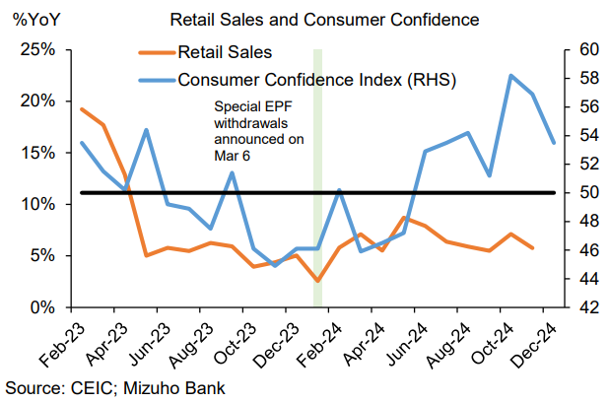
Malaysia
External Risk assessment: Susceptible to external headwinds, but still looks to be a in relatively good position amid buoyant investments. Removal from US Treasury Monitoring list in November as it met one criterion (has a goods trade surplus with the US) in the April and November 2024 report.
Domestic Risk Assessment: Resilient consumers amid savings, while robust investments in recent years in manufacturing and services sector ought to create good employment opportunities and support wages, alongside good wage growth.
BNM: View of a prolonged hold unchanged.
Notes:
Onto Malaysia, it is susceptible to external headwinds, but still looks to be a in relatively good position amid buoyant investments.
Removal from US Treasury Monitoring list in November as it met one criterion (has a goods trade surplus with the US) in the April and November 2024 report.
The Malaysian Investment Development Authority recently shared that the country saw a 14.9% YoY growth in approved investments in 2024, of which 66.8% and 31.8% were in the services and manufacturing sector respectively. Approval of projects and creation of new jobs increased 31.3% and 62.8% YoY respectively. We expect the strong growth momentum to continue, even amid headwinds on its sound macrofundamentals.
Malaysia also somewhat stands out as an outlier on resilient growth.
Q4 GDP growth was revised higher to 5.0% YoY (prelim: 4.8%) as upward revisions to services, construction and manufacturing offsetted a deeper contraction in mining and quarrying activity.
Meanwhile, inflationary pressures remain contained with headline inflation stable at 1.7% in January (Dec: 1.7%). Looking ahead, inflation is expected to dip for March's and April's prints as the base effects from last year's round of SST revision fades away, but rebound higher from May amid upward pressures could be expected as the SST expansion announced in Budget 2025 last year is due to be implemented that month. More details on the expanded scope are due this quarter. But overall, inflationary is expected to remain stable.
For the upcoming meeting this Thursday, BNM is set for another hold at the upcoming meetingamid resilient growth and contained inflationary pressures, and we expect a prolonged hold. Nonetheless, ringgit volatility still expected given the vulnerability to geo-political rade tensions.

Slide 39
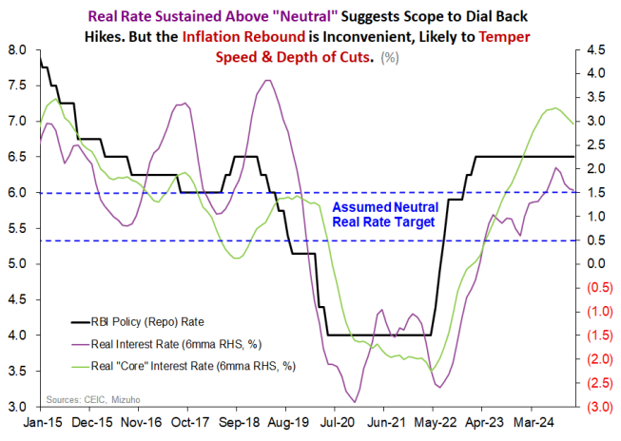
India
External Risk assessment: Higher risk given elevated net tariffs differentials; telling that India has taken steps to strengthen diplomatic ties with the US (e.g. repatriate illegal Indian immigrants) and considering tariff reductions for US imports.
Domestic Risk Assessment: Growth concerns on slowdown in growth momentum tied to noticeable stress on middle income households. Fiscal consolidation slightly better than anticipated (FY25E: 4.8%; FY26: 4.4% of GDP), but risk tilted towards fiscal slippage driven by shortfall in tax collections.
RBI: More easing to come on exceptionally elevated real (core) rates mean that scope for RBI cuts is merely moderated, not overturned. However, bumpy rate cut path expected contingent on dis-inflation restores is par for the course.
Notes:
Moving to India, we see higher risk given elevated net tariffs differentials; telling that India has taken steps to strengthen diplomatic ties with the US (e.g. repatriate illegal Indian immigrants) and considering tariff reductions for US imports.
Recent portfolio outflows and attendant pressure on the rupee may also be a reflection of this.
On the domestic front, growth concerns have been brewing amid a noticeable stress on middle income households.
Fiscal consolidation was slightly better than anticipated (from an already commendable path to deficit reduction). FY25 fiscal deficit expected to be 4.8% of GDP from earlier estimates of 4.9%. FY26 deficit is targeted to be 4.4% from earlier projections of 4.5%. But risks tilted towards fiscal slippages driven by shortfall in tax collections.
On RBI, it has commenced its easing cycle under the new RBI Governor Malhotra, marking a dovish shift swapping exceptional abstinence from easing for judicious activism to pre-empt a hard-landing. Afterall, despite mild reversal of dis-inflation, exceptionally elevated real (core) rates mean that scope for RBI cuts is merely moderated, not overturned. Nonetheless, the dovish shift presided by the new governor should not be taken that that he is an unmitigated dove. We expect a bumpy rate cut path contingent on dis-inflation restores is par for the course, but he will be wary of being unduly hawkish.

Slide 40
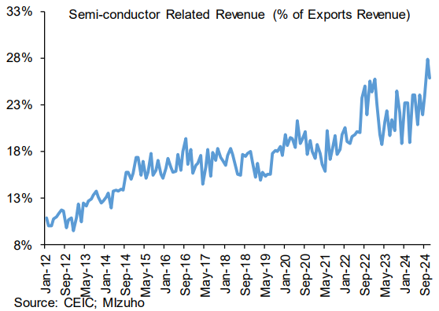
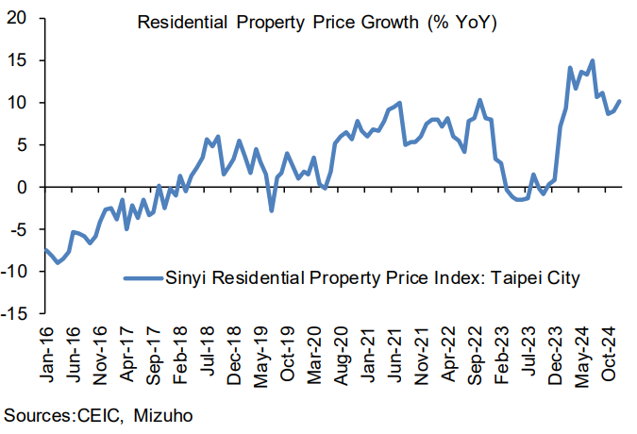
Taiwan
External Risk assessment: With semiconductor getting an increasingly larger share of exports, reliance becomes risky. Downside risks of actual semiconductor demand alongside lofty valuations of its leading semiconductor manufacturers.
Domestic Risk Assessment: Despite Q4’s GDP upward revision, 2025 GDP forecast was revised lower to 3.3% (prev: 3.1%) in part due to larger budget cuts.
CBC: A hold for now, as a hike is kept at bay given growth risks in coming quarters, while a cut is likely off the table as the CBC will also want to avert the situation of re-igniting the housing market after recent measures show signs of paying off. We delay our expectation of a calibrated rate cut to Q3 from Q2 as inflation pressures remain unrelenting and growth remains resilient.
Notes:
Taiwan does have some external risks with semiconductor getting an increasingly larger share of exports, reliance becomes risky. Downside risks of actual semiconductor demand alongside lofty valuations of its leading semiconductor manufacturers.
Domestic growth however has been surprisingly strong.
Notably, Taiwan's Q4 GDP was revised upwards 1.8% YoY in its advance estimate to 2.9% YoY was on the back of upward revision to private consumption from 1.9% to 2.5% while exports growth was stronger than expected at 8.9% YoY from 8.2% YoY. Admittedly, domestic demand has been resilient in Taiwan.
Nonetheless, a hike by CBC is kept at bay amid trade and growth headwinds as reflect by a downgrade of the 2025 GDP forecast by the authorities from 3.3% to 3.1%. Notably, the growth downgrade was also said to be in part due to larger budget cuts. Furthermore, with CPI forecast remaining at 1.9% in 2025, the CBC will likely lean on the cautious side of the policy calculus for now.
Accordingly, we delay our expectations of a calibrated rate cut to Q3 from Q2, as the CBC will also want to avert the situation of re-igniting the housing market after recent measures show signs of paying off. That said, December’s property price uptick will keep policy makers on their toes on easing too early and the initial support may come through fiscal and trade initiatives rather than monetary policy accommodation.

Slide 41
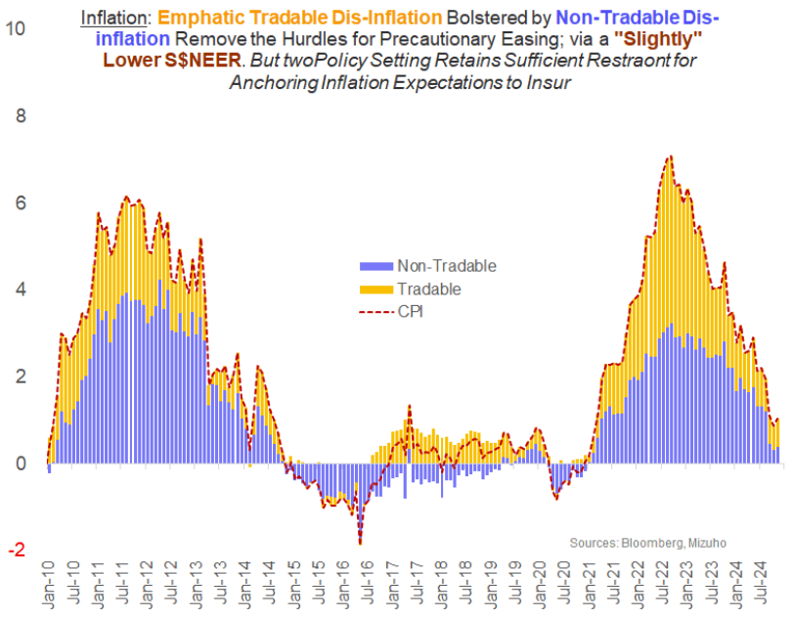
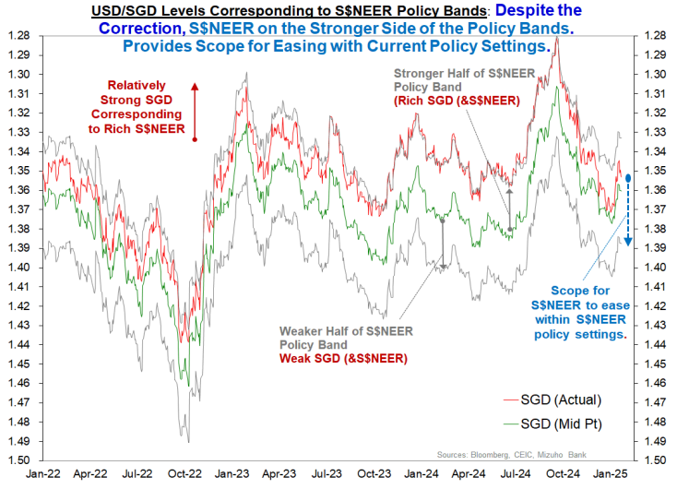
Singapore
External Risk assessment: US’ trade surplus with Singapore and Singapore-US FTA provides some kind of assurances on trade retaliation.
Domestic Risk Assessment: A generous fiscal budget which incurs 0.6% of GDP deficit ought to buffer growth headwinds ahead. 2025 growth seen at 1-3% (2024: 4.4%).
MAS: MAS has a high bar for further monetary easing, following January’s decision to reduce slope of appreciation path. Further easing in the form of a downward recentering of the mid-point of the S$NEER policy band necessitates a sharp global growth downturn. Meanwhile, even after the January’s easing, a positive slope (S$NEER appreciation bias) was retained to anchor inflation expectations whilst insuring against demand shocks by tempering S$NEER headroom (and attendant scope for SGD outperformance). Expect no further changes to MAS’ policy settings for the rest of the year.
Notes:
Finally, onto Singapore, threat of reciprocity requires us to examine the extent of import tariffs which Singapore places on US goods. The fact is that there is effectively no tariffs imposed on imports from the US considering that Singapore has a FTA with the US. In turn, there is nothing to retaliate for in addition to the reality that the US runs a trade surplus with Singapore rather than a deficit.
However, it would be naïve to be complacent, as we have seen non-quantitative aspects of improving ties with the US.
Notably, Singapore appears to be stepping up with vigilance on reporting requirements, as authorities probes into potential fraud in Nvidia’s shipments.
On the domestic front, a generous fiscal budget which incurs 0.6% of GDP deficit ought to buffer growth headwinds ahead.
For the MAS, the MAS has a high bar for further monetary easing, relative to regional peers such as BI and BSP. A downward recentering of the mid-point of the S$NEER policy band necessitates a sharp global growth downturn. Meanwhile, even after the January’s easing, they retained a positive slope (S$NEER appreciation bias) to anchor inflation expectations whilst insuring against demand shocks by tempering S$NEER headroom (and attendant scope for SGD outperformance). The slope easing in January also implies that monetary easing would continue to work through the economy in the months ahead. We are not expecting any further changes to MAS’ policy settings for the rest of the year.

Slide 42
FX summary – Head(line Volatility) & Tail (Risks)
Asia FX: USD may be prone to retaining Trump tariff premium despite bumpy two-way adjustments and should US exceptionalism hold. This would impart a distinct bearish bias for AxJ (or at least an absence of scope for sustained rebound) initially in 2025. Scope for negotiated compromises later in 2025 (or early-2026) could however set the stage for a cautious and measured recovery as AxJ risks are moderated accordingly.
CNY: Trump’s watered-down tariffs to 10% (from 60% during campaigns) complemented by PBoC backstop, has helped RMB traction initially. But imposition of another 10% tariffs subsequently means potential of further trade conflict escalation is ever-present. Latent CNH fragility and downside risks remain intact for now.
INR: Cyclical headwinds and structural impediments could conspire to impose sharper trade-off on policy easing by the RBI (justified as it is). Especially as improved fiscal consolidation targets appear stretched on the optimistic side. What’s more India’s loss of advantage from Russian oil also dims rupee at the margin. Some degree of hysteresis entailing lower rupee equilibrium limits rupee rebound, denying full reversion.
KRW: Interim relief from domestic political woes may be renewed should elections be called. Nonetheless, National Pension Service hedging will temper excessive weakness.
TWD: TWD remains vulnerable to risk-off episodes alongside allusion to defence arrangements under Trump 2.0. Easing by the CBC will remain cautious and calibrated in the months ahead.
SGD: Slight reduction in slope of the S$NEER by the MAS not an outright bearish call as the modest and gradual appreciation stance is intact. Nonetheless, deference on USD swings will drive volatility for the small open economy especially in H2’25 as indirect tariff impact and direct loophole allegations remain key risks.
IDR: Underperformance looks to persist amid a confluence of fiscal woes and global growth headwinds seeping through. Tensions between BI’s desire to ease and rupiah stability will persist. Further pressures could see tests to record lows re-emerging should USD volatility continue, even as BI attempts to temper weakness.
MYR: Two-way volatility on swings in UST yields and US-China trade tensions; but solid fundamentals should more generally position MYR in a good standing for further outperformance against regional peers.
PHP: Growth headwinds both domestically and externally pressure PHP; but BSP’s interventions merely temper excessive volatility, not determine levels. Crucially, there can be no lines in the sand as dynamic FX stability-easing trade-off analysis in the context broader relative to AxJ valuation determine BSP backstop.
THB: Volatility to persist and imply time sensitive vulnerability even as a firmer current account surplus aids prospect of recovery further out. Fiscal debt reckoning a risk to be watched even as ruling party solidifies position.
VND: Diminished FX reserves will continue to weigh on VND prospect under Trump 2.0 and current account surplus imply that there is a significant risk of being targeted.
AUD: Labour markets clouding RBA’s easing bath could backstop AUD’s decline. Furthermore, China’s fit and starts recovery will constrain.
Notes:
With that, we have a few liners summary of our FX outlook. Overall, we think that hyper-sensitivity to tariff headlines (be it pressures on elevated threats or relief from worst-case averted) amid heightened US policy uncertainty compounded by hawkish Fed divergence (vis-à-vis Asian central banks) sets the stage for accentuated two-way volatility. But USD may be prone to retaining a Trump tariff premium and impart a distinct bearish bias for AxJ (or at least an absence of scope for sustained rebound) initially in 2025 as US exceptionalism and antagonism conspire.
Nonetheless, we see scope for negotiated compromises later in 2025 (or early-2026), which could set the stage for a cautious and measured recovery as AxJ risks are moderated accordingly.

Slide 43
Disclaimer
Important Information
This publication has been prepared by Mizuho Bank, Ltd. (“Mizuho”) and represents the views of the author. It has not been prepared by an independent research department and it has not been prepared in accordance with legal requirements in any country or jurisdiction designed to promote the independence of investment research and is not subject to any prohibition on dealing ahead of the dissemination of investment research.
Disclaimer
Unless otherwise stated, all views or opinions herein are solely those of the author(s) as of the date of this publication and are not to be relied upon as authoritative or taken in substitution for the exercise of judgement by any recipient, and are subject to change without notice.
This publication has been prepared by Mizuho solely from publicly available information. Information contained herein and the data underlying it have been obtained from, or based upon, sources believed by us to be reliable, but no assurance can be given that the information, data or any computations based thereon are accurate or complete. This publication provides general background information only. It is information in summary form and does not purport to be complete. This publication has been prepared for information purposes only and is not intended by Mizuho or its affiliates to constitute investment, legal, accounting, tax or other advice of any kind and all recipients of this publication are advised to contact independent advisors in order to evaluate the publication, including, without limitation, the suitability of any security, commodity, futures contract or instrument or related derivative (hereinafter, a “financial instrument”), product or strategy herein described. This publication is not intended to be relied upon as advice to investors or potential investors and does not take into account investment objectives, financial situation or needs of any particular investor. It is not intended for persons who are Retail Clients within the meaning of the United Kingdom’s Financial Conduct Authority rules nor for persons who are restricted in accordance with US, Japanese, Singapore or any other applicable securities laws.
This publication has been prepared for information purposes only and is not intended by Mizuho to market any financial instrument, product or service or serve as a recommendation to take or refrain from taking any particular course of action or participate in any trading or other strategy. This publication is not an offer to buy or sell or a solicitation of any offer to buy or sell any security or any of the assets, businesses or undertakings described herein, or any other financial instrument, nor is it an offer to participate in any trading or other strategy, nor a disclosure document under applicable laws, rules, regulations or guidelines. Nothing contained herein is in any way intended by Mizuho or its affiliates to offer, solicit and/or market any financial instrument, product or service, or to act as any inducement to enter into any contract or commitment whatsoever. Neither the author, Mizuho nor any affiliate accepts any liability whatsoever with respect to the use of this publication or its contents or for any errors or omissions herein.
Mizuho and its affiliates, connected companies, employees or clients may take the other side of any order by you, enter into transactions contrary to any recommendations contained herein or have positions or make markets or act as principal or agent in transactions in any securities mentioned herein or derivative transactions relating thereto or perform or seek financial or advisory services for the issuers of those securities or financial instruments.
All of the information contained in this publication is subject to further modification without prior notice and any and all opinions, forecasts, projections or forward-looking statements contained herein shall not be relied upon as facts nor relied upon as any indication of future results. Opinions stated in this publication are subject to change without notice. Future results may materially vary from such opinions, forecasts, projections or forward-looking statements. The information contained in this publication may not be current due to, among other things, changes in the financial markets or economic environment. Mizuho has no obligation to update any information contained in this publication. Past performance is not indicative of future performance.
This is a strictly privileged and confidential publication. This publication contains information addressed only to a specific individual and is not intended for distribution to, or use by, any person other than the named addressee or any person or entity in any jurisdiction or country where such distribution or use would be contrary to law or regulation. Save with Mizuho’s prior written consent, you may not disclose, divulge, reproduce or furnish any information contained herein to any other party. Please notify the sender immediately if you have mistakenly received this publication.
Singapore: Mizuho is licensed as a bank under the Banking Act (Chapter 19) of Singapore, and is regulated by the Monetary Authority of Singapore.
Japan: Mizuho is authorised and regulated by the Financial Services Agency of Japan.
United Kingdom / European Economic Area: In the UK, Mizuho is authorised by the Prudential Regulation Authority and subject to regulation by the Financial Conduct Authority and limited regulation by the Prudential Regulation Authority. Details about the extent of MHBK's regulation by the Prudential Regulation Authority are available upon request. This publication may also be distributed by Mizuho International plc (“MHI”). MHI is authorised by the Prudential Regulation Authority and regulated by the Financial Conduct Authority and the Prudential Regulation Authority.
United States: This publication is not a “research report” as defined in Commodity Futures Trading Commission (“CFTC”) Regulations 1.71 and 23.605. The content of publications distributed by Mizuho Securities USA Inc. (“MSUSA”) is the responsibility of MSUSA. The content of publications distributed directly to US customers by Mizuho is the responsibility of Mizuho. US investors must effect any order for a security that is the subject of this report through MSUSA.
© 2014 Mizuho Bank Ltd.

