Slide 1
Mizuho Asia Quarterly - September FOMC and Beyond: The First Step ?
Photo Credits: Shutterstock, FT
September 2024
Notes:
Good afternoon. First and foremost, thank you for your time to tune in.
It was an eventful week…
Once again, I am BH, I am one of the macro economist, Asia Oceania Treasury Department of Mizuho Bank.
For those who joining us for the first time, thank you for joining me today and for those who are tuning in after our June update, welcome back as well.
During this webinar, I will be giving a quick update on the upcoming FOMC next week, while I am allocated

Slide 2
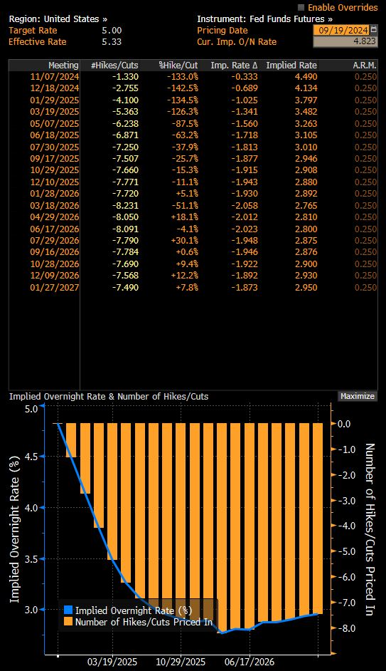
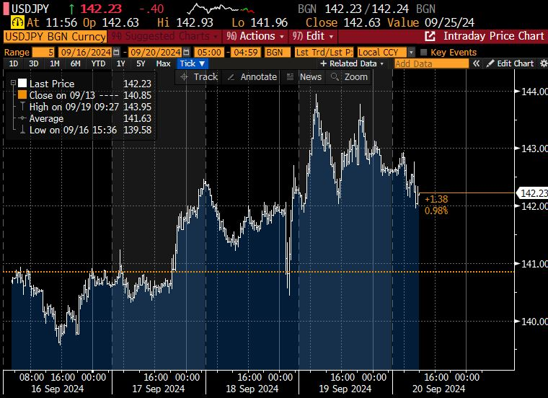
September FOMC: The First Step: Quantitative (Dot Plot) and Qualitative (Rhetoric) Easing Signals: Goldilocks and No More Bears?
September FOMC: -50bp
2024: 2 Cuts
2025: 4 Cuts
Projections
GAP
Rhetoric
Notes:
Last Wednesday, we saw the Federal Reserve cut the Fed funds rate by 50bps which was slightly bigger than what markets expected. Markets were pricing in about 70% chance of a 50bps cut right before the decision. Technically, some people was saying that the Fed had a dovish cut given that they cut more than expected.
However, if we look at market reactions, for FX, we saw that after an initial plunge in the USD, for example the USD/JPY plunge and quickly rose to offset losses, and the USD continued to strengthen post FOMC.
This underscores our take that it was not a “go big or go home”, high-roller, all-in, dovish game-book. Instead, a closer look suggests a one-off, “go big, and then go home”, insurance plan.
Or at least that was what the Fed appears to be attempting to convey.
From the Dot Plot, we see that the Fed is envisaging that there are 2 more 25bp cuts left in 2024 and only 4 cuts left in 2025. (4.375-3.375)
So while we see that the end point is slightly lower for the September dot plot compared to the previous ones, the pace of cuts is in fact the same 100bps cut which was shown in June 2024 (5.125-4.125)
This conveys to us a message that they are frontloading the rate cut with their 50bp cut last week rather than a dovish cut rates at all cost.
This is not surprising given their intentions to anchor stability and picture a soft landing.
Aside from the Dot Plot’s own changes across time, it is the gap between markets that led to a more buoyant USD, because markets were expecting more than 240bps of cuts in 2025 which is more than double compared the Fed’s Dot Plot, markets had to readjust and as such UST yields went up and USD was stronger.
We can look at the top right chart for the adjustments, now the market is pricing in a total of 190bps of cuts by end-2025, last Tuesday it was a staggering 240bps.
If we take the 190bps of cuts by end-2025 and compare it to the Dot plot, there is still a gap because the Dot plot is saying 2+4 cuts which is 150bps of cuts, but this gap of 40bps is way smaller than before the Fed meeting. As such, we can see why a larger than expected 50bps cut did not result in a weaker USD because the markets were already very aggressive in pricing in rate cuts and as a result we got a seemingly counter intuitive episode of a stronger USD from a bigger Fed cut. It is because we need to look at the Dot Plot and the Gap with market expectations of the entire policy trajectory instead of the usual qns we get about “do you think it is a 25 or 50??”

Slide 3
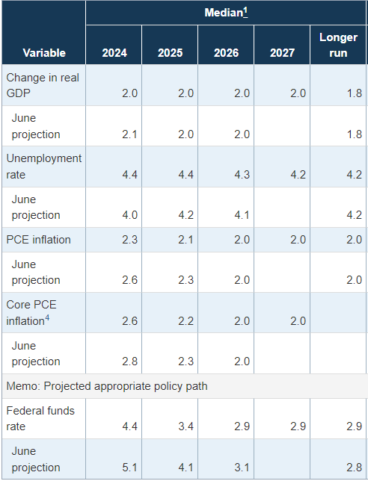
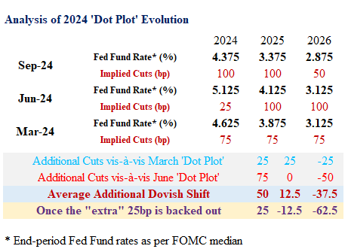
September FOMC: The First Step: Quantitative (Dot Plot) and Qualitative (Rhetoric) Easing Signals
Projections
GAP
Rhetoric
Notes:
And since we are talking about the entire policy trajectory, let me show another table to make my point even clearer on the front loading of rate cuts.
The latest Dot Plot implies that there is a total of 100bps of cuts this year, which is 50bp left after the 50bp cut last week.
This is 75bps more than the June Dot Plot but only 25bps more cuts than the March one.
For 2025, the Sept Dot plot shows 100bps of cuts and essentially this is the same as june 2024’s dot plot. In 2026, the Fed in fact showed less cut, just 50bps to end up just 25bps lower in 2026.
In totality, 100+100+50=250, just 25bps more than the 25+100+100 but a lot of front loading.
We can understand the intent that the Fed wants to communicate that they do not expect a recession in 2025 and hence no need for deep rate cuts and no need for panic.
On that note, we take a look at the summary of economic projections, we see that the Fed lower their inflation projections with core PCE inflation lower from 2.8 to 2.6% in 2025 but only slight downward revision from 2.3 to 2.2 in 2025.
The unemployment rate though was shifted significantly rising from 4.0% to 4.4% in 2024 and 4.2% to 4.4% in 2025.
In the longer term, they expect the unemployment rate to return to 4.2%.
The unemployment rate now is 4.2% for August which is lower than the 4.3% in July. The Fed expects these numbers to go up in the months ahead but still come down in 2026.
At this point, one should have some skepticism around such optimism, first it is what we have often mentioned that unemployment has a self-reinforcing momentum, people are unemployed they spending less and businesses invest less and hire less. In my opinion, expecting unemployment to rise and stop leans is as wishful or even more wishful then expecting unemployment to simply stay at current levels.
The hope from the Fed is that these early front loaded cuts can help to improve economic activity after a period of lag say 6 months and then dampen the deterioration in labour market conditions in 2025.
Looking at these projections, we can try and better understand why the Fed says they are squarely focused on their dual mandate and also why they moved 50bps.

Slide 4
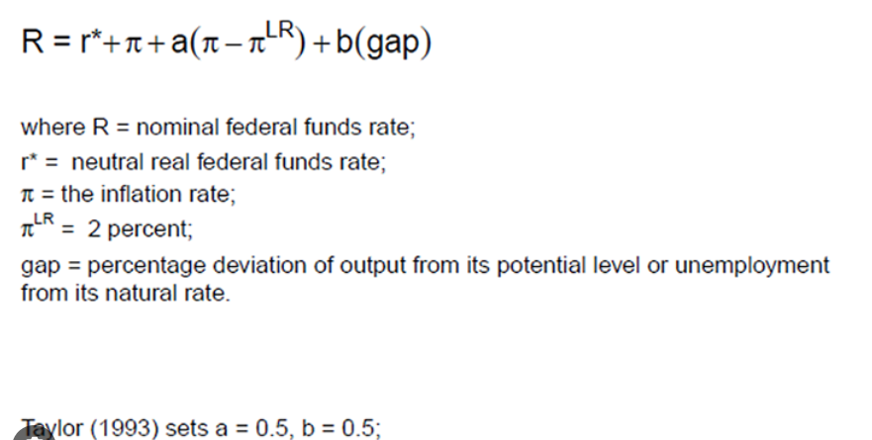
September FOMC: The First Step: Quantitative (Dot Plot) and Qualitative (Rhetoric) Easing Signals
1.75%-2.25%
1.8%
3.7%
←2019
Squarely focus on Dual Mandate
- Fed Chair Powell
∆r =
Weight*∆inflation + Weight*∆unemployment
Projections conditional on policy paths?
Projections
GAP
Rhetoric
Notes:
Indeed Fed Chair Powell started his 2am press conference by saying that the Fed is squarely Focus on the dual mandate.
Whenever the words dual mandate is mentioned, I cannot help but include the Taylor rule equation.
I hope I was sufficiently clear at the last outlook session in June when I showed this Taylor rule equation.
To re-iterate, I said that there was sufficient room to ease because we used the 2019 example, that inflation was at 1.8% and unemployment was 3.7 but the nominal policy rate was only 1.75-2.25%.
Clearly, an above 5% interest is too restrictive to tackle the current inflationary pressures. I am not saying that restriction is not needed to tackle inflation, but the point is that the stance was overly restrictive at 5.25-5.50% before the decision to cut 50bps last week.
If we do some simple math, we can see that the 0.4% point increase in unemployment and the 0.2% point decline in inflation roughly corresponds to the Fed’s decision to cut by 50bps especially if I give them equal weights.
Put simply, the decline in inflation provides room for 0.2%points of cuts while the 0.4% point increase in unemployment rate calls for a 0.4% point reduction in policy rate.
My thought experiment here for today is one which I think is useful down the road.
The first thought is to ponder if the economic forecast such as the unemployment rate conditional on the forecasted policy rates and is the anchor the pace of cuts or endpoint. Should the unemployment rate increase to say 4.5% by early 2025, what would the response of the Fed be?
If the Fed thinks that they need to cut to 3.4% by end 2024 to just maintain 4.4%, in the event, that the unemployment rate exceed that mark then, front loading their 4 cuts in 2025 to the first half or even first Qtr of 2025 is not that unforeseeable.
The first order of the day is to front load, and should the unemployment remain stubborn, the next course of action would be to deepen the cuts.

Slide 5

September FOMC: The First Step: Quantitative (Dot Plot) and Qualitative (Rhetoric) Easing Signals
Fed “do(es) not seek or welcome further cooling in labor market conditions”
- Fed Chair Powell at Jackson Hole
Broad Support for today’s decision.
- Fed Chair Powell
No one should look at the 50bps cut and think that this is the new pace.
- Fed Chair Powell
Notable step down in payroll gains.
- Fed Chair Powell
Dot plot projections are not policy plans Fed will move as fast or as slow as needed.
- Fed Chair Powell
We don’t think we are behind the curve
- Fed Chair Powell
Projections
GAP
Rhetoric
Notes:
These options to front load is certainly on the cards especially if we look at Fed chair Powell’s Rhetoric,
before I start on his words at the presss conference, it is important to recap that before the Sept Fomc meeting at the Jackson Hole Policy Symposium, Fed Chair powell said that he did not seek or welcome any further cooling in labour market conditions. This set the stage for a 50bps cut.
Fed Chair Powell started the press conference with what I showed earlier, saying that the Fed is squarely focus on its dual mandate of inflation and unemployment.
We do acknowledge that he said the 50 is not the new 25 which was why markets were not very buoyant and USD still held up. That said, he remains very open on his options, bringing in the words data dependence and saying that Dot Plot Projections are not policy plan and the Fed will move as fast or as slow as needed.
Furthermore, he has tried to sound upbeat by saying that they are not behind the curve. On this point, we retain some healthy skepticism, afterall, he did say that he would have cut earlier in July should he knew the july NFP number that showed a notable step down in payroll gains. As such, it appears that they might have caught up by doing a 50bps cut.
Accordingly, it remains to be seen if their assessment will still stand should labour market conditions worsen further.

Slide 6
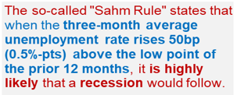
US Jobs: SAHM rule Panic?
US recession fears triggered suggests fragility of “Goldilocks” assumptions.
Claudia Rae Sahm
Notes:
On that note, it would be remiss of me not to talk about the sahm rule.
That conversation is now at it’s turning point and this was since last month’s labour market report in the US which saw a sharp jump in unemployment rate.
Last month on the Second of August we saw a sharp spike in US unemployment rate to 4.3% and triggered the SAHM rule.
The Sahm rule finds that if the 3 month average unemployment rate rises 50bps above the low point of the prior 12 months, it is likely that a recession will follow.
We acknowledge that the SHAM rule is merely a statistical occurrence or phenomena in Fed Chair Powell’s words. This is an instance where we say there is strong correlation though causality is not established.
Some people in the market argues that 50bps increase in unemployment rate is not much considering how low it was and say that those who point out recession risks are fear mongering.
What we want to point out is that our risk based driven approach to look at potential slowdown in growth is different from fearmongering.
Historically, deteriorating labor markets generate a self-reinforcing feedback loop. When jobs are harder to find, households trim spending, the economy weakens and businesses reduce investment, which leads to layoffs and further spending cuts.
This is why unemployment, having breached the 0.5-percentage-point threshold, has always increased a lot more — the smallest rise was nearly 2 percentage points, trough to peak.
That night of 2nd August, unemployment rate jumped, UST yields nose dived 20bps and US equities plummeted as recession fears were rampant. That episode underscores the fragility of goldilocks assumptions.
After that, Fed officials calm markets down by saying that the increase in unemployment rate is due to increase in labour supply and it is good problem because if more people are looking for work, the increase in labour supply will cool wage pressures and inflation.
What we want to say here is that the soft landing assumption by markets is really still an assumption, if the increase in unemployment was really such a good problem, why would Fed Chair Powell sound such a strong note at Jackson that “ he does not welcome any further cooling in labour market conditions”.
As such, the situation now depends on the Fed’s ability to navigate rate cuts in a manner that is able minimally maintain current growth conditions.
Let us take a further look at labour market conditions in the US. Afterall, in Claudia Sahm own words as the person who has a rule attached to her name — don’t just rely on one tool.

Slide 7
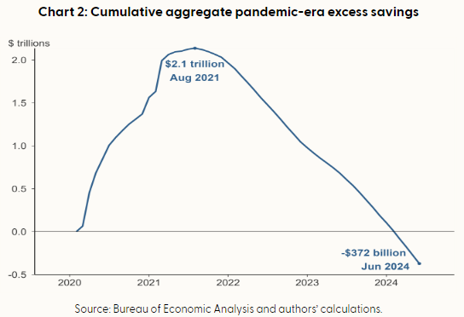

US Jobs: SAHM rule Panic?
Downward revisions to March 23 to 24: -818k
Downward revisions to prior 2 months: -86k
Notes:
Aside from the unemployment rate increase, we also see from the non-farm payrolls report that hiring has weaken significantly. At the last webinar in June, my figure here for the 3mma was 242k of workers being hired, at this point in time, the 3mm as of august is 116k. The latest non-farm payrolls at 142k released last Friday was below expectations of 165k.
While 142k is indeed still decent number but it is still one which is below pre-pandemic trends. Furthermore, it is not that there are not layoffs in the US, it is that the sector that are hiring outweigh the sectors which are retrenching workers. Manufacturing sector laid off works 4 out of 8 months in 2024 and that is consistent with the ISM manufacturing which shows that activity in manufacturing remains in contractionary territory. The longer the manufacturing sector remains in contractionary territory, the larger the risks that firms can longer hold onto their workers going forward.
Even as I talk about going forward let us go backward to 2nd august, even the dire number of 114 k last month was reduced to 89k.
Furthermore, the BLS in the US also revised downwards the total hiring from march 2023 to march 2024 by 818k because of updated data.
Data revisions are a very important part of policy making because it changes the entire picture of the economy of how they which is the Fed actually thought it was.
The data revisions induced dovish policy expectations and the reason that these historical revisions are important is that in 2021, the Fed was slow to hike rates because the labour market prints was low but it ended up that in early 2022 they saw huge upward revisions to data that caught them wrong footed.
This episode of being wrong was highlight in a recent speech by Fed Governor Michelle Bowman.
If the Fed understand the reasons of being slow to hike, these lessons would then also inform them about being slow to cut.
These type of historical experiences are what we call the subjective part of decision making on the next slide I will talk about the objective part of policy.
But before that, I will take the chance to explain the implications of a softer labour market. First, given that pandemic era savings have been eroded and as such households are continuously digging into pre-pandemic savings, my latest updated estimate which is simply extracted from the san Francisco fed, stands at -$372billion for June which is much steeped that the -$170billion we saw in august for those who were with me at the previous session three months ago.
This eroded savings imply that income from labour which is wages is increasingly important but if employment slows and wage growth slows as job openings and quit rate decline, then the purchasing power of the US consumer can slow quite significantly.
Quit rates are a very important indicator of wage growth.
Afterall, when people quit a job and join a new one, they often get a bump up in pay. With a lower quit rate, there is less churn in the labour market which implies less pressure on wage growth. As such, we do think that underlying price pressures have room to soften as wage growth turns a little bit milder.
With this backdrop of growth and inflation, we naturally turn to policy implications and expectations for the September FOMC which is happening just next week.
at this point, I have also included our risk based forecast of the Fed fund rate. We do think that there is room for 2 cuts in 2024 and further normalisation in 2025. My first caveat is that we are not calling for hard landing or recession as a base case. What we are saying is that there is potential for softening and there is a possibility of normalisation. Some time ago, I used to work with economic models, a lot of policy related numbers and get a lot of questions and today I will pose one of them today, imagine in 2019 when Fed fund rate was around 2% and inflation was 2.3%, if inflation increase to 3.4%, and you are Fed chair Yellen at that time, what do you think the Fed policy rate should be? Should it be the above 5.0% rate ? This question helps us get an objective view of interest rates, but we certainly acknowledge that decisions in life are subjective and based on past experiences, the Fed has fears of inflation resurgence and the policy rate has a different starting point is also anchored based on how much they have hike because of the 8% inflation in 2022. Nonetheless, the structural view is that there is room to normalise. (click)

Slide 8
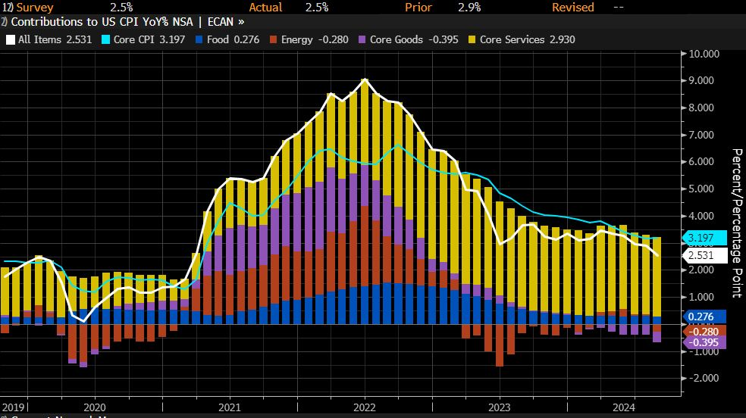
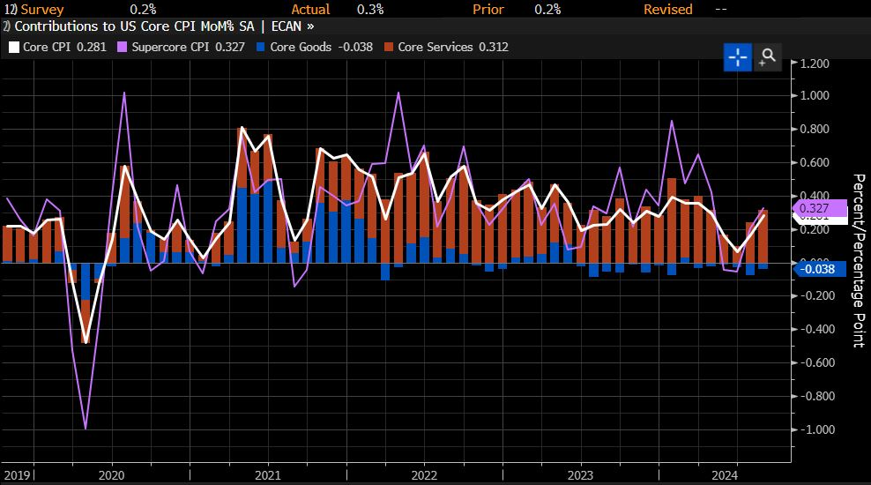
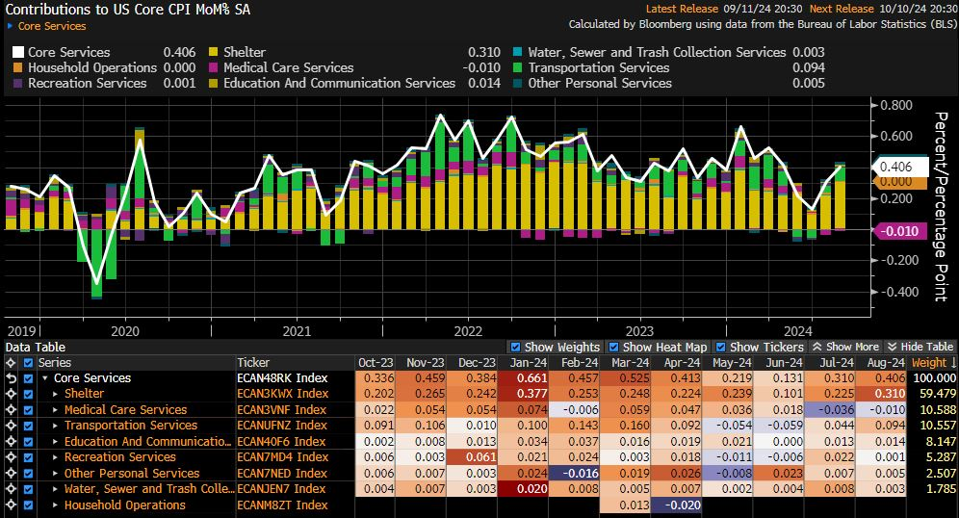
US CPI: Further Progress: Sufficient or Not??
Notes:
- I willjust take a few mins US CPI print. Even as the CPI even is not the main topic right now, it is still important as a peripheral factor to determine if member sof the FOMC want to go for another 50bps cut this year or it may still be important in late 2025 if we see a resurgence of inflation.
Last night, headline inflation in the US for August came in at 2.5% yoy which was in line with expectations and much lower than the 2.9% YoY in July.
What markets saw and focused on instead was that core inflation momentum which means the MoM% change was higher which is my top right chart.
Core inflation on a MoM basis rose to 0.3% MoM which is higher than expected and as such on a YoY basis core inflation remain sticky at 3.2%.
And why is that so? This was driven by housing costs. The factors behind the core cpi mom increase is broken down in my bottom left chart.
Clearly, we can see that core services contributed 0.4% point out of 0.3% points which also means that actually core goods prices fell. This is entirely services driven and rent driven.
Is housing/rental cost a concern to the Fed, the answer is yes but is it a bigger concern than the labour market right now, the answer is no.
How did markets adjust for this? Markets lowered the odds of a 50bps cut by the Fed at the meeting next week but remain very firm for a 25bps cut.
Aside from yesterday’s night US CPI report, the other notable price that has been falling is that of brent crude’s which has touched US$70/barrel because of global growth woes.
A quick analysis tells us that at 70-75 per barrel oil will remain a dis-inflationary force for headline inflation. In turn, Oil does not impair the Fed’s desire to ease.
On balance, our take is that this CPI print is not an impediment on the Fed’s current easing cycle especially at the initial stage of easing.

Slide 9
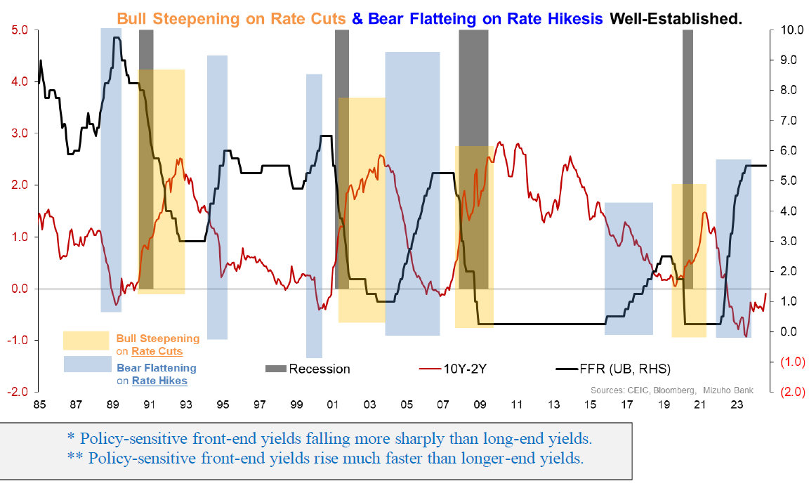
UST Yields: The Usual Bull Steepening
Notes:
As for the market impact of Fed easing, we will begin with UST yields,
the low-hanging fruit for higher long-end yields is simply a reversion (from rate hike “inversion”) to an upward sloping curve, coinciding with policy inflection to a rate cut cycle.
We can reasonably assume “bull steepening*” resulting from sharp Fed pivot to rate cuts. this reverses out the earlier “bear flattening**” from the preceding rate hike cycle,
which had ultimately “inverted” the yield curve. Put simply, the bull steepening, implies that as investors pile into USTs, the demand will be strong in the front end due to the rate cut.

Slide 10
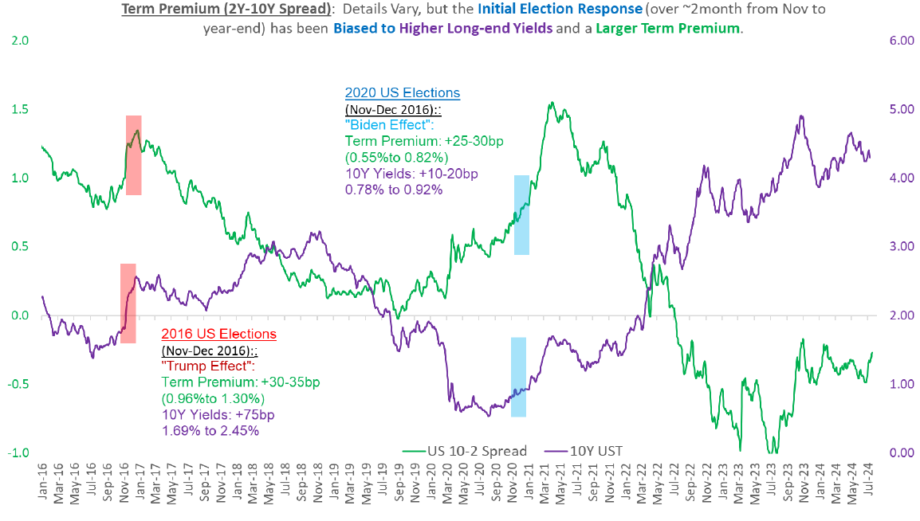
UST Yields: US Elections
Notes:
In addition, UST yield curve steepening as a by-product of US elections is arguably a factor to consider, being the lived, relatable recent experience. Not just of “Trump 1.0” in 2016 as well as the Biden win in 2020.
expectations tied to US elections are not just understandable given extrapolation of fiscal/geo-political/inflation risks

Slide 11
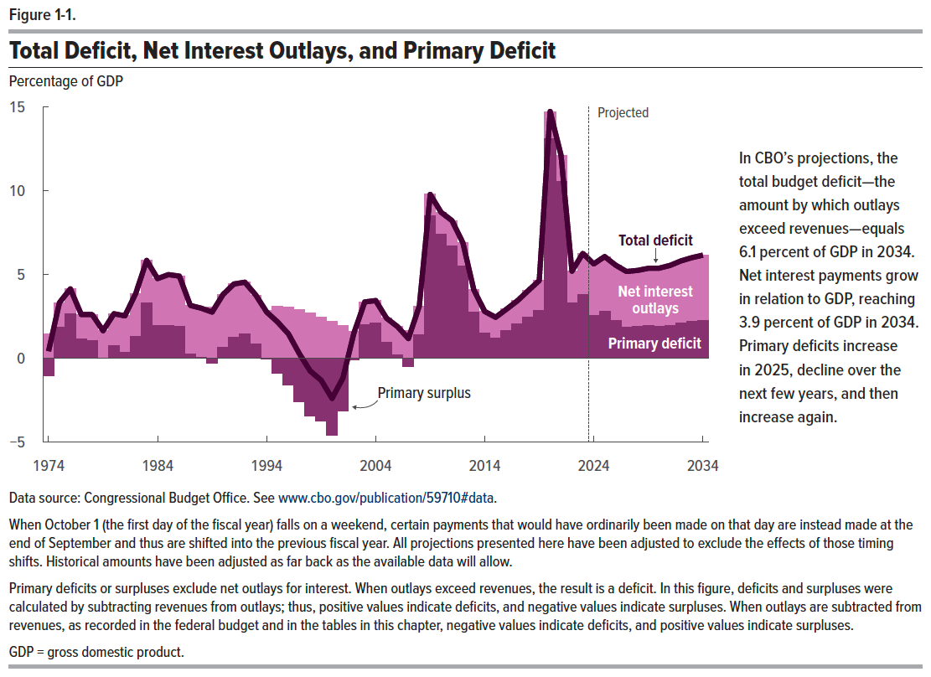
UST Yields: Why Our Fiscal & Consequent Yield Curve Views are Agnostic to Politics
Notes:
Not only is it difficult, but arguably misguided, to holistically pin down candidate-dependent fiscal policies in a vacuum.
But mostly, because our base case, limited view is that neither the Democrats nor the Republicans have the fiscal high ground.
Instead, it is merely the nature of their “fiscal sins” that differ (spending vs. tax cuts).
Hence, defaulting largely rely on the CBO’s estimates for fiscal deficit is a good start.
And the projections for fiscal deficit to be in the ballpark of 5.5-6..0% for the next decade (2025 through 2035) are reasonable, albeit worrying.
Crucially, net interest payments (NIP) starting to become the dominant source of fiscal burden (see the CBO Figure 1.1 below), necessarily limits fiscal options and imposes harsher constraints.
Notably, NIP is set to make-up 60-65% of total deficit in from 2025-2034 compared to just over a quarter of total fiscal deficit from 2010 to 2014 when fiscal deficit averaged a comparable 6.1%).
This means two things, that underpin a worrying fiscal trajectory with increasing incentive to term out debt.
First, incremental, policy-driven variations in primary deficits (ex-NIP) will have diminished sway on total fiscal deficit and the attendant bond issuances required.
Second, the incentive to term out debt issuances grows as interest rate burden crowds out current budget spending requirements.

Slide 12
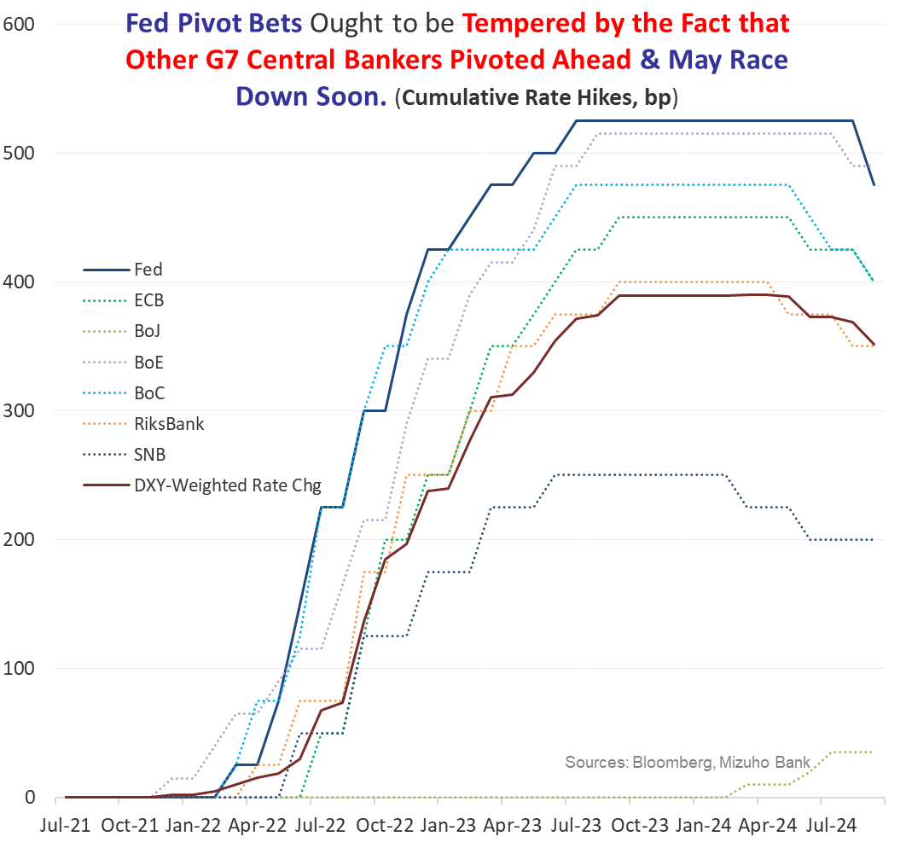
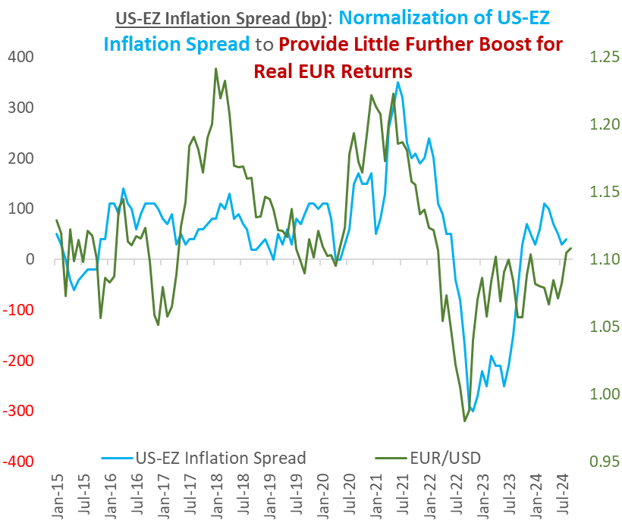
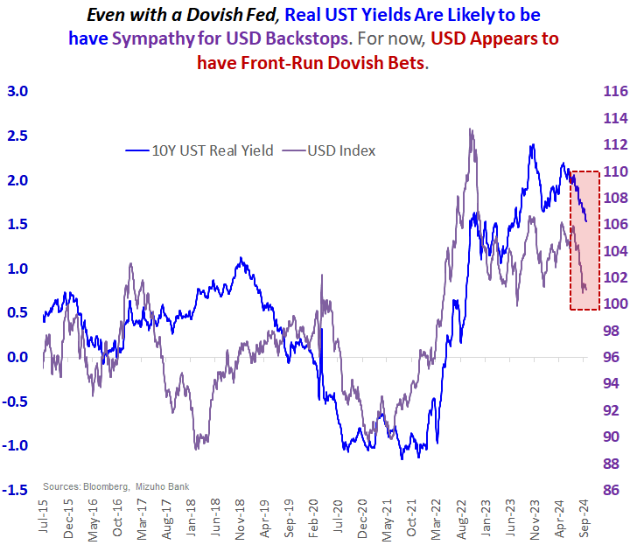
RISK - Policy: USD Bears are Exhausting One-Sided/Dimensional, Dialled-up Fed (Cut) Bets

Slide 13
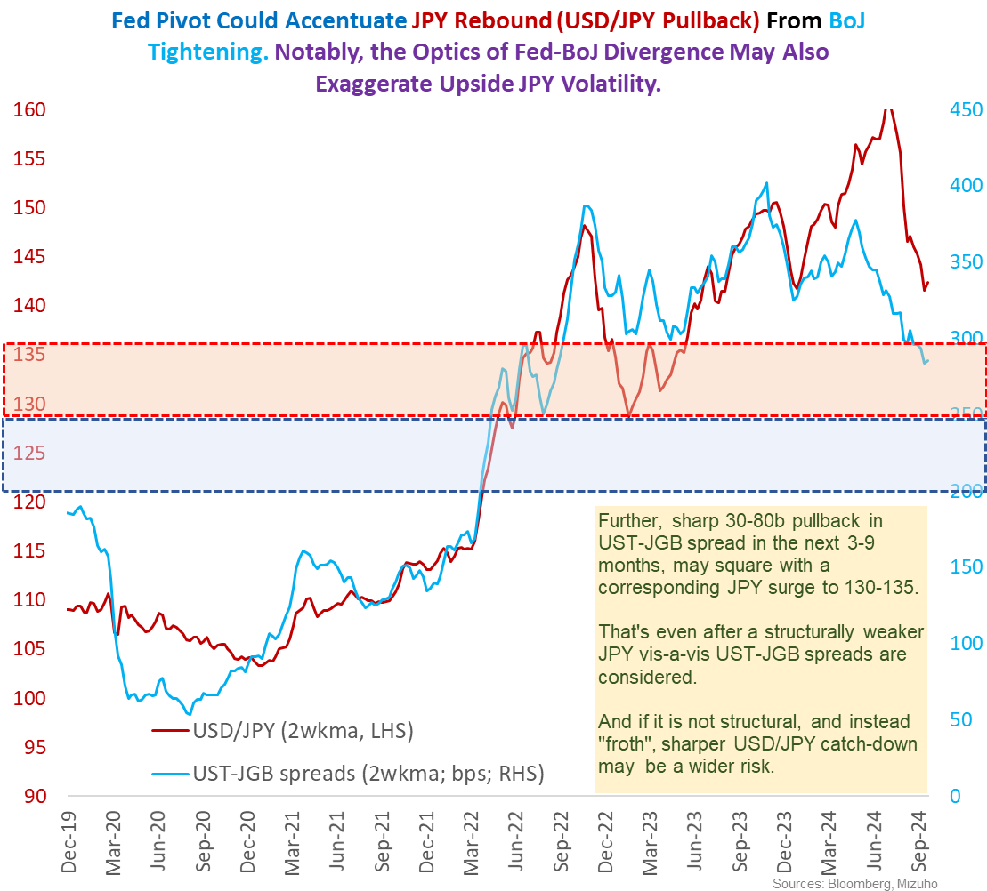
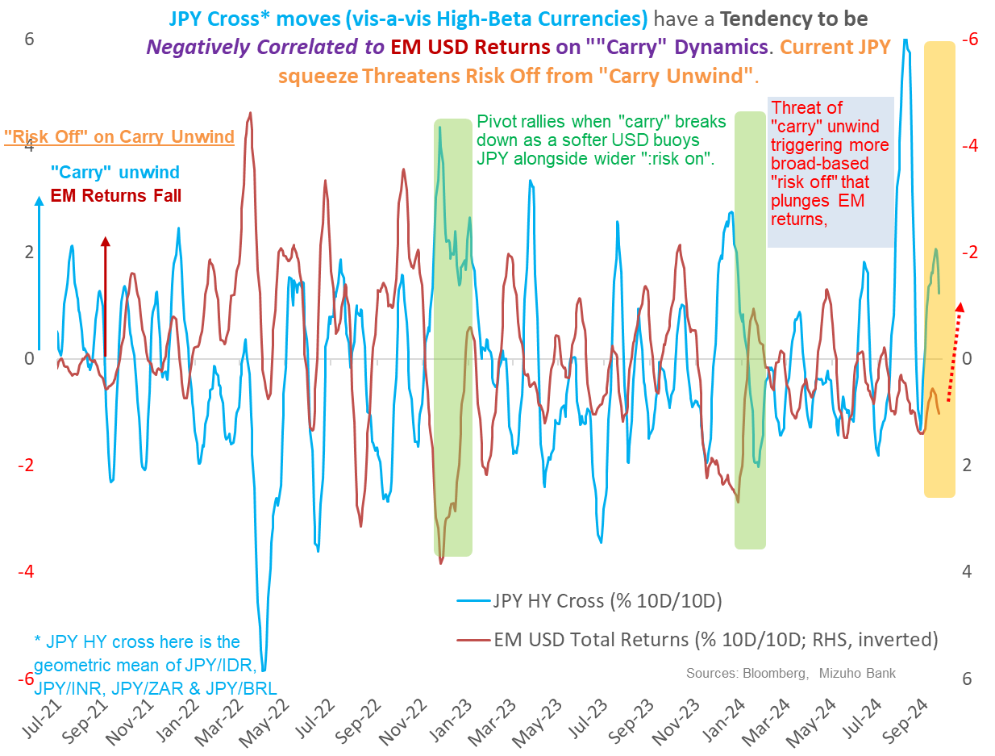
RISK: Fed-BoJ & JPY Correlations: Fed’s Greater Sway on JPY & “Carry Unwind” Contagion

Slide 14
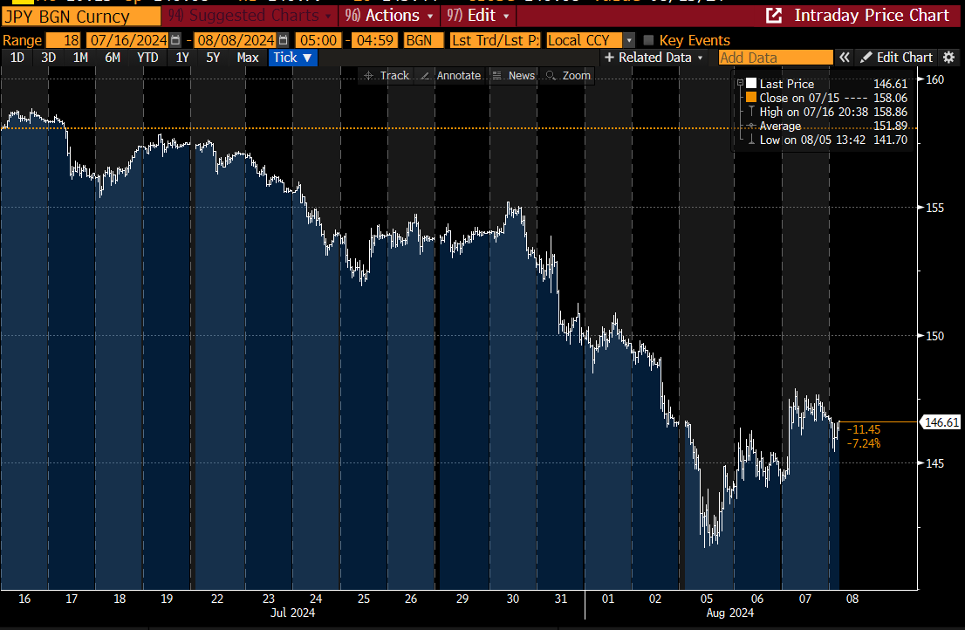
BoJ: THAT JPY Squeeze – Time-line & Thoughts
BoJ Hikes
Hawkish Talk
US Jobs Report Recession Fears
BoJ Dovish
Augmentation

Slide 15
EM-Asia: Central Bank Outlook
Photo Credits: Vector Stock
June 2024
Notes:
Hello everyone, with Fed commencing the easing cycle, let us turn to EM Asia to look at their policy trajectories. There will be quite a lot of content in this section, as we will be talking through each country individually. So, we would appreciate if you could leave questions for the Q&A session at the back.

Slide 16
Current State
bps | US | AU | PH | KR | TH | ID | TW | IN | MY | VN
Present vs end-2020 | +525 | +425 | +425 | +300 | +200 | +250 | +87.5 | +250 | +125 | +50
Present vs ’16-’19 avg | +401 | +288 | +261 | +206 | +97 | +93 | +60 | +34 | -11 | -182
Notes:
First of all, let us take stock of where we are at the moment.
The rate hike cycle began in 2022, with Korea starting earlier in 2021. But from the left chart, one prominent thing is that before 2022, the Fed funds rate, in red line, was lower than most policy rates in Asia, and that has since changed with the hiking cycle.
Now, the Fed Funds rate is only lower compared to Indonesia, India and Philippines.
But we should also note that 2020 was the year of covid, which broadly saw central banks cutting rates.
Hence, it may be useful to use the average policy rate for 2016-2019 average to get a sense of where rates are when things were more stable.
The difference between the current interest rates and the 2016-2019 average is shown in the second row of the table. And we see that in nominal terms, US rates are much higher compared to 2016-2019 averages, followed by Australia, Philippines, South Korea and so on.

Slide 17
What may policy rates look like in coming quarters?
bps | US | AU | PH | KR | TH | ID | TW | IN | MY | VN
End-2025 Forecast vs Present | -250 | -85 | -250 | -50 | -50 | -150 | -12.5 | -150 | 0 | 0
Forecast vs ’16-’19 avg | +106 | +203 | +11 | +156 | +47 | -57 | +48 | -116 | -11 | -182
Notes:
Next, let us take a look where we think rates will end up by end-2205.
The left-side chart shows the policy trajectory our team has forecast for up till end-2025. Note that the forecasts (in dotted lines) are as end-of each quarter and not monthly.
So from the left chart, the obvious thing is perhaps our view that the Fed will ease at a much faster pace compared to Asia central banks.
This is perhaps not that surprising considering that the Fed has hiked by a much larger margin compared to Asia central banks.
By end-2025, we see the FFR only higher than Thailand’s and Taiwan’s policy rate.
And Asia central banks will broadly ease, with Philippines easing the most, followed by India and Indonesia.
Nonetheless, we think that Malaysia and Vietnam will abstain from the easing cycle.
We will explain our reasoning in the subsequent slides.

Slide 18
Philippines – Fastest Pace
Policy Trajectory: Expected to cut at the fastest pace given relatively larger cumulative hikes amid growth risks. Recto has hinted on a 50bps cut in October, while RRR cut on 20 Sep was a decisive indication that BSP is no longer hawkish.
Growth: Household consumption have contracted for two consecutive quarters on a QoQ basis with non-performing consumer loans moving higher, even as external sector holds up.
Inflation: Should remain within target range for rest the year but risk of sticky inflation on resumption of administrative measures.
 | 2024 |  | 2025
 | Q3 | Q4 | Q1 | Q2 | Q3 | Q4 | ‘16-’19 Avg
BSP Policy Rate (%) | 6.25% | 5.50% | 5.00% | 4.25% | 3.75% | 3.75% | 3.64%
Notes:
Looking first at Philippines, we think that BSP would ease at the fastest pace. This is partly due to Philippines having the largest cumulative hikes compared to EM Asia central banks. But there are other factors at play too.
In particular, cracks in domestic consumption have been evident. Household consumption have contracted for two consecutive quarters on a QoQ basis, amid contracting domestic trade volumes, pointing to stretched wallets.
Even as overall growth could still hold up on increased electronics exports and continued recovery in tourism, BSP is likely to want to alleviate pressure off the domestic economy.
Meanwhile, inflation ought to remain within the target range for the rest of the year and into next, although there is some risk of sticky inflation on resumption of administrative measures. Notably, food inflation, and in particular rice, has been the key driver of inflation in the Philippines, and the recent moderation in prices in arguably on the back of relaxation of import quotas and tariffs to boost supplies. A resumption of tariffs could be expected when domestic supply stabilizes next year, which could mean that inflation does not see further moderation. But policymakers would likely be cognizant on inflationary pressures when deliberating such measures.
In balance, we think that growth risks and possibility of sticky inflation should see BSP easing until around 2016-2019 averages. In other words, we think BSP might stop easing at around 3.75%. As for the next cut, we think that there will be a 50bps cut at the October meeting, as Finance Minister Recto, which is on the BSP board, had said last week that he’ll support a 50bps cut. Such signalling their upcoming policy moves in remarks is a frequent practice adopted by BSP, especially when there are some skepticism in the markets. This was seen in October last year, where BSP alluded to the possibility of an off-cycle hike on inflationary pressures before hiking the week after, and easing expectations for an August cut this year as early as back in May. We further expect a 25bps cut in December. This is against the context of BSP decisively turning dovish with the cut in reserve requirement ratio last Friday (20 Sep), as BSP had earlier in May said that they will not cut RRR as long as they are hawkish.

Slide 19
India – Lower Nominal Policy Rates Compared to 2016-2019 averages
Policy Trajectory: Possibility of a first cut in October. But overall, measured rate cuts as dis-inflation yet to prove to be a sustained undershoot of RBI’s 4±2% target. Cuts will also be contingent on macro-stability into 2025, as INR pressures could liner into Q4. Overall see lower nominal rates on in end-2025 as inflation moderates.
Growth: Normalisation of growth towards 6-7%, with some pockets of slippage amid cyclical headwinds (albeit fairly gentle).
Inflation: Broader, underlying, inflation trend, has softened significantly. But is not exceptionally soft. Nor is it likely to be sustained unconditionally.
 | 2024 |  | 2025
 | Q3 | Q4 | Q1 | Q2 | Q3 | Q4 | ’16-’19 Avg
RBI Policy Rate (%) | 6.50 | 6.00 | 5.50 | 5.25 | 5.00 | 5.00 | 6.16%
Notes:
Next up, we have India. India hiked 250bps in the current round of rate hike cycle. And we expect quite a fast pace given their relative higher nominal rates in terms of levels, at 6.50%. We expect end-2025 nominal policy rates to be at 5.00%, taking into account our view that India’s growth could moderate and softening of inflation. But to be clear, we think the growth moderation is a growth normalization and by no means an expectation of heightened growth risks, although there could be some pockets of slippage amid fairly gentle cyclical headwinds. Even as end-2025 rates may be lower in nominal terms, we think the policy stance in real terms, which is approximately nominal less inflation, will be lower, as we expect inflation to trend lower.
In addition, we think the first RBI cut will come in Q4, and we are looking at a guarded cut in October. While the August CPI print of 3.7% was above market expectations, we are not overly concerned, as the massive dis-inflation wave which dragged July CPI down to 3.5% was likely to abate, but this stalled dis-inflation is not inflation risk re-ignited, but that drivers of emphatic dis-inflation exhausted. This is also arguably healthy for the economy, to ensure a virtuous cycle of demand-supportive price adjustments. Given that the uptick in consumer price pressures was within 20-50bps, we think it remains consistent with scope for reductions in the RBI’s policy rate. Point being, with highly restrictive real rates, a backdrop of encouraging dis-inflation, constructive reduction in global energy prices and emerging downside risks to global demand, calibrated cuts are welcome.
But we think it will be guarded and cautious cut because inflation has not yet shown to be a sustained undershoot of RBI’s inflation target mid-point of 4% and upside inflation volatility is a threat not as yet put to bed. Finally, rupee pressures could linger into an uncertain Q4.

Slide 20
Indonesia – Rupiah Reigns
Policy Trajectory: Wariness over IDR-stability likely means a staggered easing cycle – i.e. riding on IDR strength and cut, while holding on some IDR volatility. Still resilient loan growth should may mean higher nominal rates compared to 2016-2017 period.
Growth: Supported, but boost may be on the back of higher government spending. Compared to regional peers, relatively limited spillovers on electronics cycle upturn amid exposure to commodity headwinds.
Inflation: Should remain within BI’s target range of 2.5±1% even as upside risks are present on fuel rationalization policies and demand-pulled growth amid infrastructure push.
 | 2024 |  | 2025
 | Q3 | Q4 | Q1 | Q2 | Q3 | Q4 | ’16-’19 Avg
BI Policy Rate (%) | 6.00% | 5.50% | 5.00% | 4.75% | 4.75% | 4.75% | 5.32%
Notes:
Moving on to Indonesia, just last Wednesday. Indonesia delivered a surprise 25bps cut last Wednesday. This caught us by surprise, as we had thought that Bank Indonesia would remain a hold despite IDR’s recent strong rally, because it may incite some unnecessary volatility on the IDR with their meeting just hours before FOMC. And this was also given that BI has appeared to be rather conservative in their Fed rate cut outlook. At the September meeting, there were only expecting 3 FFR cuts this year, and 4 FFR cuts next year.
But the September meeting was also telling of BI’s inclination to cut, and would ride on episodes of BI’s strength to do so.
Hence, we think that BI will embark on a rather staggered rate cut cycle, which means that they may cut should the rupiah be stable, and hold when there is some volatility. This is especially so as expectations of G4 central bank policy trajectory is expected to continue to adjust.
We think that the BI will stop cutting around 4.75% because of upside inflation risks in 2025 amid infrastructure push, while growth should still remain supported. Hence, scope for rates to be higher compared to 2016-2017 lows on weak credit growth of 4.25-4.75% and Covid low of 3.50%. In particular, BI sees potential for 2025 growth to be higher than 5.2%. Finally, IDR should remain support as scope for cuts by the Fed is arguably larger than BI. Nonetheless, caution on any indications of fiscal risks.

Slide 21
Thailand – Anchoring a Rocky Recovery
Policy Trajectory: While worsening credit quality and rising NPLs are concerns, upside risks to inflation amid cash handouts would like see BoT erring to the side of caution.
Growth: Expect growth to pick up in coming quarters as manufacturing sector recovers while the services sector support remains firm. In addition, there should be a boost to consumption growth on the cash handouts.
Inflation: Although edging higher on lifting of diesel price cap, headline inflation should remain managed.
 | 2024 |  | 2025
 | Q3 | Q4 | Q1 | Q2 | Q3 | Q4 | ‘16-’19 Avg
BoT Policy Rate (%) | 2.50% | 2.50% | 2.25% | 2.00% | 2.00% | 2.00% | 1.53%
Notes:
Next, we have Thailand. In recent weeks, Bank of Thailand has shown to be increasingly concerned over worsening credit quality and rising non-performing loans. While the worsened financial conditions could spillover to growth, our base case is that Bank of Thailand would only ease in Q1 next year, and not Q4 this year. This is because inflation is expected to edge higher on the lifting of diesel price caps, and in terms of levels, inflation is hovering close to historical norms. More importantly, given upside inflation risks of the cash handouts, Bank of Thailand will likely remain cautious. In addition, Bank of Thailand room to cut is so limited that we think it will warrant a clearer indication of growth deterioration before easing cycle commences. On-going communications and signals from Bank of Thailand also reveal that a hold remains their base case for now. Given policy rates already at low levels, we do not expect Bank of Thailand to ease too excessively, and we are expecting a policy rate of 2.00% by end-2025.
Meanwhile, the lesser extent of easing is also on premised on our expectations that growth could pick up in coming quarters as manufacturing sector recovers and services sector support remains firm. Inflation, while should trend higher on the lifting of diesel price caps, should still remain managed.
+++
Growth
Q1 GDP growth stood at 2.3% YoY driven by the services sector as manufacturing sector attempted a mild recovery [update to Q2]
Limited spillovers from semiconductor upcycle
Tourism arrivals and expenditures have more room for improvement and underpin growth
Consumption pickup in Q4 on cash transfer to low income households with broad based wallet plans likely to be tweaked.
Inflation
Headline inflation stayed at 0.4% YoY as higher food inflation was offset by lower fuel prices. Core inflation inched up to 0.6% YoY from 0.5% YoY backing the case for the BoT to hold rates
Dis-inflationary pressures within the CPI basket have widened and become more broad-based (~40% of items above pre-Covid rates compared to 74% peak in Nov 22)
Policy Rate
Their latest decision saw a firmer voting outcome with 6-1 in favour of the rate hold. This bodes well for policy continuity for the rest of 2024. Policy response function may soon tilt towards financial conditions into 2025.
BoT remains highly concerned about the ongoing concerns on NPL and credit growth.

Slide 22
Singapore: No Rush
Policy Trajectory: After months of stalling core inflation in 2024 at above 3% on average, the single inflation print for July while a welcomed one for the authorities is not yet sufficient for a policy shift by the MAS.
Growth: Semiconductor led growth will be more supportive in H2’24. 2025 growth to grow around structural potential of ~2.5% with manufacturing and services sectors both supportive.
Inflation: Dis-inflationary trend retained, though a sub-2% core inflation may only prevail in late 2025.
 | 2024 |  | 2025
 | Q3 | Q4 | Q1 | Q2 | Q3 | Q4
MAS Decision | S: 2% | S: 2% | S: 2.0% | S: 1.5% | S: 1% | S: 1%
 | M: Hold | M: Hold | M: Hold | M: Hold | M: Hold | M: Hold
 | W: Hold | W: Hold | W: Hold | W: Hold | W: Hold | W: Hold
Notes:
Turning to Singapore, we think that easing would only start in Q1 2025 (at the January meeting) in view of stalling inflation at above 3% on average, even as the dis-inflationary trend is retained.
We think a sub-2% core inflation may only prevail in late 2025, and MAS is likely to be caution on upside inflation risks.
Furthermore, growth still remains supportive. We think semiconductor led growth will be more supportive in H2’24 and 2025 growth should be around structural potential of 2.5% with manufacturing and services sector continuing to be both supported.
On MAS’ easing, we also expect the easing to be moderate, and only see MAS reducing the slope of appreciation in 2025. We are not expecting any recentering given our view that upside inflation risks persist.
++++
Growth
Wholesale and retail trade, financial and insurance services continued to be the main drivers of growth.
Semiconductor boost to manufacturing led to it being a smaller drag.
GDP growth likely to hover around potential growth of 2.5%.
Inflation
Singapore’s core inflation measure for July declined to 2.5% YoY and given that this was on the back of lower inflation across all broad categories. This is further support by a MoM decline in core CPI by 0.1% Looking ahead, core inflation is also likely to moderate further in Q4 though upside risks via energy, food and shipping costs remain well flagged.

Slide 23
Malaysia – Prolonged Hold
Policy Trajectory: Prolonged hold, with rates around neutral levels.
Growth: Malaysia’s growth outrun could persist, with external sector supported by tailwinds of electronics sector, resilient consumer spending amid EPF withdrawals, and continued infrastructure spending, fader political premium. Tail risk that deterioration in household consumption could prompt a 25bps cut in 2025.
Inflation: Upside risks, although inflation has been very managed despite administrative measures (e.g. increase in services tax, fuel subsidy rationalization).
 | 2024 |  | 2025
 | Q3 | Q4 | Q1 | Q2 | Q3 | Q4 | ’16-’19 Avg
BNM Policy Rate (%) | 3.00% | 3.00% | 3.00% | 3.00% | 3.00% | 3.00% | 3.11%
Notes:
Moving on, we have Malaysia. We expect Malaysia to buck from the easing cycle and keep rates on a prolonged hold. Notably, Malaysia has demonstrated a strong commitment towards a measured and controlled hiking cycle, and has refrained from hiking as much as regional peers. With rates around 2016-2019 averages, we think it may be somewhere near the neutral rates level. BNM has also characterised the current policy stance as “supportive”.
Meanwhile, growth remains supported while inflation is managed. In particular, Malaysia’s growth outrun could persist, with external sector supported by tailwinds of electronics sector, resilient consumer spending amid EPF withdrawals, and continued infrastructure spending, while fader political premium with new Sultan (sworn in in Jan’24) could attract more investment flows.
On the inflation front, moderate price pressures despite services tax (eff Mar’24) and increase in water tariffs (eff Feb’24), and while there are upside risks to inflation in coming quarters on possible re-introduction of consumption tax or subsidy rationalization of gasoline, we do not expect it to be outsized.
Nonetheless, there is a tail risk of possible easing in late 2025 on downside risks to household consumption. Notably, EPF withdrawals have supported much of household consumption, but could dwindle along the years.
++++
FX
Better fiscal standing (on roll out of tax reforms and subsidy rationalisation programs) and improving external positions would support the MYR.
Abstaining from joining in the global easing bandwagon would also be a positive for real rate differentials.
MYR could outperform regional peers in coming quarters, although outsized gains would be restrained by a soft-CNH.

Slide 24
Vietnam – Risky Recovery
Policy Trajectory: SBV’s policy rate reflective of their on-going support for growth amid ongoing restructuring domestically. Fading demographic dividends may imply less a need of >6% nominal rates going forward.
Growth: While domestic woes persist, semiconductor led manufacturing recovery to allow official target range of 6.0% to 6.5% to be met. Typhoon woes dent risks of upside surprise.
Inflation: Well contained below the SBV’s target range of 4-4.5% amid tightly controlled oil prices and low likelihood for VAT cuts to be reversed.
 | 2024 |  | 2025
 | Q3 | Q4 | Q1 | Q2 | Q3 | Q4 | ’16-’19 Avg
SBV Policy Rate (%) | 4.50% | 4.50% | 4.50% | 4.50% | 4.50% | 4.50% | 6.32%
Notes:
For Vietnam, similar to BNM, we think SBV will be on a prolonged rate hold. In fact, at 4.50%, the refinancing rate is just 50bps above pandemic lows, which we think is slightly accommodative to account for the weak domestic situation. In particular, the ongoing restructuring needs for real estate and banking. We think it will take 2-3 years for the restructuring and by then fading demographics may imply less a need of an above 5% nominal rates going forward, accounting for quite a significant shift lower in nominal rates compared to 2016-2019 averages.
Meanwhile, inflation going into 2025 would be contained as petrol prices will remain tightly regulated with no reforms on the cards. In addition, low likelihood of restoration of VAT cuts. But even in the scenario where VAT cuts are reversed, we think policymakers would contemplate such an action only if inflation is sufficiently low, so inflation would still remain managed.
Growth
Strong semiconductor-led manufacturing recovery - 2024 growth forecast to fall within official target 6.0-6.5% ranges
Services growth to moderate as tourism activity has already normalized with tourist arrivals in June 5.4% above pre-Covid levels
Real estate credit flows and elevated NPL levels remain concerning
Inflation
Increase in purchasing power from wage revisions may underpin price pressures and sticky core inflation.
August headline dip due to petrol prices.
Overall, headline inflation to remain comfortably within the SBV’s range for the rest of the year.
Policy Rate
Even though VND depreciation pressures have eased, room for easing is limited.
Policy rate remains just 50bps above Covid lows.
FX
Appreciation restrained by USD buying due to need for FX reserve accumulation in episodes of USD weakness
Confidence in VND remains fragile – reflected by the spike in gold prices domestically
FX: Rode the tide of weaker USD. Mild appreciation a hallmark of VND’s asymmetric characteristics and a reflection of underlying woes in banking/real estate market.

Slide 25
South Korea – Bright Screens & Black Spots
Policy Trajectory: Policy normalization set to occur in Q4 as BoK has revealed dovish communications recently and higher growth risks. Nonetheless, housing debt concerns may limit room for straight forward easing even though nominal rates have potential to head lower by 100bps.
Growth: Expect some slowdown in 2025 on slowing domestic sector and downside risks on possibility of fading tailwinds from electronics cycle. Q2 GDP growth contracted QoQ due to a slump in construction activity, sharp slowdown in services sector. Private consumption also contracted QoQ.
Inflation: Inflation should continue to moderate but the downward path could be bumpy. Dis-inflation has made appropriate progress though escalating home price in Seoul remain a concern which bottomed in May and rose 2.4% (as of 4 Sep) since June 2024.
 | 2024 |  | 2025
 | Q3 | Q4 | Q1 | Q2 | Q3 | Q4 | ‘16-’19 Avg
BoK Policy Rate (%) | 3.50% | 3.25% | 3.00% | 3.00% | 3.00% | 3.00% | 1.44%
Notes:
Now, looking to South Korea, we think Bank of Korea could begin policy normalisation in Q4. Already, we see notes of dovish sentiment in Bank of Korea’s communications. In early September, Bank of Korea Governor Rhee noted that inflation progress has allowed for timing of cut to be considered. In addition, there have been some indications of growth risks, with Q2 GDP growth contracting QoQ due to a slump in construction activity, sharp slowdown in services sector and contraction in private consumption. Looking into 2025, we expect some slowdown on slowing domestic sector and downside risks on the possibility of fading tailwinds from the electronics cycle boost. However, Bank of Korea would have to balance these growth risks with elevated home prices and financial stability risks, which remain concerns. While dis-inflation has made appropriate progress, escalating home prices in Seoul remain a concern which bottomed in may and rose 2.4% since June 2024.
Consequently, we expect very controlled and measured cuts, with cuts in Q4 and Q1 next year.
From the bottom table, you may have noticed that by end-2025, we think the policy rate will be at 3.00%, which is about 150bps from the average policy rate in 2016-2019. This is because of our expectation that inflation will be slow to come down. So effectively, in real rate terms, the policy stance is far less restrictive, at just 30-50bps above historical trends, and we also have to note that near and medium term policy calculus needs to account for financial stability in the form of credit risks and housing prices.
+++
Growth
The semiconductor exports led upturn in Q1 has been very strong and in fact the growth impulse resembles that of the late 2016 to 2018 cycle reflecting Korea’s unique comparative advantage
Inflation
Dis-inflation from both headline and core CPI has been encouraging in 2024 aside from the bump-up in February.
Rising property prices in Seoul remain a key concern for policy makers.
Policy Rate
Amid near term housing price and debt concerns, the Bank of Korea faces the reality of 50-75bps of cuts in the quarters ahead even though 150bps of cuts is not unwarranted should demand and inflation falter synchronously.
FX
KRW bulls remain restrain by prospects of BoK cuts and risk off episode of tech sell-off trigger foreign fund outflows.
FX: On a relative basis KRW bulls continue to be weighed down by US-China tensions and risk-off episode of tech sell-off and even a Fed easing cycle catalyst is dampened by BoK calibration.

Slide 26
Taiwan – Minimal Easing
Policy Trajectory: Minimal easing as tight labour market and escalating property prices (+10% YoY in August for Taipei City) underpin case for higher neutral rates and restrain easing prospects.
Growth: Growth remains robust as exports are buoyant on AI related semiconductor shipments, but 2025 growth could slow on nonfavourable base effects from 2024’s AI led growth
Inflation: Stubborn services inflation as well as inflation on non-durable and durable consumer goods.
 | 2024 |  | 2025
 | Q3 | Q4 | Q1 | Q2 | Q3 | Q4 | ‘16-’19 Avg
CBC Policy Rate (%) | 2.000% | 2.000% | 2.000% | 1.875% | 1.875% | 1.875% | 1.40%
Notes:
Taiwan faces some of the similar problems as South Korea, in particular, escalating property prices. Taiwan also faces a tight labour market which presents upside risks to inflation. These underpin the case for higher neutral rates and restrain easing prospects. Meanwhile, growth remains robust as exports are buoyant on AI related semiconductor shipments, but 2025 growth could slow on nonfavourable base effects from 2024’s AI led growth.
Accordingly, we have only factored in a 12.5bps easing by end-2025, with a rate cut only Q2 2025.

Slide 27
Australia – Holding On From Multiple Fronts
Policy Trajectory: Easing to commence in late-Q1, motivated by below-trend growth. Current situation of inflation looks slow to return back to target and tight labour markets look unlikely to significantly improve in Q4. Notably, Governor Bullock has dismissed cuts in 2024. Nothwithstanding this, bar for a further hike remains high.
Growth: Growth risks remain tilted to the downside, as private consumption has continued to weaken amid stretched wallets. Low household savings ratio remain a key risk and main obstacle of a return to pre-Covid growth trends. Growth remains largely supported by government spending.
Inflation: Expect dis-inflation progress to continue, but could be slow amid sticky services inflation and stubborn rental inflation.
 | 2024 |  | 2025
 | Q3 | Q4 | Q1 | Q2 | Q3 | Q4 | ’16-’19 Avg
RBA Policy Rate (%) | 4.35 | 4.35 | 4.10 | 3.85 | 3.50 | 3.50 | 1.50%
Notes:
Finally, turning over to Australia, arguably, Australia has a relatively large cumulative hikes, at 425bps compared to Covid-lows, but sticky inflation and tight labour markets have meant that RBA is still on the hawkish side. In particular, inflation looks slow to return back to target and tight labour markets look unlikely to significantly improve in Q4. Likelihood of easing thus remains slim in 2024, with RBA Governor Bullock openly dismissing cuts in 2024. Nonetheless, bar for a further hike remains high as it risks further derailing growth prospects.
We think easing will commence in late-Q1 as growth concerns, and we think that the labour market would have soften by then with inflation closer the RBA’s inflation target upper bound of 3%. In particular, growth has been below-trend for about 5-6 quarters already, with growth largely supported by government spending while private consumption remains tepid as consumers wallets shrink on high prices. Growth risks are also titled to the downside, and with low household savings ratio remain a key risk and main obstacle of a return to pre-Coivd growth trends.
We also do not expect too much of an easing as we think that even as dis-inflation continues, it is expected to be slow amid sticky services inflation and stubborn rental inflation.

Slide 28
FX subject to policy rate outlook, but also external balances, and internal political premium and fiscal health.
TWD: Performance dented by tensions with China
AUD: Gains have often fallen short of 68 cents, unable to shake off policy cut bets and China risks given continued decline in commodity prices.
KRW: On a relative basis KRW bulls continue to be weighed down by US-China tensions and risk-off episode of tech sell-off and even a Fed easing cycle catalyst is dampened by BoK calibration.
MYR: Could outperform regional peers on prolonged hold, supported by faded political premium.
THB: Relative near term allure to regional peers is retained in the form for potential gains on comparatively more prolonged hold relative to ASEAN peers such as the PHP and IDR. Though marginal attraction is diminished by its heightened volatility especially for those who yearn for stability. That said, structural risks of fiscal deficit enlarging and rising public debt imply that THB bulls ought to remain cautious in the medium term.
SGD: Stable anchor in the region, slippage on CNH risks
IDR: Poised for volatility on broad-based USD weakness/strength; fiscal bugbear continue to cast an overhang, restraining outsized rallies; especially as upside for commodities appear limited.
PHP: Dovish BSP, expected fast pace of rate cuts, slow-to-consolidate fiscal deficit should mean little room for outperformance vis-à-vis regional currencies.
INR: Lower oil prices and consolidating fiscal deficit (albeit still large) and improving current account balance ought to provide support; but outperformance might be tough.
VND: Rode the tide of weaker USD. Mild appreciation a hallmark of VND’s asymmetric characteristics and a reflection of underlying woes in banking/real estate market.
Notes:
With that, we have a few liners summary of our FX forecasts for the coming quarters for each currency. The main gist of this slide is that while FX strength/weakness is subject to policy rate outlook since this affects relative rate dynamics, other factors such as external balances, internal political premium and fiscal health comes in too. Currencies which are more sensitive to JPY, like the THB, or CNH, like the MYR and SGD would also have spillovers on the growth and policy trajectories in Japan and China.

Slide 29
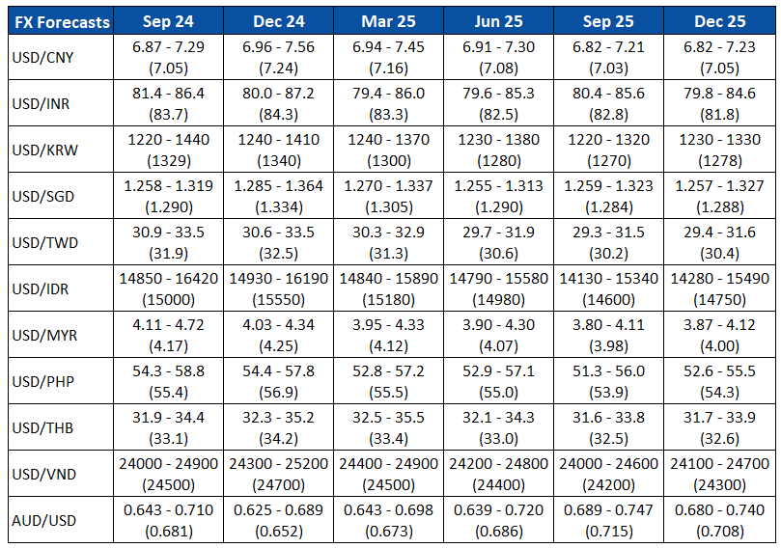
FX Outlook
Notes:
This is our FX outlook for the coming quarters.
And with that, we have come to the end of our presentation and are happy to take questions.

Slide 30
Disclaimer
Important Information
This publication has been prepared by Mizuho Bank, Ltd. (“Mizuho”) and represents the views of the author. It has not been prepared by an independent research department and it has not been prepared in accordance with legal requirements in any country or jurisdiction designed to promote the independence of investment research and is not subject to any prohibition on dealing ahead of the dissemination of investment research.
Disclaimer
Unless otherwise stated, all views or opinions herein are solely those of the author(s) as of the date of this publication and are not to be relied upon as authoritative or taken in substitution for the exercise of judgement by any recipient, and are subject to change without notice.
This publication has been prepared by Mizuho solely from publicly available information. Information contained herein and the data underlying it have been obtained from, or based upon, sources believed by us to be reliable, but no assurance can be given that the information, data or any computations based thereon are accurate or complete. This publication provides general background information only. It is information in summary form and does not purport to be complete. This publication has been prepared for information purposes only and is not intended by Mizuho or its affiliates to constitute investment, legal, accounting, tax or other advice of any kind and all recipients of this publication are advised to contact independent advisors in order to evaluate the publication, including, without limitation, the suitability of any security, commodity, futures contract or instrument or related derivative (hereinafter, a “financial instrument”), product or strategy herein described. This publication is not intended to be relied upon as advice to investors or potential investors and does not take into account investment objectives, financial situation or needs of any particular investor. It is not intended for persons who are Retail Clients within the meaning of the United Kingdom’s Financial Conduct Authority rules nor for persons who are restricted in accordance with US, Japanese, Singapore or any other applicable securities laws.
This publication has been prepared for information purposes only and is not intended by Mizuho to market any financial instrument, product or service or serve as a recommendation to take or refrain from taking any particular course of action or participate in any trading or other strategy. This publication is not an offer to buy or sell or a solicitation of any offer to buy or sell any security or any of the assets, businesses or undertakings described herein, or any other financial instrument, nor is it an offer to participate in any trading or other strategy, nor a disclosure document under applicable laws, rules, regulations or guidelines. Nothing contained herein is in any way intended by Mizuho or its affiliates to offer, solicit and/or market any financial instrument, product or service, or to act as any inducement to enter into any contract or commitment whatsoever. Neither the author, Mizuho nor any affiliate accepts any liability whatsoever with respect to the use of this publication or its contents or for any errors or omissions herein.
Mizuho and its affiliates, connected companies, employees or clients may take the other side of any order by you, enter into transactions contrary to any recommendations contained herein or have positions or make markets or act as principal or agent in transactions in any securities mentioned herein or derivative transactions relating thereto or perform or seek financial or advisory services for the issuers of those securities or financial instruments.
All of the information contained in this publication is subject to further modification without prior notice and any and all opinions, forecasts, projections or forward-looking statements contained herein shall not be relied upon as facts nor relied upon as any indication of future results. Opinions stated in this publication are subject to change without notice. Future results may materially vary from such opinions, forecasts, projections or forward-looking statements. The information contained in this publication may not be current due to, among other things, changes in the financial markets or economic environment. Mizuho has no obligation to update any information contained in this publication. Past performance is not indicative of future performance.
This is a strictly privileged and confidential publication. This publication contains information addressed only to a specific individual and is not intended for distribution to, or use by, any person other than the named addressee or any person or entity in any jurisdiction or country where such distribution or use would be contrary to law or regulation. Save with Mizuho’s prior written consent, you may not disclose, divulge, reproduce or furnish any information contained herein to any other party. Please notify the sender immediately if you have mistakenly received this publication.
Singapore: Mizuho is licensed as a bank under the Banking Act (Chapter 19) of Singapore, and is regulated by the Monetary Authority of Singapore.
Japan: Mizuho is authorised and regulated by the Financial Services Agency of Japan.
United Kingdom / European Economic Area: In the UK, Mizuho is authorised by the Prudential Regulation Authority and subject to regulation by the Financial Conduct Authority and limited regulation by the Prudential Regulation Authority. Details about the extent of MHBK's regulation by the Prudential Regulation Authority are available upon request. This publication may also be distributed by Mizuho International plc (“MHI”). MHI is authorised by the Prudential Regulation Authority and regulated by the Financial Conduct Authority and the Prudential Regulation Authority.
United States: This publication is not a “research report” as defined in Commodity Futures Trading Commission (“CFTC”) Regulations 1.71 and 23.605. The content of publications distributed by Mizuho Securities USA Inc. (“MSUSA”) is the responsibility of MSUSA. The content of publications distributed directly to US customers by Mizuho is the responsibility of Mizuho. US investors must effect any order for a security that is the subject of this report through MSUSA.
© 2014 Mizuho Bank Ltd.

