Slide 1
Mizuho Treasury Quick Webinar - September FOMC and Beyond: The First Step ?
Photo Credits: Shutterstock, FT
September 2024
Notes:
Good afternoon. First and foremost, thank you for your time to tune in. For those who tuned into the very entertaining US presidential Trump-Harris Debate yesterday, I certainly cannot provide higher entertainment value but I will aim to be more informative.
Once again, I am BH, I am one of the macro economist, Asia Oceania Treasury Department of Mizuho Bank.
For those who joining us for the first time, thank you for joining me today and for those who are tuning in after our June update, welcome back as well.
During this webinar, I will be giving a quick update on the upcoming FOMC next week, while I am allocated 30mins, I will just try to take around 20-25 mins and leave some time for Q and A which is done through the chat box as I am told by the organizers. After that, I will pass on to Kiyota-san who is one of Mizuho’s many sales product expert who will brief you about Fxweb.

Slide 2
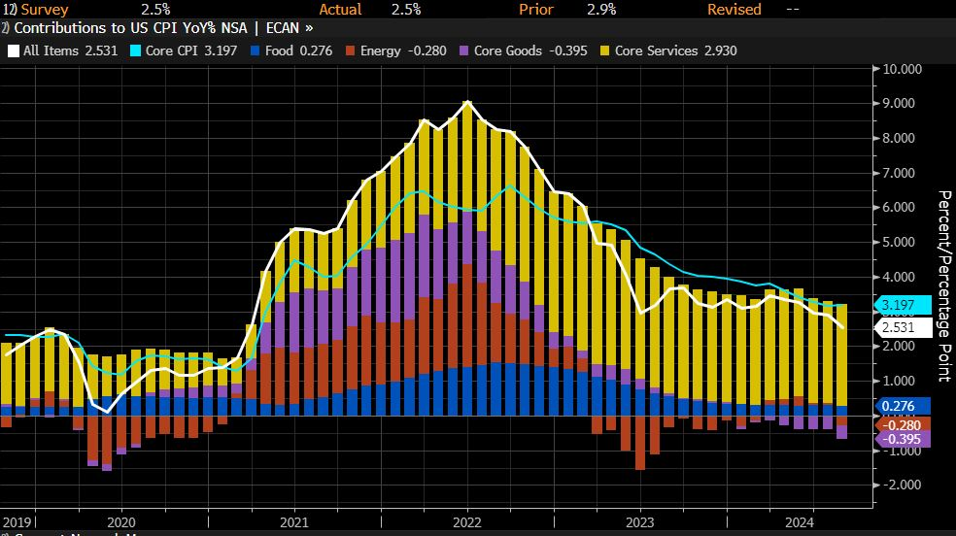
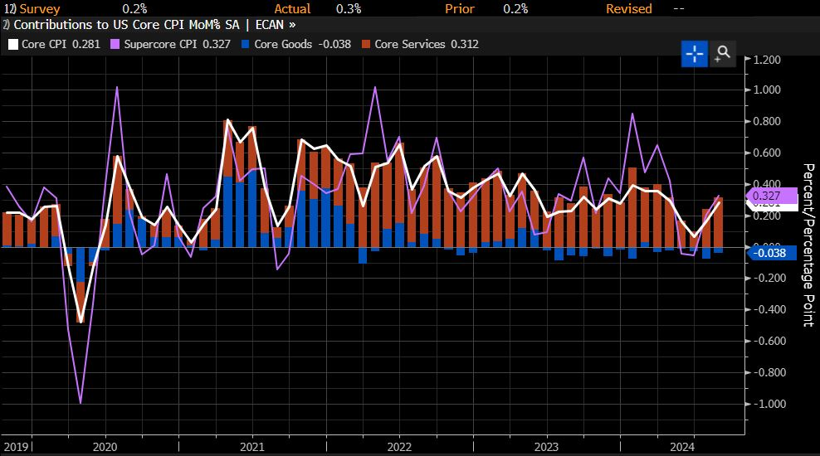
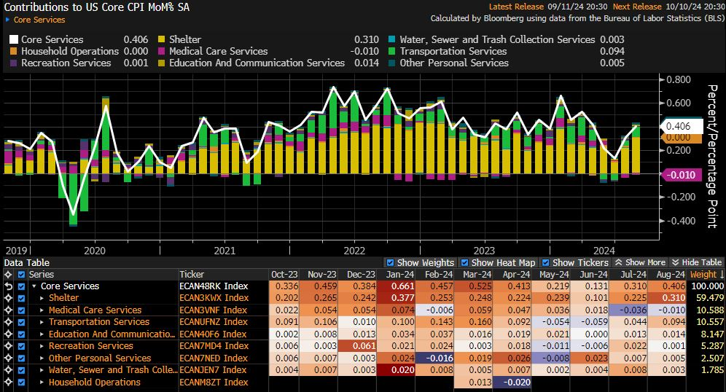
1. US CPI: Further Progress: Sufficient or Not??
 | Event
19 September (2 am) | FOMC Rate Decision
Notes:
We will start with last night US CPI print. First of all, I have titled my slide US CPI further progress: sufficient or not but that is actually no longer the qns, because no matter what the CPI print was last night, we are heading for our first rate cut in 2024 next week.
That said, the CPI even if it is not the main topic right now, it is still important as a peripheral factor to determine if member of the FOMC want to go for a 50bps cut this year or it may still be important in late 2025 if we see a resurgence of inflation.
Last night, headline inflation in the US for August came in at 2.5% yoy which was in line with expectations and much lower than the 2.9% YoY in July.
What markets saw and focused on instead was that core inflation momentum which means the MoM% change was higher which is my top right chart.
Core inflation on a MoM basis rose to 0.3% MoM which is higher than expected and as such on a YoY basis core inflation remain sticky at 3.2%.
And why is that so? This was driven by housing costs. The factors behind the core cpi mom increase is broken down in my bottom left chart.
Clearly, we can see that core services contributed 0.4% point out of 0.3% points which also means that actually core goods prices fell. This is entirely services driven and rent driven.
Is housing/rental cost a concern to the Fed, the answer is yes but is it a bigger concern than the labour market right now, the answer is no.
How did markets adjust for this? Markets lowered the odds of a 50bps cut by the Fed at the meeting next week but remain very firm for a 25bps cut.
Aside from yesterday’s night US CPI report, the other notable price that has been falling is that of brent crude’s which has touched US$70/barrel because of global growth woes.
A quick analysis tells us that at 70-75 per barrel oil will remain a dis-inflationary force for headline inflation. In turn, Oil does not impair the Fed’s desire to ease.
On balance, our take is that this CPI print last night is not an impediment on the Fed’s current easing cycle especially at the initial stage of easing.

Slide 3
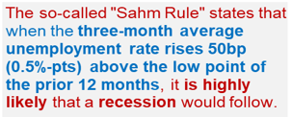
2. US Jobs: SAHM rule Panic?
US recession fears triggered suggests fragility of “Goldilocks” assumptions.
Claudia Rae Sahm
Notes:
Indeed, For the past two years, what most people hear and see and talk about is inflation, is inflation coming down and how much is it coming down by.
That conversation is now at it’s turning point and this was since last month’s labour market report in the US which saw a sharp jump in unemployment rate.
Last month on the Second of August we saw a sharp spike in US unemployment rate to 4.3% and triggered the SAHM rule.
The Sahm rule finds that if the 3 month average unemployment rate rises 50bps above the low point of the prior 12 months, it is likely that a recession will follow.
We acknowledge that the SHAM rule is merely a statistical occurrence or phenomena in Fed Chair Powell’s words. This is an instance where we say there is strong correlation though causality is not established.
Some people in the market argues that 50bps increase in unemployment rate is not much considering how low it was and say that those who point out recession risks are fear mongering.
What we want to point out is that our risk based driven approach to look at potential slowdown in growth is different from fearmongering.
Historically, deteriorating labor markets generate a self-reinforcing feedback loop. When jobs are harder to find, households trim spending, the economy weakens and businesses reduce investment, which leads to layoffs and further spending cuts.
This is why unemployment, having breached the 0.5-percentage-point threshold, has always increased a lot more — the smallest rise was nearly 2 percentage points, trough to peak.
That night of 2nd August, unemployment rate jumped, UST yields nose dived 20bps and US equities plummeted as recession fears were rampant. That episode underscores the fragility of goldilocks assumptions.
After that, Fed officials calm markets down by saying that the increase in unemployment rate is due to increase in labour supply and it is good problem because if more people are looking for work, the increase in labour supply will cool wage pressures and inflation.
What we want to say here is that the soft landing assumption by markets is really still an assumption, if the increase in unemployment was really such a good problem, why would Fed Chair Powell sound such a strong note at Jackson that “ he does not welcome any further cooling in labour market conditions”.
As such, the situation now depends on the Fed’s ability to navigate rate cuts in a manner that is able minimally maintain current growth conditions.
Let us take a further look at labour market conditions in the US. Afterall, in Claudia Sahm own words as the person who has a rule attached to her name — don’t just rely on one tool.

Slide 4
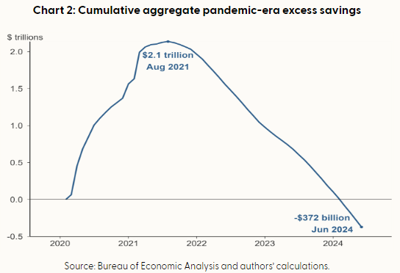

2. US Jobs: SAHM rule Panic?
Downward revisions to March 23 to 24: -818k
Downward revisions to prior 2 months: -86k
Notes:
Aside from the unemployment rate increase, we also see from the non-farm payrolls report that hiring has weaken significantly. At the last webinar in June, my figure here for the 3mma was 242k of workers being hired, at this point in time, the 3mm as of august is 116k. The latest non-farm payrolls at 142k released last Friday was below expectations of 165k.
While 142k is indeed still decent number but it is still one which is below pre-pandemic trends. Furthermore, it is not that there are not layoffs in the US, it is that the sector that are hiring outweigh the sectors which are retrenching workers. Manufacturing sector laid off works 4 out of 8 months in 2024 and that is consistent with the ISM manufacturing which shows that activity in manufacturing remains in contractionary territory. The longer the manufacturing sector remains in contractionary territory, the larger the risks that firms can longer hold onto their workers going forward.
Even as I talk about going forward let us go backward to 2nd august, even the dire number of 114 k last month was reduced to 89k.
Furthermore, the BLS in the US also revised downwards the total hiring from march 2023 to march 2024 by 818k because of updated data.
Data revisions are a very important part of policy making because it changes the entire picture of the economy of how they which is the Fed actually thought it was.
The data revisions induced dovish policy expectations and the reason that these historical revisions are important is that in 2021, the Fed was slow to hike rates because the labour market prints was low but it ended up that in early 2022 they saw huge upward revisions to data that caught them wrong footed.
This episode of being wrong was highlight in a recent speech by Fed Governor Michelle Bowman.
If the Fed understand the reasons of being slow to hike, these lessons would then also inform them about being slow to cut.
These type of historical experiences are what we call the subjective part of decision making on the next slide I will talk about the objective part of policy.
But before that, I will take the chance to explain the implications of a softer labour market. First, given that pandemic era savings have been eroded and as such households are continuously digging into pre-pandemic savings, my latest updated estimate which is simply extracted from the san Francisco fed, stands at -$372billion for June which is much steeped that the -$170billion we saw in august for those who were with me at the previous session three months ago.
This eroded savings imply that income from labour which is wages is increasingly important but if employment slows and wage growth slows as job openings and quit rate decline, then the purchasing power of the US consumer can slow quite significantly.
Quit rates are a very important indicator of wage growth.
Afterall, when people quit a job and join a new one, they often get a bump up in pay. With a lower quit rate, there is less churn in the labour market which implies less pressure on wage growth. As such, we do think that underlying price pressures have room to soften as wage growth turns a little bit milder.
With this backdrop of growth and inflation, we naturally turn to policy implications and expectations for the September FOMC which is happening just next week.
at this point, I have also included our risk based forecast of the Fed fund rate. We do think that there is room for 2 cuts in 2024 and further normalisation in 2025. My first caveat is that we are not calling for hard landing or recession as a base case. What we are saying is that there is potential for softening and there is a possibility of normalisation. Some time ago, I used to work with economic models, a lot of policy related numbers and get a lot of questions and today I will pose one of them today, imagine in 2019 when Fed fund rate was around 2% and inflation was 2.3%, if inflation increase to 3.4%, and you are Fed chair Yellen at that time, what do you think the Fed policy rate should be? Should it be the above 5.0% rate ? This question helps us get an objective view of interest rates, but we certainly acknowledge that decisions in life are subjective and based on past experiences, the Fed has fears of inflation resurgence and the policy rate has a different starting point is also anchored based on how much they have hike because of the 8% inflation in 2022. Nonetheless, the structural view is that there is room to normalise. (click)

Slide 5
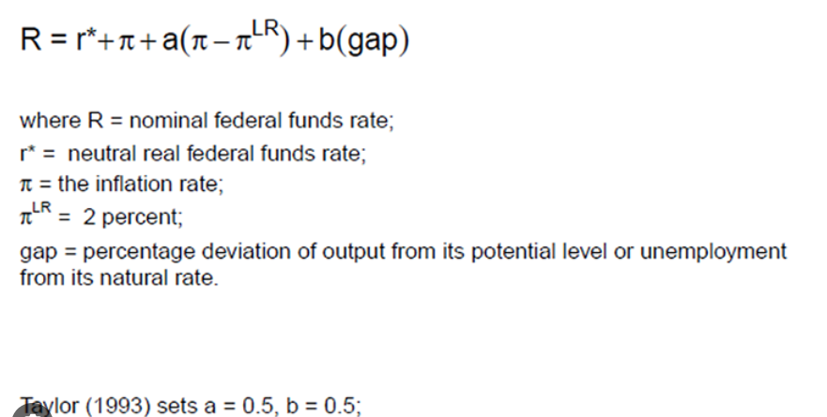
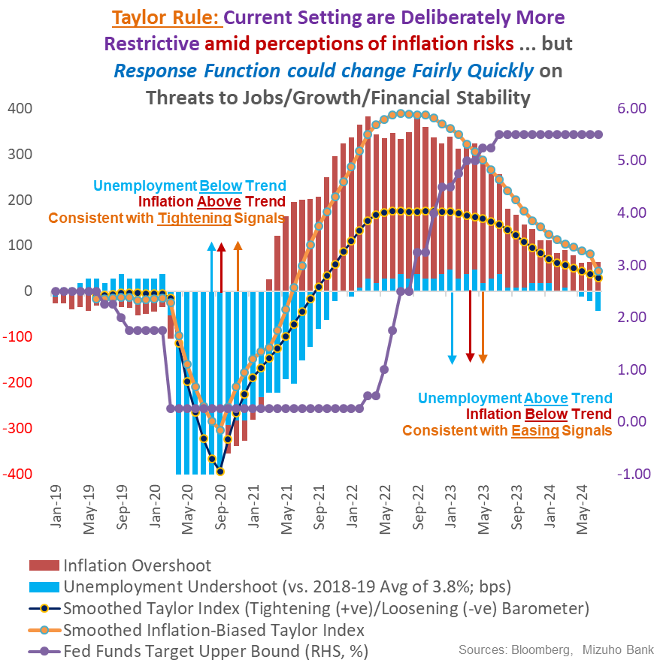
3a. September FOMC: Response Function Change
1.75%-2.25%
1.8%
3.7%
←2019
“Too High for Too Long” Risks Defer but Don’t Diminish Fed Rate Cuts
The quirks of post-pandemic durability in demand defer Fed rate cuts vis-à-vis past Fed cycles. But ‘Type-2’ error (from overcompensating for “transitory”) of “too high, for too long” are accentuated now. Which accentuates the risks of having to catch-down more hurriedly with belated rate cuts.
“2024 Runway Curtailed, but 2-3 Cuts Likely …
Barring a crisis (not our base case), rate cut run-way for 2024 is constrained by data-watching and elections.. September, November and December are “live”. 50-75 bps of rate cuts still on the table, with 75bp being most likely.
Rate Cuts to Gather Pace in H1 2025
Sharper demand softening alongside rapid slowdown set to diminish wage-price spiral risks. Consequently, Fed rate cuts will gather pace in H1 2025 so as to alleviate acute policy restriction. Up to 200bp of rate cuts by mid-2025 is not as outlandish. Fact is, 3.25-3.50% is likely still restrictive.
Consumer Slowdown, Not Crisis
Brisker cuts are premised on sharper consumption slowdown amid tightening cash-flows ➔ Not so soft landing And not a crisis from a balance sheet shock – for which far deeper and larger rate slashing will be required.
Notes:
Just now, I touched on the subjective part of fed policy making talking about historical experiences about how data revisions caught the Fed wrong footed which caused the need for huge hikes.
Now, we will start with explaining objectively why we think that there is significant room to loosen even without a recession.
I will start with the Taylor Rule. This is economist John Taylor not the Taylor Swift who just endorsed Kamala harris.
First of all, the taylor rule is simply a mechanical rule that guides policy makers on what interest rate to set depending on how far inflation is from their target, that is the pie and pie long run respectively. And how far unemployment Is from its natural rate.
Let us turn this alien looking Greek equation into a simple scenario.
Some time ago, I used to work with a lot economic models at a central bank, a lot of policy related numbers and get a lot of questions and today I get a chance to pose rhetorical one
Imagine in 2019 when Fed fund rate was around 1.75% to 2.25% depending on which month you are looking at because the Fed was actually cutting rates.
and inflation in 2019 was averaging 1.8%, if inflation increase to 2.9%, and you are Fed chair Yellen at that time, what do you think the Fed policy rate should be? How much will you increase policy rate by to tackle 2.9% inflation? Should it be the above 5.0% rate ?
The current Fed funds rate has an upper bound is 5.50% and lower bound is 5.25%. That is at least a full 300bps higher than the 2019 rates even if I take the most conservative estimate.
Furthermore, unemployment rate in 2019 was averaging 3.7% in 2019 but now it is 4.3% which means rates should be lower.
This taylor rule thought experiment helps us get an objective view of interest rates, but we certainly acknowledge that decisions in life are subjective and based on past experiences
As such, it is should be evident that there is ample policy space to lower policy rates.
We do think that the risk is now being too high for too long which then causes the Fed to catch down more with hurriedly with belated cuts.
75bps of cuts is the most likely for the rest of 2024 with three meeting left and rate cuts have potential to gather pace in h1 2025
Our rate cuts are premised on sharper consumption slowdown amid tightening cash-flows, it is basically a Not so soft landing but it is not a crisis from a balance sheet shock because that requires much bigger cuts.

Slide 6


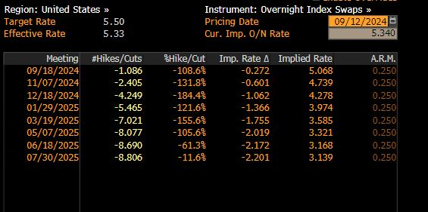
3b. September FOMC - The First Step: Size of Cuts (Surprising or Not?)
I am open-minded about the size and pace of cuts, which will be based on what the data tell us about the evolution of the economy, and not on any pre-conceived notion of how and when the Committee should act.
I was a big advocate of front-loading rate hikes when inflation accelerated in 2022, and I will be an advocate of front-loading rate cuts if that is appropriate.
- Fed Governor Waller in a speech after the NFP print last Friday
Fed “do(es) not seek or welcome further cooling in labor market conditions”
- Fed Chair Powell at Jackson Hole
 | Event
 | Downward revisions to prior 2 months: -86k Aug NFP: 142k July NFP: 89k, Unemployment rate: 4.3% to 4.2% (4.25% to 4.22%)
 | US Headline/Core CPI: 2.5%/3.2% (Aug) 2.9%/3.2% (Aug)
19 September (2 am) | FOMC Rate Decision
Notes:
After our analysis that there is ample room to cut, we want to take a brief look at what the policy makers think. It is important to differentiate ability from willingness. The Fed can afford to go for 50 bps cut but the question is are they willing to do so? This week, we did not get any Fed speak because it is blackout period before the Fed decision.
The last person to speak was Fed Governor Waller and his speech was on last Friday after the non-farm payrolls report.
He said I am open-minded about the size and pace of cuts, which will be based on what the data tell us about the evolution of the economy, and not on any pre-conceived notion of how and when the Committee should act. He also said he was a big advocate of front loading rate hikes.
Furthermore, during Jackson hole, Fed Chair powell, said that Fed “do(es) not seek or welcome further cooling in labor market conditions” and Jackosn hole is prior to the current NFP print.
Perhaps more importantly, it is what Fed Chair Powell did not say, he gave zero hints on his thinking of the size of rate cuts, he did not do the usual spiel of we will start small and calibrated and we will be careful. None of those, I search his entire speech, it did not contain any words such as careful or calibrated. he simply said it was time to cut rates, implicitly being open to the size of rate cuts
After Jackson hole, there was the non farm payrolls which we touched on just now, that there were downward revisions to historical data such as 89k downgrade to July and June.
Though august showed an improvement to 142k of hiring.
As for unemployment rate, the decline in unemployment rate was marginal, 4.25% to 4.22%, I decided to open up the to 2 decimal places which in this case is rather important.
Given such strong language and to me what looks like weak labour market data, I am very hesitant to dismiss the possibility of a 50bps cut given that there is non-trivial likelihood of the Fed front loading rate cuts.
Markets are pricing in a one in three chance of a 50bps cut next week.
In fact, it is perhaps important to point out that markets via fed funds futures are expecting 110bps of cuts by December.
At this point, you might think, hold on, there are only 3 meetings left. 110bps of cuts and 3 meetings imply that markets expect one of these meetings to have a 50bps cut, no one in the right mind will expect some odd size cuts such as 35bps of cuts right. That said, the Fed has often over-delivered at every rate cut and easing cycle. Simply put, is that the Fed in almost the start of every easing cycle tend to over deliver.
As such, the market turbulence from a 50bps cut if it happens which be immediately volatile depending on how Fed chair Powell communicates the cut. More important, it might smooth itself out because this is a case of surprising but really so surprising. While a 50bps cut is surprising in the sense that two thirds got it wrong, the entire market already expects one 50bps somewhere this year.
In turn, while the USD has potential to turn much weaker if the Fed cuts 50bps, we must also consider that if the cut is alr front loaded, the potential for further USD weakness might become marginally diminished which means that USD weakness may not be as straight forward.

Slide 7
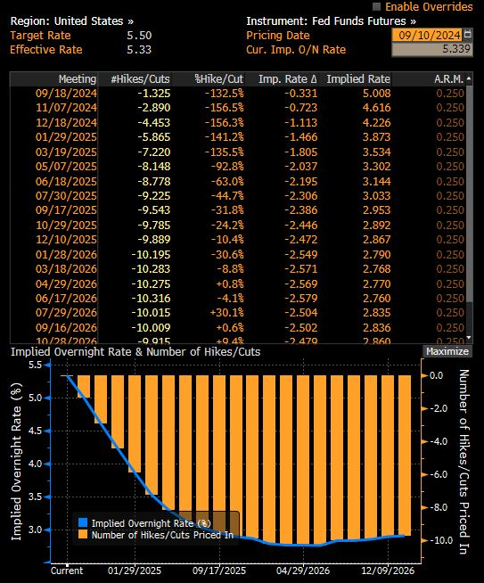
3c. September FOMC: The First Step: Quantitative (Dot Plot) and Qualitative (Rhetoric) Easing Signals
Current:5.375%.
4.875% = 3 cuts
4.625% = 4 cuts
3.625%=5 cuts in 2025 Inclination to be lower
Dispersion
GAP
Rhetoric
Notes:
Aside from words, the upcoming FOMC will feature the release of the Dot Plot. Here, let us postulate some possibilities, for 2024, the Fed may be inclined to show 4.875% for end 2024 which means one 25 bps of cut at each of the two meetings left which add up to 50bps of cuts for the rest of the year, assuming that they start off with a small 25bp cut.
What we will look out for is the dispersion of the Dots, how many members lean towards 4.625% and how many favours 4.875%.
In fact, by virtue of me saying this, it means that it is a dovish shift, we are essentially asking how many member favours at least 3 cuts?
Into 2025, it is where the Dot Plot gets more interesting, how dovish can the Fed afford to get?
We anchor the end 2025 rates at 3.625% which is the lower end point of their previous forecast in the past years. This represents just 125bps of cuts in 2025, 5 cuts in total.
We do think that the FOMC will have a dovish bias to go lower than 3.625%.
The challenge for the Fed who may want to communicate lower rates in 2025 without inviting recession and risk off fears as such there is a chance they may just keep it at 3.625%
For those of us who are closing watching the markets, the obvious gap is that markets are pricing in end 2025 rates at 2.8% with 245bps of cuts. So the gap is 125bps. So markets expect 10 cuts but this dot plot if it comes out shows 5 cuts, there is a gap of 5 cuts. If markets start to close this gap, it means that markets need to price in less cuts which in turn may backstop the USD and lead to what some people call counter intuitive movements such as episodes of USD strength in a rate cut cycle.
The question here is how strong will Fed Chair Powell playdown the Dot plot in 2025 which is to say that during his press conference he may down play the Dot plot to say there is potential to cut more than what the Dot plot suggest or to the effect that if labour market conditions soften, we will not hesitate to cut more and not rigidly stick to what is in the Dot Plot.
More importantly, if the Fed chooses to stick with 25bps they have a huge inclination to send dovish signal by giving room for more cuts in 2025.
Then the USD has room to weaken.
With so much to look at next week, some of you might be concern on what happens to the central banks in our region?

Slide 8
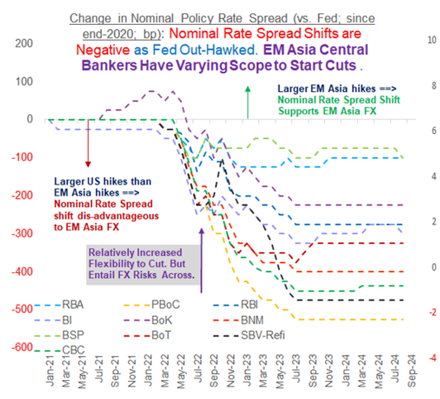
4. FX Outlook: USD: EM-Asia's Differentiated Responses and Risks
Rate Hold in August:
Bank of Thailand (dovish tones on credit quality)
Bank of Korea (hints of Q4 cut but property prices obstruct)
Bank Indonesia (open up possibility of Q4 cut)
Bank Negara Malaysia
Rate Cut in August:
BSP cut by 25 bps with the possibility of more easing in Q4
Notes:
For all of us in the region, the recent sharp and anticipatory drop in UST yields and USD, suggests scope for EM Asia central banks to start cutting as some of the pressure on regional currencies ease.
But this is only cautiously and tentatively as nascent rate cut plans must necessarily be responsive to any flux in market conditions and ready for any remedial interim suspension.
Last month we saw the likes of the Bank of Thailand, Bank Indonesia and the BoK cautiously stayed on hold while the BSP’s rate cut two weeks ago was deftly executed, seizing on Fed rate cut expectations.
To be clear, the BSP’s cut did not solely hinge on Fed expectations shift. Instead, the BSP had the benefit of ample economic justification as well.
In Philippines private consumption contracted for 2 consecutive quarters and their nominal policy rates are elevated which imply that they have at least 150bps of cuts of room to cut if growth continues to weaken.
In their case, 25bps of cuts is really calibrated because I remember waking up to headlines of the BSP hiking rates of 75 bp and 50bps in off cycle moves so the current moves are really in the realm of being calibrated.
The BSP also signaled that there is possibility of more easing in Q4.
In Korea, the BoK kept rates on hold but has hinted at the possibility of Q4 cut and their inability to pinpoint at which meeting reflects their own constraints such as escalating property prices in Seoul and the authorities are cognizant not to fuel any property asset price bubble. Nonetheless, they epitomized the need to be responsive to market conditions and also nimble to their own conditions and not stick to a pre-defined path.
Meanwhile, in Indonesia, given the recent rupiah appreciation, Bank Indonesia also opened up the possibility of easing in Q4 but they signaled their caution by only assuming two fed cuts in 2024 which then implicity assumes two or less cuts for Bank Indonesia given that they may not front run and certainly not out cut the Fed.
The BNM remains at the opposite end of the spectrum given their neutral policy stance and that has aided the MYR outperformance in August.
As for Thailand, the BoT indeed held rates and characterized their policy also as neutral. but their warning on tightening financial conditions amid worsening credit quality among household and SME really strikes a dovish note in my view and as such the BoT has some potential to ease in 2025 but only one or two cuts given that their policy rates are only at 2.5%.
On balance, in our region, rate cut plans must be rather fluid rather than set in stone so that they are responsive to any flux in market conditions and ready for any remedial interim suspension

Slide 9
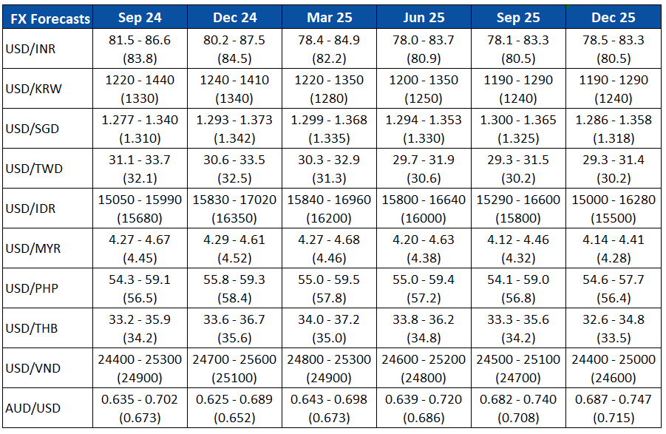
Q and A
Kindly Drop Your Questions in the Chat Box
Notes:
Lastly, while we have also acknowledge the tendency for a softer USD, we continue to see threats to one way bearish USD bets.

Slide 10
Disclaimer
Important Information
This publication has been prepared by Mizuho Bank, Ltd. (“Mizuho”) and represents the views of the author. It has not been prepared by an independent research department and it has not been prepared in accordance with legal requirements in any country or jurisdiction designed to promote the independence of investment research and is not subject to any prohibition on dealing ahead of the dissemination of investment research.
Disclaimer
Unless otherwise stated, all views or opinions herein are solely those of the author(s) as of the date of this publication and are not to be relied upon as authoritative or taken in substitution for the exercise of judgement by any recipient, and are subject to change without notice.
This publication has been prepared by Mizuho solely from publicly available information. Information contained herein and the data underlying it have been obtained from, or based upon, sources believed by us to be reliable, but no assurance can be given that the information, data or any computations based thereon are accurate or complete. This publication provides general background information only. It is information in summary form and does not purport to be complete. This publication has been prepared for information purposes only and is not intended by Mizuho or its affiliates to constitute investment, legal, accounting, tax or other advice of any kind and all recipients of this publication are advised to contact independent advisors in order to evaluate the publication, including, without limitation, the suitability of any security, commodity, futures contract or instrument or related derivative (hereinafter, a “financial instrument”), product or strategy herein described. This publication is not intended to be relied upon as advice to investors or potential investors and does not take into account investment objectives, financial situation or needs of any particular investor. It is not intended for persons who are Retail Clients within the meaning of the United Kingdom’s Financial Conduct Authority rules nor for persons who are restricted in accordance with US, Japanese, Singapore or any other applicable securities laws.
This publication has been prepared for information purposes only and is not intended by Mizuho to market any financial instrument, product or service or serve as a recommendation to take or refrain from taking any particular course of action or participate in any trading or other strategy. This publication is not an offer to buy or sell or a solicitation of any offer to buy or sell any security or any of the assets, businesses or undertakings described herein, or any other financial instrument, nor is it an offer to participate in any trading or other strategy, nor a disclosure document under applicable laws, rules, regulations or guidelines. Nothing contained herein is in any way intended by Mizuho or its affiliates to offer, solicit and/or market any financial instrument, product or service, or to act as any inducement to enter into any contract or commitment whatsoever. Neither the author, Mizuho nor any affiliate accepts any liability whatsoever with respect to the use of this publication or its contents or for any errors or omissions herein.
Mizuho and its affiliates, connected companies, employees or clients may take the other side of any order by you, enter into transactions contrary to any recommendations contained herein or have positions or make markets or act as principal or agent in transactions in any securities mentioned herein or derivative transactions relating thereto or perform or seek financial or advisory services for the issuers of those securities or financial instruments.
All of the information contained in this publication is subject to further modification without prior notice and any and all opinions, forecasts, projections or forward-looking statements contained herein shall not be relied upon as facts nor relied upon as any indication of future results. Opinions stated in this publication are subject to change without notice. Future results may materially vary from such opinions, forecasts, projections or forward-looking statements. The information contained in this publication may not be current due to, among other things, changes in the financial markets or economic environment. Mizuho has no obligation to update any information contained in this publication. Past performance is not indicative of future performance.
This is a strictly privileged and confidential publication. This publication contains information addressed only to a specific individual and is not intended for distribution to, or use by, any person other than the named addressee or any person or entity in any jurisdiction or country where such distribution or use would be contrary to law or regulation. Save with Mizuho’s prior written consent, you may not disclose, divulge, reproduce or furnish any information contained herein to any other party. Please notify the sender immediately if you have mistakenly received this publication.
Singapore: Mizuho is licensed as a bank under the Banking Act (Chapter 19) of Singapore, and is regulated by the Monetary Authority of Singapore.
Japan: Mizuho is authorised and regulated by the Financial Services Agency of Japan.
United Kingdom / European Economic Area: In the UK, Mizuho is authorised by the Prudential Regulation Authority and subject to regulation by the Financial Conduct Authority and limited regulation by the Prudential Regulation Authority. Details about the extent of MHBK's regulation by the Prudential Regulation Authority are available upon request. This publication may also be distributed by Mizuho International plc (“MHI”). MHI is authorised by the Prudential Regulation Authority and regulated by the Financial Conduct Authority and the Prudential Regulation Authority.
United States: This publication is not a “research report” as defined in Commodity Futures Trading Commission (“CFTC”) Regulations 1.71 and 23.605. The content of publications distributed by Mizuho Securities USA Inc. (“MSUSA”) is the responsibility of MSUSA. The content of publications distributed directly to US customers by Mizuho is the responsibility of Mizuho. US investors must effect any order for a security that is the subject of this report through MSUSA.
© 2014 Mizuho Bank Ltd.

Slide 11
Mizuho Global e-Banking
FX Web Service
September 2024
Mizuho Bank
Singapore Corporate Banking Department
Global Transaction Banking Department Asia & Oceania Office
Asia & Oceania Treasury Department

Slide 12






Additional service FX Web
Online FX service
Features & Benefits | Users will deal FX transaction through Mizuho Global e-banking (MGeB)
 | Users will have indication quickly and timely
 | Do not need to submit confirmation letter
 | Users can check the list of historical transactions ( Users can refer to the reference number on FX Web )
POINT
Available Currency pair | USD/SGD, JPY/SGD, EUR/SGD, THB/SGD, AUD/SGD, GBP/SGD, CHF/SGD, CAD/SGD,NZD/SGD, GBP/USD, EUR/USD, AUD/USD, USD/JPY, EUR/JPY, USD/THB, USD/CHF, NZD/USD, USD/CAD, USD/DKK, EUR/GBP, USD/NOK, USD/SEK, USD/CNH, CNH/SGD (For currency pairs not listed here, please contact us)
【New workflow for FX dealing】
Step1 Call for the deal and Done FX dealing
Done FX dealing and Confirm through one platform
Step2 Need to sign back the Confirmation to Bank
Do not need to sign back the Confirmation to Bank
Check indication
Done FX dealing
Confirm the deal
You
Bank
You/User
Function | Opening time of FX Web service
FX Transaction | Weekdays 8：30～17：00 * *Exclude value same day transaction (Value Same day transaction will be available until 11:00AM in the FX Web) Above service hour is subject to change without prior notice
Inquiry /Setting | Weekdays 7：00～23：00 Saturday 7：00～21：00
Notes
The customer needs to apply with documents to add online FX service.
For FX transactions done after 16:00, the contract date will be the next business day
Online FX Service can provide FX Forward transactions within 1 Year, also can provide value same day transactions
Dealing FX Forward is subject to bank’s assessment. For your eligibility, please check with the branch

Slide 13
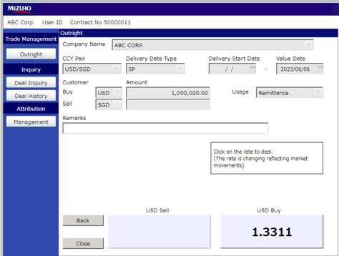
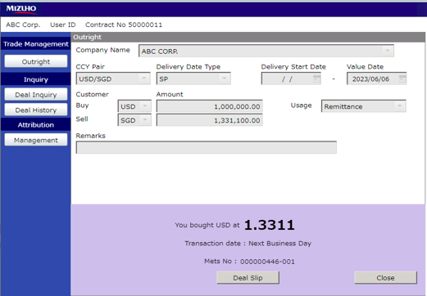
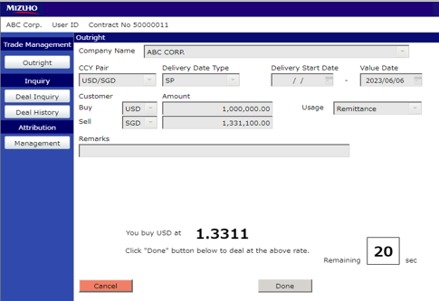
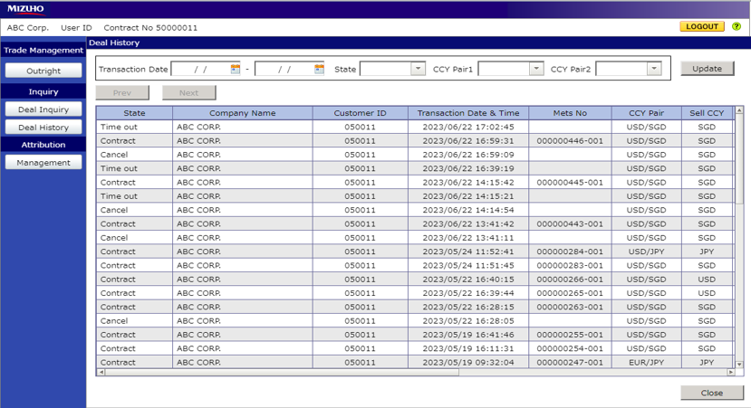
Sample Screen of FX web
1.Transaction Input
You can input the Amount, Currency pair and Value date for Outright
3.Download Deal Slip
You can print out the Deal Slip by clicking the [Deal Slip] button.
POINT
1
3
2.Deal Done
Click the［Done］button.
4.Manage historical data
You can view the historical deal information
2
4

Slide 14
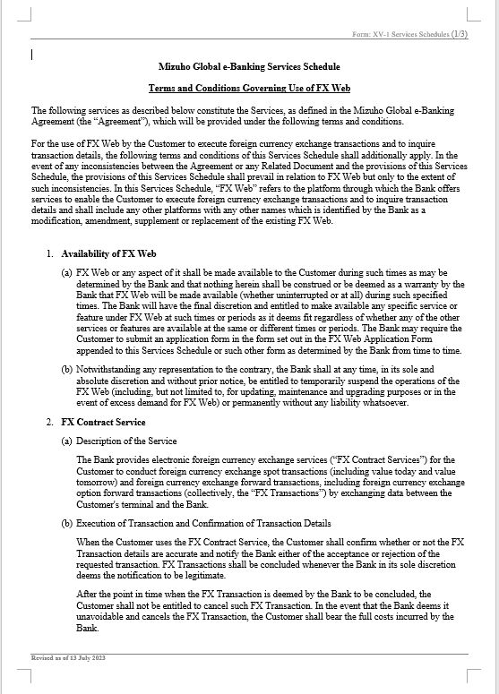
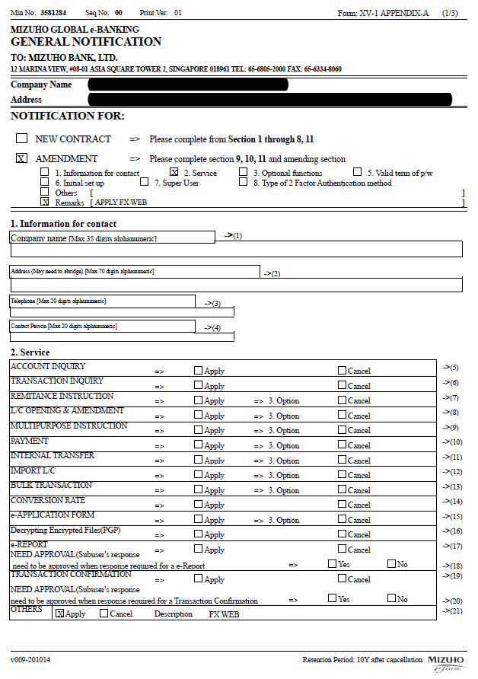
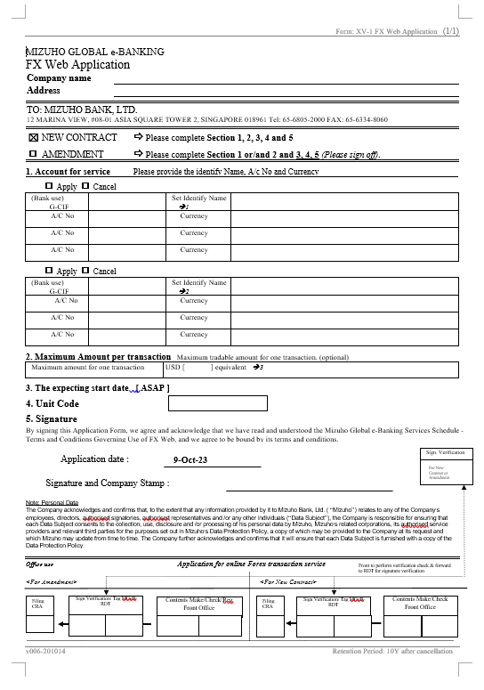
Necessary Documents to Start the online FX service
Necessary
Documents
To Start
Online FX Service
1
Terms and Conditions Governing Use of the Mets Global Service(No signature required)
2
MIZUHO GLOBAL e-BANKING Appendix A for Mets Global(Signature required)
3
MIZUHO GLOBAL e-BANKING FX Web Application(Signature required)
Notes:
The above documents are examples of customers who have already signed a contract with MIZUHO GLOBAL e-BANKING(MGeb)
If Customer dose not have a MGeb service, we would appreciate it if customer would consider joining MGeb service first
Terms and Conditions Governing Use of the Mets Global Service
2. MIZUHO GLOBAL e-BANKING Appendix A for Mets Global
3. MIZUHO GLOBAL e-BANKING FX Web Application
Note: The above consent letter format is a sample and the format differs by Mizuho branches.

Slide 15
Setup before FX Web Use
After applying for FX Web, the following two settings are required before customer can use the service
(Both settings must be made by Super User)
FX Web Usage Settings (p. 5)
Local Service Usage Settings (p. 6-7)
Changes to the settings in "1. FX Web Usage Settings" will be reflected on the next business day.
Please complete the setup by one business day before to the actual execution of the FX transaction.

Slide 16
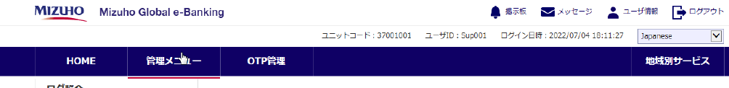
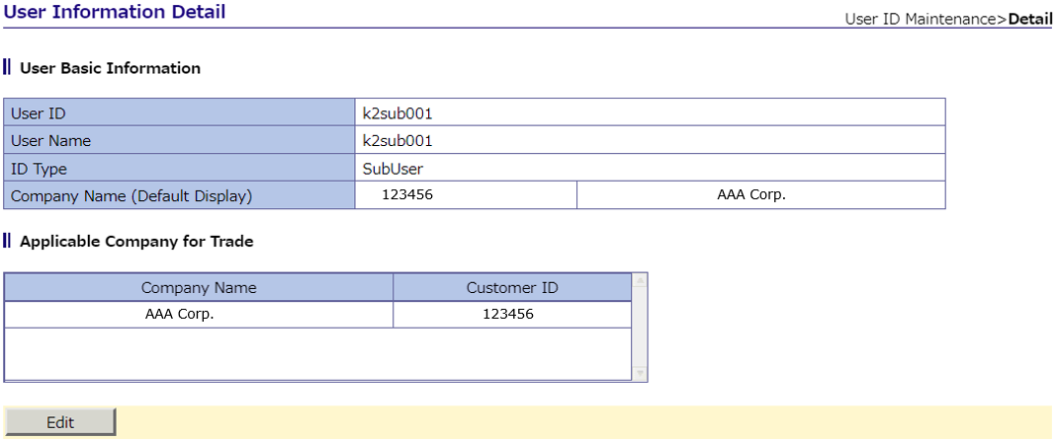
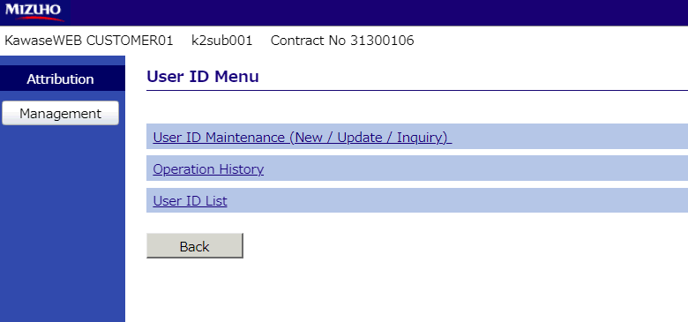
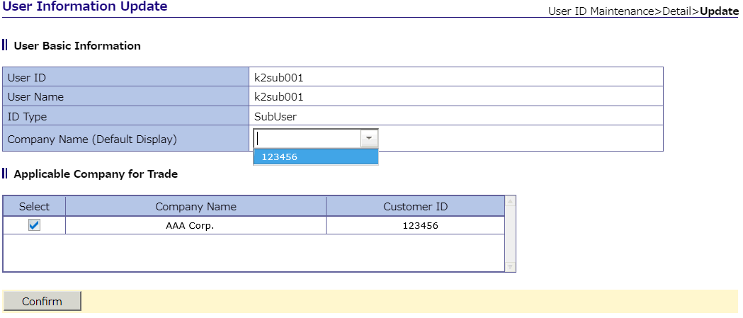
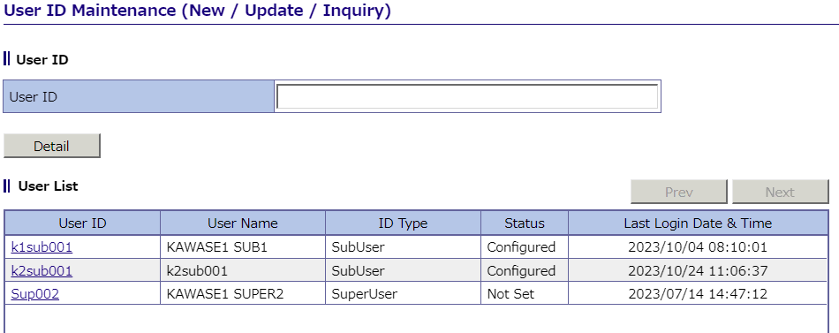
1.FX Web Setup
1, Login to Mizuho Global e-Banking (MGeB) with Super User ID and select FX Web from “Local Service”
4, Click "Edit" to display the selected user information.
2, Select "User ID Maintenance" on the screen
5, Select "Company Name" from the list and click "Confirm
3, Select the Sub User ID to be authorized.
6, The registration contents screen is displayed.
If all done the check, click "Update" to reflect the registration.
*The attached image may differ from the actual screen display.

Slide 17
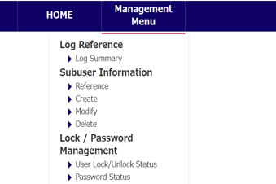
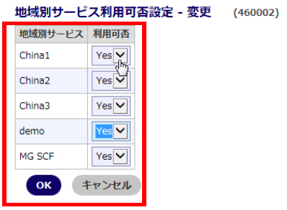
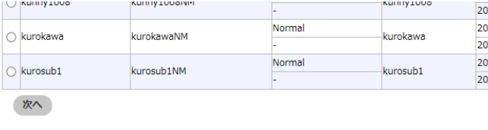

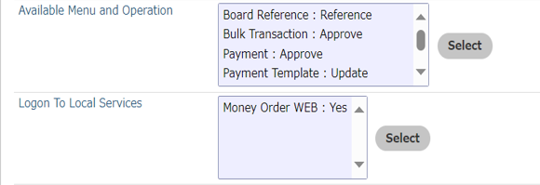
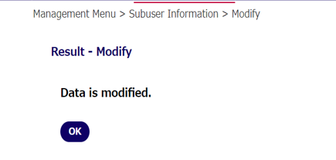
2. local service use setting
1、Login to Mizuho Global e-Banking (MGeB) with your Super User ID, and select Administration Menu > Sub User Information > Change
4，Change "FX Web" to "Yes" from the pop-up window and click "OK.
2，Select the user whose settings you want to change and click "Next
5，Confirm that the changes are reflected on the original screen (the screen in item 3) and click "OK".
3，Click "Select" for services by region
6，Configuration change is completed.
*The attached image may differ from the actual screen display.

Slide 18
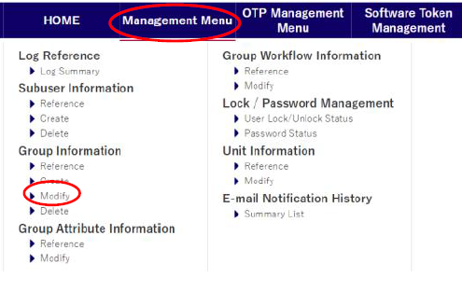
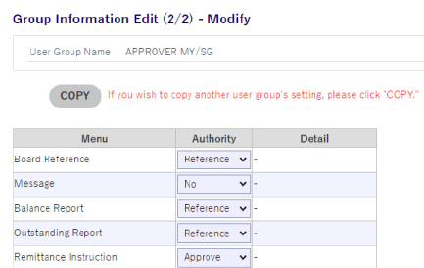
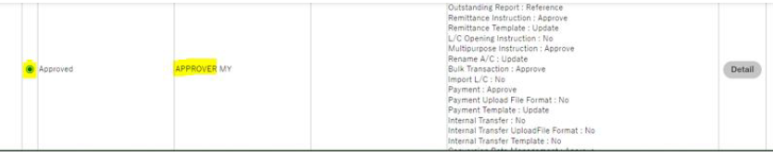
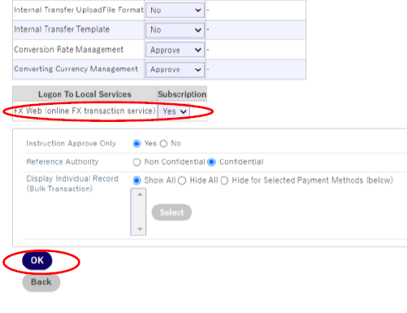
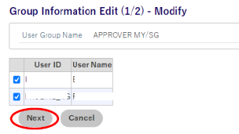
2. local service use setting
(For group workflow setting customer)
1, Login to Mizuho Global e-Banking (MGeB) with your Super User ID, and select Management Menu > Group Information > Modify
4，Click “Yes” for FX Web (online FX transaction service)
Click OK
Message “Ready to execute”, click OK (Ensure you see a message “Data is modified”
2，Select Approver Group and Click Continue
3，Click Next (Important: Do not remove the tick beside the User ID)
*The attached image may differ from the actual screen display.

Slide 19
Disclaimer
This Presentation is for general information only and is not intended to constitute any investment, legal, accounting, taxation or other advice of any kind from Mizuho Bank, Ltd. or any of its affiliates (individually or together, as the context may require or admit, “Mizuho”).
While every care has been taken in preparing this Presentation, no representation, warranty or other assurance of any kind is made with respect to the accuracy, completeness or suitability of any information in the Presentation for any purpose, including any data obtained from third party sources, and neither Mizuho nor any officer, director, employee, agent, advisor or controlling person of Mizuho shall have any liability to anyone relating to or arising from the use of any of the information in the Presentation or for any error, omission or misstatement thereof (negligent or otherwise).
All opinions, estimates, forecasts, projections or forward-looking statements contained herein (if any) may not be relied upon as facts nor as any representation or guarantee of future results. No representation is made as to the reasonableness of the assumptions made within or the accuracy or completeness of any modelling, valuation or back-testing. Mizuho does not have any obligation to update any of the information contained in this Presentation.
This Presentation may not be modified, reproduced, copied, distributed or disclosed to third parties in whole or in part and no commercial use or benefit may be derived from this Presentation without the prior written permission of Mizuho.

