Slide 1


This Time, is Different(iated)?
Why Asia FX may be Compromised
“In a dark place we find ourselves, and a little more knowledge lights our way disturbing”
- Master Yoda, Star Wars
“I find your lack of faith disturbing”
- Darth Vader,
Star Wars (Ep IV): The Empire Strikes Back
Photo Credits: Shutterstock, FT
June 2024

Slide 2
This Time It is Different? Euphoria
Will the Fed Manage a Soft Landing or Muddle through Miscalculations?
    Historical Precedents are not Encouraging
    The Plot Has Thickened: More Hawkish ‘Dot Plot’!
    Policy is Exceptionally Tight vis-à-vis Economic Conditions
    Consumer Exceptionalism May be Overstated
    Cash-flow Constriction a Risk to Consumer Demand
    Jobs Not as Hot & Wage-Price Risks are Overstated
    Risk View to Stoic Fed: Deeper Cuts in 2025!
Challenging Received Wisdom on Bearish Pivot USD
    Bearish USD on Peak Fed is Common, But Not Without Exception
    Prolonged Peak Introduces “Fear” & “Fed” Boost for USD
    USD Retains Policy Advantage … at least in terms of Direction Bias
    Not to Confuse Peak USD for Bearish USD
The (Geo-)Politics of USD Trump
Why AXJ Reversion is Not Guaranteed?
    Relative Under-performance Reveal Eroding Advantages
    Adverse Policy-FX Loop May Amplify Downside Volatility
    Carry Unwind Risks on JPY Upside Volatility Flare
Especially in the Context of CNH Risks
    China & Attendant CNH Risks Loom Large
    Exceptional CNY Pressures Amplifies Policy Conundrum ...
    … Including Devaluation Risks

Slide 3
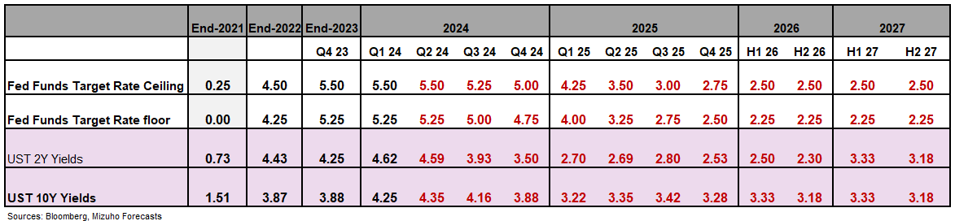
The Fed’s “Type-2” Error Risks – Baggage from “Transitory” Risks “Too High for too Long”
“Too High for Too Long” Risks Defer but Don’t Diminish Fed Rate Cuts
The quirks of post-pandemic durability in demand defer Fed rate cuts vis-à-vis past Fed cycles.
But ‘Type-2’ error (from overcompensating for “transitory”) of “too high, for too long” are accentuated now
Which accentuates the risks of having to catch-down more hurriedly with belated rate cuts.
“2024 Runway Curtailed, but 2 Cuts Likely …
Barring a crisis (not our base case), rate cut run-way for 2024 is constrained by data-watching and elections.
July FOMC virtually ruled out. September, November and December are “live”.
50-75 bps of rate cuts still on the table, with 50bp being most likely.
Rate Cuts to Gather Pace in H1 2025
Sharper demand softening alongside rapid slowdown set to diminish wage-price spiral risks.
Consequently, Fed rate cuts will gather pace in H1 2025 so as to alleviate acute policy restriction.
Up to 200bp of rate cuts by mid-2025 is not as outlandish. Fact is, 3.25-3.50% is likely still restrictive.
Consumer Slowdown, Not Crisis
Brisker cuts are premised on sharper consumption slowdown amid tightening cash-flows ➔ Not so soft landing
And not a crisis from a balance sheet shock – for which far deeper and larger rate slashing will be required.
Type 1 Error: person may see the bear when there is none (raising a false alarm) where :
“There is no bear”.
Type 2 Error: A person may miss discovering the bear when in fact a bear is present (hence fails in raising the alarm)
Notes:
Point 1: too high for too long raises the likelihood of Type 2 error,
Recap on why the rate cuts were defered.
Outlook on cuts.
Reason for cuts.

Slide 4
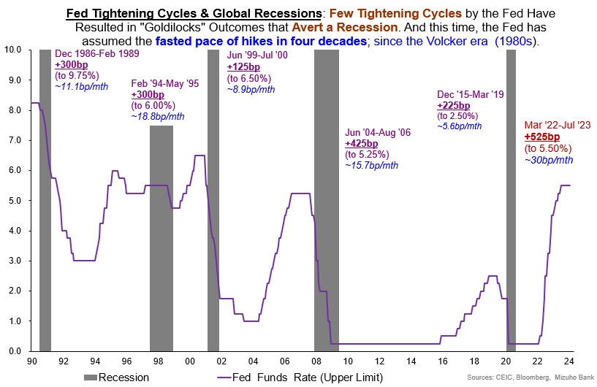
Historically, Aggressive Rate Hikes Have Seldom Been Without Economic Pain
Notes:
So let us start with a gentle reminder.

Slide 5
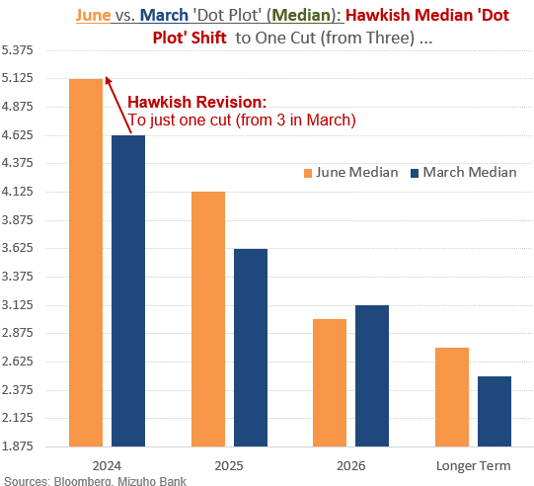
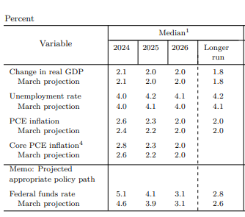



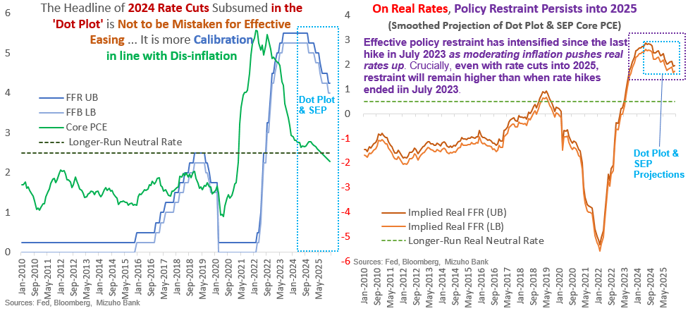
Fed Has Gotten More Hawkish at the Margin
Summary of Economic Projections (SEP)
Notes:
Aside from history, I am sure you are concerned on what is the latest take during the June FOMC two weeks ago.
A quick recap to get everyone on the same page.
3 cuts to 1 cuts in the Dot plot.
At the same time, inflation projections were upgraded.
As per our usual practice, we want to know if the Fed is more restrictive in real terms.
Do math
In real terms, my bottom right chart still shows that in 2025 real rates are more restrictive than when rate hikes ended in July 2023.
Certainly we admit that there is some easing when the Fed starts cutting rates. But it is not actually outright effective easing, it is merely calibrating the very high nominal rates which has not been adjust despite the substantial dis-inflation which had take place.

Slide 6
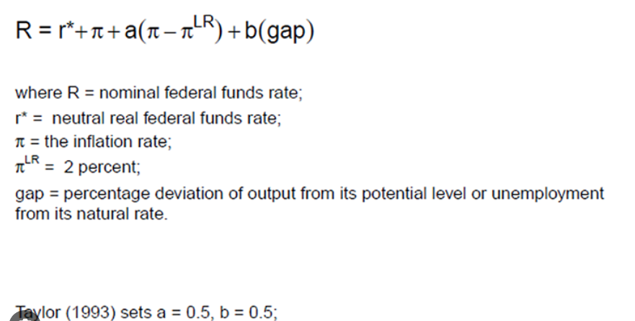
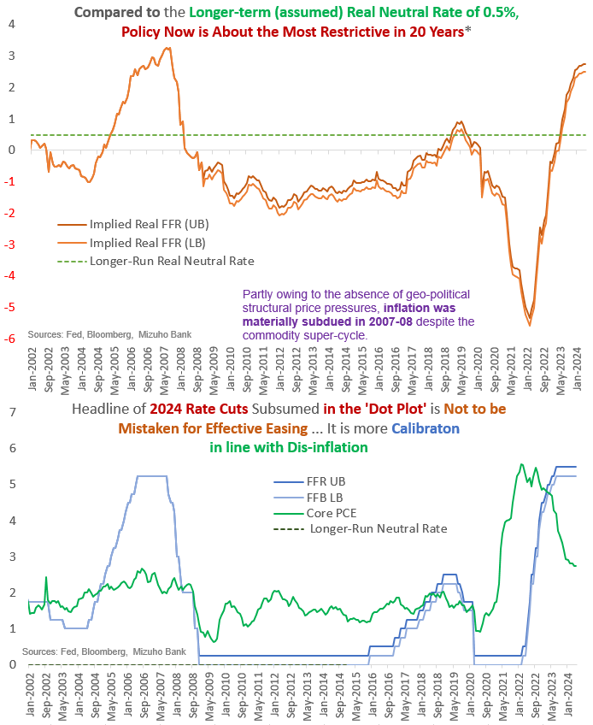
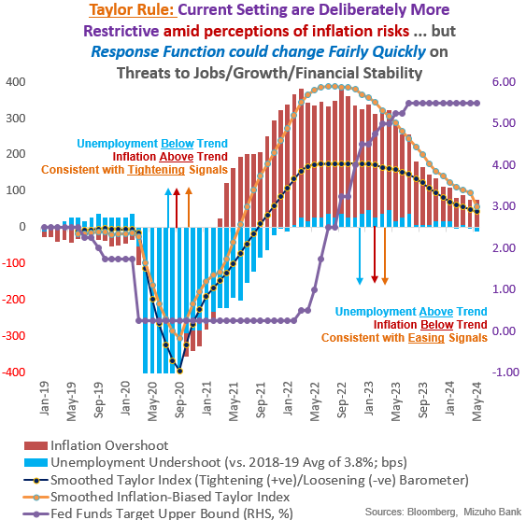
Conditions are Exceptionally Tight! Taylor Rule Does Not Require This Much Restriction
1.75%-2.25%
1.8%
3.7%
←2019
Notes:
Then the qns which stands out is how do I know that calibration is needed?

Slide 7
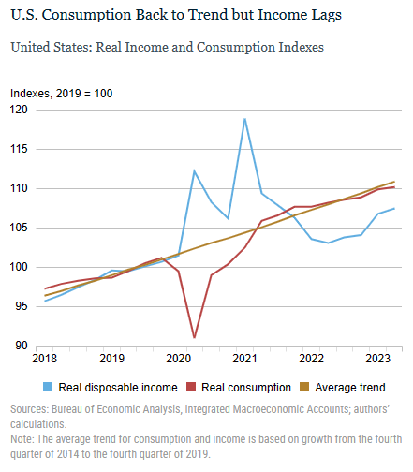
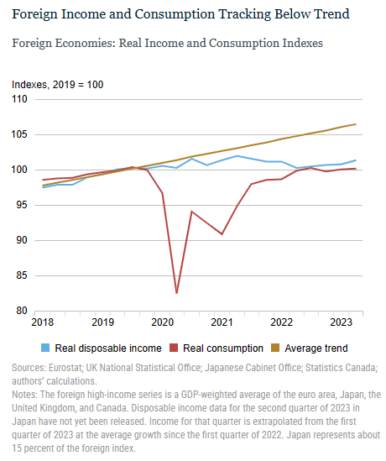
US Consumer Exceptionalism Requires Exceptional Conditions
Source: Federal Reserve Bank of New York
Notes:
And why are monetary conditions so tight? Part of it has been the on-going narrative around US consumer exceptionalism.
Like we said earlier, policy making is not mechanical and is also based on other indicators. In the US, consumption spending by households have been very robust.
This is in constrast to other developed countries, namely.. Below trend..

Slide 8
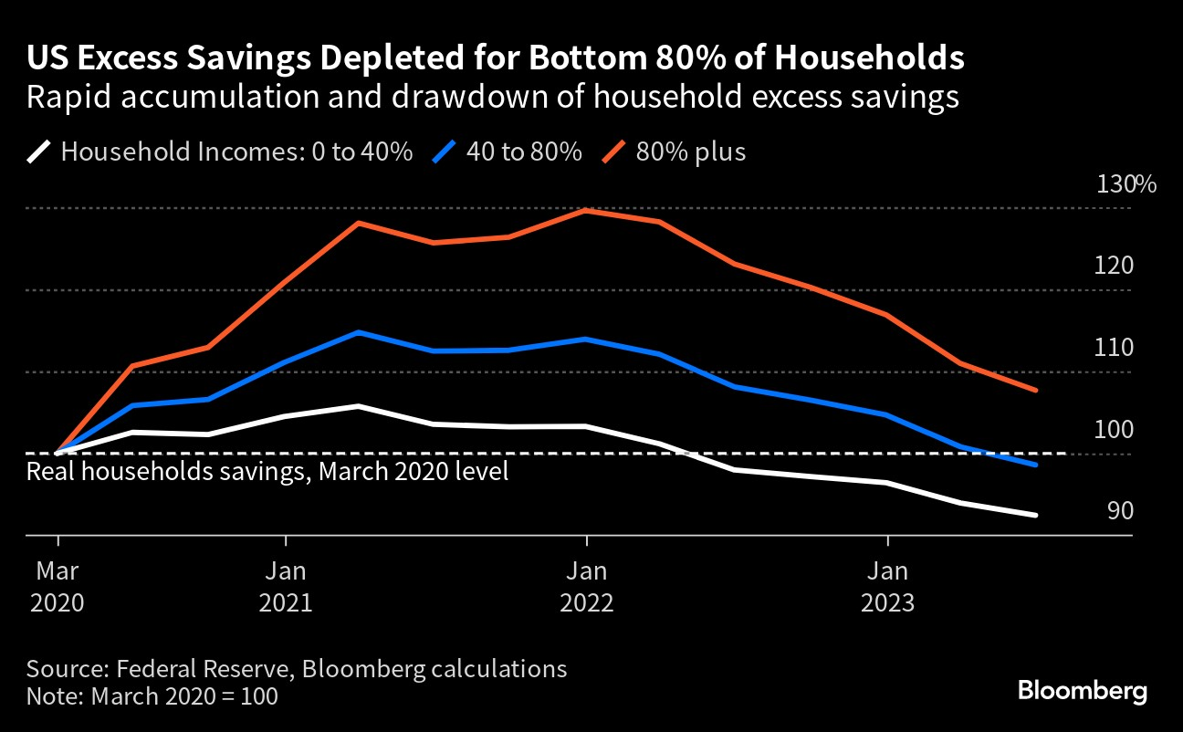
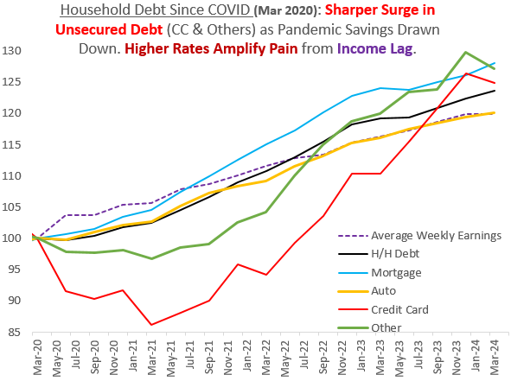
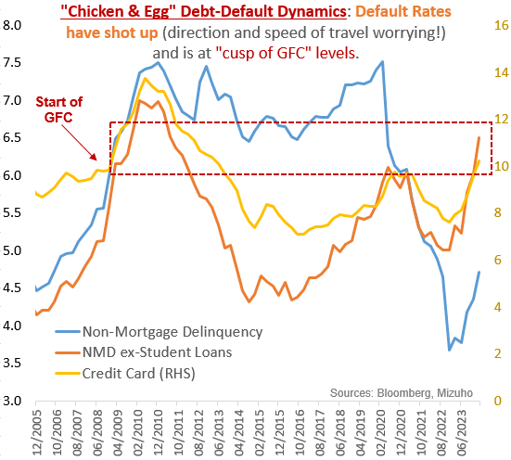
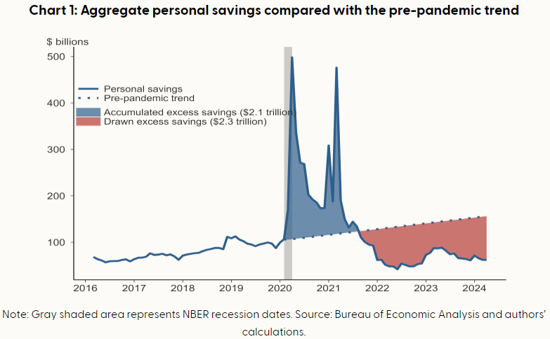
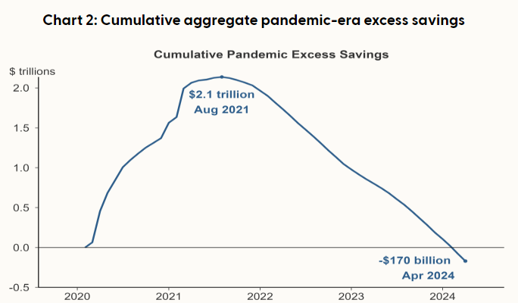
Consumer Tea Leaves Suggest Intensifying Cash-flow Constraints on Demand Growth
Chart from Bloomberg, San Francisco Fed,
Notes:
We continue to see signs of intensifying cash flow constraints on demand growth,
Households have continued to draw down on savingds
Shown you this top right hand side black chart in the past, we update for the latest data for the bottom right chart.
Household debt
Deb default levels have started to rise.
But it is not at GFC levels like what many US economists have pointed out.
In our view, this is a chicken and egg problem,
It is the GFC that caused the default and not the defaults which caused the GFC.
People were laid off during the crisis and therefore cannot pay their loans which is why delinquencies shot up.
As such, without a crisis now, certainly, it is not surprising that defaults rates are not at GFC levels.
However, we are at rates similar to pre-GFC.
And there delinquency rates are slightly higher.

Slide 9
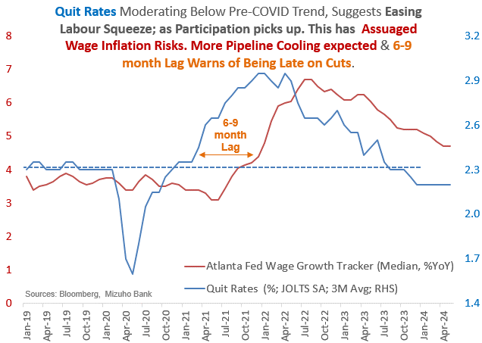
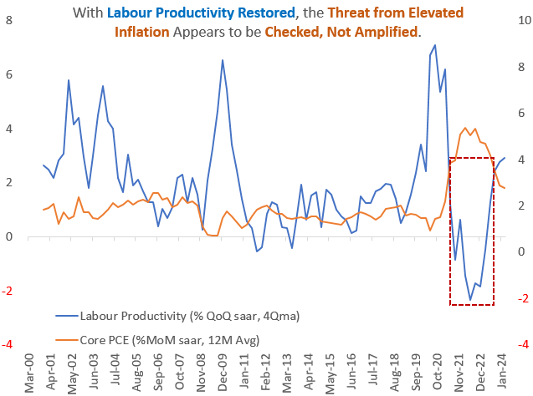
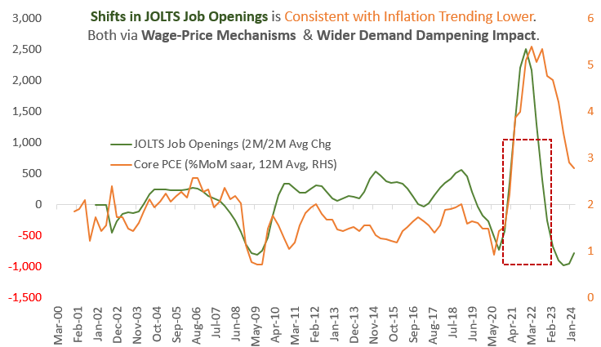
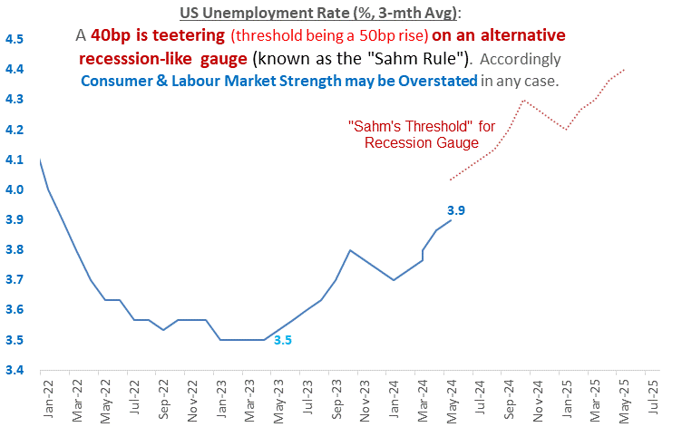
Significantly Diminished Wage-Price Risks May Augment Fed Response Function
Notes:
Aside from consuming from savings and debt, we also consume from wages.
Quite rates
Implication from productivity.
Job openings.

Slide 10
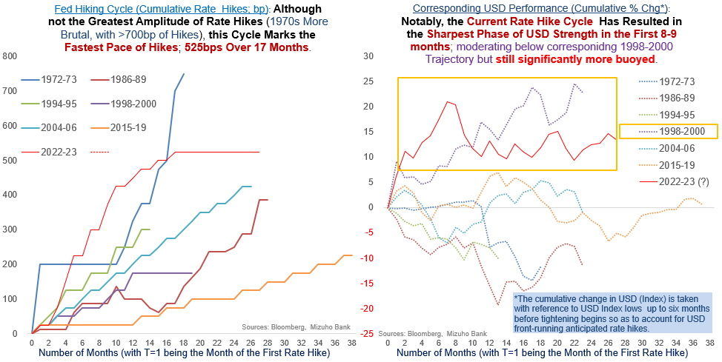
Policy Nuance: Not All Pivots are Created Equal! “Competitive Pivot”/US Exceptionalism
Notes:
How has the Fed responded? And how has the USD responded?

Slide 11
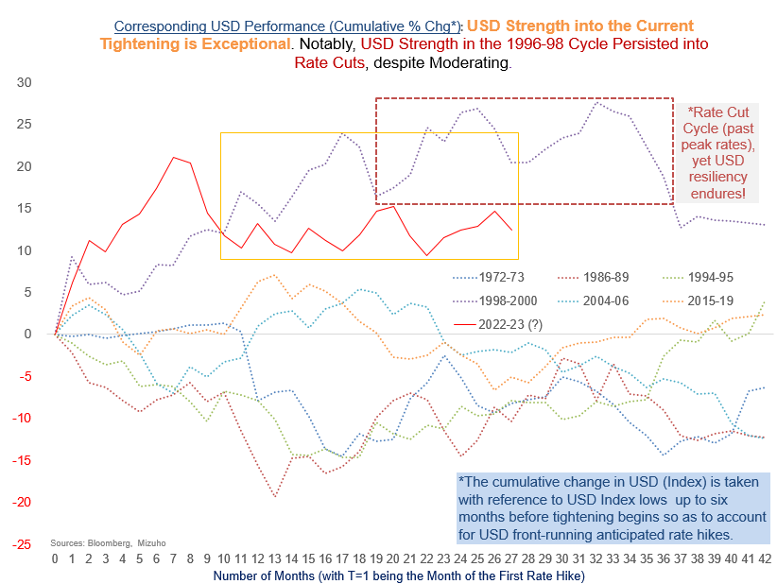
2a: Corresponding USD Response is Not the Usual “Peak USD ahead of Peak Fed”
Notes:
Current cycle is the solid line.

Slide 12
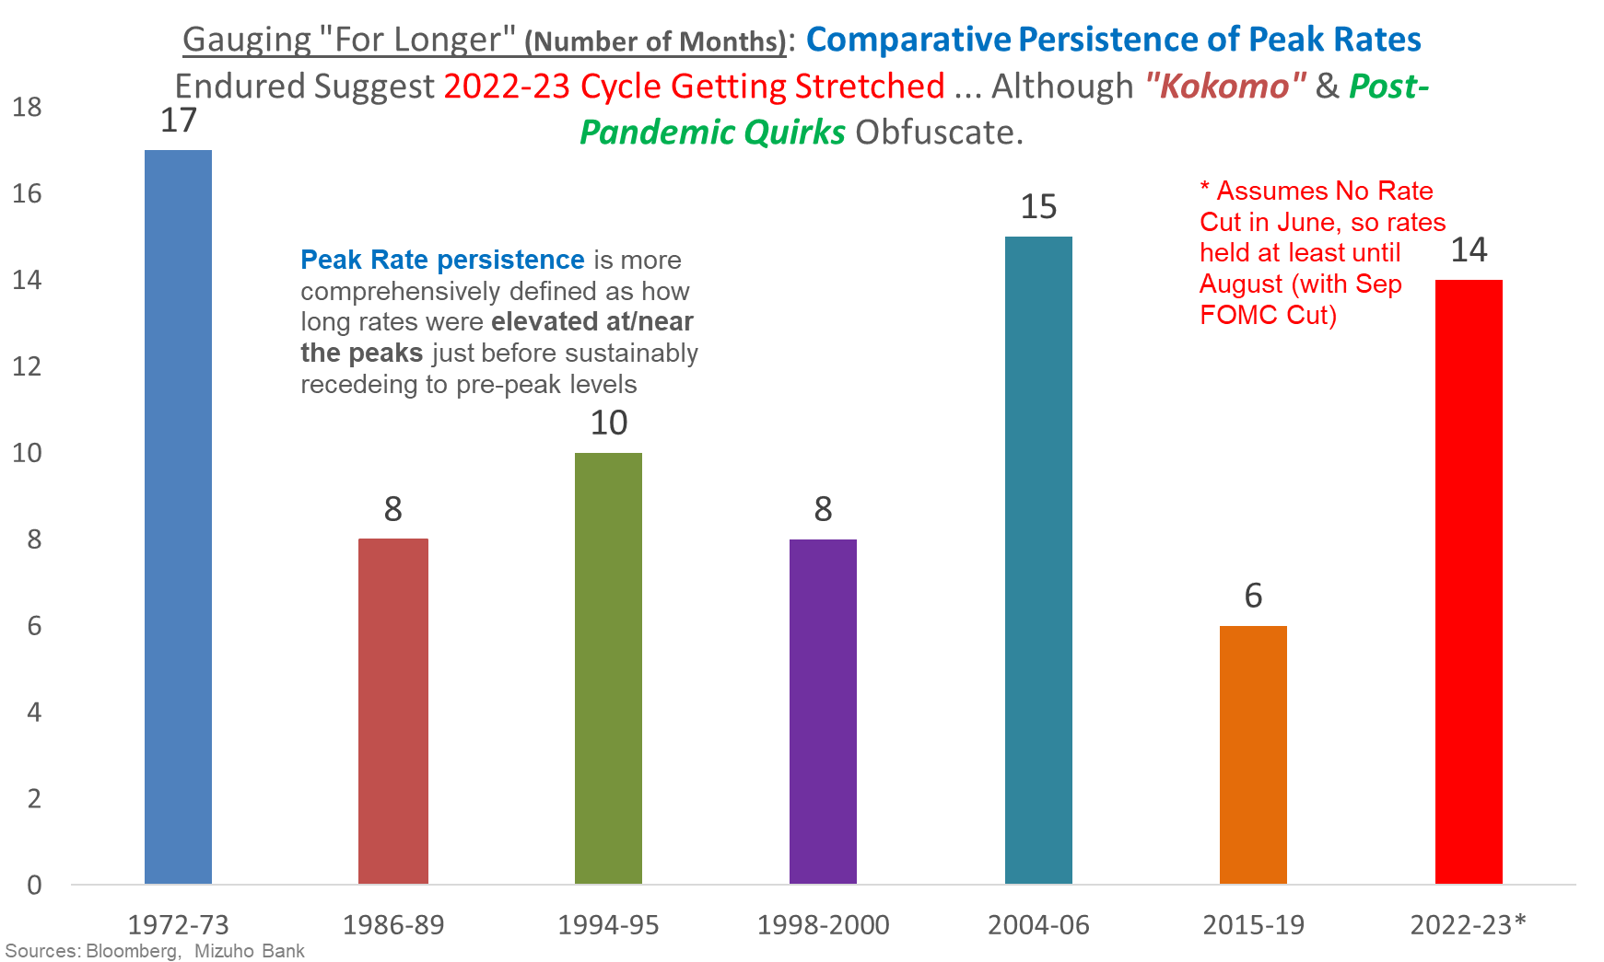
2b: Peak Persistence Increases Tail Risks on Both Ends – Fear & Fed Involved!
Notes:
Number of months of peak rates.

Slide 13
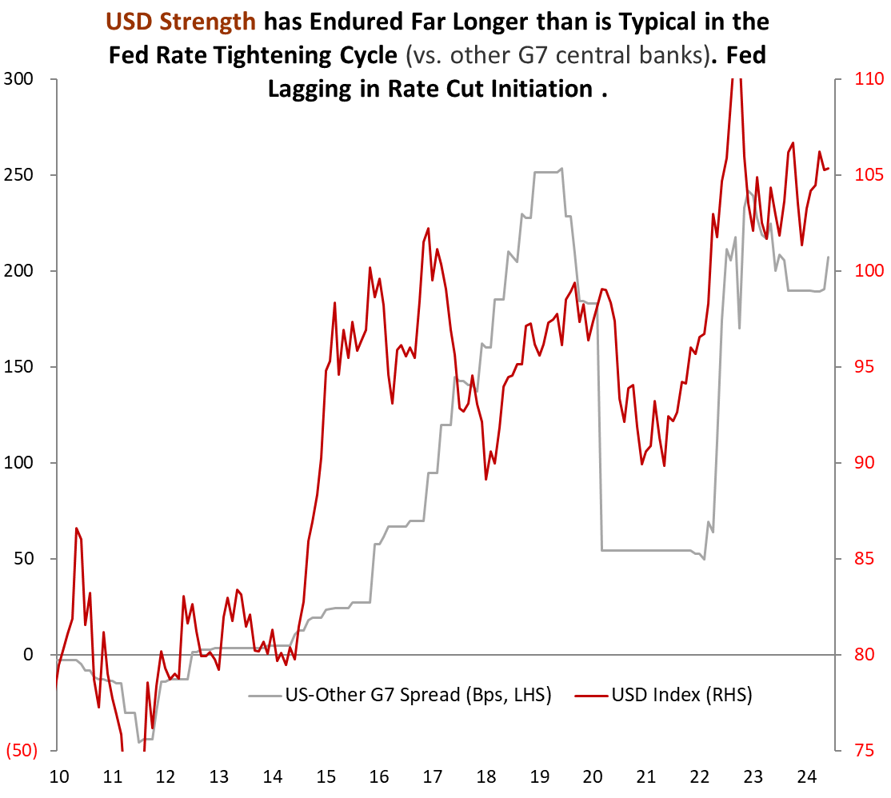
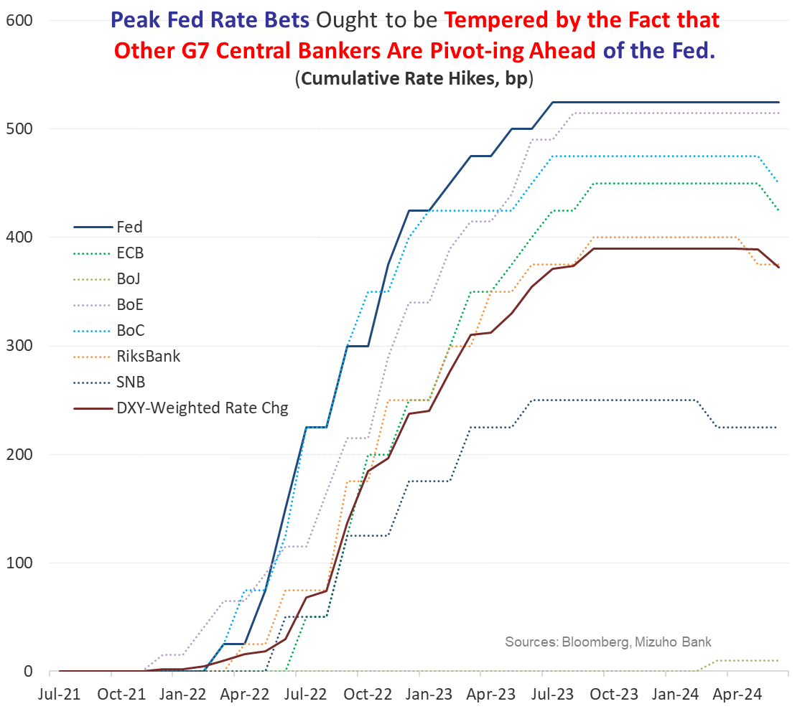
2c: Relative Rate Strength Understate “Competitive Pivot” Inclination Shifts

Slide 14
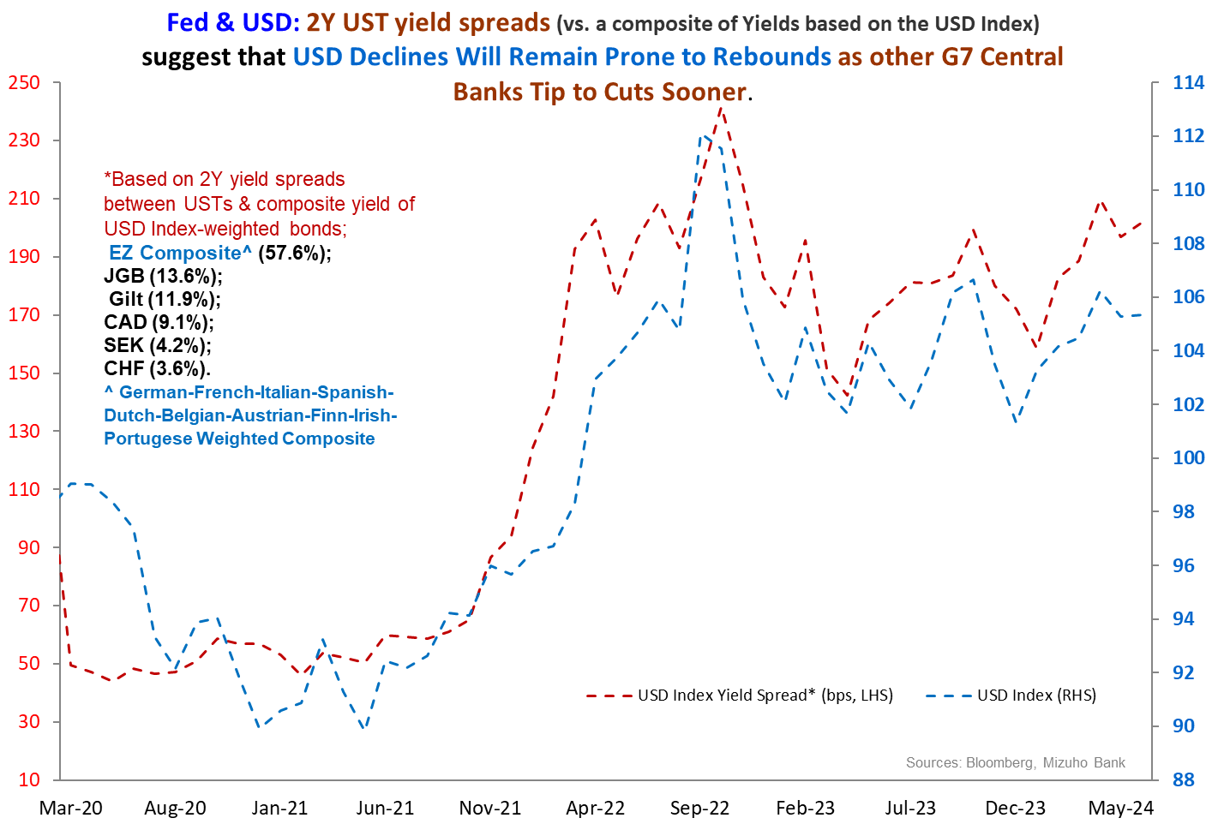
2c: Yield Spreads Better Capture the Tendency for USD Bounce .. At Least USD Resiliency

Slide 15
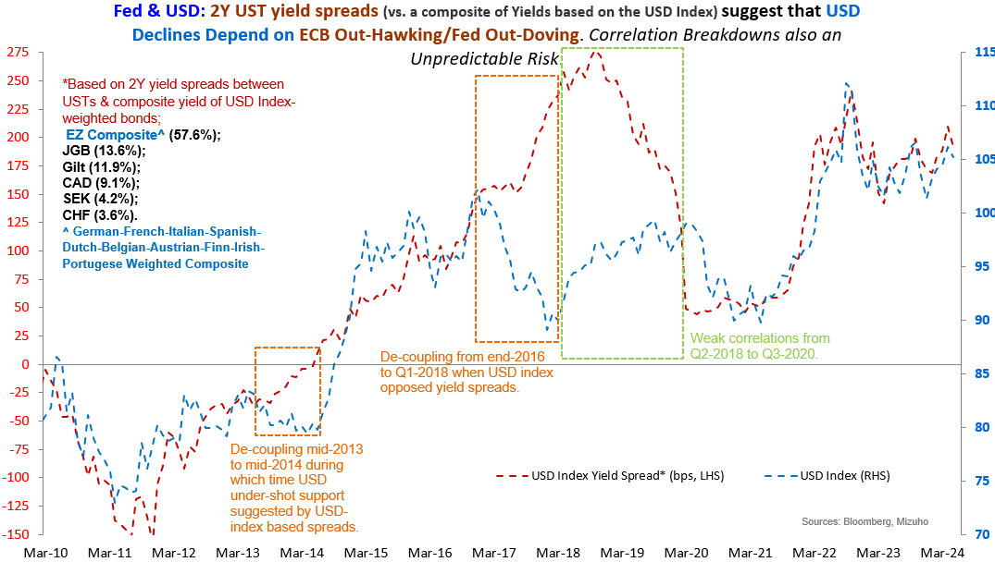
2c Caveat: Correlation Shifts & De-Coupling Cloud the Outlook!

Slide 16
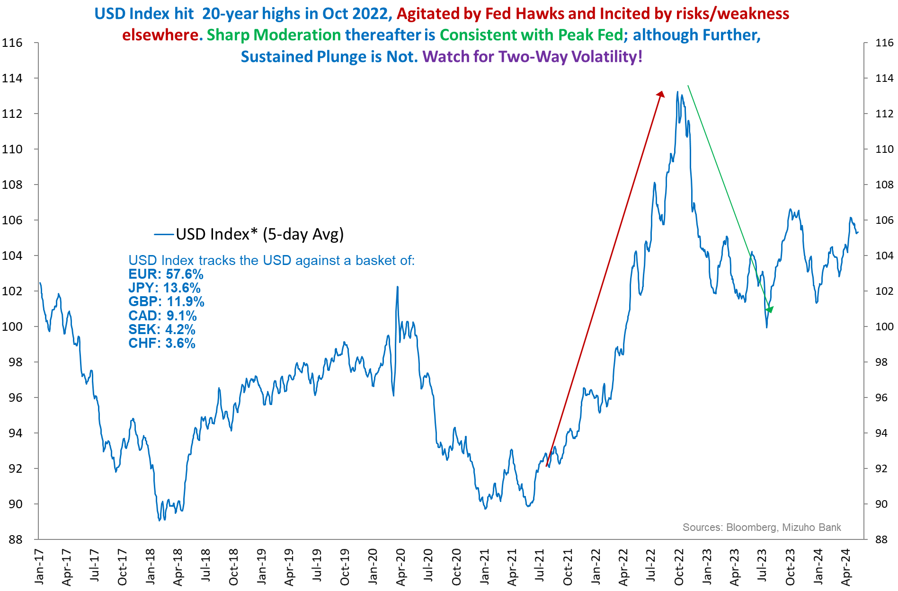
2d: Peak USD is Not the Same as a Bearish USD

Slide 17
3. Politics: Trump 2.0 (US Elections): Bracing for Geo-economic Blows
Weaker CNH, AXJ & MXN
Weaker EUR
Elevated Global Threats
Near-term USD Resilience
Trump 2.0
Trade (Tariffs)
Energy/Oil
Remove Restrictions
Impose Higher China/wider Tariffs!
Infrastructure [Fiscal]
Tax Cuts [Fiscal]
Ukraine [Conflict]
Gaza [Conflict]
Pull/Cut Aid
Uncertain Israel-Saudi Dynamics
Ramp-up Spending?
Extend Tax Cuts
Higher Inflation?
Tempers
Higher Yields
Higher Term Premium

Slide 18
Channels of “Dollar Trump”
Strong USD
FX Sentiments
ToT (OCF)
Investments (ICF)
Real Rate Spreads
Weak FX Elsewhere
Strong USD
Nominal Rate Spread
Inflation Spread
Price Effects
Volume Effects
Geo-political Leverage
Diplomatic Advantage
Risk Aversion
Fiscal-RC Lift in UST Yields
Energy Buffer
Trade Wars
Economic Advantage

Slide 19
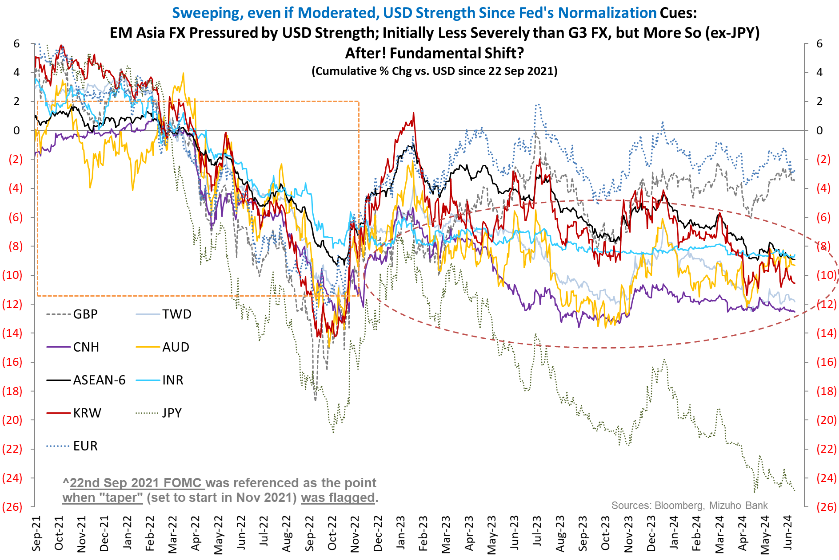
4a. Relative AXJ Under-performance is Worth Analyzing … Apart from Hysteresis Risks

Slide 20
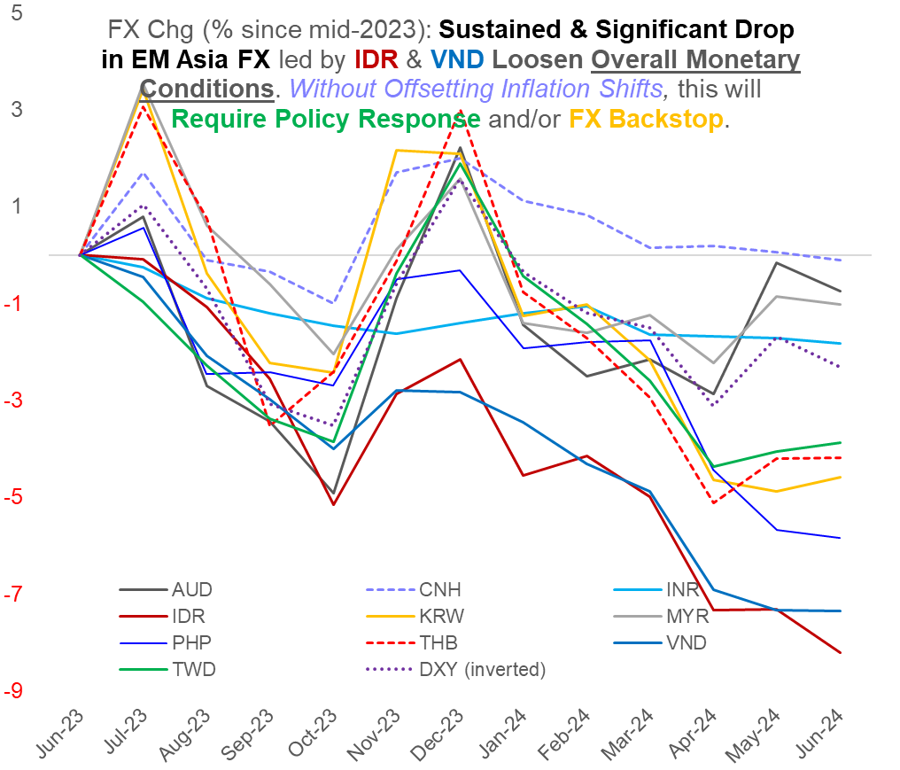
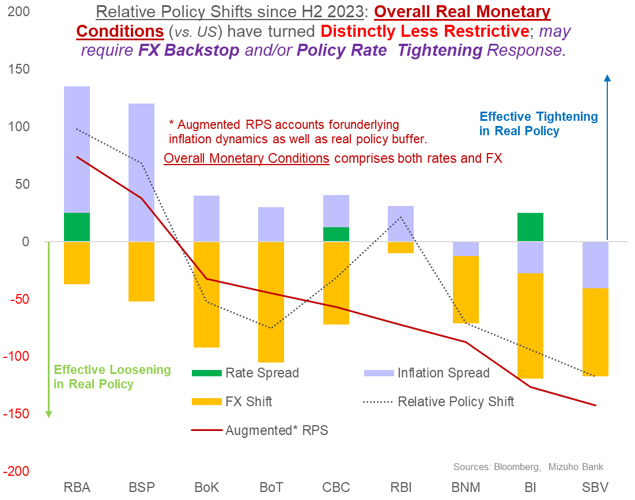
4b. EM Asia Erosion: … With FX Amplifying Circular/Reflexive Policy-FX Risks ➔ Reflexivity!

Slide 21
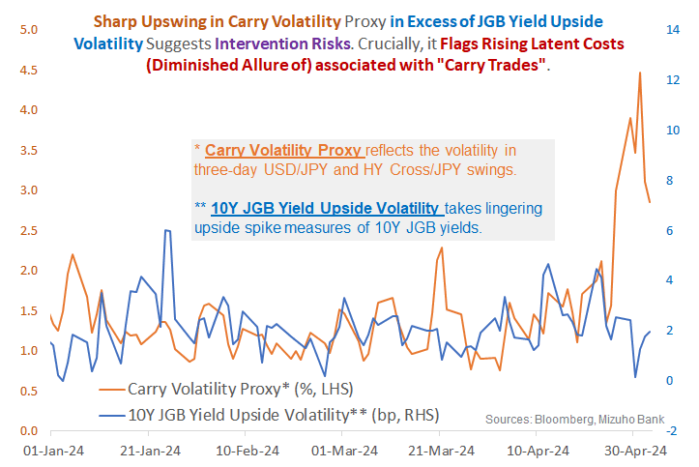
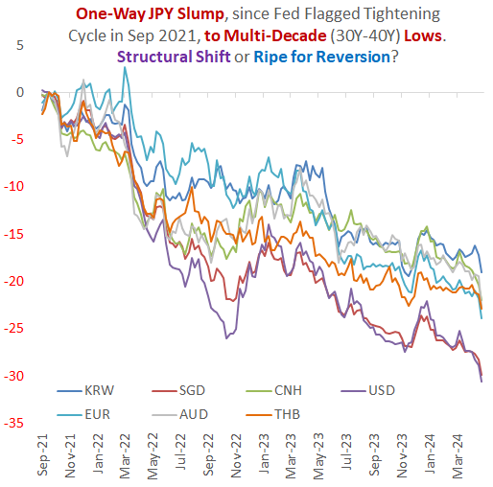
4c. Latent JPY (Upside) Volatility with “Carry (Unwind) Impact!
Mizuho Brief - JPY Intervention Risks" Of "Live" & Line
Vishnu Varathan SO Munisamy
to:
03/05/2024 07:30 am
This email (including all attachments) contain(s) information that is privileged and confidential. You are hereby notified that you are prohibited from disseminating, distributing, publicizing, copying or further disclosing in any manner any such information unless we specifically authorize you to do so. If you have received this email in error, please notify us immediately by return email and delete all copies from your system. Thank you.

Slide 22
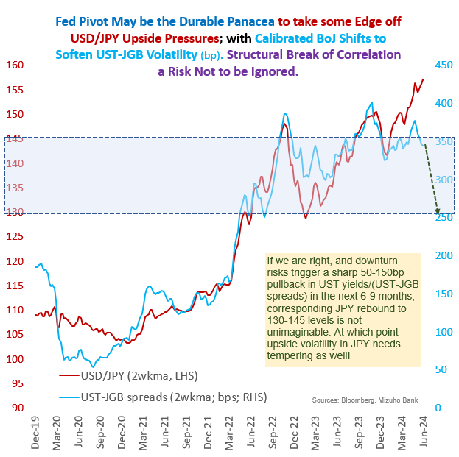
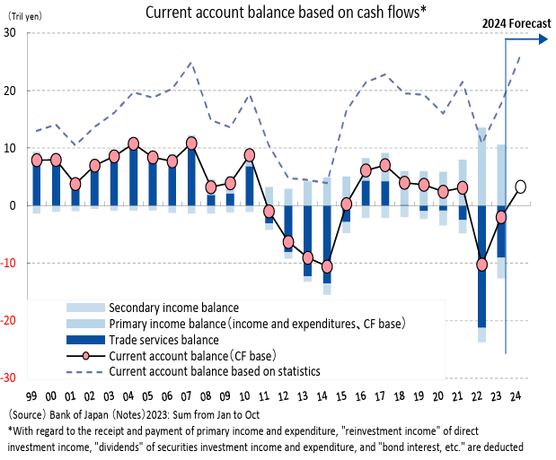
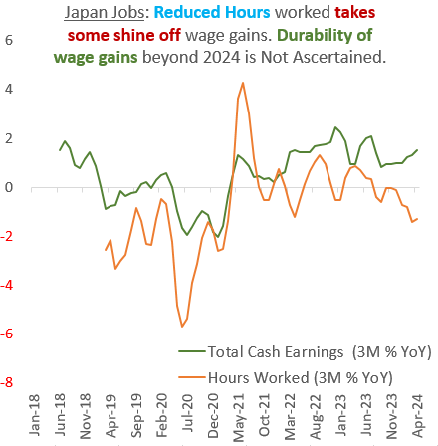
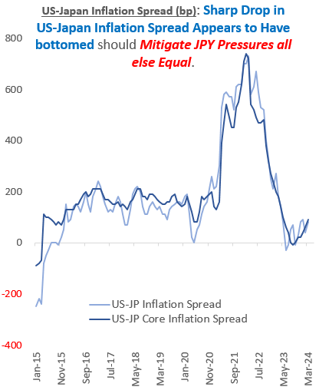
4c: Despite JPY Pressures (“BoJ Problem”), Sharp JPY Upside Introduces “Fed Solution”Risks

Slide 23
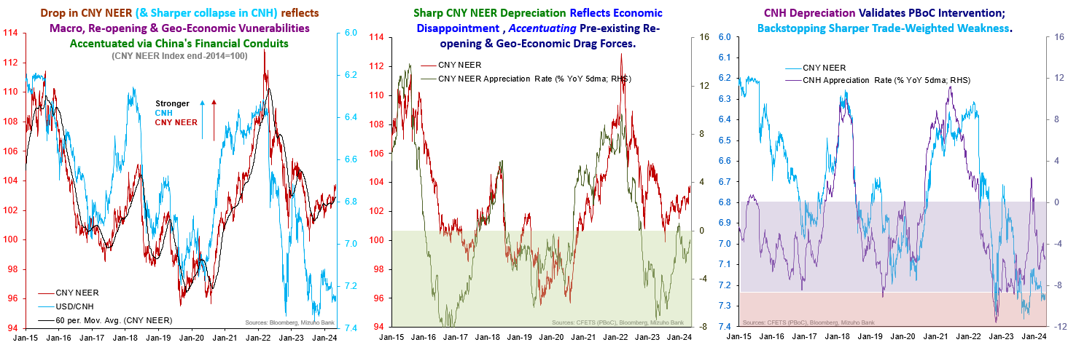
5a. China Factor: CNH is Still Not Out of the Woods & A Drag Factor!
Update
1.Property stimulus a good start but not the end to on-going problems.
Lower downpayments and lower mortgage rates.
Relending program (RMB 500b) at 1.75%
Pilot: 30% discount on home purchases, favourable interest rates between 2.8-3%, 80% loan to asset ratio and government subsidies
2. Squeeze on net Interest margins, tough price negotiations and weak household sentiments
3. ~31% YTD decline in home sales

Slide 24
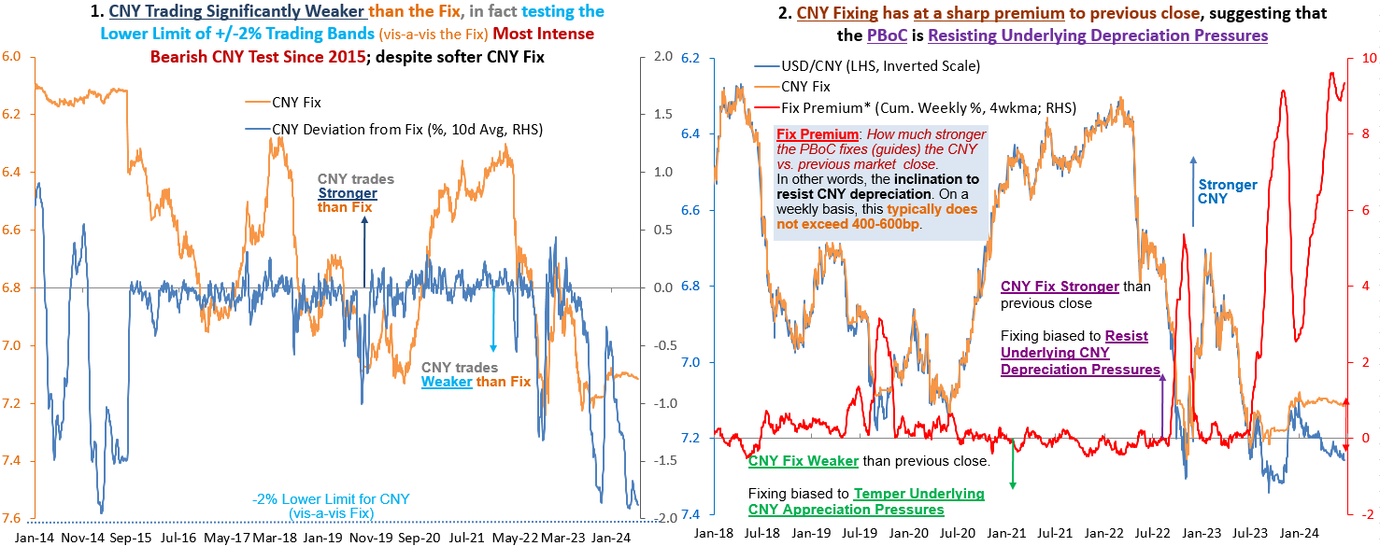
5b China Factor: PBoC Pressures – Respect, Not Trust
Notes:
Explain PboC fix.

Slide 25
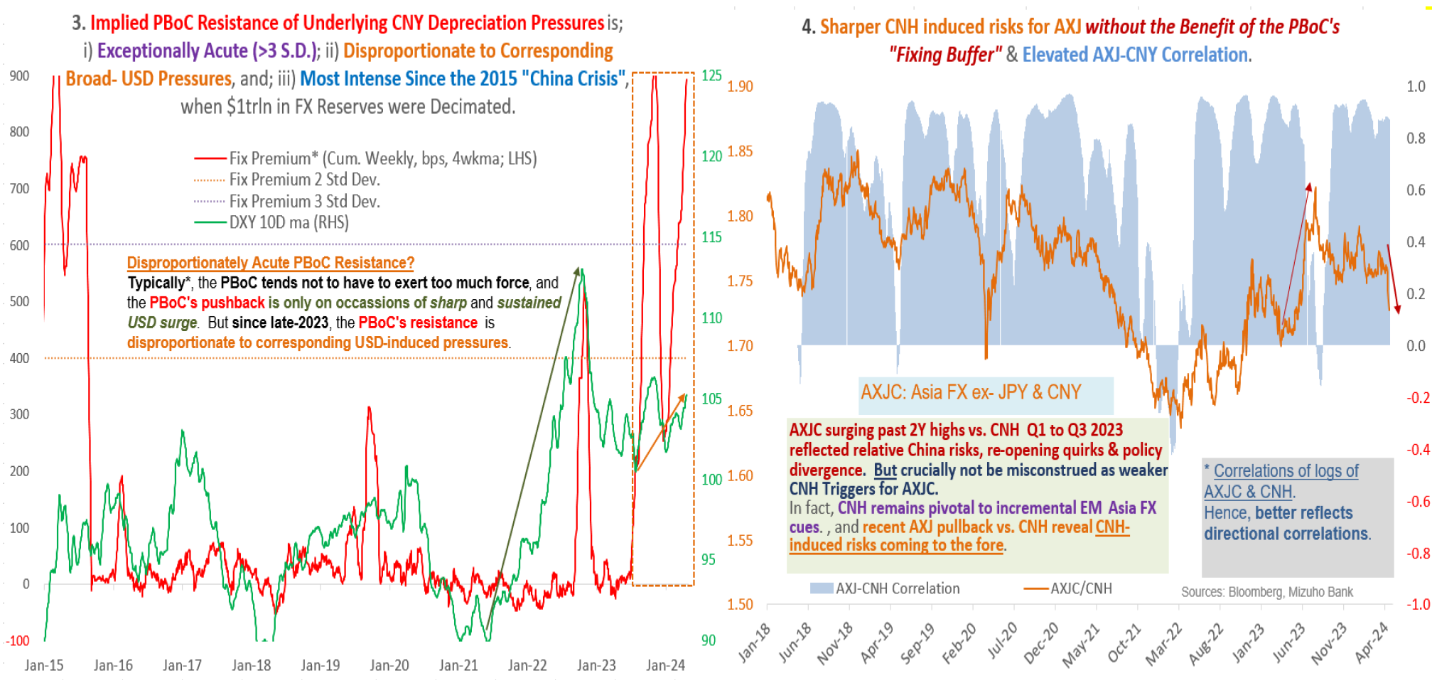
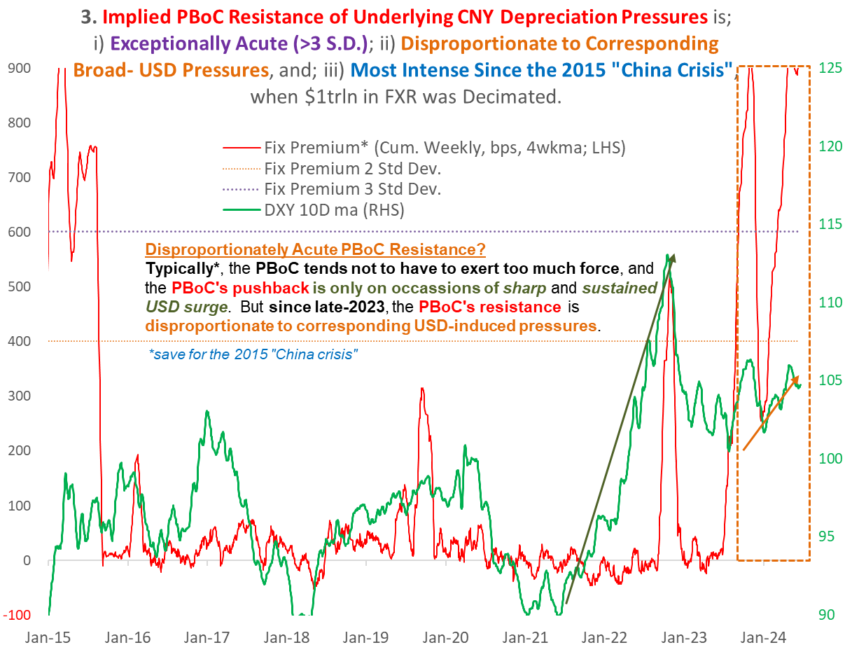
5b. China Factor: Disproportionate Pressures a Reflection of China-specific Risk (Spill-over)

Slide 26
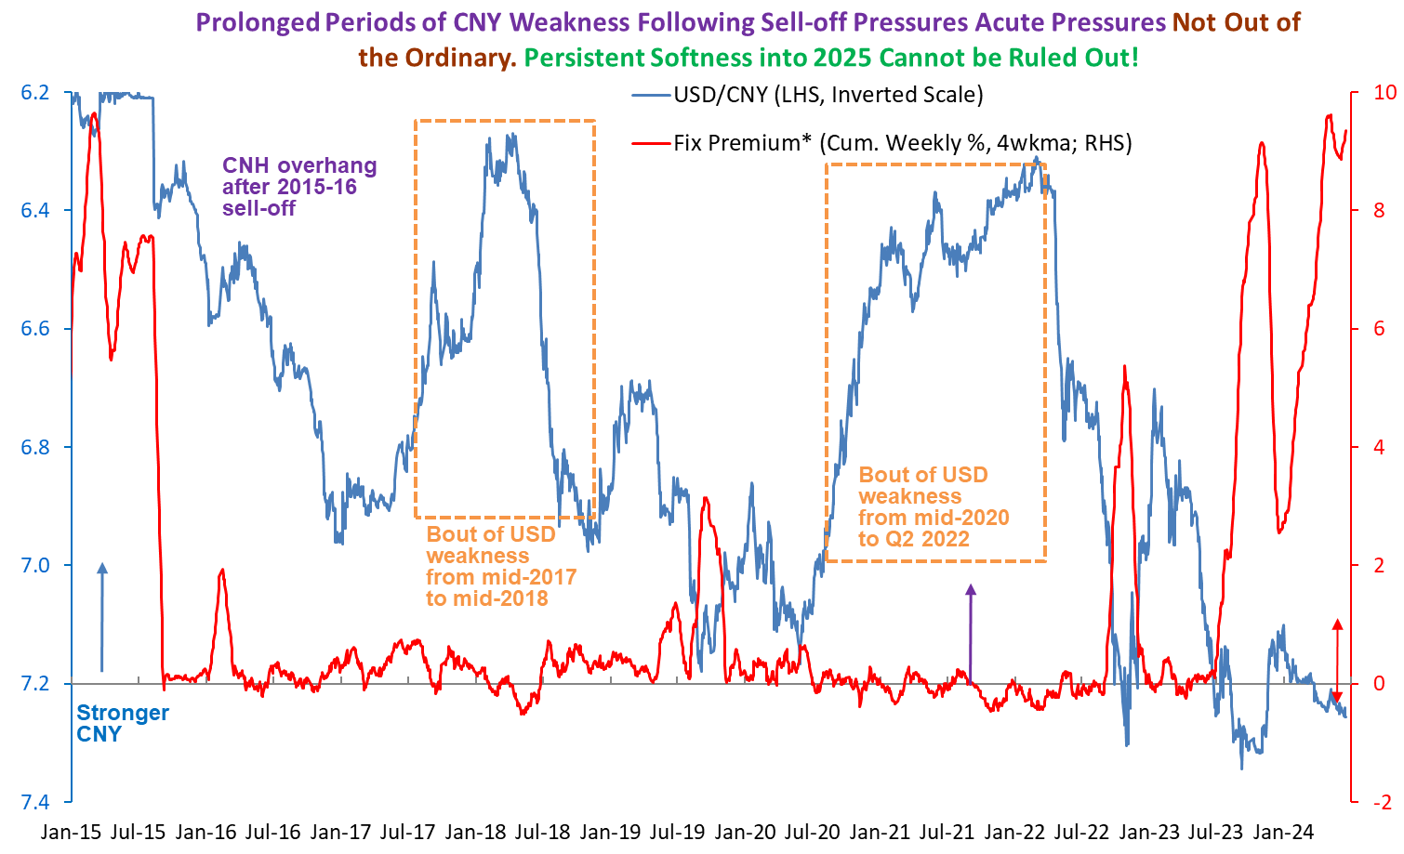
5c. China Factor: Disproportionate Pressures a Reflection of China-specific Risk (Spill-over)

Slide 27
EM-Asia
Photo Credits: Vector Stock
June 2024

Slide 28
Outline
ASEAN Focus: Re-examining How ASEAN Stocks Up Goods-Services Cycle – Between Exhaustion & Exploitation
  The Goods Upturn: Semi-Conductors the Bellwether for Exploiting a More Distinct and Defined Upturn?
  The Tourism Boost: Hitting Exhaustion with the Low-Hanging Big Gains?
  How ASEAN’s Fiscal Shifts Impact
Notes:
Hi everyone, today I will be talking about a special feature on ASEAN, re-examining how ASEAN-5, comprising Indonesia, Malaysia, Philippines, Thailand and Vietnam, are faring in the goods and services cycle.
In particular, I will be speaking on manufacturing and the tourism industry;
Before ending the presentation on how fiscal shifts fit in amid the good-services cycle.

Slide 29
Goods & Services Balance: Past vs Present
Notes:
First, it may be good to take stock of where we are at the moment
To get a sense of the current state of goods and services in ASEAN-5, we can plot the goods and services balance as a percentage of GDP, as shown in the top chart..
The blue columns indicate the goods balance while the orange columns indicate the services balance, and
a positive number generally will mean that a country is exporting more than it is buying from other countries, and vice versa.
We compare the 2023 goods and services balance against the 2016-2019 average, which we think is a more appropriate benchmark due to possible distortionary effects during the Covid years of 2020 and 2021.
From the top chart, we can make several observations –
The first is that goods balance have deteriorated for Malaysia, Thailand and Philippines, while Vietnam and Indonesia have seen improvement.
Although there are some idiosyncratic factors at play here.
For example, Vietnam had a huge import compression in 2023 which flattered the goods balance, while commodity prices were still coming down from the Covid-highs, supporting Indonesia’s goods balance.
Meanwhile, most services balances in 2023 are worse compared to 2016-2019 averages, with the exception of Philippines, which has outperformed.
Now that we have a better overview, the big question is –what lies ahead?
I will be stating the three key points that I want to make in this presentation upfront.
The first is that in 2024, broadly speaking, manufacturing will be a stronger driver compared to tourism-driven services growth given that there are signs of a global manufacturing inflection upturn, while the majority of the easy tourism gains are likely already enjoyed in 2023.
The second is that the extent of manufacturing growth would not be synchronized. This is especially so because this global manufacturing upturn is on the back of semiconductor-led growth, with some countries like Malaysia, Philippines and Vietnam, better-positioned to reap spillovers, as compared to Thailand which have more exposure in downstream goods like automotives and Indonesia with relatively less exposure to electronics and more exposure to commodity. Furthermore, manufacturing growth could also be pushed back by geopolitics.
For services, while growth would moderate, there is potential for laggards in 2023 like Thailand to outperform as they play catch-up.
The third is that in addition to external balances, fiscal outlook also plays a role. With the exception of Malaysia, fiscal outlook is tilted to the downside.
We will delve into the details in the subsequent slides.

Slide 30
Goods – Broadbased or Peculiar Drivers?
Notes:
Let us first start off with manufacturing.
The left chart shows manufacturing growth in real terms for ASEAN-5 economies while the right chart shows manufacturing growth in Northeast Asia.
Note that both charts have the same scale.
We can see that manufacturing growth in ASEAN-5 economies have been much more uneven compared to Northeast Asia.
Compared to South Korea and Taiwan, which have seen a material uptick in manufacturing growth, Thailand manufacturing remains in contraction territory, although we do see some modest improvement to Philippines, Malaysia and Vietnam, as indicated by the blue line and dark grey line.
In contrast, Indonesia’s manufacturing growth have been pretty stable in the recent quarters.
This suggests that manufacturing growth in this cycle is likely driven by peculiar drivers, instead of a broadbased growth in demand for manufactured goods, as we saw during the Covid years, where demand for manufactured goods have generally seen a sharp increase across the board.

Slide 31
Goods – Composition of South Korea and Taiwan’s Manufacturing Industry
Notes:
To understand the key drivers, we take a look at the industrial production growth for the top 3 products which constitute the largest manufacturing share in South Korea and Taiwan,
For South Korea, electronic components indicated by the green line and which constitutes a whopping 26% of manufacturing industry, has visibly outperformed other product groups.
Similarly, over in Taiwan, we can also see robust growth in electronic components.
This suggests the this manufacturing upturn is mostly driven by an increase in demand of electronic components, and in particular semiconductors.
++++
Notes: Taiwan – Fabricated Metals (5.1%); Electronic Parts (49.6%) and Computers (7.0%).

Slide 32
Goods – Drivers of Semiconductor Growth
Notes:
Zooming in further, there has been a notable increase in external demand, suggesting improved demand.
This is on top of a rundown in inventory, which we see in the left chart, which suggests that demand has been outpacing production.
What is driving this demand then?
And would this upturn in semiconductors be because of the AI-drive that we read in the news?

Slide 33
Goods – External Drivers
Notes:
Given all the AI-hype in the news of American companies, let us take a look at US imports of semiconductors first, which is subsumed under HS Code 85) and indicated by the red line.
We notice that US imports of semiconductors haven’t been exactly that strong.
However, US demand for automatic data processing machines (which is subsumed under HS Code 84) saw stronger growth.
It thus appears that US demand is stronger for final products like computers and servers, instead of intermediate products like semiconductors.
Although demand for computers and servers would also indirectly drive demand for semiconductors, it is unlikely to drive such a huge increase in demand.
So where is the demand coming from?
China.
Taking a look at the right chart, China’s imports of electrical machinery and equipment (of which semiconductors are a sub-category) from Taiwan and South Korea have accelerated.
We think that the increased in demand from China is driven by their own industrial needs;
But pat of the increase in demand could also in part be incentivized by front loading, due to the various US trade restrictions resulting in the need to source for alternate sources of chips.
For example, American companies prohibited from selling high-end chips to China.
This need to stockpile and front is perhaps exacerbated by the upcoming US elections and a possibility that the already fraught geo-political relations could worsen, while supply chain resiliency and domestic production needs remain priorities.
Understanding the drivers of growth would help us frame our thinking surround the strength of recovery and outlook for this manufacturing cycle.

Slide 34
Goods – Strength of Recovery
’19-’21: Differentiated, widespread demand for electronics and related products during pandemic
‘16-’18: Advent of cloud based computing, virtual drives etc.
Notes:
The left chart shows the rolling 3 month average of semiconductor shipments worldwide, and we can broadly see that the semiconductor have a cycle in every 4-5 years, although the strength differs.
2012 to 2014 appears to be more of a typical business cycle;
while a stronger recovery in 2016-2018 was arguably supported by the advent of cloud based computing, virtual drives and gdrives.
Meanwhile, the strength of the cycle in 2019-2021 is underpinned by differentiated, widespread demand for electronics and related products during pandemic.
We don’t think the strength of this cycle would be as strong as 2019-2021 cycle,
Because compared to the 2019-2021 cycle where there was widespread demand for electronic products, this cycle have thus far appeared to be more focused towards semiconductors and AI-complementary products, and could have more could have more limited spillovers to other electronic goods.
This would thus be more similar to the 2016-2018 cycle where the upturn is concentrated to a specific segment.
While we have not yet seen the peak of the this cycle, it could be near.
While strong demand for computers and servers could provide some support, frontloaded demand from China could mean that it could fizzle out in coming quarters.
This could also mean that further outsized growth in demand from China may not be that durable.
Afterall, China’s weak consumer sentiments and tepid economic recovery ought to restrain optimism surrounding an unfettered boom for the electronics.
But this is not to say that the upturn will drastically deteriorate.
Afterall, the need to replenish inventories could also mean that the cycle would be more prolonged.
So demand for semiconductors could remain strong into late 2024 and early 2025.
As to the spillovers to ASEAN, one crude measure could be to look at the net exports revenue of electrical machinery & equipment, as it takes away part of the imports cost given that semiconductor is quite a long value chain.
Based on this alone, Malaysia, Philippines and Vietnam looks more well-positioned to benefit from this trade upcycle, as compared to Thailand and Indonesia.

Slide 35
Goods –Spillovers to ASEAN
 | Top Electrical machinery and Equipment Exports
Malaysia | Electronic integrated circuits (5.6%) Disc, tapes, solid-state devices (1.8%) Diodes, transistors, similar semiconductor devices (1.4%)
Philippines | Electronic integrated circuits (11.6%) Insulated wire, cable etc. (1.7%) Electric transformers, static converters (1.1%)
Vietnam | Telephone sets (14.4%) Monitors and projectors (1.3%) Transmission apparatus (1.1%)
Thailand | Transmission apparatus (0.4%) Electric transformers, static converts (0.3%)
 | Others Vehicles, other than rail (8.0%) Rubber and articles thereof (6.1%) Nuclear reactors, boilers etc. (5.5%)
Indonesia | Monitors and projectors (0.6%) Insulated wire, cable (0.2%)
 | Others Animal or vegetable fats (14.0%) Mineral fuels, mineral oils (7.0%) Iron and steel (3.9%)
Source: UNComtrade (2021), Mizuho
Notes:
Let us take a deeper look at the top electrical machinery and equipment exports, Malaysia and Philippines have a significant proportion of exports in electronics.
Malaysia, Philippines has a material presence in the semiconductor cycle, but do not follow the semiconductor cycle as smoothly as Taiwan and Korea, especially in recent years.
For example in Philippines, there could be a considerable lag, and this could be due to Philippines more downstream role in the semiconductor value chain, being active in assembly and packaging.
Meanwhile, Malaysia’s production appears to be more smoothened out, and this could be due to diverse product offerings within the electrical machinery and equipment sector which sees varying recovery.
Meanwhile, Vietnam trails as gains are likely from downstream use of chips in consumer goods.
Meanwhile, Thailand’s spillovers would be somewhat diminished by the high semiconductor import reliance for downstream use, such as in autoos.
But Indonesia may be poised to benefit the least given relatively lower electronics activity exposure.

Slide 36
The Tourism Boost: People vs Dollars
Notes:
Now, turning over to tourism.
When thinking about tourism, we not only want to know whether the tourists are coming back, but also whether the tourist dollars are coming back.
So in this top chat, the green columns show the 2023 recovery in absolute tourists arrival numbers against 2019, which we use as a benchmark for pre-covid tourist volumes.
Across the region, recovery has on average recovered about say 60-70%, with Indonesia and Malaysia outperforming.
But what is more important is whether the tourist dollars are coming back with the tourists.
Because if tourist expenditures recover more than tourist arrivals, this would be a plus for an economy because it would mean more tourism revenues generated on a similar number of tourists.
Conversely, a shortfall in tourist expenditures would mean that less tourism revenues are generated on a similar number of tourists; and this could mean that higher-spending tourists are simply not coming back.
The red dots indicate the recovery in tourist dollars in local currency terms, while the blue dots indicate the recovery in tourist dollars in USD terms.
The difference in the red dot and blue dot is because we are comparing 2023 numbers against 2019 numbers, and there will be FX translate gains and losses when we convert into USD terms.
So in the bottom chat, the blue column shows the shortfall in tourist expenditures vs arrivals attributed to FX, while the black dot shows the net shortfall in expenditures.
We see all ASEAN-5 have FX translation losses, which means that on average, local currency is weaker in 2023 compared to 2019.
We also note that Philippines, Vietnam and Indonesia have a net expenditure excess;
And this is perhaps understandable because inflation would tend to mean that even for the same item, a tourist would spend more in local currency terms in 2023 compared to 2019.
For Malaysia, FX losses have offset any increment in excess expenditures.
And finally, Thailand is the worst performer out of the pack, as it sees an expenditure shortfall, which means that money simply isn’t coming in even as tourists are coming into the country.

Slide 37
Tourism: The Last-Mile Tourist Dollar
 | Where are the Tourists?
Thailand | Lagging in recovery of higher spending Chinese tourists could mean more catch-up in coming quarters amid a permanent visa-free travel from March 2024. Visa free travel from India starting June.
Malaysia | Surge in day tourists from neighboring countries on weaker MYR could have inflate arrivals recovery but less impact on revenue recovery could mean more scope for further recovery. Scope for outperformance on recovery in Chinese tourists is much more limited.
Philippines | Indications that efforts to attract Middle East tourists are paying off. Albeit constituting a small proportion, could boost tourism dollars. But stringent visa requirements could mean Chinese tourists recovery will be lackluster.
Indonesia | Tourism recovery still supportive, but no notable indications for outperformance.
Vietnam | Stellar performance in 2023 on the back of early launch of visa exemption program in August 2023 Better performance in 2023 could mean moderating growth in 2024.
Notes:
To get a sense of why this may be so, we can look at the differentiated recovery by different segments of tourists, as shown in the bottom chart.
One possible reason explain Thailand’s lackluster recovery is the relatively benign recovery of Chinese tourists to Thailand, as compared to Indonesia and Malaysia, yet accounting for a larger proportion of tourists arrivals.
This is because based on 2019 data, Chinese tourists also have the highest daily expenditure compared to other segments.
But does this mean that looking forward, room for catch-up would be larger?
We think there will be a room for catch-up, but it may not be a spectacular one, insofar as even with the Chinese tourists coming back, the tourism dollars may not be as much as in the past given weaker sentiments.
For Malaysia, we think that the situation is not as bad as Thailand.
Although ASEAN tourists recovery on the whole is not as good, within ASEAN recovery of Singapore tourists and Indonesia tourists have been great.
We think that the weaker MYR relative to MYR and IDR in 2023 could have driven more tourists to Malaysia.
In particular, an increase in day tourists from Singapore would artificially inflate tourism numbers without doing as much for revenues.
Next, based on the previous chart, Philippines have outperformed the pack. We think Philippines outperformance thus far is on the back of successful efforts to attract Middle East tourists – these would be a higher-spending tourist segment even if they constitute a small proportion.
The key for Philippines could be dependent on whether there is a relaxation of visa requirements, which is currently the most stringent among ASEAN-5 economies, necessitating manual application of visas, compared to visa-free arrangements for Malaysia, Thailand and Indonesia and eVisa for Vietnam..
Meanwhile, Indonesia and Vietnam do not have any notable indications for outperformance.
All said, tourism recovery is expected to continue, and services balance approaching 2016-2019 averages.
++++
Vietnam: Since August 2023, Vietnam has introduced e-visas for all nationalities, extended maximum stays from 30 to 90 days, and allowed unlimited entries. Additionally, those benefitting from Vietnam’s unilateral visa exemption policy can now stay for 45 days, up from previous 15.

Slide 38
Goods & Services Balance: Past vs Present
Mfg boost;
Services slump
All Engines Firing
Sputtering Growth
Services boost;
Mfg slump
Notes:
This is a chart showing the goods and services balance.
The dot indicates the 2016-2019 averages, the diamond indicates the 2023 levels, while the square indicates our forecast for 2024.
The top right quadrants means that both goods and services balances are in surplus, and we can see that Thailand has deteriorated the most.
Although tourism inflows would continue, it may be more subdued compared to 2016-2019 because we expect Chinese tourists, even if they return, to spend less; and services balance on a whole also include income flows which has seasonal deficits that offset services receipts.
Malaysia, represented by orange, is arguably moving closest to pre-pandemic average and see an improvement in both goods and services balance.
For Vietnam, in blue, while we expect an improvement to services balance, we think that the goods balance might deteriorate given the large import compression seen in 2023, which we think will revert in 2024.
Indonesia, in green, would also be weighed down by limited spillovers from the semiconductor-led manufacturing growth, while soft commodity prices suppress the goods balance.
Meanwhile, Philippines, in purple should see an improvement in services balance, while manufacturing improves but not as much, given their large import expenditures, and we expect higher imports to alleviate food shortages in in Philippines on poor harvests.

Slide 39
The Fiscal Situation
Historical Budget Deficits (as % of GDP) and Fiscal Trajectory
 | ‘16-’19 Avg | 2022 | 2023 | 2024E | Fiscal Trajectory
ID | 2.3% | 2.4% | 1.7% | 2.8% | Expected to be maintained within 3% of GDP ceiling.
MY | 3.3% | 5.6% | 5.0% | 4.3% | Target at 3.5% of GDP for 2024-2026 under Medium Term Fiscal Framework
PH | 2.7% | 7.3% | 6.2% | 5.6% | Target to reach 3.7% of GDP by 2028.
TH | 2.8% | 3.5% | 3.3% | 3.6% | 2025 budget deficit widen to 4.4% on digital wallet plans.
VN | 2.9% | 4.4% | 4.1% | 3.6% | 2021-2025 National Financial Plan targets fiscal deficit at 3.7% of GDP.
Source: CEIC; National Authorities; Mizuho
Notes:
Next, moving on to fiscal positions.
Fiscal positions of ASEAN economies generally improved in 2023, buoyed by continued economic recovery.
ASEAN-5 economies are also still on the road towards fiscal consolidation after higher spending during Covid.
Although the pace differs.
But one thing to note is that, ASEAN-5 economies are broadly in a worse state, in terms of external balances compared to 2016 to 2019.
We can see this in the bottom chart.
Thailand has turned from a surplus position to a deficit position while Philippines twin deficit has exacerbated to very large extent.
For Vietnam and Malaysia, positions have also deteriorated, although not as bad as Philippines and Thailand.
Indonesia is the only economy which has shown an improvement, but commodity exposure is likely to mean a return to a larger deficit with downside risks to fiscal spending.
+++
The recovery of domestic demand and employment amid high inflation environment generally boosted revenue collection, while the stabilization of oil prices moderated resource-based revenue in commodity-exporting countries.

Slide 40
Fiscal Standing Assessment
 | Notable Revenue Measures | Notable Expenditure Measures | Assessment
Malaysia | Introduction of capital gains tax Increase in services tax (eff 1 Mar 2024) | Reduction in diesel subsidies (eff 10 Jun 2024) | Concrete actions undertaken thus far provide confidence on government’s commitment towards fiscal sustainability.
Vietnam | Extended VAT rate cut ((from 10% to 8% introduced in early 2022) from Jul 2023 to Jun 2024, after a brief rate reversal in early 2023. | Public investments likely to continue to struggle to hit targets, though land law reforms should aid better disbursements | Continued VAT rate cut extension likely but no imminent fiscal worries. Risks remain on ensuring financial sector stability.
Philippines | Many tax reforms pending, including Digital Services Tax Bill, Mining Fiscal Regime | Continuation of current programmes, target 5-6% of GDP yearly on infrastructure. National government’s spending performance for 2023 surpassed target by 2.1%. | Slow-to-consolidate fiscal deficits amid slow progress on revenue measures.
Indonesia | Scrap VAT of 11% on home purchases worth less than IDR2bn until Jun 2024, after which it will be halved for an unspecified time. | Free lunch programs and other welfare measures (likely rolled out end 2024/2025) expected to cost IDR460tn, more than the entire 2023 budget deficit. | Albeit still within 3% GDP ceiling, higher fiscal expenditures on campaign pledges cast an overhang; uncertainty over debt outlook incites worries.
Thailand | VAT reduction from 10% to 7% (from Covid) extended till Sep 2024. | Digital wallet plans expected to cost THB500bn (~3% of GDP). | 2025 budget deficit widen to 4.4% on digital wallet plans. Public debt path may come dangerously close to legal ceiling in the next 2-3 years.
Notes:
This table details notable revenue and expenditure measures in ASEAN-5, ranked in accordance to how we view each economy’s fiscal outlook.
We think that Malaysia is the bright spot because it has undertaken concrete actions towards fiscal sustainability, in particular on the subsidy rationalization programme.
We are neutral towards Vietnam as we do not see any imminent fiscal worries.
For Philippines, we are concerned as the fiscal deficit is slow to consolidate with little progress evidenced.
Meanwhile, for Indonesia, despite good progress, the incoming administration risks large expenditures and could see a loss in investors’ confidence built up over the years.
Notably, we have seen episodes of the rupiah selling off on fiscal woes, and just last week, the USDIDR broke 16300 levels after Prabowo’s intention to increase debt-to-GDP to ratio to 50% was revealed.
We rank Thailand below Indonesia because of significant fiscal expenditures, particularly on the digital wallets, and this is on top of their already poor-er fiscal position relative to Indonesia.
Philippines
Mar 6: DOF said the revised proposal for the Rationalisation of the Mining Fiscal Regime proposes to impose a four-tier, margin-based royalty ranging from 1.5% to 5% on income from mining operations outside of mineral reservations. https://www.pna.gov.ph/articles/1220204
May 17: Drafts the Senate is looking at a five-tier structure with lower minimum rates for both the windfall profit tax (WPT) and the margin-based royalty, compared to the earlier proposal of the DOF that pitched a four-tier approach with higher starting rates. https://www.philstar.com/business/2024/05/13/2354575/proposed-mining-fiscal-regime-taking-shape
https://neda.gov.ph/dbcc-joint-statement-review-of-the-medium-term-macroeconomic-assumptions-and-fiscal-program-for-fy-2024-to-2028-april-4-2024/
Reforms to Mining Fiscal Regime (pending), Reform on the Motor Vehicle Users’ Charge (MVUC)
VAT on non-resident Digital Service Providers, Imposition of Excise Tax on Single-use Plastics; Tax reforms (CTRP)
Digital Services Tax Bill imposes a 12% VAT on transactions of digital services providers such as online auction hosts, subscription-based services, e-learning and marketing services.
Enhancing the Fiscal Regime for the Mining Industry seeks to limit interest expense deduction of metallic mining contractors, imposes a royalty rate on large-sale metallic mining operations…
Create More seeks to address uncertainty over the implementation of VAT and tax administration provisions of the CREATE Act. It mandates the simplified VAT refund system, clarifies VAT regime for registered business enterprises.

Slide 41
External and Fiscal
Net Goods & Services Boost; Wide Fiscal Deficit
Net Goods & Services Slump; Wide Fiscal Deficit
Notes:
With that, we come to the final chart of this presentation.
In this chart, we add up the goods and services to get one balance, and plot it against the fiscal balance.
Indonesia, represented by green, is the only economy that has shown some improvement in both fiscal balances and goods & services balance.
However, the outlook for its fiscal balance is not as rosy with some heavy expenditures expected with the incoming government.
Vietnam has also shown some improvement, although it is set back by a larger fiscal deficit.
While Malaysia’s fiscal balance is bad, outlook is more positive given concrete actions taken on subsidy rationalization and increase in fiscal revenues.
Thailand and Philippines are poor performers.
Comparing against 2023 against 2016 to 2019, Philippines fiscal balance has deteriorated the most significantly.
While Thailand’s have been suffering from a contracting goods & services balance.
Digital wallet plans also threaten to widen the fiscal deficit.
So based on fiscal positioning and goods and services balance alone, Malaysia is arguably poised to lead the pack and could outperform in currency gains in coming quarters, followed by Vietnam and Philippines.
Indonesia and Thailand would be dragged by the wider fiscal deficit, but that Thailand’s fiscal overhang should have been largely priced in could mean that looking forward, the IDR could be the underperformer.

Slide 42
Disclaimer
Important Information
This publication has been prepared by Mizuho Bank, Ltd. (“Mizuho”) and represents the views of the author. It has not been prepared by an independent research department and it has not been prepared in accordance with legal requirements in any country or jurisdiction designed to promote the independence of investment research and is not subject to any prohibition on dealing ahead of the dissemination of investment research.
Disclaimer
Unless otherwise stated, all views or opinions herein are solely those of the author(s) as of the date of this publication and are not to be relied upon as authoritative or taken in substitution for the exercise of judgement by any recipient, and are subject to change without notice.
This publication has been prepared by Mizuho solely from publicly available information. Information contained herein and the data underlying it have been obtained from, or based upon, sources believed by us to be reliable, but no assurance can be given that the information, data or any computations based thereon are accurate or complete. This publication provides general background information only. It is information in summary form and does not purport to be complete. This publication has been prepared for information purposes only and is not intended by Mizuho or its affiliates to constitute investment, legal, accounting, tax or other advice of any kind and all recipients of this publication are advised to contact independent advisors in order to evaluate the publication, including, without limitation, the suitability of any security, commodity, futures contract or instrument or related derivative (hereinafter, a “financial instrument”), product or strategy herein described. This publication is not intended to be relied upon as advice to investors or potential investors and does not take into account investment objectives, financial situation or needs of any particular investor. It is not intended for persons who are Retail Clients within the meaning of the United Kingdom’s Financial Conduct Authority rules nor for persons who are restricted in accordance with US, Japanese, Singapore or any other applicable securities laws.
This publication has been prepared for information purposes only and is not intended by Mizuho to market any financial instrument, product or service or serve as a recommendation to take or refrain from taking any particular course of action or participate in any trading or other strategy. This publication is not an offer to buy or sell or a solicitation of any offer to buy or sell any security or any of the assets, businesses or undertakings described herein, or any other financial instrument, nor is it an offer to participate in any trading or other strategy, nor a disclosure document under applicable laws, rules, regulations or guidelines. Nothing contained herein is in any way intended by Mizuho or its affiliates to offer, solicit and/or market any financial instrument, product or service, or to act as any inducement to enter into any contract or commitment whatsoever. Neither the author, Mizuho nor any affiliate accepts any liability whatsoever with respect to the use of this publication or its contents or for any errors or omissions herein.
Mizuho and its affiliates, connected companies, employees or clients may take the other side of any order by you, enter into transactions contrary to any recommendations contained herein or have positions or make markets or act as principal or agent in transactions in any securities mentioned herein or derivative transactions relating thereto or perform or seek financial or advisory services for the issuers of those securities or financial instruments.
All of the information contained in this publication is subject to further modification without prior notice and any and all opinions, forecasts, projections or forward-looking statements contained herein shall not be relied upon as facts nor relied upon as any indication of future results. Opinions stated in this publication are subject to change without notice. Future results may materially vary from such opinions, forecasts, projections or forward-looking statements. The information contained in this publication may not be current due to, among other things, changes in the financial markets or economic environment. Mizuho has no obligation to update any information contained in this publication. Past performance is not indicative of future performance.
This is a strictly privileged and confidential publication. This publication contains information addressed only to a specific individual and is not intended for distribution to, or use by, any person other than the named addressee or any person or entity in any jurisdiction or country where such distribution or use would be contrary to law or regulation. Save with Mizuho’s prior written consent, you may not disclose, divulge, reproduce or furnish any information contained herein to any other party. Please notify the sender immediately if you have mistakenly received this publication.
Singapore: Mizuho is licensed as a bank under the Banking Act (Chapter 19) of Singapore, and is regulated by the Monetary Authority of Singapore.
Japan: Mizuho is authorised and regulated by the Financial Services Agency of Japan.
United Kingdom / European Economic Area: In the UK, Mizuho is authorised by the Prudential Regulation Authority and subject to regulation by the Financial Conduct Authority and limited regulation by the Prudential Regulation Authority. Details about the extent of MHBK's regulation by the Prudential Regulation Authority are available upon request. This publication may also be distributed by Mizuho International plc (“MHI”). MHI is authorised by the Prudential Regulation Authority and regulated by the Financial Conduct Authority and the Prudential Regulation Authority.
United States: This publication is not a “research report” as defined in Commodity Futures Trading Commission (“CFTC”) Regulations 1.71 and 23.605. The content of publications distributed by Mizuho Securities USA Inc. (“MSUSA”) is the responsibility of MSUSA. The content of publications distributed directly to US customers by Mizuho is the responsibility of Mizuho. US investors must effect any order for a security that is the subject of this report through MSUSA.
© 2014 Mizuho Bank Ltd.

Slide 43
Appendix: Ascertaining Spillovers from Value-Chain positioning
To work on
Notes:
To do so, one angle is to estimate the relative value chain positioning in the semiconductor cycle.
However, inventory replenishment would see more limited spillovers to ASEAN.
Conversely, demand for end products could have more spillovers to ASEAN.
followed by Malaysia, given relatively upstream exposures, while Philippines benefit to a lesser extent.
Vietnam trails as gains are likely to be from downstream use of chips in consumer goods.
+++
Malaysia’s strength on the semiconductor manufacturing supply chain lies in packaging, assembling and testing, and it has a global market share of 13% in semiconductor packaging and testing. The Malaysian government has already set a target of increasing its market share to 15% by 2030. Penang, the centre of Malaysia’s semiconductor sector, has ana rea of 1,049 square kilometres – 40% bigger than Singapore. Several of the world’s biggest chip makers including Intel and Micron from the US, nfineon from Germany, have set up bases there.
Philippines’s strength are in assembly, test and packaging.
Vietnam primarily participates in the final phases of semiconductor production, focusing on assembly, testing and packaging. This role, while crucial, represents the lower-value end of the supply chain.

Slide 44
Appendix: Goods – Limited Tailwinds for Others
Thailand
Indonesia
Notes:
However, Indonesia and Thailand appears to have less to gain from electronics cycle upturn.
Thailand gains may be somewhat diminished by the high semiconductor import reliance for downstream use (e.g. autos).
While Indonesia would likely enjoy limited spillovers given relatively lower electronics activity exposure.
Instead, growth in the future will likely be dependent on investment inflows from downstreaming policies as well as commodity exports.

Slide 45
Appdendix: Tourism: Hitting Exhaustion with the Low-Hanging Big Gains?

Slide 46
Appendix: Tourism: The Chinese Tourists
Visa Requirements for Chinese Tourists
Destination | Visa Requirements
Thailand | Visa-Free (eff 25 Sep 2023)
Malaysia | Visa-Free (eff 1 Dec 2023)
Singapore | Visa-Free (eff 9 Feb 2024)
South Korea | Visa-free to Jeju or if transitting to certain destinations only.
Vietnam | eVisa; Visa-free for Phu Quoc only
Philippines | Apply Visa at consulate following suspension of eVisa on 30 Nov 2023
Japan | eVisa
Source: Government agencies; various news outlets; Mizuho

Slide 47
Disclaimer
Important Information
This publication has been prepared by Mizuho Bank, Ltd. (“Mizuho”) and represents the views of the author. It has not been prepared by an independent research department and it has not been prepared in accordance with legal requirements in any country or jurisdiction designed to promote the independence of investment research and is not subject to any prohibition on dealing ahead of the dissemination of investment research.
Disclaimer
Unless otherwise stated, all views or opinions herein are solely those of the author(s) as of the date of this publication and are not to be relied upon as authoritative or taken in substitution for the exercise of judgement by any recipient, and are subject to change without notice.
This publication has been prepared by Mizuho solely from publicly available information. Information contained herein and the data underlying it have been obtained from, or based upon, sources believed by us to be reliable, but no assurance can be given that the information, data or any computations based thereon are accurate or complete. This publication provides general background information only. It is information in summary form and does not purport to be complete. This publication has been prepared for information purposes only and is not intended by Mizuho or its affiliates to constitute investment, legal, accounting, tax or other advice of any kind and all recipients of this publication are advised to contact independent advisors in order to evaluate the publication, including, without limitation, the suitability of any security, commodity, futures contract or instrument or related derivative (hereinafter, a “financial instrument”), product or strategy herein described. This publication is not intended to be relied upon as advice to investors or potential investors and does not take into account investment objectives, financial situation or needs of any particular investor. It is not intended for persons who are Retail Clients within the meaning of the United Kingdom’s Financial Conduct Authority rules nor for persons who are restricted in accordance with US, Japanese, Singapore or any other applicable securities laws.
This publication has been prepared for information purposes only and is not intended by Mizuho to market any financial instrument, product or service or serve as a recommendation to take or refrain from taking any particular course of action or participate in any trading or other strategy. This publication is not an offer to buy or sell or a solicitation of any offer to buy or sell any security or any of the assets, businesses or undertakings described herein, or any other financial instrument, nor is it an offer to participate in any trading or other strategy, nor a disclosure document under applicable laws, rules, regulations or guidelines. Nothing contained herein is in any way intended by Mizuho or its affiliates to offer, solicit and/or market any financial instrument, product or service, or to act as any inducement to enter into any contract or commitment whatsoever. Neither the author, Mizuho nor any affiliate accepts any liability whatsoever with respect to the use of this publication or its contents or for any errors or omissions herein.
Mizuho and its affiliates, connected companies, employees or clients may take the other side of any order by you, enter into transactions contrary to any recommendations contained herein or have positions or make markets or act as principal or agent in transactions in any securities mentioned herein or derivative transactions relating thereto or perform or seek financial or advisory services for the issuers of those securities or financial instruments.
All of the information contained in this publication is subject to further modification without prior notice and any and all opinions, forecasts, projections or forward-looking statements contained herein shall not be relied upon as facts nor relied upon as any indication of future results. Opinions stated in this publication are subject to change without notice. Future results may materially vary from such opinions, forecasts, projections or forward-looking statements. The information contained in this publication may not be current due to, among other things, changes in the financial markets or economic environment. Mizuho has no obligation to update any information contained in this publication. Past performance is not indicative of future performance.
This is a strictly privileged and confidential publication. This publication contains information addressed only to a specific individual and is not intended for distribution to, or use by, any person other than the named addressee or any person or entity in any jurisdiction or country where such distribution or use would be contrary to law or regulation. Save with Mizuho’s prior written consent, you may not disclose, divulge, reproduce or furnish any information contained herein to any other party. Please notify the sender immediately if you have mistakenly received this publication.
Singapore: Mizuho is licensed as a bank under the Banking Act (Chapter 19) of Singapore, and is regulated by the Monetary Authority of Singapore.
Japan: Mizuho is authorised and regulated by the Financial Services Agency of Japan.
United Kingdom / European Economic Area: In the UK, Mizuho is authorised by the Prudential Regulation Authority and subject to regulation by the Financial Conduct Authority and limited regulation by the Prudential Regulation Authority. Details about the extent of MHBK's regulation by the Prudential Regulation Authority are available upon request. This publication may also be distributed by Mizuho International plc (“MHI”). MHI is authorised by the Prudential Regulation Authority and regulated by the Financial Conduct Authority and the Prudential Regulation Authority.
United States: This publication is not a “research report” as defined in Commodity Futures Trading Commission (“CFTC”) Regulations 1.71 and 23.605. The content of publications distributed by Mizuho Securities USA Inc. (“MSUSA”) is the responsibility of MSUSA. The content of publications distributed directly to US customers by Mizuho is the responsibility of Mizuho. US investors must effect any order for a security that is the subject of this report through MSUSA.
© 2014 Mizuho Bank Ltd.

Slide 48
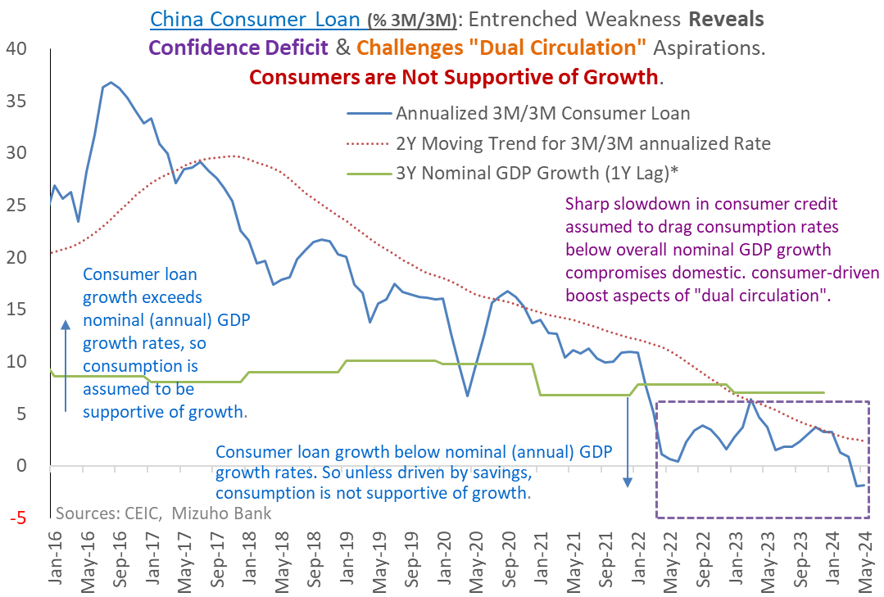
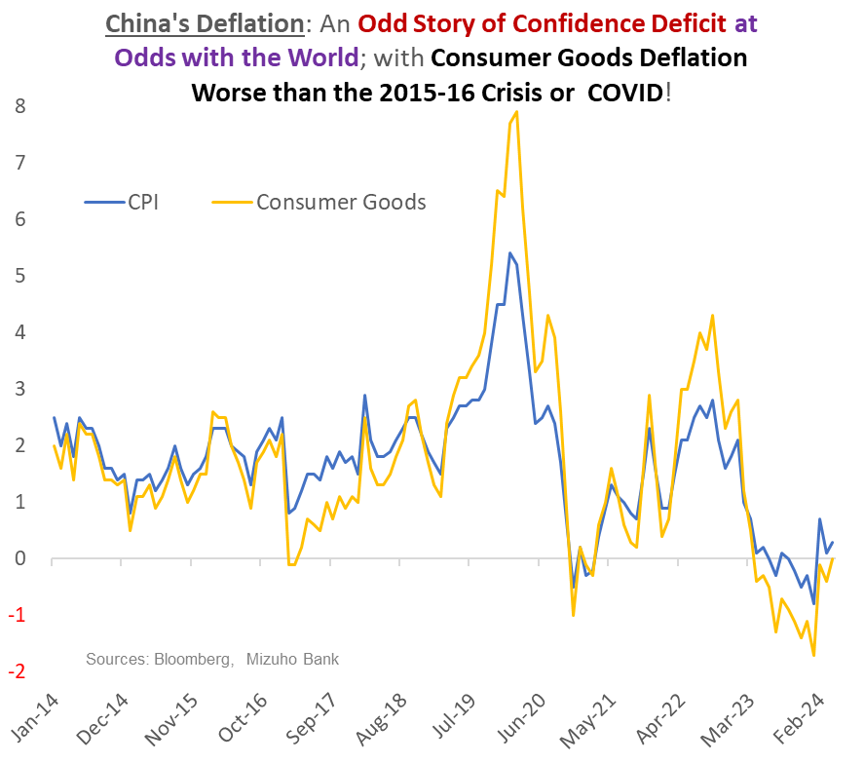
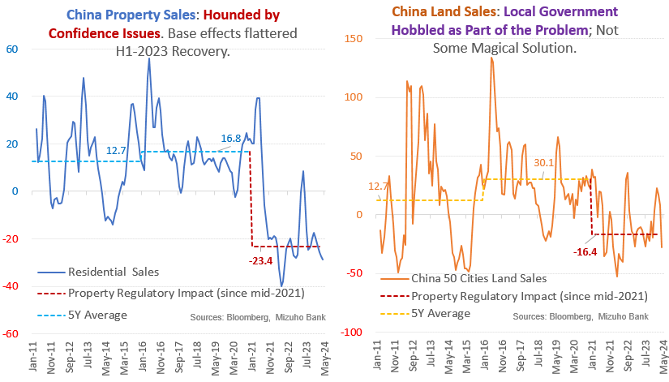
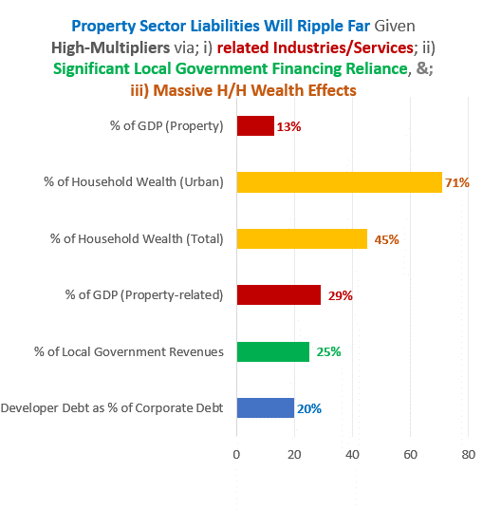
Appendix: China Consumer Confidence Impaired

Slide 49
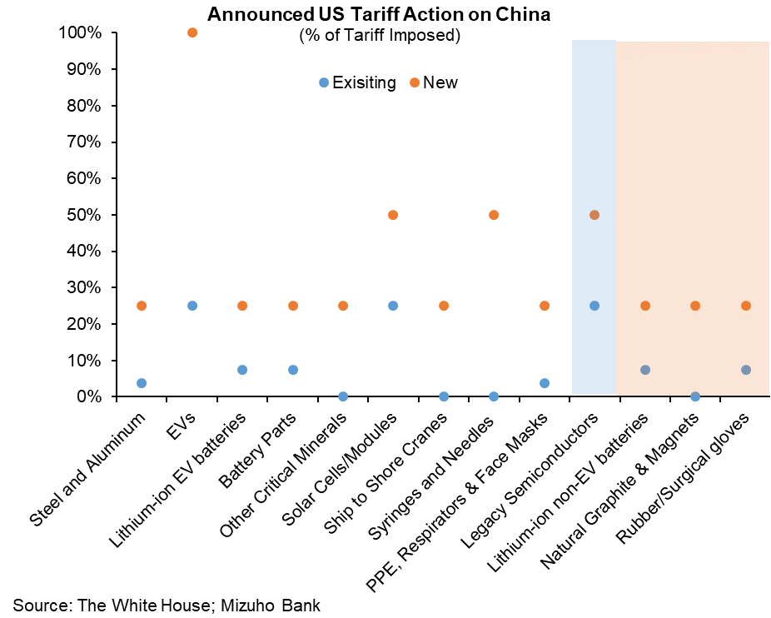
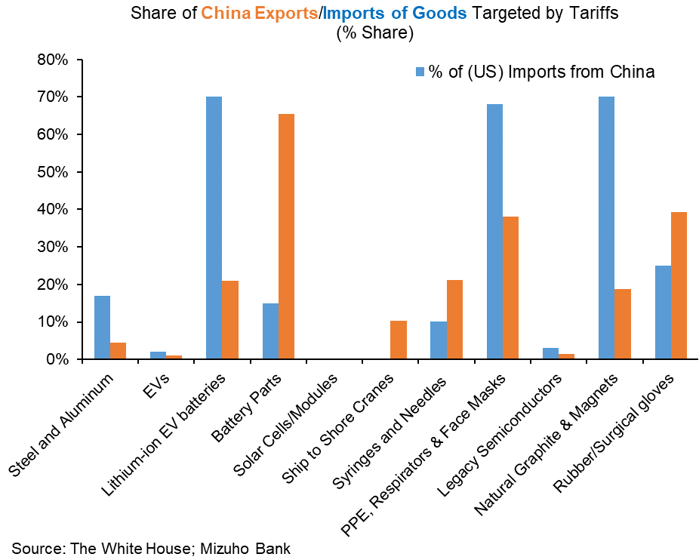
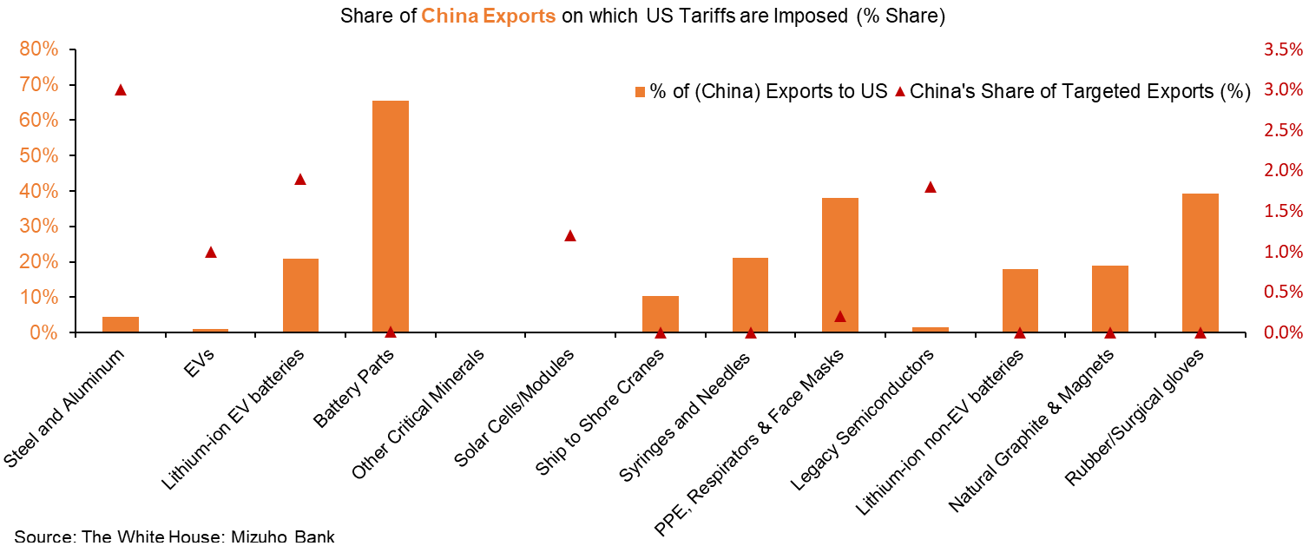
Appendix: Geo-Political Flares to Watch

Slide 50

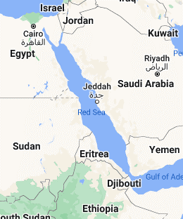
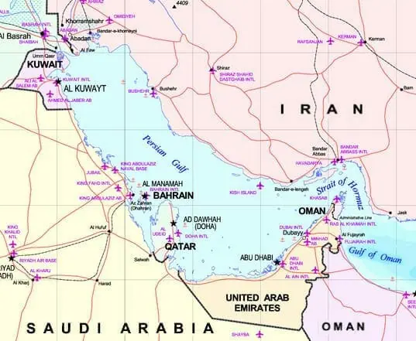


Appendix-Geo-Politics: Conflict, Production & Passage
Straits of Hormuz:
Conflict risks
Most critical Oil choke point – Iran risk
20-22MBpD of Oil (~$1.2b worth)
Most of Saudi’s Oil passage
~20-25% od seaborne Oil Passage
➔ as Large as a Doubling in Prices!
Red Sea:
Conflict risks - Houthi Rebels
Could disrupt passage of Oil
~12% of global shipping (~$1trln)
CoGH detour adds 3-4 weeks to Asia routes
      ➔ approximated to be 20% of shipping capacity impact
Panama Canal: Water Crisis (Non Conflict Risk)

