Slide 1

Your challenge.
Our approach.
FIRM NAME
Notes:
Pages to be deleted as required.
Any sections in red to be personalised and updated before sending.
Page numbers to be added after editing
Save as a PDF – Best for electronic distribution for links to work

Slide 2

Your challenge
Our solution
Our proposal
Your challenge.
Our understanding, based on our conversations, is that you would like to:
Bullets
What success looks like for XXX:
Bullets

Slide 3

Your challenge
Our solution
Our proposal
Who we are.
We deliver world class quality.
Verve is a multi-award winning financial services support company, founded in 2009. We initially started life as Para-Sols, an outsourced paraplanning company. Since then, our offering has grown one service at a time, into the most comprehensive support services company in financial services. Verve now proudly supports over 300 advice firms on an ongoing basis nationwide, of all shapes and sizes, from sole adviser firms to larger nationals & networks.
​Alongside this we support hundreds of other firms, either on ad hoc projects, one-off pieces of work, events and CPD training or supporting them through our sister company, The Verve Foundation, to get up and running. We have our own community, where Verve member firms can chat, share and collaborate and we focus on researching and knowledge sharing, to help all advice firms to thrive.
Based largely up at our head office in Darlington, we employ 50+ industry specialists and are proud to deliver all of our services to clients through employed staff. We don’t use contractors, which means the whole team is passionate about the Verve mission to deliver the best support services around. ​
Our overall mission is to contribute towards a flourishing advice market, to ultimately help more individual's realise the benefit of financial planning and to help the firm's involved in this to achieve their own missions.
Whatever your challenge, we're here to help.
We keep ahead
of the curve.
We do the right thing.
We have got
your back.

Slide 4
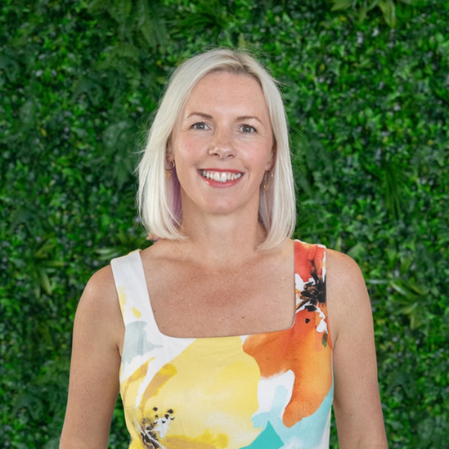
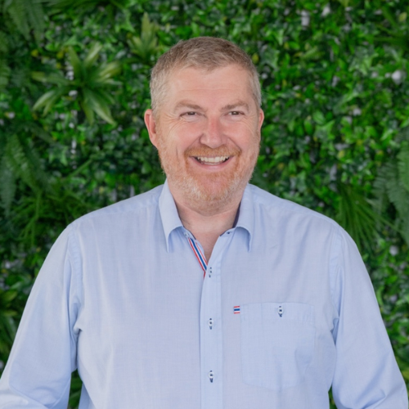
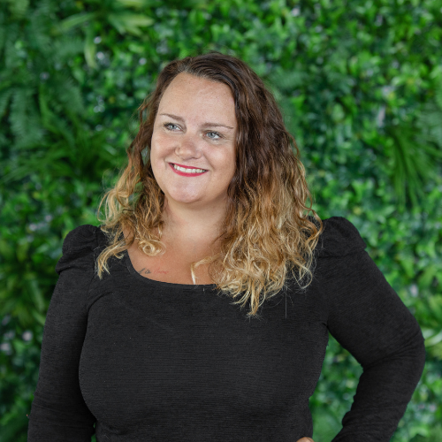
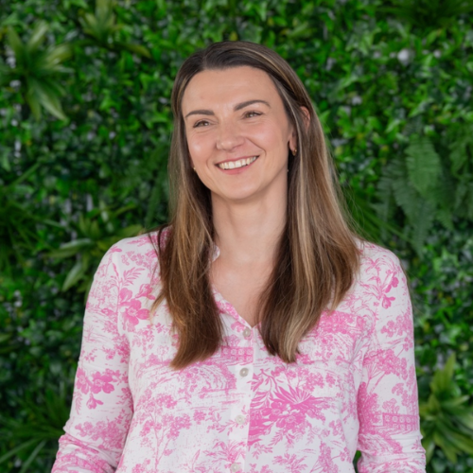
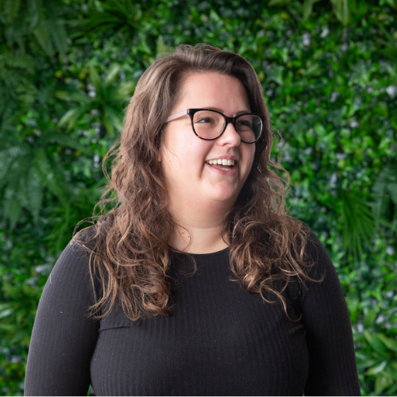
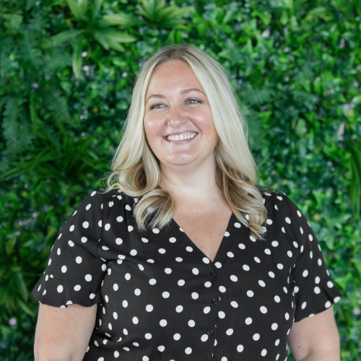
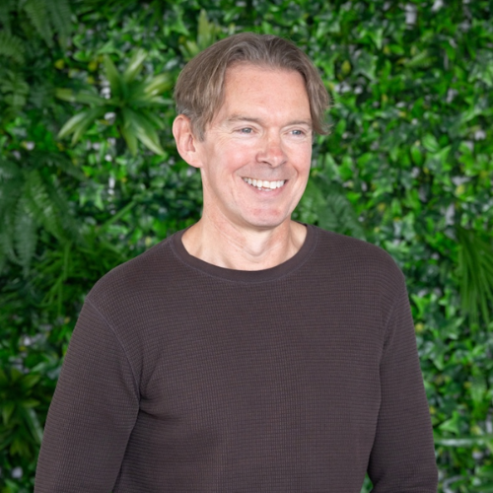
Your challenge
Our solution
Our proposal
Our leadership.
Cathi Harrison FPFS
CEO & Founder
With a passion for financial services and for breaking the mould, she uses her extensive experience, knowledge and qualifications to push new boundaries to help the industry evolve.
Darren Lowry
Chief Commercial Officer
Darren joined the team as Chief Commercial Officer in 2024 after an impressive 17 years at platform provider Nucleus and before that, worked directly in the financial planning sector.
Jo Campbell DipPFS
Chief Operations Officer
Jo’s focus is on helping to build scale and maintain the incredible service and client focus that was the main factor of success in the early years while ensuring the team continue to thrive and evolve.
Kim Binks DipPFS
Head of Finance & Corporate
Kim’s insightful knowledge of financial advice and firms, and understanding what advisers need, helps us to ensure we can support and deliver the support services required by financial advisers.
Maddie Delboy DipPFS
Compliance Manager
With a fresh outlook on the industry, Maddie can help firms understand the regulators current focuses and ensuring it's embedded effortlessly within their processes and culture.
Natalie Bell
Chief Engagement Officer
Using her brand and marketing expertise, as well as her qualifications in coaching and motivational behaviour, she's responsible for telling our story and engaging audiences.
Paul Sylvester-Evans
Training Manager
With over 20 years experience of working in the industry, Paul understands the needs and requirements of our clients to support them to develop and move their businesses forward.
Notes:
The leadership page is to be edited on a case by case basis depending on the nature of the proposal. i.e. Paul doesn’t need to be included in a proposal without training. Keep core C suite in every proposal.

Slide 5
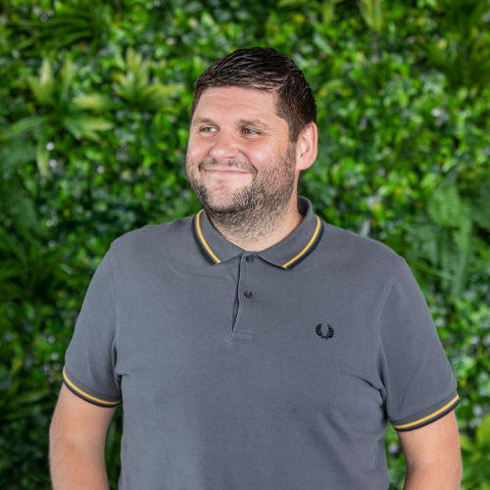
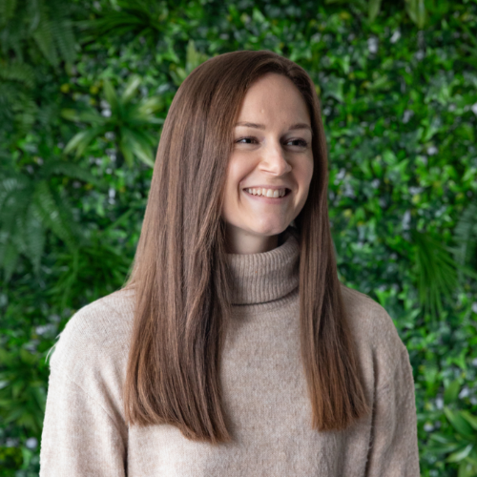
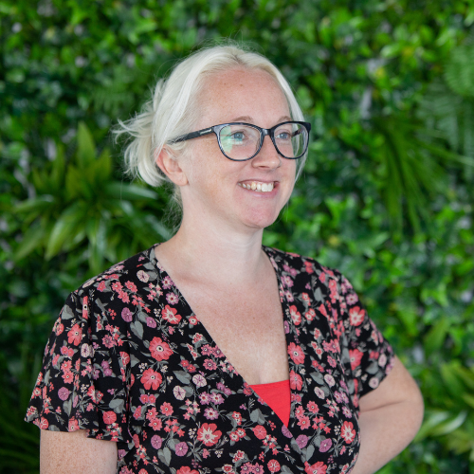
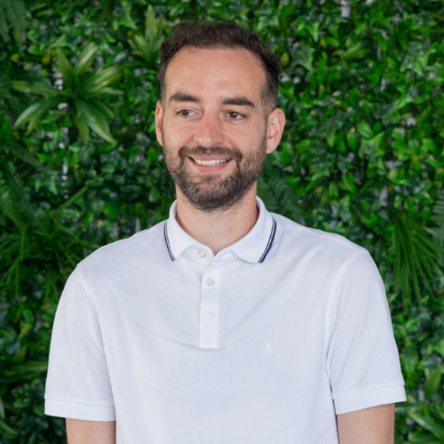
Your challenge
Our solution
Our proposal
Our leadership.
Pete Rhoden DipPFS
Paraplanning Manager
Pete uses his technical knowledge, experience of advice firms and organisational skills to manage the large paraplanning team. His passion is in team mentoring.
Rachael Callaghan APFS
Paraplanner Manager
As a chartered paraplanner, Rachael loves working on the holistic side of financial planning and creates beautiful financial plans for our clients, covering a huge amount of areas, in great detail.
Kylie Rushton
Admin Manager
With a passion for people development and admin, Kylie is hands on with the day to day administration while helping to develop the rest of the team to allow them to achieve their full potential.
Grant Callaghan APFS
Financial Planning Specialist
Grant is our resident technical expert. He supports our clients with technical queries, investment and platform propositions, compliance checks and creating templates and blueprints.
Notes:
The leadership page is to be edited on a case by case basis depending on the nature of the proposal. i.e. Paul doesn’t need to be included in a proposal without training. Keep core C suite in every proposal.

Slide 6
Your challenge
Our solution
Our proposal
Your membership.
Your Verve services are accessed and delivered through our bespoke technology DexteraTM, which not only provides you with the facility to easily access additional support and services from us, but also has a huge range of tech features too. In addition, signing up as a paid member of Verve gives you access to a wide range of membership benefits too, giving you exceptional value for money. Being a member also gives you;
From £75 + VAT per month
1 x DexteraTM licence included
A whole load of compliance and business management updates and resources
Access to our Protection panel with exclusive enhanced rates
Access to The Verve Exchange; our friendly and helpful community
Discounts on a variety of tools and software
Free tickets to Evolution; our annual conference and awards
50% off all our e-learning modules within DexteraTM
No paraplanning retainer required

Slide 7

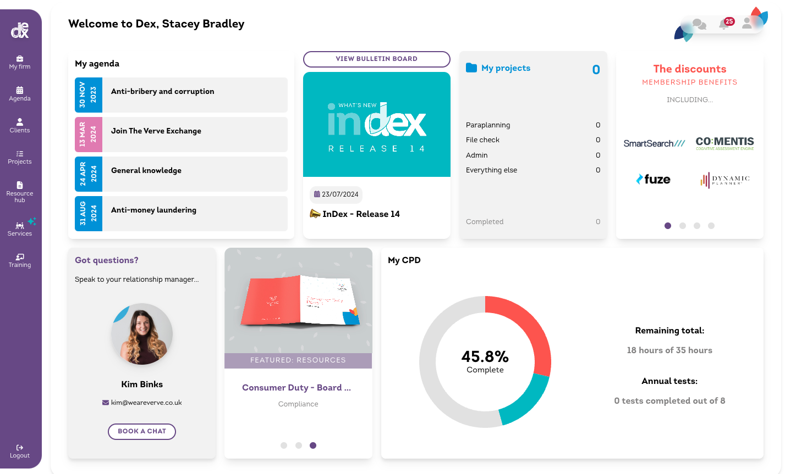

Your challenge
Our solution
Our proposal
Our technology.
Dextera™ is at the core to all services across Verve. Each of the elements of the proposal are concluded on the software, creating one source of truth for all of your data.
Integrated and interactive policies
Full regulatory framework
Live compliance bulletins
CPD tracking and team oversight
Annual testing
Personalised task list
Templates, guides and checklists
Easy access to hands-on support

Slide 8
Your challenge
Our solution
Our proposal
Our paraplanning service.
Our award-winning paraplanning support is suitable for a wide range of firms. There’s no such thing as a typical paraplanning client; we work with a wide variety of firms, from sole advisers through to national & network firms. In addition to the report writing, we can get involved from the start, chasing LOA's and gathering data if needed. The team can also get involved with true paraplanning, helping with research, tax calculations, cashflow modelling and helping to take a case from start to finish with guidance from the adviser.
We offer different levels of support, and a large, experienced and dynamic paraplanning team on hand to ensure no matter the make up of your existing firm, we can offer paraplanning support that suits you and your individual requirements. This also means that we can tailor our support to fit in with your existing processes, such as using your own templates, preferred research and cashflow modelling tools for instance.
Price list
Retirement Planning Report sample
The Small Print Report sample
Periodic Suitability Review sample
5 working day turnaround times
Your templates, or ours - fully branded & personalised
Option to have dedicated paraplanners
Range of specialists available for different areas
Consumer Duty focused reporting

Slide 9
Your challenge
Our solution
Our proposal
Our admin service.
Financial services administration goes way beyond the usual label of ‘admin’ support.
Our administration understand the lingo and the challenges often associated with dealing with providers and the day-to-day process that need to be followed to keep your firm ticking.
Admin support can be used to plug a number of gaps, from chasing LOA’s and data harvesting, to updating back offices and completing the necessary but onerous tasks of annual review prep. Your admin support can be a completely bespoke offering to your needs.
Costs
XXXXXX
Team of experts on hand
Support from chasing LOAs to updating back office systems
Bespoke support to meet the needs of your business
Available as ad-hoc or weekly admin support
Notes:
Ad-hoc £50 + VAT p/h / 10 hours p/w £1,700 + VAT / 20 hours p/w £3,000 + VAT

Slide 10
Your challenge
Our solution
Our proposal
Our compliance service.
Our compliance support package is the perfect solution for those firms who are looking for some external support to complement their internal resource; with the ability to bolt-on additional help as and when needed.
Your compliance dashboard can easily be activated through your Dextera account and will give you access to an additional layer of technical resources and compliance documents in addition to all of the other complimentary features available throughout Dextera. No matter the size of the firm, the cost of our compliance support package stays the same, you just need to be a paid user to benefit from the features including;
Costs
£185 + VAT per month
Tech Zone complete with online search facility for all of our regulatory and technical resources
Free technical queries to get a direct answer from our team if the online database can't help
Technical helpdesk access if you’d prefer to get your queries answered over the phone
Additional suite of documents and templates to provide everything you need to run a regulated firm, including suitability templates

Slide 11
Your challenge
Our solution
Our proposal
Our compliance premium service.
Compliance premium is a comprehensive and proactive approach to help support you and your firms' regulatory needs. Supported by your compliance manager, we can support you with a full audit of current systems, processes, policies and procedures, including support rewriting anything where needed.
We’ll carry out an initial assessment of your advice process, client facing documentation, internal policies and procedures, Consumer Duty implementation plan and monitoring program. We’ll then create a plan based on our findings and your business plan to implement any changes needed to create a suitable long term Compliance regime and calendar that is aligned to the FCA’s requirements and your business needs. Quarterly meetings are held to keep you on track, alongside access to your Compliance Dashboard and consistent communication from your consultant with ensure you’re updated with any regulatory changes.
Costs
XXXXXXX
Full audits of existing systems
Initial assessment and plan
Quarterly meetings to keep you on track
Dashboard for full visibility
Dedicated compliance consultant
Optional extra: remedial work for an extra charge
Notes:
Initial 12 months £445 + VAT (reducing to £320 + VAT thereafter) / Initial 12 months £550 + VAT (reducing to £445 + VAT thereafter) / Bespoke

Slide 12
Your challenge
Our solution
Our proposal
Our file checking service.
We proudly offer file checking with a difference. We don’t just use a generic checklist to see if a file meets the basic requirements, we look at a file from a rounded approach - not just checking the suitability and disclosure of a file, but the process too. Of course, we want to ensure that a piece of advice in isolation is compliant and right for the client, but we also look at process to help spot any trends where a certain process may be failing in your firm to help you improve processes and ultimately de-risk your operations. ​
The aim is for our file check feedback to be common sense and practical, with easy-to-understand feedback to outline changes to be made. Any firm with Dextera access can upload file checks at any point, this is also a service that can added as a complimentary addition to your ongoing compliance and T&C support.
Price List
File Check Sample
A rounded approach to checking both the file and the process
Helping to spot any potential downfalls and de-risk your operations
Common sense approach and practical feedback
Uploaded easily via DexteraTM

Slide 13
Your challenge
Our solution
Our proposal
Our training & competency service.
Our T&C offering is available to a range of different competency levels, supporting everyone in your firm from administrators to senior staff such as those in Senior Management roles.
Training programmes are put together and delivered on a bespoke basis, with your dedicated training manager first completing a plan with the business owner to ensure we are setting KPI’s relevant to your business. Individual training needs analysis is then completed for each member of staff on the program followed by personal development plans to help meet personal goals which are then delivered and monitored by us.
Not only does our T&C offering take the stresses and strains of constant team development off your hands, it also helps you keep up to date with a robust and compliant T&C framework.
Cost
XXXXXXX
Non-client facing programmes include:
Monthly/quarterly
1-2-1’s
Monitor CPD
Assess compliance & product knowledge through system-based testing
In addition, all other programmes include:
Initial Fit & Proper assessment
Advice process and cash flow training validated by role play assessments
Fit and Proper assessment and CAS status certification
Complete relevant FCA notifications
Notes:
Non-client facing. £125 + VAT pp/pm / Trainee adviser £250 + VAT pp/pm / Competent adviser
£150 + VAT pp/pm / Route to competency £350 + VAT pp/pm (6 months)

Slide 14
Your challenge
Our solution
Our proposal
Our business consultancy service.
Business consultancy can be taken up either on a standalone basis, or as a complimentary. Our consultants have a vast experience of running successful IFA firms and the current regulatory landscape. This gives our consultants the depth of experience needed to help transform a firm’s current operations and help get them on the right track to achieving their desired business goals. ​
As with most businesses, their need for consultancy can take many forms! The beauty of having a diverse and experienced team means we can tailor the support to your business.
Cost
XXXXXXX
Initial chat about your firms’ goals and aspirations
Explanation of what and how we’ll help you achieve these
Support and expertise in creating and implementing
Flexibility to have full, half and ad-hoc days
A relationship approach to maximise your benefit
Consultant can work without you sacrificing time yourself
Notes:
Virtual Consultancy £950 + VAT per day / In-Person Consultancy £1,500 + VAT per day
(plus expenses)

Slide 15
Your challenge
Our solution
Our proposal
Our direct authorisation service.
For firms choosing to go directly authorised, you’ll benefit from comprehensive support from an experienced and dedicated consultant who will guide you through the whole process from an initial consultation to provide her An easy-to-use project management system to upload documentation.
We also have a range of complimentary services available to help you fully prepare for your application. We can also provide a full proposition package to ensure you have a clean and documented process around your ideal client types, service levels, charging & appropriate solutions for your business plan. In addition, a lot of applicants benefit from Senior Management training to help support their individual application. ​
Cost
£1,500 + VAT payable upfront
A full suite of templates to complete the supporting documentation
Review and advice on documentation before submission
Help completing the supporting documentation
Completion of FCA forms and applications
Interview prep and guidance

Slide 16
Your challenge
Our solution
Our proposal
Our proposition service.
Your firm’s centralised proposition is core to everything you do. Our specialist team will help consult with you to design, research and compliantly document your firms PROD, platform due diligence, centralised investment and retirement propositions.
Creating your PROD client segmentation is a consultancy led service which will help you document your ideal client types, products offered and an appropriate complimentary charging structure. Your PDD, CIP & CRP services are research led and will help you identify the right solutions for your client types and your preferred styles of investment.
We’d recommend completing all 4 elements together, although you do have the option to mix and match to suit your requirements.
CIP SAMPLE
PDD SAMPLE
Cost
XXXXXXX
Meet with your technical specialist for your PROD consultation
Complete solution preference questionnaires to help piece together research
Share your input on existing providers and strategies used
First drafts are produced prior to completion for one full round of amends
A simple overview document containing evidence for your buyer (providers, strategies, service levels & charges)
Ad-hoc research projects are also available to justify the use of more specialist investment providers such as EIS / VCT providers at £160 + VAT p/h.
Notes:
PROD - £1,450 + VAT Platform Due Diligence - £1,150 + VAT. Centralised Investment Proposition – From £1,150 + VAT (to document existing strategies), From £1,450 + VAT (to consult with the firm to create new strategies). Centralised Retirement Proposition – From £495 + VAT.
All prices from. As a rule of thumb with CIP's Three strategies included in standard costs.

Slide 17
Your challenge
Our solution
Our proposal
Our template creation service.
Having a robust suite of templates in place will ensure that you not only have a consumer duty friendly, compliant set of documents to deliver to client’s; but it also helps paraplanners become more efficient. A set of easy to use templates fully personalised to your firm’s requirements will help your paraplanners spend less time editing and rewriting old reports, and therefore able to produce reports in a much more-timely manner.​
Your templates can be produced either in word or Intelliflo, and all advice areas can be covered, depending on which areas of business you typically focus on. ​
We also offer a template maintenance service for updates such as tax year end or regulatory updates can be completed by us at an hourly of £150 + VAT​.
Cost
XXXXXXX
Retirement Planning Report example
The Small Print Report example
Initial call to discuss your options with a specialist
Share any ideas on any current styles, tone of voice and design
Share details of your proposition to personalize your report
Receive a first draft of your most-used template
Initial feedback and amends followed by review and testing
Finalised templates after one full round of amends
Notes:
See template crib sheet for full breakdown of pricing options.
https://brand.weareverve.co.uk/wp-content/uploads/2025/02/Template-Pricing-2025.pdf

Slide 18
Your challenge
Our solution
Our proposal
Our HR service.
Our HR service, provided by our partners at HR Alchemy, is tailored people and culture support for your firm, no matter the size or stage that you’re at. This includes unlimited HR advice, recruitment process advice, talent and succession planning, new starter and leaver admin support, organizational design support, and so much more!
By partnering with HR Alchemy, we’ve taken care of the third-party due diligence and made the best professional guidance available whenever you need it.
Access to HR support from HR Alchemy sits seamlessly alongside your Verve services in Dextera™ - ideal for firms that are scaling, growing and changing.
Cost
Bespoke
Bespoke, personable HR solutions for all shape and size of businesses
Experienced and qualified professionals – from employment law to culture
Blend professional guidance with real-life practical support
Get exclusive access to their services via DexteraTM
Notes:
See template crib sheet for full breakdown of pricing options.
https://brand.weareverve.co.uk/wp-content/uploads/2025/02/Template-Pricing-2025.pdf

Slide 19
Your challenge
Our solution
Our proposal
Our bespoke support.
Text about our bespoke support
Cost
XXXXXXX
Key point 1
Key point 2
Key point 3
Key point 4

Slide 20

Your challenge
Our solution
Our proposal
The costs.
Duration
Cost
Comments on pricing
Costs are exclusive of VAT
Scoping out
X days
£XXX
Phase 1
X days
£XXX
Phase 2
X days
£XXX
Phase 3
X days
£XXX
X days
£XXX
Full Pricing List
Notes:
Full breakdown of costs and services to be summarised here.

Slide 21
Your challenge
Our solution
Our proposal
The next steps.
1
Text
2
Text
3
Text
Notes:
Include here full and personalised details on next steps, i.e. arranging follow up meetings, links to sign up etc.

Slide 22
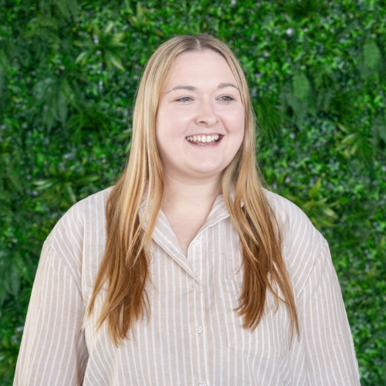


Your challenge
Our solution
Our proposal
Your key contacts.
Darren Lowry
Chief Commercial Officer
darren@weareverve.co.uk
01325 952116 ext. 107
Jamie Rudrum
Client Experience Lead
jamie.rudrum@weareverve.co.uk
01325 952116 ext. 309
Notes:
Delete as necessary & re-arrange

Slide 23

darren@weareverve.co.uk
Information: This file is confidential and intended solely for the use of the individual or entity to whom it is sent. Do not retain, copy or disclose it without our consent. Verve is the trading name of Verve Holdings Ltd. Registered in England & Wales. Company registration number 11212673.

