Slide 1

Your challenge. Our approach.
FIRM NAME

Slide 2

Your challenge
Our proposal
Our approach
The brief.
Text here…

Slide 3
Your challenge
Our proposal
Our approach
Your challenge.
Our understanding, based on our conversations, is that you would like to:
Bullets
What success looks like for XXX:
Bullets

Slide 4
Your challenge
Our proposal
Our approach
Your requirements.
Text here…
Notes:
.

Slide 5
Your challenge
Our proposal
Our approach
Proposal overview.
This proposal is split into three distinct areas where we believe we can support XXX; the areas can operate independently, but also complement one another:
1
Text
2
Text
3
Text
Notes:
.

Slide 6

Proposal: Subject
Summary of section

Slide 7

Your challenge
Our proposal
Our approach
Our proposal.
Phase 1
Discover
Text
Phase 2
Arrange
Text
Phase 3
Cascade
Text
Phase 4
Migrate
Text

Slide 8
Your challenge
Our proposal
Our approach
Your requirements.
Objective: to fully document and build end-to-end process to support client transfers in a scalable and compliant manner.
Phase 1
Scope
Team creation and training
PROD and segmentation
Research & analysis
Compliance consultation
Tracking & dashboard
Client comms / suitability
Phase 2
Assemble
Data gathering
Personal analysis
Suitability templates
Client comms
Reports & illustrations
Data keying
Phase 3
Implement
Submit applications
Transfer packs
Progress reporting
Follow-up programme
Client comms

Slide 9
Your challenge
Our proposal
Our approach
The deliverables.
The suite of roll out materials contains:
a
Text
b
Text
c
Text

Slide 10
Your challenge
Our proposal
Our approach
The timeline.
Month 2025
Delivery of phase 1 - scope
Month 2025
Delivery of phase 3 - implement
Month 2025
Agree terms, define scope of work and contract agreement
Month 2025
Delivery of phase 2 - assemble
Month 2025
Firm engagement*

Slide 11
Your challenge
Our proposal
Our approach
The costs.
Duration
Cost
Phases 1 – 3 are indicative maximum time-frames and will be confirmed following scoping out. It is
Costs are exclusive of VAT
Scoping out
X days
£XXX
Phase 1
X days
£XXX
Phase 2
X days
£XXX
Phase 3
X days
£XXX
X days
£XXX

Slide 12
Your challenge
Our proposal
Our approach
The costs.
Combined template options |  | Standalone templates
Replacement business (pensions and investments) | £1,750 + VAT | Replacement pensions Replacement investments | £950 + VAT £950 + VAT
New business (pensions and investments) | £1,750 + VAT | New pensions New investments | £950 + VAT £950 + VAT
Decumulation (drawdown and annuity) | £2,750 + VAT | Drawdown (existing) Drawdown (new) Annuity | £950 + VAT £950 + VAT £950 + VAT
Estate planning (WoL, trusts, BR) | £1,750 + VAT | Business Relief Trusts | £950 + VAT £950 + VAT
N/A |  | Specialist Investments (EIS & VCT) | £1,500 + VAT
Annual review (including advice) | £1,750 + VAT | Annual Review (no advice) AR & Drawdown review AR & Bed & ISA / fund switch/top up | £500 + VAT £750 + VAT £750 + VAT
Protection (new and and replacement) | £1,750 + VAT | New protection Replacement protection | £950 + VAT £950 + VAT
N/A |  | Business Protection | £950 + VAT
N/A |  | Defined Benefits (to remain) Defined Benefits (to transfer) | £1,250 + VAT £1,750 + VAT
IO BUNDLE
Cost for all as Word documents
IO premium (10%)
£9,750 + VAT
£11,000 + VAT

Slide 13
Your challenge
Our proposal
Our approach
The next steps.
1
Text
2
Text
3
Text

Slide 14

Summary
Your team, costs and exclusions.

Slide 15

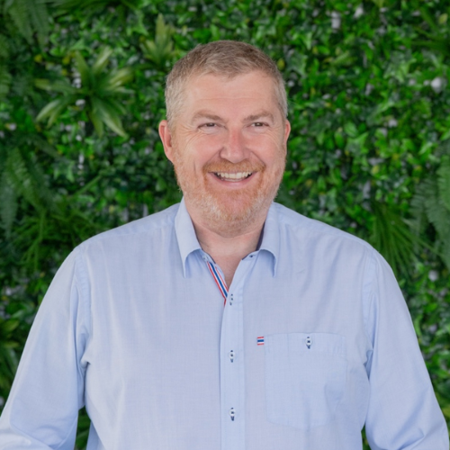
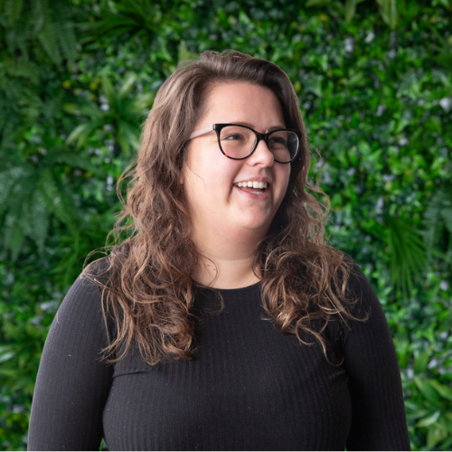
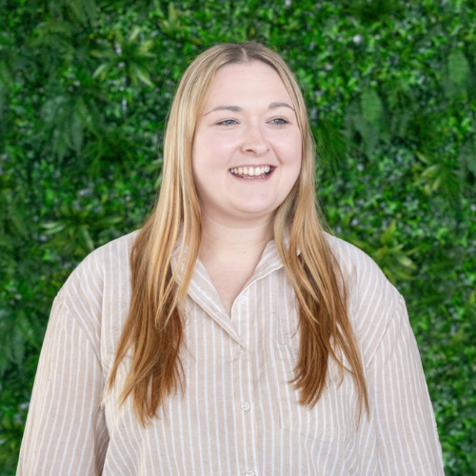
Your challenge
Our proposal
Our approach
Our relationship.
Darren Lowry
Chief Commercial Officer
XXX
Maddie Delboy
Compliance Manager
XXX
Jamie Rudrum
Client Experience Lead
XXX

Slide 16
Your challenge
Our proposal
Our approach
Cost summary.
Service | Cost | Current Annual Total | Year 1 Cost
Dextera | £1,900+VAT per month (£10per month per user) | £22,800+VAT
Advanta Wealth Compliance | £2,000+VAT per month + £1,500+VAT one off cost | £24,000+VAT + £1,500+VAT
Acquisition current and future Compliance | £175+VAT per month + £1,500+VAT one off cost | £8,400+VAT + £6,000+VAT (4 current additional entities)
File Checks | PAYG | Dependent on usage and case type
Business Support | Covered by The Verve Group | N/A | £62,700+VAT

Slide 17
Your challenge
Our proposal
Our approach
Current exclusions.
Verve are experienced and equipped to support you in other elements of the business need however, are currently excluded in the proposal. We would be able to discuss and offer support in all aspects of the below if and when required to be included for additional cost.
a
The monitoring and training within the T&C scheme.
b
The completion of the compliance framework documents.
c
The reports for migration of acquired firms to Advanta Wealth’s proposition.

Slide 18
Appendix

Slide 19
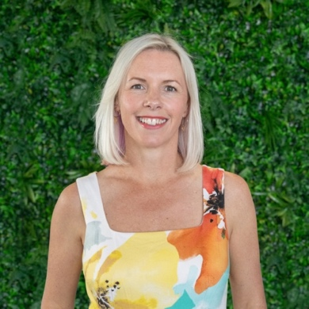
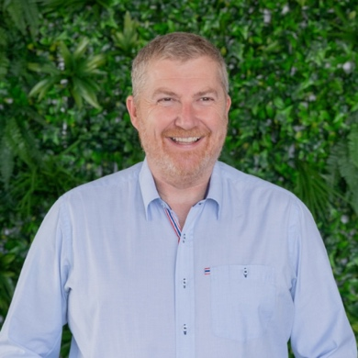
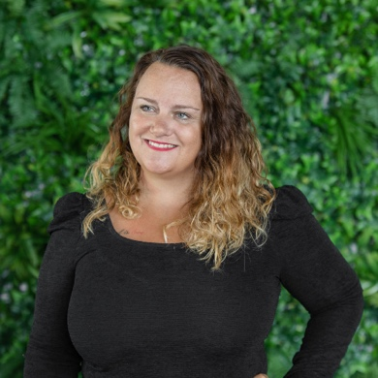
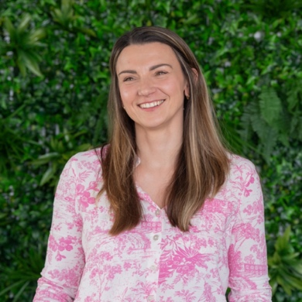

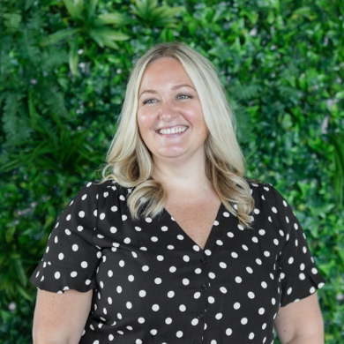
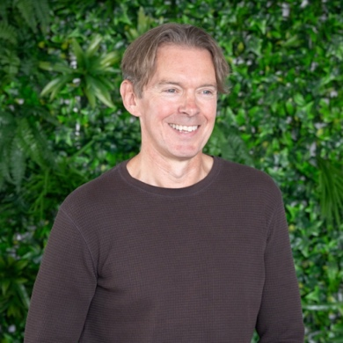
Your challenge
Our proposal
Our approach
Our leadership.
Cathi Harrison FPFS
CEO & Founder
With a passion for financial services and for breaking the mould, she uses her extensive experience, knowledge and qualifications to push new boundaries to help the industry evolve.
Darren Lowry
Chief Commercial Officer
Darren joined the team as Chief Commercial Officer in 2024 after an impressive 17 years at platform provider Nucleus and before that, worked directly in the financial planning sector.
Jo Campbell DipPFS
Chief Operations Officer
Jo’s focus is on helping to build scale and maintain the incredible service and client focus that was the main factor of success in the early years while ensuring the team continue to thrive and evolve.
Kim Binks DipPFS
Head of Finance & Corporate
Kim’s insightful knowledge of financial advice and firms, and understanding what advisers need, helps us to ensure we can support and deliver the support services required by financial advisers.
Maddie Delboy DipPFS
Compliance Manager
With a fresh outlook on the industry, Maddie can help firms understand the regulators current focuses and ensuring it's embedded effortlessly within their processes and culture.
Natalie Bell
Chief Engagement Officer
Using her brand and marketing expertise, as well as her qualifications in coaching and motivational behaviour, she's responsible for telling our story and engaging audiences.
Paul Sylvester-Evans
Training Manager
With over 20 years experience of working in the industry, Paul understands the needs and requirements of our clients to support them to develop and move their businesses forward.

Slide 20
Your challenge
Our proposal
Our approach
Our purpose and values.
We deliver world class quality.
Our purpose
Verve has a focus on supporting financial advisers with the support they need to start, grow or refine their firm. We always look at how things can be done better – for the firms, and for the end client.
We keep ahead
of the curve.
Our values
We do the right thing.
We’re incredibly proud of our values and have invested a great deal of time and resource in to developing a framework to underpin every element of who we are as individuals, and who we are collectively as a business. How we approach recruitment, how we do business with clients and how we interact as a team are all guided by our company values.
We have got
your back.

Slide 21




Your challenge
Our proposal
Our approach
Our credentials.
1,800+
users
Verve has a focus on supporting advisers, but not doing what has always been done before. We combine:
330+
firms
Technical expertise
Practical experience
Common sense
A desire to simplify
A focus on the positive
An obsession with quality
c.5520
completed projects*
We also demonstrate our commitment to building capacity within the industry via our not-for-profit arm, the Verve Foundation.
c.450
work items*
Source: Dextera™ as of 31/07/25
* in preceding 12 months

Slide 22
Your challenge
Our proposal
Our approach
Our capabilities.
Proposition
Compliance
Paraplanning
Platform due diligence
Centralised investment solutions
Centralised retirement solutions
PROD client analysis as per MiFID II requirements
ESG focus
Cashflow planning framework
Tailored compliance consultancy
File checking
PI / capital adequacy
Technical notes
Complaints handling
Reporting including RegData
Business review and audits
Project-led approach
5 working day turnaround
Data gathering
Full plan research
Flexibility of templates which have a personalised structure, format and language for the firm
Training
Consultancy
Data Services
T&C framework and delivery
CPD focused events on a variety of subjects
Specialised e-learning modules
Training library full of resources to complete CPD requirements across all job roles and functions
Business consultants, focused on a firms needs
M&A support, creating efficiencies and building team and culture
Online or in person and tailored to the business and its requirements
Follow up MI and reporting
Proprietary technology stack for business, regulatory and staff management – Dextera™
Data insight trends and analysis
Overview of asset flows, trends on platforms and managers and firm approaches to teams and training

Slide 23

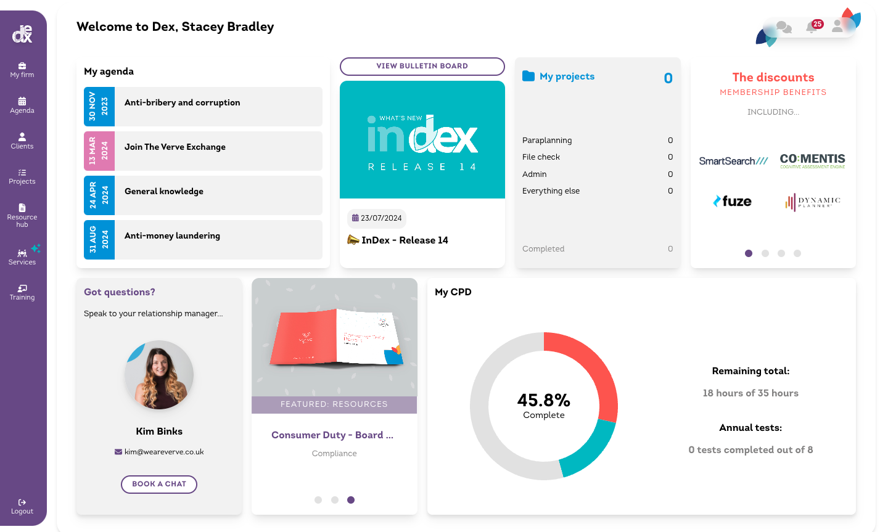

Your challenge
Our proposal
Our approach
Our technology.
Dextera™ is at the core to all services across Verve. Each of the elements of the proposal are concluded on the software, creating one source of truth for all of your data.
Integrated and interactive policies
Full regulatory framework
Live compliance bulletins
CPD tracking and team oversight
Annual testing
Personalised task list
Templates, guides and checklists
Easy access to hands-on support

Slide 24
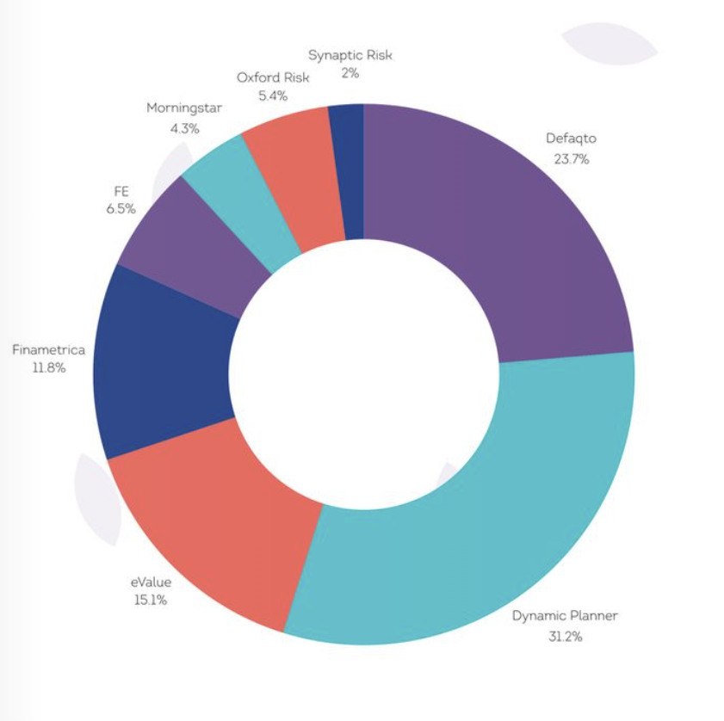
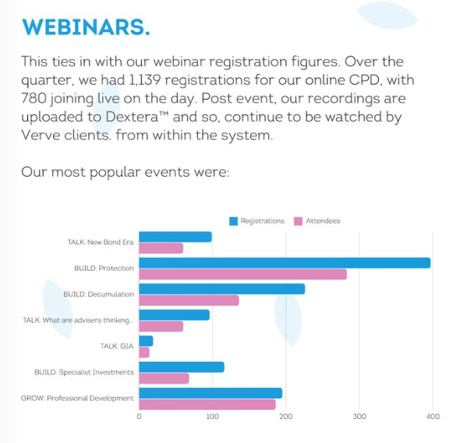
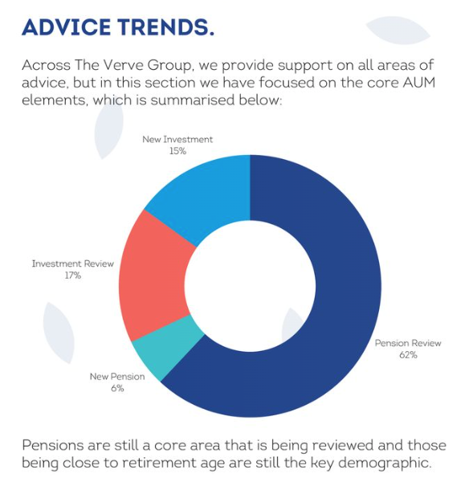
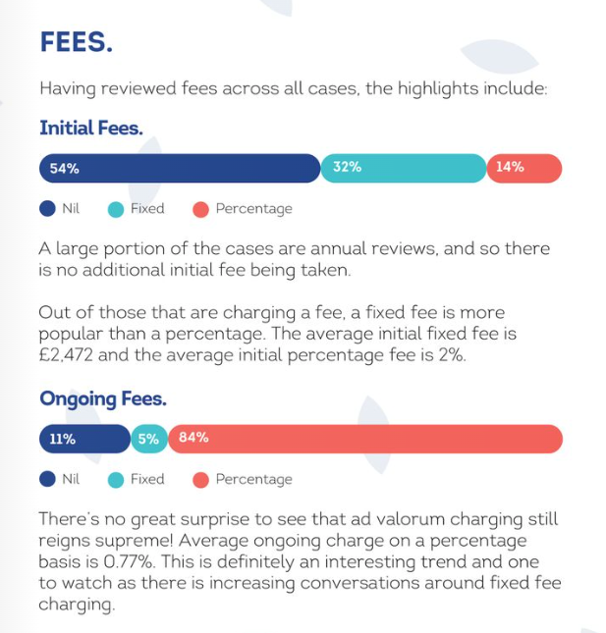
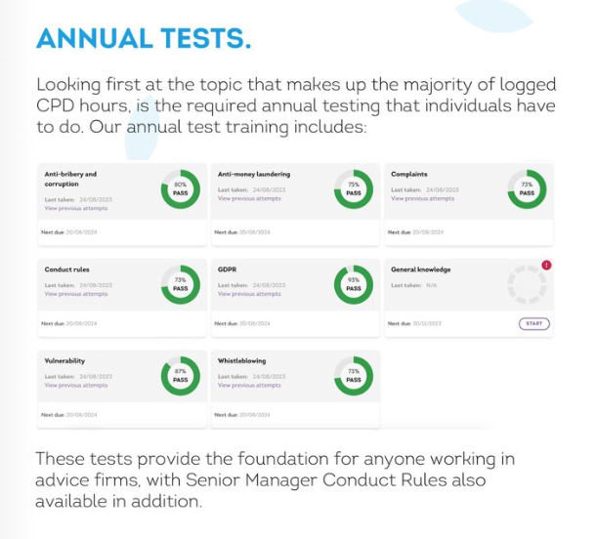
Your challenge
Our proposal
Our approach
Our insight.
Dextera™ allows us to see data and trends across firms and all areas of advice - aka “who is doing what, where and with who?”, including:
Firm data - compliance providers, backoffice providers, risk profiling tools.
CPD and training - sources of CPD, annual tests, CPD subjects, popular webinar subjects
Advice data - advice trends, fees, replacement business, destinations, reviews

Slide 25










Your challenge
Our proposal
Our approach
Our key clients.
We work with a range of partners to deliver the services they need.
Consistent approach
Industrialised processes
Tailored to firm requirements
Dedicated relationship management
Notes:
https://radiantfinancial.co.uk

Slide 26
Your challenge
Our proposal
Our approach
A case study.
“We’ve transformed our entire approach to compliance”
Before we switched to Verve, our experience with compliance providers was frustrating - the process felt incredibly disjointed and the tools we were given were rudimentary at best - a basic website with documentation where you were simply signposted to templates.
It became clear that this approach wasn’t working for us, then someone recommended what was then Apricity. From the first conversation I had with the team, I could tell this would be different. The team had worked in advisory businesses before, which was crucial because it meant that they understood how we operated. Straight away, I felt like we were on the same page.
Working with Verve has completely changed the way we approach compliance. It’s no longer a burden or a source of stress. Instead, it’s an integrated part of our business that supports our growth and helps us deliver better outcomes for our clients.
Lee Walters, CEO & Financial Planner at Barwells Wealth
Read full article here

Slide 27
Your challenge
Our proposal
Our approach
A case study.
”I’ve reimagined advice for the next generation”
Working with Verve allowed me to rethink compliance and focus on delivering real value to clients. Together, we tackled the unique aspects of my business model. Cathi helped me navigate the regulatory environment, and we identified that much of the risk regulation didn’t apply because my model isn’t about distribution - it’s about creating financial confidence.
The final piece was recognising the need for bravery. My model pairs female advisers in their 30s and 40s with clients of the same demographic, creating long-term partnerships where both parties can grow together. These advisers focus on skills relevant to their clients’ immediate needs, like building emergency funds and maximising ISA subscriptions, rather than inheritance tax planning or wealth transfer.
Cathi and her team understand that the next generation of clients won’t tolerate outdated models. Digital-savvy clients demand speed, quality, and competitive pricing. Margins are shrinking, and businesses must differentiate through human connection and exceptional service.
Sam Secomb, Founder & Chartered Financial Planner at Women’s Wealth
Read full article here

Slide 28
Your challenge
Our proposal
Our approach
A case study.
“AAB’s journey to Positive Compliance”
One of the biggest differences we noticed with Verve was their approach - it’s much more collaborative. They provide feedback, but how we implement that feedback is up to us. If we don’t agree with something, we can challenge it, and there’s always an open conversation. That level of two-way communication is something we really value - it’s such a fresh way to work
For us, Verve is more than just a compliance provider - it’s a true partner. They take the time to ask what support firms need, knowing that compliance isn’t static, it’s always changing. Their approach is intuitive, collaborative, and forward-thinking.
Working with the team has given us the confidence to manage compliance in a way that works for our business, rather than feeling forced into a one-size-fits-all approach. We’ve moved beyond traditional, reactive compliance and embraced a proactive, strategic, and technology-driven approach that aligns with our long-term goals.
Vikki Venerus, Head of Risk & Compliance at AAB Wealth
Read full article here

Slide 29

darren@weareverve.co.uk
Information: This file is confidential and intended solely for the use of the individual or entity to whom it is sent. Do not retain, copy or disclose it without our consent. Verve is the trading name of Verve Holdings Ltd. Registered in England & Wales. Company registration number 11212673.

