Slide 1
Volatility and Sequence of Returns
Portfolio Construction Series
Lucas Allen, CFP®

Slide 2
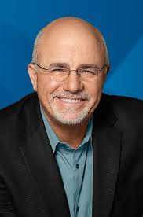
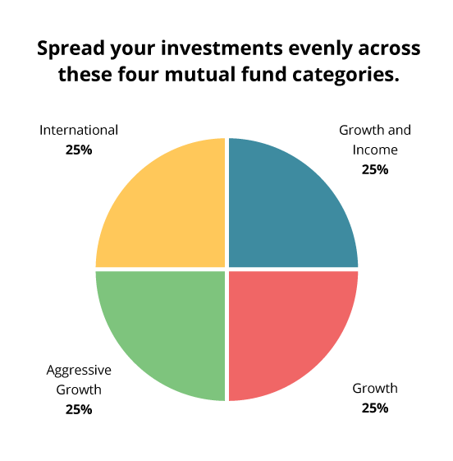
A financial Guru’s approach to SWR
“As long as you didn’t take the ready-fire-aim approach to retirement planning, you should already know how to make retirement last. But, here’s a refresher:
You’re going to keep your nest egg invested and averaging 12% growth. We’re estimating inflation at 4%. So, to maintain your nest egg and break even with inflation, you will live on 8% income from your nest egg. That means if you have a nest egg of $625,000, you will live on $50,000 per year: $625,000 x 8% (.08) = $50,000.”
Source: https://www.daveramsey.com/blog/how-to-wreck-your-nest-egg-at-retirement
What is wrong with this picture?

Slide 3
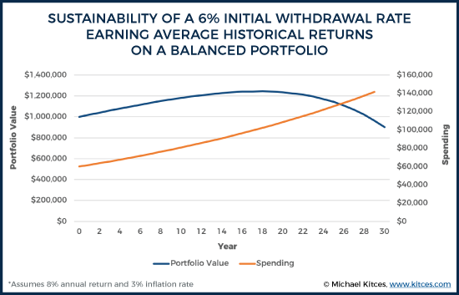
Of course, it’s the sequence of returns!
Some Numbers to think about…
Since 1929, an annually rebalanced 60/40 (Large Cap’s/Intermediate Govt Bonds) portfolio has averaged ~8%
This could support an initial withdrawal rate of 6% with annual inflation adjustments and still have the bulk of the principal after 30 years

Slide 4
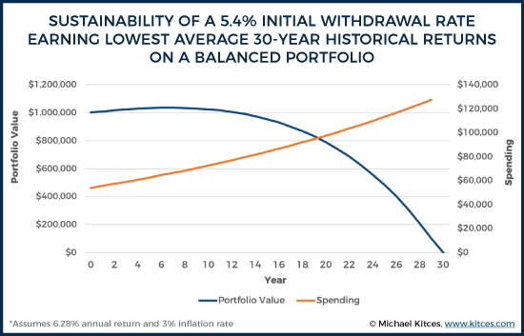
Even with the worst 30 year return of a balanced portfolio, you could still withdraw 5.4% and just barely run out of money…

Slide 5
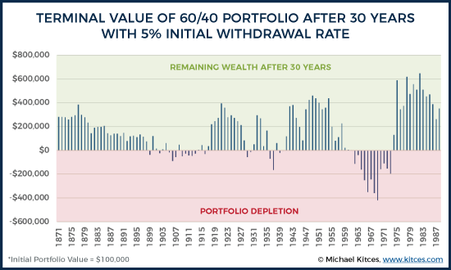
The Truth
Even though returns may average out in the long run, it doesn’t necessarily mean the SWR can be sustained amongst volatile returns
Real Life =25% Failure Rate

Slide 6
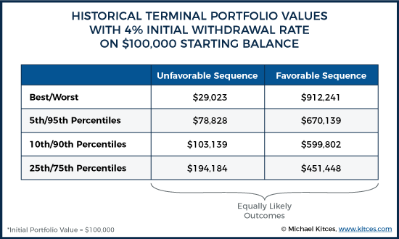
It can also be more than expected
Note: Kitces advocates for some sort of planning contingency to spend wealth accumulated beyond the plan, he suggests some sort of dynamic spending strategy that kicks in if the portfolio experiences extremely favorable sequences of return

Slide 7
So that’s why the 4% rule exists!
Interesting Facts..
A 1966 retiree had a 30 year CAGR of 9.56%, but only could sustain a 4% SWR
A 1937 retiree had a 30 year CAGR of 7.24%, but also only could sustain a 4% SWR
A 1912 retiree had a 30 year CAGR of 5.5%, could sustain a 4.6% SWR
A 1874 retiree had a 30 year CAGR of 5.96%, but ultimately could sustain a 9.2% SWR
KEY TAKEAWAY:
Portfolio withdrawals are driven far more by the sequence of returns rather than the actual long term returns themselves

Slide 8
Volatility…Why does that matter?
Volatility=Opportunity
Also..
Volatility=Financial Ruin
Both are true
Let’s take a look at a study that analyzes the correlation of volatility to risk of plan failure

Slide 9
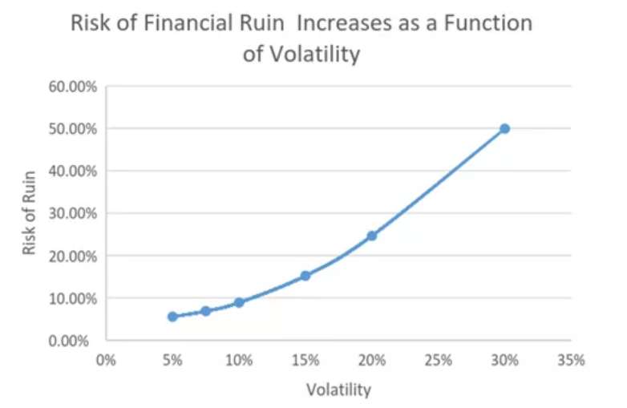
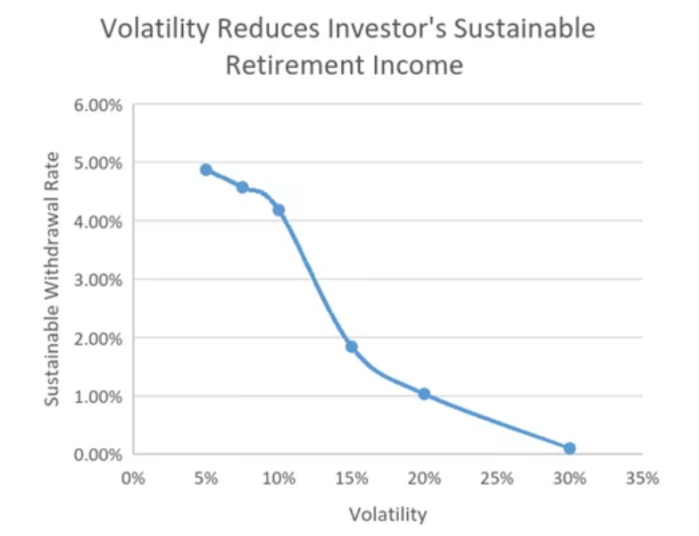
Constant Expected Return of 6%
Volatility levels of 5%,7.5%,10%,15%,20%,30%
5% withdrawal Rate
Financial Ruin = Running out of money
An investor with a 20% volatility had 3x the risk of ruin than a 10% volatility portfolio
According to this study…
A portfolio with a 5% volatility can sustain withdrawals nearly 5x the annual retirement income as a portfolio with 20% volatility
Source: Blue Sky Asset Management, http://www.bsam.com/research/the-importance-of-managing-risk-in-retirement/

Slide 10
The Human Element
“Everyone has a plan, till they get punched in the face.”- Mike Tyson
Continuing the research by BSAM, they posed a realistic scenario of a retiree of Joe Smith with the following facts…
$1mm portfolio drawing $60,000 a year
Started retirement and portfolio withdrawals beginning 2007
Let’s see what Joe does assuming he stays the course with his allocation and withdrawals heading into the Great Financial Crisis (GFC)
Source: http://www.bsam.com/wp-content/uploads/2017/07/Managing-Risk-in-Retirement-Part-II.pdf

Slide 11
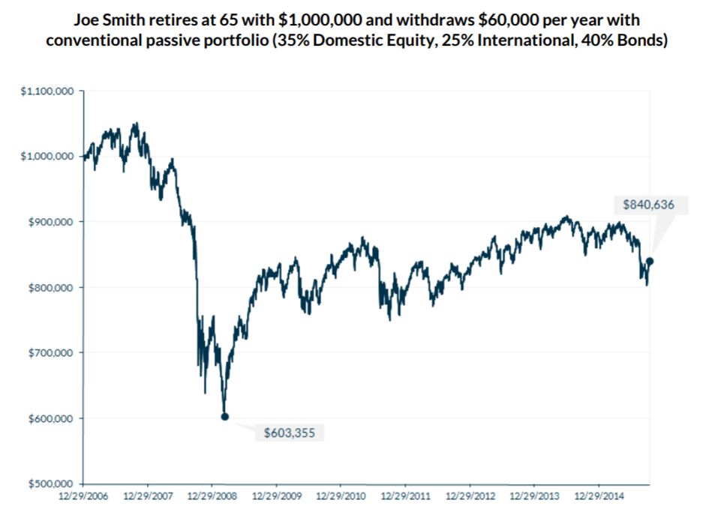
If he held to the plan…
Source: http://www.bsam.com/wp-content/uploads/2017/07/Managing-Risk-in-Retirement-Part-II.pdf

Slide 12
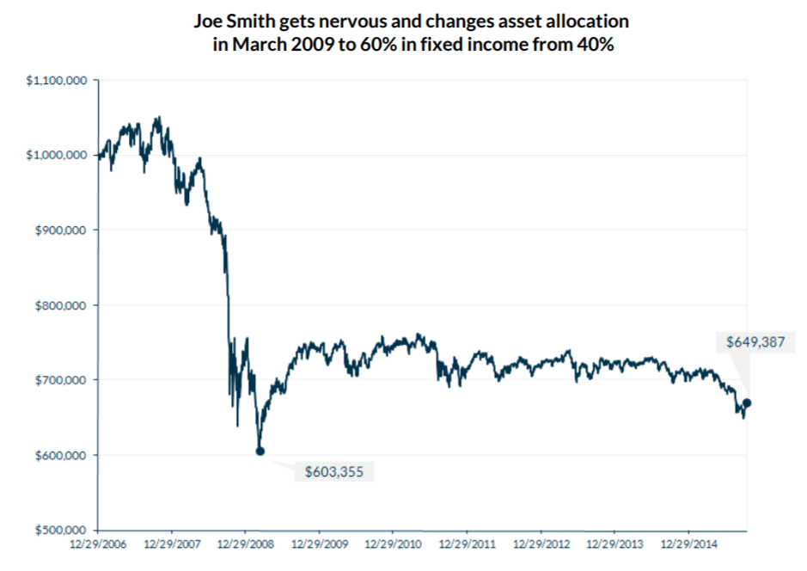
What most likely happened…
Source: http://www.bsam.com/wp-content/uploads/2017/07/Managing-Risk-in-Retirement-Part-II.pdf

Slide 13
What happened?
Joe endured all the downside portfolio of his chosen allocation, but at the worst moment “got more conservative” at one of the worst times to do so.
While this seemed sensible at the time given what had happened to his nest egg, this literally meant a $200k hit to his savings, very significant for only a 20% shift in his allocation.
“Optimism means expecting the best, but confidence means knowing how to handle the worst.” – Max Gunther
A simple technique
Ask your client during the initial phases of planning what amount of money being lost will cause them to lose sleep at night in pursuit of long term returns offered by the market?
Amount allocated to equities X 50% = Dollar amount they could lose based on past history

Slide 14
Recap of key concepts
Portfolio withdrawals are driven far more by the sequence of returns than the actual average rates of return. Higher returning portfolios don’t necessarily increase SWR success and/or higher spending rates
While there is a possibility of running out of money, there is also the possibility of accumulating much more than anticipated. Discuss those possibilities with your clients
Volatility represents both opportunity and risk, it is vital that we as planners take this into account when constructing a portfolio and communicate that effectively to our clients
Be aware of the value of a well built plan and the value you provide to help your clients stick to it, this value is nearly unquantifiable and most likely exceeds any fees they pay you
While we can’t predict how clients will react to possible downturns, it helps to have those discussions before they come to gauge their reactions

Slide 15
Advisory services provided by Capita Financial Network, an SEC Registered Investment Adviser. Registration with the SEC does not imply certain training or skill. Capita Financial Network and its representatives do not provide tax or legal advice. Each taxpayer should seek independent advice from tax professional based on his or her individual circumstances. This material is provided for general information and educational purposes based on provided and available information and from sources believed to be reliable. This information is not to be considered investment advice. Past performance is no guarantee of future results.
9980 S. 300 W Ste #140, Sandy UT 84070

