Slide 1
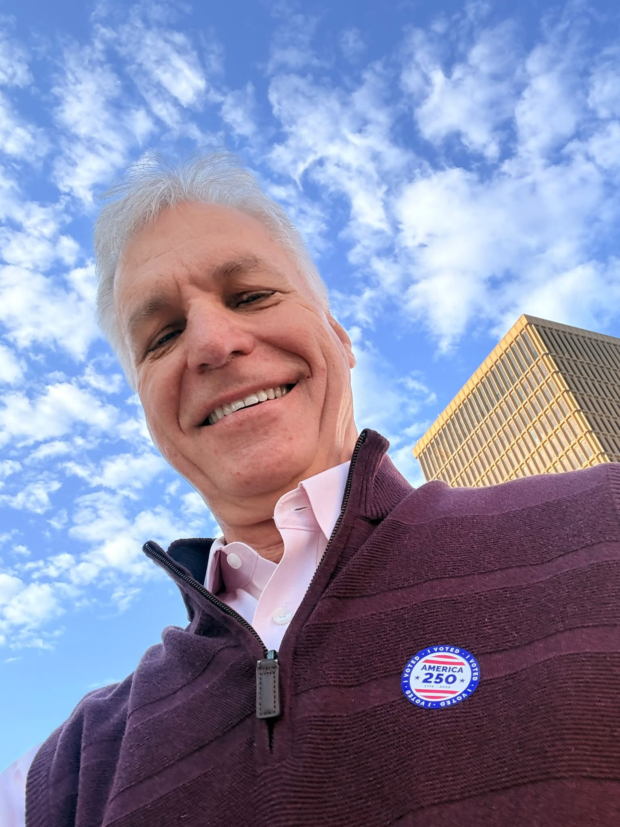
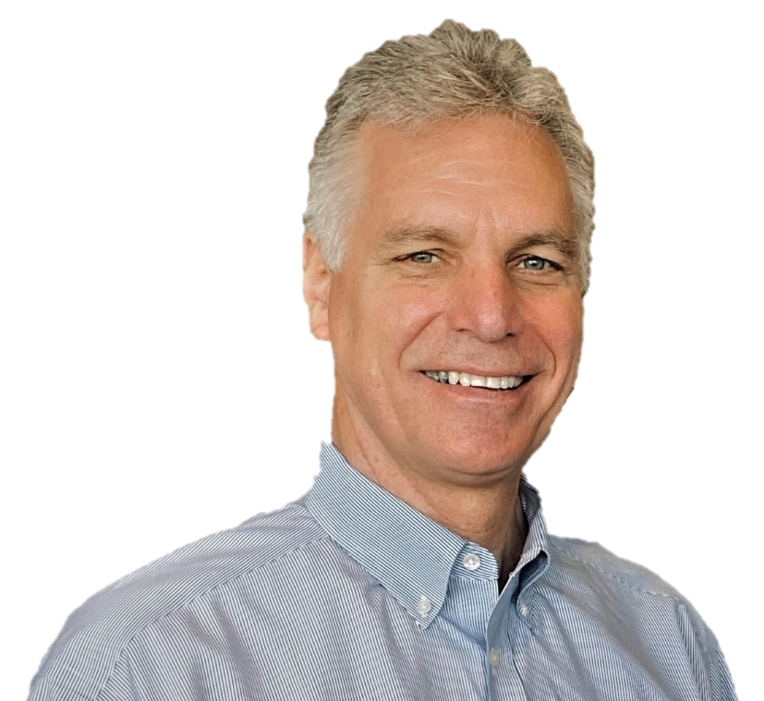
M. Kent Stroman
[America’s Asking Coach]
Purpose in life: Equip, Inspire & Encourage
Published Author
Popular Speaker
Dedicated Leader
Frequent Award Recipient
Trusted Consultant (since 1999)
Background in Higher Ed. (25 years)
Certified Fund Raising Executive (CFRE)
Introducing:

Slide 2
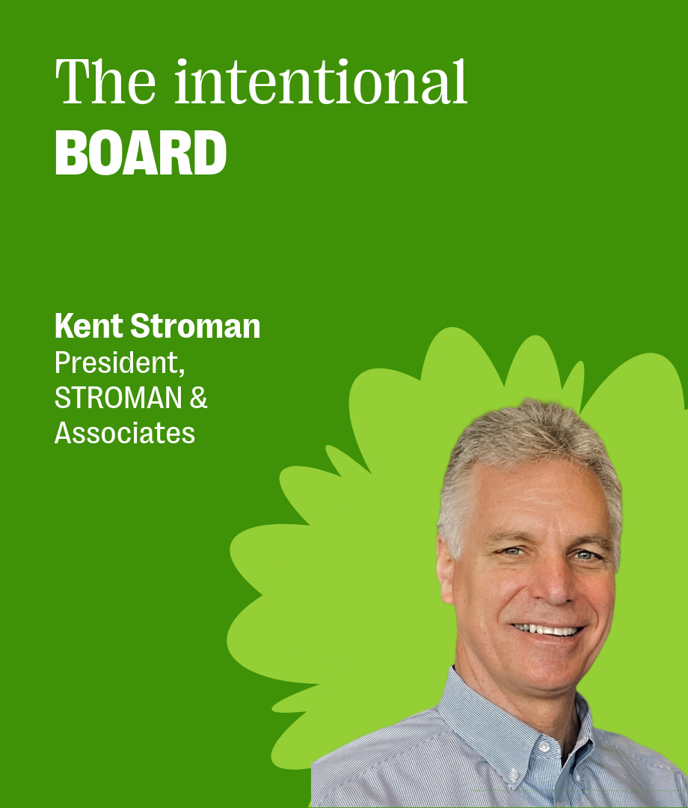
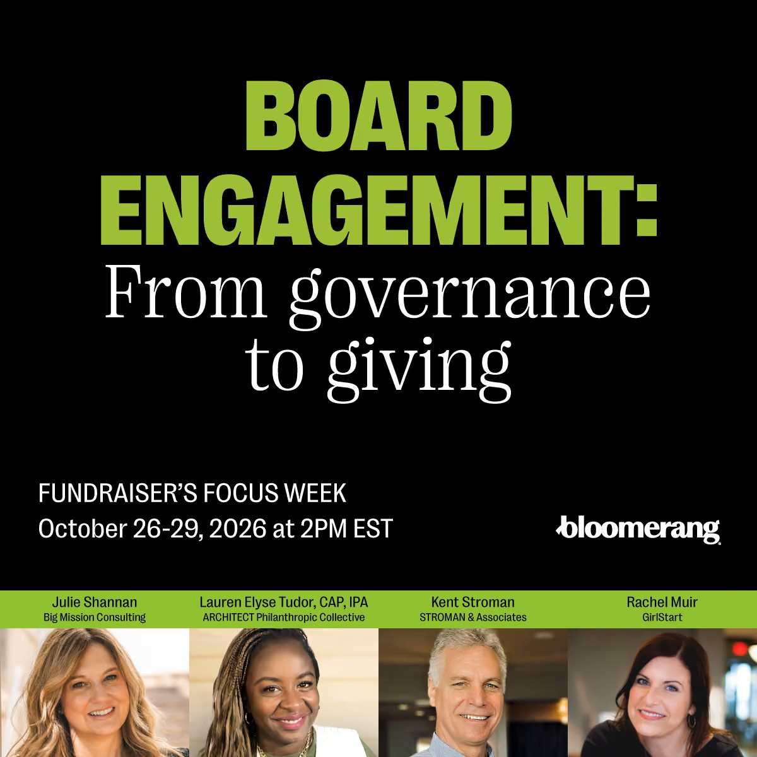

Slide 3
It all begins with a phone call . . .

Slide 4

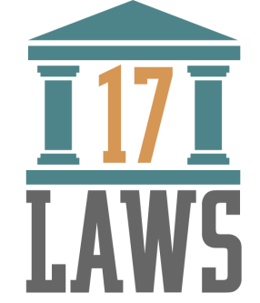
The Law of
the Page
LAW 1
You can’t get on the page
if there’s not a page.
Notes:
4

Slide 5
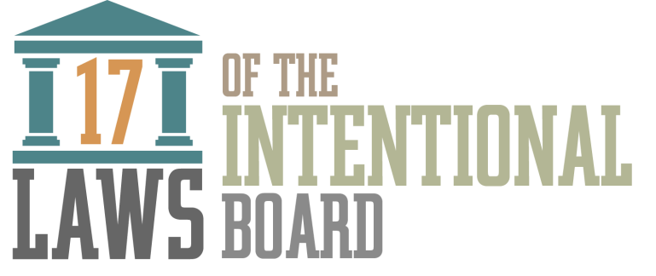
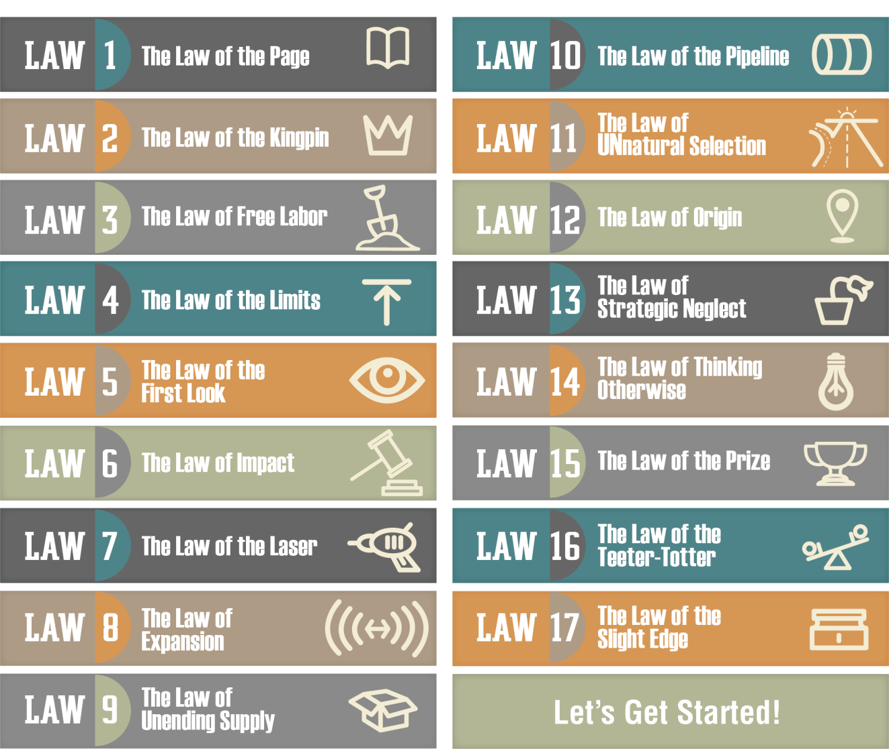

Slide 6
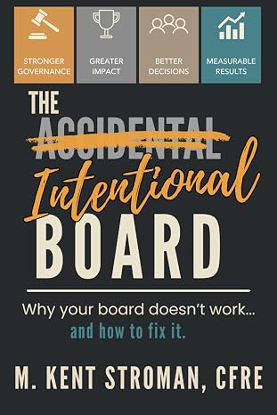

Recommended Resource
Notes:
6

Slide 7
?
Why Board Governance Matters:
Public Trust
Mission Relevance
Vision Clarity
Impact!
Why?

Slide 8
?
What’s the board’s primary purpose?
Bylaws
Mission & Vision
LT Strategic Goals
Budget
Member Expectations
Confidentiality
Conflict of Interest
Establish policy
Assess performance against policy.

Slide 9
?
What policies do we need that we don’t have?
What policies do we have that we don’t need?
What policies do we have that we don’t follow?
What else needs to change to elevate our Board effectiveness / satisfaction?
Policy Questions

Slide 10
Reality
People
Boards don’t own
what they don’t create.
we
Notes:
10

Slide 11

/
[Me]
distinction
Board
[We]
Board Member

Slide 12
Equipping
Board Members
for Success

Slide 13
?
What do board members feel UNequipped
(or ill-equipped) to do?
in your view
How do we know?

Slide 14
You cannot expect board members to do anything you haven’t equipped them to do.
Reality
Notes:
14

Slide 15
?
What results have I
equipped our board
to deliver?
introspection

Slide 16



Under pressure you don't rise to the occasion,
you sink to the level of your training.
That's why we train so hard.
– Navy Seal
Notes:
16

Slide 17

Recommended Resource
Notes:
17

Slide 18

The Law of
Expansion
LAW 8
Whatever we focus on expands.
Notes:
18

Slide 19
Tip
To improve BOARD effectiveness, evaluate BOARD performance,
Notes:
19

Slide 20
?
How are we doing as a board?
What would we like to change?
How might that happen?
What legacy would we like to leave?

Slide 21
Tip
To improve board MEMBER effectiveness, evaluate board MEMBER performance,
Notes:
21

Slide 22
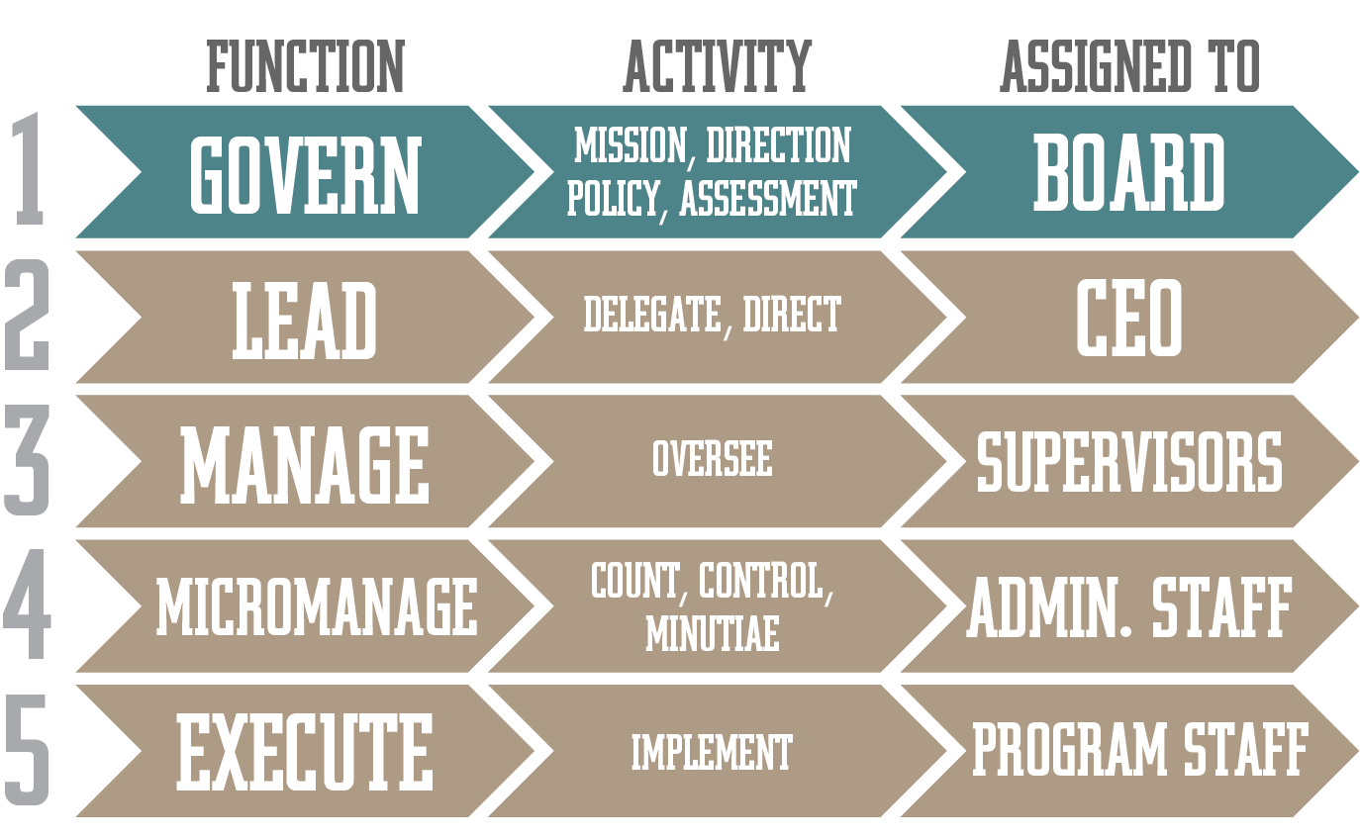
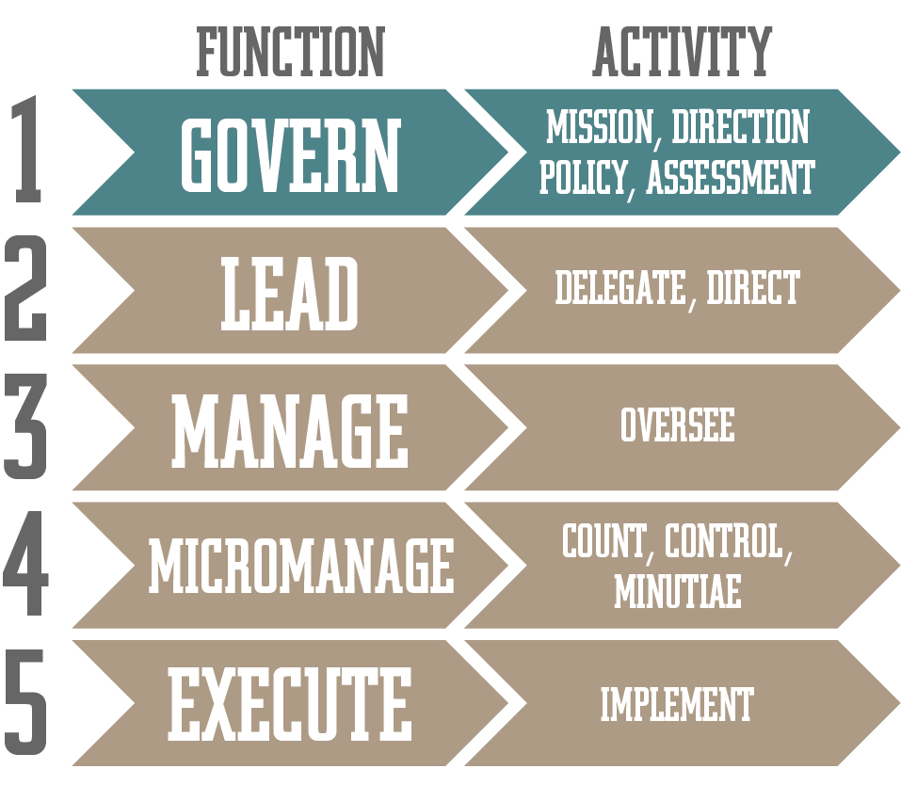
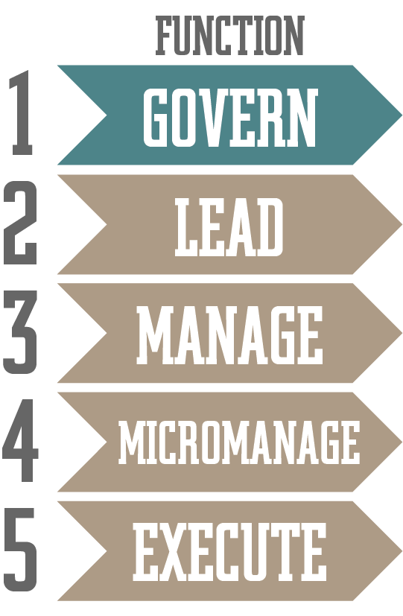


ORGANIZATIONAL ROLES
5
Notes:
22

Slide 23
Today’s
Most Important
Point
?

Slide 24
Reminder
Boards don’t own
what they don’t create.
Notes:
24

Slide 25
Thank you for joining us today.
I wish you every success
as you develop
your Intentional Board!

Slide 26

v Governance v
v Board Retreats v
v Feasibility Studies v
v Capital Campaigns v
v The Asking Academy v
v Conference Keynotes v
When your campaign is about more than money. .
Notes:
26

