Slide 1
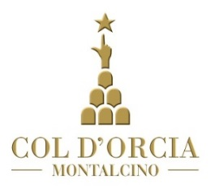
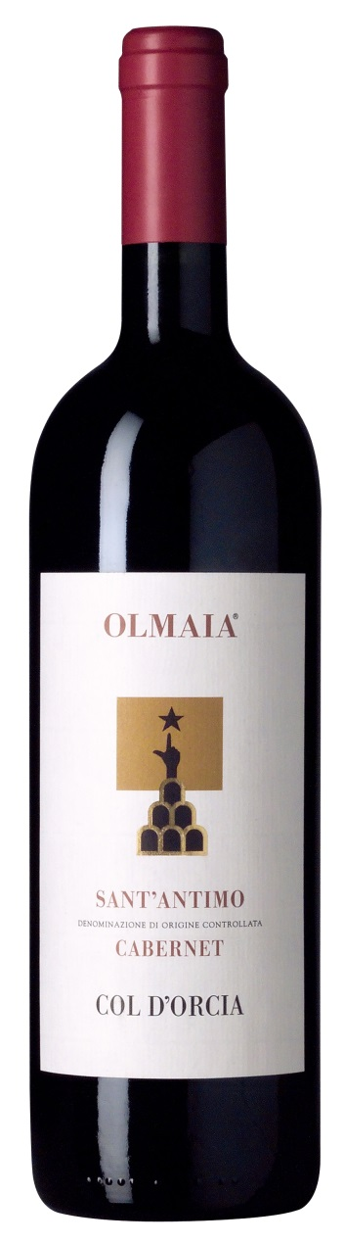
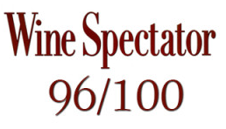
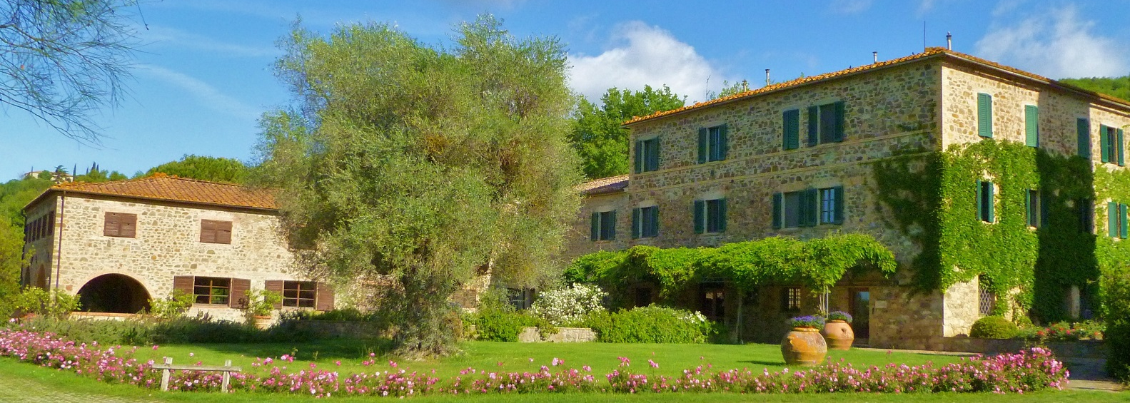
Olmaia Sant’Antimo Cabernet DOC 1990
The Château Latour of Italy. Stupendous masses of cherry, berry and mint character and loads of tannins. It's super-concentrated yet shows refined tannins. Truly superb. Best after 1997. 500 cases made. February 1995

Slide 2
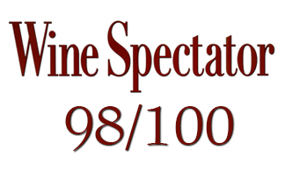
Olmaia Sant’Antimo Cabernet DOC 1990
A stupendous red, made from young Cabernet Sauvignon grapes. Black color, with intense violet, mint and berry aromas and hints of earth. Full-bodied, with big velvety tannins and a long, caressing finish.--1990 Tuscany retrospective. Drink now through 2010. 500 cases made. –JS October 2000.

