Slide 1

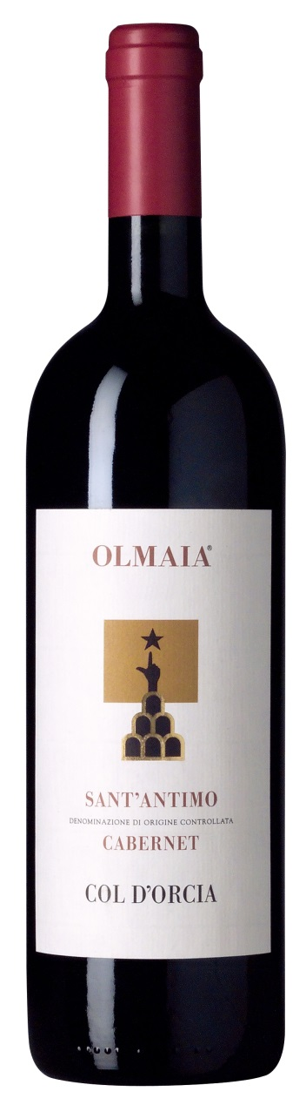

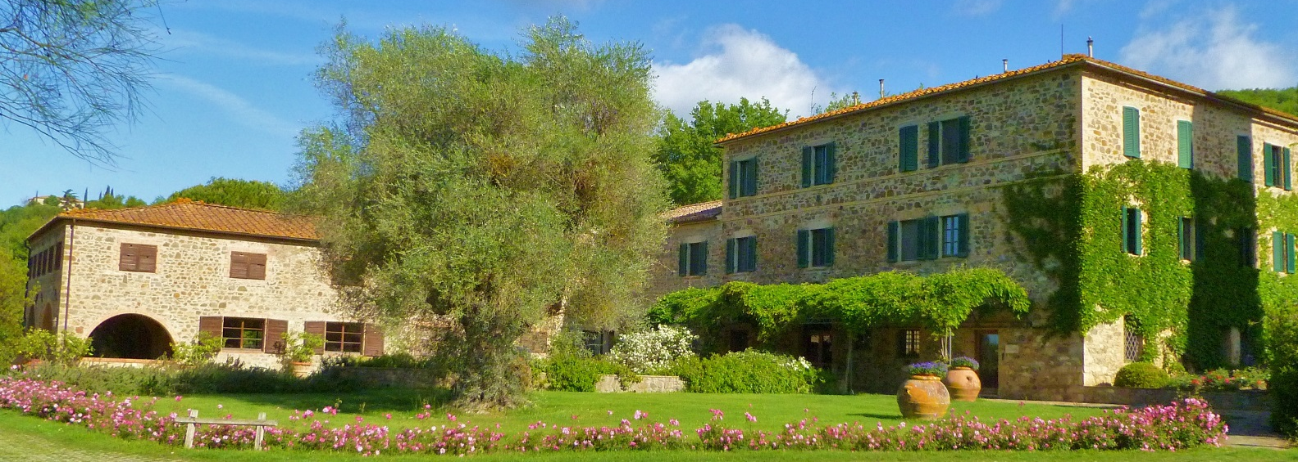
Olmaia Sant’antimo Cabernet DOC 1993
Fabulous winemaking. Silky and caressing from start to finish. it's full-bodied, with blackberry, cherry and tobacco aromas and flavors and full yet polished tannins. Long finish. Better after 1998.

