Slide 1

Peer Support Group Workshop
Personalised Eating Disorder Support
‘Building A Life To Get Well For’
Mandy Scott – Co-Founder & Registered Nurse
Shama Hanif – Peer Support Worker
Charlotte Norman - Peer Support Worker
Office Tel: 01733 300290
Website: www.pedsupport.co.uk
Email: admin@pedsupport.co.uk

Slide 2

Coming into ED services and what to expect:
Accessing services can feel daunting; however, you have done the right thing by reaching out for support!
After referral into PEDS, the next step is an initial assessment to understand your needs and goals, followed by collaborative planning on what support may be helpful.
We have a personalised approach; we aim to create a care plan that focuses on your personal needs and goals.

Slide 3
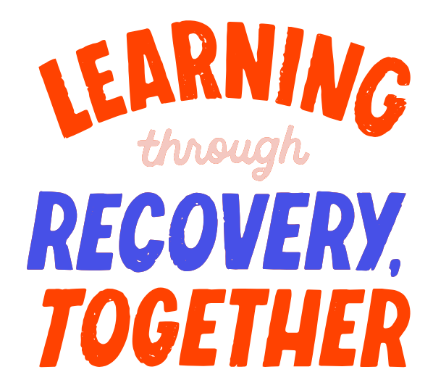
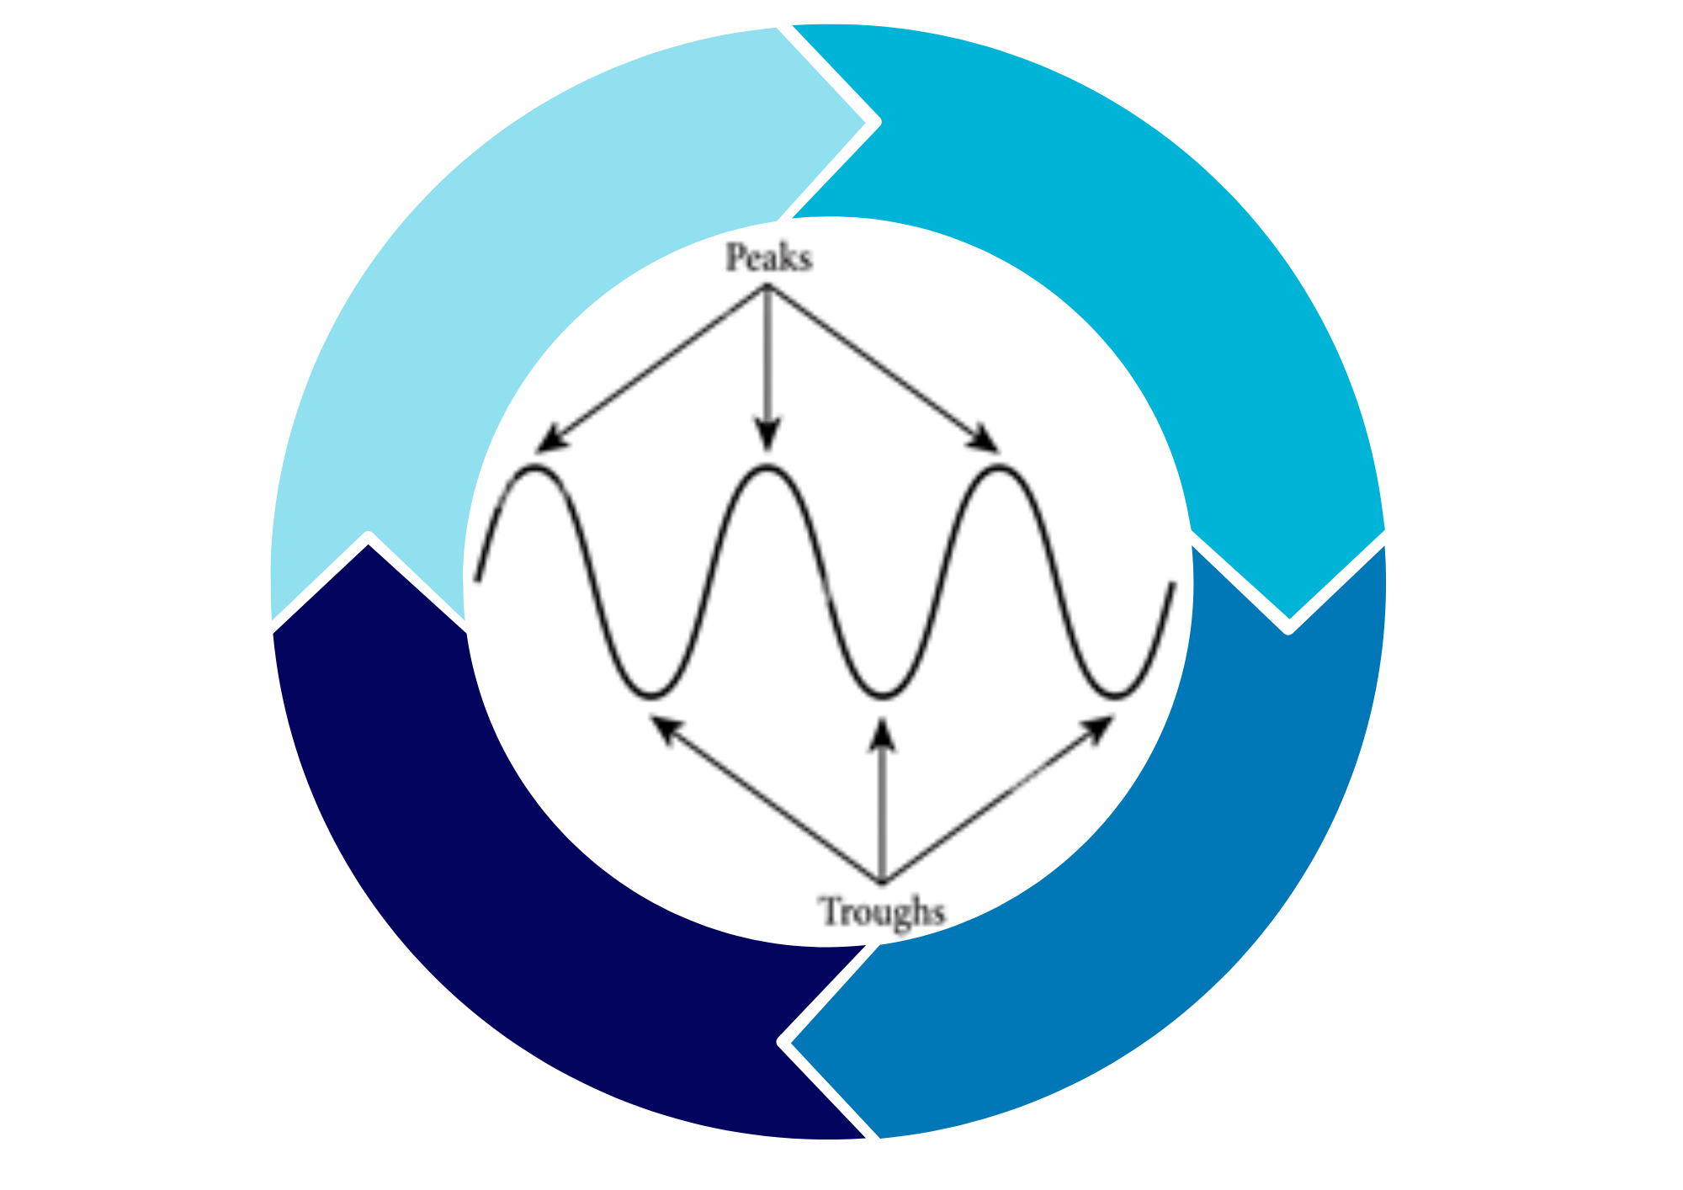
Cycle of Recovery and Hope:
Not a linear process.
Recovery is about building a toolkit to deal with things if they happen.
Things become easier the more you face them.
What works for you? What didn’t work?
Practice self-compassion during difficult times.
Lean on your support network- you don’t have to do this alone.
Celebrate progress, even the wins that feel small.
Strategies may change, so be flexible with what works for you.
Hold on to hope; recovery is possible.
There may well be setbacks or blips; these don’t mean you have failed!
Put a plan in place for if setbacks happen.
HOPE – Hold On Pain Ends
Magic bean

Slide 4
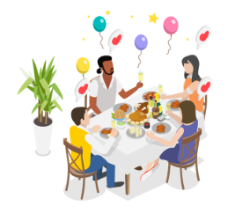
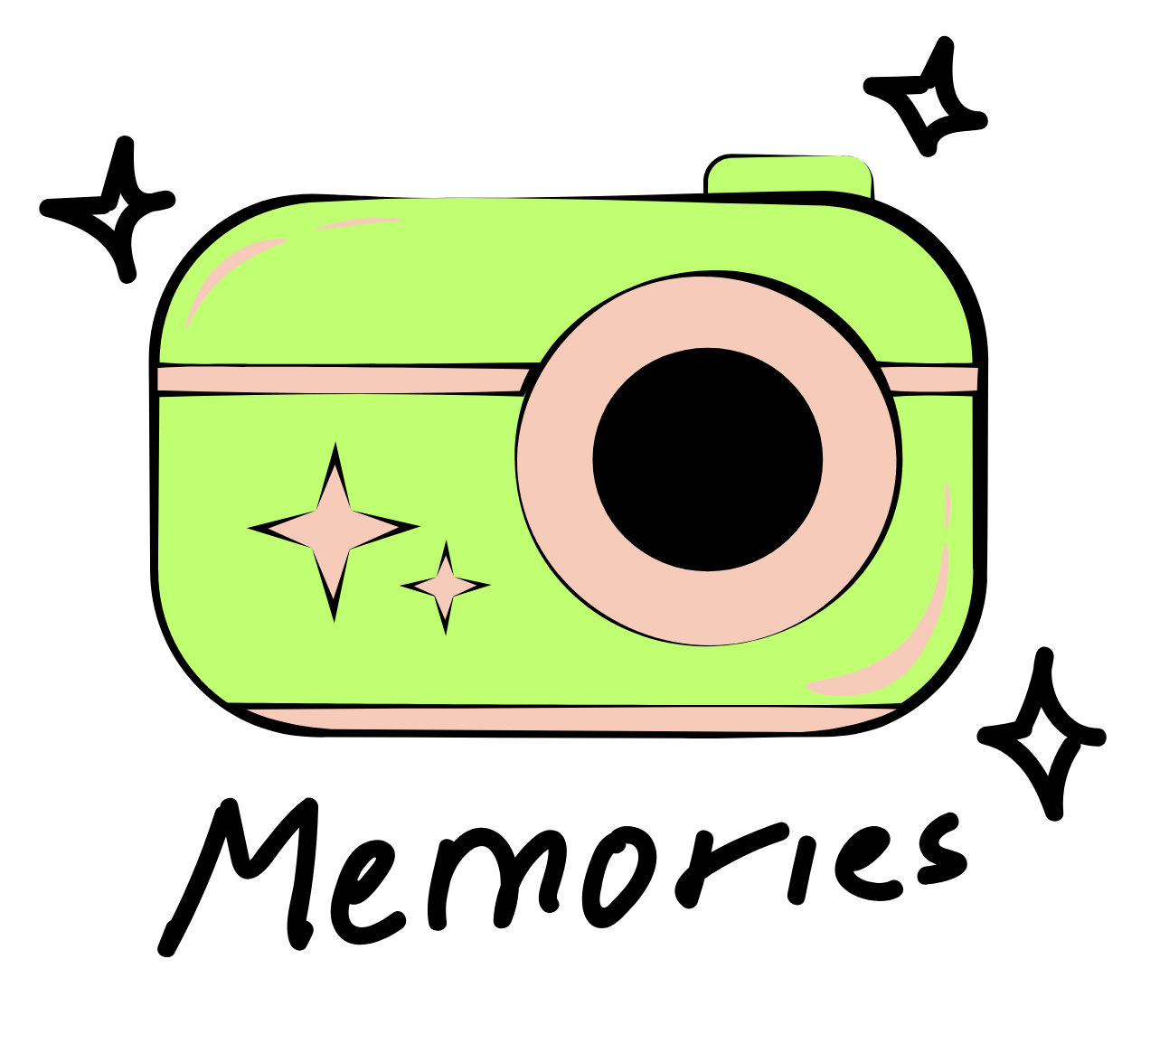
Coping with parties and holidays (Summer/Christmas/Easter):
What are your fears?
Which holiday do you dread the most and why?
Plan – outfit/food.
Share with a safe family member or a trusted friend.
Discuss in sessions.
Push yourself, but not so much that you won’t enjoy it.
Remind yourself that life is about making memories!
Don’t want to look back on pictures with regrets.

Slide 5
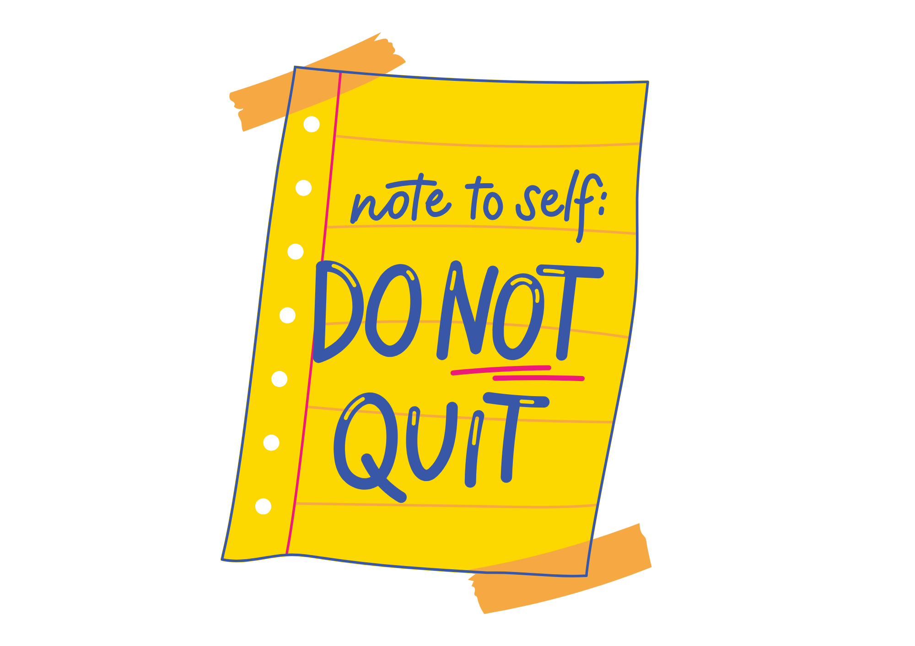
Coping with parties and holidays (Summer/Christmas/Easter):
Set realistic expectations and accept that things may not go perfectly and that it’s about progress, not perfection.
Prepare coping strategies and plan how to handle difficult situations that may arise
Self-care before and after, schedule time for rest, reflection, or relaxation
Acknowledge your courage and effort for attending and engaging, even if it felt challenging.
Focus on enjoyment and connection with people who are important to you.

Slide 6

Body image and weight gain:
What is body image? What does it mean to you? What can your body now do that it didn’t before? What are you grateful for? Stop/limit body checking. Gradually phase it out.
List all the positives you are gaining from recovery – focus, not cold, less extreme hunger. How is your life changing for the better?
Normalise change: our bodies naturally change over time, and that’s part of health and healing.
Focus on what your body allows you to do (energy, concentration, connecting with the people you love).
Challenge unhelpful comparisons and notice when you compare yourself to others and redirect back to your own journey.
Wear clothes that feel comfortable and supportive, donate or sell clothes that no longer fit.

Slide 7

Body image and weight gain:
Replace negative thoughts with kinder, neutral, or appreciative statements about your body and all the things it is capable of and allows you to do
Treat yourself as you would treat a close friend going through recovery
Remember you are more than your body, focus on your values, relationships, skills, and hobbies
Celebrate milestones and acknowledge progress in your recovery, even small wins e.g. enjoying a meal with friends, going on holiday
Clothes clear out! Wardrobe experiment – throw out or bring forward a new you
Numbers don’t define you - letters
Aiming for body acceptance

Slide 8
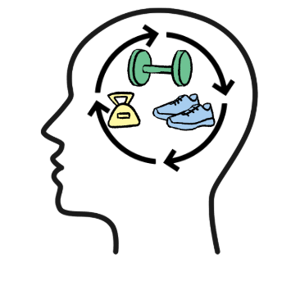
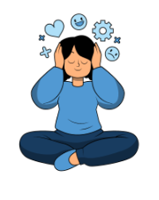
Managing addictive exercise :
Take a moment… Why do you exercise?
What do you think other people’s answers would be?
Risks of compulsive exercise on your body
Gradually reduce (make it shorter, one less day)
Change up your exercise – something less intense or more social
Find time for other things you enjoy – experiment with these
Pie chart of your life – what takes up most of your life now?
How could or would you like it to look?
Commitment to yourself… What could you change?

Slide 9
Managing addictive exercise:
Plan rest and recovery days as essential for health
Engage in gentler, mindful activities such as yoga, stretching and walking in
nature that focus on enjoyment rather than calorie burn.
Track progress based on your mood, energy, or strength improvements rather
than calories or weight. Ditch the apps and the watch!
Share your exercise goals with a trusted friend, family member, or clinician for
accountability.
Acknowledge and celebrate each time you challenge your thought and reduce the intensity or frequency of exercise
Remind yourself that it is important to choose movement that energises and
nurtures you, rather than letting it dominate your life. It should enhance your
wellbeing and daily life, without taking over your time, energy, or focus.
Fuel for exercise – car.

Slide 10

Coping with comments/expectations from others:
Put yourself in a bubble – let them bounce off.
Comments say more about the person making them than you.
Responses can be helpful to have in your toolkit :
‘I’d rather not discuss …’ ‘This conversation is not helpful to me’ or change the topic entirely.
Remember, you are allowed to set boundaries.
It’s okay to walk away from conversations that feel harmful.
Seek support from people who understand and respect your journey.
Practice self-compassion after hearing unhelpful comments and
remind yourself of your progress.
Set negotiable and non-negotiable boundaries.
Family/trusted people and work colleagues.
Managing ‘you are looking well/healthy’ and ‘well done’ (poem).

Slide 11

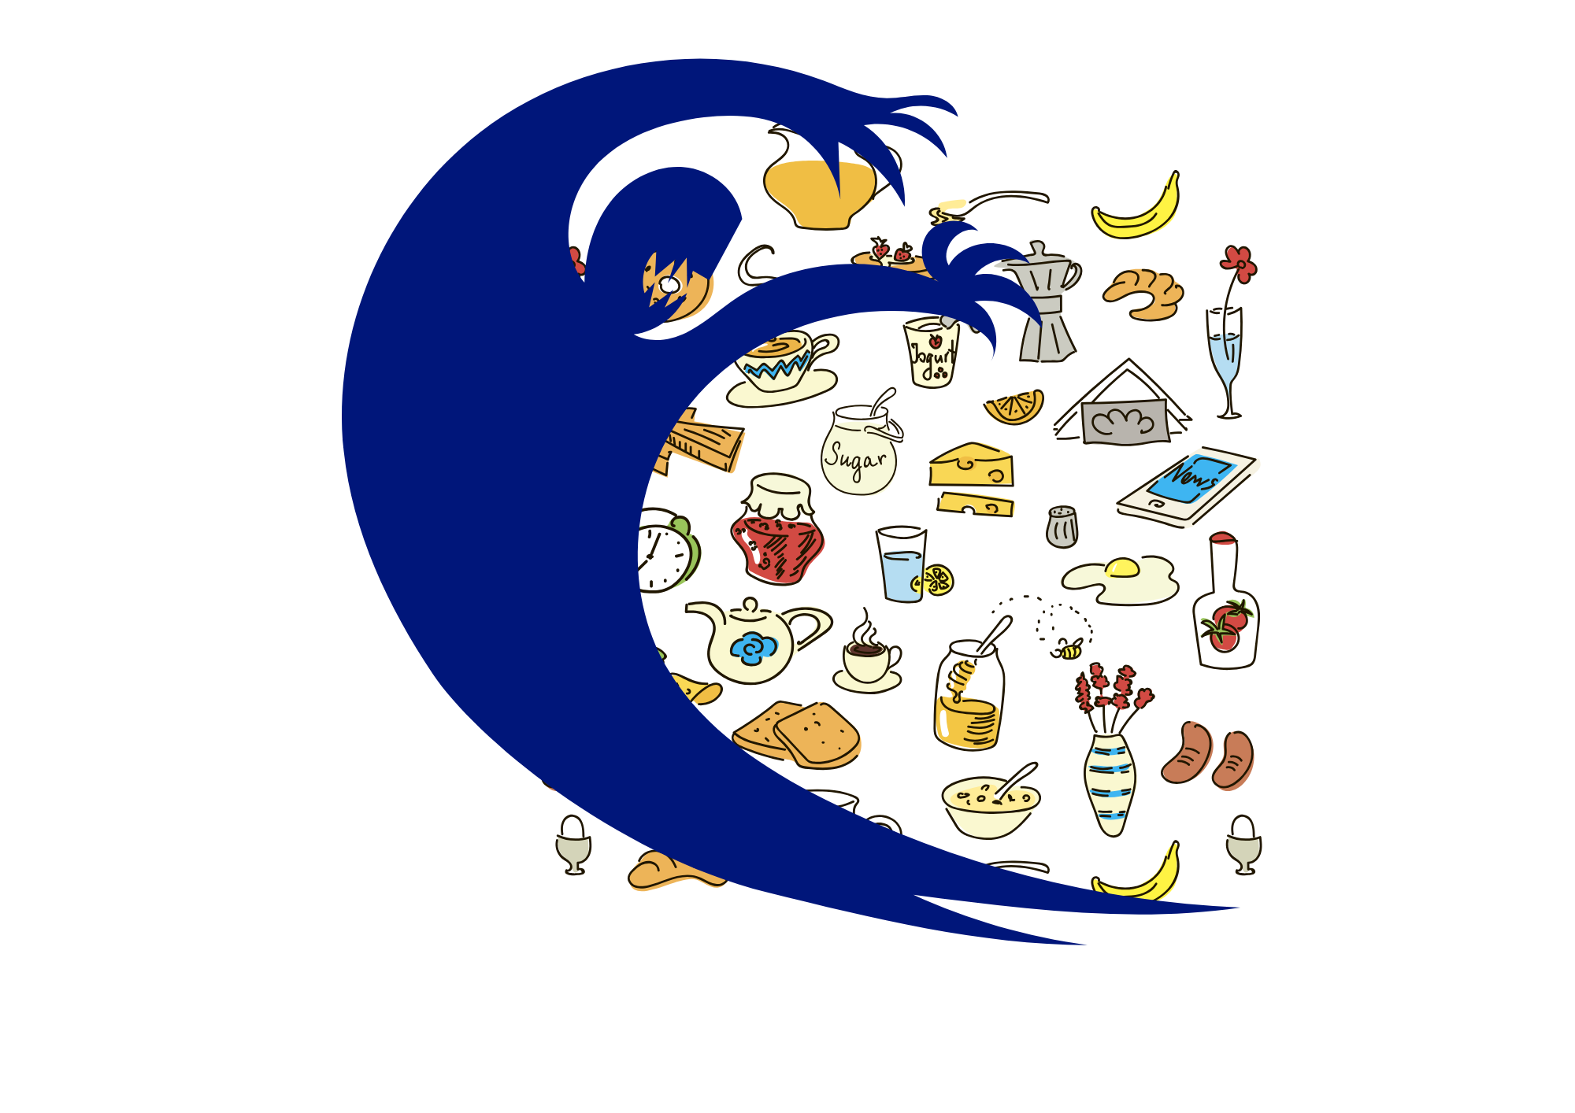
Facing fear foods:
What is a fear food?
How does it impact your life?
Make a list of fear foods – do you miss any?
Make a ladder – baby steps to get there.
Could be – first write it on the list, then buy it and take it home,
then buy it and have a bite with a friend or someone you trust,
have a bite by yourself. Eat half. Then the whole thing.
Note down afterwards how it made you feel – what did you enjoy? Taste?
Celebrate wins, each attempt strengthens confidence and
helps reduce fear over time
Use strategies to manage thoughts, challenges, distractions,
motivations and sitting with

Slide 12
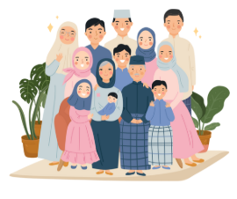
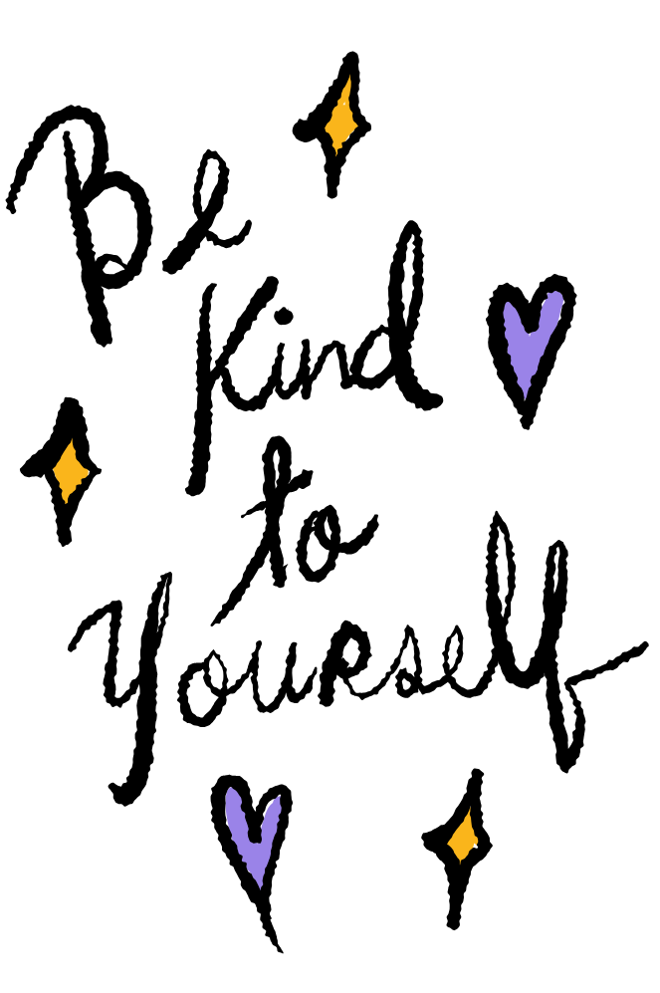
Coping with Eid/Ramadan/
Religious festivals:
Plan and consider how fasting, meal times, and celebrations may affect your eating and recovery routine.
Communicate with trusted people and share your needs with family, friends, or faith leaders if certain practices might be triggering.
See if you can participate in ways that feel safe for you and in a way that supports your recovery
Focus on connection and the social, spiritual, and cultural aspects of the festival, not just the food.
Practise self-compassion and acknowledge that it’s normal to feel challenged by food-related aspects of the festival.
Reflect afterwards and make a note of what worked well and what was difficult. You can use sessions to think about how you might use this to adjust for next time.
Celebrate wins, as any step you take to balance participation with recovery is progress.

Slide 13
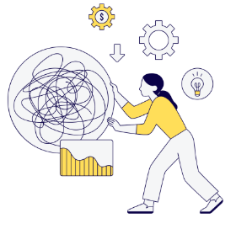
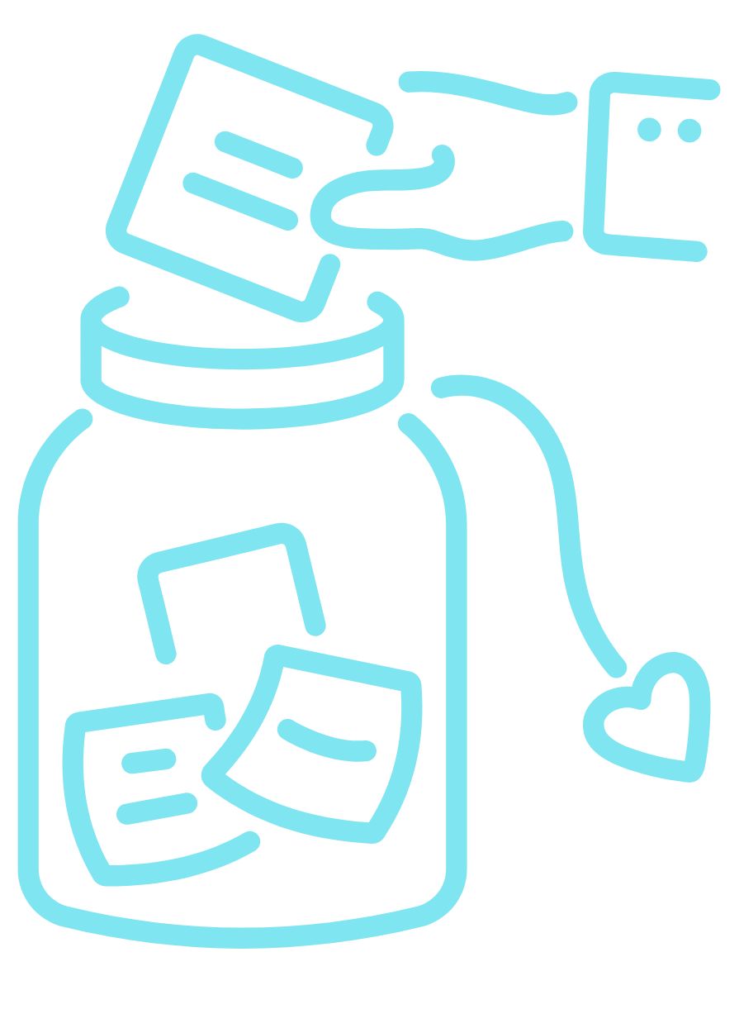
Managing ED thoughts:
5 main strategies – distraction, challenging, motivation to recover,
sitting with thought, stamp it out - no airtime.
Write them down – flashcards (sometimes this helps to rationalise) .
Write down evidence as to why your intrusive thought isn’t true.
ED will get louder when you start to fight it – proves it’s working.
ED thoughts are like a plant.
Voices decrease over time.
Sit with the thought – it can’t hurt you!
Identifying motivations for recovery- vision boards.
Celebrate when you’ve challenged and not acted on a thought, add it to a Wins Jar.

Slide 14

Going to university/ planning for university:
Starting university can bring a lot of change and while that can feel challenging, it’s also an exciting time to grow and learn, meet new people, and explore new interests. Common challenges that people with an ED might face when they are going to University include changes in routine, being responsible for their own food shopping and making meals, social pressures, academic stress and anxiety and leaving support networks.

Slide 15
Going to university/ planning for university:
Planning ahead:
Contact the university’s wellbeing or disability team before you start so that you can request adjustments and see what support is available.
If it would be helpful, PEDS can contact the university with your consent to share relevant information and help with getting support put in place
Register with the local GP as soon as possible.
Prepare a wellbeing plan- triggers, signs you are struggling, what helps when you’re struggling, who to contact, how to ask for help.
Managing Routine Changes:
Create a flexible but structured daily plan that includes meals, rest, and study breaks.
Keep a few safe and easy meals you can fall back on during busy or stressful times.
Consider setting meal reminders or alarms on your phone if you are prone to forgetting meal/snack times. Fuel will provide energy to help you focus
3 P’s- Plan, Prepare, Pack

Slide 16
Going to university/ planning for university:
Support Networks
Contact the university wellbeing service or university nurse to see what support is available.
Stay connected to support systems at home and check in regularly
Self-Compassion & Adjustment
Remember that it’s okay to take things at your own pace- recovery is ongoing and is about progress not perfection
Practice self-care activities often
Celebrate small wins - attending lectures, trying new foods, or reaching out for help are important to recognise.

Slide 17
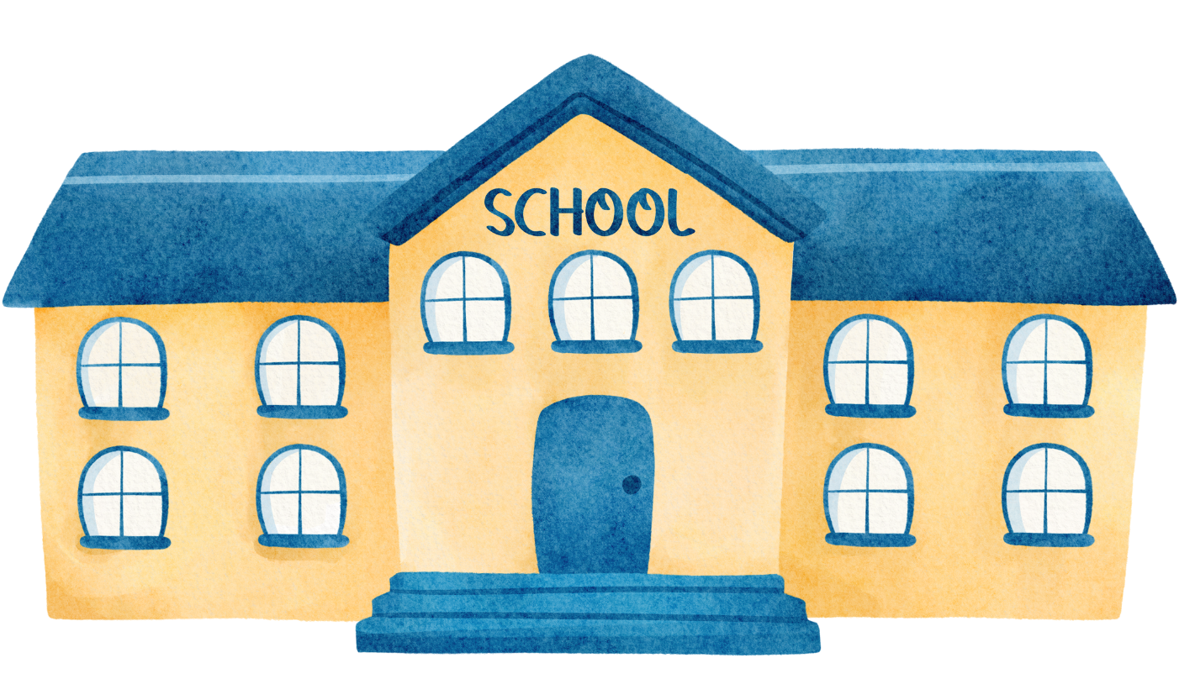
Returning to school:
3 P’s- Plan, prepare, pack
Communicate and seek support- let a trusted teacher, school nurse, or counsellor know if you might
need extra support.
Tell a friend or family member what helps you during busy or stressful school days.
Keep your support team updated about how you’re coping.
It’s normal to feel anxious or unsettled- be kind to yourself
Focus on small wins- getting up on time, eating breakfast, staying through the day, using coping tools.
Identify tricky situations and brainstorm ways to handle them. You might find it helpful to do this in
a session with PEDS.
Have a plan for what you can do if you are struggling and who you can talk to
Schedule downtime and self-care after school
Remind yourself that one tough day doesn’t mean you’re going backwards-
recovery is about progress, not perfection.

Slide 18

Social media:
Be aware of your triggers- notice what types of posts or accounts make you feel worse about yourself
If something consistently makes you feel anxious, guilty, or inadequate, that’s a sign to mute, unfollow, or block.
Follow accounts that promote things that lift you up, not weigh you down.
Include non-appearance content too- hobbies, animals, art, nature, music, to remind yourself there’s more to life
than body image.
Social media should be a tool for connection, not comparison.
Give yourself permission to step back and take a break from social media, as this can help with reducing anxiety and comparison.
Schedule periods where you are not spending time on your phone or set screen-time limits. Notice how your mood shifts when you spend less time scrolling. That awareness helps you choose what feels healthy for you.
Remember that social media is highlight reels, not real life. Photos and videos are filtered, staged, and edited.
Remind yourself- I don’t know what’s really going on behind that post.
If you use recovery accounts, make sure they focus on hope, healing, and balance rather than numbers or body image.

Slide 19
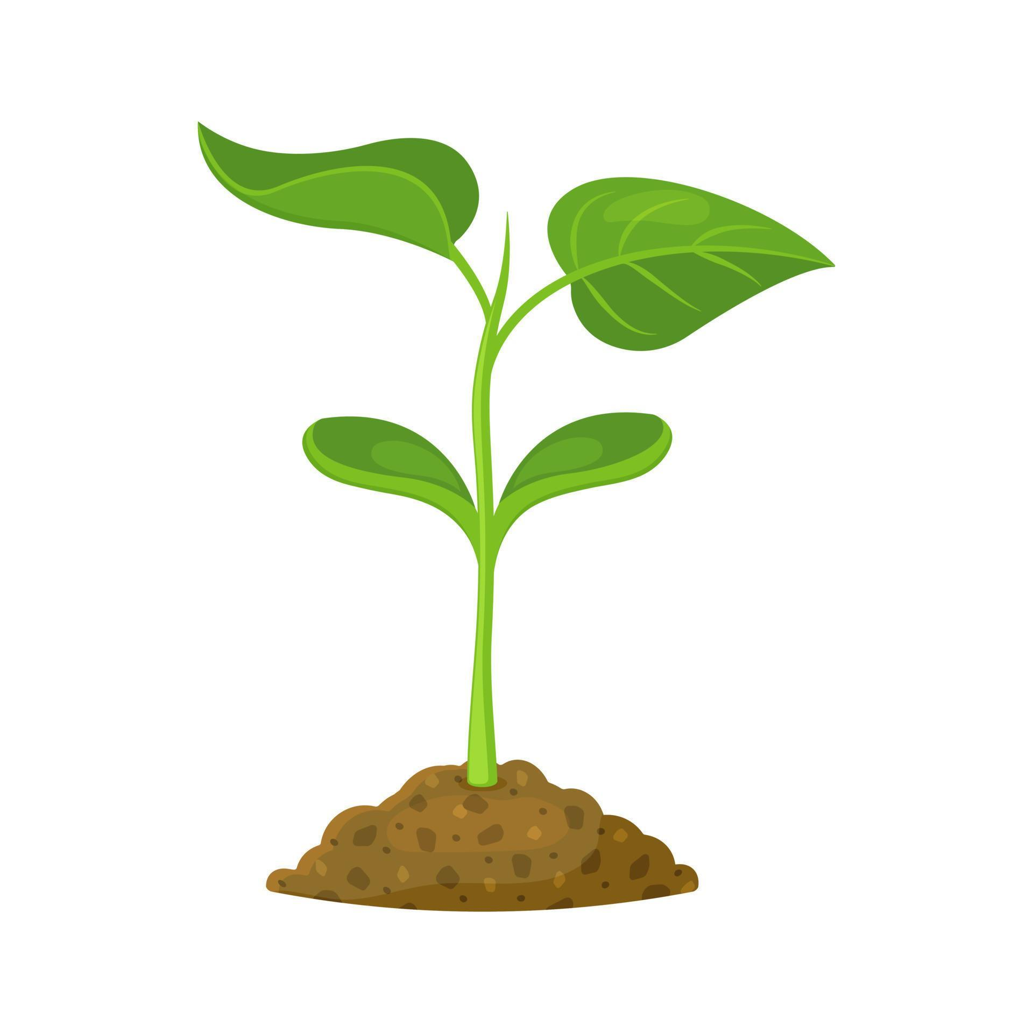
Coping with endings and moving on
Even positive endings can feel difficult, and the eating disorder may feel like something reliable during uncertainty around ending. You might notice needing to challenge eating disorder behaviours more frequently when you are coming towards ending as the behaviours might feel familiar or comforting.
Endings can bring up:
Fear of losing support or stability
Fear of coping alone
Feelings of grief or loss
Uncertainty about the future
Loss of structure or routine
Fear of change

Slide 20
Coping with endings and moving on
Remind yourself that it is ok to feel mixed emotions about ending
Reflect on how you’ve coped with endings in the past. If you have had a negative experience, think about how you can manage differently and what support you might need. Alternatively, consider any positive experiences with ending and how this was managed
If you are someone who struggles with endings, it might be helpful to plan ahead and prepare as this can help reduce anxiety
Keeping routines around meals and daily activities can provide stability
Ending one support doesn’t mean being alone- consider what other support is available and people you can lean on when you are moving on
Reflect on the progress you have made and remind yourself what you’ve learned and how far you’ve come. Ending support doesn’t erase the progress you’ve made, and you will have your toolbox from sessions and your managing setbacks plan to support you with continuing your recovery
Could your experience help others? Could this be a motivator to keep you accountable with your recovery and something to work towards?

Slide 21
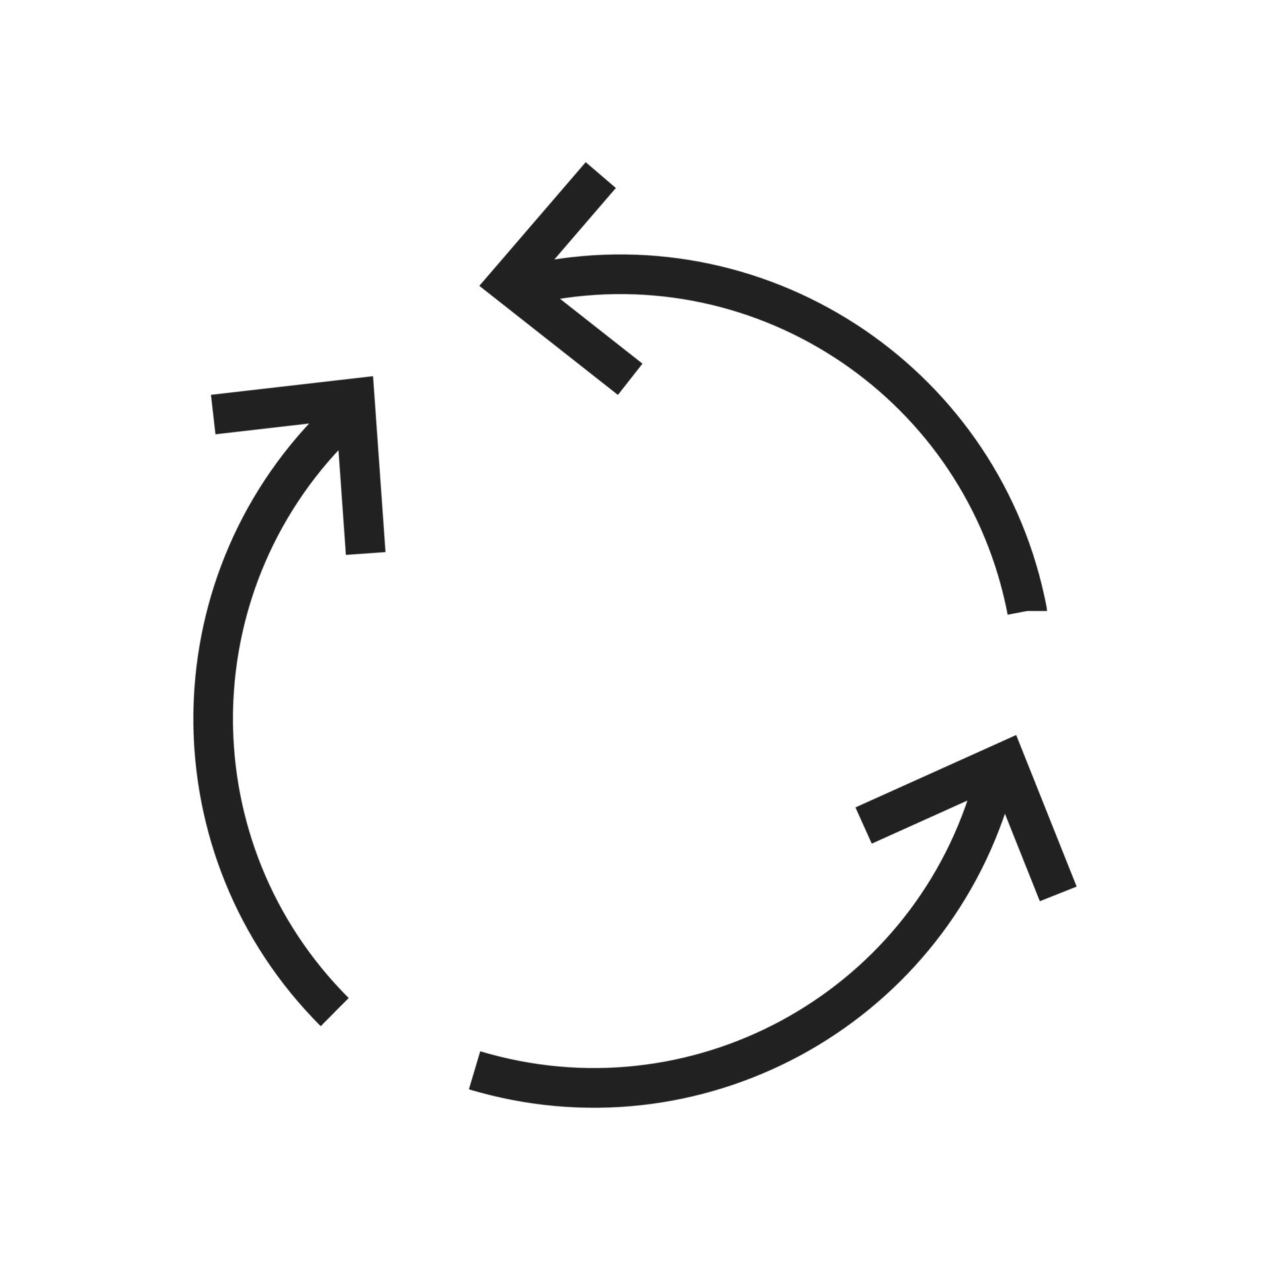
Replacing one ED behaviour with another
Replacing one ED behaviour with another
In Eating disorder recovery, it’s common for one eating disorder behaviour to reduce while another increases. This can be difficult to manage and can often feel disheartening or that recovery is impossible.
When people start working on their recovery, the ED might feel louder and thoughts may become more frequent. This often reflects that the eating disorder is trying to maintain a sense of control or safety.
Eating disorder behaviours often serve purposes such as managing anxiety, feeling in control, coping with difficult emotions or seeking comfort or distraction, so it can be helpful to think about what role the ED plays in your life.
Registered Charity Number: 1156578

Slide 22
Replacing one ED behaviour with another
Think about the role the ED plays in your life and whether there is an underlying need it is fulfilling. It is helpful to see if you can notice any patterns as this will allow you to identify triggers and support you might need.
Use strategies to manage thoughts- challenging, distraction, motivation and sitting with the thought.
Build a toolbox of alternative ways to cope, this might include- talking to a friend or family member, journaling or grounding exercises.
If you are stuck in this cycle, consider harm minimisation e.g. If you feel you need to go to the gym for 2 hours before going to a restaurant for dinner, consider reducing the time at the gym to 1 hour.
Work on gradually reducing behaviours and implement small steps to tackling behaviours
Add any successes to your wins jar- when you’ve reduced a behaviour and not replaced it with another
Most importantly, be patient with yourself. Recovery is often not a linear process and each step away from harmful behaviours is progress.

Slide 23
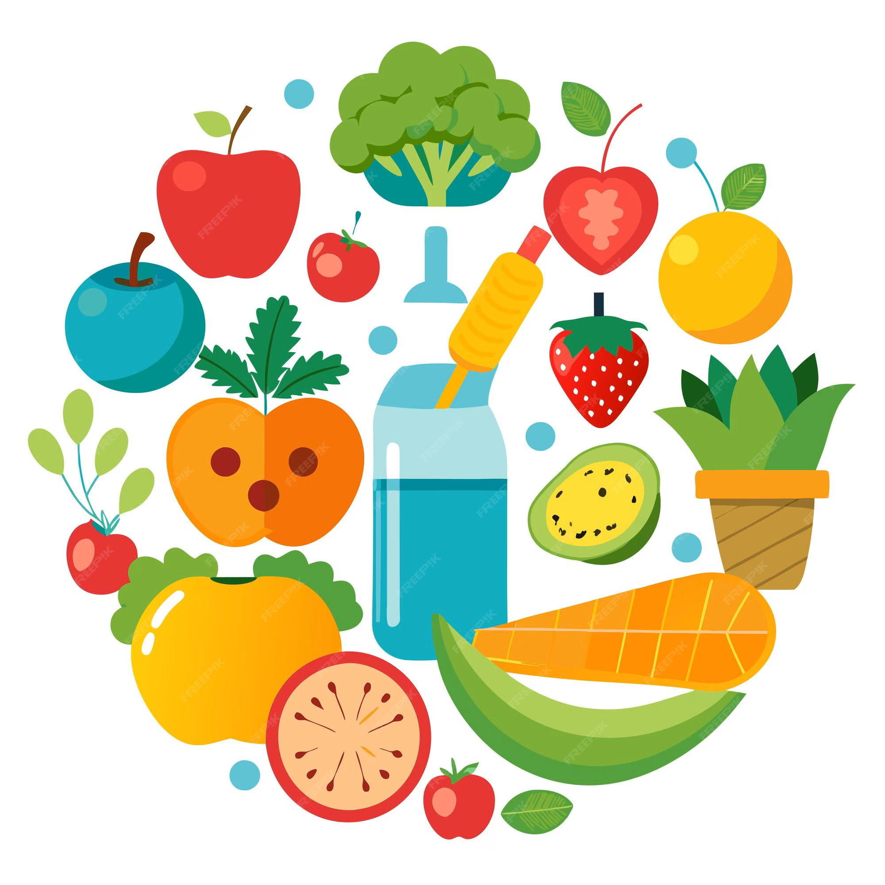
Orthorexia
Orthorexia involves an intense focus on eating in a way that is perceived as “healthy” or “clean”. Whilst it is important for us to be mindful of how we are fuelling our bodies and getting the nutrients that we need, orthorexia can become harmful as it causes anxiety, restriction and rigid rules. It often develops gradually and can feel socially acceptable, making it harder to recognise despite the negative impact it can have on daily life.
Potential physical and mental negative effects of Orthorexia:
Nutritional deficiencies and weakened immune system as a result of avoiding food groups
Impact on bone health and development of Osteoporosis
Hormonal disruption and loss of period which can affect bone health and result in fertility issues
Stress on organs including heart, kidneys and liver
Increased anxiety and guilt about food
Social withdrawal as a result of avoiding meals out or family gatherings
Low mood
Rigid food rules and restriction

Slide 24
Orthorexia
Things that can help:
Challenging food rules gradually with the support of professionals and loved ones
Reminding yourself that all foods can have a place in recovery and there is no “good or bad” foods.
Focusing on your overall wellbeing as health includes mental, emotional, and social wellbeing.
Food is more than just nutrition- for example, it allows us to connect with people, experience different cultures, it can involve celebration, comfort and enjoyment.
Include fun foods- food pyramid
The REAL Food Pyramid
Registered Charity Number: 1156578

Slide 25
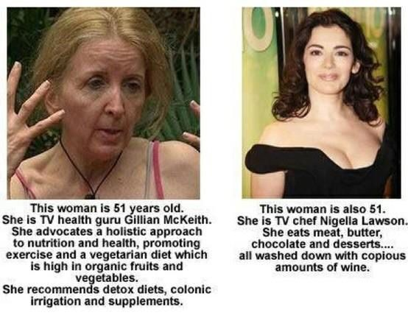
Orthorexia

Slide 26
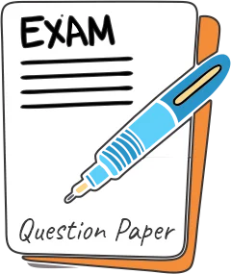
Coping with exams
Exams often cause increase anxiety and stress which can make it harder to manage an eating disorder.
Not fuelling your body properly will impact concentration, memory and decision making which makes revision more difficult.
Food = fuel for the brain and will help with focus and concentration
Stick to your meal plan as much as possible and aim for regular meals and snacks
If you are cooking your own meals, think about pre-planning, it might be helpful to purchase some ready meals or batch cook meals
During high stress, it might be helpful to think about a list for snacks and meals that feel safe and accessible
Create structure where you schedule in meals/ snacks and time to rest between revision
Schedule self-care and time to wind down
Reach out for support from friends, family and tutors/ teachers
Remind yourself of your motivations for recovery and goals and hopes for the future

Slide 27

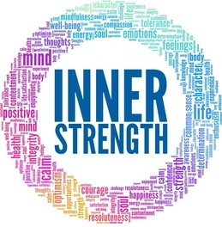
Coping with guilt
An important part of recovery is challenging eating disorder thoughts and behaviours. However, it is common for people with an eating disorder to experience guilt after doing this. The guilt can feel overwhelming and is often something the eating disorder uses to try to stay in control. However, each time you challenge the eating disorder, you are becoming stronger and taking back control. It can be helpful to think about ways you can manage this as you continue to work through your recovery.
Registered Charity Number: 1156578

Slide 28
Coping with guilt
Use the 4 strategies to manage thoughts- distraction, challenge, motivation and sitting with the thought
Use flashcards to help with challenging thoughts, write down the thought on one side and the challenge on the other
Identify your reasons for recovery and hopes you have for the future- create a vision board as a reminder
Remind yourself of the times you have challenged the ED before, you can do this and recovery is possible- create a win's jar to help recognise positives and see this fill up as you move through your recovery
Normalise the feeling and tell yourself that “The eating disorder is making me feel guilty”
Practise self-compassion and use positive affirmations e.g. – “My body is just my shell, it’s what inside that counts”
Use grounding techniques
Reach out for support

