Slide 1
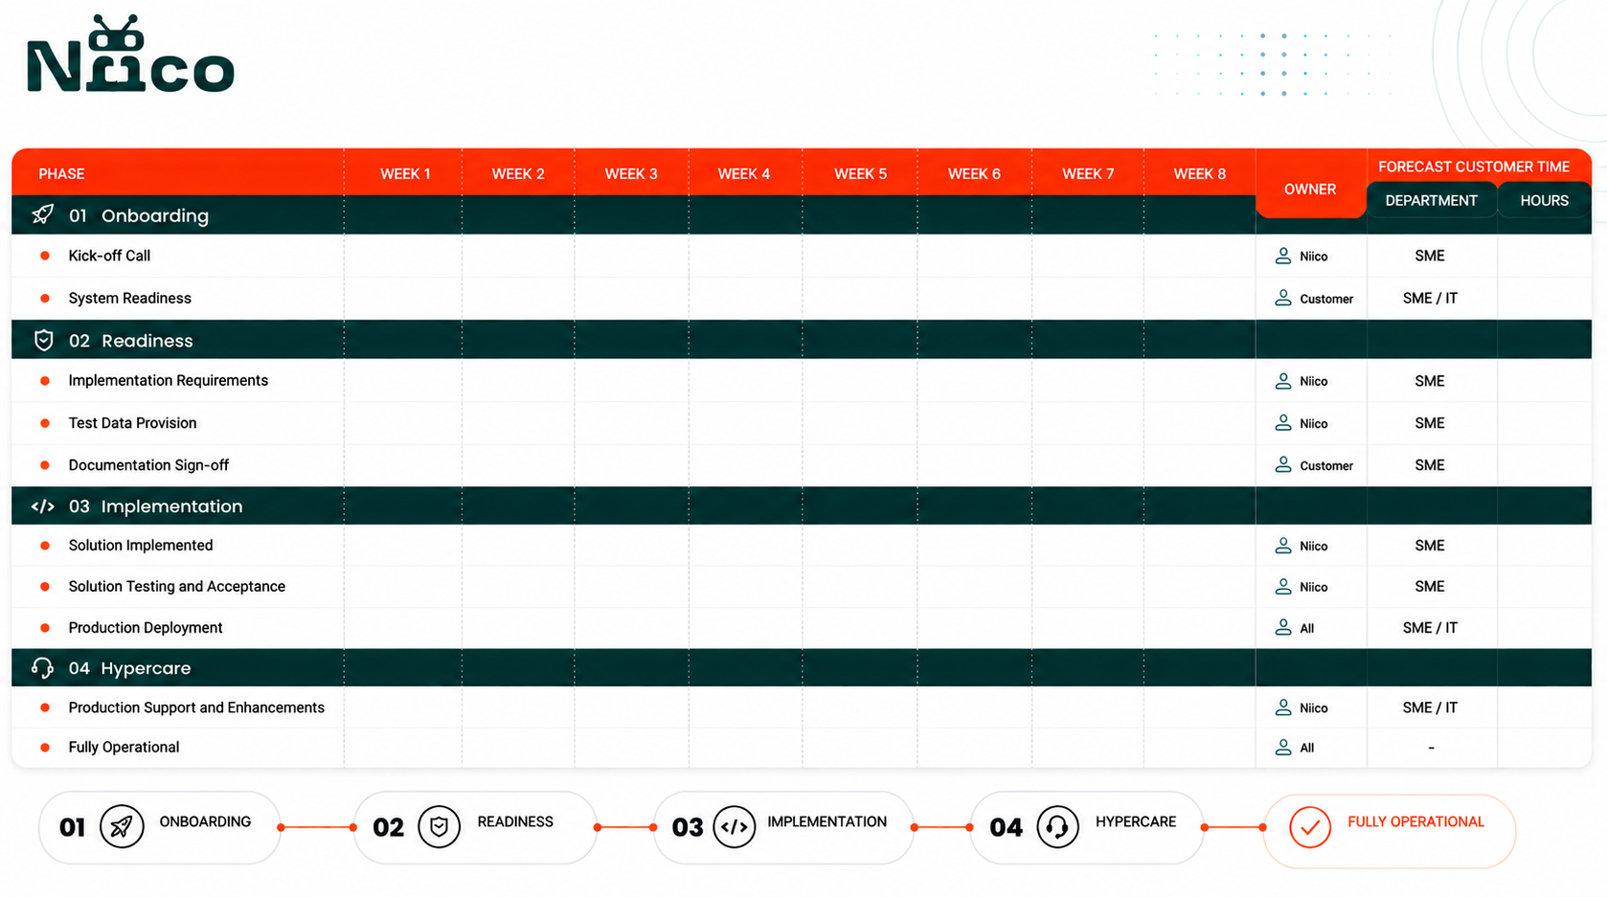
Document Ingestion and Management
1
2
4
2
2
2
4
2
4
-
WEEK 1
WEEK 2
WEEK 3-6
WEEK 6-7
WEEK 8

Slide 2
ELTV
1
2
4
2
2
2
3
2
4
-
WEEK 1
WEEK 2
WEEK 3-5
WEEK 5-6
WEEK 7

Slide 3

Interview Scheduling
1
2
4
2
2
2
5
2
4
-
WEEK 1
WEEK 2
WEEK 3-7
WEEK 7-8
WEEK 9

Slide 4
Academic Eligibility Decision
1
2
4
2
2
2
6
2
4
-
WEEK 1
WEEK 2
WEEK 3-8
WEEK 8-9
WEEK 10

