Slide 1



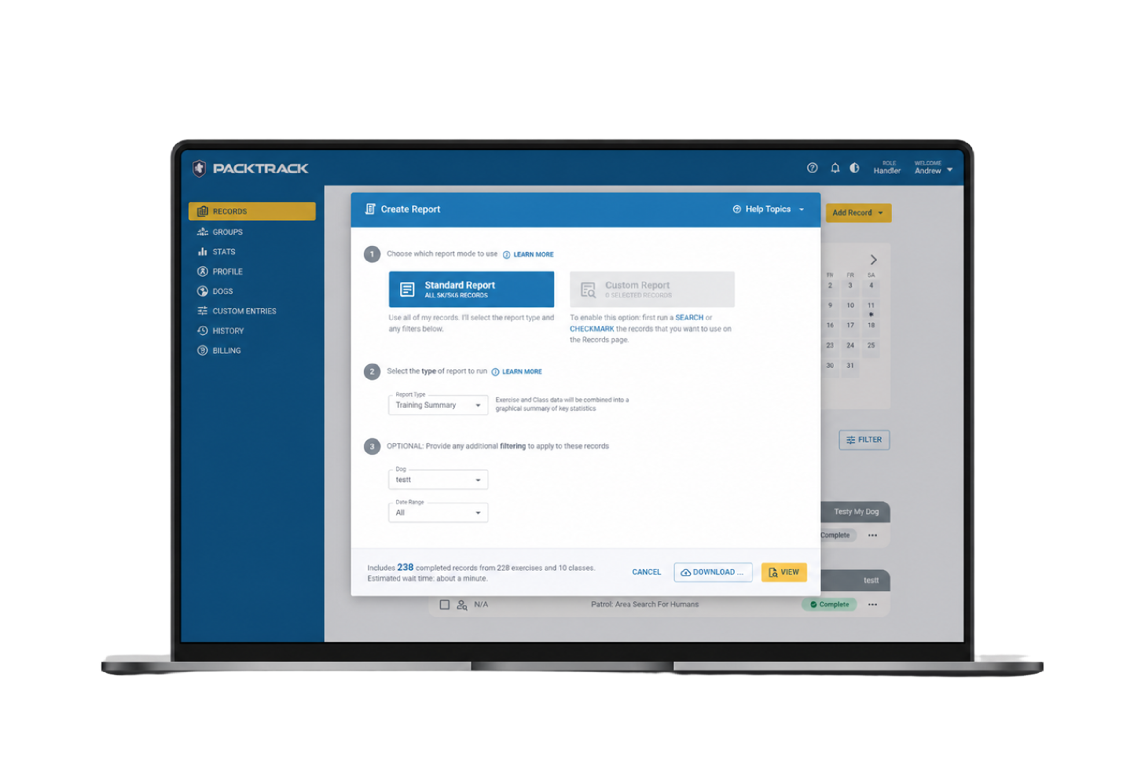
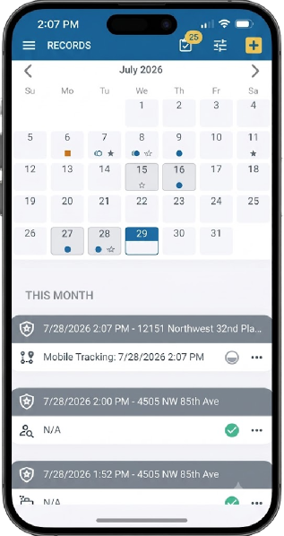


★ 5.0 App Store · ★ 4.5 Google Play
K9 record management built for consistent, court-ready documentation
Log training and deployments, reduce repetitive entry, and generate reports from recorded activity in one system.

Slide 2





K9 documentation should not depend on scattered notes, spreadsheets, or memory
Training and deployments get entered late
Short sessions never make it into the record
Reports get rebuilt from scattered files
Trainer feedback gets separated from the official record
Supervisors chase files instead of reviewing the unit

Slide 3





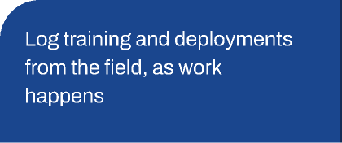
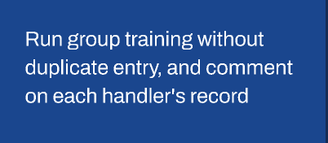
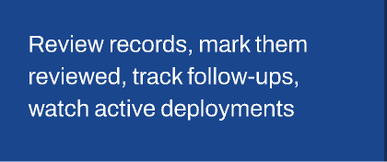
With PackTrack, you get one system for records, reporting, and review
Field logging
Structured records
Trainer feedback
Supervisor review
Reports
PackTrack connects the full K9 documentation workflow, so the same record can support every role in the unit.
One record. Multiple roles. Less re-entry.
Handlers
Trainers
Supervisors
Command
See documented activity across the program and pull reports on demand

Slide 4






Less paperwork after the fact
Handlers can log training, deployments, and short sessions from the field instead of rebuilding records later from notes or memory.
Quick Training
Mobile field logging
Automatic date, time, and location capture
Voice-to-text notes
Reports from recorded activity
Less catch-up after the shift. More complete records when documentation is needed.

Slide 5
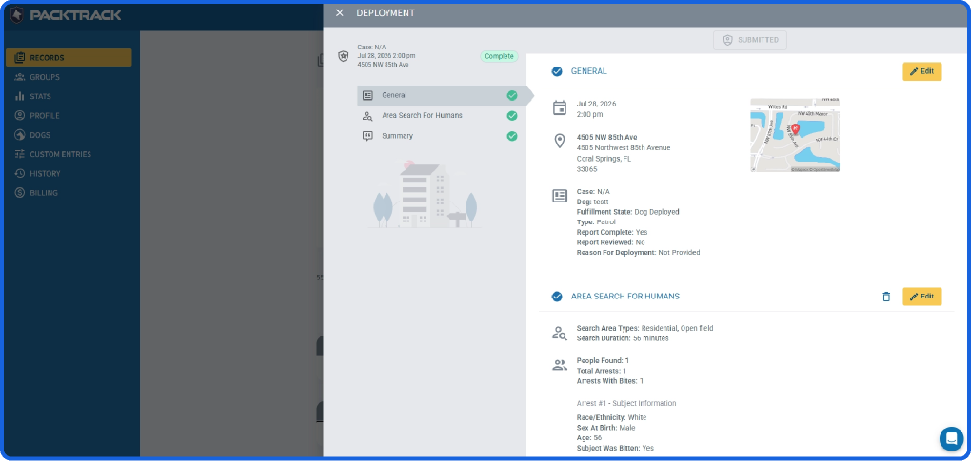




Clearer oversight without chasing records
Supervisors can review handler records, mark records as reviewed, generate summary reports, and monitor active tracking deployments in real time.
Reviewed status
Follow-ups surfaced clearly
Summary reports across handlers
Live tracking visibility
GPS handler movement plotted on the dashboard

Slide 6


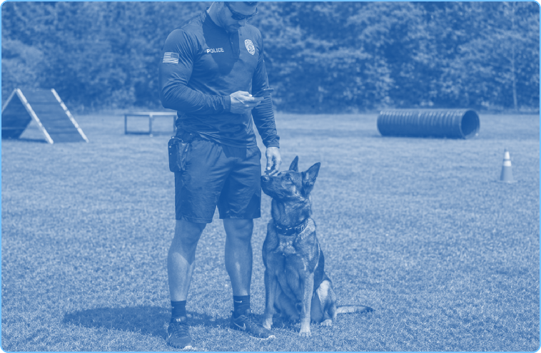
Consistent training records with feedback tied to the record
K9 Training Groups
Shared exercise details entered once
Trainers can reduce duplicate entry during group training and leave comments, corrections, and positive actions directly on each handler’s training record.
Individual performance records preserved
Trainer comments on each record
Corrections and positive actions documented in one place
Cleaner training history. Less duplicate entry. Feedback that stays with the record.

Slide 7
Simple pricing for handlers and departments
Trainer access included
Supervisor access included
Billing manager access included
30 day free trial
Monthly subscription
Annual subscription
Save $28 per year
$14/mo
$140/year
Per handler
Per handler
A handler subscription covers the handler and all of their dogs.
A handler subscription covers the handler and all of their dogs.
Full access to PackTrack web and mobile app
Full access to PackTrack web and mobile app
Map tracking features
Map tracking features
Handler access for all assigned dogs
Handler access for all assigned dogs

Slide 8


Questions your department may ask before approving PackTrack
Yes — PackTrack supports web access plus dedicated iPhone and Android apps.
Yes — supervisors can access records, mark them as reviewed, and generate summary reports.
Yes — trainers can comment on individual training records and document corrections or positive actions.
Records remain available unless removal is requested, including viewing and creating reports from old records.
User roles, access needs, mobile access, record retention, and department security requirements.

Slide 9

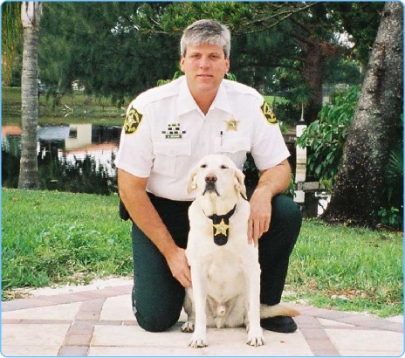
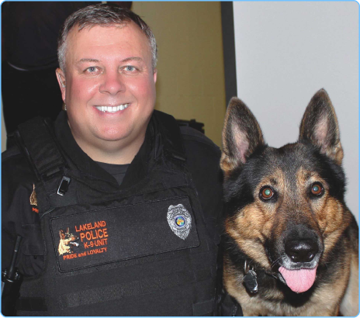

Built by people who understand K9 work
30+ years each in law enforcement and K9 work
Co-authors of Canines in the Courtroom
Developed and tested with K9 training experts connected to HITS K9
Andrew Weiman
Jeff Barrett
I’ve learned more about training police dogs from Jeff Barrett and Andy Weiman [PACKTRACK’s creators] than from all of my other classes combined. These guys know what they’re talking about and it works. They know it works because they’re on the streets catching bad guys and finding drugs like no one else.
Retired law enforcement / K9 professional
Retired law enforcement / K9 professional
★ 5.0 App Store · ★ 4.5 Google Play
Deputy Morgan Case, Ada County Sheriff’s Office, Idaho

Slide 10
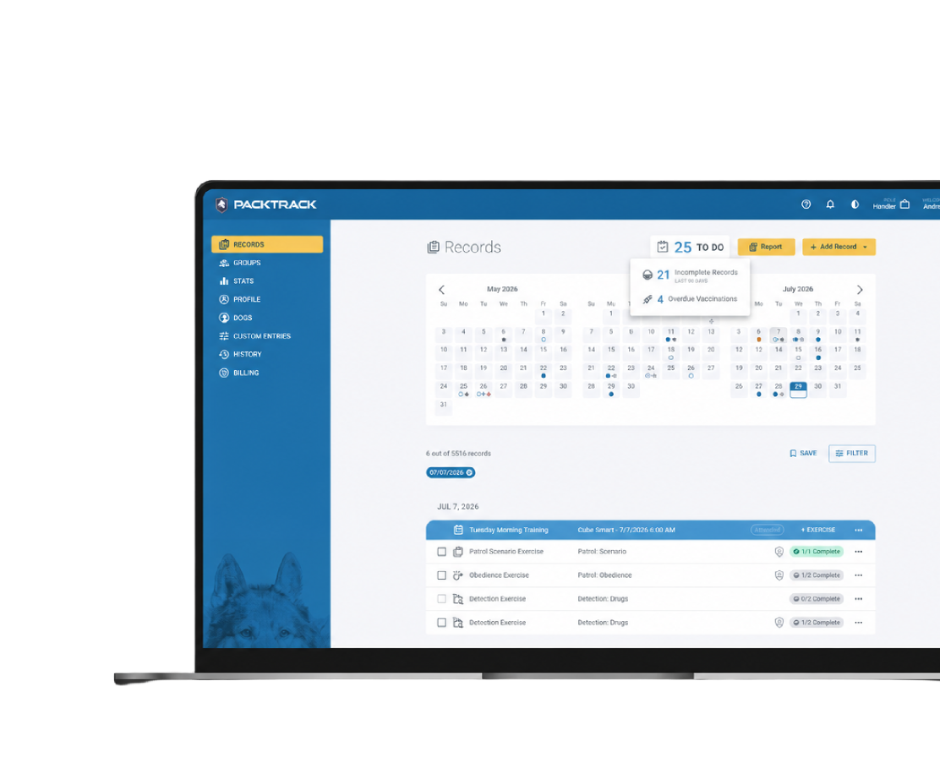

Ready to keep K9 records consistent, report-ready, and easier to manage?
★ 5.0 App Store · ★ 4.5 Google Play
PackTrack helps K9 units log training and deployments, reduce repetitive entry, review records, and generate reports from recorded activity — all in one system.
Start with one handler
Roll out across the department
Keep documentation ready when it matters

