Slide 1
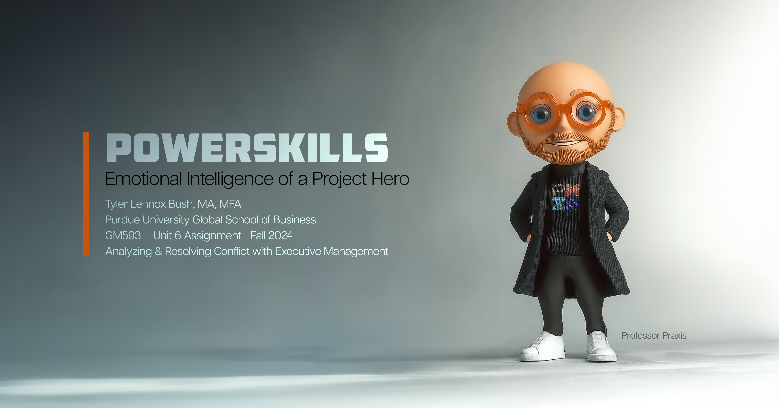
Notes:
This presentation, examines the role of Emotional Intelligence (EI) in transforming a project manager into an effective leader who navigates project complexities and challenges with empathy, resilience, and collaboration. Anchored in Joseph Campbell's "hero’s journey" (1949), the project manager is cast as a modern-day hero, equipped with EI as a guiding compass. Through an analysis of real-world scenarios, this paper explores how EI enables project managers to build trust, manage conflicts, secure stakeholder buy-in, and foster a cohesive team environment. By aligning with theories of EI (Goleman, 1995; Mayer, Salovey, & Caruso, 2008) and tribal leadership (Godin, 2008; Logan, King, & Fischer-Wright, 2008) and drawing on Agile methodologies as an empathetic approach (Griffiths, 2023), this journey demonstrates how project managers can evolve into project heroes.

Slide 2
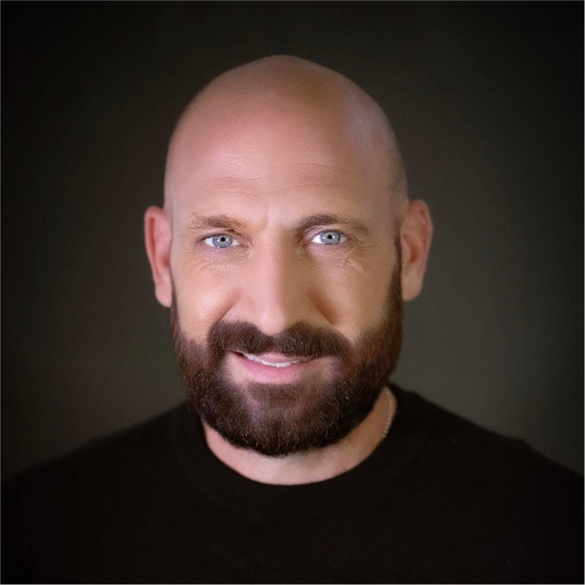
Tyler Lennox Bush, MA, MFA
Purdue Global School of Business – Fall 2024
Professor of Practice at Purdue University Northwest
PMI Member – Calumet Chapter
Specific Research Area:
Visual Communication & Design
Art & STEM Integration
TV & Film Practicum
Screenwriting
Media Studies
Project Management
Generative Ai
Notes:
Good Afternoon everyone. My name is Tyler Bush, and I’m delighted to have the opportunity to share insights today on Emotional Intelligence in project management and how it transforms project managers into true leaders, capable of guiding their teams through the many challenges that come with complex projects. As a Professor of Practice at Purdue University Northwest and a member of the Project Management Institute's Calumet Chapter, my work and research bridge multiple disciplines. My focus areas include Visual Communication & Design, Art & STEM Integration, and Media Studies, alongside practical applications in TV & Film Practicum and Screenwriting. This interdisciplinary approach allows me to examine how storytelling, creativity, and emotional intelligence come together to shape effective leadership. I believe that project management is more than just timelines and deliverables; it's a journey that requires resilience, empathy, and an understanding of human dynamics, which are all supported by Emotional Intelligence. Today, we'll dive into how EI can serve as a project manager's compass, helping navigate both technical and interpersonal challenges, and I hope you'll find these insights valuable in your own roles."

Slide 3
Table of Contents
  Introduction
  Emotional Intelligence (EI)
  Conflict Resolution Skills
  Problem-Solving Techniques
  Conclusion
  References
Notes:
"Here’s a quick overview of what we’ll cover in today’s presentation. We’ll start with an introduction to the concept of Emotional Intelligence, or EI, in the context of project management. From there, we’ll dive deeper into what EI is and how it serves as a foundational skill for effective leadership. We'll then explore conflict resolution skills, which are essential for managing complex relationships, particularly with executive-level stakeholders and functional managers. This will be followed by a look at some problem-solving techniques—specifically, models that can be used to get buy-in from stakeholders and navigate challenges effectively. We'll wrap up with a conclusion that highlights the transformative impact of EI on project leadership, followed by a references slide that credits the scholarly works that have shaped this presentation. This outline will guide our journey through the critical skills and insights needed for project managers to lead not just with efficiency but with empathy and resilience. Let’s get started."

Slide 4
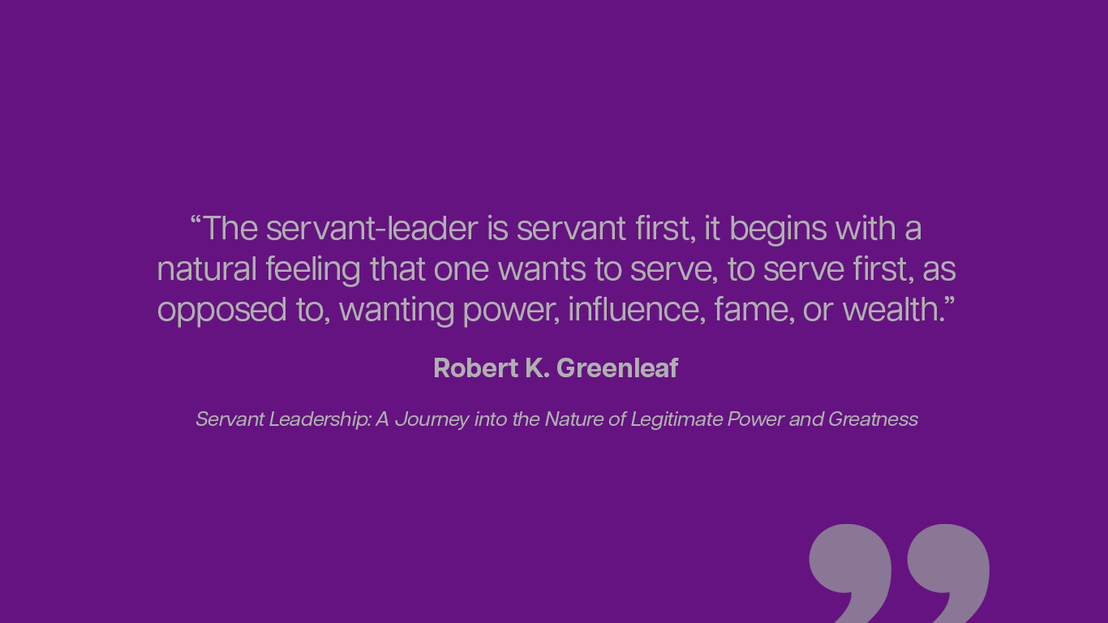
Notes:
Robert K. Greenleaf, the founder of the concept of 'servant leadership.' Greenleaf’s work challenges the traditional view of leadership as a position of power and control. Instead, he suggests that true leadership begins with a desire to serve others. The servant-leader, he argues, puts the needs of the team and the community above their own ambitions for influence or personal gain.
This idea is particularly relevant in project management, where collaboration and trust are essential. By approaching leadership as service, project managers can foster a culture of empathy, support, and respect. When we focus on empowering and uplifting others, we’re better able to inspire our teams, navigate challenges, and drive projects to success. This aligns closely with the principles of Emotional Intelligence—especially empathy and self-awareness—as well as Agile methodologies, which prioritize people and interactions over strict hierarchies.
Greenleaf’s vision of servant leadership reminds us that effective leadership is less about control and more about facilitating growth, well-being, and shared purpose within the team. In essence, it’s about leading with the heart and prioritizing the impact we have on others."

Slide 5
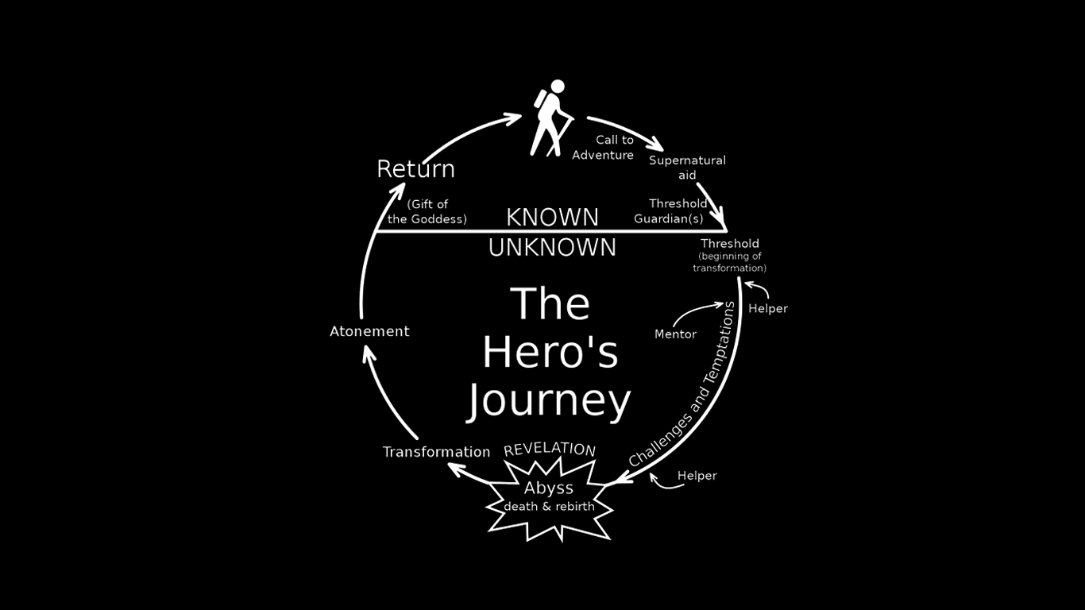
Notes:
"Here, we have a visual of Joseph Campbell's 'Hero's Journey,' a classic framework that represents the path of transformation many leaders and project managers experience. Campbell describes the hero’s journey as a 'monomyth,' a universal story pattern that exists across cultures. In his words, 'A hero ventures forth from the world of common day into a region of supernatural wonder: fabulous forces are there encountered and a decisive victory is won' (Campbell, 1949). This journey mirrors the challenges and growth we often face in leadership.
For leaders, the journey starts with a 'Call to Adventure,' much like the beginning of a new project or responsibility. As we cross the threshold into unknown challenges, we encounter mentors, allies, and sometimes obstacles that test our commitment and resilience. Just like in project management, we face trials and may experience a 'dark night' or the 'Abyss,' where doubts and fears arise. Yet, it’s through this process that we achieve transformation, gaining the insights and strengths that ultimately prepare us for the 'Return'—where we bring new knowledge and skills back to our teams.
This framework encourages us to view challenges as an integral part of growth. Every leader’s journey involves a cycle of struggle and learning, and by embracing this, we build resilience and a deeper understanding of ourselves and our teams. Campbell’s model helps us recognize that the path of leadership is not linear but cyclical, filled with both trials and triumphs that shape who we become.

Slide 6
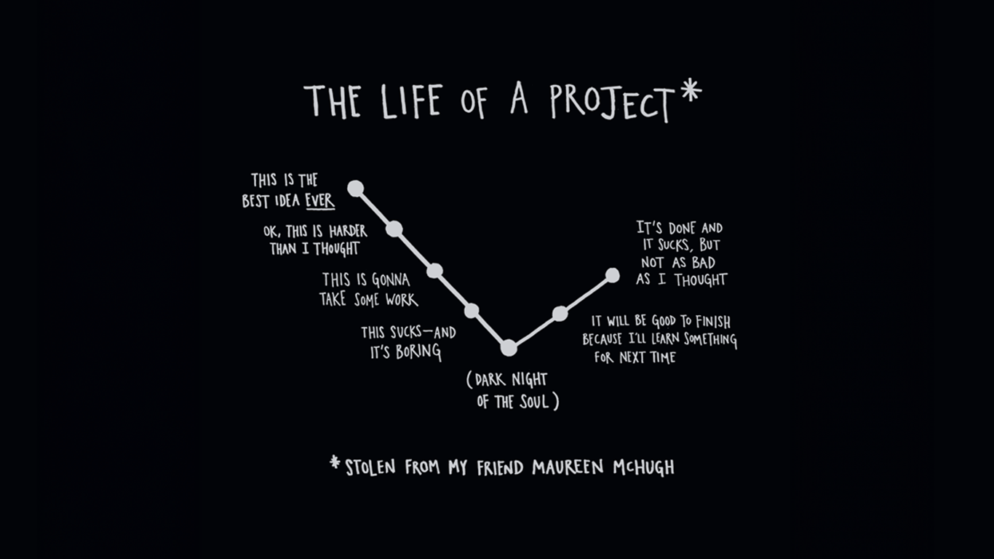
Notes:
In the world of project management, every new project feels like a journey—a hero's journey, to be precise. Joseph Campbell’s concept of the hero's journey describes a cyclical path filled with highs and lows, moments of triumph and despair. Much like Campbell’s hero, a project manager begins with a “call to adventure”—the thrill of a new idea, the belief that this project is unique and bound for success. Enthusiasm runs high, and we’re convinced that what lies ahead will be smooth sailing. Yet, just like in any hero's story, reality sets in, challenges arise, and we begin to understand the true scope of what we’ve committed to.
The journey quickly shifts into phases of trials and self-doubt. As the work gets harder, the complexity increases, and our initial excitement wanes, we encounter what Campbell calls the "Ordeal"—the darkest part of the journey, where self-doubt and frustration are at their peak. It’s the point where, as project managers, we begin to wonder if we’ll ever get through, if the project is worth the effort, or if giving up would be easier. This "dark night of the soul" is an inevitable phase where we confront our deepest doubts. But it’s also where we dig deep, find resilience, and push through, inching toward the other side with a renewed sense of commitment.
Finally, as we reach the end of the project, we experience a transformation. Like the hero's "Resurrection," we emerge with new insights, a changed perspective, and a sense of accomplishment. The project may not have turned out exactly as we envisioned—perhaps it falls short of that original excitement—but it’s complete, and in that completion lies valuable growth. We learn, we reflect, and we return stronger, ready to take on the next journey with a bit more wisdom and resilience. In Campbell's terms, we’ve come full circle, but we are not the same person who started. Each project, with its highs and lows, shapes us, preparing us for the challenges that lie ahead.

Slide 7
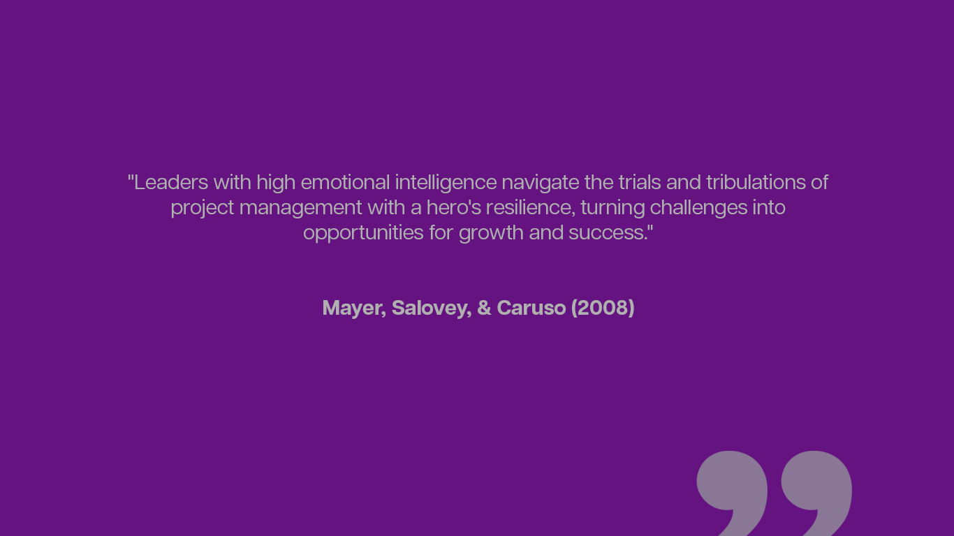
Notes:
"This quote from Mayer, Salovey, and Caruso (2008) highlights the vital role that Emotional Intelligence, or EI, plays in project management. Just as a hero faces trials and challenges along their journey, project managers encounter obstacles that test their resilience and adaptability. Leaders who possess high Emotional Intelligence are better equipped to handle these difficulties, not just by enduring them but by transforming them into opportunities for growth and team development. Emotional Intelligence encompasses key traits such as self-awareness, empathy, and self-regulation. These traits allow project managers to maintain composure under pressure, understand the emotional dynamics within their teams, and foster a supportive environment that encourages collaboration and problem-solving. With this approach, challenges become a source of strength, helping both the manager and the team to learn and improve with each project. Ultimately, project managers with strong EI lead with resilience, inspiring their teams to persevere and achieve success even in the face of adversity. This resilience and adaptability are what make a project manager not just a leader but, in many ways, a hero for the team, guiding them through complex projects toward a successful outcome."

Slide 8
Introduction
The journey of a project manager begins with a call to adventure, a challenge to step into the unknown, face limitations, and rise to serve a purpose beyond oneself. As Campbell (1949) describes, every hero’s journey starts with a call to adventure. For project managers, this call involves gathering a “tribe” of stakeholders, team members, and key contributors to the project. Logan, King, and Fischer-Wright (2008) emphasize that "tribes form around shared values and common goals," making alignment essential. Similarly, Godin (2008) argues that a tribe is a group connected to a leader and an idea, forming a foundation of trust and unity to ensure collaborative success.
The Power Skills of a Project Hero
Active Listening
Communication
Servant Leadership
Emotional Intelligence
Empathy
Notes:
Project managers are both visionaries and problem-solvers, embodying a unique blend of creativity, resilience, and strategic foresight (Harvard Business Review, 2021). Project work is inherently aspirational and often requires a heroic approach to overcome the many challenges encountered along the way. Each project begins a new journey, akin to a quest, where the project manager steps up as a leader, guiding their team through complexities and obstacles (Logan, King, & Fischer-Wright, 2008). Equipped with Emotional Intelligence (EI) as a core "powerskill," project managers are better prepared to navigate adversity, foster team alignment, and pursue a greater purpose (Goleman, 1995; Mayer, Salovey, & Caruso, 2008). Research suggests that EI significantly enhances leadership effectiveness and team collaboration, which are essential for managing diverse work teams and aligning them with organizational goals (Coronado-Maldonado & Benítez-Márquez, 2023; The School of Life, 2019). Central to this journey is "The Truth of the Scope"—the critical understanding that clarity and alignment with project objectives are essential to achieving success (Project Management Institute, 2017).

Slide 9
Emotional intelligence (EI)
is a crucial power skill that significantly impacts a project manager's ability to lead teams, engage stakeholders, and navigate complex project environments. Emotional intelligence involves understanding and managing your own emotions, as well as recognizing and influencing the emotions of others.
Here are the key components of EI as a Hero Power Skill:
Self-Awareness: The ability to recognize and understand your own emotions, strengths, weaknesses, values, and drivers
Self-Regulation: The ability to control or redirect disruptive emotions and impulses and adapt to changing circumstances.
Motivation: A passion for work that goes beyond money and status, and a propensity to pursue goals with energy and persistence.
Empathy: The ability to understand the emotional makeup of other people and treat them according to their emotional reactions.
Social Skills: Proficiency in managing relationships and building networks, and an ability to find common ground and build rapport.
Notes:
Self-awareness, a key component of EI, allows project managers to recognize their own emotions and potential biases, leading to better self-management and controlled interactions with functional managers. According to Goleman (1995), self-awareness enables individuals to understand their reactions and adapt their behavior to promote positive interactions. For project managers, this means approaching discussions about resources with a calm and composed demeanor, which can reduce tension and create a constructive environment for negotiation (Mayer, Salovey, & Caruso, 2008).
Empathy
Empathy is another core aspect of EI that allows project managers to understand the perspectives of functional managers, particularly when faced with resource limitations or competing priorities. Coronado-Maldonado and Benítez-Márquez (2023) highlight that empathy contributes to effective leadership by building trust and fostering a collaborative atmosphere. When project managers demonstrate empathy, they acknowledge the challenges functional managers face and create a supportive environment, enhancing the likelihood of cooperation in resource allocation (The School of Life, 2019).
Self-Regulation
The ability to manage one’s emotions, known as self-regulation, is vital for project managers during high-stakes discussions about resources. Goleman (1995) explains that self-regulation helps individuals maintain focus and avoid impulsive reactions, particularly under stress. By exhibiting self-control, project managers can stay solution-oriented, even when facing resistance from functional managers (Project Management Institute, 2017). This level-headedness not only helps in finding compromises but also shows respect for the functional manager’s concerns, strengthening the relationship.
Social Skills
Effective communication and social skills are crucial for project managers, as they need to convey resource needs clearly and diplomatically. Harvard Business Review (2021) notes that social skills help leaders navigate complex interpersonal dynamics, which is especially beneficial in project management when negotiating with other departments. By engaging in clear, positive communication, project managers can find common ground with functional managers and persuade them of the project’s value, thereby motivating them to allocate resources more favorably (Logan, King, & Fischer-Wright, 2008).
Motivation
Finally, EI-driven motivation enables project managers to inspire functional managers to view resource allocation as an investment in project success. Godin (2008) describes how leaders can create a shared vision that encourages others to support common goals. By expressing genuine enthusiasm and commitment to the project, project managers can help functional managers see the potential impact of their contributions. This alignment of interests encourages resource allocation, as functional managers become more invested in the project’s success.

Slide 10
Importance of Emotional Intelligence:
Enhanced Communication:
EI improves communication by helping a PM Hero understand and manage their own emotions and those of their team members.
Better Decision-Making:
High EI leads to better decision-making by allowing project managers to remain calm and focused under pressure.
Conflict Resolution:
EI aids in resolving conflicts by fostering understanding and empathy among team members.
Leadership Effectiveness:
Project managers with high EI are more effective leaders because they can inspire and motivate their teams.
Team Cohesion:
EI helps in building strong, cohesive teams by promoting trust and collaboration.
Notes:
Speaker Notes for Importance of Emotional Intelligence Slide
"In today’s presentation, we’re highlighting the critical role Emotional Intelligence (EI) plays in successful project management. Each of these areas—enhanced communication, decision-making, conflict resolution, leadership effectiveness, and team cohesion—reflects how EI enables project managers to go beyond mere task management and step into true leadership.
Enhanced Communication: Emotional Intelligence enhances communication by helping project managers understand and manage both their own emotions and those of their team members. This awareness allows for clearer, more compassionate interactions, helping to reduce misunderstandings and foster an environment where team members feel heard and valued.
Better Decision-Making: High EI allows project managers to remain calm and focused, especially under pressure. This emotional stability contributes to more thoughtful and less reactive decision-making, enabling leaders to evaluate options with clarity and make choices that align with the team’s goals and well-being.
Conflict Resolution: Conflict is inevitable, but EI equips leaders to handle it constructively. By fostering empathy and understanding, project managers can navigate conflicts in a way that builds trust, respects differing viewpoints, and strengthens team bonds rather than allowing disagreements to become disruptive.
Leadership Effectiveness: A project manager with high EI can inspire and motivate, not through authority, but through genuine connection and understanding. This level of effectiveness helps in aligning the team with the project’s vision and encourages each member to bring their best.
Team Cohesion: Finally, EI is foundational for team cohesion. By promoting trust, open communication, and collaboration, project managers can create a cohesive team that works well together, overcoming challenges collectively and achieving greater results.
Together, these elements underscore why Emotional Intelligence is not just a desirable trait but a foundational skill for effective project management and leadership."

Slide 11
Developing Emotional Intelligence:
Self-Reflection:
Regularly reflect on your emotions and how they influence your behavior and decisions.
Feedback:
Seek feedback from colleagues and team members to understand how your emotions and actions are perceived.
Mindfulness:
Practice mindfulness techniques to stay present and manage stress.
Empathy Exercises:
Engage in exercises that enhance your ability to understand and share the feelings of others.
Social Skills Training:
Participate n training programs that focus on improving your interpersonal skills.
Notes:
Speaker Notes for Developing Emotional Intelligence Slide
"In this slide, we’re focusing on practical steps for developing Emotional Intelligence, which is crucial for effective leadership and team management. Building EI is an ongoing journey, and these strategies can help project managers strengthen their emotional and social skills.
Self-Reflection: This is a foundational practice for EI. Regularly taking time to reflect on our emotions and examining how they influence our behavior and decisions helps us gain self-awareness. By understanding our emotional triggers, we can make more intentional choices in how we respond to challenges.
Feedback: Seeking feedback from colleagues and team members provides valuable insights into how others perceive our actions and emotions. This external perspective helps us identify blind spots in our behavior and recognize areas for growth. It can be humbling but is essential for true self-improvement.
Mindfulness: Practicing mindfulness techniques, like deep breathing or meditation, can help us stay present and manage stress. Mindfulness trains us to observe our thoughts and emotions without immediate reaction, which is especially useful in high-pressure situations where we need to remain calm and collected.
Empathy Exercises: Empathy is a cornerstone of EI. Engaging in exercises that enhance empathy—like active listening or imagining oneself in another person’s position—strengthens our ability to connect with others on an emotional level. This is particularly helpful in managing team dynamics and resolving conflicts.
Social Skills Training: Finally, structured social skills training can help project managers improve their interpersonal skills, such as communication, conflict resolution, and collaboration. These programs provide strategies for interacting effectively with diverse personalities and help build stronger, more cohesive teams.
Together, these practices create a framework for project managers to develop and strengthen their Emotional Intelligence, ultimately leading to more resilient and effective leadership."

Slide 12
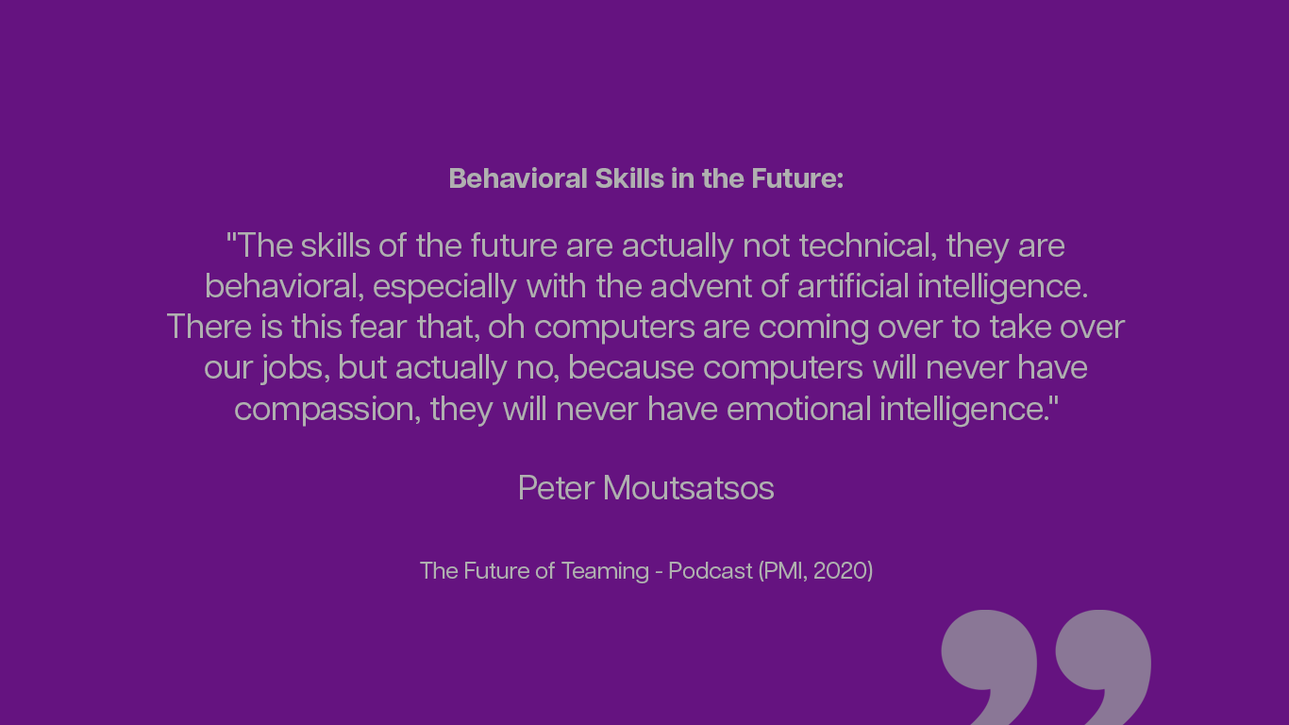
Notes:
Speaker Notes for Behavioral Skills in the Future Slide
"In this quote, Peter Moutsatsos highlights an important perspective on the future of work and the essential skills that will distinguish us in a world increasingly impacted by artificial intelligence. Moutsatsos argues that while technical skills have long been valued, behavioral skills—like empathy, compassion, and emotional intelligence—are what will truly set us apart in the era of AI (PMI, 2020).
As AI and automation take on more technical tasks, there’s often a fear that human roles will diminish. However, Moutsatsos reassures us that computers and algorithms lack the inherently human qualities of empathy and emotional intelligence. These traits enable us to connect, understand, and support one another on a personal level—qualities that machines cannot replicate.
For project managers, this insight is crucial. As we lead teams, navigate conflicts, and engage with stakeholders, our ability to demonstrate emotional intelligence will define our effectiveness. By cultivating these behavioral skills, we can enhance team dynamics, build trust, and foster resilience, ensuring our roles remain indispensable in a technologically advanced world."

Slide 13
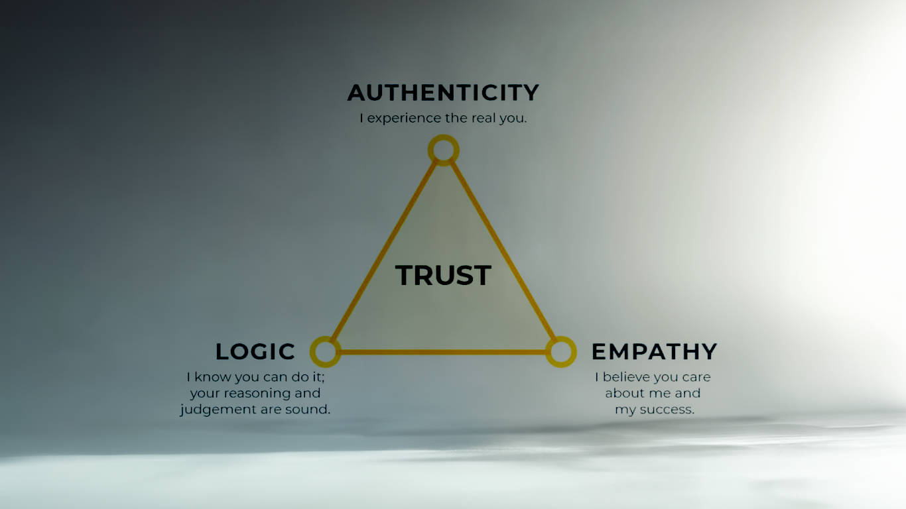
Building TRUST
with functional and executive managers
As Goleman (1995) emphasized, effective leadership stems from EI skills, including empathy and active listening, which help project managers understand and align with others’ motivations and constraints.
Notes:
Building Trust with Functional and Executive Managers
To foster trust with functional and executive managers, project managers must embody the qualities of a mentor. As Goleman (1995) emphasized, effective leadership is grounded in Emotional Intelligence (EI), where empathy and active listening help project managers understand and align with others’ motivations and constraints. By empathizing with the unique pressures that executives face, project managers can shift from potential resistance to building supportive alliances. Coronado-Maldonado and Benítez-Márquez (2023) highlight that EI enables leaders to cultivate collaborative and high-performing environments, making these alliances essential for organizational success.
"Building trust with functional and executive managers is foundational to successful project management. Trust in this context relies on three pillars: authenticity, logic, and empathy. Drawing on Goleman’s (1995) insights, EI skills like empathy and active listening serve as the bedrock of trust-building. Authenticity ensures we present our true intentions, while logic provides a clear rationale for decisions. Empathy, often seen as the heart of EI, shows we genuinely care about our colleagues’ goals and pressures. Together, these elements enable project managers to forge resilient, trust-based relationships, facilitating open communication and easing the navigation of complex challenges."

Slide 14
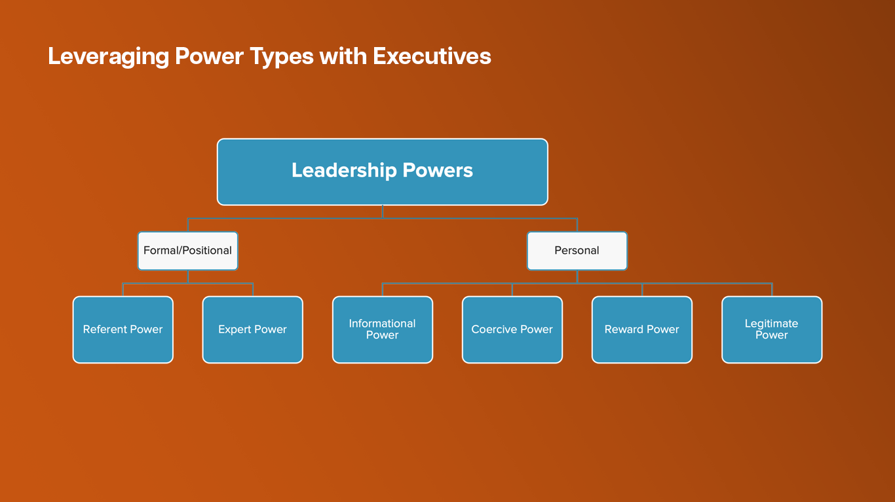
Notes:
Building trust with executive stakeholders often requires a strategic use of power types. Goleman (1995) discusses how expert and referent power—rooted in knowledge and respect—are key to building credibility. By demonstrating expertise and empathy, project managers gain executive support and create alignment without exerting force. Logan, King, and Fischer-Wright (2008) argue that referent power, which stems from relational trust, is particularly powerful for fostering a sense of shared purpose within a team. The Project Management Institute (2017) adds that informational power, rooted in clear communication, aligns project goals across all levels, reinforcing the project manager’s influence.

Slide 15
Tools of the Hero: Effective Conflict Resolution
Understanding Conflict as an Opportunity:
  Recognize that conflict, when managed constructively, can lead to growth and stronger team dynamics.
  View conflicts as opportunities to build trust, promote open dialogue, and encourage diverse perspectives.
Key Conflict Resolution Strategies
  Compromise: Find middle ground where both parties can agree, balancing interests and fostering cooperation.
  Collaboration: Work together with all involved parties to create solutions that satisfy everyone’s needs, promoting a sense of unity and shared purpose.
  Avoidance: Recognize situations where stepping back temporarily may prevent escalation, allowing time to reflect before re-engaging.
  Accommodation: Sometimes, putting the team's needs above individual preferences can help maintain harmony and team cohesion.
Communication Skills in Conflict Resolution
  Active Listening: Show empathy and ensure each team member feels heard, which can diffuse tension and open the way for understanding.
  Clear and Respectful Communication: Articulate viewpoints calmly, focusing on facts and issues rather than personal attacks.
  Non-verbal Cues: Pay attention to body language and tone, as they significantly impact how messages are received.
Building a Collaborative Environment
  Encourage an open environment where team members feel safe to express concerns.
  Use regular team check-ins to address potential issues early, before they escalate into conflicts.
Leveraging Emotional Intelligence (EI)
  Self-awareness: Recognize personal triggers and biases to maintain objectivity in conflict situations.
  Empathy: Try to understand the perspectives and emotions of others, which can lead to more effective resolutions.
  Adaptability: Be flexible and willing to adjust approaches based on the unique needs of each conflict.
Following Through on Conflict Resolution
  After a conflict is resolved, check in with team members to ensure the solution is working and that no lingering issues remain.
  Reflect on conflict resolution experiences to learn and improve future strategies, fostering continuous improvement in team dynamics.
Notes:
"On this slide, we’re exploring essential tools for effective conflict resolution. Conflict is inevitable in any team or project environment, but instead of seeing it as a barrier, we can view it as an opportunity for growth. When managed constructively, conflict can lead to stronger team dynamics and build deeper trust.
Let’s begin with some key conflict resolution strategies:
Compromise helps find a middle ground, ensuring both parties feel heard and respected.
Collaboration encourages working together with all involved parties to create solutions that meet everyone’s needs, promoting unity and shared purpose. As the Project Management Institute highlights, these collaborative practices support a high-functioning team environment (Project Management Institute, 2017).
Avoidance is sometimes a wise choice, especially in heated situations where stepping back temporarily can prevent escalation.
Accommodation is about putting the team’s needs above individual preferences when it benefits the group, an approach that fosters cohesion and mutual respect.
Next, let’s discuss some communication skills essential in conflict resolution:
Active Listening shows empathy, helping each team member feel heard, which, according to Goleman (1995), is a fundamental aspect of emotional intelligence that promotes understanding and reduces tension.
Clear and Respectful Communication ensures that we focus on facts and issues rather than personal attacks, which can diffuse tension effectively.
Non-verbal Cues, like body language and tone, significantly impact how our messages are received, reminding us that communication isn’t just about what we say but how we say it.
Building a collaborative environment also plays a crucial role. Encouraging an open atmosphere where team members feel safe to express their concerns, along with regular check-ins, allows us to address issues early on, preventing escalation into bigger conflicts. As Coronado-Maldonado and Benítez-Márquez (2023) note, fostering a collaborative culture is essential for high-performing teams.
Emotional Intelligence, or EI, is critical throughout these strategies. Self-awareness allows us to recognize our own triggers and biases. Empathy helps us understand others’ perspectives, and adaptability lets us adjust our approach to fit each unique conflict, aligning with the EI principles advocated by Mayer, Salovey, and Caruso (2008).
Finally, we should always follow through on conflict resolution. After resolving an issue, it’s essential to check in with the team to ensure the solution is working and that no lingering issues remain. Reflecting on each conflict resolution experience helps us learn and refine our future strategies, fostering continuous improvement in our team dynamics.
By integrating these conflict resolution tools, we don’t just solve conflicts—we strengthen our teams and build resilience, setting the stage for sustained project success."

Slide 16
The ADKAR Model is a change management framework developed by Jeff Hiatt of Prosci.
It provides a structured approach to help individuals and organizations manage change effectively. The model is often used by project managers and change leaders to guide people through transitions in a way that builds awareness, supports buy-in, and sustains improvements. The acronym ADKAR stands for the five essential stages of change:
  A - Awareness: Recognize the need for change.
  D - Desire: Foster the motivation to participate in the change.
  K - Knowledge: Equip with the information and skills to make the change.
  A - Ability: Develop the capability to implement the change.
  R - Reinforcement: Sustain the change through continuous support.
The ADKAR model (Awareness, Desire, Knowledge, Ability, and Reinforcement) provides a structured framework for securing stakeholder buy-in, as noted by PMI (2017).
Notes:
"The ADKAR Model, developed by Jeff Hiatt at Prosci, provides a roadmap for guiding individuals and teams through organizational change. This framework is especially valuable for project managers, as it facilitates a structured approach to build stakeholder buy-in and ensure change is effectively implemented and sustained.
The ADKAR acronym stands for five essential stages of change. It begins with Awareness—recognizing the need for change. This is foundational, as without awareness, it's difficult to gain support. Then comes Desire, which focuses on fostering motivation within team members and stakeholders to participate in the change process. Knowledge follows, equipping them with the necessary information and skills to feel prepared.
The fourth stage, Ability, centers on developing the capacity to carry out the change. Finally, Reinforcement ensures the change endures over time, securing long-term success. As the Project Management Institute (2017) suggests, securing buy-in across each stage is critical for sustainable impact.
Additionally, Seth Godin (2008) speaks to the importance of creating a 'tribe' of aligned individuals with shared goals, which promotes commitment. Emotional Intelligence, as noted by Coronado-Maldonado and Benítez-Márquez (2023), plays a vital role in this process, allowing leaders to tap into their teams' intrinsic motivations and strengthen alignment. By integrating the ADKAR model with these EI insights, project managers can effectively drive both immediate and lasting support."

Slide 17
Real World Scenario Case Study
Case Study:
Improving Communication and Role Clarity in a Construction Project
Background:
Project X is a high-stakes construction project for a 30-story mixed-use high-rise building. The initiative involves multiple departments, including structural, electrical, plumbing, and HVAC teams, each with different priorities, schedules, and workflows. Recently, the project has experienced significant delays, missed milestones, and misalignment on deliverables. Team members report feeling out of the loop regarding updates and expectations, and there's considerable confusion around roles and responsibilities. Critical tasks are often duplicated or neglected, leading to costly rework and frustration among team members.
Define the Problem:
The lack of structured communication channels and unclear role definitions are causing misunderstandings and inefficiencies in collaboration. Without clear, consistent updates and designated responsibilities, teams struggle to coordinate effectively, resulting in delays and missed deliverables.
Notes:
Slide Title: Real-World Scenario Case Study – Background
Refined Speaker Notes: "Let’s dive into a real-world scenario with Project X—a high-stakes construction project for a 30-story mixed-use high-rise building. This project is complex, involving multiple departments: structural, electrical, plumbing, and HVAC teams. Each team has distinct priorities, schedules, and workflows, making effective coordination both crucial and challenging. Recently, Project X has faced significant setbacks: delays, missed milestones, and misaligned deliverables. Team members have expressed feeling disconnected from project updates and unclear about expectations, leading to role confusion and duplicated or neglected tasks. This disconnect results in costly rework and growing frustration among team members. Here, we see the importance of diagnosing the underlying issues—lack of clear communication channels and role definitions—rather than simply addressing surface-level symptoms like missed deadlines. Addressing these root causes will allow us to build a foundation for more effective collaboration and streamline workflows, ultimately preventing future disruptions."
Slide: Real-World Scenario Case Study - Define the Problem
Speaker Notes: "The core issue here is the absence of structured communication channels and clear role definitions. Without a system in place to provide consistent updates and designated responsibilities, teams find it challenging to work together effectively. This leads to misunderstandings, inefficiencies, and ultimately, delays and missed deliverables. Addressing this communication breakdown is crucial to preventing further setbacks and ensuring that the project progresses smoothly. Now, let's explore some solutions that could mitigate these challenges."

Slide 18
Real World Scenario Case Study
Solutions:
Implement a Centralized Communication Platform: Use a construction project management software, like Procore or PlanGrid, where all updates, schedules, and task assignments are posted in real-time. This will ensure that every department has visibility into project progress and individual responsibilities.
Conduct Weekly Coordination Meetings: Hold weekly meetings with department leads to review current progress, discuss upcoming tasks, and clarify roles. This allows team members to address potential conflicts and dependencies early, reducing misunderstandings.
Develop a Responsibility Assignment Matrix (RACI): Create a RACI matrix that clearly outlines who is Responsible, Accountable, Consulted, and Informed for each task. This will help clarify roles and ensure that all team members understand their duties and dependencies.
Appoint a Communication Liaison: Designate a team member as a liaison to manage interdepartmental communication, monitor updates on the project platform, and ensure that all teams are informed of any changes or critical developments.
Create a Visual Project Timeline and Workflow Chart: Develop a timeline and workflow chart for the entire project that maps out key phases, milestones, and task dependencies. This visual aid can help each department understand the sequence of tasks and prepare for upcoming deliverables.
Notes:
"In any complex project like Project X, diagnosing the root cause of issues is essential. Too often, teams fall into the trap of addressing surface symptoms rather than tackling the core problem. Here, we focus on five targeted solutions that address the deeper issues of communication breakdown and role ambiguity—key barriers to project success
Implement a Centralized Communication Platform: Using construction project management software such as Procore or PlanGrid centralizes all updates, schedules, and task assignments in real-time. With everyone accessing the same information, transparency is enhanced, which keeps all departments aligned. As the Project Management Institute (2017) notes, centralizing information is critical for ensuring everyone stays informed and up-to-date.
Conduct Weekly Coordination Meetings: Regular weekly meetings with department leads are essential for continuous alignment. These sessions allow teams to review progress, discuss upcoming tasks, and clarify roles, reducing misunderstandings and addressing potential conflicts early. Consistent communication, as emphasized by project management best practices, is key to mitigating issues before they escalate (Project Management Institute, 2017).
Develop a Responsibility Assignment Matrix (RACI): The RACI matrix is a straightforward yet powerful tool for defining who is Responsible, Accountable, Consulted, and Informed for each task. It eliminates ambiguity by clearly outlining roles and responsibilities, thus enhancing accountability across the project team (Project Management Institute, 2017).
Appoint a Communication Liaison: Designating a communication liaison helps streamline interdepartmental coordination. This role ensures that updates and changes are effectively communicated across departments. Coronado-Maldonado and Benítez-Márquez (2023) highlight that strong communication across departments is crucial for creating a high-performing, collaborative environment.
Create a Visual Project Timeline and Workflow Chart: Finally, developing a visual timeline and workflow chart enables the team to see the entire project layout, including key phases, milestones, and task dependencies. Seth Godin (2008) advocates for visual aids in creating a shared vision, which aligns everyone with the project’s goals and prepares them for upcoming deliverables.
By implementing these strategies, we address underlying issues, fostering better communication, clarity of roles, and a more streamlined workflow. Grounded in project management best practices, these solutions set Project X on a trajectory for effective coordination and successful completion."

Slide 19
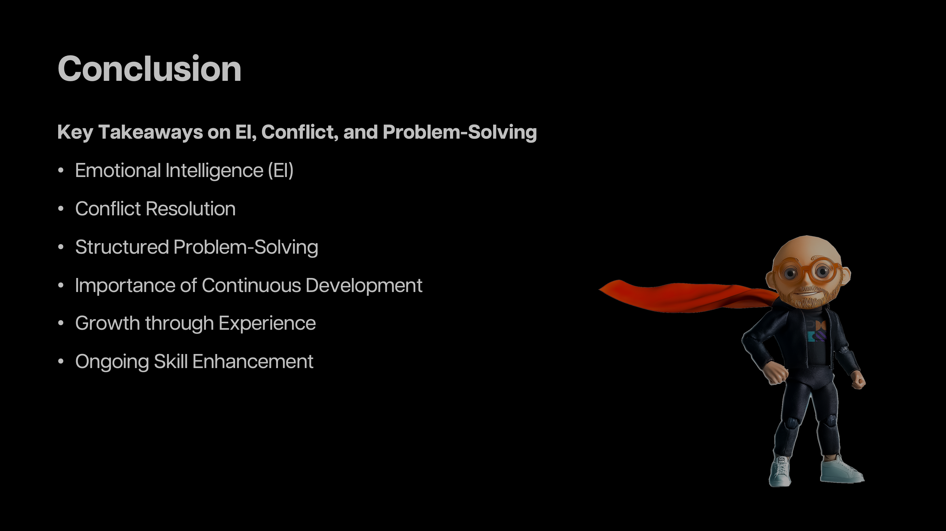
Notes:
The journey of a project manager is one of continuous transformation, resembling the classic hero’s journey. Each project presents opportunities for growth, trust-building, and the application of Emotional Intelligence (EI) to create resilient, unified teams. By embracing EI, project managers become modern workplace heroes, returning from each project with enhanced purpose, new insights, and a commitment to lead with empathy (Goleman, 1995). As Campbell (1949) suggests, the hero’s return is marked by newfound wisdom—knowledge that, for project managers, translates into empathy, collaborative conflict resolution, and effective problem-solving strategies.
Leaders who learn from their journey inspire a culture of shared knowledge and resilience within their teams (The School of Life, 2019). Through EI, project managers foster trust and empathy, turning challenges into collaborative opportunities (Mayer, Salovey, & Caruso, 2008; Coronado-Maldonado & Benítez-Márquez, 2023). Conflict, when approached constructively, strengthens team cohesion, while structured problem-solving enhances project outcomes (Harvard Business Review, 2021; Project Management Institute, 2017). Each project thus becomes an avenue for personal and professional growth, shaping adaptable leaders prepared to face future challenges. This ongoing development not only deepens their leadership impact but also inspires teams to strive for excellence and resilience.

Slide 20
References:
Campbell, J. (1949). The hero with a thousand faces. Pantheon Books.
Coronado-Maldonado, I., & Benítez-Márquez, M. D. (2023). Emotional intelligence, leadership, and work teams: A hybrid literature review. Heliyon, 9(10), e20356.
Godin, S. (2008). Tribes: We need you to lead us. Portfolio.
Goleman, D. (1995). Emotional intelligence: Why it can matter more than IQ. Bantam Books.
Harvard Business Review. (2021). The power of creative leadership. Harvard Business School Publishing.
Kleon, A. (2012). Steal like an artist: 10 things nobody told you about being creative. Workman Publishing.
Logan, D., King, J. P., & Fischer-Wright, H. (2008). Tribal leadership: Leveraging natural groups to build a thriving organization. Collins.
Mayer, J. D., Salovey, P., & Caruso, D. R. (2008). Emotional intelligence: Theory, findings, and implications. Psychological Inquiry, 15(3), 197–215.
Mayer, J. D., Salovey, P., & Caruso, D. R. (2008). Emotional intelligence: New ability or eclectic traits? American Psychologist, 63(6), 503–517.
Project Management Institute. (2017). A guide to the project management body of knowledge (PMBOK guide) (6th ed.). Project Management Institute.
Project Management Institute. (2020, April 15). The future of teaming [Audio podcast episode]. In Projectified®. PMI. https://www.pmi.org/podcast
The School of Life. (2019). The emotionally intelligent office: 20 key emotional skills for the workplace. Alain de Botton (Ed.).
Notes:
References:
Campbell, J. (1949). The Hero with a Thousand Faces. New York, NY: Pantheon Books.
Coronado-Maldonado, I., & Benítez-Márquez, M. D. (2023). Emotional intelligence, leadership, and work teams: A hybrid literature review. Heliyon, 9(10), e20356.
Godin, S. (2008). Tribes: We Need You to Lead Us. New York, NY: Portfolio.
Goleman, D. (1995). Emotional Intelligence: Why It Can Matter More Than IQ. New York, NY: Bantam Books.
Harvard Business Review. (2021). The Power of Creative Leadership. Harvard Business School Publishing.
Logan, D., King, J. P., & Fischer-Wright, H. (2008). Tribal Leadership: Leveraging Natural Groups to Build a Thriving Organization. New York, NY: Collins.
Mayer, J. D., Salovey, P., & Caruso, D. R. (2008). Emotional Intelligence: Theory, Findings, and Implications. Psychological Inquiry, 15(3), 197–215.
Project Management Institute. (2017). A Guide to the Project Management Body of Knowledge (PMBOK Guide) (6th ed.). Newtown Square, PA: Project Management Institute.
The School of Life. (2019). The Emotionally Intelligent Office: 20 Key Emotional Skills for the Workplace. Alain de Botton (Ed.).
Project Management Institute. (2020, April 15). The Future of Teaming [Audio podcast episode]. In Projectified®. PMI. https://www.pmi.org/podcast
Mayer, J. D., Salovey, P., & Caruso, D. R. (2008). Emotional intelligence: New ability or eclectic traits? American Psychologist, 63(6), 503-517.
Kleon, A. (2012). Steal like an artist: 10 things nobody told you about being creative. Workman Publishing.

