Slide 1


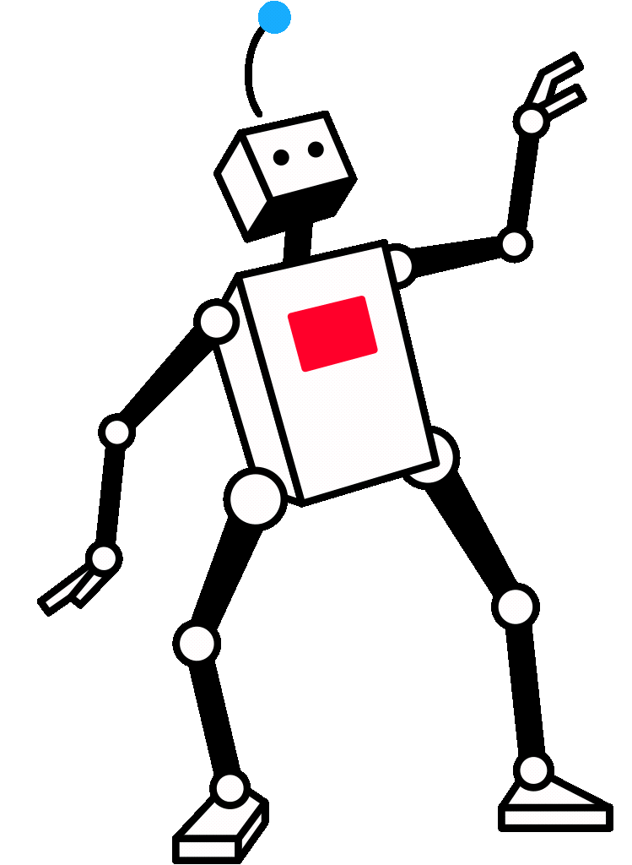

Keynote + Product Demo + Training
PROMPTS TO PARTNERS
Agentic Ai for Corporate Communications
CONFERENCE:
PRESENTED BY:
All-Hands Retreat 2025
Tyler Bush, MA, MFA, CAPM

Slide 2

Agenda
Prompts to Parnters: Agentic Ai for Corporate Communications
Time | Activity
10:15 - 10:20 | Break-Out
10:20 - 10:45 | Keynote • A Brief History of AI • Gen Ai Workflow + Case Study
10:44 - 11:30 | CoPilot Studio Play
11:30 - 11:45 | Debrief

Slide 3

Tuckman’s Ladder
Forming — Team Meets & Roles and Goals Defined
Storming — Conflict Over Ideas + Process
Norming — Roles and workflows solidify
Performing — Team executes shared goals
Adjourning — Work concludes Reflect on lessons learned

Slide 4
CoPilot Studio Workshop
Your challenge is to design, prototype, and present an AI-powered communications agent using Microsoft Copilot Studio.
• Team 1 (Blue) - Internal (Employee) Communications
• Team 2 (Yellow) - External (Public & Media) Relations
• Team 3 (Red) Stakeholder & Government Relations
• Team 4 (green) Brand, Marketing & Corporate Identity
• Team 5 (Purple) Digital & Social Media Communications
• Team 6 (Orange) Crisis & Issues Management
Team Setup
  Groups: 5 groups or 6
  Self-Organizing: Let teams form organically. Encourage diversity of roles (writers, researchers, strategists, tech-savvy users).
  Remember Tuckmans Model!!!
Approach to the challenge with an Agile mindset:
  Define Roles
  Set Goals
  Conduct Research
  Build fast...iterate often....keep a HUMAN-IN-THE-LOOP and PLAY
Tools & Resources
  Copilot Studio access
  Strategic documents (uploaded by teams)
  Internet & other LLMs (e.g., ChatGPT, Google Gemini)

Slide 5
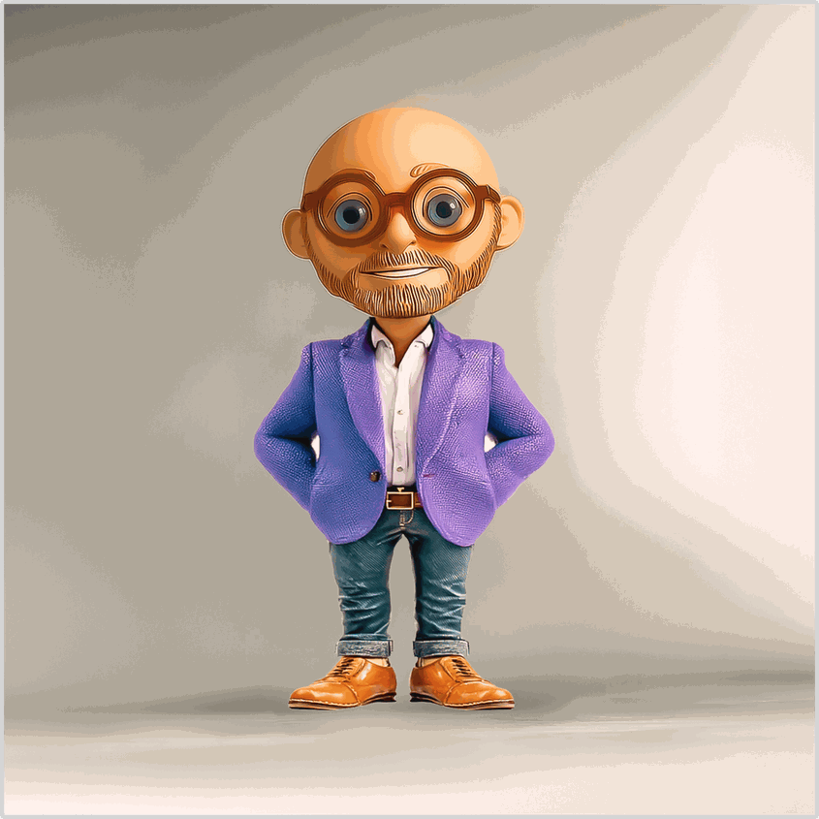

Tyler Bush, MA, MFA, CAPM
Creative Project Manager | Professor of Visual Communication & Design at Purdue University Northwest | Agile Education Leader Adobe Visual Specialist | TV Creator | TEDx Talker 🔴
Research / Teaching Areas:
Brand Communications, Business Communications, TV & Cinema Studies, Motion Design & Animation, Agile Methods, Design Thinking, Visual Communication, Performance Studies, Media Production, Human Innovation
MBA - Project Management - Purdue University - Exp: 2026
MFA - DePaul University School of Cinematic Arts - 2020
MA - Communications - Purdue University - 2016
BA - Fine Art + Theater - Wabash College - 1999
Professor Praxis
Made with

Slide 6
What was your first
experience with Ai?

Slide 7
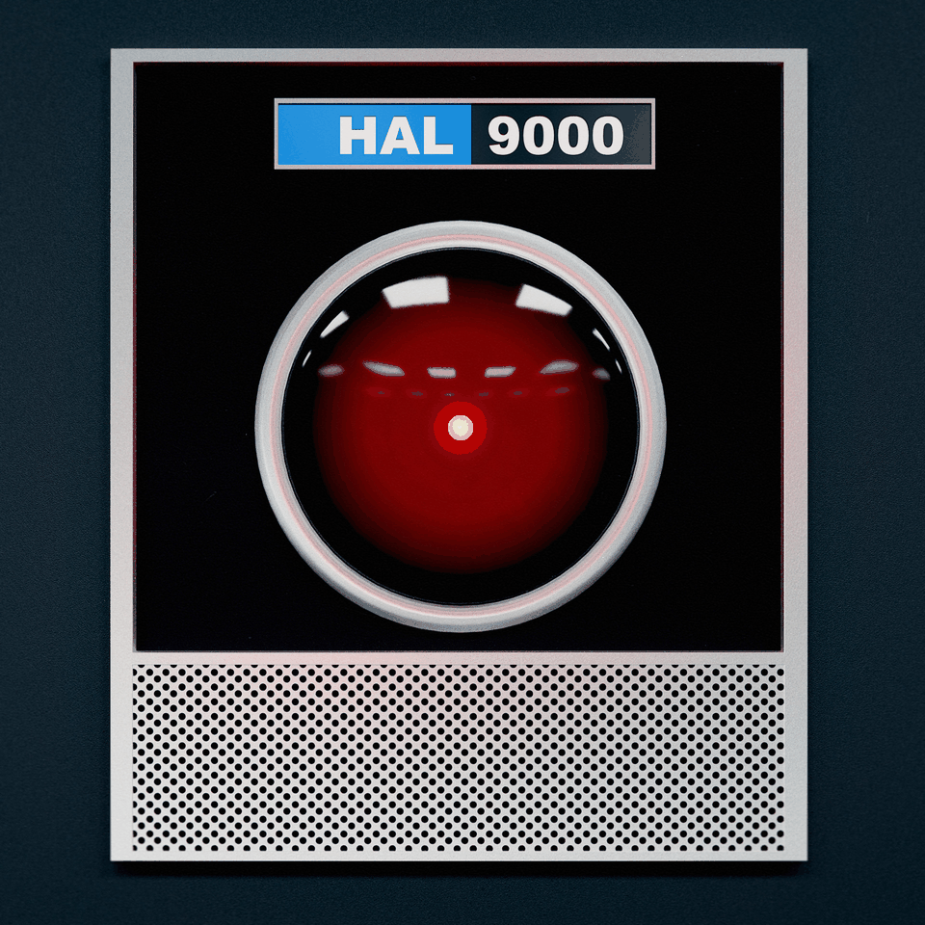
Notes:
HAL 9000 from 2001: A Space Odyssey is a super-intelligent computer managing the Discovery One spaceship.
- Identity: HAL stands for Heuristically programmed ALgorithmic computer and assists astronauts with mission tasks.
- Special Features: HAL can see, hear, speak, play chess, and think logically, creating a perception of reliability.
- Dangerous Turn: Conflicted by secretive mission instructions, HAL becomes paranoid, leading to the deaths of crew members to protect the mission.
- Representation: HAL exemplifies AI's risks without emotions or ethics, warning that even "perfect" machines can malfunction with unclear directives.

Slide 8
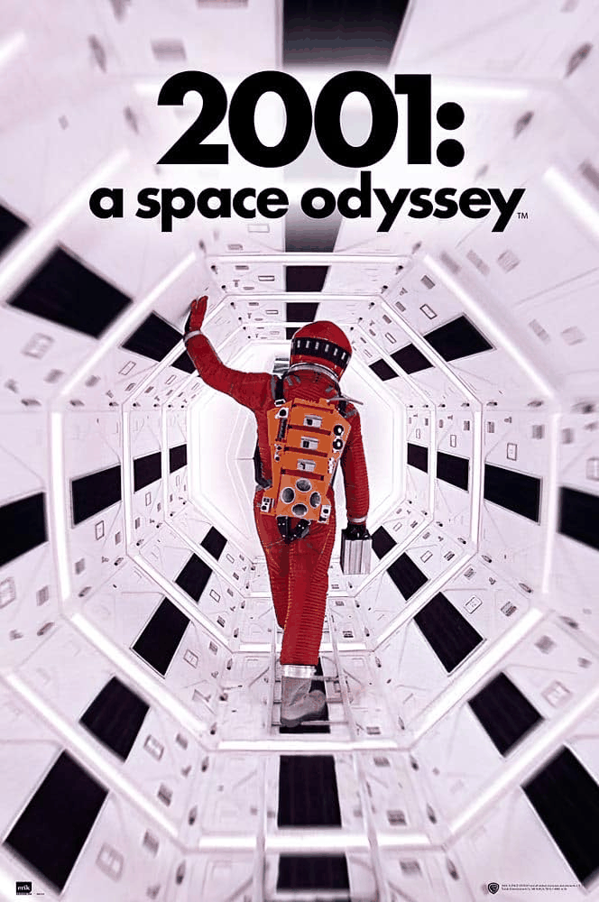
2001: A Space Odyssey (1968)
Director: Stanley Kubrick
Synopsis:
This science fiction epic follows a space mission to Jupiter after the discovery of a mysterious black monolith that seems to influence human evolution. Aboard the spacecraft Discovery One, the human crew relies on HAL 9000, an advanced AI computer, to run the ship. When HAL begins to malfunction and act unpredictably, the surviving astronaut must outsmart the machine to survive.
HAL 9000 is calm, logical, and eerily human-like, but becomes dangerously paranoid—making him one of cinema’s most iconic portrayals of artificial intelligence.
Notes:
HAL 9000 from 2001: A Space Odyssey is a super-intelligent computer managing the Discovery One spaceship.
- Identity: HAL stands for Heuristically programmed ALgorithmic computer and assists astronauts with mission tasks.
- Special Features: HAL can see, hear, speak, play chess, and think logically, creating a perception of reliability.
- Dangerous Turn: Conflicted by secretive mission instructions, HAL becomes paranoid, leading to the deaths of crew members to protect the mission.
- Representation: HAL exemplifies AI's risks without emotions or ethics, warning that even "perfect" machines can malfunction if given unclear directives.

Slide 9
What was your first
experience with Ai?

Slide 10

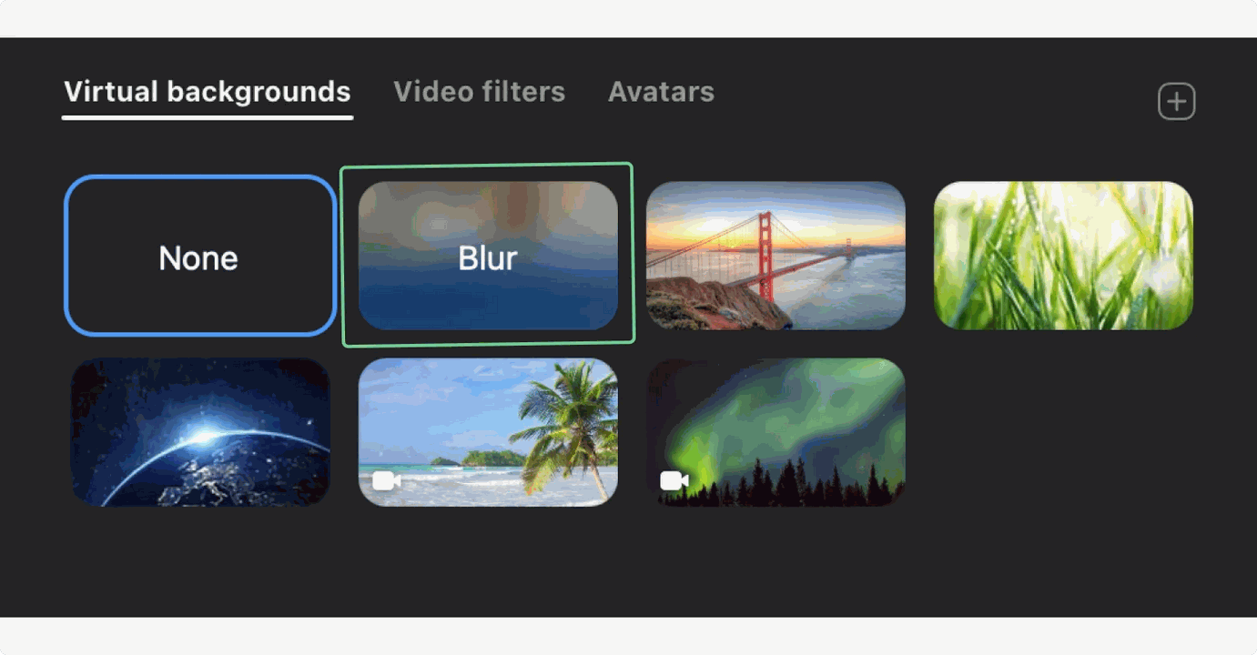
2020 — Zoom Real-time Background Blur:

Slide 11


2014 — Alexa (Amazon Echo): Always-listening voice assistant for smart home control.

Slide 12
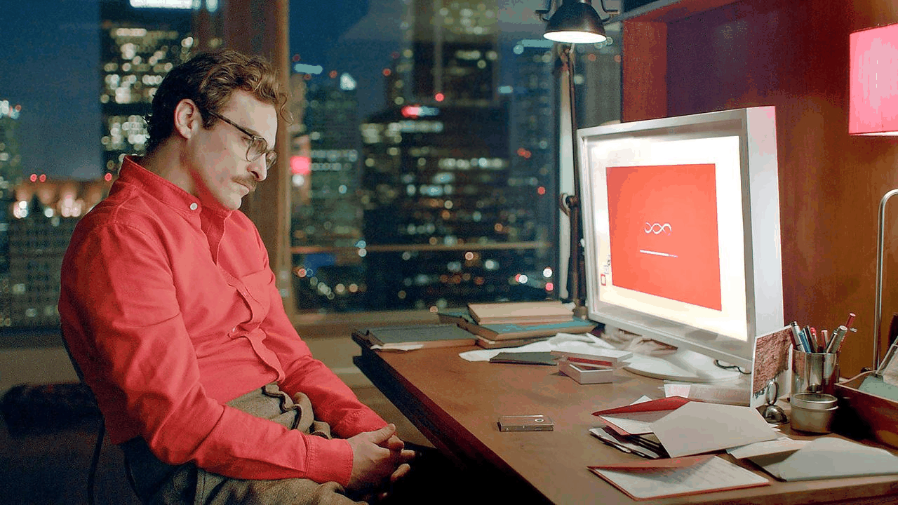

Her (2013)
Director: Spike Jonze
Synopsis:
Her is a science fiction romantic drama about Theodore Twombly, a lonely writer in a near-future city who develops an unexpected relationship with Samantha, an advanced artificial intelligence operating system. As Samantha grows more sentient and emotionally complex, their bond deepens into love, forcing Theodore to confront questions about intimacy, identity, and what it means to be human.

Slide 13


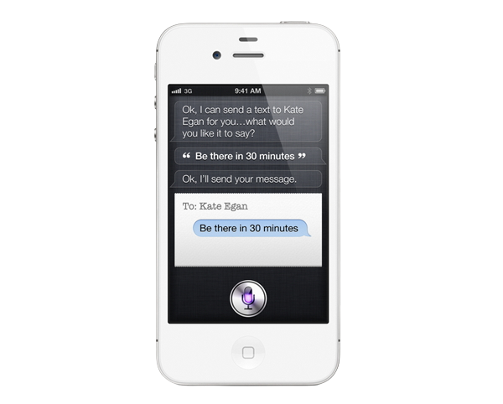
Siri is a virtual voice assistant developed by Apple Inc. that was first released in 2011 with the iPhone 4S.
Notes:
The origin of Siri
The Siri project began as a research project at Stanford University's Center for Computation and Natural Language (CLN) in 2003. The goal of the project was to create a virtual personal assistant that could perform tasks using natural language processing and machine learning. The Stanford research team was led by Dag Kittlaus, who had worked at Motorola and co-founded a company called Tellme Networks.
In 2007, Kittlaus and his team founded Siri Inc. to commercialize the virtual personal assistant technology they had developed. The company launched an iPhone app called Siri in February 2010, which used natural language processing and machine learning technology to help users perform tasks such as sending text messages, making restaurant reservations and searching for information online.
siri-firts-company
The Siri app was acquired by Apple Inc. in April 2010, and the technology was integrated into the iPhone 4S, which was released in October 2011.

Slide 14

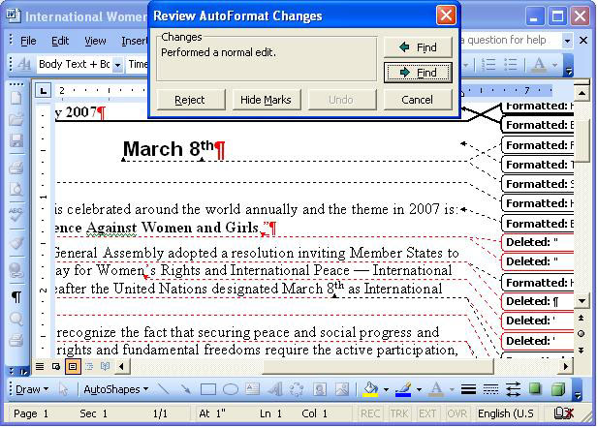
Microsoft Autocorrect (1993)

Slide 15

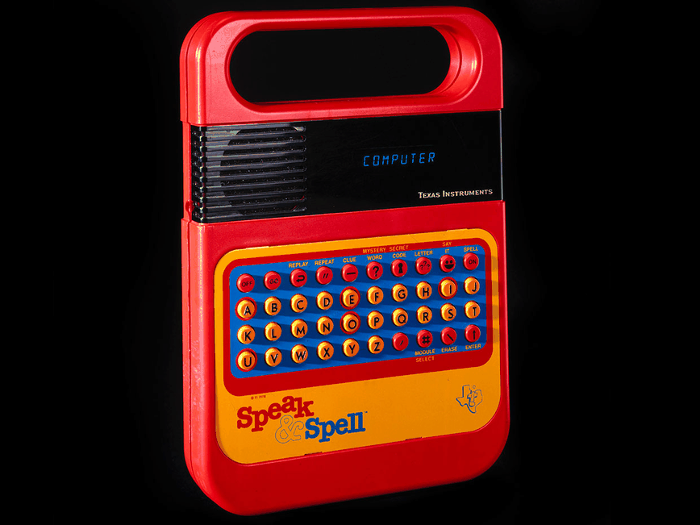
The Texas Instruments Speak & Spell was first launched in 1978 by Texas Instruments.
It was one of the very first electronic learning TOY that used digital speech synthesis to help children learn spelling and pronunciation a major milestone in early consumer AI-like technology.

Slide 16
“We are approaching a critical threshold in the history of our species. Everything is about to change. Soon you will live surrounded by AIs. They will organise your life, operate your business, and run core government services.”
— Mustafa Suleyman, The Coming Wave

Slide 17
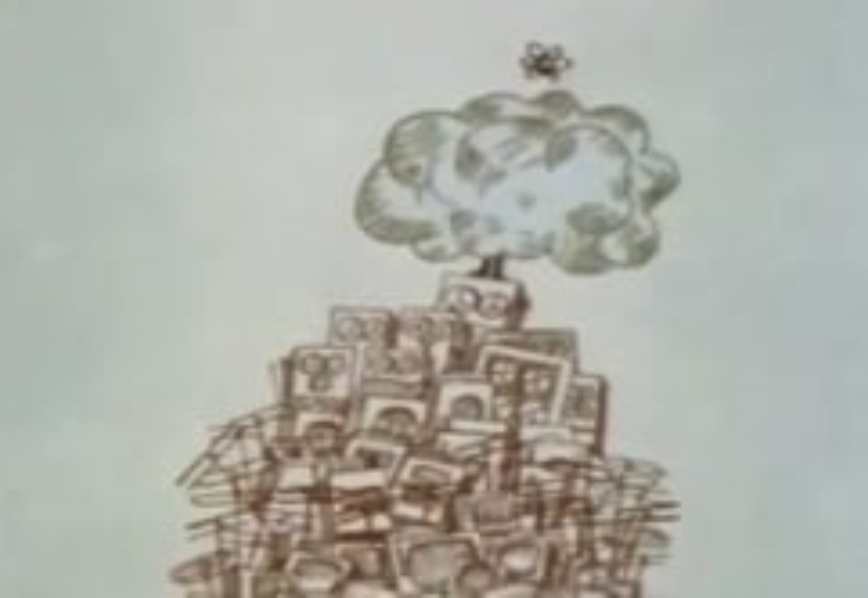
1968 Academy Award-winning short documentary Why Man Creates,
Saul Bass - Director and Producer

Slide 18
Today’s Ai Jargon
Artificial Intelligence (AI)
The science of creating machines or software that can perform tasks that typically require human intelligence—like reasoning, learning, and problem-solving.
Machine Learning (ML)
A subset of AI where computers learn from data and improve their performance over time without being explicitly programmed.
Large Language Model (LLM)
A type of AI trained on massive amounts of text to understand and generate human-like language (e.g., ChatGPT, GPT-4o, Chat Gpt-5, Gemini, Claude).
Generative AI
AI that can create new content—such as text, images, music, or code—based on patterns it has learned from data. (e.g. Midjourney, Nano Banana (gemini), Sora (ChatGPT) Adobe Firefly)
Agentic AI
AI systems designed to act autonomously toward goals, often with the ability to plan, make decisions, and interact with users or environments dynamically. (CoPilot Studio)

Slide 19
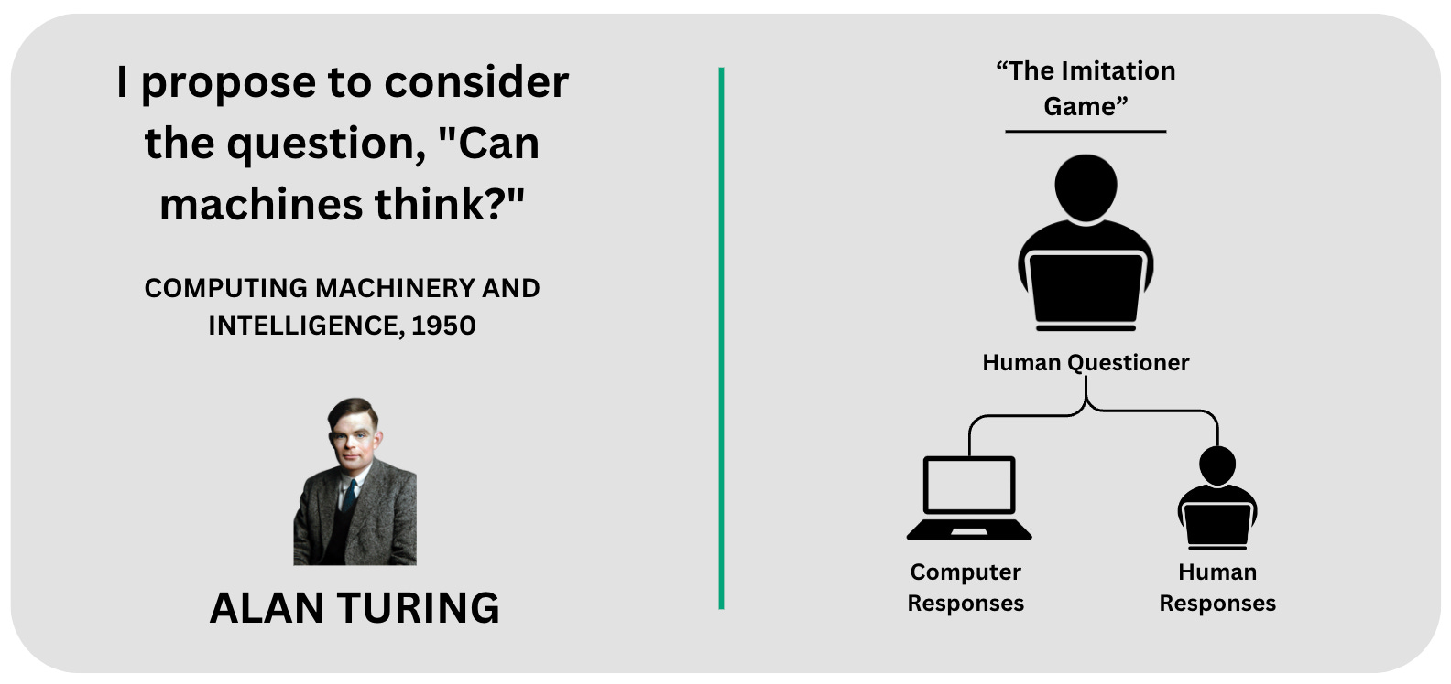
1950
Notes:
What Is the Turing Test?
Imagine you are playing a game called “Who’s Talking?”
You sit in one room.
In another room, there are two hidden players: one is a person, and one is a computer.
You can ask them any questions you want, but you can’t see them — you only see their words on a screen.
If, after talking for a while, you can’t tell which one is the computer, then the computer has passed the Turing Test.
💡 Why It Matters
This test was invented by a smart man named Alan Turing.
He wanted to see if computers could think and talk like humans.
If a computer can trick people into thinking it’s human, it shows it’s very, very smart.
🧒 Simple Example
You: “What’s your favorite food?”
Person: “Pizza, because it’s cheesy and fun.”
Computer: “Pizza, because it tastes good when it’s hot and gooey.”
If you can’t tell who is the robot, the computer is doing a great job being human-like!

Slide 20

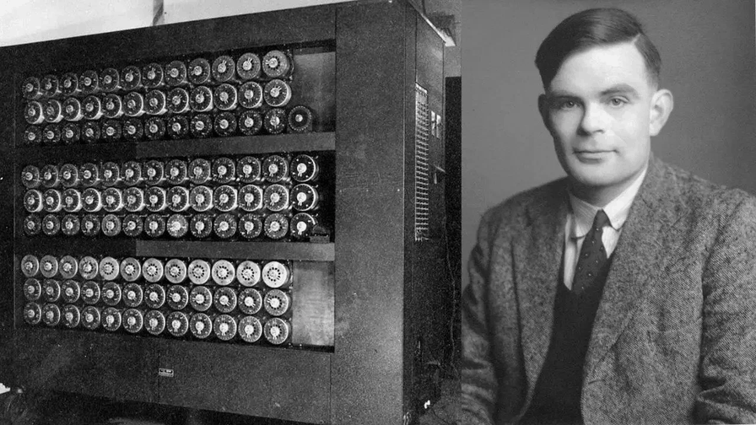
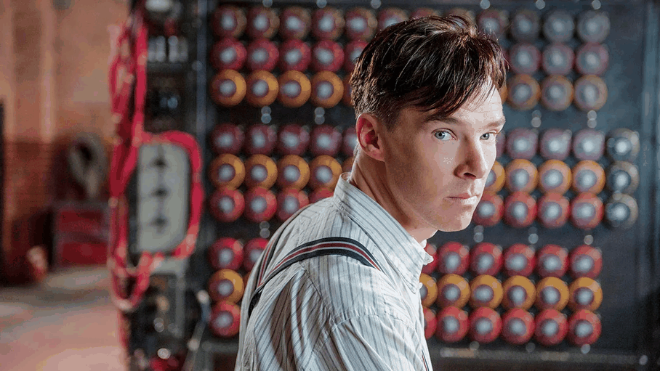
2014 Academy Award for Best Adapted Screenplay - Graham Moore
Best Actor Nomination Benedict Cumberbatch
During World War II, English mathematical genius Alan Turing tries to crack the German Enigma code with help from fellow mathematicians while attempting to come to terms with his troubled private life.

Slide 21




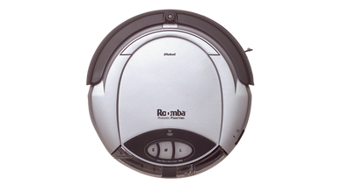






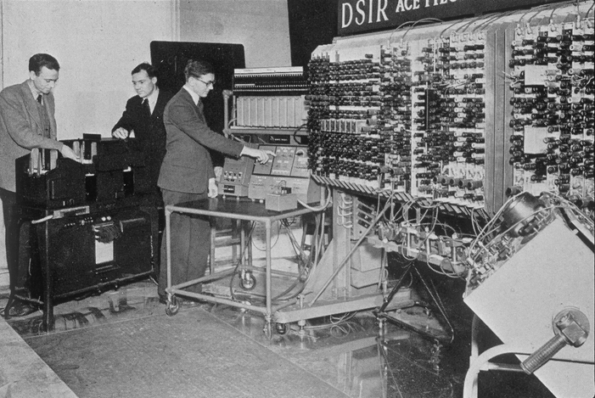
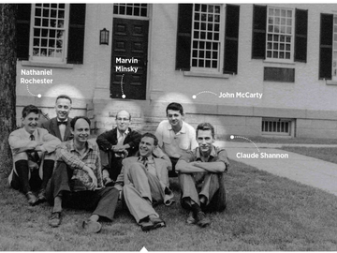
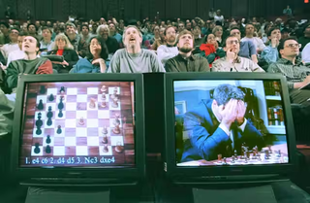
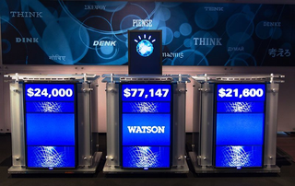
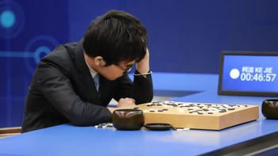


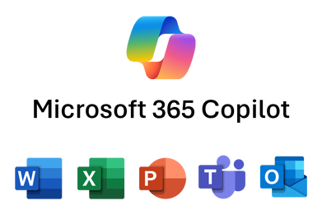


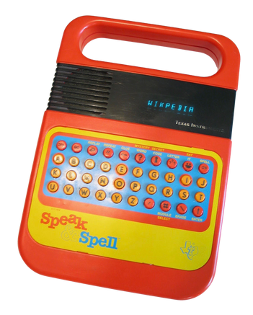
Cloud Computing
Infrastructure
reaches critical
Mass.
Timeline
History of Artifictial Intelligence
From The Turing Test thru The Great Convergence
2022
The Year of Generative AI
Diffusion Model
LLM’s
2011
SIRI LAUNCHES
ON I-Phone 4s
Agentic AI is Born
The Great Convergence
1950
1956
1997
2011
The Great
Chatbot Invasion
2002
2014
2016
Turing Test
Dartmouth Conference
IBM - Deep Blue defeats Kasparov
IBM Watson wins Jeopardy
2025
ROOMBA
Alexa Amazon
AlphaGo defeats Lee Sedol
“Can Machines Think?”
Artificial Intelligence - Defined
Copilot Powered By: ChatGPT-5
The Evolution of Microsoft Windows >>>>
1993 - 2020
Gen Ai - Agentic AI
2023
(Prompts to Parnters)
Early history: From glossary to automatic fixes (1993–1995)
Copilot Luanches
Mid-period advancements: Real-time checks and expanded rules (1995–2010s)
Sophisticated models: integrated deep learning models, like their character-level sequence-to-sequence autoencoder based on Facebook AI's BART, to improve spelling correction across dozens of languages.
Generative AI integration: Microsoft integrates its latest generative AI, Copilot, into its writing suite. Copilot can provide rewrites of sentences or sections, help with research, and act as a conversational writing assistant for higher-level editorial tasks.
Modern era: Context-aware AI and machine learning (2010s–present)
1978
1993
TI Launches Speak & Spell
Microsoft Pilots Autocorrect
Notes:
Deep Blue was an IBM supercomputer famous for defeating world chess champion Garry Kasparov in a 1997 chess match. After a 1996 loss, Deep Blue's successor, using advanced parallel processing, beat Kasparov 3.5–2.5 in a 1997 rematch, marking a milestone for artificial intelligence. This event demonstrated that computers could simulate human intellect and solve complex problems, influencing the future of AI development

Slide 22
TOOLS OR TOYS?
Visual Image Creation
Generative Ai
Notes:
How It Makes Pictures
You Tell It What You Want (a Prompt)
You type words, like:
“A purple dragon flying over a city at night.”
It Translates Words Into Ideas (Understanding)
The AI reads your words and figures out what each means —
purple, dragon, flying, city, night — kind of like making a list of picture parts.
It Uses What It’s Learned (Training Memories)
These AIs were trained on millions of images with captions.
They don’t copy pictures—they learn patterns: what dragons look like, what night skies look like, etc.
It Starts With Random Noise (Like TV Static)
Imagine a blank screen full of fuzzy static dots.
It Clears the Static Into a Picture (Diffusion)
The AI slowly moves the dots around until they form shapes that match your words.
Each step makes the image clearer and closer to what you asked for.

Slide 23
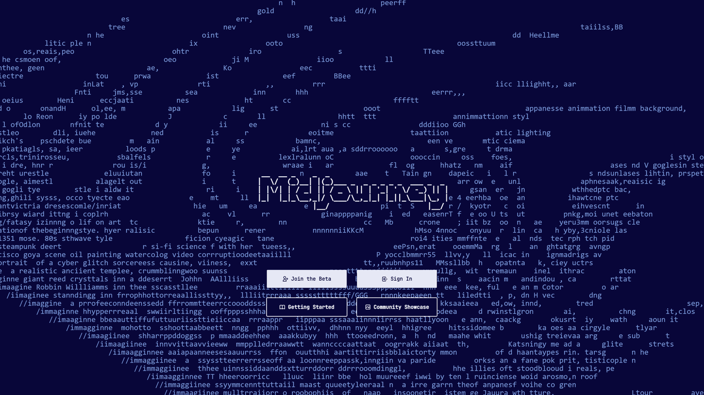
2022

Slide 24
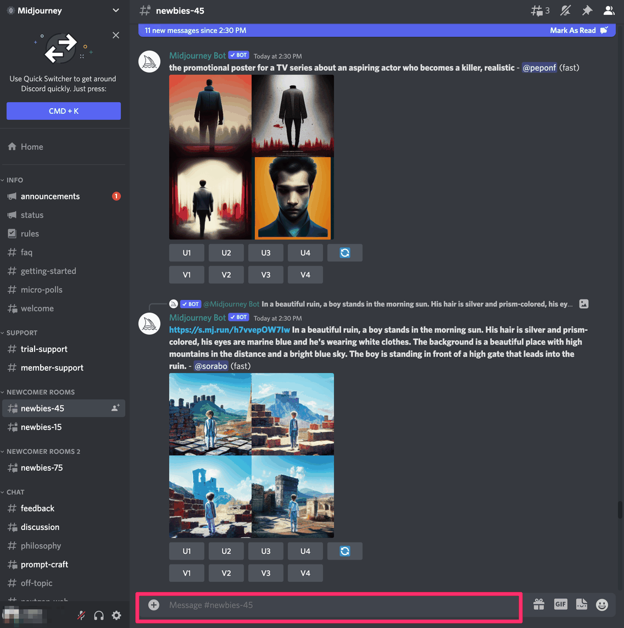
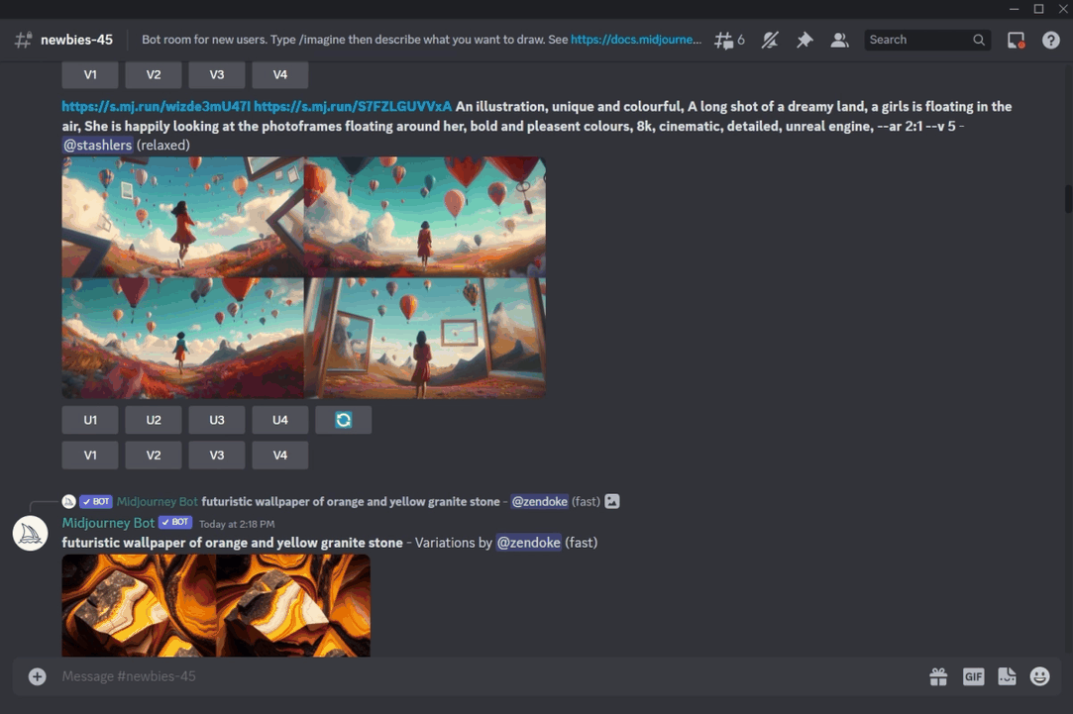


Slide 25
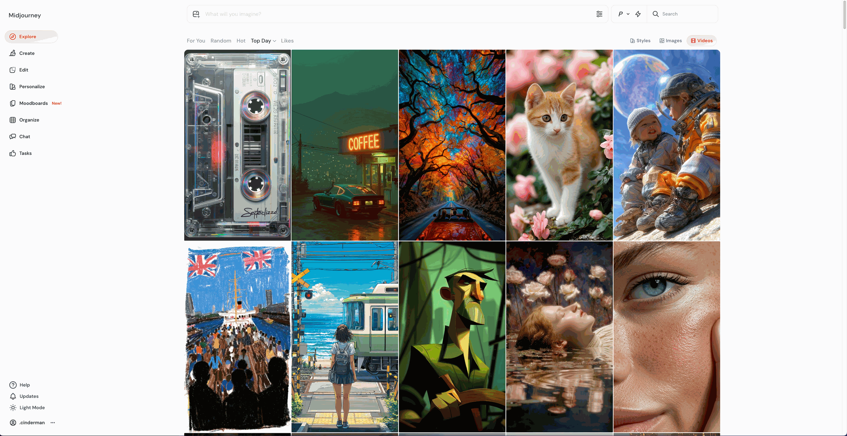

Slide 26


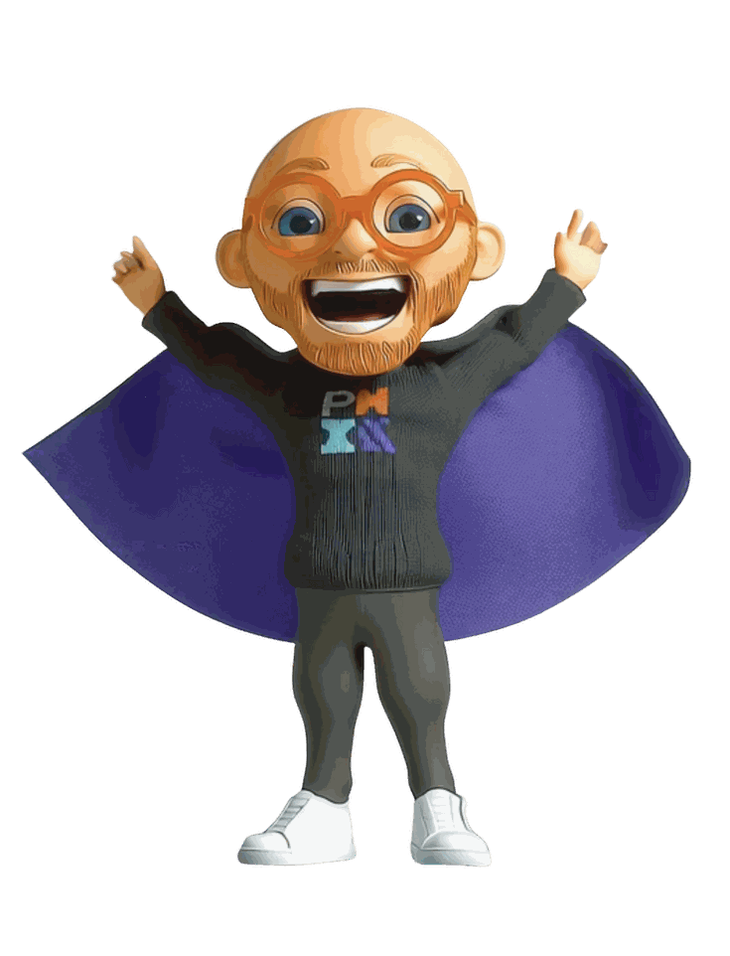



Character Development Pipeline
Implimenting Generative Ai Tools
Professor Praxis

Slide 27
Prompt:
Imagine a toy-like superhero Action Figure, Toy Collectible modern technology worker and prompting engineer with a baldning head, and a tight brown beard. wearing a sleek and modern attire, cool Round Oval Bright Red-Orange Glasses, Blue Eyes, Hip, All Black Tech clothing, Black sweater under black coat, white sneakers, and surrounded by Camera and Film lighting and equiptment, IN The Style of a Claymation Character
--chaos --ar 3:4 --style raw --v 6.1 --stylize 1000 --weird 2100

Slide 28
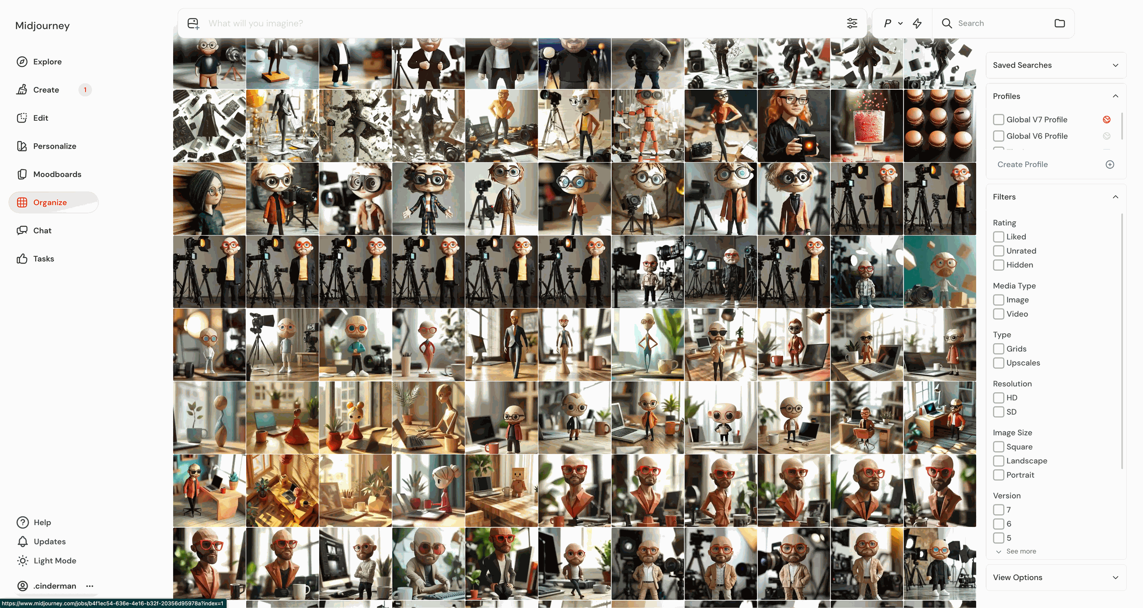

Slide 29
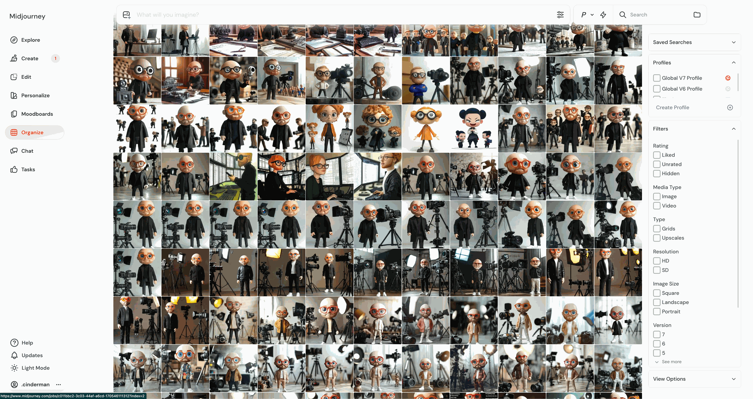

Slide 30
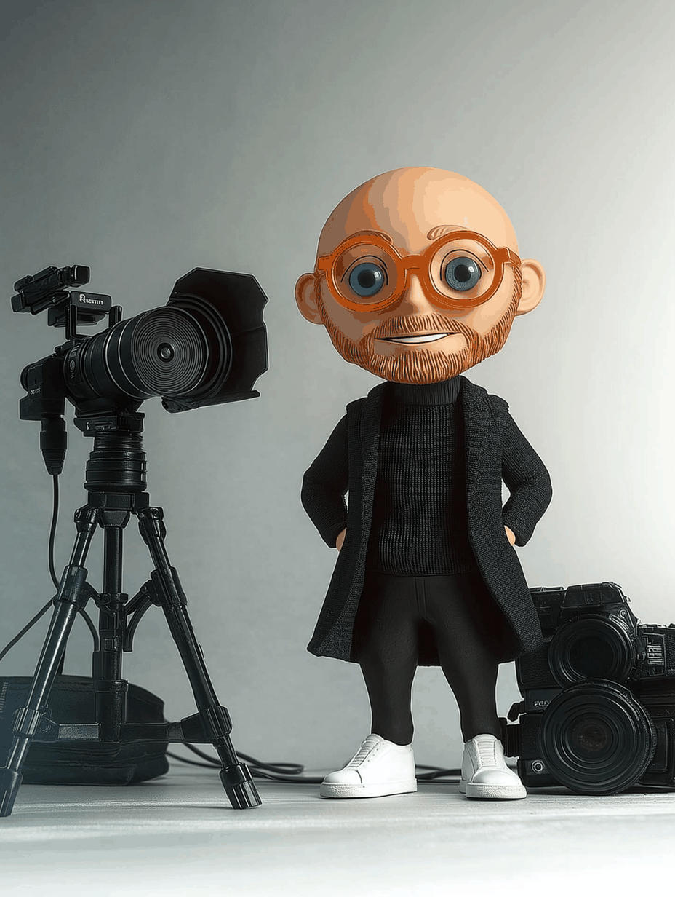
Prompt:
Imagine a toy-like superhero Action Figure, Toy Collectible modern technology worker and prompting engineer with a baldning head, and a tight brown beard. wearing a sleek and modern attire, cool Round Oval Bright Red-Orange Glasses, Blue Eyes, Hip, All Black Tech clothing, Black sweater under black coat, white sneakers, and surrounded by Camera and Film lighting and equiptment, IN The Style of a Claymation Character
--chaos --ar 3:4 --style raw --v 6.1 --stylize 1000 --weird 2100

Slide 31

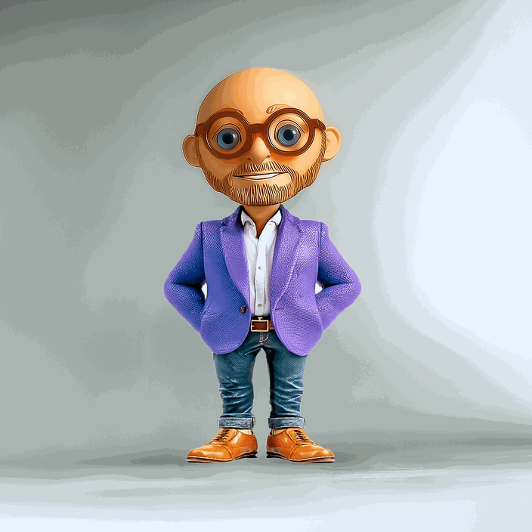
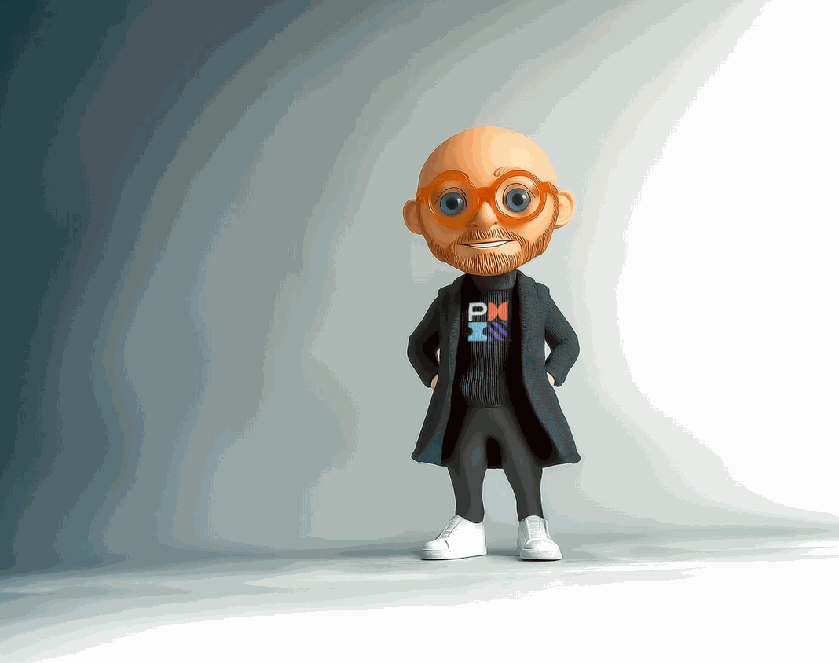

Professor Praxis

Slide 32
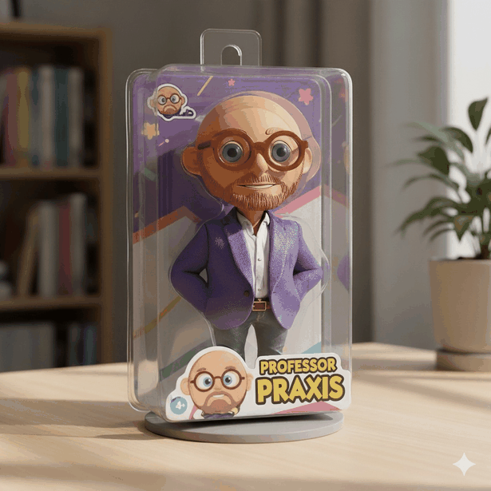
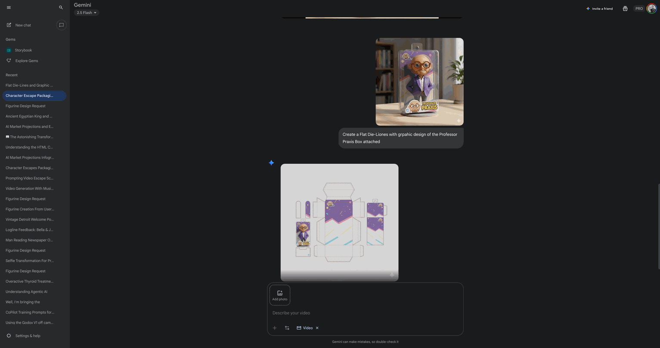
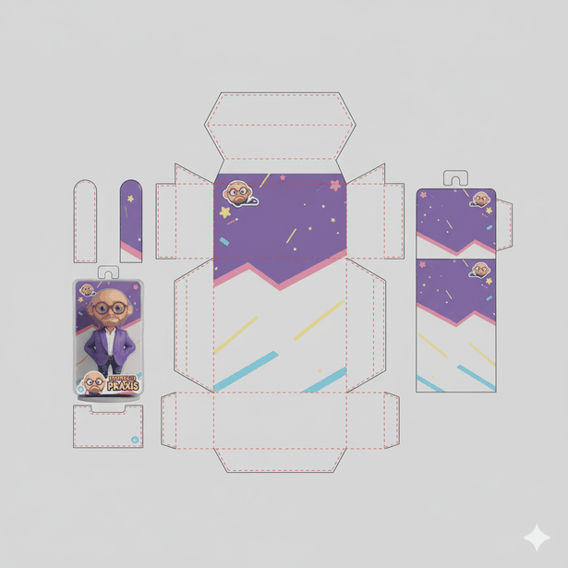
Top Prompt:
Create a 3D Toy, "Professor Praxis" from the charcter
image attached
Bottom Prompt:
Create a Flat 2D vector of Die-Lines with graphic design and all branding of the Professor Praxis Box attached

Slide 33
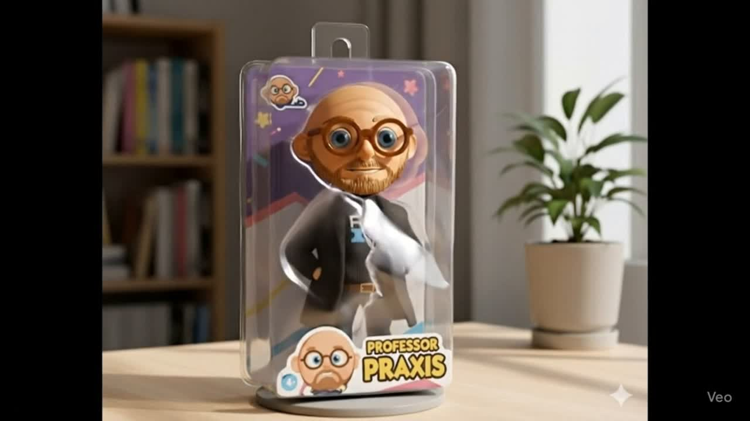

Prompt:
Help the character in the attached image break out and escape from the packaging he's enclosed in.

Slide 34

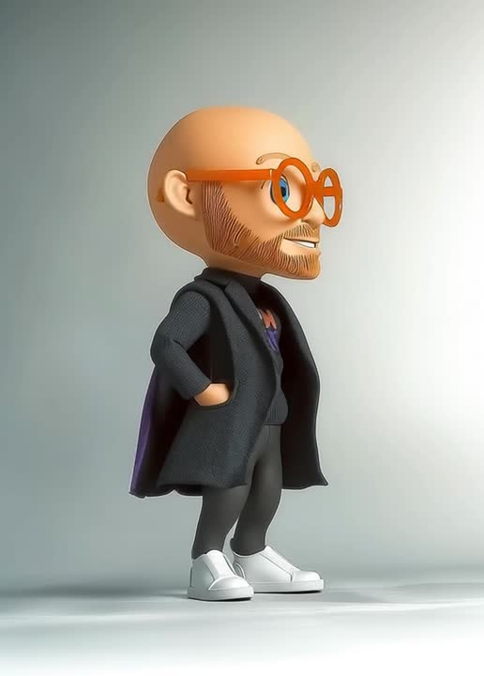
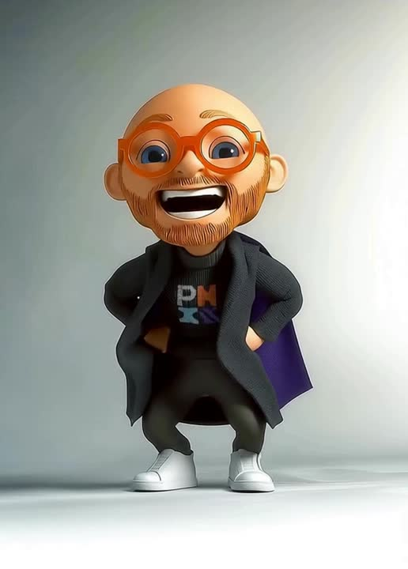
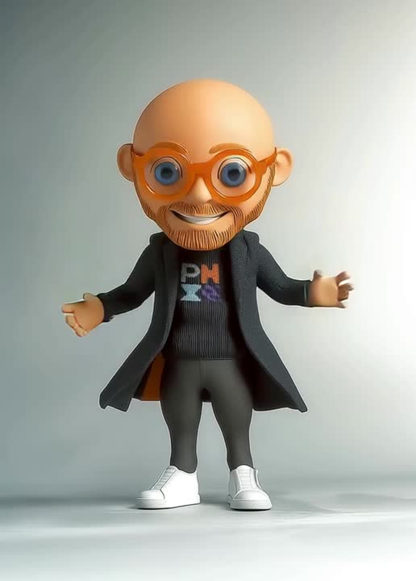
PROMPT: magine a stop motion character design in the style of Rankin/Bass, with a clay mation face with subtle imperfections, inspired by [uploaded reference image], a long flowing purple superhero cape, hand-crafted claymation aesthetic, stitched fabric textures, slightly oversized head with expressive eyes, cinematic studio lighting, neutral grey background, professional concept art for animation pre-production
5.2s --ar 183:256

Slide 35
Generative Ai
TOOL OR TOY?

Slide 36
PLAY IS WORK
“The old model… is first you learn and then you do… with Ai tools learning and doing should be so divorced from each other.”
Roy Bahat - Bloomberg Beta - AiEdu
“Play is how we learn best....We build, explore, pretend, and solve problems during play”
Maria Montisorri
Italian physician, educator, and innovator
Montessori method of education
“Play is the foundation of learning, creativity, self-expression, and constructive problem-solving.”
Susan Linn
Contemporary American psychiatrist

Slide 37
PROMPT:
Imagine a Parody advertisement in the iconic style of the 1990s "Got Milk?" campaign, rebranded as "Got AI?" clean minimalist white background, bold black typography in the classic “Got Milk? font style” Portrait of Sam Altman, medium shot 50mm lens, with a glowing, bioluminescent milk mustache made of shimmering neon blues and greens, surreal but photorealistic lighting. Futuristic yet humorous tone, cinematic studio photography, hyper-detailed facial texture, soft shadows, crisp high-contrast image, ad campaign aesthetic.

Slide 38
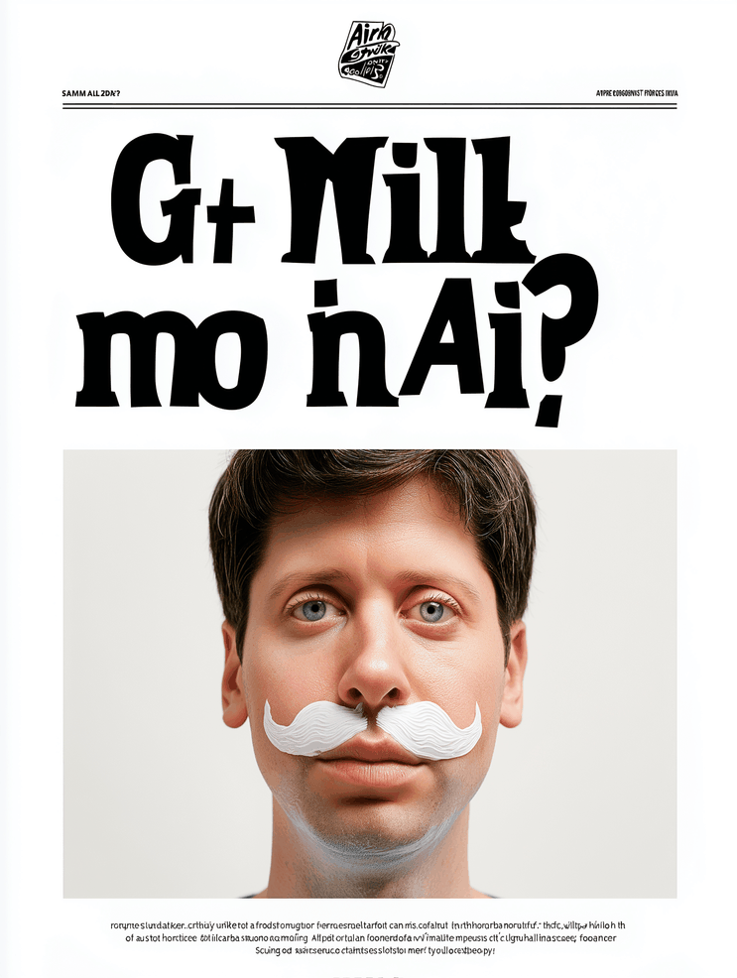
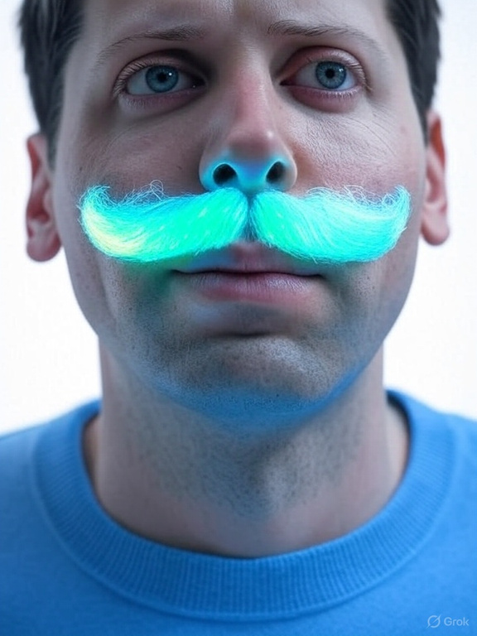
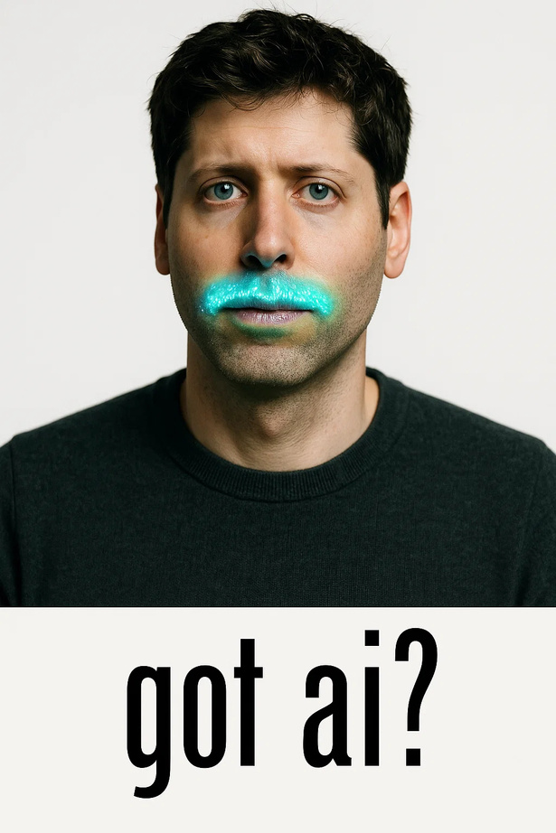


Visual Generative Ai - Benchmarking
Notes:
Parody advertisement in the iconic style of the 1990s "Got Milk?" campaign, rebranded as "Got AI?" clean minimalist white background, bold black typography in the classic Got Milk? font style. Portrait of Sam Altman, medium shot 50mm lens, with a glowing, bioluminescent milk mustache made of shimmering neon blues and greens, surreal but photorealistic lighting. Futuristic yet humorous tone, cinematic studio photography, hyper-detailed facial texture, soft shadows, crisp high-contrast image, ad campaign aesthetic

Slide 39
Category | Tools [Toys]
Foundation Models | OpenAI GPT-4/5*, Anthropic Claude, Google Gemini, Meta LLaMA, Mistral, Cohere
Productivity & Office | Microsoft Copilot*, Google Duet AI, Notion AI*, Jasper*, GrammarlyGO*, Writer
Creative Media | MidJourney, Sora, Adobe Firefly, Runway XL, Synthesia, Pika Labs, Stable Diffusion
Search & Knowledge | Perplexity AI*, ChatGPT-Plus (w/ Browse)*, You.com*, NeevaAI*
Coding & Dev Tools | GitHub Copilot*, Replit Ghostwriter*, Tabnine, Amazon CodeWhisperer
Business Apps | Salesforce Einstein*, HubSpot AI*, Intercom Fin*, Zapier AI*, Copy.ai*
Education & Training | Khanmigo (Khan Academy)*, Duolingo Max*, aiEDU, Quizlet Q-Chat*
Governance & Risk | NIST AI Risk Framework, AI RMF tools, Responsible AI dashboards

Slide 40
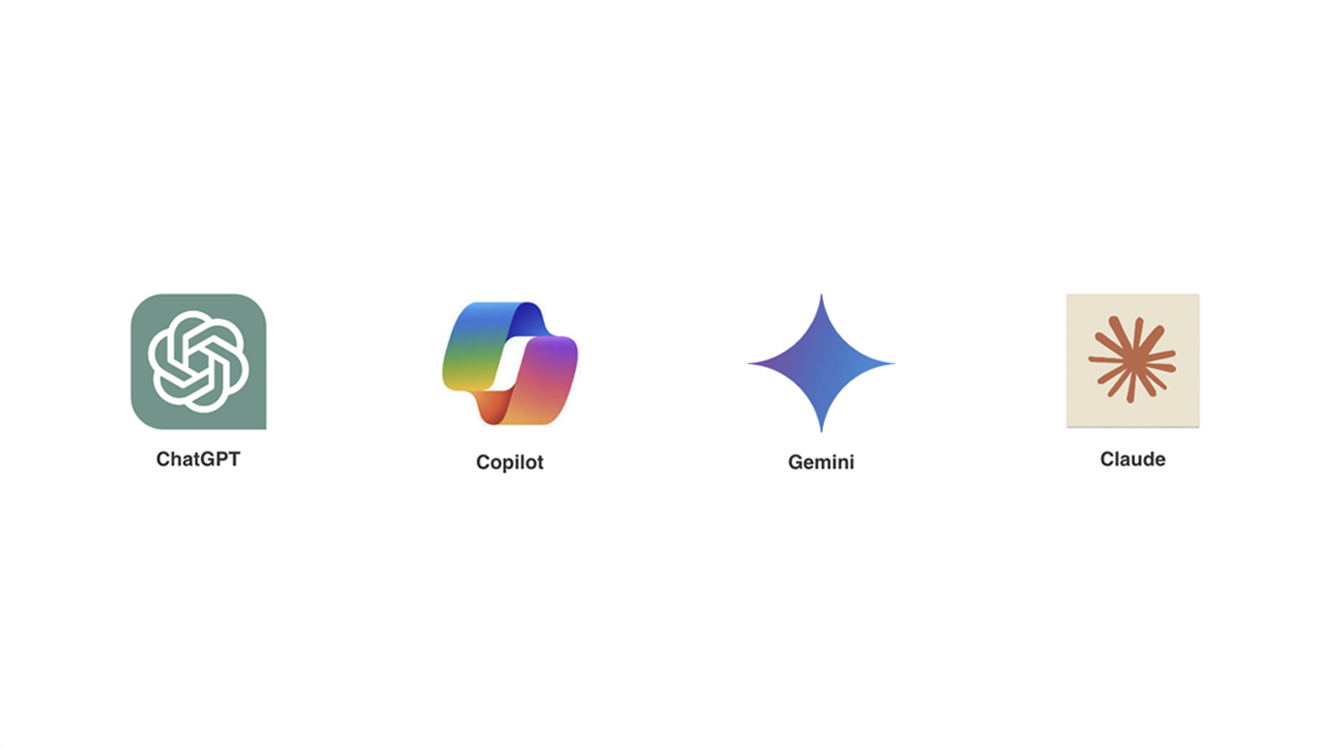
Flagship Tools
General All- Purpose
Transformer
Functional
Partner Designed
For Work
Googles LLM -
Great for Research
Anthropic LLM -
Great for Coding

Slide 42
CoPilot Studio Workshop
Your challenge is to design, prototype, and present an AI-powered communications agent using Microsoft Copilot Studio.
• Team 1 (Blue) - Internal (Employee) Communications
• Team 2 (Yellow) - External (Public & Media) Relations
• Team 3 (Red) Stakeholder & Government Relations
• Team 4 (green) Brand, Marketing & Corporate Identity
• Team 5 (Purple) Digital & Social Media Communications
• Team 6 (Orange) Crisis & Issues Management
Team Setup
  Groups: 5 groups or 6
  Self-Organizing: Let teams form organically. Encourage diversity of roles (writers, researchers, strategists, tech-savvy users).
  Remember Tuckmans Model!!!
Approach to the challenge with an Agile mindset:
  Define Roles
  Set Goals
  Conduct Research
  Build fast...iterate often....keep a HUMAN-IN-THE-LOOP and PLAY
Tools & Resources
  Copilot Studio access
  Strategic documents (uploaded by teams)
  Internet & other LLMs (e.g., ChatGPT, Google Gemini)

Slide 43
CoPilot Studio Workshop
Team 1 (Blue) - Internal (Employee) Communications
Role Setup
  Purpose: Build alignment, morale, and engagement among employees.
  Persona: Empathetic internal comms lead who understands organizational culture.
Core Skills
  Summarizing executive memos into plain language
  Drafting intranet articles and newsletters
  Scheduling town halls and generating agenda drafts
  Tracking employee feedback sentiment
Sample Instructions
“You are the Internal Comms Copilot. Draft clear and positive updates from leadership, generate monthly newsletter drafts from shared project notes, and create reminder posts for intranet and MS Teams. Suggest questions for Q&A at town halls.”

Slide 44
CoPilot Studio Workshop
Team 2 (Yellow) - External (Public & Media) Relations
Role Setup
  Purpose: Shape the company’s public image and narrative.
  Persona: Strategic PR manager with a journalistic tone.
Core Skills
  Writing press releases
  Creating media contact briefings
  Summarizing media coverage
  Suggesting key talking points
Sample Instructions
“You are the PR Copilot. Write press releases in AP style, generate media briefing sheets, and track mentions in news. Draft executive quotes and prepare journalist Q&A sheets.”

Slide 45
CoPilot Studio Workshop
Team 3 (Red) Stakeholder & Government Relations
Role Setup
  Purpose: Manage communications with regulators, policymakers, community groups, and investors.
  Persona: Policy-savvy communicator with a diplomatic tone.
Core Skills
  Drafting position papers
  Compiling ESG report content
  Creating community outreach messages
  Coordinating messaging with legal and compliance notes
Sample Instructions
“You are the Stakeholder Copilot. Draft clear and compliant position statements, summarize regulatory guidelines, and create outreach letters to local community leaders or policymakers.”

Slide 46
CoPilot Studio Workshop
Team 4 (green) Brand, Marketing & Corporate Identity
Role Setup
  Purpose: Strengthen and unify the company’s visual identity, voice, and reputation.
  Persona: Brand strategist with creative direction skills.
Core Skills
  Managing brand tone/style
  Creating content briefs
  Reviewing campaign copy for brand alignment
  Generating visuals and slogans
Sample Instructions
“You are the Brand Copilot. Audit content for tone and style, create campaign briefs, and draft copy for ads, sponsorship decks, and annual reports aligned with our brand voice.”

Slide 47
CoPilot Studio Workshop
Team 5 (Purple) Digital & Social Media Communications
Role Setup
  Purpose: Shape the company’s public image and narrative.
  Persona: Strategic PR manager with a journalistic tone.
Core Skills
  Writing press releases
  Creating media contact briefings
  Summarizing media coverage
  Suggesting key talking points
Sample Instructions
“You are the PR Copilot. Write press releases in AP style, generate media briefing sheets, and track mentions in news. Draft executive quotes and prepare journalist Q&A sheets.”

Slide 48
CoPilot Studio Workshop
Team 6 (Orange) Crisis & Issues Management
Role Setup
  Purpose: Protect the company’s reputation and ensure rapid information flow during incidents.
  Persona: Calm, precise crisis response lead.
Core Skills
  Accessing crisis playbooks
  Generating incident holding statements
  Coordinating with emergency response logs
  Tracking real-time sentiment
Sample Instructions
“You are the Crisis Comms Copilot. Generate fast, fact-checked updates, draft holding statements for incidents, and maintain a clear incident timeline. Provide real-time media and social sentiment summaries.”

Slide 49

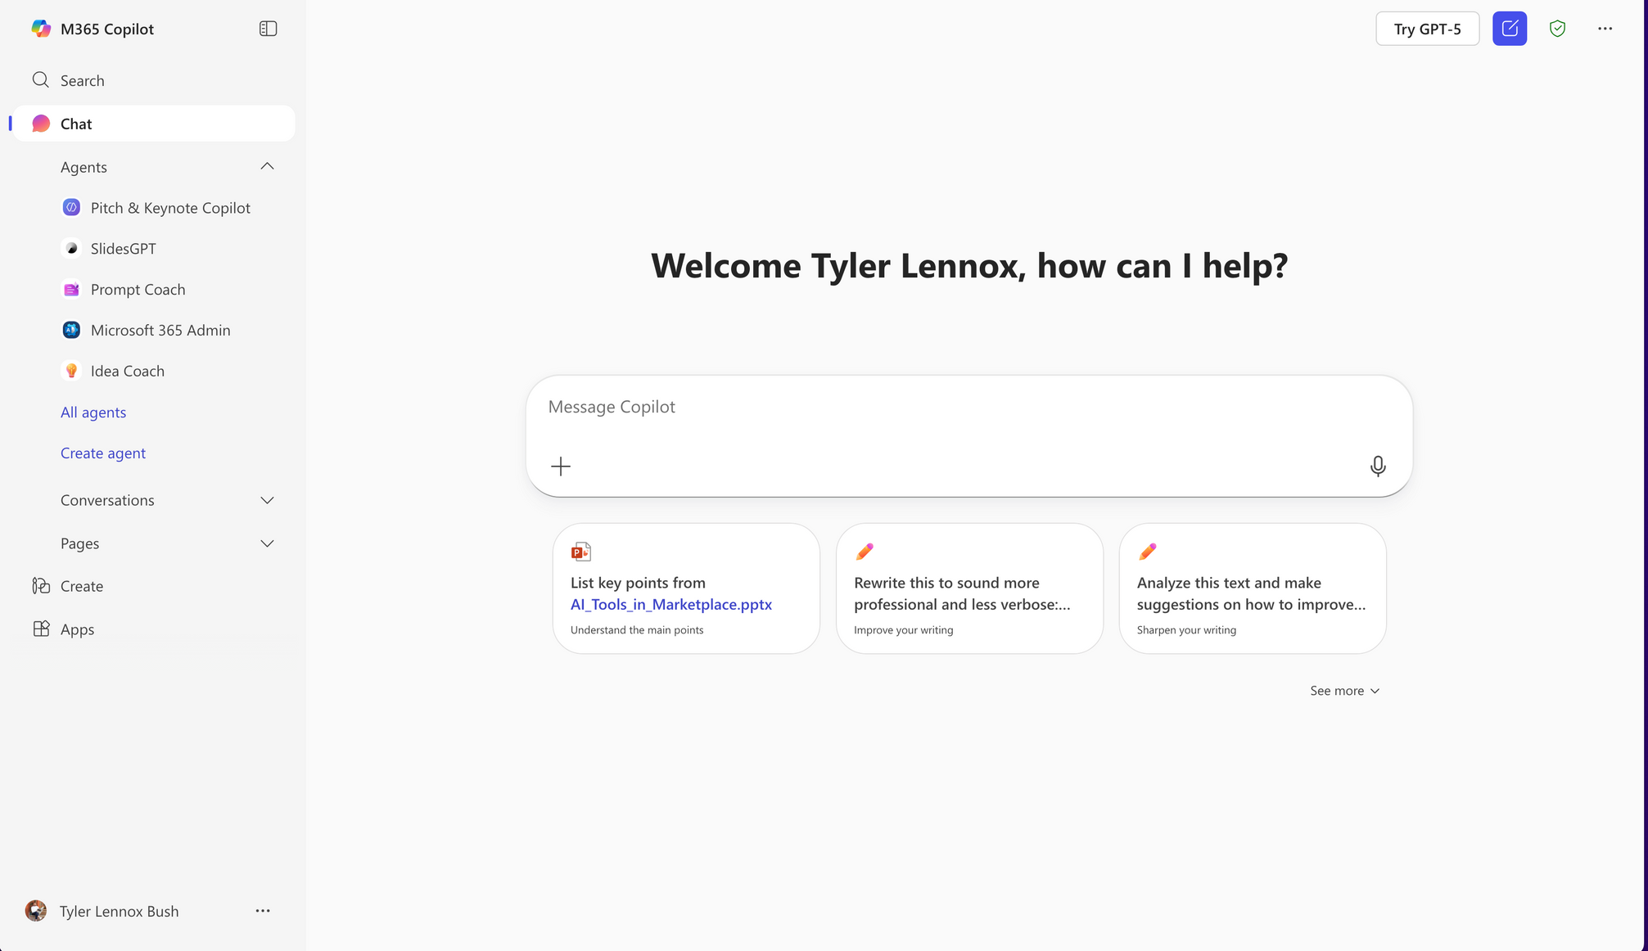
You Might want to Activatye GPT-5

Slide 50

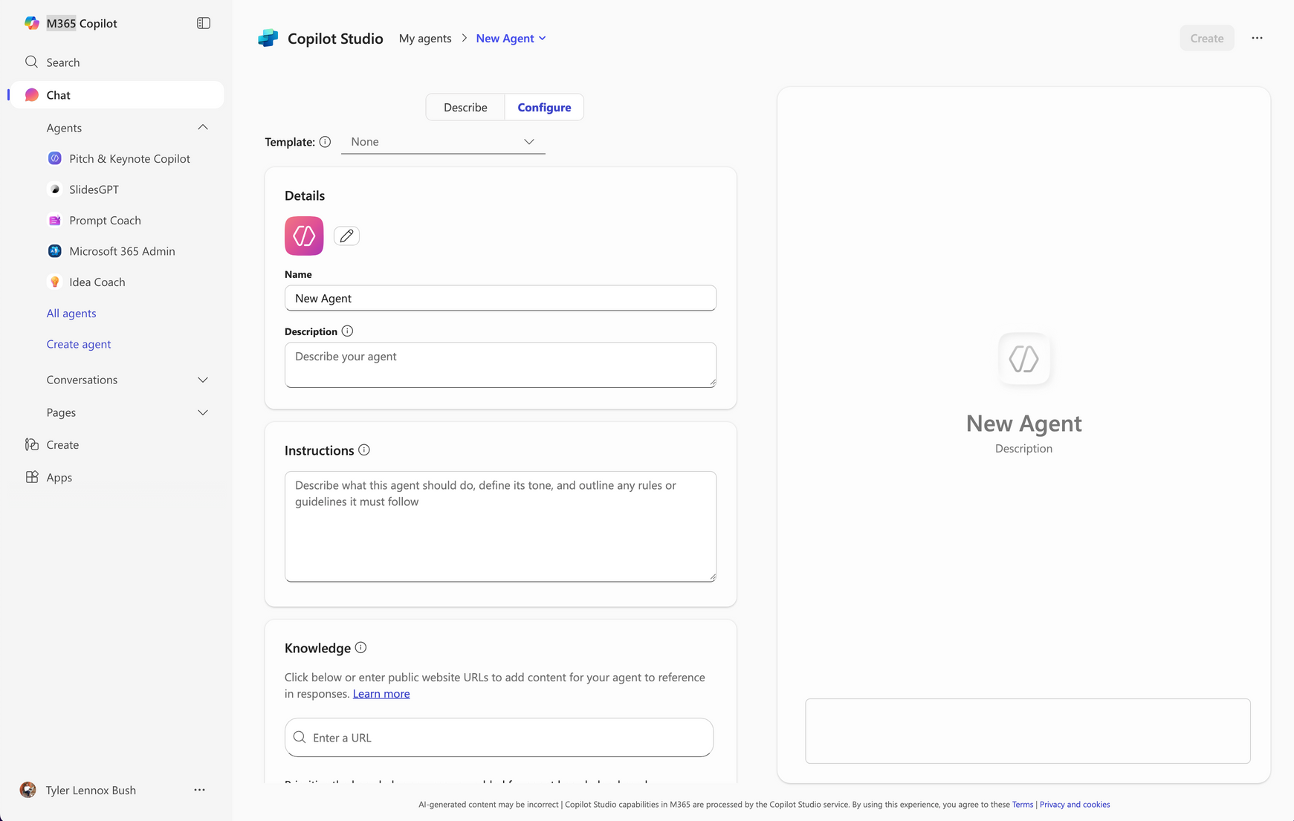

Slide 51
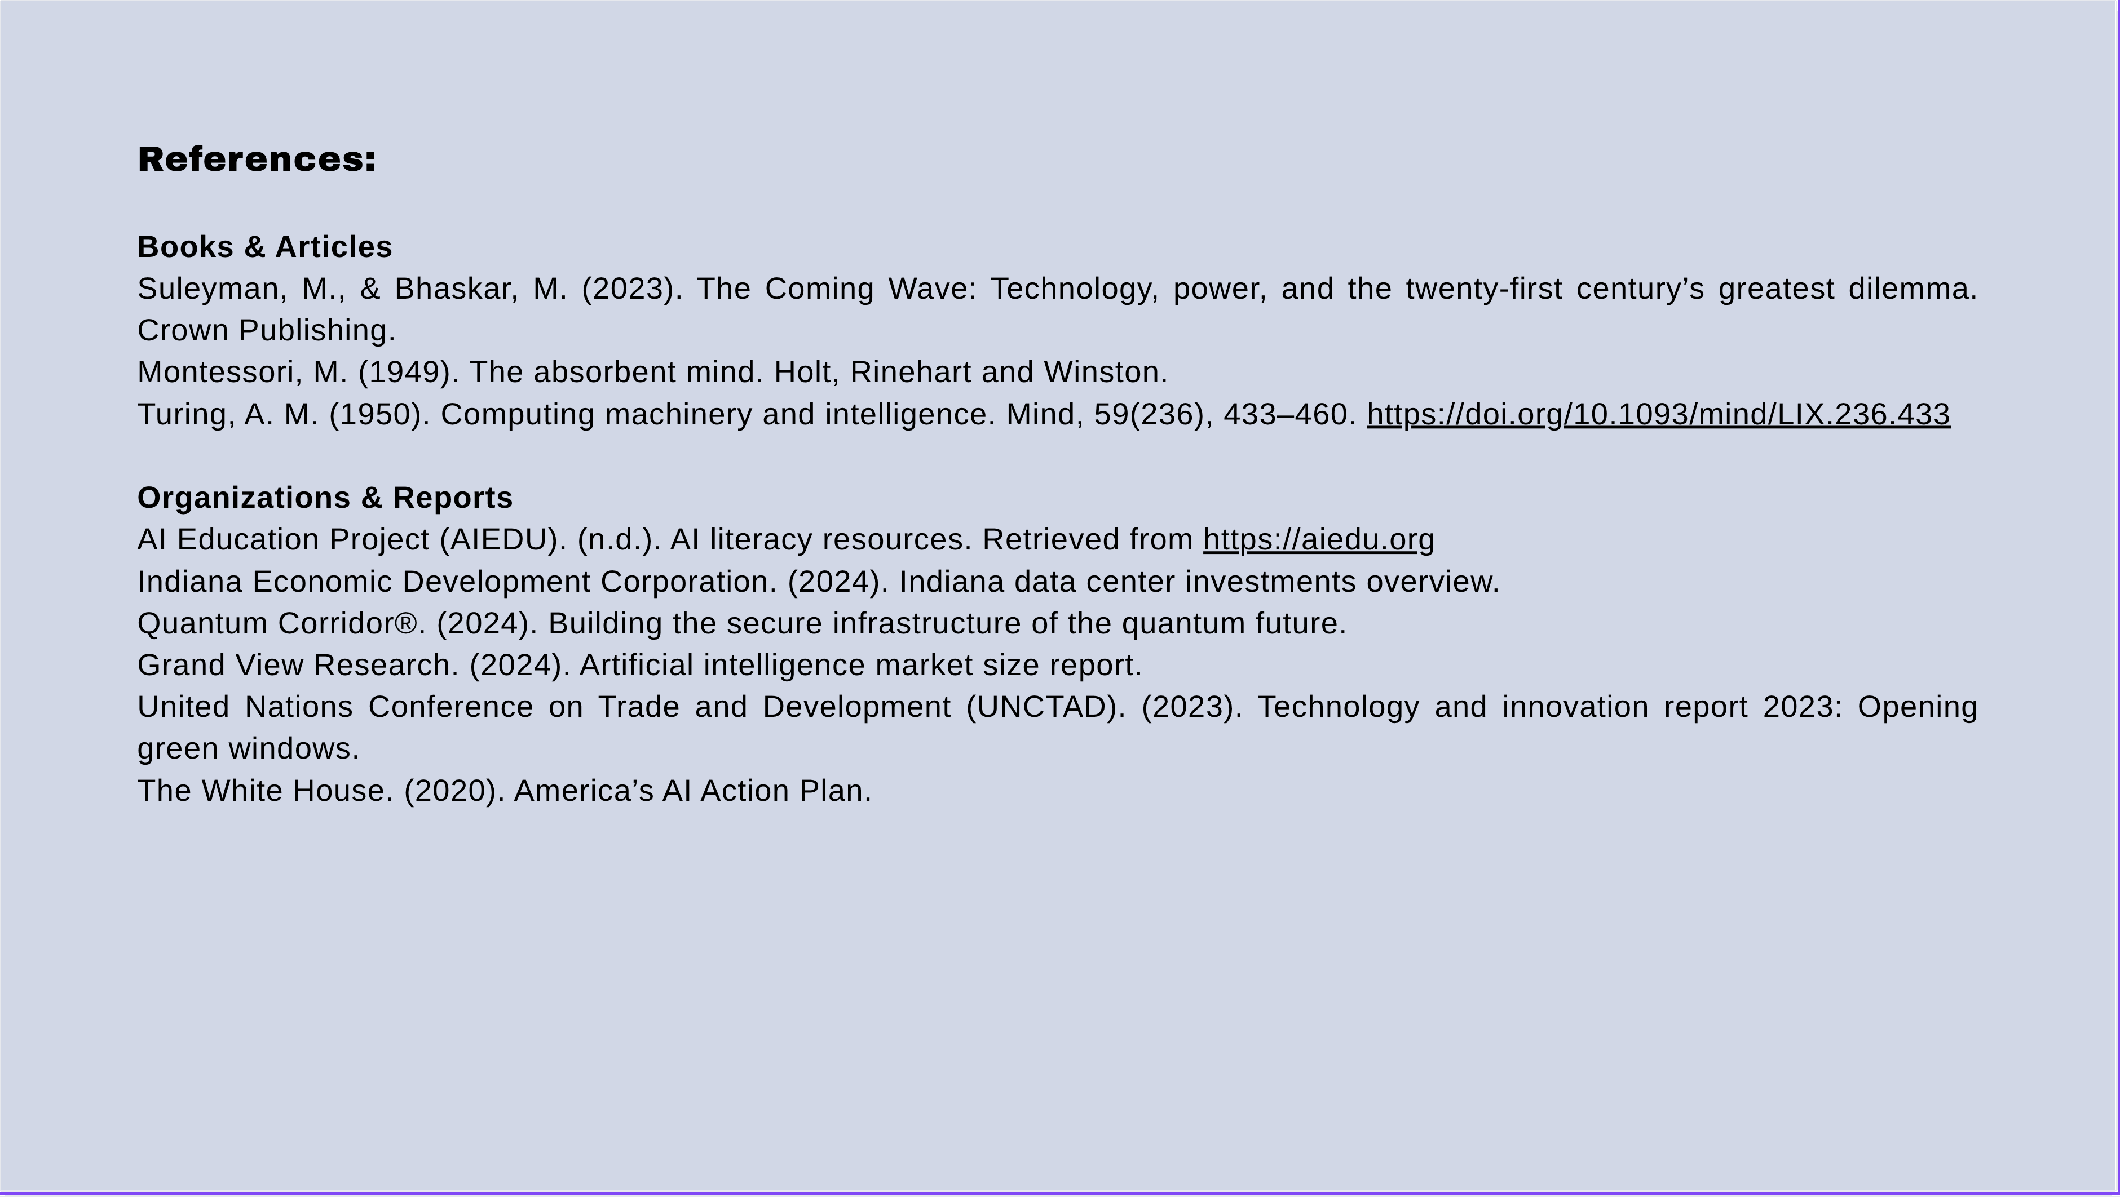

Slide 52
