Slide 1
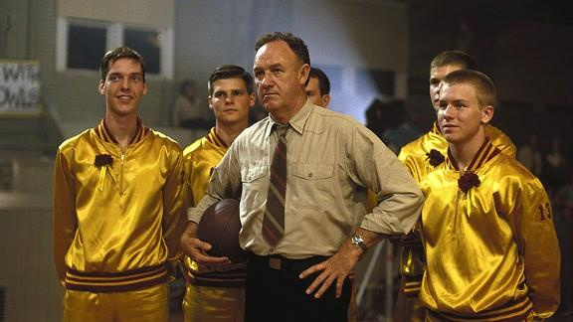
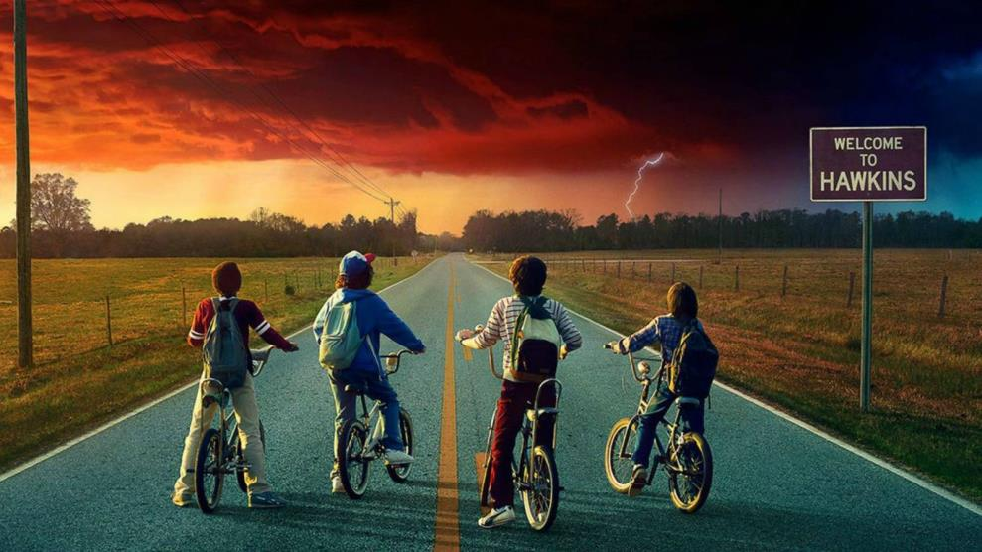

TY BUSH
/ A STORYTELLER FROM THE HEARTLAND
From Hoosiers
to Hawkins
Framing Indiana (Land of The Indian)
in American Film and Television
TYLER LENNOX BUSH - MA, MFA, MBA
LECTURER at PURDUE UNIVERSITY NORTHWEST
THE HAAN SYMPOSIUM / 29 SEPT 2026
PLACE. PEOPLE. PURPOSE.

Slide 2
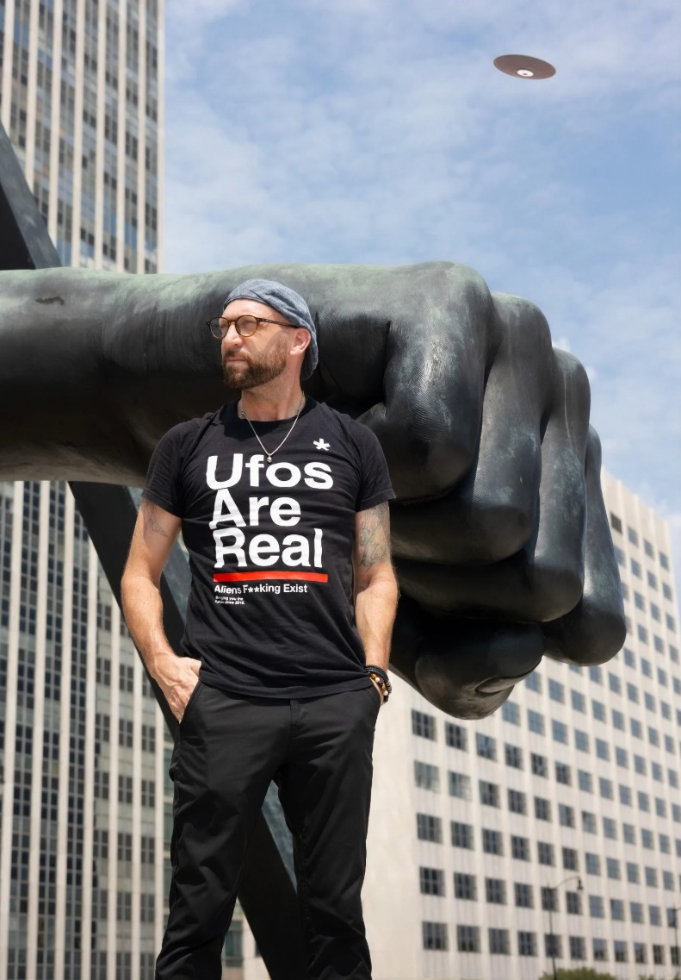



TY BUSH
/ A STORYTELLER FROM THE HEARTLAND
ABOUT THE SPEAKER
Tyler Lennox Bush
Continuing Lecturer at Purdue University Northwest
Writer & Producer at TwointheBush Television Co.
Studio Practice and Story Lab at CINDERBOX.IO
CREDENTIALS
MFA, Film Production & Screenwriting · DePaul University
MBA, Project Management (2027) · Purdue University
MA, Communication & Media Studies · Purdue University
BA, Fine Art & Theater · Wabash College
CV
PRODUCTION CO.
LAB
tybush.com
twointhebush.tv
cinderbox.io
TYLER LENNOX BUSH
THE HAAN / 29 SEPT 2026
TYBUSH.COM ↗
2 / 70

Slide 3
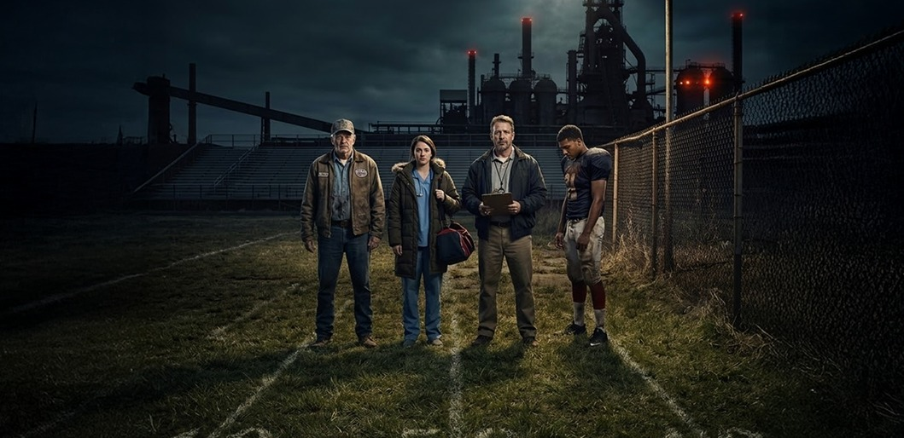
TY BUSH
/ A STORYTELLER FROM THE HEARTLAND
SCREENWRITING
I write about people
wrestling with
machines.
THE STORIES
THE WORK
Character-driven dramas set in the industrial Midwest: dysfunctional families, communities in peril, and the rituals and systems that shape us. I am drawn to haunted places, buried histories, and people fighting to survive as the world violently changes around them.
I study the industry to learn where these stories fit and how to shape them for TV, in the family-drama lane yet peppered with genre for flavor. The non-negotiables: the themes, and the real local history under the fiction. The towns are often composites of the many small Indiana towns I have called home. I’m haunted by these places.
TYLER LENNOX BUSH
THE HAAN / 29 SEPT 2026
TYBUSH.COM ↗
3 / 70

Slide 4
TY BUSH
/ A STORYTELLER FROM THE HEARTLAND
The questions we are exploring
PLACE.
How does Indiana’s geography, Indiana’s landscapes, cities and communities, shape artistic vision? What does it mean to make art about and from a specific place?
PEOPLE.
Who are the makers, teachers and storytellers who carry Indiana’s creative traditions forward? How do we document, celebrate and learn from living artists?
PURPOSE.
Why does art matter to communities and institutions? How do cultural organizations sustain themselves and stay relevant? What is the artist’s responsibility, if any, to the public?
Place. People. Purpose. A Symposium of Art, Culture and Community. The Haan Museum of Indiana Art.
TYLER LENNOX BUSH
THE HAAN / 29 SEPT 2026
TYBUSH.COM ↗
4 / 70

Slide 5
TY BUSH
/ A STORYTELLER FROM THE HEARTLAND
A working collection of 20 case studies
20
TWENTY WORKS / FOUR MODES / ONE GENRE CALLED INDIANA
01
Knute Rockne, All American
11
Prancer
02
Hoosiers
12
In & Out
03
A League of Their Own
13
Lonesome Jim
04
Rudy
14
The Judge
05
Breaking Away
15
Quantum Leap: “The Leap Back”
06
Madison
16
Parks and Recreation
07
Close Encounters of the Third Kind
17
Public Enemies
08
Eerie, Indiana
18
Columbus
09
Stranger Things
19
One Day at a Time
10
A Christmas Story
20
The Bear: “Gary”
A selective inheritance of settings, regional memory and dramatic possibilities.
TYLER LENNOX BUSH
THE HAAN / 29 SEPT 2026
TYBUSH.COM ↗
5 / 70

Slide 6
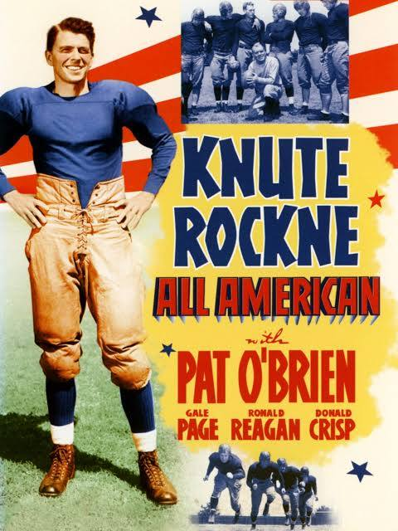
TY BUSH
/ A STORYTELLER FROM THE HEARTLAND
← THE COLLECTION / 01 OF 20 / THE SPORTS MYTH
1940 / SOUTH BEND, INDIANA
Knute Rockne,
All American
A Norwegian immigrant’s son rises from Chicago’s sandlots to coach Notre Dame, reinvents the game, and turns a small Catholic college into a national faith.
How does a coach become a public legend?
TYLER LENNOX BUSH
THE HAAN / 29 SEPT 2026
TYBUSH.COM ↗
6 / 70

Slide 7
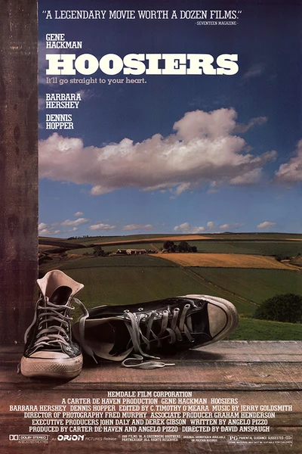
TY BUSH
/ A STORYTELLER FROM THE HEARTLAND
← THE COLLECTION / 02 OF 20 / THE SPORTS MYTH
1986 / HICKORY, INDIANA
Hoosiers
A disgraced coach with a past takes a job in tiny Hickory, Indiana, and must win over a suspicious town to take its small-school team to the state championship.
Who earns the right to belong?
TYLER LENNOX BUSH
THE HAAN / 29 SEPT 2026
TYBUSH.COM ↗
7 / 70

Slide 8
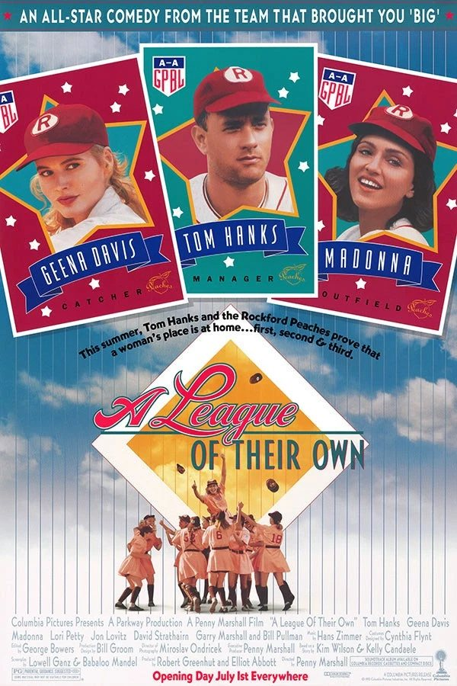
TY BUSH
/ A STORYTELLER FROM THE HEARTLAND
← THE COLLECTION / 03 OF 20 / THE SPORTS MYTH
1992 / EVANSVILLE + HUNTINGBURG, INDIANA
A League of Their Own
With the men off at war, a candy maker funds a women’s pro baseball league, and rival sisters Dottie and Kit play for the Rockford Peaches under a washed-up manager.
The game belonged to them, briefly.
TYLER LENNOX BUSH
THE HAAN / 29 SEPT 2026
TYBUSH.COM ↗
8 / 70

Slide 9
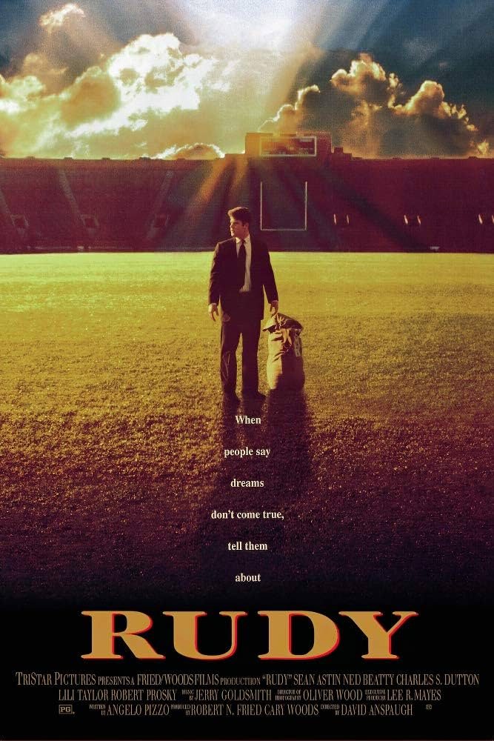
TY BUSH
/ A STORYTELLER FROM THE HEARTLAND
← THE COLLECTION / 04 OF 20 / THE SPORTS MYTH
1993 / SOUTH BEND, INDIANA
Rudy
Undersized and underestimated, a Joliet steelworker’s son walks away from the mill to chase an impossible dream: one play on the field at Notre Dame.
Who is allowed to want that much?
TYLER LENNOX BUSH
THE HAAN / 29 SEPT 2026
TYBUSH.COM ↗
9 / 70

Slide 10
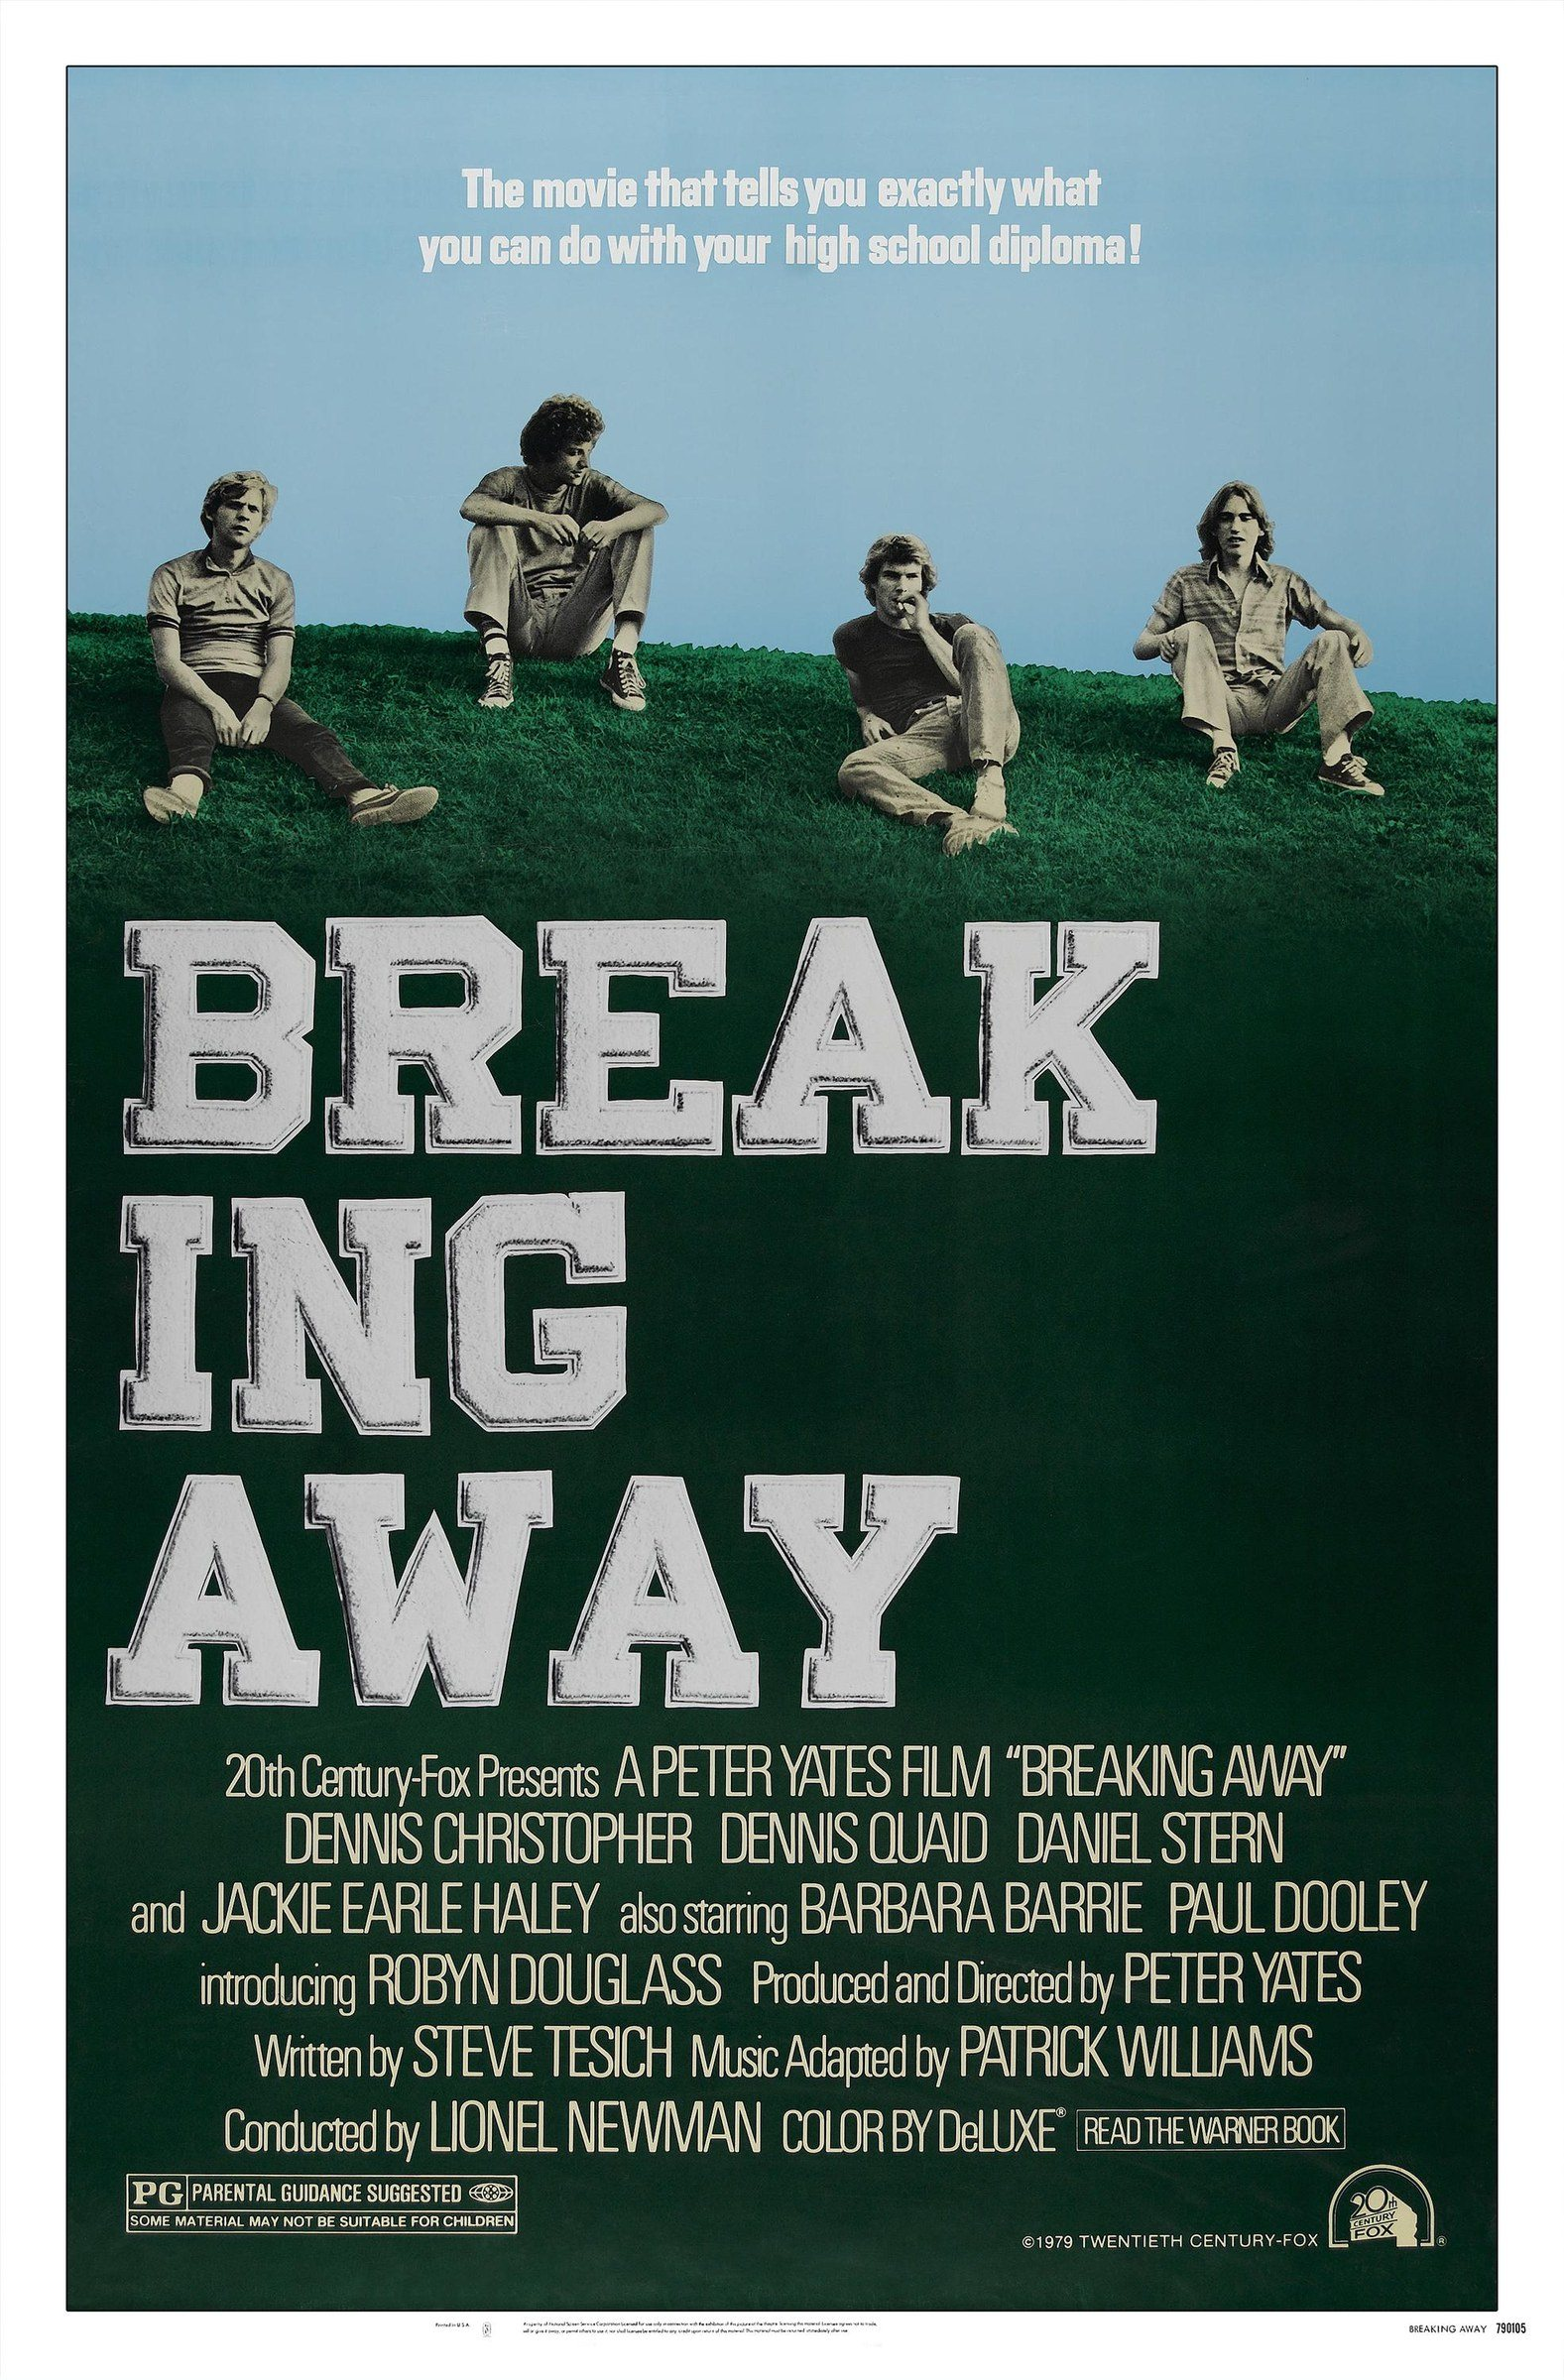
TY BUSH
/ A STORYTELLER FROM THE HEARTLAND
← THE COLLECTION / 05 OF 20 / THE SPORTS MYTH
1979 / BLOOMINGTON, INDIANA
Breaking Away
Four working-class Bloomington townies drift through their last summer, until one, obsessed with Italian cycling, leads them against the college kids in the Little 500.
Class decides who gets to leave.
TYLER LENNOX BUSH
THE HAAN / 29 SEPT 2026
TYBUSH.COM ↗
10 / 70

Slide 11
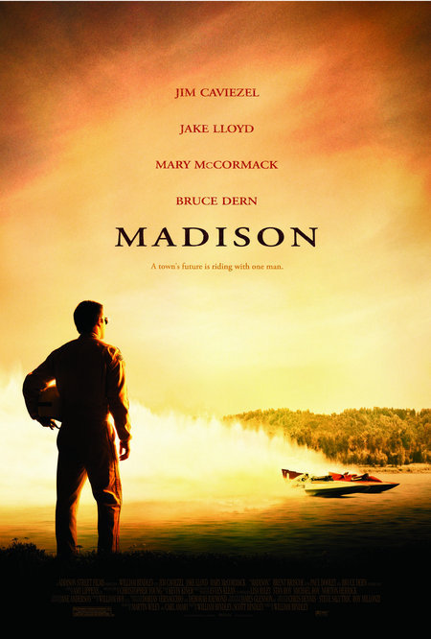
TY BUSH
/ A STORYTELLER FROM THE HEARTLAND
← THE COLLECTION / 06 OF 20 / THE SPORTS MYTH
2001 / MADISON, INDIANA
Madison
After a crash ends his hydroplane career, Jim McCormick fixes air conditioners in Madison, until the town’s boat, and its pride, need him back on the Ohio River.
A river town bets its pride on one race.
TYLER LENNOX BUSH
THE HAAN / 29 SEPT 2026
TYBUSH.COM ↗
11 / 70

Slide 12
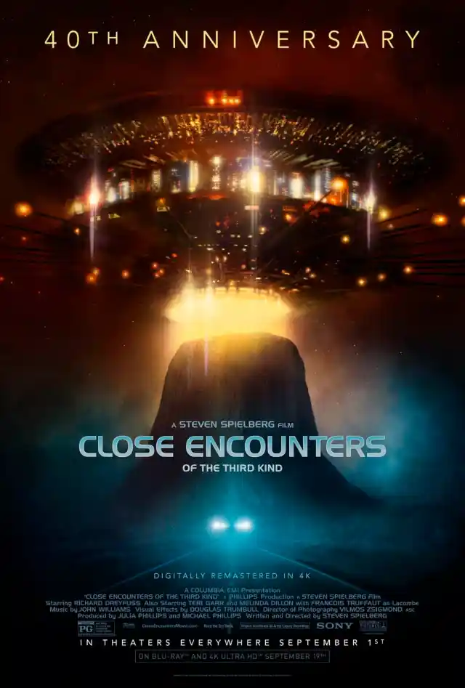
TY BUSH
/ A STORYTELLER FROM THE HEARTLAND
← THE COLLECTION / 07 OF 20 / WONDER & THE UNCANNY
1977 / MUNCIE, INDIANA
Close Encounters
of the Third Kind
After a close encounter on a night service call, a Muncie power lineman becomes obsessed with a vision that costs him his job and his family.
Familiar life opens onto wonder.
TYLER LENNOX BUSH
THE HAAN / 29 SEPT 2026
TYBUSH.COM ↗
12 / 70

Slide 13
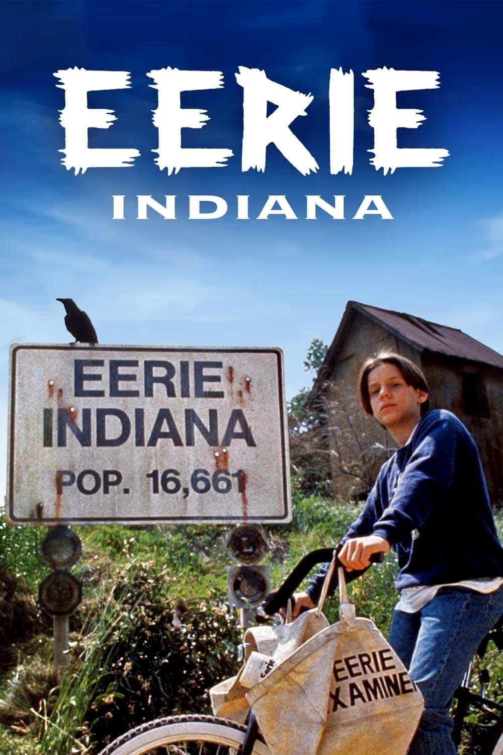
TY BUSH
/ A STORYTELLER FROM THE HEARTLAND
← THE COLLECTION / 08 OF 20 / WONDER & THE UNCANNY
1991 / EERIE, INDIANA
Eerie, Indiana
A new kid discovers his perfectly normal Indiana hometown is the center of weirdness in America, and sets out to prove it to adults who refuse to see.
What hides beneath normal?
TYLER LENNOX BUSH
THE HAAN / 29 SEPT 2026
TYBUSH.COM ↗
13 / 70

Slide 14
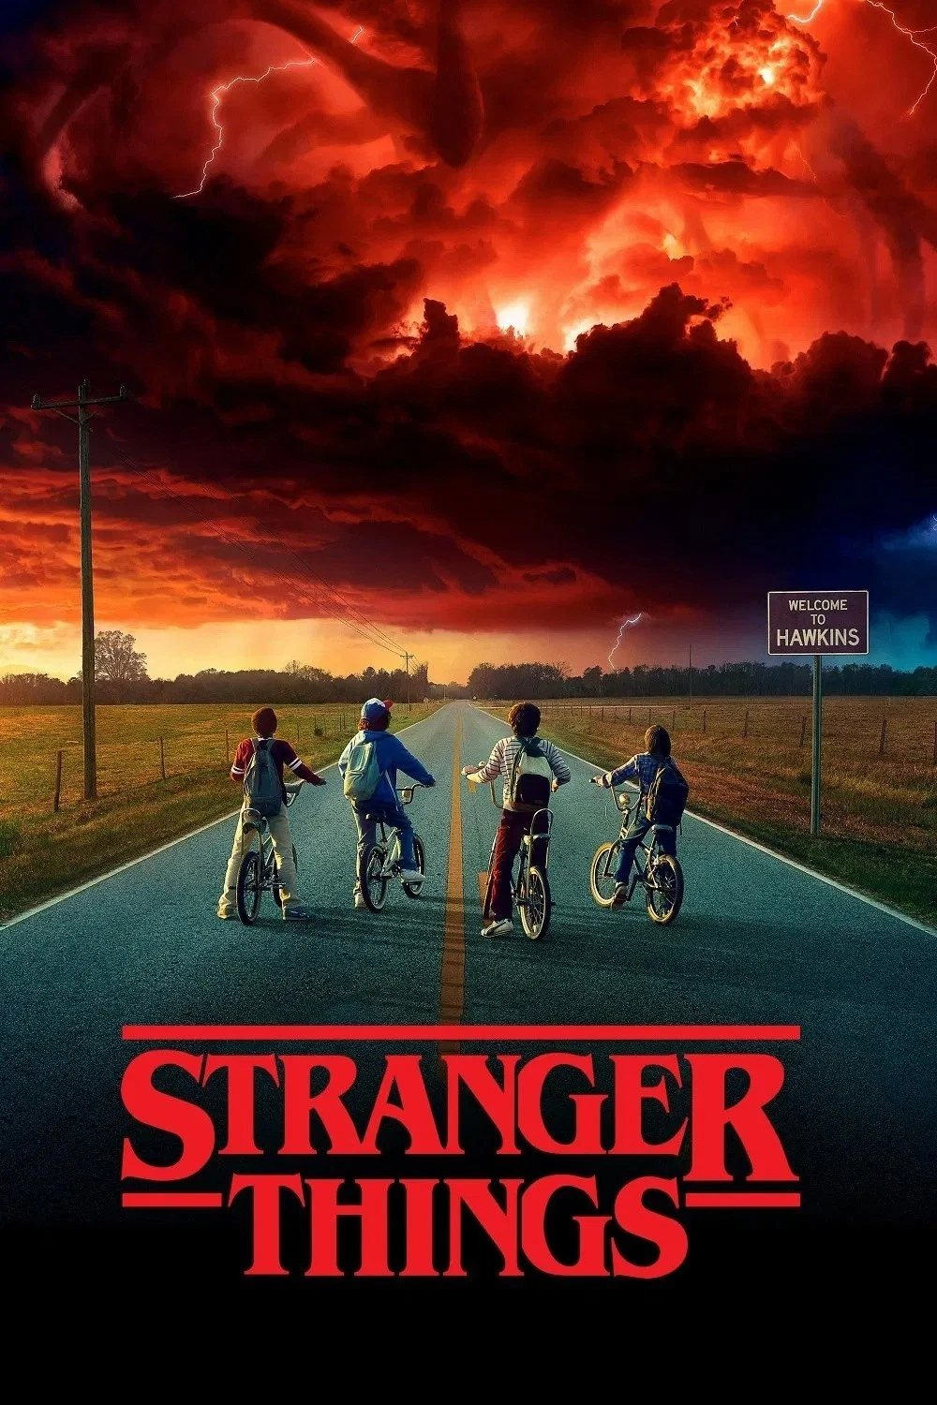
TY BUSH
/ A STORYTELLER FROM THE HEARTLAND
← THE COLLECTION / 09 OF 20 / WONDER & THE UNCANNY
2016 / HAWKINS, INDIANA
Stranger Things
In 1983 Hawkins, a boy vanishes, and his friends, his mother and the police chief uncover a secret government lab and a monstrous world beneath their town.
What happens when the ordinary becomes threatening?
TYLER LENNOX BUSH
THE HAAN / 29 SEPT 2026
TYBUSH.COM ↗
14 / 70

Slide 15
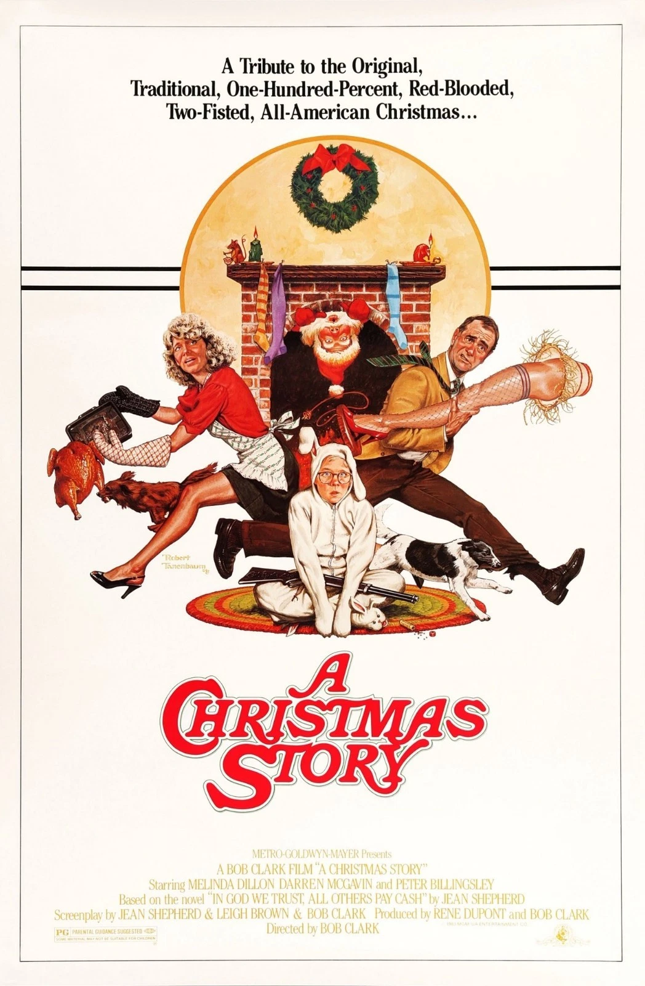
TY BUSH
/ A STORYTELLER FROM THE HEARTLAND
← THE COLLECTION / 10 OF 20 / HOME & FAMILY
1983 / HOHMAN (HAMMOND), INDIANA
A Christmas Story
In 1940s Hohman, Indiana, nine-year-old Ralphie schemes to get the one Christmas present every adult says will shoot his eye out.
Family rituals, everyday desires and the comedy of remembering.
TYLER LENNOX BUSH
THE HAAN / 29 SEPT 2026
TYBUSH.COM ↗
15 / 70

Slide 16
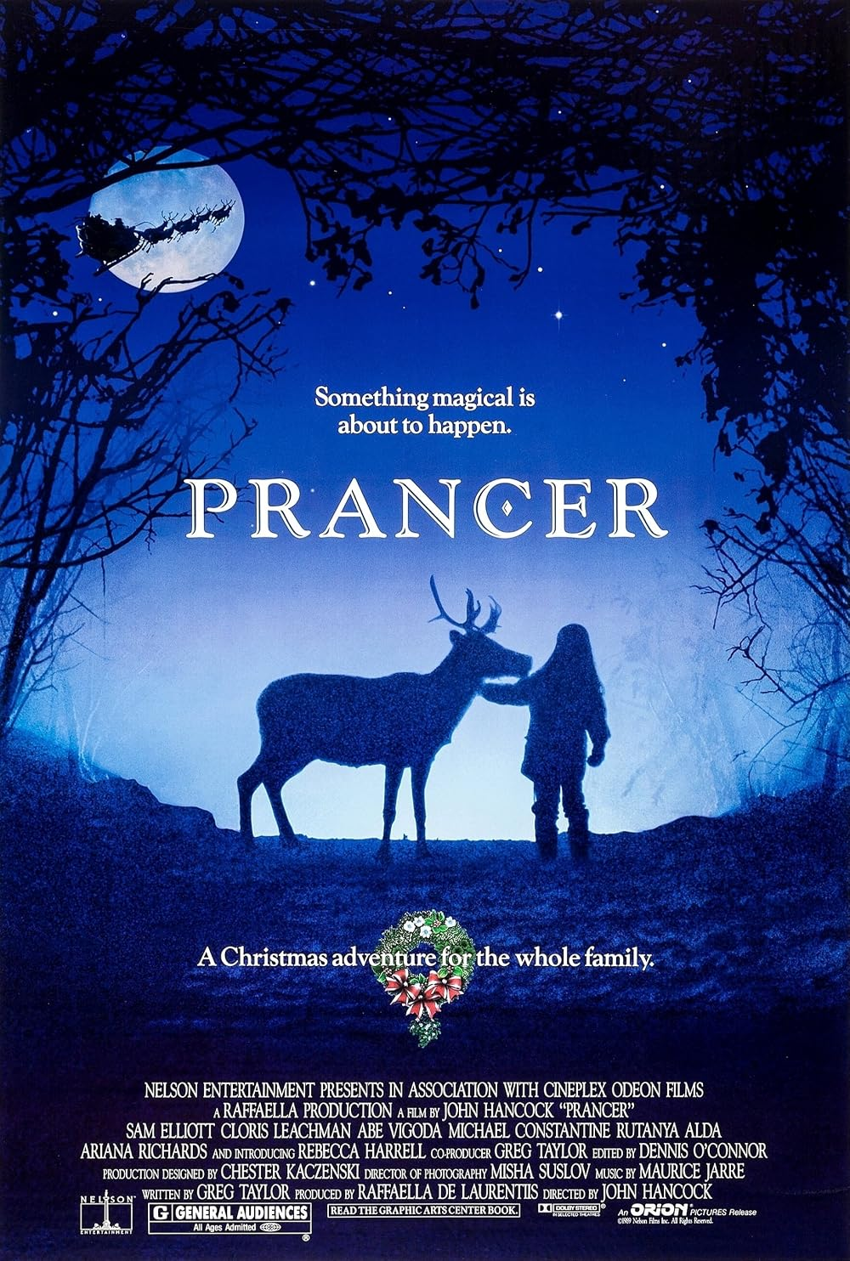
TY BUSH
/ A STORYTELLER FROM THE HEARTLAND
← THE COLLECTION / 11 OF 20 / HOME & FAMILY
1989 / LA PORTE, IN + THREE OAKS, MI
Prancer
On a struggling apple farm, a girl who has lost her mother nurses a wounded reindeer she believes is Santa’s, while her father fights to keep the farm.
Family tenderness, vulnerability and the possibility of wonder.
TYLER LENNOX BUSH
THE HAAN / 29 SEPT 2026
TYBUSH.COM ↗
16 / 70

Slide 17
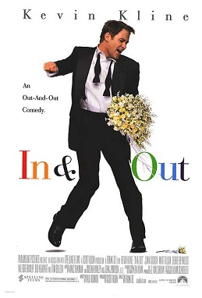
TY BUSH
/ A STORYTELLER FROM THE HEARTLAND
← THE COLLECTION / 12 OF 20 / HOME & FAMILY
1997 / GREENLEAF, INDIANA
In & Out
Days before his wedding, small-town English teacher Howard Brackett is outed on live TV by a former student accepting an Oscar, and all of Greenleaf takes a side.
A hometown learns who its own people are.
TYLER LENNOX BUSH
THE HAAN / 29 SEPT 2026
TYBUSH.COM ↗
17 / 70

Slide 18
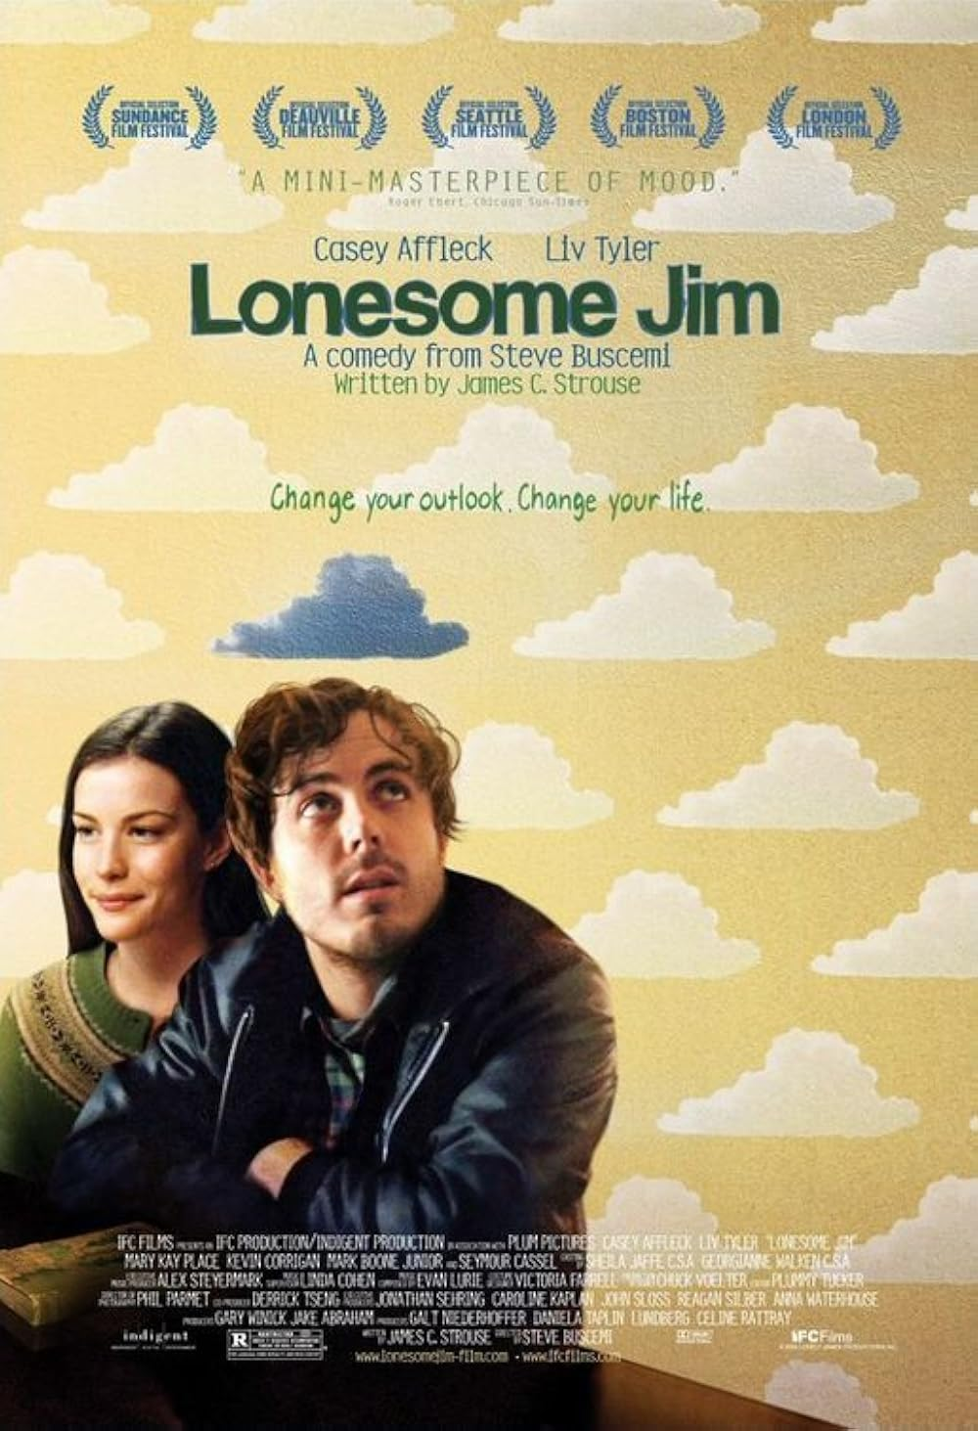
TY BUSH
/ A STORYTELLER FROM THE HEARTLAND
← THE COLLECTION / 13 OF 20 / HOME & FAMILY
2006 / GOSHEN, INDIANA
Lonesome Jim
After failing as a writer in New York, Jim slinks home to Goshen, where his gloom spreads to his brother and a local nurse offers him an unlikely second chance.
Coming home as defeat, and as a second chance.
TYLER LENNOX BUSH
THE HAAN / 29 SEPT 2026
TYBUSH.COM ↗
18 / 70

Slide 19
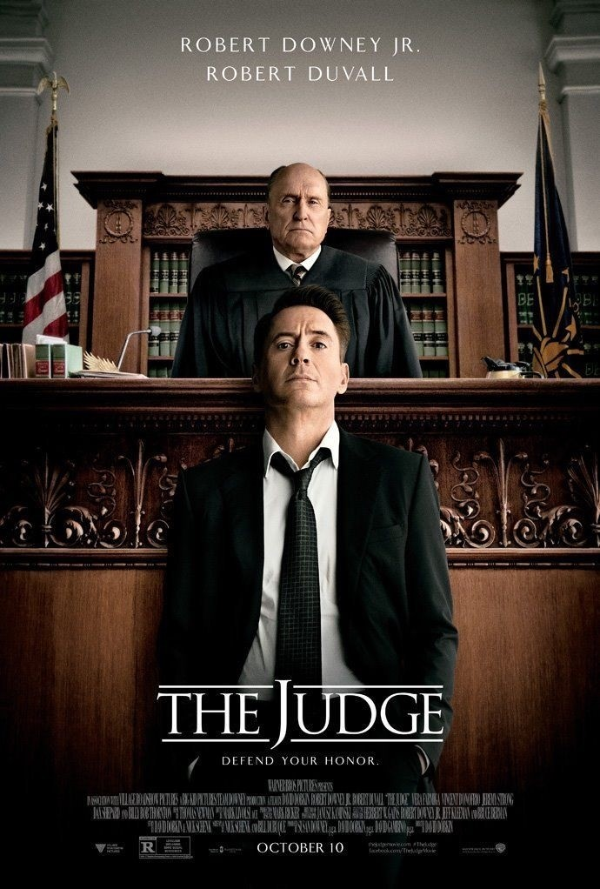
TY BUSH
/ A STORYTELLER FROM THE HEARTLAND
← THE COLLECTION / 14 OF 20 / HOME & FAMILY
2014 / CARLINVILLE, INDIANA
The Judge
A hotshot Chicago lawyer comes home to small-town Indiana for his mother’s funeral and ends up defending his estranged father, the town judge, against a murder charge.
When a father embodies the town’s authority.
TYLER LENNOX BUSH
THE HAAN / 29 SEPT 2026
TYBUSH.COM ↗
19 / 70

Slide 20
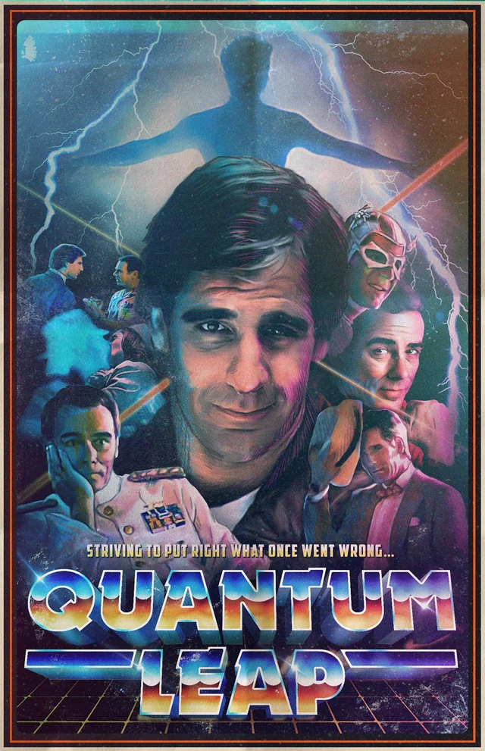
TY BUSH
/ A STORYTELLER FROM THE HEARTLAND
← THE COLLECTION / 15 OF 20 / HOME & FAMILY
1991 / CROWN POINT, INDIANA
Quantum Leap:
“The Leap Back”
A lightning strike sends Al into a presumed-dead POW coming home to Crown Point in 1945, with two days to stop the tragedy waiting for him.
A hometown waiting for a man who was supposed to be dead.
TYLER LENNOX BUSH
THE HAAN / 29 SEPT 2026
TYBUSH.COM ↗
20 / 70

Slide 21
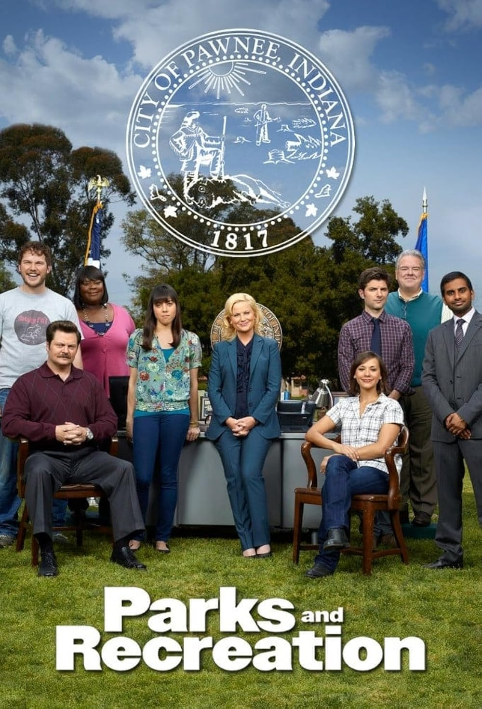
TY BUSH
/ A STORYTELLER FROM THE HEARTLAND
← THE COLLECTION / 16 OF 20 / CIVIC LIFE & THE REGION
2009 / PAWNEE, INDIANA
Parks and
Recreation
In Pawnee, Indiana, a relentlessly optimistic bureaucrat sets out to turn an abandoned pit into a park, and spends seven seasons serving a town that doesn’t want serving.
Loving a town while laughing at its contradictions.
TYLER LENNOX BUSH
THE HAAN / 29 SEPT 2026
TYBUSH.COM ↗
21 / 70

Slide 22
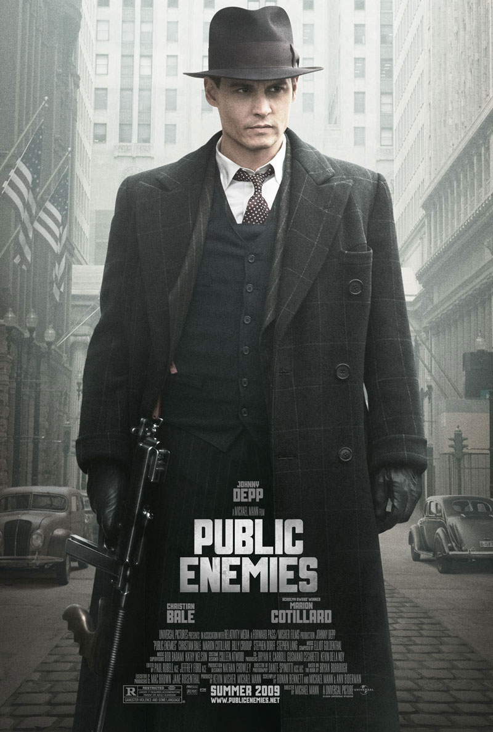
TY BUSH
/ A STORYTELLER FROM THE HEARTLAND
← THE COLLECTION / 17 OF 20 / CIVIC LIFE & THE REGION
2009 / CROWN POINT, INDIANA
Public Enemies
In the Depression, bank robber John Dillinger tears across the Midwest as a folk hero, while J. Edgar Hoover’s new Bureau hunts him with modern methods.
An American dream gone bad.
TYLER LENNOX BUSH
THE HAAN / 29 SEPT 2026
TYBUSH.COM ↗
22 / 70

Slide 23
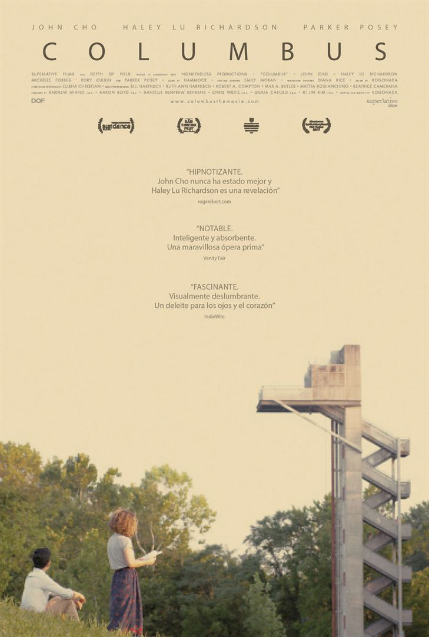
TY BUSH
/ A STORYTELLER FROM THE HEARTLAND
← THE COLLECTION / 18 OF 20 / CIVIC LIFE & THE REGION
2017 / COLUMBUS, INDIANA
Columbus
Stranded in Columbus, Indiana, by his father’s coma, Jin befriends Casey, a young local who loves the city’s modernist buildings but won’t leave her mother.
Here, the architecture is the argument.
TYLER LENNOX BUSH
THE HAAN / 29 SEPT 2026
TYBUSH.COM ↗
23 / 70

Slide 24
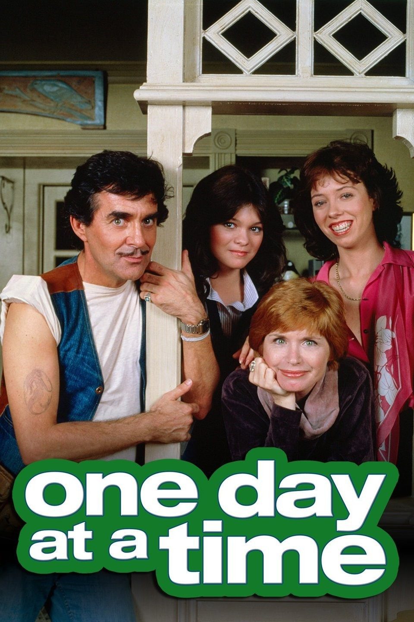
TY BUSH
/ A STORYTELLER FROM THE HEARTLAND
← THE COLLECTION / 19 OF 20 / CIVIC LIFE & THE REGION
1975 / INDIANAPOLIS, INDIANA
One Day at a Time
Newly divorced, Ann Romano moves her two teenage daughters into an Indianapolis apartment and starts over, with Schneider the super never far from the door.
Starting over without leaving Indiana.
TYLER LENNOX BUSH
THE HAAN / 29 SEPT 2026
TYBUSH.COM ↗
24 / 70

Slide 25
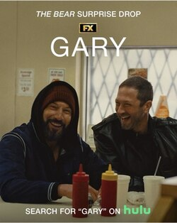
TY BUSH
/ A STORYTELLER FROM THE HEARTLAND
← THE COLLECTION / 20 OF 20 / CIVIC LIFE & DA REGION
2026 / GARY, INDIANA
The Bear: “Gary”
Mikey and Richie run a quick errand from Chicago to Gary, and a day of killing time becomes a reckoning between two friends, one of whom won’t be around much longer.
Set in DA Region. Who gets to make it here?
TYLER LENNOX BUSH
THE HAAN / 29 SEPT 2026
TYBUSH.COM ↗
25 / 70

Slide 26
TY BUSH
/ A STORYTELLER FROM THE HEARTLAND
ACT 2 / THE GENRE CALLED INDIANA
The raw materials
THE PEOPLE.
The outsider coach. The newcomer who notices. The dreamer from the mill. The prodigal child. The lost child. The outlaw folk hero. The civic optimist. The utopian American prophet with “a vision.”
THE PLACES.
The gym and the stadium. The quarry, the mill and the farm. The courthouse, the diner and the dive bar. The company out by the interstate. Founder statues de-sanctified and defaced, Victorian homes and Mid-century moderns being restored. Million Dollar Modern White Farmhouses on ½ acre
THE RITUALS.
The big game. The town meeting. The holiday table. The homecoming. The funeral. The race. The vote.
THE THEMES.
Who gets to leave, and who stays. Faith in the team. Class and inheritance. Wonder breaking the ordinary. The bargain of progress. What the Land remembers.
Four modes: the sports myth, wonder and the uncanny, home and family, civic life and the Region. The raw materials for the next Indiana story.
TYLER LENNOX BUSH
THE HAAN / 29 SEPT 2026
TYBUSH.COM ↗
26 / 70

Slide 27
TY BUSH
/ A STORYTELLER FROM THE HEARTLAND
ACT 2 / THE GENRE CALLED INDIANA
Dominant protagonists
01
The underdog striver
02
The outsider who must earn the town
Wants more than the town allows. Rudy, Breaking Away’s Dave, the Hickory team.
Arrives with a past, is tested, is redeemed. Norman Dale, Knute Rockne.
03
The young witness
04
The blue-collar visionary
Sees what adults refuse to. Marshall, the Stranger Things kids, Jessica, Ralphie.
An ordinary worker called by the extraordinary, at great cost. Roy Neary.
05
The returning prodigal
06
The civic believer who stays
Comes home to reckon with a father, a past, a death. Hank Palmer, Tom Jarrett.
Fights for the town from inside it. Leslie Knope, Ann Romano, Casey.
07
The outlaw folk hero
08
The visitor’s gaze
The American dream pursued by other means. John Dillinger.
Outsiders looking across a line. Richie and Mikey in Gary; Woody, in reverse.
About 11 of the 16 center men or boys. Women lead only in Parks, One Day at a Time and Prancer, and share the lead in Columbus and Stranger Things.
TYLER LENNOX BUSH
THE HAAN / 29 SEPT 2026
TYBUSH.COM ↗
27 / 70

Slide 28


TY BUSH
/ A STORYTELLER FROM THE HEARTLAND
PRODUCTION CO. / TWOINTHEBUSH TELEVISION
Never fear.
TwointheBush
is here.
A family production company, founded by siblings Ty and Ashley Joyce Bush. The service department for the next Indiana story: development, writing and production, rooted where the stories grow.
twointhebush.tv
SCAN TO SEE THE WORK
TYLER LENNOX BUSH
THE HAAN / 29 SEPT 2026
TYBUSH.COM ↗
28 / 70

Slide 29

TY BUSH
/ A STORYTELLER FROM THE HEARTLAND
TWOINTHEBUSH TV CO. / PROOF OF CONCEPT
WORKPLACE COMEDY / A SMALL-TOWN YOGA STUDIO
Zenroom
A workplace comedy about a small-town yoga studio, where “stretching” isn’t necessarily a thing.
STARRING
Cheri Oteri, Lisa Beasley, Ashley Joyce
DIRECTED BY
Layne Marie Williams
Yoga gets big in a small town.
Dances With Films 2026, TCL Chinese Theatre.
Proof we work with the industry and deliver as producers.
TYLER LENNOX BUSH
THE HAAN / 29 SEPT 2026
TYBUSH.COM ↗
29 / 70

Slide 30
TY BUSH
/ A STORYTELLER FROM THE HEARTLAND
ACT 3 / TWOINTHEBUSH TELEVISION CO. / THE SLATE
The story pipeline
Five stories built from some common raw materials.
NOW SHOWING
Yoga gets big in a small town, where “stretching” isn’t necessarily a thing.
Zenroom
HALF-HOUR COMEDY
IN DEVELOPMENT
The hyperscale transformation of a small Indiana town pushes an ag-tech founder’s vision of American utopia into the legacy of a football family cursed by the land.
Raking Prophets Rock
HOUR-LONG PRESTIGE DRAMA
IN DEVELOPMENT
A girls’ high school wrestling team fights for mat space and respect.
Lady Dogs
COMING-OF-AGE SPORTS DRAMA
EARLY DRAFTS
The Black Dragon Fighting Society. A Chicago beautician who moonlights as a bouncer at the Playboy Club and transforms into a kung fu guru and self-made subculture legend.
Count Dante
KUNG FU · CRIME · CHICAGO NOIR
IN RESEARCH
Chicago, 1894. George Pullman cuts wages but not the rent in his model company town. A fiery Hoosier railroad man, Eugene V. Debs, calls a boycott that stops trains nationwide, and Washington sends in federal troops.
Pullman
LIMITED SERIES · LABOR · GILDED AGE
TYLER LENNOX BUSH
THE HAAN / 29 SEPT 2026
TYBUSH.COM ↗
30 / 70

Slide 31
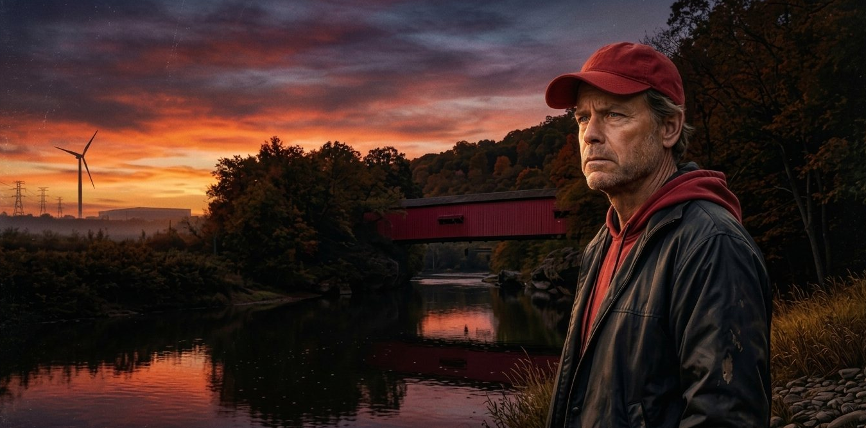
TY BUSH
/ A STORYTELLER FROM THE HEARTLAND
A MIDWESTERN GOTHIC SERIES / WORK IN PROGRESS
RAKING Prophets Rock
The hyperscale transformation of a small Indiana town pushes an ag-tech founder’s vision of American utopia into the legacy of a football family cursed by the land.
Erasure and extraction.
False prophets, and lost children.
5 SEASONS / 10 EPISODES EACH / A WORK IN PROGRESS
GREG KINNEAR / AS VICTOR RAKE
TYLER LENNOX BUSH
THE HAAN / 29 SEPT 2026
TYBUSH.COM ↗
31 / 70

Slide 32
TY BUSH
/ A STORYTELLER FROM THE HEARTLAND
ACT 3 / THE PROTAGONIST
Victor Rake
Legendary high school football coach. AP U.S. History teacher. Decorated Veteran…carries on a familial curse that is generation….a dark contract to remain stewards of The Rock…the Lands and Aquifers that feed the devils Punchbowl in the shades
WANTS
The championship that has always eluded him.
WOUND
A son lost twenty years ago, in what may have been a hazing ritual gone wrong.
CODE
Stoic, humble, a storyteller. He teaches kids to think for themselves and to be citizens. His morality is not clean. He has a passionate for the fight.
IN HIS CORNER
Patty Rake, his partner and the school board’s lone dissenting vote. Fellow teachers for 35 years, she rose through the union and is now in state politics and the democratic Party wants to make her a star…the data center battle is center stage of her campaign
A composite of my old football coach and my old history teacher. The legend standing in the way.
TYLER LENNOX BUSH
THE HAAN / 29 SEPT 2026
TYBUSH.COM ↗
32 / 70

Slide 33
TY BUSH
/ A STORYTELLER FROM THE HEARTLAND
TYLER LENNOX BUSH
THE HAAN / 29 SEPT 2026
TYBUSH.COM ↗
33 / 70

Slide 34
TY BUSH
/ A STORYTELLER FROM THE HEARTLAND
ACT 3 / THE ANTAGONIST
Aragon Small
Founder of Small Industries. Tech billionaire. The prodigal son of Prophets Rock.
WANTS
To rebuild his hometown as a tech utopia: the American dream on the prairie, wired along I-65.
METHOD
A $20 million gift to the football program, moved in before anyone can say no.
ROOTS
Descended from Harmonite settlers. His data centers echo generations of extraction.
IN HIS WAY
Coach Victor Rake, and a town that still remembers what the land cost.
A plastic veneer over the present. The Rock has been bleeding for a long time.
TYLER LENNOX BUSH
THE HAAN / 29 SEPT 2026
TYBUSH.COM ↗
34 / 70

Slide 35
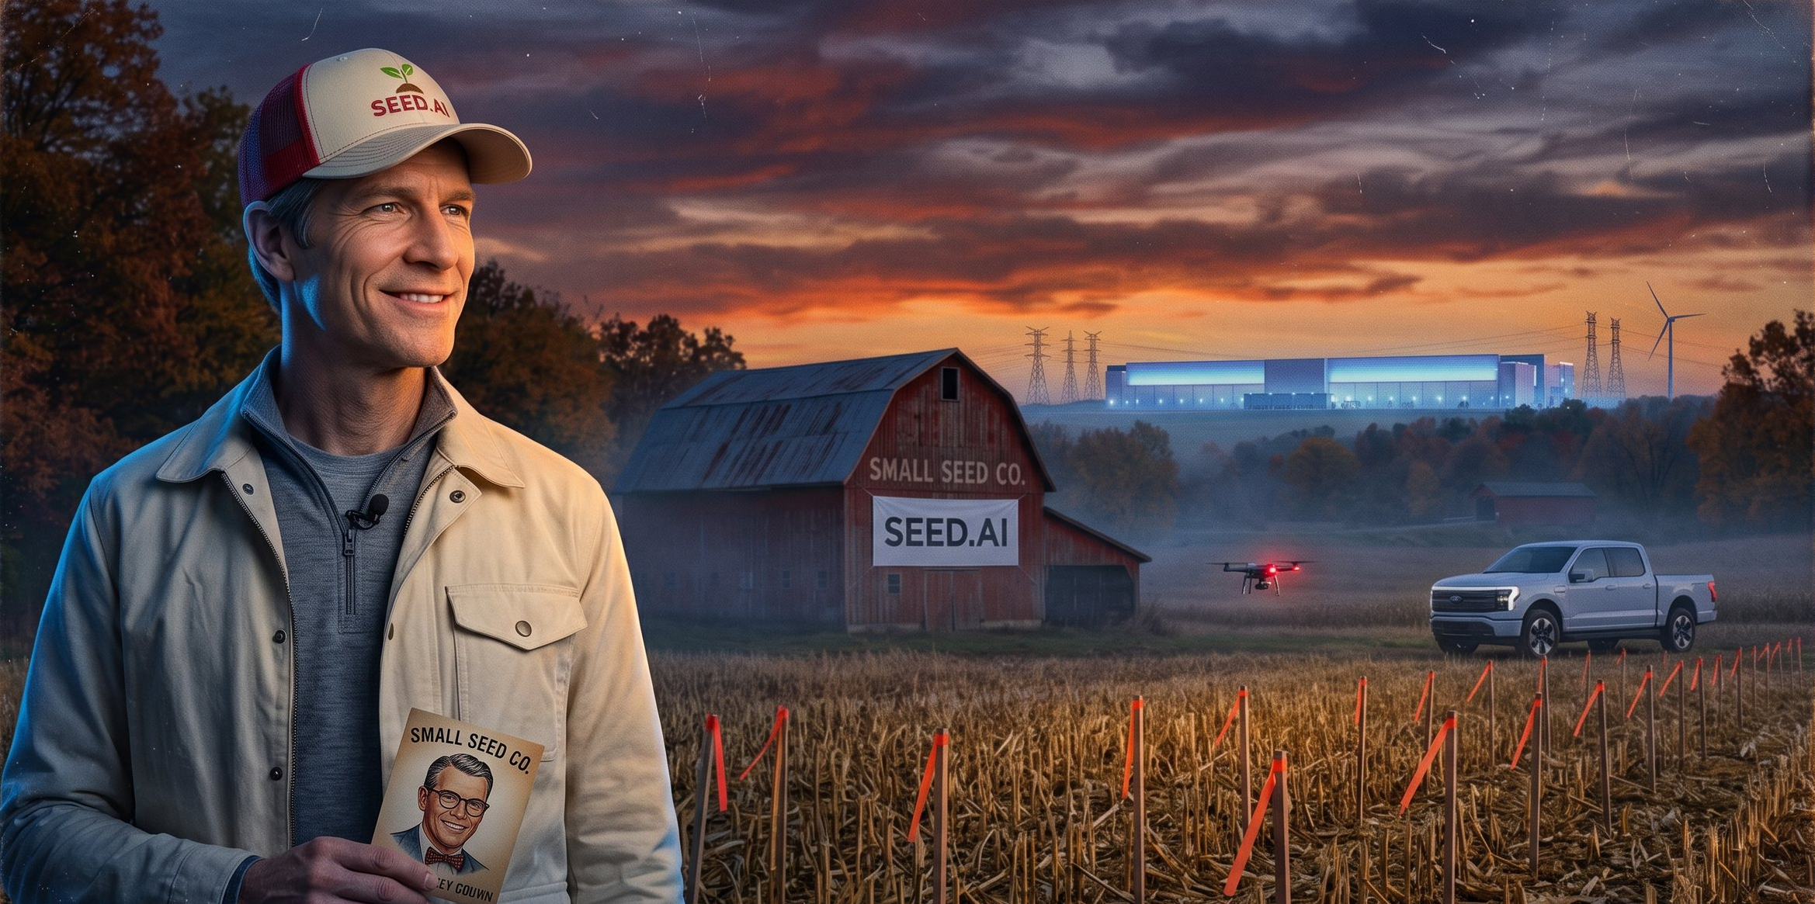
TY BUSH
/ A STORYTELLER FROM THE HEARTLAND
TYLER LENNOX BUSH
THE HAAN / 29 SEPT 2026
TYBUSH.COM ↗
35 / 70

Slide 36
TY BUSH
/ A STORYTELLER FROM THE HEARTLAND
ACT 3 / THE PRODIGAL SON
Geno Rake
“Gunner.” Fourteen seasons as an NFL special-teams gunner. Victor’s son, home after twenty years.
WANTS
To save his father’s program, and to prove he was never the family’s mistake.
WOUND
At seventeen he was sent in under the lights in his brother’s place. The town still remembers how that
game ended.
GIFT
Magic hands and a reader’s eye. He sees the kid hiding in plain sight.
IN HIS CORNER
Jack Straw, the friend who stayed. Chepi, the girl he left behind.
A body that paid for every yard. The prodigal son comes home to coach.
TYLER LENNOX BUSH
THE HAAN / 29 SEPT 2026
TYBUSH.COM ↗
36 / 70

Slide 37
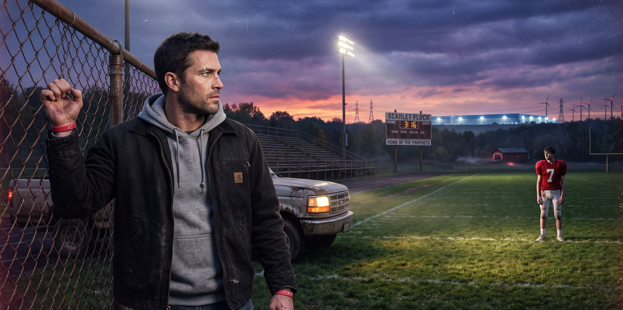
TY BUSH
/ A STORYTELLER FROM THE HEARTLAND
TYLER LENNOX BUSH
THE HAAN / 29 SEPT 2026
TYBUSH.COM ↗
37 / 70

Slide 38
TY BUSH
/ A STORYTELLER FROM THE HEARTLAND
ACT 3 / THE FRIEND WHO STAYED
Jack Straw
Assistant coach. Geno’s childhood best friend. Twenty years of drills, rides and favors.
WANTS
Victor’s job, and proof that staying mattered.
WOUND
He married the girl Geno left behind, and still wonders if he’s a husband or a placeholder.
PRESSURE
Geno’s return threatens to leapfrog him one more time.
IN HIS CORNER
His son, Bobby Jr., wearing Jack’s old number 44.
Warm, familiar, always there. Loyalty with a bill coming due.
TYLER LENNOX BUSH
THE HAAN / 29 SEPT 2026
TYBUSH.COM ↗
38 / 70

Slide 39
TY BUSH
/ A STORYTELLER FROM THE HEARTLAND
ACT 3 / THE BRIDGE
Chepi Straw
Runs the Three Fires Inn. Potawatomi, of the Marsh People.
WANTS
To keep her marriage, her daughter and the inn in one piece.
PROMISE
Her grandmother made her promise to watch The Rock. To witness. To remember.
KNOWS
Who’s drinking too much, who’s lying, and who needs to eat.
IN HER CORNER
Wayne, her kin on the Ingram line. And Suni, her daughter.
People tell the bartender what they’d never say in church. Watching may no longer be enough.
TYLER LENNOX BUSH
THE HAAN / 29 SEPT 2026
TYBUSH.COM ↗
39 / 70

Slide 40
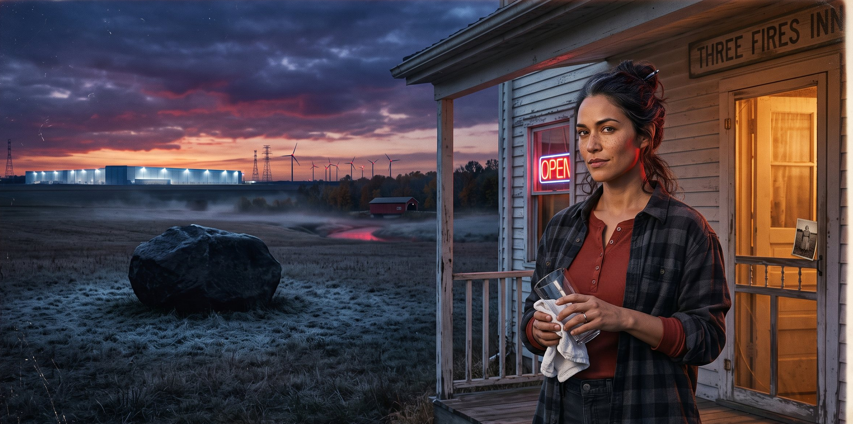
TY BUSH
/ A STORYTELLER FROM THE HEARTLAND
TYLER LENNOX BUSH
THE HAAN / 29 SEPT 2026
TYBUSH.COM ↗
40 / 70

Slide 41
TY BUSH
/ A STORYTELLER FROM THE HEARTLAND
ACT 3 / THE VOICE
Wayne Ingram
“DJ Tallquip.” Ex-con poet, open-mic host, and the late-night voice of Voices from the Shades.
WANTS
To be heard.
NEEDS
To be believed.
WOUND
He did time for a crime the town needed somebody to carry.
ROLE
The Greek chorus. He opens and closes the night from the Three Fires Inn.
Cutting and holy in the same breath. He’s been telling the truth in plain hearing.
TYLER LENNOX BUSH
THE HAAN / 29 SEPT 2026
TYBUSH.COM ↗
41 / 70

Slide 42
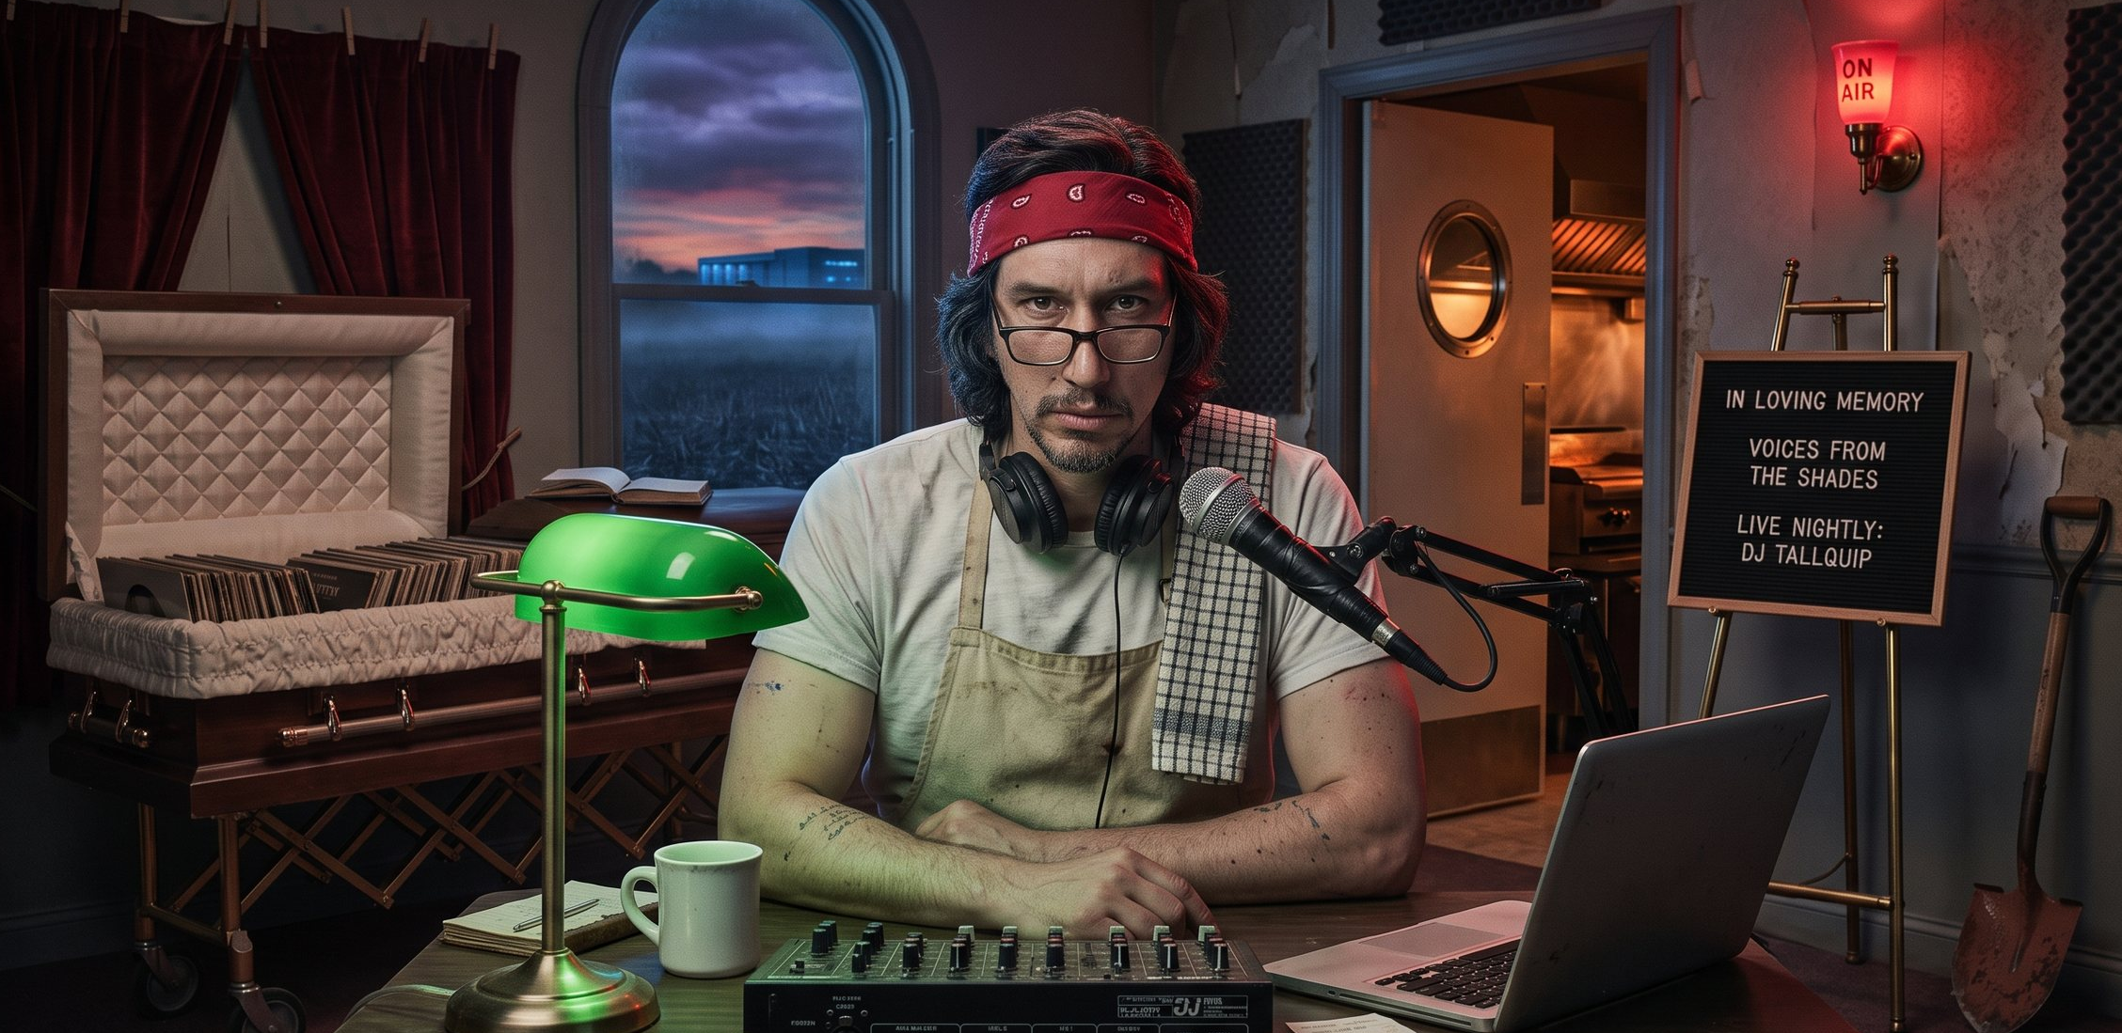
TY BUSH
/ A STORYTELLER FROM THE HEARTLAND
TYLER LENNOX BUSH
THE HAAN / 29 SEPT 2026
TYBUSH.COM ↗
42 / 70

Slide 43
TY BUSH
/ A STORYTELLER FROM THE HEARTLAND
ACT 3 / THE NEXT GENERATION
The Kids
Seventeen. Inheriting a town they didn’t build and asking the questions the adults won’t.
CONRAD CANNON
Number 1, the star. Quarterback, slot, punt returner. A learning disability the school never learned how to teach, and a 6,000-word paper for Victor anyway.
ADA LUX SMALL
Aragon’s daughter. A goth ghost-hunting YouTuber exiled from Silicon Valley. She comes for content and stays as a witness.
SUNI STRAW
Chepi’s daughter. An activist with a stage light, front row in Victor’s class. When the town says curse, she says water.
UMBERTO CALEL
Number 99. Left tackle, honor student, protector. He auditions “Ya Got Trouble” while the scrimmage runs.
Four kids, one town. The ghost story is the alibi.
TYLER LENNOX BUSH
THE HAAN / 29 SEPT 2026
TYBUSH.COM ↗
43 / 70

Slide 44
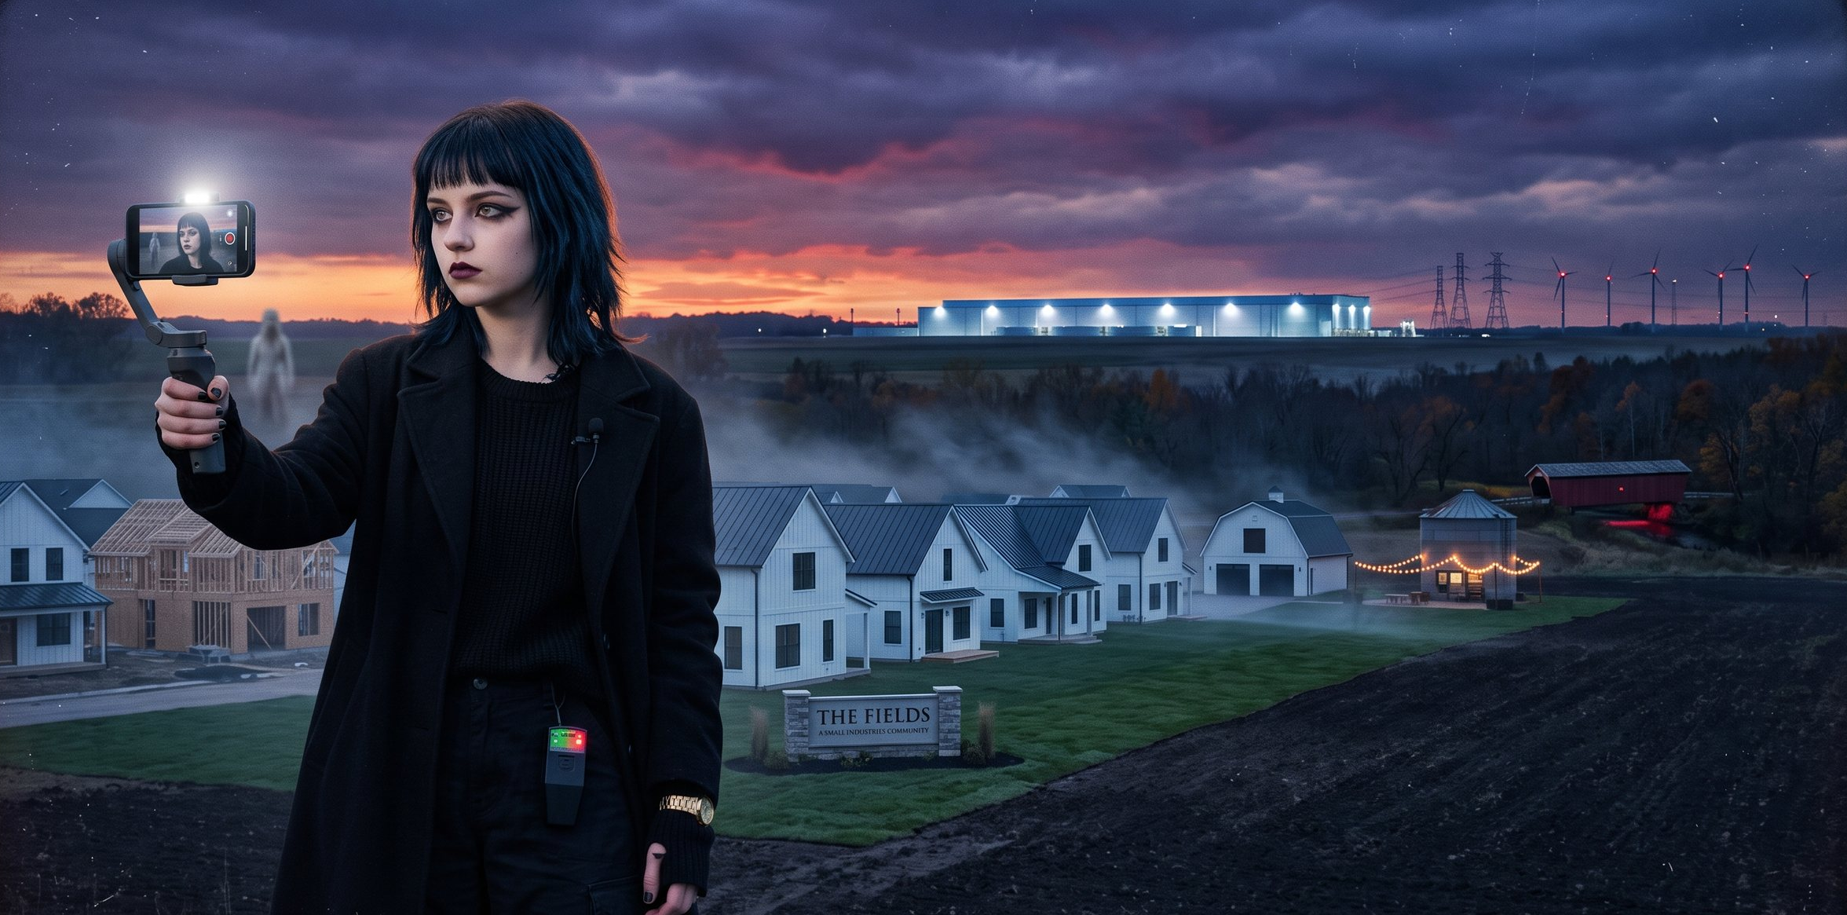
TY BUSH
/ A STORYTELLER FROM THE HEARTLAND
TYLER LENNOX BUSH
THE HAAN / 29 SEPT 2026
TYBUSH.COM ↗
44 / 70

Slide 45
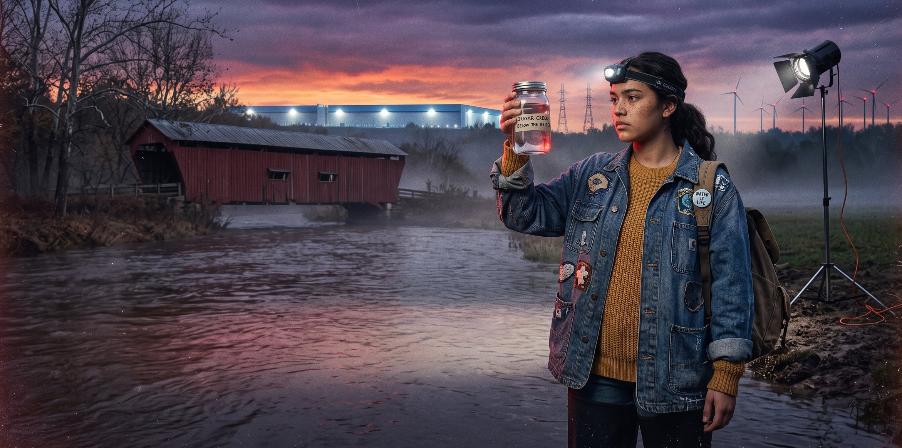
TY BUSH
/ A STORYTELLER FROM THE HEARTLAND
TYLER LENNOX BUSH
THE HAAN / 29 SEPT 2026
TYBUSH.COM ↗
45 / 70

Slide 46
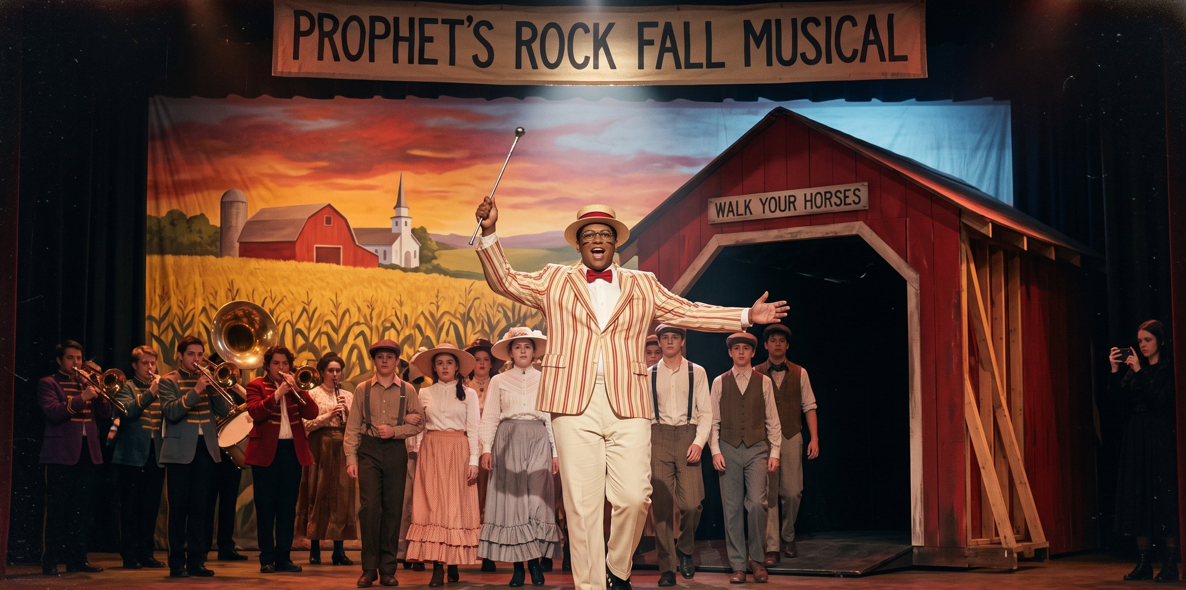
TY BUSH
/ A STORYTELLER FROM THE HEARTLAND
TYLER LENNOX BUSH
THE HAAN / 29 SEPT 2026
TYBUSH.COM ↗
46 / 70

Slide 47
TY BUSH
/ A STORYTELLER FROM THE HEARTLAND
ACT 3 / THE CURSE
The Curse
What the town blames every time the season ends early.
THE LEGEND
1811. Harrison beats the Prophet at Tippecanoe. The Prophet curses him, and Harrison dies a month into his presidency. Or so the town tells it.
THE RECORD
Three state finals lost. A creek that runs red. A program that can never win the one that matters.
THE NIGHT
November 11, 2005. Luke Rake, Gunner’s older brother and the golden quarterback, walked into the Shades. His jersey washed up in Sugar Creek. He never did.
THE RUMOR
Some say hazing gone wrong. Some say the curse. Some say Coach Victor Rake knows more than he has ever told.
Every town needs a curse. It’s easier than a confession.
TYLER LENNOX BUSH
THE HAAN / 29 SEPT 2026
TYBUSH.COM ↗
47 / 70

Slide 48
TY BUSH
/ A STORYTELLER FROM THE HEARTLAND
The transformation of
Prophets Rock
5 SEASONS / 10 EPISODES EACH
Rural community to technological suburban utopia
American idealism meets institutional satire.
The promise of progress opens into psychological horror.
Truth and conflict make room for solidarity, healing and hope.
TYLER LENNOX BUSH
THE HAAN / 29 SEPT 2026
TYBUSH.COM ↗
48 / 70

Slide 49
What every studio exec asks for in a pitch…
Same
but different.

Slide 50
TY BUSH
/ A STORYTELLER FROM THE HEARTLAND
ACT 3 / SIXTEEN FOUND OBJECTS, ONE NEW SHOW
The recipe for Prophets Rock
01
Knute Rockne, All American → The coach as town priest.
09
Prancer → The failing family farm, and the land at stake.
02
Hoosiers → The coach who comes home to a town that tests him.
10
The Judge → The estranged father who is the town’s authority.
03
Rudy → The mill as destiny, and the kid who wants out.
11
Quantum Leap → The ghost with unfinished business.
04
Breaking Away → Town versus the institution.
12
Parks and Recreation → The local company, and the curse.
05
Close Encounters → The calling that breaks a family.
13
Public Enemies → The American dream gone bad.
06
Eerie, Indiana → The town’s official version of normal.
14
Columbus → A town that bets its future on design.
07
Stranger Things → The lost child, and the lab at the edge of town.
15
One Day at a Time → The family holding the line in Anywhere, USA.
08
A Christmas Story → Love letter and roast.
16
The Bear: “Gary” → Set in the Region. Now LETS make it here.
One found object from each, assembled as bricolage: of the place, not about it.
TYLER LENNOX BUSH
THE HAAN / 29 SEPT 2026
TYBUSH.COM ↗
50 / 70

Slide 51
TY BUSH
/ A STORYTELLER FROM THE HEARTLAND
The questions, answered
PLACE.
Make work of a place, not about it. With respect to T. C. Steele, on screen the landscape is only the establishing shot; the people are the story. Start in the grassroots and listen to what the Land remembers.
PEOPLE.
The folk, and the storytellers who gather their struggles, large and small: elders, mentors, teachers, a regular at the bar. We honor them by passing the good stuff along.
PURPOSE.
Stories are equipment for living: warnings and hope. Drama unpacks the complex conflicts of life. Make more of the work here, with Indiana crews and talent, backed by Bi State and federal tax credit that supports production in every state. American Regionalism 2.0
How we make the work, and why it matters.
TYLER LENNOX BUSH
THE HAAN / 29 SEPT 2026
TYBUSH.COM ↗
51 / 70

Slide 52
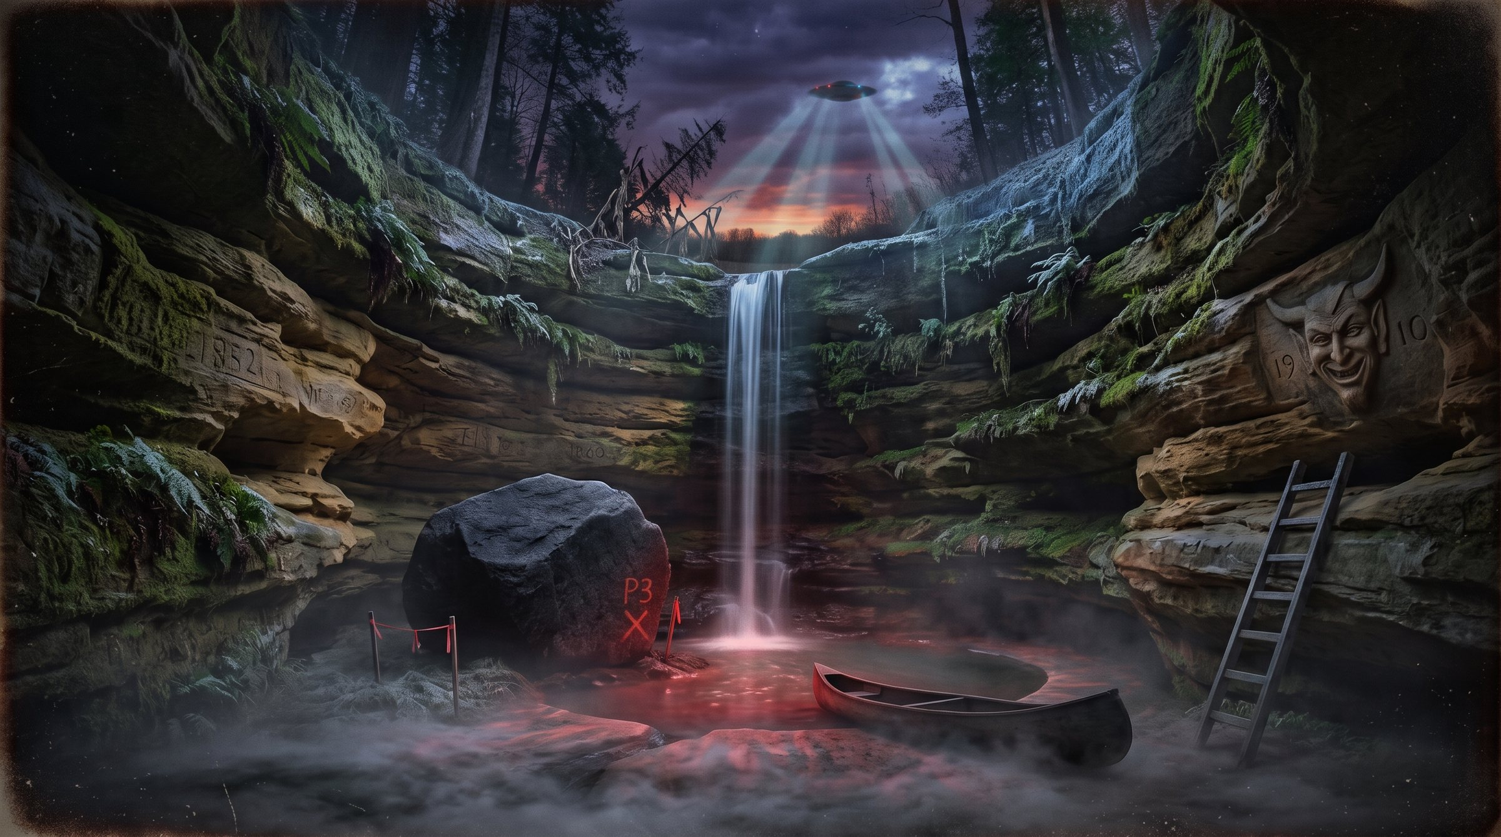

Slide 53
TY BUSH
/ A STORYTELLER FROM THE HEARTLAND
SCREENWRITING
Wrestling with Machines.
THE STORIES
THE WORK
Character-driven dramas set in the industrial Midwest: dysfunctional families, communities in peril, and the rituals and systems that shape us. I am drawn to haunted places, buried histories, and people fighting to survive as the world violently changes around them.
I study the industry to learn where these stories fit and how to shape them for TV, in the family-drama lane yet peppered with genre for flavor, The non-negotiables: the themes, and the real local history under the fiction. The town is a composite of the small many Indiana towns I have called home. I’m haunted by these places.
TYLER LENNOX BUSH
THE HAAN / 29 SEPT 2026
TYBUSH.COM ↗
53 / 70

Slide 54
TY BUSH
/ A STORYTELLER FROM THE HEARTLAND
A storyteller from the Heartland
THE FIELDWORK
Uncommon folk from the common herd, gathered by oral tradition in mills, refineries, farms, local dives and locker rooms.
THE MACHINES
Football programs, mills, data centers, AI and political machines. The machinery of progress, and of ignorance: salty real estate deals and government corruption.
THE GAMEPLAN
Characters defined by labor, loyalty and stubborn integrity, forced by fate to become extraordinary.
Stories that celebrate the people who refuse to give up on a dream.
TYLER LENNOX BUSH
THE HAAN / 29 SEPT 2026
TYBUSH.COM ↗
54 / 70

Slide 55
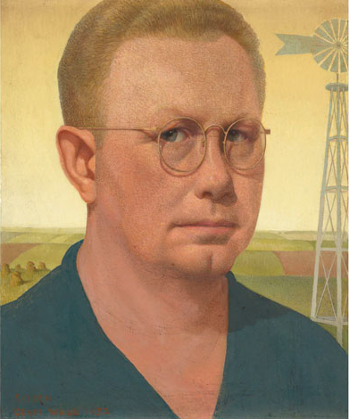
TY BUSH
/ A STORYTELLER FROM THE HEARTLAND
Grant Wood:
Icon of American Regionalism
01
Painted the Midwest with subtle satire, in the exacting realism of 15th-century northern European masters.^{2,3}
02
Used who he knew: American Gothic is his sister and his dentist. Young Corn became a 1996 Iowa stamp.^{1,3}
03
Sold himself with the work: the Europe-trained painter played the Iowa farmer-artist for the press.
Self-Portrait, Grant Wood, 1932
1 World Tribune, Dec. 1, 2025 2 NPR, “The Story Behind Grant Wood’s American Gothic,” Jul. 12, 2005
3 T. Hoving, American Gothic: The Biography of Grant Wood’s American Masterpiece, 2005
TYLER LENNOX BUSH
THE HAAN / 29 SEPT 2026
TYBUSH.COM ↗
55 / 70

Slide 56
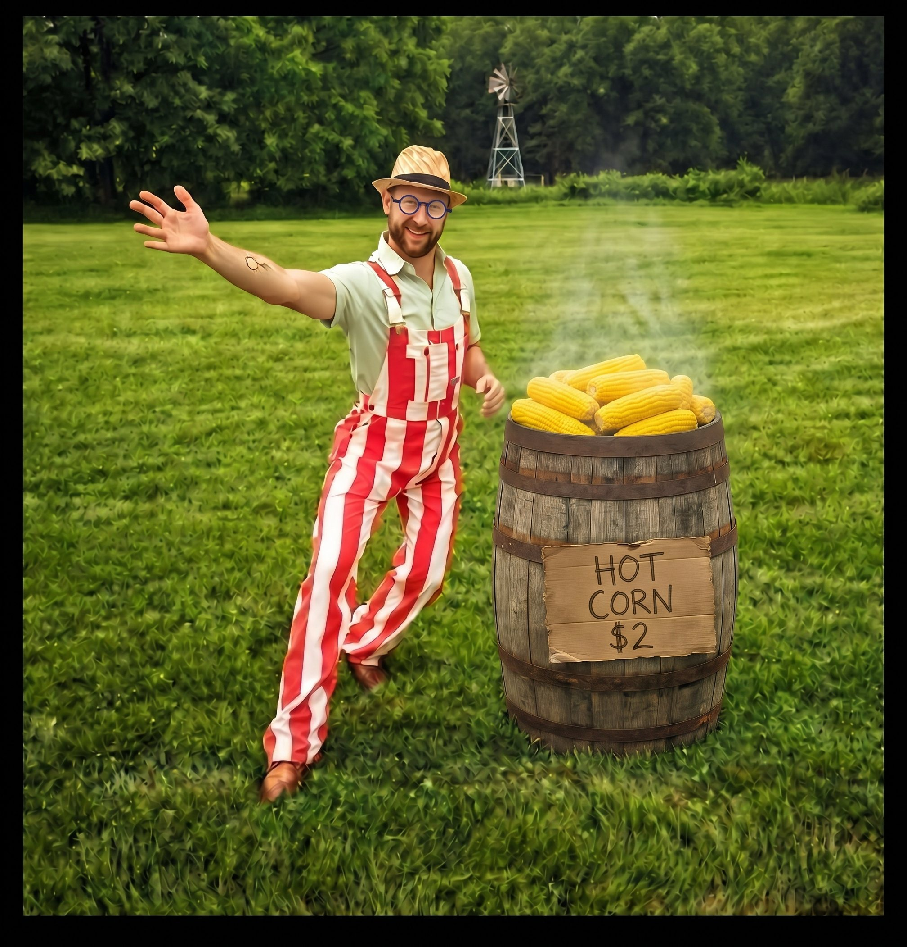
TY BUSH
/ A STORYTELLER FROM THE HEARTLAND
American
Regionalism 2.0
01
TV stories shaped by regional knowledge: an opportunity to create innovative new media.
02
Professional production in the places stories grow from, supporting underserved urban and rural communities in Indiana.
03
Local authorship, workforce development, paid work and lasting relationships. An American propaganda campaign to put creatives to work.
After Wood, Benton and Curry, 1930s
Like Grant Wood: paint home with love and satire, and wear the overalls.
TYLER LENNOX BUSH
THE HAAN / 29 SEPT 2026
TYBUSH.COM ↗
56 / 70

Slide 57
TY BUSH
/ A STORYTELLER FROM THE HEARTLAND
THE BILL
20%
Federal tax credit on U.S. film and TV production labor¹
Up to 30% with uplifts for opportunity zones, independent films and shoots in 10+ locations.
Motion Picture, Television, and Entertainment Revitalization Act. Bipartisan, House and Senate, introduced Sept. 24, 2026.
The Call:
Make it here
01
Governor Braun: rally Indiana’s delegation in Congress behind the federal film and TV tax credit.
02
Mr. President: sign the bipartisan bill and make the credit law.
03
Indiana: use the opportunity-zone uplift to bring productions to our mills, farms and main streets.
The pitch / Sept. 2026
1 The Hollywood Reporter, Sept. 24, 2026
TYLER LENNOX BUSH
THE HAAN / 29 SEPT 2026
TYBUSH.COM ↗
57 / 70

Slide 58
TY BUSH
/ A STORYTELLER FROM THE HEARTLAND
ILLUSTRATIVE $3M SERIES SHOT IN INDIANA
Assumes $1.5M labor at the 30% federal max; $250K Indiana cap
The business case:
Stack the credits
01
Today: about $20M a year in direct production spend in Indiana, supporting roughly 180 jobs.²
02
Indiana caps its credit at $250K per project and $2M a year statewide. The federal layer carries bigger budgets.³
03
The federal credit also covers post-production and VFX, so Indiana post houses can bid the finishing work.¹
Sources
1 Hollywood Reporter, 2026 2 Econsult for IEDC, 2026 3 iedc.in.gov
TYLER LENNOX BUSH
THE HAAN / 29 SEPT 2026
TYBUSH.COM ↗
58 / 70

Slide 59
TY BUSH
/ A STORYTELLER FROM THE HEARTLAND
CREDITS COMPARED
The Region play:
Two states, one story
 | Indiana | Illinois | Federal*
Base credit | 20% | 35% | 20%
Maximum | 30% | 45%+ | 30%
Per project cap | $250K | None | —
Annual cap | $2M | None | —
Post / VFX | Yes | Yes | Yes
01
Exteriors in Blue Island, IL, plus Lake, Tippecanoe and Marion Counties on Indiana’s 20–30% credit.¹
02
Build sets on stages at Cinespace Chicago. Illinois has no project cap and hit a record $703M in film spend.^{2,3}
03
Add the proposed federal credit on top of each state’s, on U.S. labor in both.⁴
* Proposed federal bill: 20% base on U.S. labor, up to 30% with uplifts; caps not specified. Illinois maximum includes uplifts. Each state credits only spend in that state.
Sources
1 Film Indy; IEDC 2 Illinois DCEO; Illinois Production Alliance
3 Governing, 2026 4 Hollywood Reporter; Indiana Chamber
TYLER LENNOX BUSH
THE HAAN / 29 SEPT 2026
TYBUSH.COM ↗
59 / 70

Slide 60
TY BUSH
/ A STORYTELLER FROM THE HEARTLAND
PRODUCTION / LOCATIONS AND CREW
Where we shoot
CREW IATSE Local 125 · IATSE Local 476
01 WABASH VALLEY
Along the Wabash
River exteriors: levees, bottomland and river towns.
02 MONTGOMERY COUNTY
Shades and Sugar Creek
Sandstone ravines and creek water at the wild edge of town.
03 PARKE COUNTY
The red covered bridges
West central Indiana’s red bridges, the town’s postcard.
04 ST. JOSEPH COUNTY
The data center build
A hyperscale campus rising out of farmland: the machine arrives.
05 BOONE COUNTY
The LEAP District
The LEAP Lebanon Innovation District outside Indianapolis.
06 NEWTON COUNTY
Fair Oaks Farms
Agritourism on I-65: the family farm as a branded experience.
SHOOT PLAN
Stages in Chicago. Exteriors in Cook County, IL (Blue Island) and Lake, Tippecanoe and Marion Counties, IN.
TYLER LENNOX BUSH
THE HAAN / 29 SEPT 2026
TYBUSH.COM ↗
60 / 70

Slide 61
TY BUSH
/ A STORYTELLER FROM THE HEARTLAND
PRODUCTION / FOOTBALL FIELDS AND STAGES
Chicago and the Calumet
CREW IATSE Local 125 · IATSE Local 476
01 GARY, IN
Gilroy Stadium
Friday nights in the Steel City. The Ghost of a Football Field
02 BLUE ISLAND, IL
Eisenhower High School
The football field just across the state line in Factory
03 LOWELL, IN
Lowell High School
Small-town rural football in south Lake County.
04 CROWN POINT, IN
Crown Point High School
County-seat stadium and Friday-night crowds.
05 HAMMOND, IN
Hammond High School
City football field, minutes from Chicago. Chicago Bears Home
06 CHICAGO, IL
Cinespace | The Fields
Soundstages for interior sets. Site TBD.
SHOOT PLAN
Football fields across the Calumet Region. Interiors on Chicago stages.
TYLER LENNOX BUSH
THE HAAN / 29 SEPT 2026
TYBUSH.COM ↗
61 / 70

Slide 62
TY BUSH
/ A STORYTELLER FROM THE HEARTLAND
Season one. Ten episodes. Made in the Industrial Midwest. Just like Us!
THE ASK / FX · HULU
THE GENRE
Indiana as a Genre. Scraps of the shows we grew up on, collaged into something remixed and new: a tribute to home. A warning to the folk.
THE SHOW
The Bear went to Gary for authentic storytelling and American Realism for one episode. Raking Prophets Rock stays for five seasons.
THE MONEY
Chicago stages, Indiana locations and establishing exteriors. Two state credits stacked, and a federal credit on the way.
TYLER LENNOX BUSH
THE HAAN / 29 SEPT 2026
TYBUSH.COM ↗
62 / 70

Slide 63
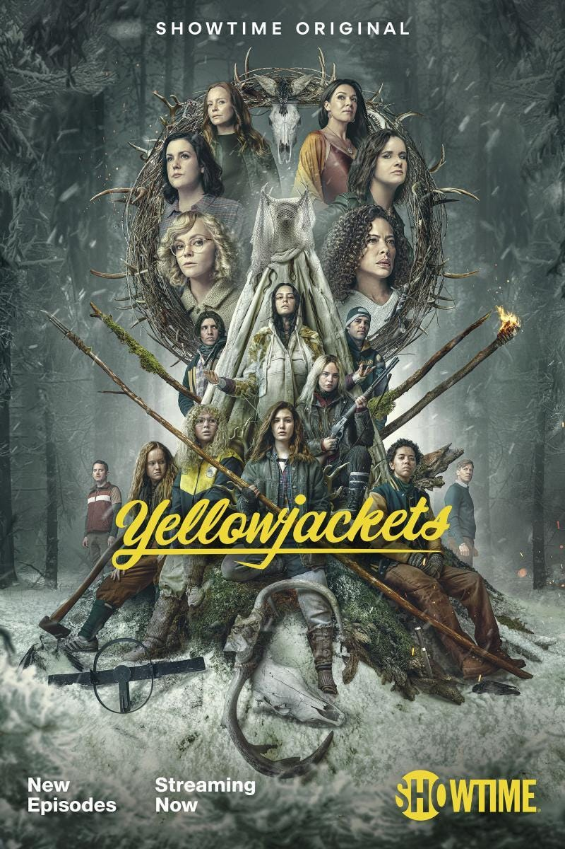
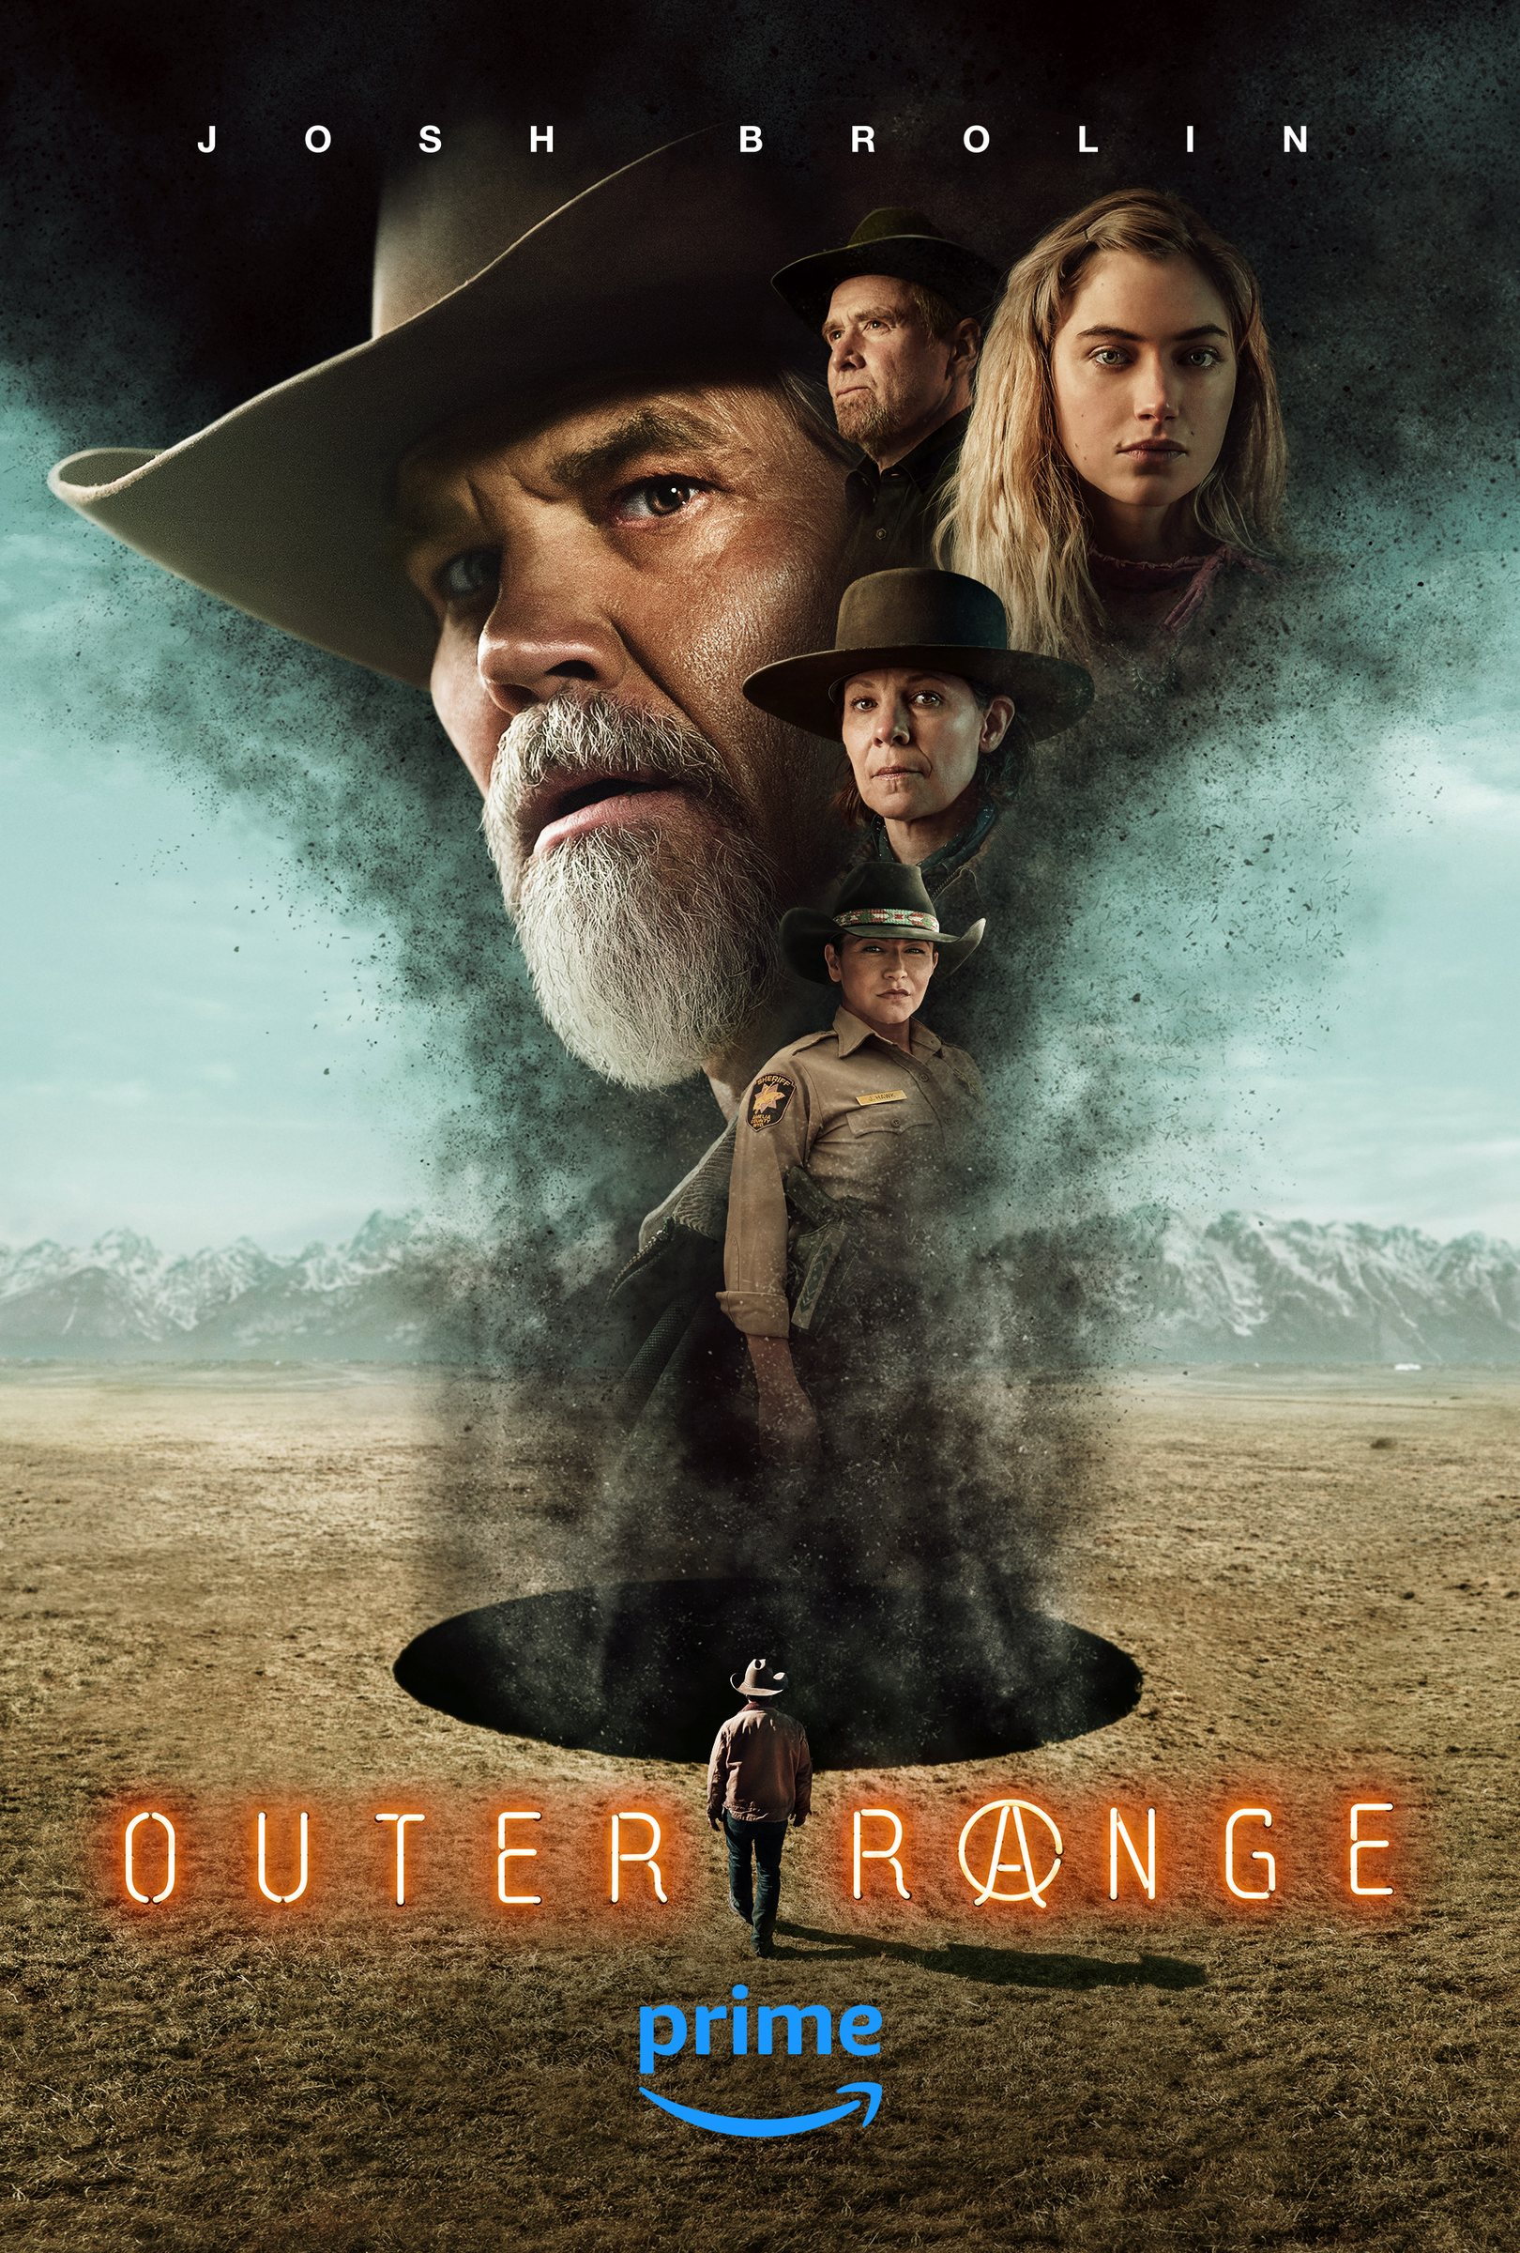
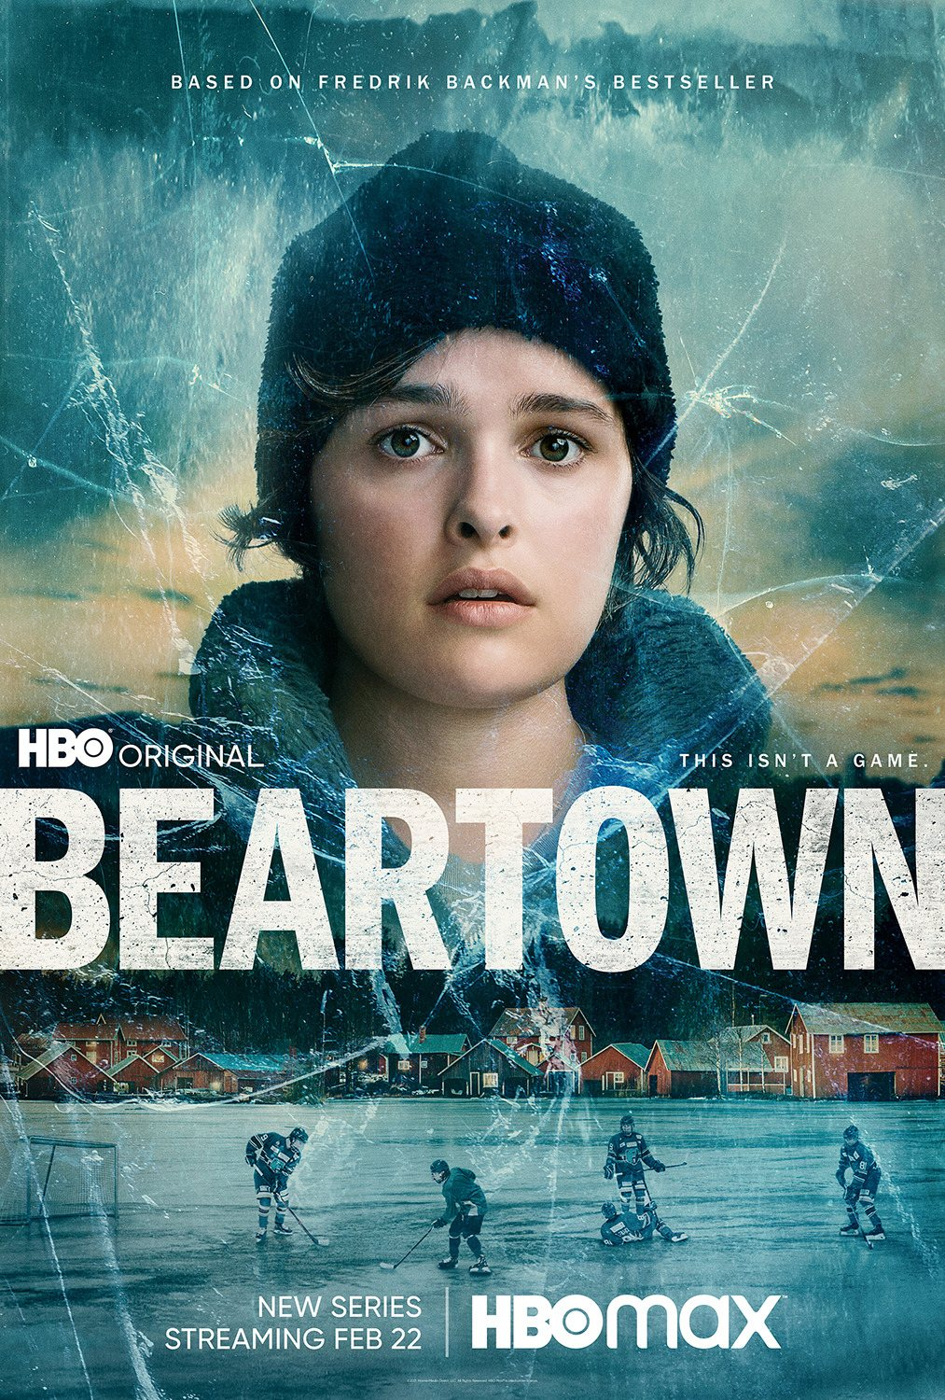
TY BUSH
/ A STORYTELLER FROM THE HEARTLAND
MARKET COMPS / SUNDANCE EPISODIC DEVELOPMENT
A proven hybrid genre lane
ENSEMBLE THRILLER / HORROR
A girls’ soccer team survives a crash, and what it took follows them home.
FAMILY WESTERN / SCI-FI
A Wyoming rancher finds a black void on his land and fights to keep it.
FAMILY SPORTS CRIME DRAMA
A hockey town bets its future on a junior team, until a crime splits it apart.
TYLER LENNOX BUSH
THE HAAN / 29 SEPT 2026
TYBUSH.COM ↗
63 / 70

Slide 64
MARKET COMPS / CASE STUDY
Yellowjackets Studio pitch
A husband-and-wife writing team answered a skeptical online comment with a pitch, then sold it the traditional way: package it, rehearse it, tour the networks.
ORIGIN Lyle reads about an all-female Lord of the Flies remake, and the doubters.
2018 Lyle and Nickerson pitch with a faux high school yearbook.
PACKAGE Entertainment One (The Mark Gordon Company) comes aboard.
TOUR A memorized, two-voice pitch goes to about 15 networks.
PILOT Showtime orders the pilot; Jonathan Lisco joins as co-showrunner.
NOV 2021 Series premieres on Showtime.
GAME PLAN FOR RPR
Package before pitching: attach a producer, build a leave-behind object as the yearbook was (A Football Playbook with a Cryptic Cypher inside) and rehearse one shared pitch.

Slide 65
MARKET COMPS / CASE STUDY
Outer Range Sundance Labs
A playwright's spec pilot went through the Sundance Episodic Lab with its producer, then to Plan B and Amazon with a movie star attached.
SPEC Brian Watkins writes the pilot on spec from his rural Western upbringing.
2014 / LAB Producer Heather Rae develops it in the Sundance Episodic Lab.
MENTORS The Lab pairs the project with working showrunners.
PACKAGE Plan B (Dede Gardner, Brad Pitt) champions the series.
ORDER Amazon Studios orders it, with Josh Brolin starring.
APR 2022 Premieres on Prime Video; two seasons through 2024.
GAME PLAN FOR RPR
Take the Lab route: a producer-led Sundance Episodic application, a spec pilot rooted in home ground, then a company with reach.

Slide 66
MARKET COMPS / CASE STUDY
Beartown Novel rights
Fredrik Backman first drafted the story as a TV script, turned it into a novel, then sold it back to television as an HBO limited series.
2016 Backman publishes Beartown; it becomes a bestseller.
FEB 2017 Filmlance International (The Bridge) secures screen rights.
JAN 2019 HBO Europe orders five one-hour Swedish-language episodes.
FEB–MAY 2019 72-day shoot in Gällivare, Norrbotten, northern Sweden.
OCT 2020 Premieres on HBO Nordic.
FEB 2021 US debut on HBO and HBO Max.
GAME PLAN FOR RPR
Own the source: if RPR's world already exists in another form, the rights and the author as EP become the package.

Slide 67
TY BUSH
/ A STORYTELLER FROM THE HEARTLAND
APPENDIX / WORKS CITED
References
01 / THE SPORTS MYTH
Knute Rockne, All American, 1940. Lloyd Bacon, Warner Bros.
Hoosiers, 1986. David Anspaugh, Orion.
A League of Their Own, 1992. Penny Marshall, Columbia.
Rudy, 1993. David Anspaugh, TriStar.
Breaking Away, 1979. Peter Yates, 20th Century Fox.
Madison, 2001. William Bindley.
02 / WONDER & THE UNCANNY
Close Encounters of the Third Kind, 1977. Steven Spielberg, Columbia.
Eerie, Indiana, 1991–92. José Rivera, Karl Schaefer, NBC.
Stranger Things, 2016–25. The Duffer Brothers, Netflix.
03 / HOME & FAMILY
A Christmas Story, 1983. Bob Clark, MGM.
Prancer, 1989. John Hancock, Orion.
In & Out, 1997. Frank Oz, Paramount.
Lonesome Jim, 2006. Steve Buscemi, IFC Films.
The Judge, 2014. David Dobkin, Warner Bros.
Quantum Leap, “The Leap Back,” 1991. NBC.
04 / CIVIC LIFE & THE REGION
Parks and Recreation, 2009–15. Greg Daniels, Michael Schur, NBC.
Public Enemies, 2009. Michael Mann, Universal.
Columbus, 2017. Kogonada.
One Day at a Time, 1975–84. Whitney Blake, Allan Manings, CBS.
The Bear, “Gary.” Christopher Storer, FX / Hulu.
ART & REGIONALISM
World Tribune, Dec. 1, 2025.
NPR, “The Story Behind Grant Wood’s American Gothic,” Jul. 12, 2005.
Hoving, T. American Gothic: The Biography of Grant Wood’s American Masterpiece, 2005.
POLICY & ECONOMICS
The Hollywood Reporter, Sept. 24, 2026, on the Motion Picture, Television, and Entertainment Revitalization Act.
Econsult Solutions for the Indiana Economic Development Corp. (IEDC), 2026; iedc.in.gov.
Film Indy. Indiana Chamber of Commerce. Governing, 2026.
Illinois DCEO, Film Office. Illinois Production Alliance.
MARKET COMPS
Yellowjackets, 2021–. Ashley Lyle, Bart Nickerson, Showtime.
Outer Range, 2022–24. Brian Watkins, Prime Video.
Beartown, 2020. HBO Europe press release, 2021; IndieWire, Feb. 22, 2021.
IMAGES & TOOLS
Posters, stills and key art © their studios and networks, shown for commentary and teaching.
Design and research assistance: Claude (Anthropic), 2026.
TYLER LENNOX BUSH
THE HAAN / 29 SEPT 2026
TYBUSH.COM ↗
68 / 70

Slide 68
TY BUSH
/ A STORYTELLER FROM THE HEARTLAND
CLOSING / THE GAMEPLAN
Trust the Process.
Develop a gameplan. Practice Hard.
Keep Making…Keep Writing…
and Keep Fighting.
01 / CRAFT
02 / MISSION
Keep it simple. Let the story lead you.
Accept the vocation. Let the stories choose you.
TYLER LENNOX BUSH
THE HAAN / 29 SEPT 2026
TYBUSH.COM ↗
67 / 70

Slide 69
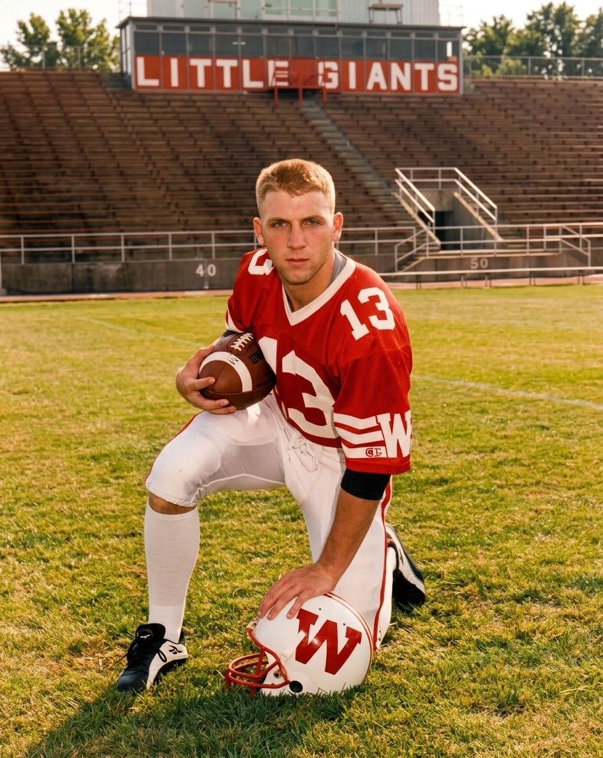
TY BUSH
/ A STORYTELLER FROM THE HEARTLAND
← EXHIBIT 00, THE ORIGIN STORY
WABASH LITTLE GIANTS / NEW YORK ARTS PROGRAM / 1997
Why I can
tell this story
Prophets Rock wasn’t in my fourth-grade Indiana history book. I first saw it in October 1996, through a chartered team bus window, on one of my last road trips as a player.
Earlier that week, I had decided to walk away from football for the GLCA New York Arts Program. Back then, the Rock was just another roadside landmark.
30 years later I believe now that Stories choose their storytellers. This one, about a rock in Indiana, haunts me to the core.
It took Odysseus twenty years. It took me thirty to come home: ball player, artist, reluctant Hoosier.
TYLER LENNOX BUSH
THE HAAN / 29 SEPT 2026
TYBUSH.COM ↗
69 / 70

Slide 70
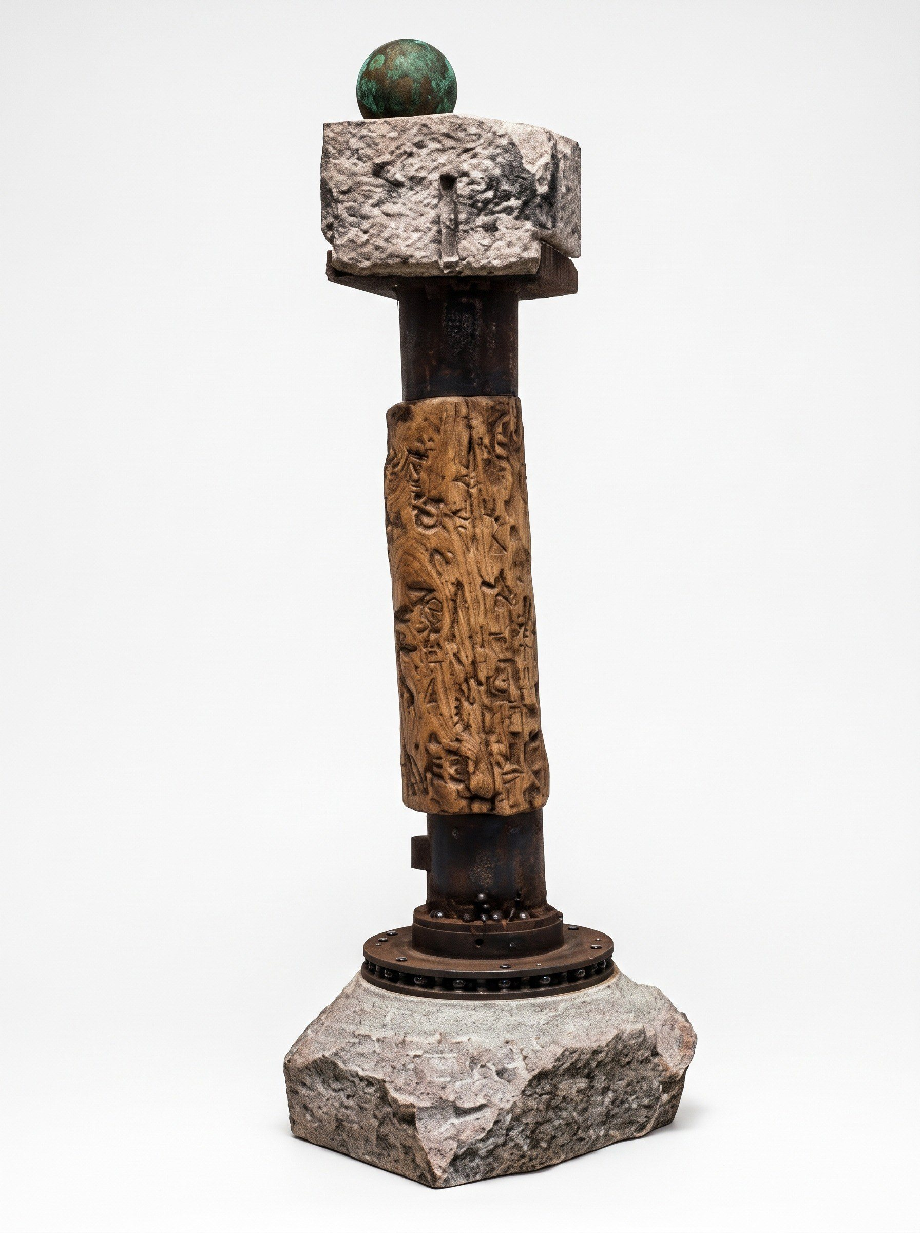
TY BUSH
/ A STORYTELLER FROM THE HEARTLAND ... MAN
← MY OWN WORK / 1999 Wabash College Senior Show
WHAT DOES IT MEAN TO MAKE ART ABOUT PLACE?
Alter 19
BEDFORD, IN/ LIMESTONE
Quarried, cut and shaped by hand.
GARY, IN / STEEL
Seamless pipe, the kind my family made in the mill.
WAVELAD, IN / OSAGE ORANGE HARDWOOD
Reclaimed fence post from abandoned Indiana homestead.
AURORA, IN / CAST IRON
A 19-pound Civil War cannonball from Stedman Machine Company.
A sculptural collage of place, made from found and reclaimed materials: familiar things, separated by time and labor, I hunt. I gather. I search for connection and remix histories.
TYLER LENNOX BUSH
THE HAAN / 29 SEPT 2026
TYBUSH.COM ↗
70 / 70

