Slide 1
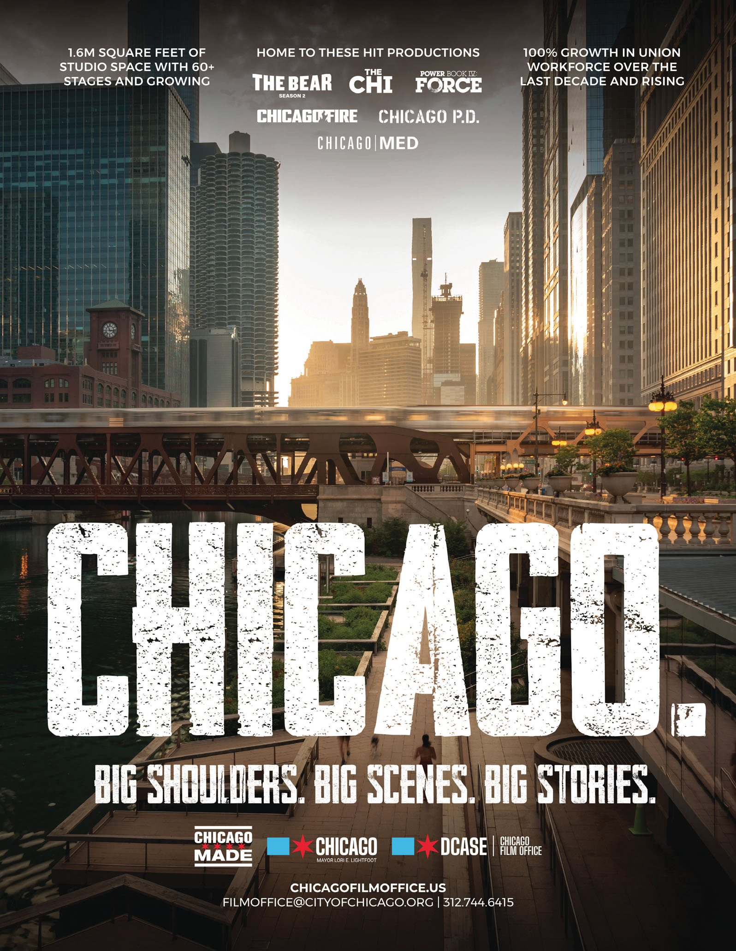
TRADE TALK
COM 32200 - TV PRODUCTION - FALL 2023
BTS IN THE CHICAGO FILM
AND TV INDUSTRY
A crew-level view from soundstages, scenic shops, locations,
and union halls
TY BUSH, MA, MFA, CAPM©
Continuing Lecturer, Purdue University Northwest
Writer & Producer, TwointheBush Television Co.

Slide 2


Slide 3
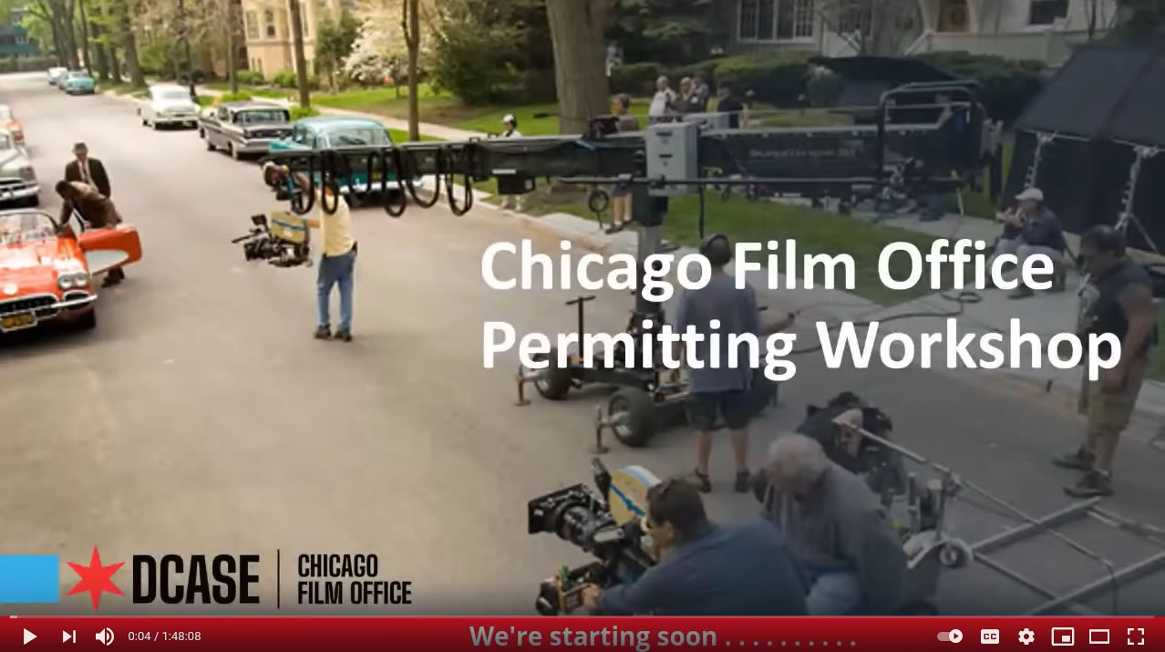

Slide 5
EVERY FRAME HAS A CALL TIME
BEFORE WE ROLL · THE SPEAKER'S CREW CARD
I KNOW THIS WORLD BECAUSE I'VE GRINDED HERE.
This talk starts at call time. The question for this room: how do we prepare students for the work as it is actually done?
CHICAGO CREW GIGS
BROADCAST
Overhire: Chicago Scenic Studios, IATSE Local 2
Camera Operator: Lakeshore TV
Overhire: North of the 10, IATSE Local 476
Technical Director: Gary SouthShore RailCats
STAGE AND SCENIC
TRAINING AND TODAY
Scenic Carpenter Chicago: Chicago Shakespeare Theater, Stage 773, A Red Orchid Theatre
MFA in Cinema: DePaul University
ARRI certified: camera and lighting systems
Stagehand and Scenic Carpenter New York: Atlantic Theater Company, The Vineyard, The Yiddish Theater
Producer: TwointheBush Television Co., an IATSE-signatory shop
Model Maker & Scenic: Curious Pictures, New York
Continuing Lecturer: Purdue University Northwest

Slide 6

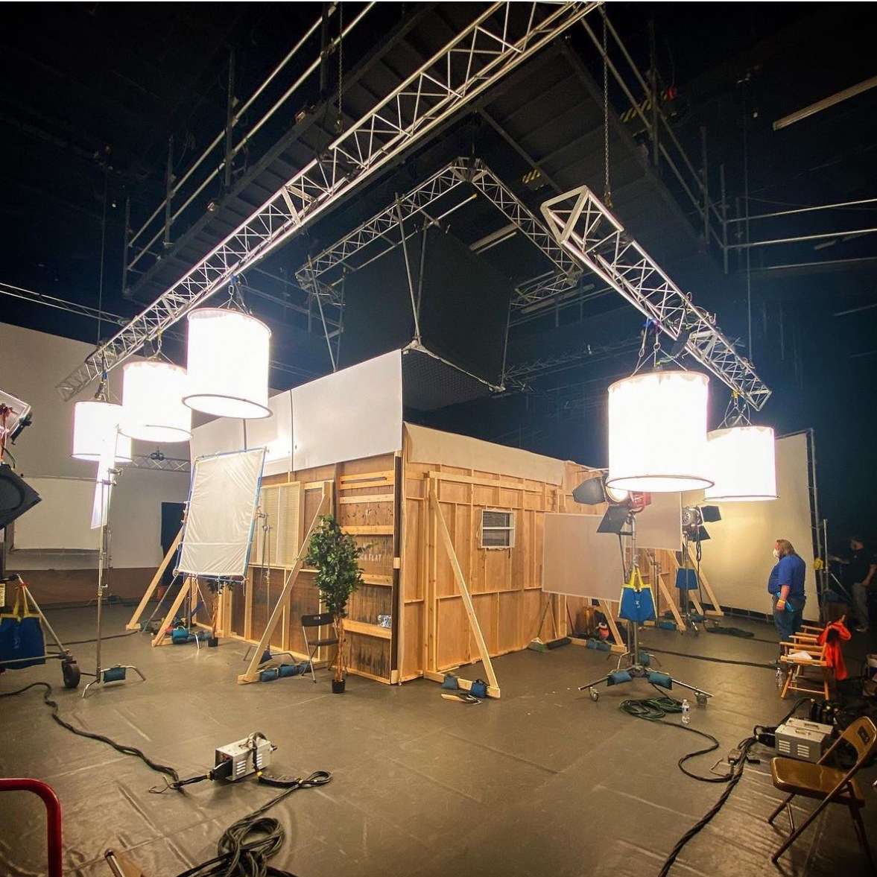
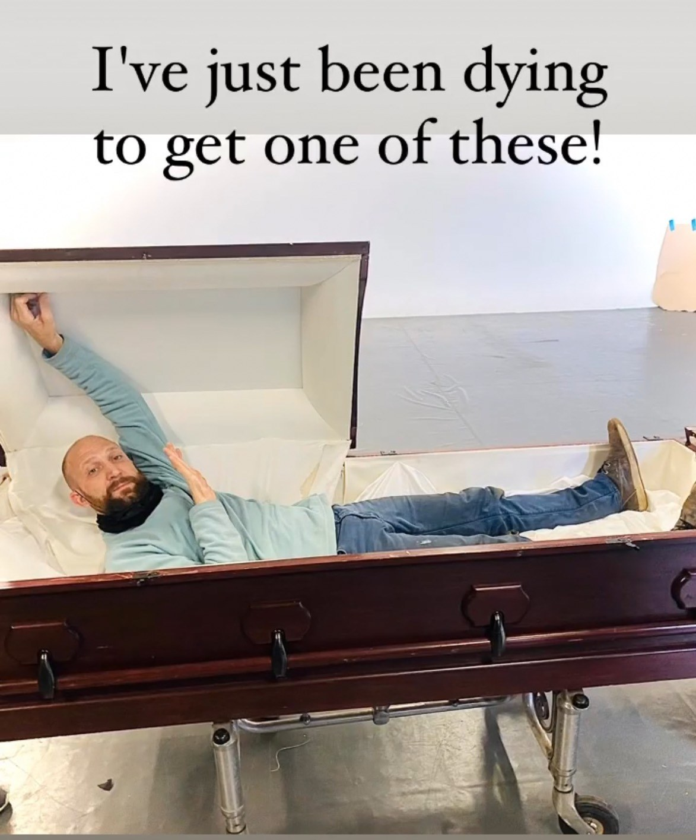
FROM THE FLOOR: NORTH OF THE 10
BEFORE WE ROLL · OVERHIRE DAYS
Overhire on North of the 10, working alongside IATSE Local 476 and ICG Local 600 camera crews.
The floor teaches what school can’t.

Slide 7
FOUR STARS, FOUR ACTS
THE RUN OF SHOW
The Chicago flag carries four red stars, each marking a moment when the city was forced to innovate and rebuild itself.
Today the stars separate our talk into four discreet acts.
ACT I
ACT II
ACT III
ACT IV
THE GROUND
THE LABOR FLOOR
THE LINE
THE GRIND
Chicago made movies first. A century of booms, bans, and backlots.
The stages, locations, shops, and stations where film and TV get made.
Above and below the line: union work, political economy of film and TV, creative labor and how the money moves.
The real-world realities of the work, and the doors into it.
STAR 1
FORT DEARBORN
STAR 2
THE GREAT FIRE, 1871
STAR 3
COLUMBIAN EXPOSITION, 1893
STAR 4
CENTURY OF PROGRESS, 1933

Slide 8
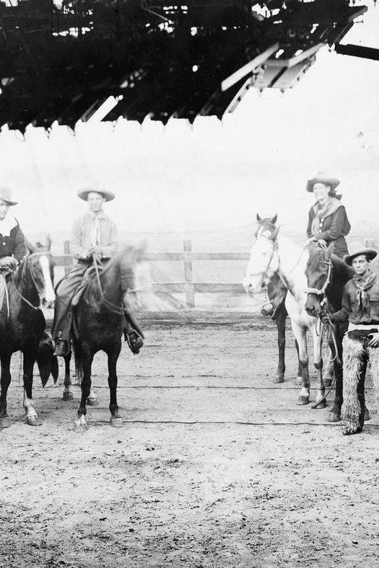
THE GROUND
ACT I · STAR 1: FORT DEARBORN
Before Hollywood, there was Argyle Street.

Slide 9
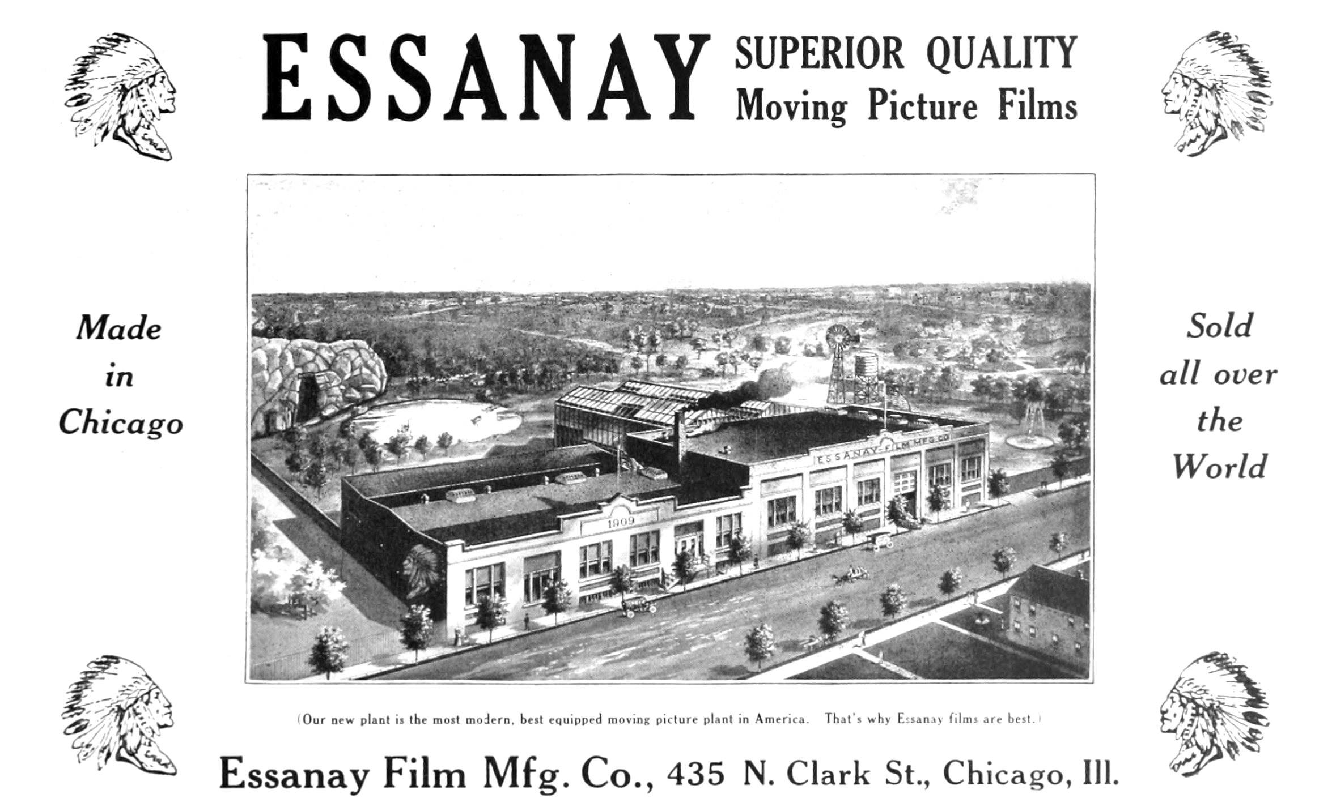

Slide 10
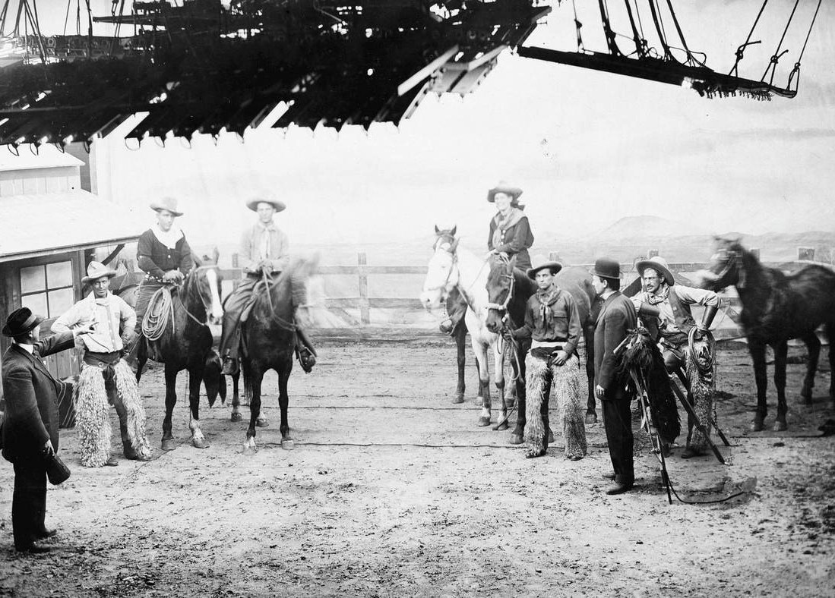
ACT I · THE GROUND
CHICAGO MADE MOVIES BEFORE HOLLYWOOD DID
1907
George K. Spoor and Gilbert “Broncho Billy” Anderson found S&A: “Essanay.”
1908
The studio opens at 1333–45 W. Argyle St. in Uptown.
1915
Charlie Chaplin shoots His New Job on Argyle, then heads west.
1918
Production ends as the industry consolidates in California.
1996
Named a Chicago Landmark. St. Augustine College holds the lot today.
Broncho Billy at Essanay Studios, 1910
10

Slide 11
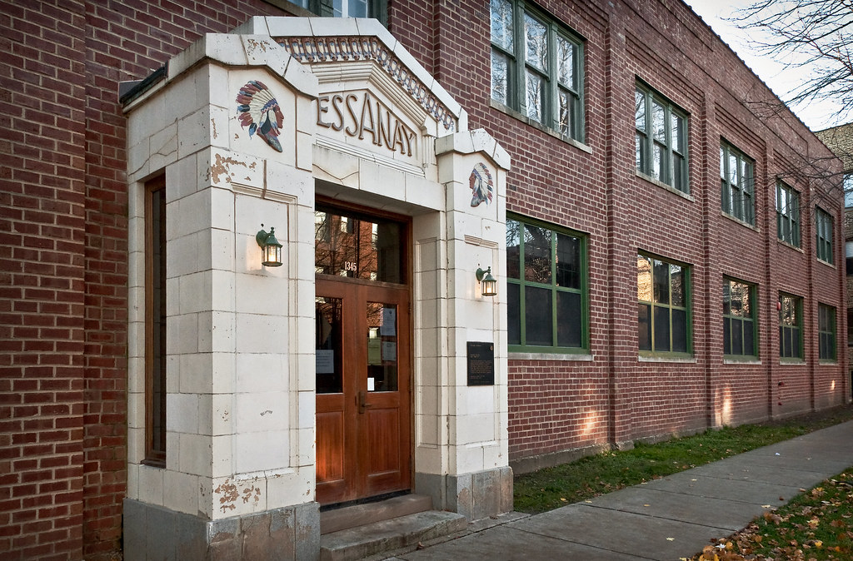
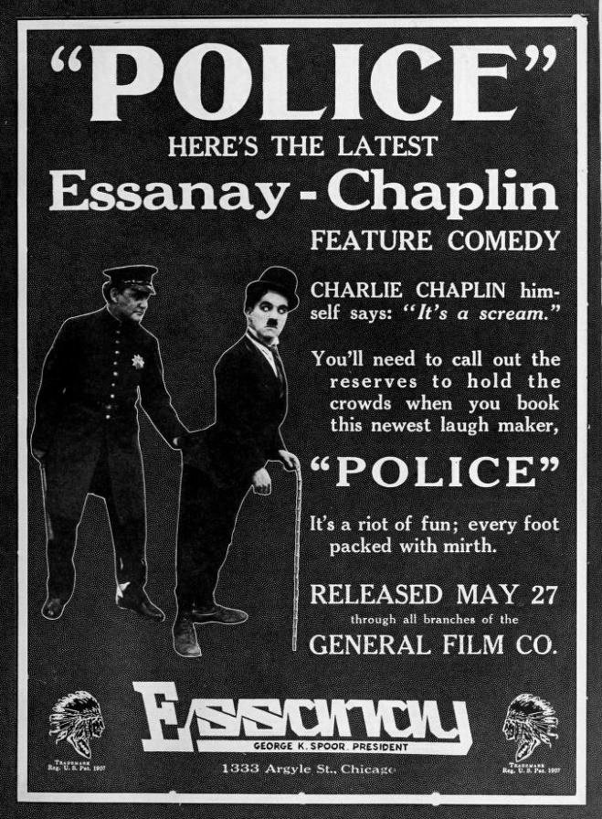

Slide 12
CHICAGO ON SCREEN, 1907 TO NOW
ACT I · THE GROUND
1907
1918
1955–76
1979
Essanay opens. Chaplin, Gloria Swanson, and Broncho Billy make Chicago a movie capital.
Essanay stops production as the industry consolidates in California.
Mayor Richard J. Daley keeps cameras at arm’s length, reportedly over traffic and Capone.
Mayor Jane Byrne gives the Chicago Film Office real standing. A gaffer opens Chicago Studio City.
1980
1986–91
2004
2010–12
The Blues Brothers crashes into Daley Plaza, with City Hall’s blessing.
Ferris Bueller, Home Alone, Backdraft: Chicago becomes a backlot.
Illinois creates its film tax credit: 25% at first, 30% by 2009.
Cinespace opens in North Lawndale. Chicago Fire premieres, and One Chicago is born.

Slide 13
A $703 MILLION INDUSTRY, BY THE STATE'S COUNT
ACT I · THE GROUND
$703M
spent in Illinois in 2025, an all-time record
$401M
in wages paid that year
18,100
hires, excluding extras (18,200 in 2024)
No official totals were published for 2020 or 2023 (pandemic, strikes). 2025 is the all-time record.

Slide 14
THE ENGINE IS THE TAX CREDIT
ACT I · THE GROUND
35%
Resident wages and Illinois vendor spend: the base credit
THE FINE PRINT
30%
SB 1911: signed Dec. 12, 2025; covers productions starting July 1, 2025 or later
Non-resident wages: up to 13 crew slots plus 4 to 6 actors
+15%
Wages for hires from economically disadvantaged areas
Wage cap: $500K per person. The credit runs through 2038.
+5%
Resident labor outside the six-county Chicago region
Incentive-driven: about 90% of Illinois production, per the governor
+5%
TV series that relocate to Illinois
+5%
The debate: an industry study claims $6.81 back per $1; USC’s Michael Thom estimates 10 to 20 cents
Certified green productions

Slide 15
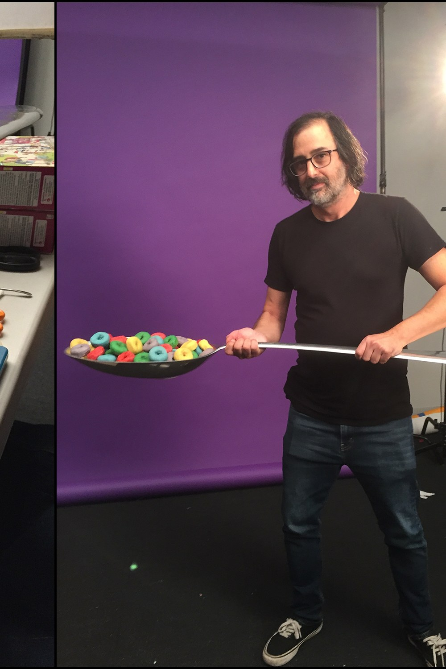
THE LABOR FLOOR
ACT II · STAR 2: THE GREAT FIRE, 1871
A city rebuilt by hand. So is every set.

Slide 16
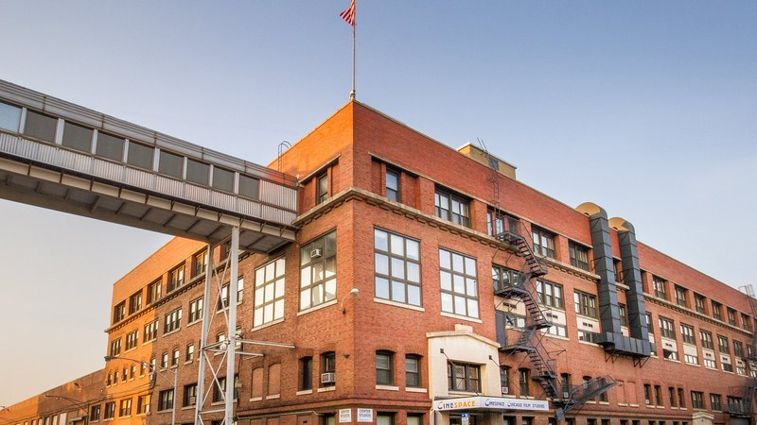
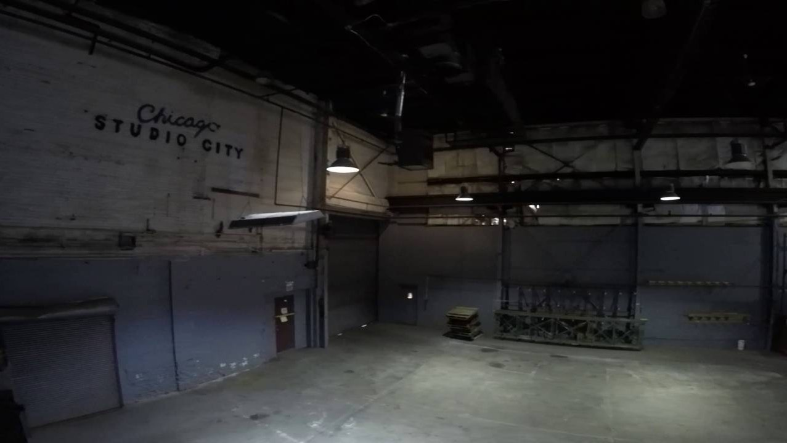
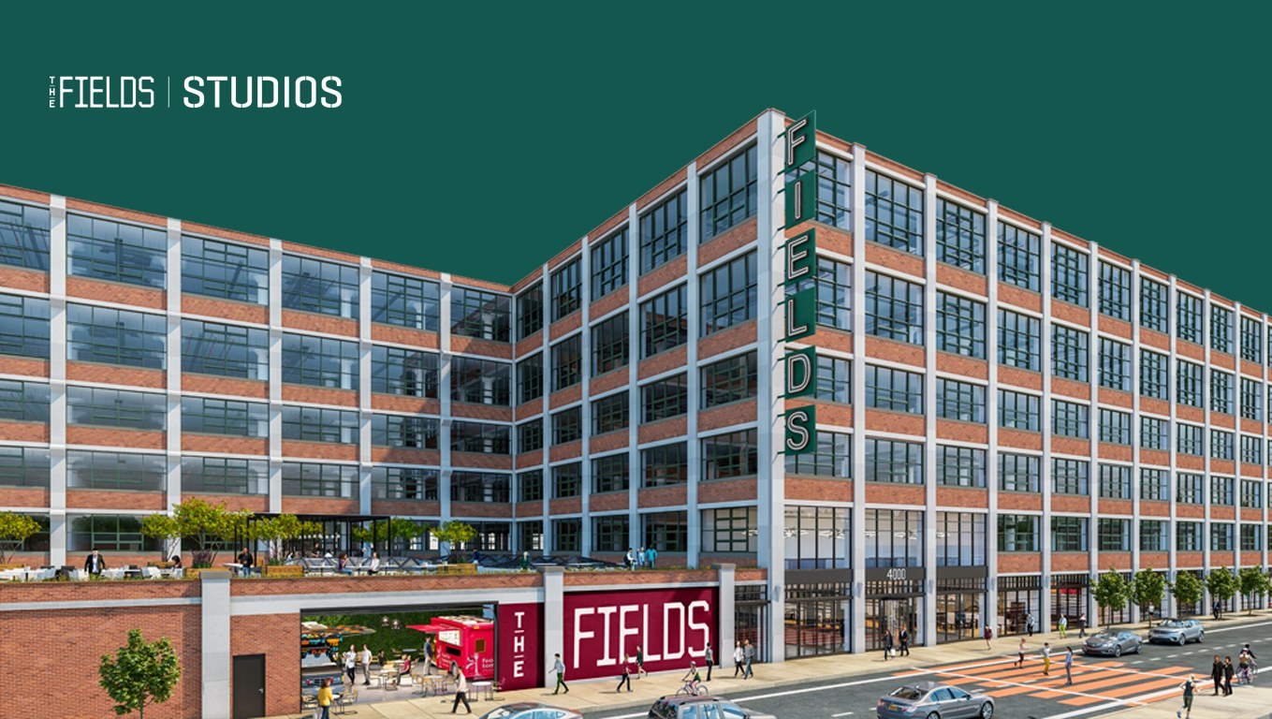
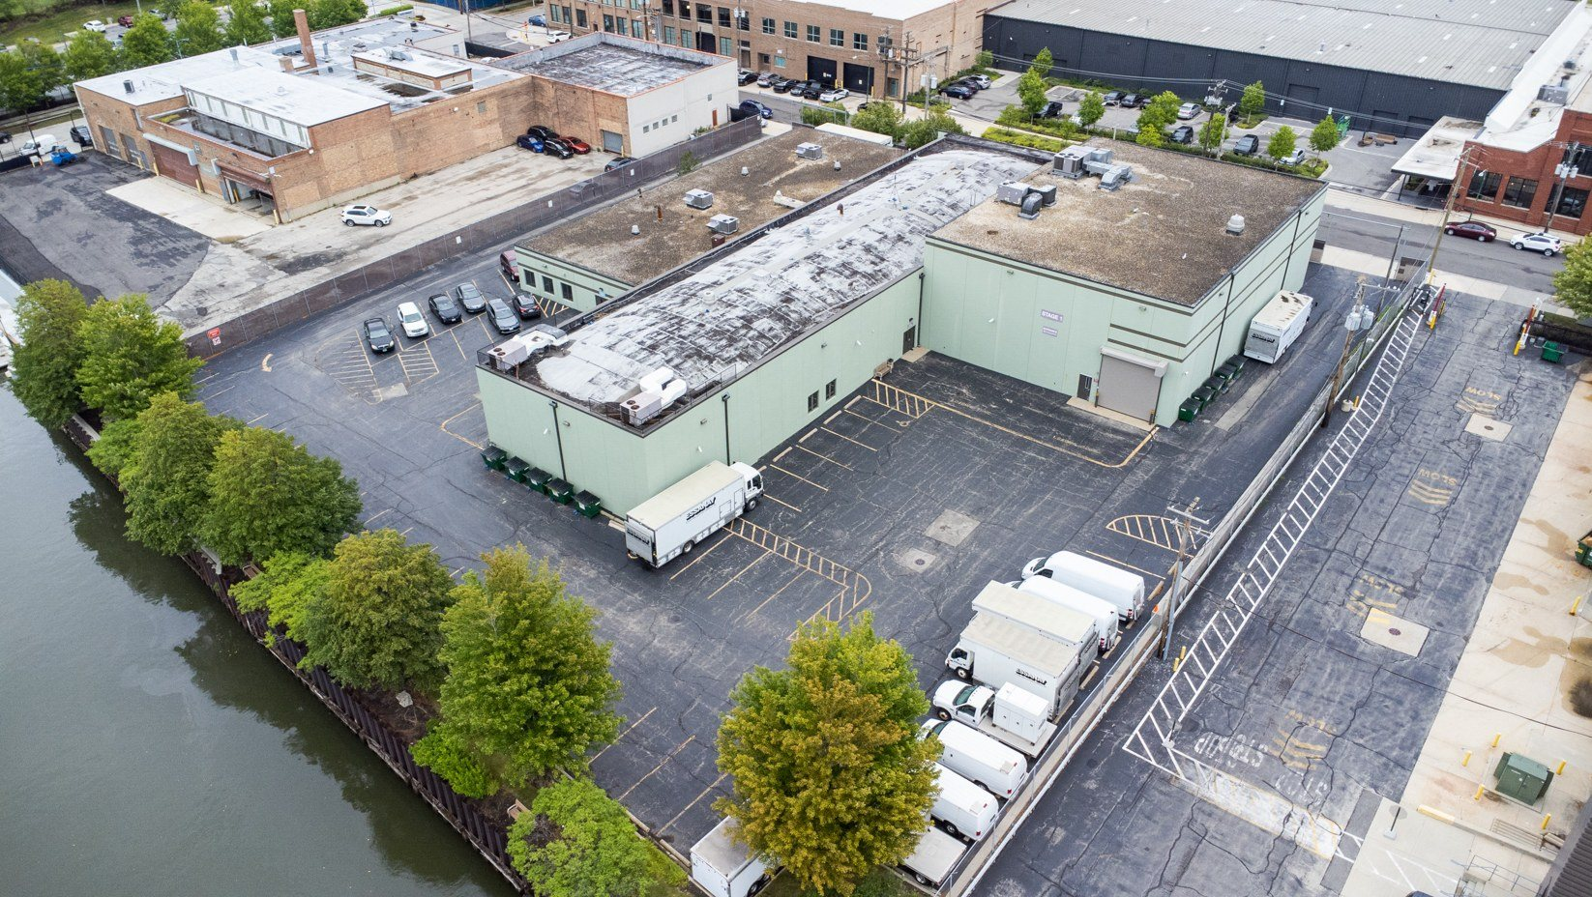
THE STAGES: WHERE THE WORK SITS STILL
ACT II · THE LABOR FLOOR
CINESPACE CHICAGO
CHICAGO STUDIO CITY
THE FIELDS STUDIOS
ESSANAY STUDIO
NORTH LAWNDALE
WEST SIDE · SINCE 1979
NORTHWEST SIDE · 2024
GOOSE ISLAND · LIGHTING
1.6M sq ft and 36 stages, by the company’s count. Home of One Chicago. TPG bought it with Toronto in 2021 (~$1.1B).
8 stages on about 13 acres, run by the Crededio family’s third generation. Ferris Bueller, Backdraft, Home Alone.
9 stages, a $250M build in the old Marshall Field’s warehouse, with $5M each from the state and city.
Two stages plus lighting rental, about 200 feet from the Salt Shed. Concert noise vs. quiet takes.

Slide 17
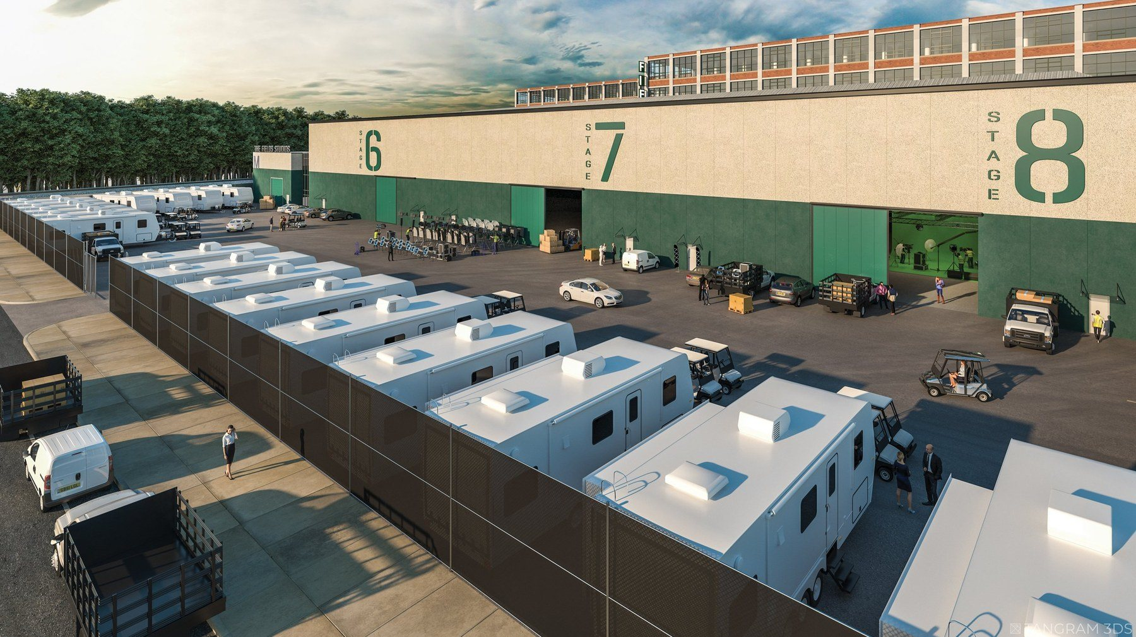
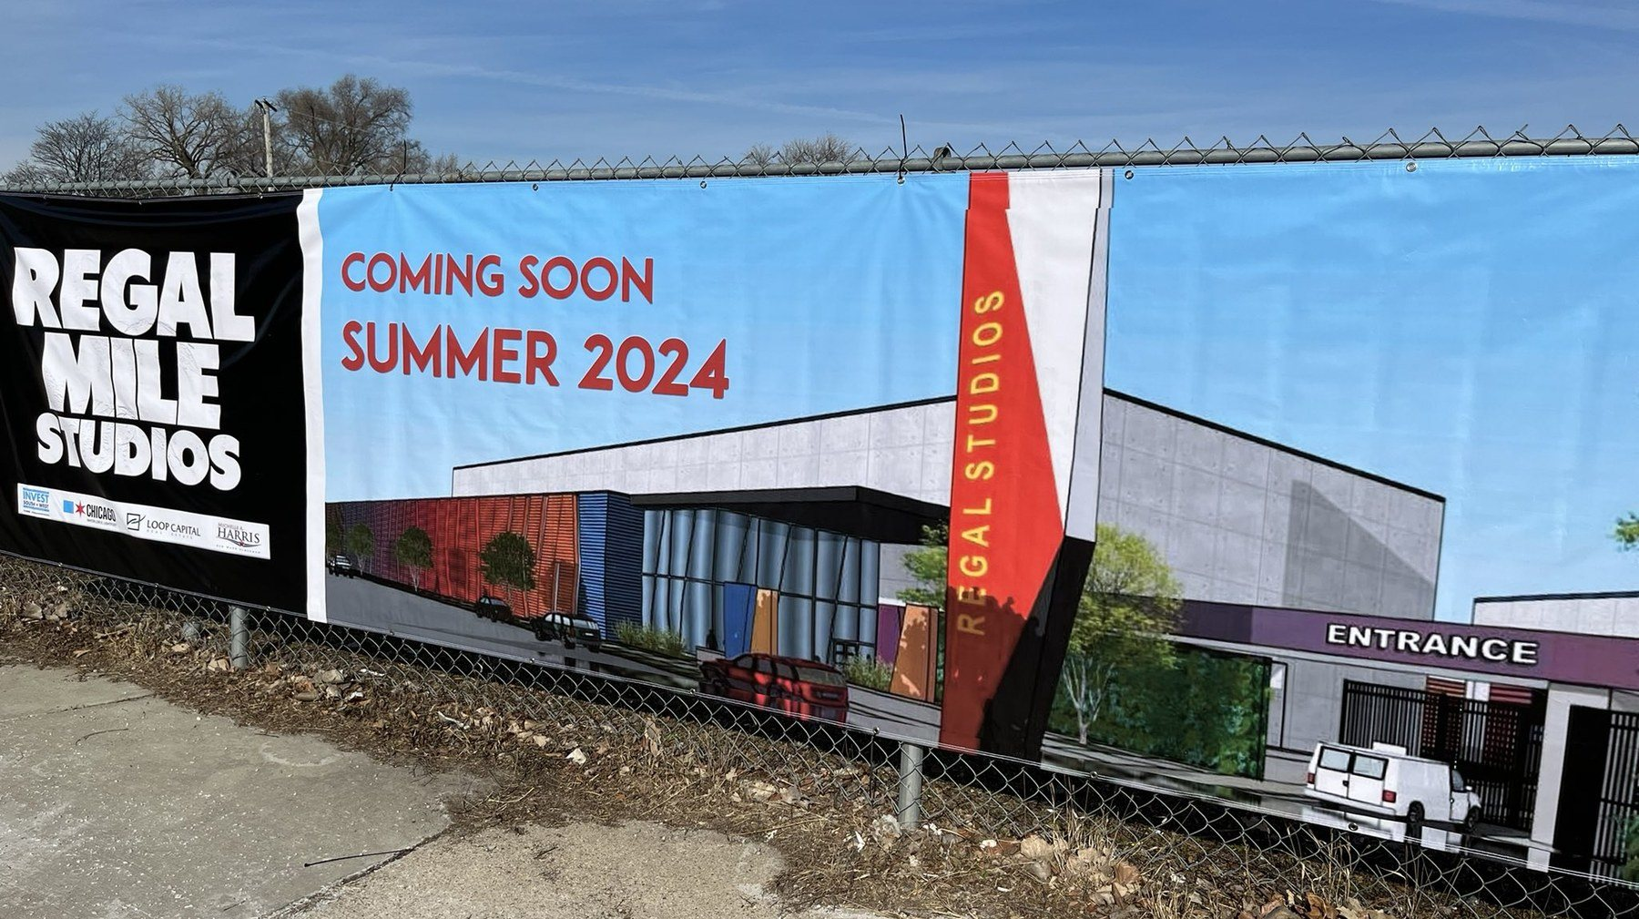
NEW STAGES, BIG PROMISES
ACT II · THE LABOR FLOOR
$62M
estimated cost, Metro East
THE FIELDS STUDIOS
REGAL MILE STUDIOS
HOLLYWOOD RIVER STUDIOS
NORTHWEST SIDE · OPEN
SOUTH SHORE · WAITING
WOOD RIVER · BREAKING GROUND
Opened in 2024 on about 23 acres: 9 stages in the old Marshall Field’s warehouse, a $250M build.
Ground broke at 7700 S. Stony Island in Feb. 2023 for a fall 2024 opening. No opening has been reported.
Broke ground Oct. 5, 2026: up to six buildings and about 140K sq ft, aiming for production in summer 2027.
Illinois launched a $10M soundstage capital grant program in 2024 to help build new stages.

Slide 18
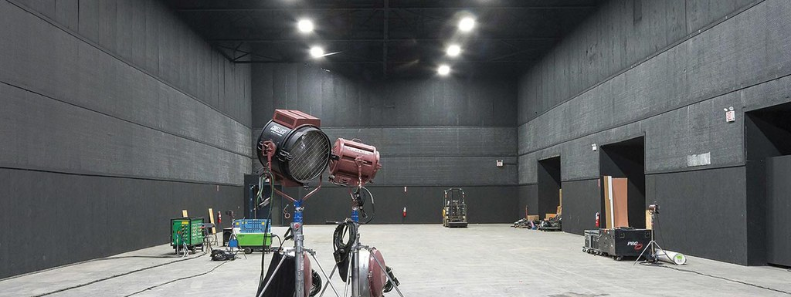
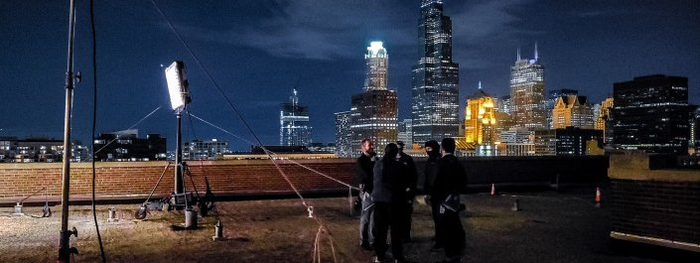
STAGE DAY VS. LOCATION DAY
ACT II · THE LABOR FLOOR
STAGE DAY
LOCATION DAY
Controlled light and sound, if the walls hold
Permits, neighbors, parking, the ‘L’ overhead
Pre-rigged greenbeds, permanent power, “A Mill”
Basecamp, trucks, and Teamsters 727 drivers
Standing sets reset in minutes, not hours
Lake wind, winter light, sound you can’t control
You fight the clock and turnaround, not weather
Every company move costs part of the day

Slide 19

WHO'S ON THE CALL SHEET IN 2026
ACT II · THE LABOR FLOOR
STAYING
One Chicago renewed in March 2026: Fire season 15, P.D. season 14, Med season 12.
ENDING
The Bear’s final season premiered June 2026. The Chi’s eighth and final season premiered May 2026.
PASSING THROUGH
Dark Matter S2, Deli Boys S2, Monster: The Ed Gein Story, A24’s Enemies, and Disney’s Last Kids on Earth pilot.
~$2B
brought into Illinois by One Chicago since 2011
IN LIMBO
American Blue, a WBTV pilot shot in Joliet and Chicago. HBO Max passed in Aug. 2026.

Slide 20
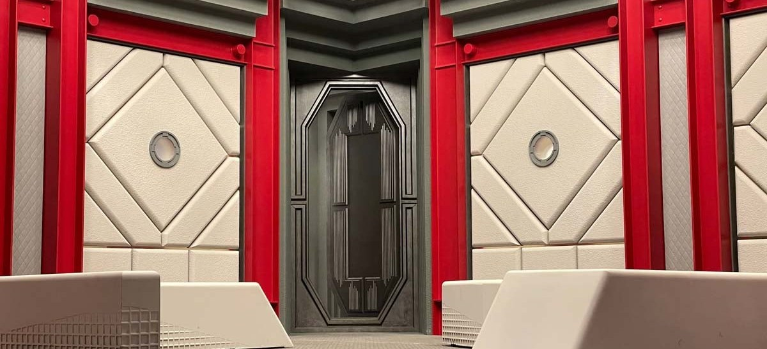
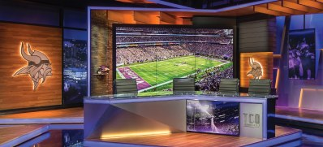
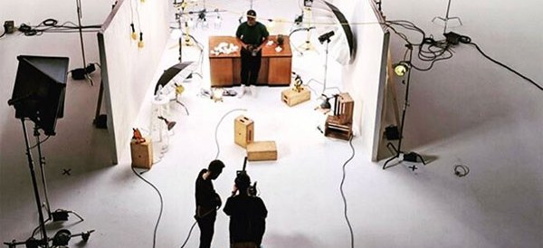
BELOW THE LINE IS A SUPPLY CHAIN
ACT II · THE LABOR FLOOR
BUILD
SCENIC
LIGHT AND GRIP
Bridgewater Studio, McKinley Park: fabrication that started with One Chicago props in 2015
Chicago Scenic Studios, Pilsen: 165K sq ft and 65 artisans
Essanay Studio & Lighting, Goose Island: stages plus lighting rental
Shops: carpentry, welding, CNC, and branded installations
Builds broadcast, event, and stage scenery
Rental houses: prep, returns, and deliveries are real first jobs

Slide 21


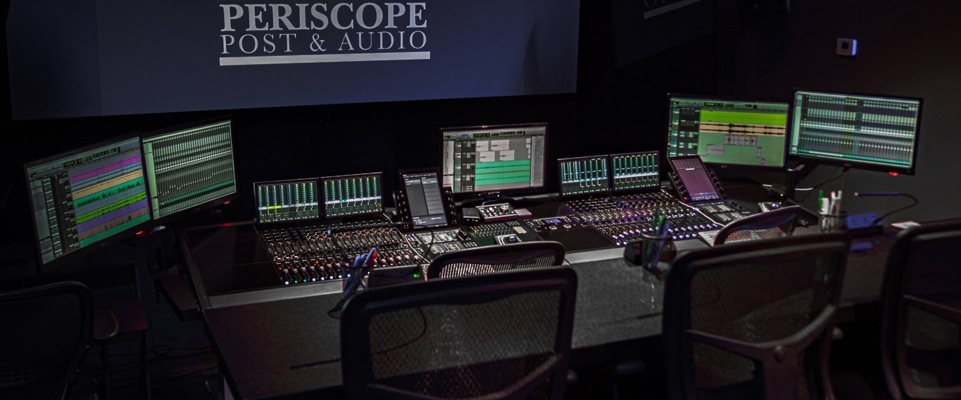
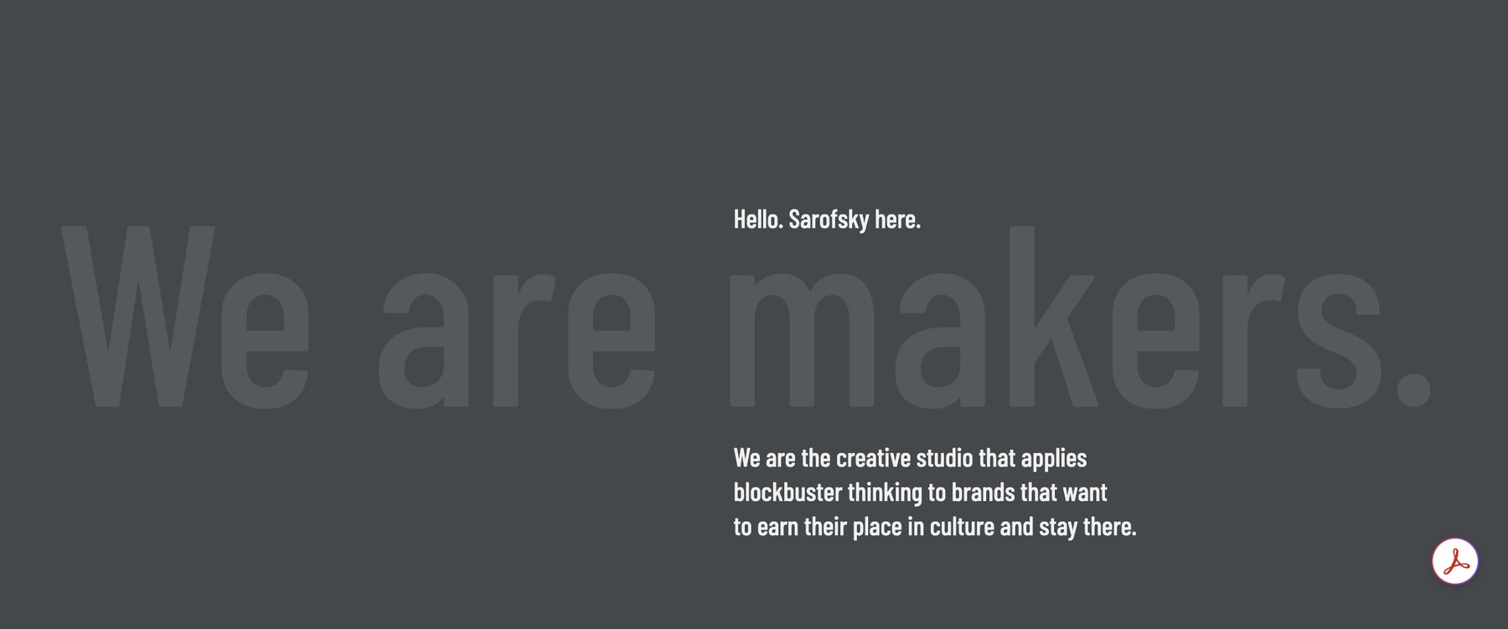
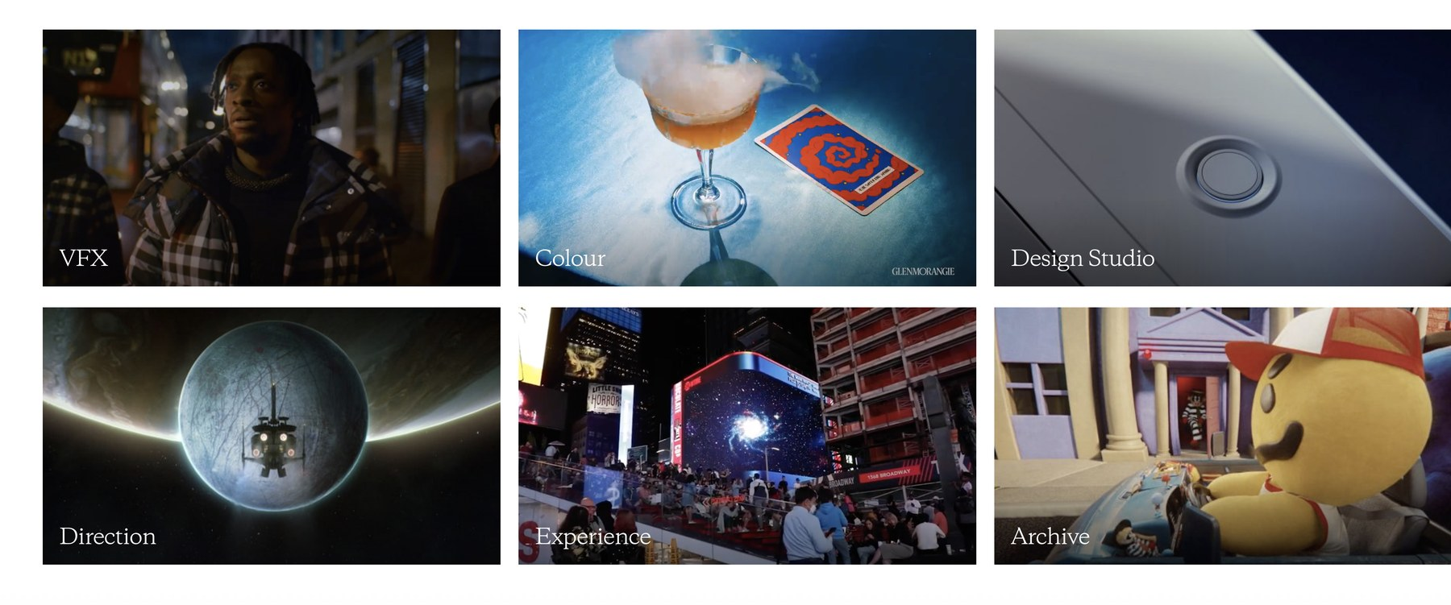
WHERE THE PICTURE GETS FINISHED
ACT II · THE LABOR FLOOR
FRAMESTORE
CARBON
PERISCOPE POST & AUDIO
VFX and animation in the West Loop
VFX studio on Canal Street
Sound and picture finishing
POST IS PORTABLE. STAGES ARE NOT.
When Technicolor collapsed, The Mill’s U.S. shops closed. A fiber line can move a VFX job. It can’t move a stage.
SAROFSKY
THE MILL
Design-led studio, Fulton Market, since 2009
U.S. operations shut in Feb. 2025

Slide 22







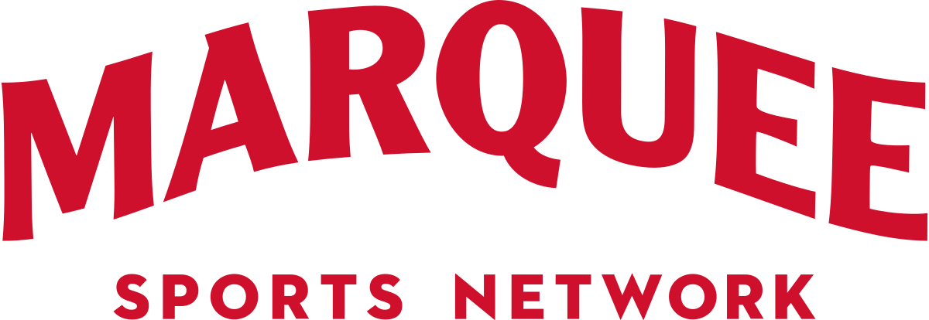


BROADCAST IS THE SAME LABOR MARKET
ACT II · THE LABOR FLOOR
GROWING
SHRINKING
NBC 5 + Telemundo: a combined newsroom and studio of about 70K sq ft in NBC Tower (2026)
WGN-TV: owner Nexstar cut on-air staff in Feb. 2026
CHSN: Bulls, Blackhawks, and White Sox since 2024–25
WTTW: 15 to 20 departures after Congress rescinded public media funding (2025)
Big Ten Network and Weigel: national networks based in Chicago
Marquee Sports Network: cost cuts in Dec. 2025

Slide 23
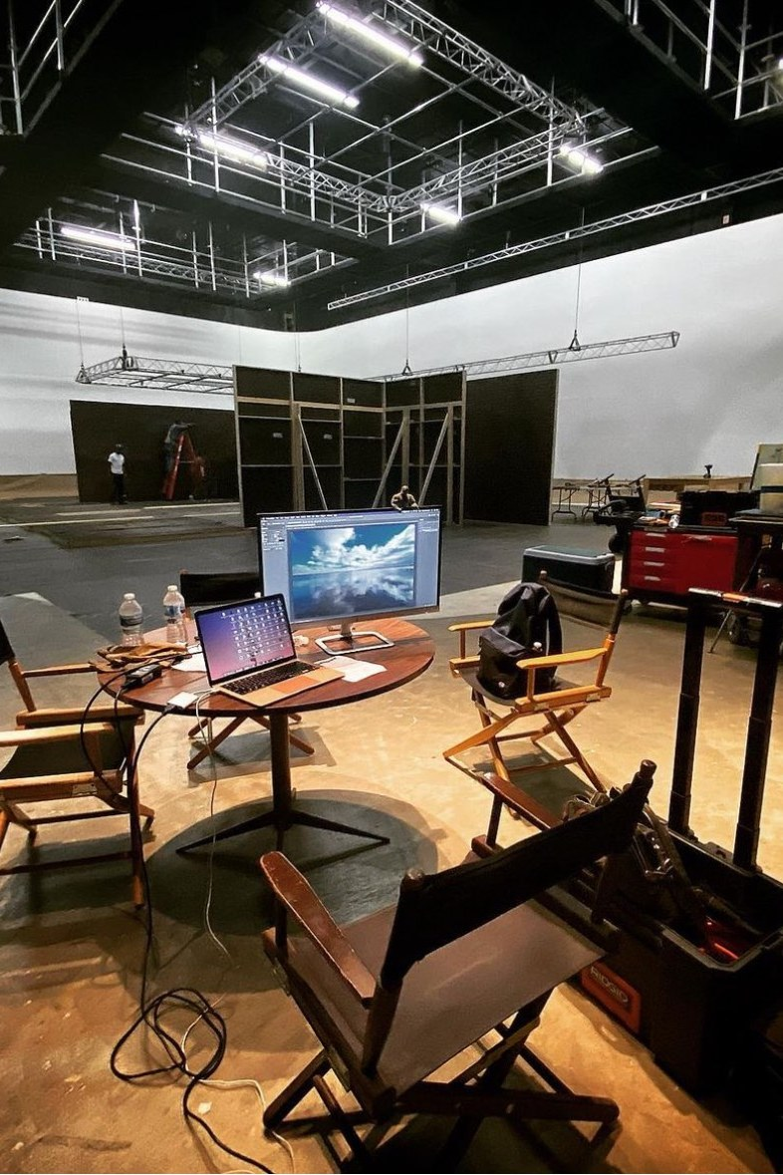
THE LINE
ACT III · STAR 3: COLUMBIAN EXPOSITION, 1893
The city learned to sell itself. Every budget draws a line.

Slide 24
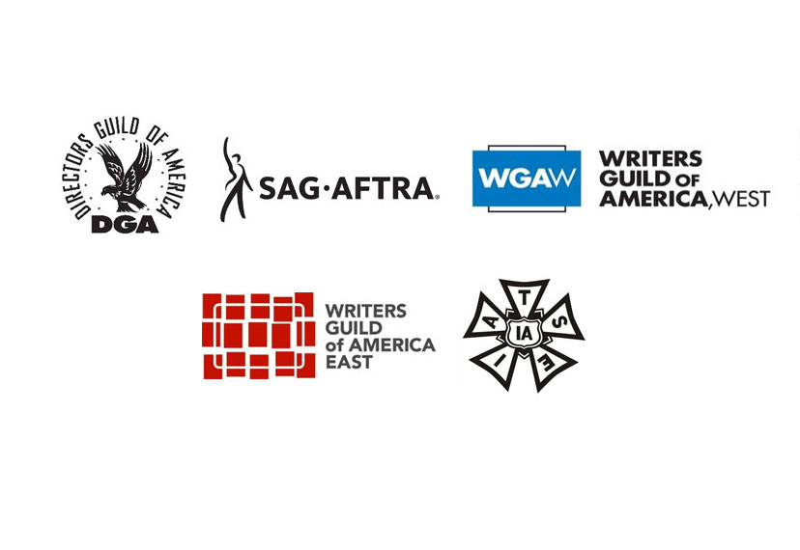
ABOVE THE LINE, BELOW THE LINE
ACT III · THE LINE
ABOVE THE LINE
HOW ILLINOIS DRAWS THE LINE
WRITERS · DIRECTORS
PRODUCERS · PRINCIPAL CAST
Residents: 35% credit on wages
Negotiated deals over guild minimums. Often hired out of Los Angeles or New York.
Non-residents: 30%, capped at 13 crew slots plus 4 to 6 actors
BELOW THE LINE
THE LINE
2023 to 2025: the law named the jobs worth importing: writer, director, DP, production designer, costume designer, accountant, VFX supervisor, editor, composer
CAMERA · GRIP · ELECTRIC · PROPS · SET DEC
CONSTRUCTION · HAIR · MAKEUP · WARDROBE
SOUND · DRIVERS · AND MORE
Hourly scale, overtime, and fringe. Hired local.

Slide 25

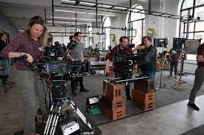
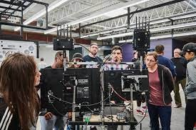
WHO COVERS WHAT ON A CHICAGO SET
ACT III · THE LINE
STUDIO MECHANICS
21 DEPARTMENTS
ICG LOCAL 600
BTL
IATSE LOCAL 769
BTL
Camera; a national guild with a Chicago regional office
Wardrobe and costume
Grip · Electric · Rigging · Props · Set decoration · Construction · Paint and scenic · Sound · Hair · Makeup · Script supervisor · Special effects · Craft service · Video playback, and more
TEAMSTERS LOCAL 727
BTL
IATSE LOCAL 2
BTL
Drivers
Stagehands: TV, concerts, theater, trade shows
DGA
ATL
SAG-AFTRA CHICAGO
ATL
Directors, plus ADs and UPMs
Performers across IL, IN, WI, and eastern IA
WGA
ATL
USA 829
BTL
Writers; a national guild
Scenic artists and designers

Slide 26
HOW A CREW DOLLAR MOVES
ACT III · THE LINE
WAGES
YOUR CHECK
Hourly scale and overtime
What lands after taxes and dues
PRODUCTION
PAYS
FRINGE
BENEFIT FUNDS
Health, pension, and annuity, paid on top of wages
Contributions bank toward health eligibility and retirement
DUES
THE LOCAL
Local 476 work dues: 3%, members and overhires alike
Contracts, training, and the roster
Health is earned in hours. Local 476’s Welfare Fund banks hours; IATSE’s national Plan C counts contribution dollars.

Slide 27
WHAT SCALE LOOKS LIKE
ACT III · THE LINE
Chicago is outside that agreement. Local 476 has its own deals with producers, and its rates are not posted publicly.
The 2024 IATSE deals: raises of 7%, 4%, and 3.5%. They expire July 31, 2027.
Benefits ride on top: the 2024 national agreement set $175 a day in contributions, rising $15 a day each year.
2026 guild cycle: WGA, SAG-AFTRA, and DGA ratified with no strike. WGA and SAG-AFTRA deals run to 2030.
A benchmark, not Chicago scale: non-Maryland feature rates under the national Area Standards Agreement.

Slide 28
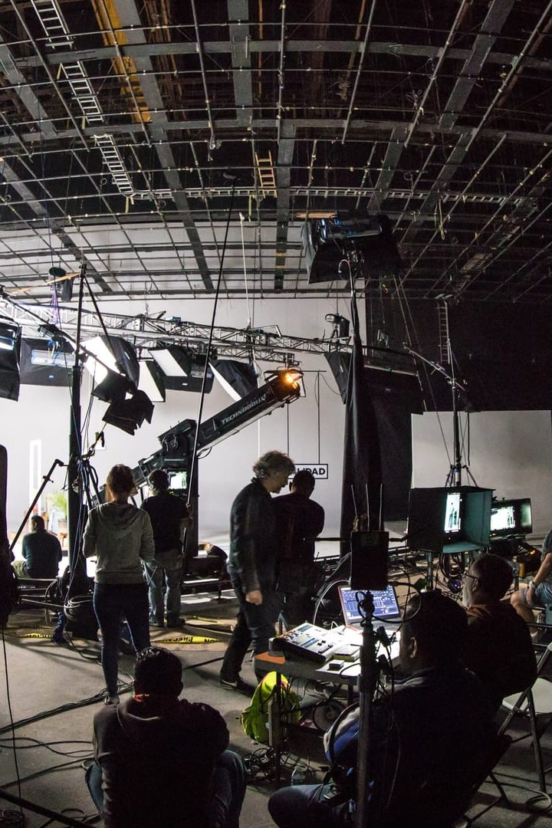
THE GRIND
ACT IV · STAR 4: A CENTURY OF PROGRESS, 1933
A world’s fair in the middle of the Depression. Progress takes work.

Slide 29






WHAT NOBODY PUTS IN THE SYLLABUS
ACT IV · THE GRIND
GIG TO GIG
PERMIT BEFORE CARD
WHO YOU KNOW
Every show wraps. The Bear and The Chi both aired their final seasons in 2026.
A 2024 candidate for Local 476’s top job said he waited seven years on permit.
Day players get called through crew relationships, outside formal union channels.
HEALTH IS EARNED
TWO-TIER PAY
POLICY MOVES THE WORK
Coverage rides on hours or contributions. A slow year can cost you coverage.
Candidates in the 2024 Local 476 race cited stagnant wages and a two-tier day-player scale.
About 90% of Illinois production is incentive-driven. When the credit moves, the jobs move.

Slide 30
BOOM, BUST, AND THE BANKED HOURS
ACT IV · THE GRIND
−67%
−69%
~2,000
0
Local 476 member earnings during the 2023 strikes
hours worked in the same stretch
members of Local 476 riding it out
strikes in the 2026 guild cycle
Banked health hours were frozen while the guilds were out.
In Nov. 2024 the local’s business manager called it a “historical low point.”
In 2025 Illinois set a spending record, but hires stayed flat while wages rose about $50M.

Slide 31






WHERE ENTRY-LEVEL WORK ACTUALLY LIVES
ACT IV · THE GRIND
PA: SET AND OFFICE
OVERHIRE AND DAY PLAYER
SHOPS AND RENTAL HOUSES
Watch the Chicago Film Office’s current production list and the Illinois Film Office’s filming list.
Local 476 departments call day players through crew relationships. Permits come before cards.
Scenic, fabrication, lighting, and grip: prep, returns, deliveries.
BROADCAST AND SPORTS
LIVE AND EVENTS
TRAINING PROGRAMS
Stations, CHSN, Marquee, Big Ten Network: ops, camera, audio, graphics.
IATSE Local 2 opened a new training center in Nov. 2025 with a $5M state grant.
CineCares, Chicago Filmmakers, Free Spirit Media, and the state’s workforce grants.

Slide 32
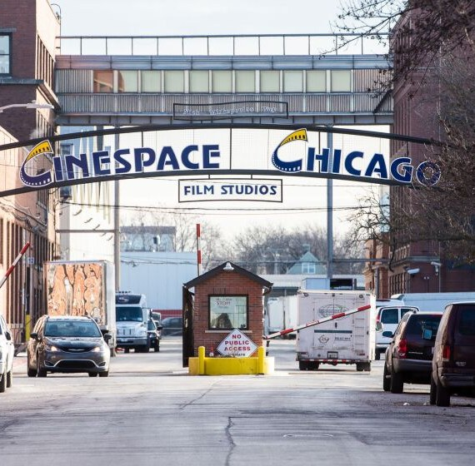
CINECARES: A DOOR IN NORTH LAWNDALE
ACT IV · THE GRIND
Cinespace’s workforce program, launched in 2017 with NBCUniversal, Wolf Entertainment, and IATSE Local 476 on the North Lawndale campus.
86
50%+
18+
trainees to date
of union-track trainees earned cards: 476, 600, 769
Chicago residents eligible
Placed across One Chicago: set decoration, props, grip, sound, costume, electric
Recruiting partners: North Lawndale Employment Network, Sinai Chicago, 100 Black Men Chicago, Chicago State
Earlier interns: 90%+ finished, 60%+ worked full seasons, and CineCares paid union initiation fees (ABC7, 2020)

Slide 33
THE STATE BUILT A PIPELINE, AND A REASON TO USE IT
ACT IV · THE GRIND
ILLINOIS FILM OFFICE WORKFORCE TRAINING
+15%
550+
60%+
$1M
people trained
got work offers
in grants, FY2026
Free Spirit Media ($180K, 2025–27): West Side youth media nonprofit rooted at Homan Square in North Lawndale; Creative Pathways serves ages 18 to 25
extra credit on wages paid to residents of economically disadvantaged areas
Chicago Filmmakers PA Training: 80 hours, tuition-free, 12 seats in Edgewater. Next cohort Dec. 5, 2026 to Jan. 23, 2027; apply by Nov. 15
Training a North Lawndale grip is good policy and good math.
Every state-funded cohort: 12 to 15 trainees, half from underserved areas. Fresh Films runs the downstate grant.

Slide 34
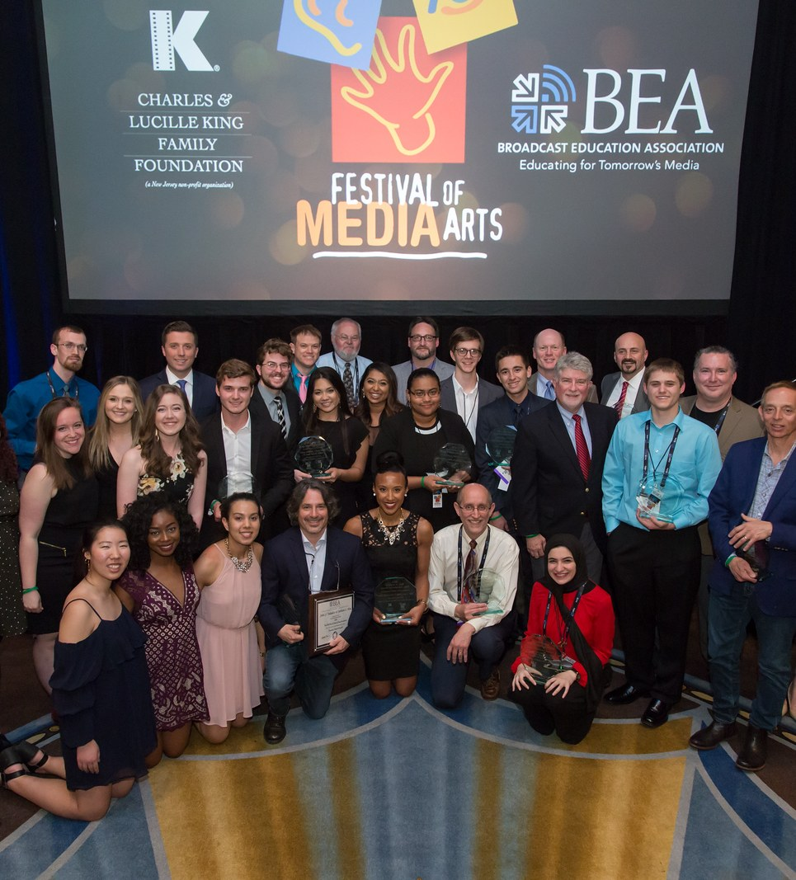
FIELD NOTES: IF YOU WANT IN
ACT IV · FOR THE STUDENTS IN THE ROOM
01
GET ON THE LISTS
Film office production lists, Mandy, ProductionList, Reel Chicago
02
TRAIN FOR THE SET
Chicago Filmmakers, Free Spirit Media, CineCares
03
SAY YES TO OVERHIRE
The next call comes from the crew you worked with last
04
TRACK YOUR HOURS
Health coverage and union status are earned in days and hours
05
LEARN THE PAPER
Deal memos, timecards, fringe, dues: know what you sign
06
GET A CAR
Most PA jobs require one

Slide 35
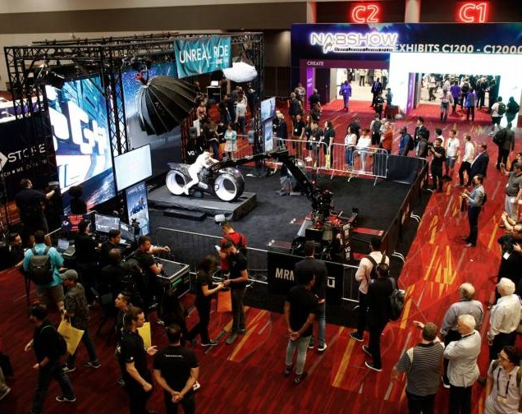


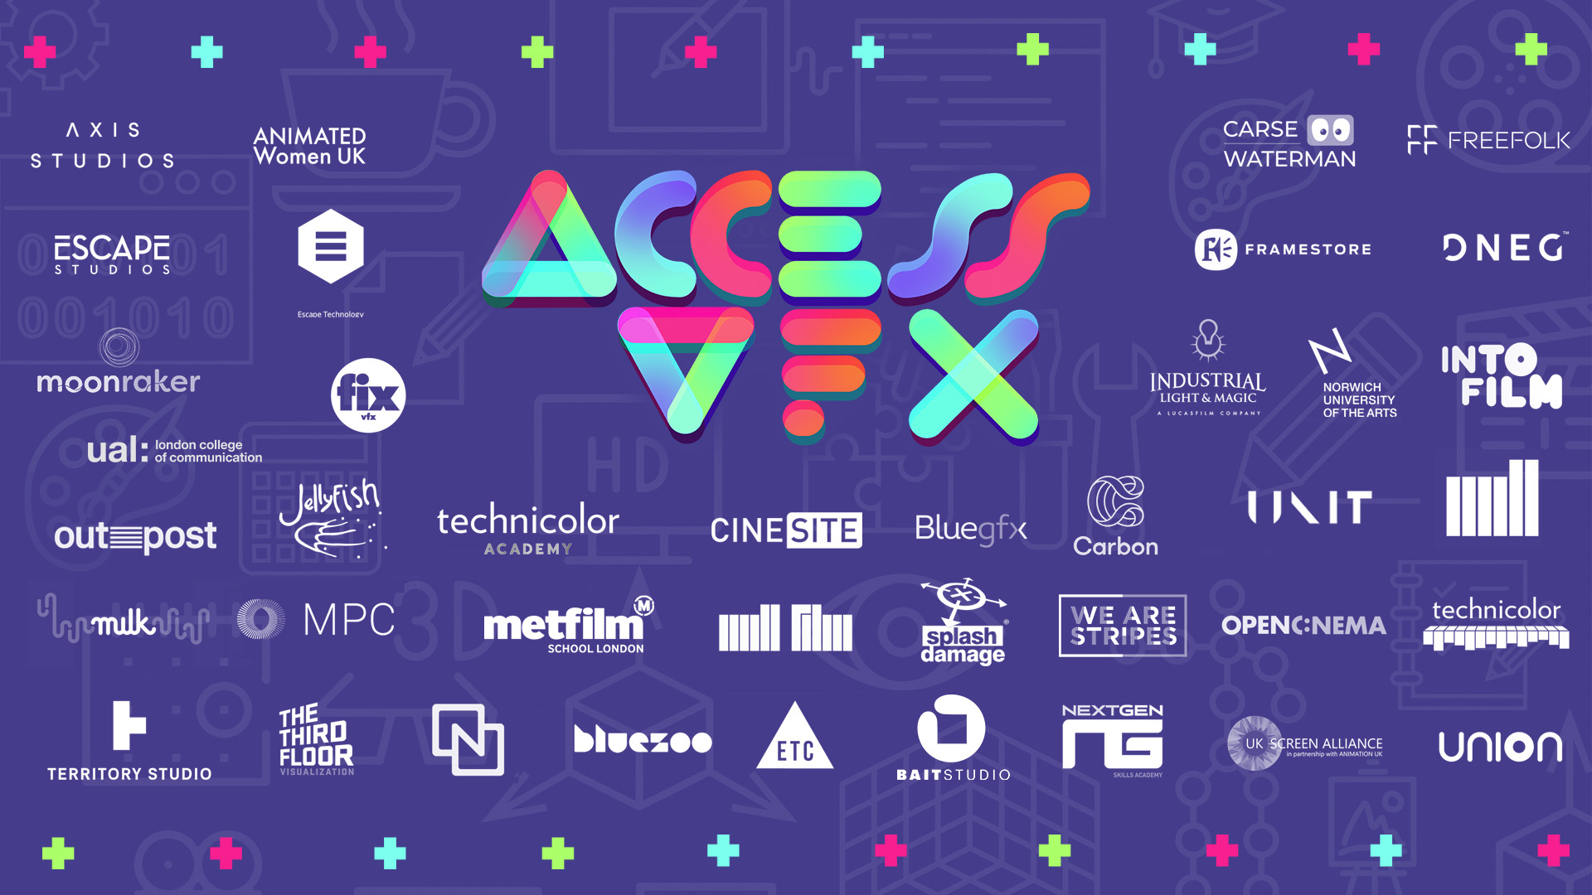
FIND YOUR PEOPLE
BEFORE WE CUT
BEA
Student work competes in the Festival of Media Arts.
NAB
NAB SHOW
Co-located with BEA2027 in Las Vegas, April 2027.
NATAS CHICAGO / MIDWEST
The regional chapter behind the Chicago/Midwest Emmys.
ACCESS:VFX
An industry-led inclusion initiative across VFX, animation, and games.

Slide 36
THANK YOU
TRADE TALKS · BEA2027
EVERY FRAME HAS A CALL TIME
For discussion: where do your students first touch a real set, and who in your city holds the door?
TY BUSH, MFA tybush.com · Purdue University Northwest · TwointheBush Television Co.

Slide 37
SOURCES
FOR THE RECORD
Reel Chicago: Jane Byrne, patron saint of Chicago’s film industry, Nov. 17, 2014 · Illinois Policy Institute: film tax credit report
Office of the Governor (IL): 2025 record film spending release, Mar. 19, 2026; 2024 release, Apr. 15, 2025
Reel Chicago: Illinois breaks film records, Mar. 2023; SB 1911 signed, Dec. 12, 2025; What’s filming, Nov. 2025 and July 2026
Illinois DCEO / Illinois Film Office: Film Production Services Tax Credit; soundstage list (2026)
Cast & Crew: Illinois SB 2951 summary, Mar. 21, 2023 · Axios Chicago: film tax credits, Apr. 8, 2026
WTTW News: film tax credit analysis (Michael Thom, USC)
City of Chicago Landmarks: Essanay Studios · essanaystudios.org history
Cinespace: Chicago campus; CineCares Chicago; CineCares Workforce Training Program (rev. Jan. 2026)
Hollywood Reporter: TPG buys Cinespace, Nov. 12, 2021 · Reel Chicago: Chicago Studio City at 45, Nov. 7, 2025
CBS Chicago: The Fields Studios opens, Feb. 2024 · Chicago Sun-Times: Salt Shed vs. Essanay Studio, Sept. 16, 2022
Urbanize Chicago: Regal Mile Studios groundbreaking, Feb. 10, 2023 · NPR Illinois: Hollywood River Studios, Oct. 6, 2026
TheWrap: NBC renews One Chicago, Mar. 27, 2026 · Variety: The Bear final season, May 6, 2026
Reel Chicago: The Chi final season, Apr. 25, 2026; American Blue, Aug. 14, 2026
NewscastStudio: Technicolor shutters U.S. offices, Feb. 24, 2025
Axios Chicago: NBC Chicago studio, Apr. 6, 2026 · The Desk: WGN layoffs, Feb. 2026
Current: WTTW departures, Sept. 26, 2025 · Bleacher Nation: Marquee cuts, Dec. 2, 2025
IATSE Local 476: department descriptions; day player checklist · Reel Chicago: Local 476 and the strikes, Sept. 19, 2023; business manager race, Nov. 12, 2024; ICG on Chicago, Nov. 30, 2011
ICG Local 600 history · SAG-AFTRA Chicago Local · DGA Chicago Coordinating Committee, Oct. 2023 · USA 829
IATSE: 2024 Area Standards Agreement MOA and 2024–27 ASA wage rates · Wrapbook: IATSE contract guide, July 19, 2024 · Variety: IATSE ratifies, July 2024
IATSE National Benefit Funds: Plan C at a Glance, July 2026
WGA: 2026 MBA ratified, Apr. 24, 2026 · Screen Global Production: SAG-AFTRA deal, May 13, 2026 · TheWrap: DGA contract, June 12, 2026
ABC7 Chicago: CineCares interns, Feb. 22, 2020
Illinois GATA: Film and TV Workforce Training Program (CSFA 420-45-2336) · Chicago Filmmakers: PA Training Program
Reel Chicago: Free Spirit Media at Homan Square, Dec. 11, 2015; IATSE Local 2 training center, Nov. 14, 2025
Chicago Film Office: Current Production Information; Chicago Made toolkit and permit workshop imagery · BEA: BEA2027 FAQs

