Slide 1
State Sunlight-Long
(Lowry Ranch CAP)
Neighborhood Meeting
February 27, 2024
3 PM – 7 PM
1

Slide 2
01
Who We are
02
Project Information
03
Planned Mitigation Measures
Table of Contents
04
Current Permit Status
05
Contact Information
06
Questions

Slide 3
Who we are
Civitas Resources, Inc. was formed in November 2021 with the merger of four Colorado operating companies
Crestone Peak Resources Operating LLC is a wholly-owned subsidiary of Civitas Resources, Inc
Civitas is committed to the communities where we live and operate. We proudly demonstrate this commitment through leadership in Environmental, Social, and Governance(ESG) practices and is the first Carbon neutral oil and gas producer in Colorado
Civitas is utilizing best in class best management practices to protect public health, safety, welfare, and environment, including wildlife resources

Slide 4
Project Information

Slide 5
Location Plans and Information
Plans
We plan to drill up to 32 wells from one newly-constructed pad
Up to 16 wells will be drilled from east to west, through sections 22 W2, 21, 20, and 19 or sections 27 W2, 28, 29, and 30, to a total horizontal length of 3.5 miles
Up to 16 wells will be drilled from west to east, through sections 22 E2, 23, and 24 or sections 27 E2, 26, and 25, to a total horizontal length of 2.5 miles
Information
Location: SWNE Section 27 T5S-R65W 6th PM
Ownership: State Surface
Current & Future Land Use: Rangeland
Initial Disturbance Area: 35.2 acres
Initial Working Pad Surface: 15.6 acres
Interim Reclaimed Disturbance Area: 28.8 acres
Interim Reclaimed Pad Surface Area: 6.3 acres
Planned # of wells: Up to 32
Nearest cross streets: East Quincy Ave. & S Harvest Rd.

Slide 6
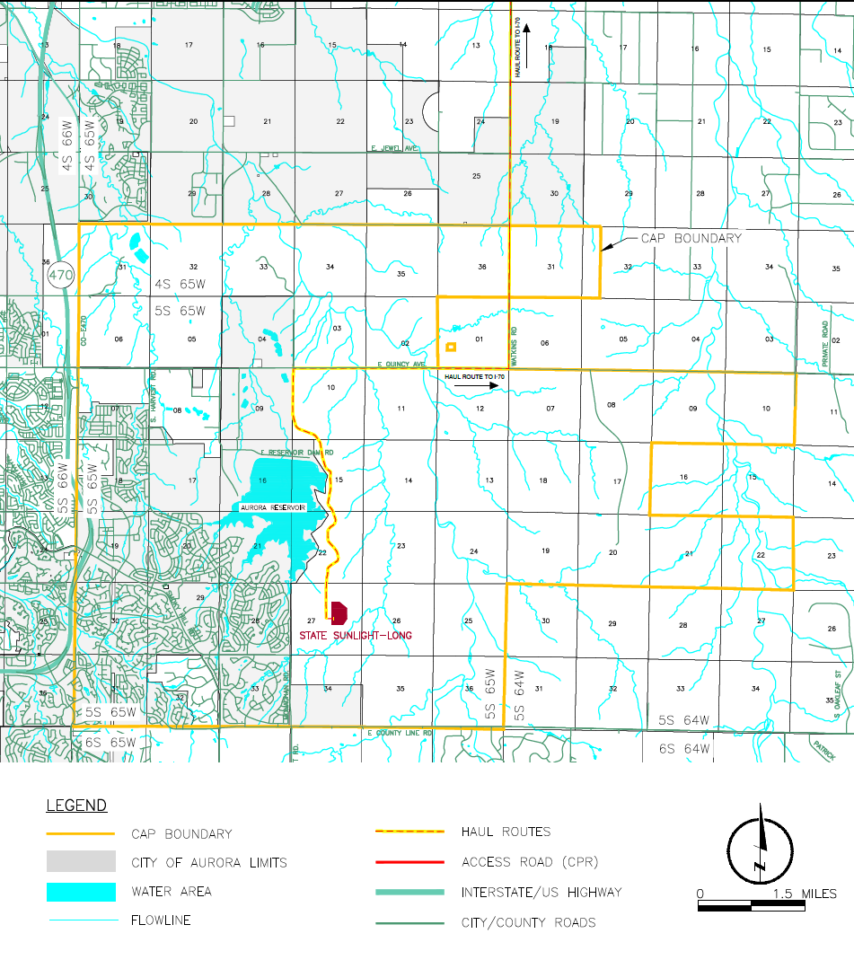
Location and
Haul Route
Map
Proposed Haul Route Directions:
From the State Sunlight-Long site, drive ~3.75 miles North on private access road to E. Quincy Ave. then East 3 miles to Watkins Road. Proceed North for 7 miles. Enter i70 westbound toward Denver (~21 miles)
Yellow line depicts Haul Route.

Slide 7
Setbacks
Measured from Working Pad Surface to the feature:
Nearest Residential Building Unit (RBU): 3,074’ W
Nearest Open Space: > 5,280’ NW
Nearest School Facility or Childcare Center: > 5,280’ W
Nearest surface water: 3,220’ NW
Aurora Reservoir: 3,220’ NW
Planned Reservoir B: >5,280’ NE
7

Slide 8
Estimated Timeline (subject to change)
Initial Construction: Q3 2025 (~60 Days)
Drilling: Q4 2025 – Q2 2026 (~230 days)
Completions: Q2 – Q3 2026 (~180 days)
Anticipated First Production: Q4 2026
Anticipated Interim Reclamation: Q4 2026

Slide 9
Planned Mitigation Measures and
Best Management Practices (BMPs)

Slide 10
Mitigation and BMPs
Water
Crestone shall, at its own cost, perform initial baseline sampling and testing of all water sources located within one-half (1/2) mile radius of Oil and Gas Facility pursuant to ECMC Rule 615 and Arapahoe County Rule 5-36.F.9(b.).
Crestone utilizes a polyethylene liner beneath the drilling rig during drilling operations and beneath the areas where completions equipment (including pump trucks and other heavy equipment) during completion operations to ensure there is an impermeable layer between the rig and the earth. The use of this liner prevents hydrocarbons and other fluids from reaching the soil in the unlikely event a leak does occur. The liner is inspected for integrity throughout drilling operations and maintenance/repair to the liner occurs as needed.
Crestone will install an engineered containment system around and beneath the tank battery. The containment system is constructed of a perimeter of walls that are post driven into the ground around a flexible geotextile base. All components including the underlayment are sprayed with a polyurea liner technology. This liner technology maintains impermeability and puncture resistance under exposure to UV rays, weather extremes, and chemicals commonly encountered in oil and natural gas production and provides seamless protection.

Slide 11
Mitigation and BMPs (continued)
Air
Engineering Practices to Reduce Cumulative Impacts
Tier IV engines (or equivalent) will be employed during Completions to reduce emissions.
If deemed technically feasible by the local utility provider, an electric drilling rig will be employed. However, in the event that an electric rig cannot be utilized, Crestone pledges to use a Tier IV or equivalent drilling rig.
To minimize emissions, we employ top of the line engineering practices. These include utilizing instrument air pneumatics, implementing tank and loadout controls, and prioritizing electrification wherever feasible.
Air Monitoring and Leak Detection Procedures
During drilling, completion, and production operations, regular Auditory, Visual, and Olfactory Monitoring (AVO) inspections are performed on equipment containing hydrocarbons, fluids, or associated chemicals. AVO inspections include taking the time to look, smell and listen for leaks.
Crestone has developed a robust Leak Detection and Repair (LDAR) program, which utilizes Forward Looking Infrared (FLIR®) cameras to identify and fix leaks. These inspections will begin during the drilling phase and continue throughout the life of the Oil & Gas Location.
An Air Monitoring plan will be reviewed and approved by both the Colorado Department of Public Health and Environment (CDPHE).

Slide 12
Mitigation and BMPs (continued)
Noise
A noise mitigation plan will be submitted to Arapahoe County as a part this application.
Crestone shall provide a 24-hour contact number for noise complaints on the facility sign required in section 5-3.6.F.3.h of Arapahoe County Oil and Gas Regulations, as well as the ECMC’s complaint hotline number.
Crestone will utilize a quiet completion fleet during completion operations to help minimize noise originating from the location.
Unnecessary sounds such as honking the horn, revving vehicle engines, loud music, and unwarranted metal hammering/banging are all examples of sound that can create nuisance; failure to eliminate unnecessary sound from location will be subject to an internal compliance assessment if reported by a landowner.
Idling Equipment – While idling engine/equipment, maintain at the lowest frequency possible, as well as, in a position/location that will prevent sound from carrying to nearby residents.
Light
Lighting shall be pointed inward and downward.
No permanent lighting shall be installed on the location.
At move-in, rig-up and regularly during Drilling and Completion phases, Crestone will routinely walk around the outside of the disturbance area to identify and reduce obtrusive lighting from leaving the site where possible.

Slide 13
Mitigation and BMPs (continued)
Odor
All drilling fluids are routed through a closed loop system.
Will employ IOGP Group III – oil-based mud and odorless (no BTEX).
No open earthen pits will be used to store fluids or drill cuttings.
Dust
Dust suppression during initial construction will be accomplished by the application of freshwater to the access road(s) and exposed earthen surfaces to reduce the transportability of dust when atmospheric conditions are conducive to sustained winds and/or periodic gusts. All dust suppression efforts will consist of only freshwater unless otherwise requested and approved as applicable.
To minimize sand-related dust emissions, the Crestone will be utilizing containerized box technology for sand transport, storage and use during the completions phase. These sand containers (or “sand boxes”) are sealed containers that protect the sand from exposure to wind and prevent dust generation.
Crestone will post an access road speed limit not to exceed 20 miles per hour to minimize fugitive dust emissions from vehicle traffic traveling on the access road.
Crestone will perform regular inspections and road maintenance to ensure the integrity of the access road and associated features is maintained throughout the life of this project. Maintenance consists of re-compacting the road base/recycled asphalt mix on an as-needed basis.
Crestone will install and maintain vehicle tracking controls (i.e., coarse aggregate, a tracking pad, paved apron, or cattle guard) to further reduce and remove loose mud and dirt on construction equipment and vehicles servicing location.

Slide 14
Mitigation and BMPs (continued)
Traffic
Crestone must use approved traffic haul route.
Traffic impact fees will be paid to Arapahoe County.
Water will be provided to the site via above ground pipeline for drilling and completions.
A Traffic Impact Study will be included with this application.
Oil and gas pipeline will be in place at the start of the Production phase to reduce truck traffic.
Lightning Mitigation
All permanent equipment onsite will be connected to an underground steel grounding grid.
Visual
Location and access road shall be free of identified noxious weeds throughout operations.
Wildlife and nearby High Priority Habitat (HPH)
Crestone will coordinate with Colorado Parks & Wildlife (CPW) regarding operations within HPH and will implement CPW recommendations to reduce HPH impacts.

Slide 15
Current Permit Status

Slide 16
Permit Status
Arapahoe County
Administrative Energy Use by Special Review (AEUSR)
- Not yet filed
ECMC
CAP
- In Process, anticipated hearing June 2024
OGDP/Form 2A (Location Assessment)
- Not yet filed
Form 2s (Well Permits)
- Not yet filed

Slide 17
Contact Information

Slide 18
Company Contacts
Dan Harrington
Asset Development Lead
Email: lowryranchcap@civiresources.com

Slide 19
Questions?

Slide 20
Thank You

