Slide 1
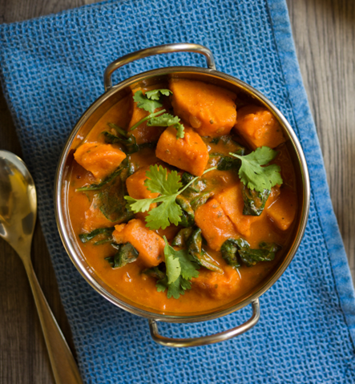
Ingredients: 1 onion 20ml of vegetable oil 2 cloves of garlic, finely chopped 2 small chunks of fresh ginger, peeled and chopped 1/2 teaspoon of cayenne pepper 600g of sweet potato, washed, peeled, and cut into cubes 1 tablespoon of mild or medium curry paste 300ml of passata 300ml of low-salt vegetable stock 200g of spinach leaves, washed 4 tablespoons of peanut butter fresh coriander to garnish black pepper
Sweet potato satay stew
A healthy vegetarian satay bursting with flavour, a perfect mid-week meal!
Method
Peel and chop the onion, garlic and ginger.
Heat the oil in a large saucepan.
Add the chopped onion, garlic, ginger and cayenne pepper and fry gently for 10 minutes, taking care not to let the onion or garlic go brown.
Add the curry paste and stir well.
Add in the chopped sweet potato and mix well.
Add the passata and the stock. Bring to the boil, cover and simmer for 20 minutes until the potatoes are almost tender.
Add the spinach and cook for a further 5 minutes.
Mix a few spoonful of the stew juices with the peanut butter to soften it and then mix it all back into the stew.
Season with black pepper and garnish with coriander.
Prep time & Cooking time 20 minutes prep time
40 minutes cooking time
Perfect for freezing
Meal Type
✔ Dinner
Cooking method
✔ Stew
Nutritional Information
 Vegan  Vegetarian  Healthy
 Low Fat  No added sugar  High Fibre
Tips ☝
Serve alone or with rice
Level of difficulty
✔ Medium
Foods used: ✔Sweet Potato ✔Peanut butter ✔Spinach ✔Garlic ✔Ginger ✔Onion ✔Coriander

