Slide 1




Nuvei + Acumatica
Streamline cash flow with integrated
payments and AR automation

Slide 2
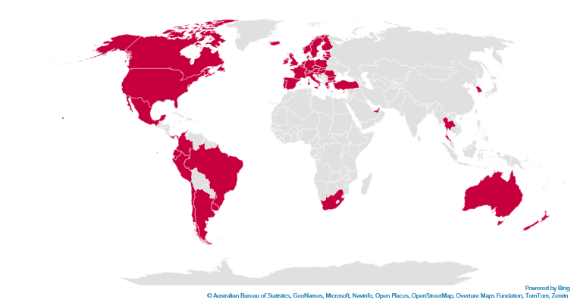
Nuvei at a glance
200+
Global
Markets
20+
Global
Offices
50+
Local Acquiring
Markets
700+
Payment
Methods
A combination of direct acquiring and local acquiring partnerships grants you access to markets across the globe.
~150
Currencies
2,800+
Team Members
Canada
United States
Mexico
Argentina
Brazil
Chile
Colombia
Ecuador
Ecuador
Peru
Austria
Belgium
Bulgaria
Croatia
Republic of Cyprus
Czech Republic
Denmark
Estonia
Finland
France
Germany
Gibraltar
Greece
Hungary
Iceland
Ireland
Italy
Latvia
Liechtenstein
Lithuania
Luxembourg
Malta
Netherlands
Norway
Poland
Portugal
Romania
Slovakia
Slovenia
Spain
Sweden
Switzerland
United Kingdom
Turkey
UAE
South Africa
Hong Kong
Singapore
South Korea
Thailand
Australia
New Zealand

Slide 3




No cost implementations
Increased visibility & control
Enhanced customer experience
Decades of ERP experience
Why Customers
Choose Nuvei

Slide 4


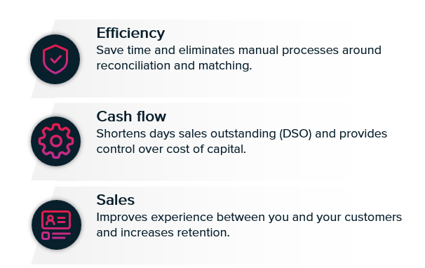
Acumatica Integrated Payments
Why integrated payments matter

Slide 5

Acumatica Integrated Payments
Primary functions
  Gateways to support both Card Present and Not Present processing
Credit, Debit & ACH
EMV, NFC & Swipe
  In-transaction payment processing
Voids & Refunds
Sales Orders & Sales Invoices
Register Customer Payments
Customer Card
Service Orders & Service Invoices
  Settlement Integration with Bank Account Reconciliation and AR Automation
Full Integrated Customer Portal
Anonymous Click2Pay Links
Customizable Notifications

Slide 6
ERP Customer Portal - Commerce Suite
Commerce Suite with Click2Pay Functionality
The Nuvei Integrated Commerce Suite AR Solution keeps users working inside Acumatica and provides customers with the means to self-service for payment related tasks all while providing customers with a suite of solutions that expands Acumatica capabilities.
COMPLETE ERP PORTAL that provides customers with all the tools necessary for self-services for payment related tasks.
Customer Portal
Modern and easy-to-use for customers. Merchants control the brand experience through color stories, logos and font selection.
Key Benefits
  Improve working capital efficiency
  Centralize customer information
  Reduce invoice processing expense
  Manage buyer level payment options
  Automate time consuming tasks

Slide 7
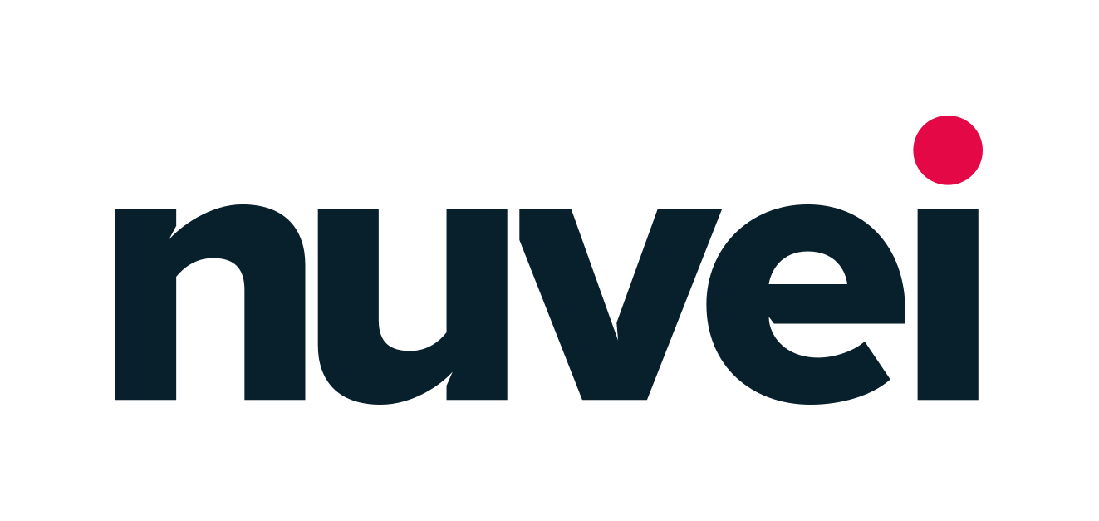



Focused approach to industry challenges
Surcharging
Problem: Customers want to surcharge and need to manage the complex surcharging requirements.
Solve: Nuvei surcharging offers a flexible solution that that allows merchants to stay in compliance. This feature also provides additional fee recovery capabilities that allow customers to better manage the cost of acceptance while giving buyers flexible payment options.
Capture for More
Problem: Sales and shipping tax are often not known at the time of invoicing. Capturing the payment can create multiple authorizations, short pays, or other workflow challenges.
Solve: Take Deposit (PreAuth), allowing Capture For More upon final payment capture when product is picked/packed/shipped.
Partial Pay, Multi Pay, Credit Memo
Problem: Short payments and unique buyer behavior represent significant reconciliation challenges in the ERP.
Solve: Nuvei allows for the ERP/Merchant to handle complex accounting and workflow tied to these needs; link between invoice, SKU, payment and general ledger.

