Slide 1



Dynamics BC ERP Integration
Streamline cash flow with integrated
payments and AR automation

Slide 2
MICROSOFT DYNAMICS BC ERP INTEGRATION
Introduction
Nuvei’s integrated payments and AR automation allows BC customers to manage financial operations with complete transparency and compliance
“Enabling Microsoft to connect to its customers across a wide range of products is testament to our technology and dedication to world-class customer service. We're excited to optimize payments for such a universal brand that is trusted and relied upon by so many people.”
“We're pleased to extend our payment solutions to the Middle East and African region. Whether it is a one-off purchase, software subscription, or in-game purchasing, payments are critical to our overall customer experience. Partnering with Nuvei enables our customers to pay wherever they are and whenever they want to.”
“We’re thrilled that Nuvei has integrated their payment platform with Microsoft Dynamics 365 Business Central, enhancing our offering for our customers.”
“Our relationship with Nuvei is one of the longest existing partnerships we have with any payments services provider and is comprehensively connected to our entire product suite.”
“Our relationship with Nuvei is one of the longest existing partnerships we have with any payments services provider and is comprehensively connected to our entire product suite.”
Phil Fayer
Nuvei Chair & CEO
Ajith Thekadath
Vice President Global Payments
Mike Morton
Vice President, Dynamics 365 Business Central

Slide 3
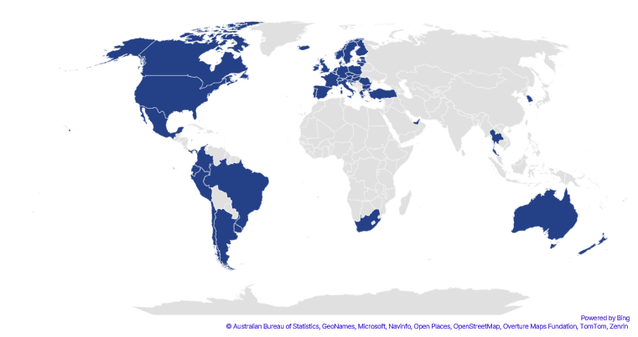
MICROSOFT DYNAMICS BC ERP INTEGRATION
Nuvei at-a-glance
By the numbers
200+
Global Markets
20+
Global Offices
50+
Local Acquiring
Markets
720+
Payment Methods
A combination of direct acquiring and local acquiring partnerships grants you access to markets across the globe.
150
Currencies
2,500+
Team members
Canada
United States
Mexico
Argentina
Brazil
Chile
Colombia
Ecuador
Ecuador
Peru
Austria
Belgium
Bulgaria
Croatia
Republic of Cyprus
Czech Republic
Denmark
Estonia
Finland
France
Germany
Gibraltar
Greece
Hungary
Iceland
Ireland
Italy
Latvia
Liechtenstein
Lithuania
Luxembourg
Malta
Netherlands
Norway
Poland
Portugal
Romania
Slovakia
Slovenia
Spain
Sweden
Switzerland
United Kingdom
Turkey
UAE
South Africa
Hong Kong
Singapore
South Korea
Thailand
Australia
New Zealand

Slide 4
 | No cost implementations
 | Decades of ERP experience
 | Increased visibility & control
 | Enhanced customer experience
Why customers choose Nuvei

Slide 5

MICROSOFT DYNAMICS BC ERP INTEGRATION
BC Integrated Payments
Why integrated payments matter
  Greater efficiency
  Saves time and eliminate manual processes around reconciliation and matching.
  Improves cash flow
  Shortens days sales outstanding (DSO) and provides control over cost of capital.
  Boosts sales and retention
  Improves experience between you and your customers and increases retention.

Slide 6


MICROSOFT DYNAMICS BC ERP INTEGRATION
BC Integrated Payments
Primary Functions
Gateways to support both Card Present and Not Present processing
Credit card and ACH
EMV, NFC, and swipe
In-transaction payment processing
Voids & Refunds
Sales Orders & Sales Invoices
Register Customer Payments
Customer Card
Service Orders & Service Invoices
Settlement Integration with Bank Account Reconciliation and AR Automation
Full Integrated Customer Portal
Anonymous Click2Pay Links
Customizable Notifications

Slide 7
MICROSOFT DYNAMICS BC ERP INTEGRATION
ERP Customer Portal - Commerce Suite
The Nuvei Integrated Commerce Suite AR Solution keeps users working inside BC and provides customers with the means to self-service for payment related tasks all while providing customers with a suite of solutions that expands BC capabilities.
Commerce Suite with Click2Pay Functionality
Complete ERP portal that provides customers with all the tools necessary for self-services for payment related tasks.
Customer Portal
Modern and easy-to-use for customers. Merchants control the brand experience through color stories, logos and font selection.
Key benefits
  Improve working capital efficiency
  Centralize customer information
  Reduce invoice processing expense
  Manage buyer level payment options
  Automate time consuming tasks

Slide 8
MICROSOFT DYNAMICS BC ERP INTEGRATION
Focused approach to industry challenges
Surcharging
Problem: Customers want to surcharge and need to manage the complex surcharging requirements.
Solution : Nuvei surcharging offers a flexible solution that that allows merchants to stay in compliance. This feature also provides additional fee recovery capabilities that allow customers to better manage the cost of acceptance while giving buyers flexible payment options.
Capture for More
Problem: Sales and shipping tax are often not known at the time of invoicing. Capturing the payment can create multiple authorizations, short pays, or other workflow challenges.
Solution : Take Deposit (PreAuth), allowing Capture For More upon final payment capture when product is picked/packed/shipped.
Partial Pay, Multi Pay, Credit Memo
Problem: Short payments and unique buyer behavior represent significant reconciliation challenges in the ERP.
Solution: Nuvei allows for the ERP/Merchant to handle complex accounting and workflow tied to these needs; link between invoice, SKU, payment and general ledger.

Slide 9
Every payment, everywhere.

