Slide 1


“The Spread a Smile team has always gone beyond our imagination and expectation in creating engaging activities and lasting memories. Hats off to each and every entertainer we get to see and those who work behind the scenes to make all this glitter come alive. Thanks a million from a very grateful set of parents…”

Slide 2
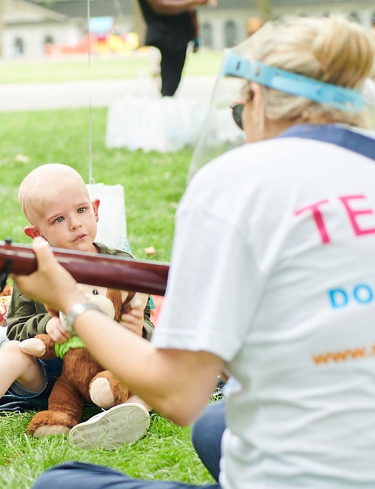
About Spread a Smile
Spread a Smile provides critically ill children in NHS hospitals and hospices with access to enhanced play and entertainment during an unimaginably challenging time.
Working closely with our 33 NHS hospital and hospice partners, our team of entertainers - magicians, singers, fairies, artists, musicians and therapy dogs - make regular in-person and virtual visits to hospital bedsides, returning the joy and positivity of childhood and bringing distraction from the pain and anxiety of treatment.
Alongside our visit programme, our resident artists help to make the hospital environment more child-friendly and we deliver a programme of family-focused events, enabling families to spend precious time together outside of hospital. Our work delivers a meaningful change to each child’s wellbeing, mental health and recovery process.
In 2023-24, we will deliver over 12,000 in-person bedside visits and over 2,000 virtual visits, in partnership with 27 hospitals and three hospice partners. We plan to increase the number of partners to 31 this year.
Please see a video about one family's story here.
“Being in isolation is like groundhog day, but Spread a Smile was like a breath of fresh air. Seeing Kaiya’s eyes and face light up when the team arrived was just brilliant”

Slide 3
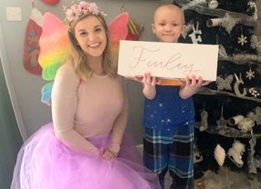
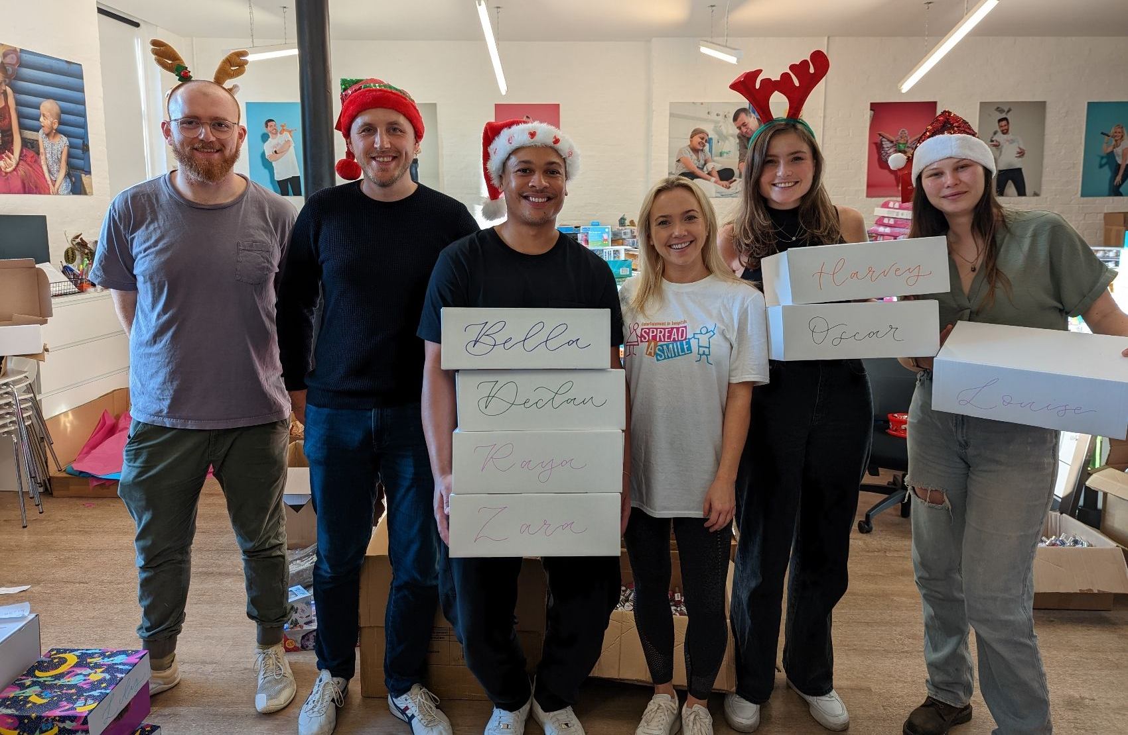
How PMA members can help spread smiles this Christmas:
This year, Spread a Smile celebrate our 10th Anniversary, and we are more determined than ever to bring the magic of Christmas to the thousands of children we support and their families.
In November, we hope to send 4,000 toys to our 33 NHS Partners across the country and 1,000 personalised hampers out to children in their homes. In January, we will welcome 400 children and their family members for a fun-filled day at our Winter Party. We would be so grateful if you could support in sourcing the below gifts (with an average of 100 required of each product):
Superheroes capes and dress-up
General dress-up
Teddies for teddy bear t-shirt decorating - 600
T-shirts for teddies to decorate - a600
Barbie products
Makeup and nail varnish
Baby gifts
Teenage gifts
Water bottles
Notepads and pens for gifts
Bath products
Slippers
PJs
T-shirts for decorating in children’s sizes
Mobile phone cases to decorate
Please contact Amanda Azouz on Amanda@spreadasmile.org if you can support this festive season.
Fairy wings x 200
Snowflake boppers
Reindeer boppers
Pirate hats
Fabric pens
Any sensory toys
LEGO sets

Slide 4
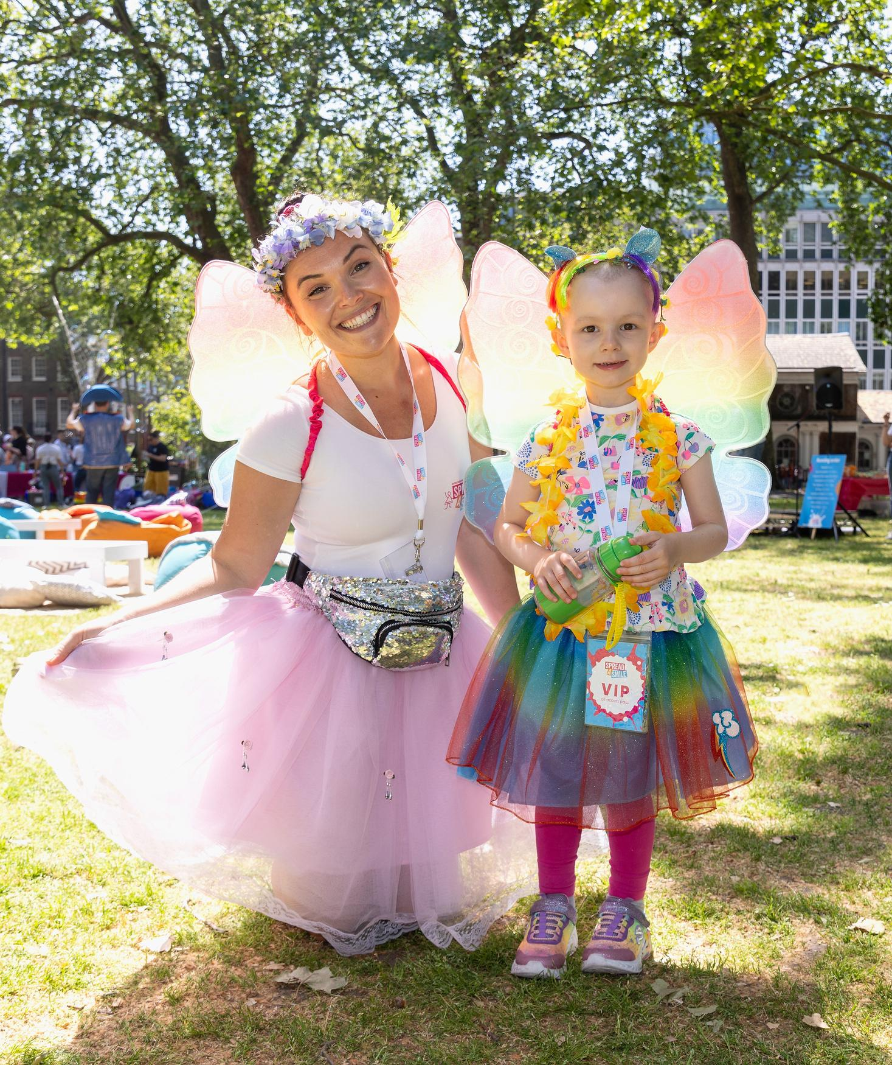
Thank you for choosing Spread a Smile as your Charity Partner for 2024!

