Slide 1

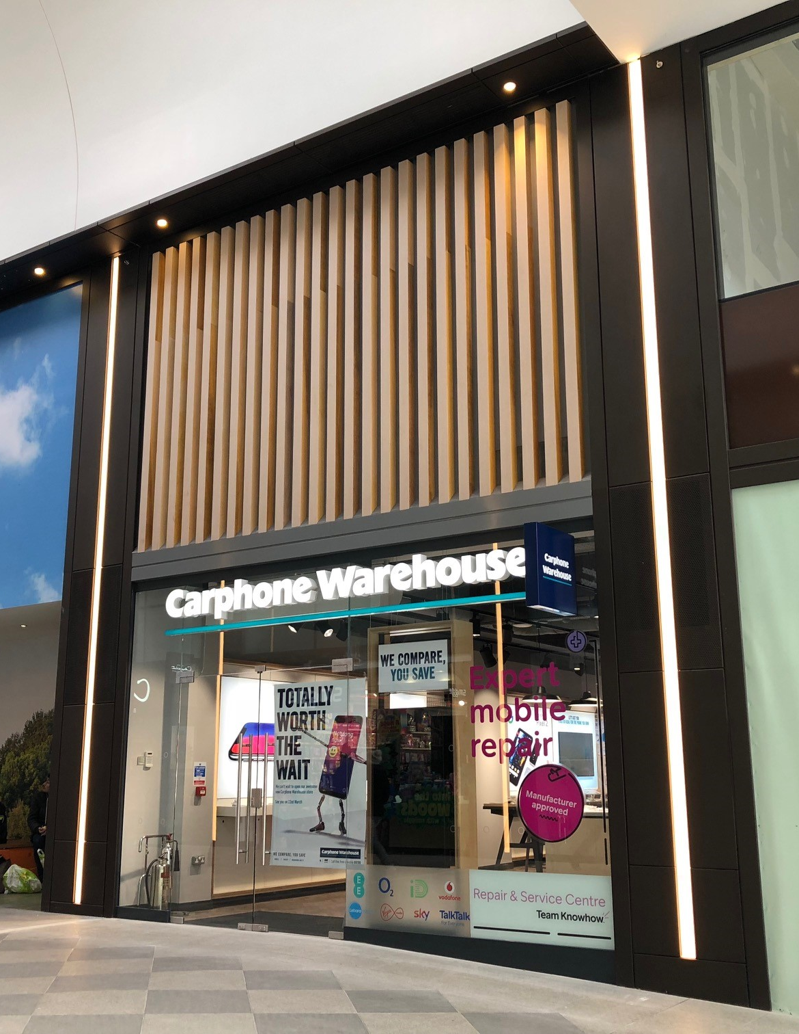



CS2 DILAPIDATIONS WEBINAR

Slide 2
introduction
Today’s presentation will discuss Dilapidations and how they affect businesses like yours within the retail sector. The webinar will be structured as follows:
Overview of Industry Data and Average Savings
Exploration of Jervis V Harris Claims
Break clauses and vacant possession
Schedules of Condition
Scottish Dilapidations
Opportunity for Q&A
ABOUT CS2
Our services include construction consultancy, building surveying, dilapidations, energy & sustainability and cost consultancy, covering a range of sectors.
Because we’re independent, clients can rely on complete discretion, integrity and impartiality. Our national teams work in partnership with clients to deliver tailored targeted long- term solutions.
Notes:
DJ

Slide 3
CS2 Data – dilaps stats
Claims and Settlements
Notes:
DJ

Slide 4
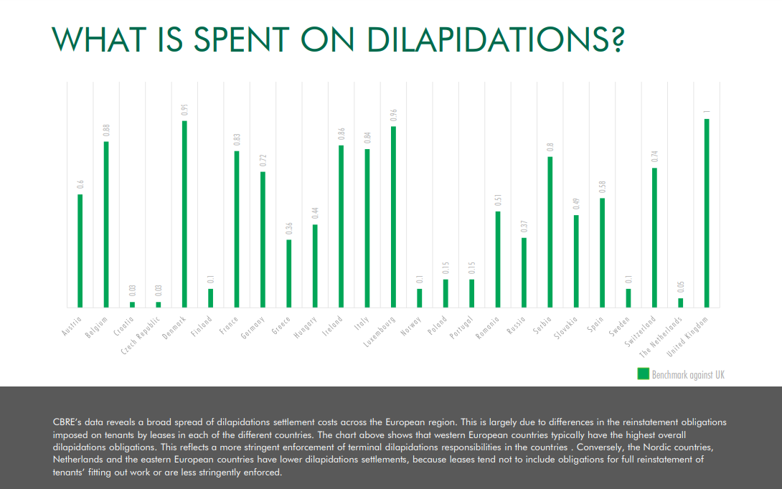
Notes:
DJ

Slide 5



Recent data suggests Dilaps market in U.K. is estimated at £4.7bn.
The BRC estimates that there are around 5,000 fewer stores since the start of the pandemic, meaning one in seven shops now lie empty.
The overall GB vacancy rate increased to 14.1 percent in Q1 of 2021, from 13.7 percent in Q4 of 2020.
This marks three consecutive years of increasing vacancy rates from Q1 2018.
Source: British Retail Consortium (2021).
Notes:
DJ

Slide 6



The most recent RICS Survey into the Dilapidations Market took place at The Dilapidations Forum with 45,000 respondents. This survey found:
Average final settlements for each type of property were as follows.
Offices – £12.18/square foot.
Industrial – £9.28/square foot.
Retail – £27.51/square foot.
Average reduction of:
50% where surveyors act for tenants,
This compares to CS2 who save tenant clients an average of 64.01%.
The dilapidations industry had an estimated total number of 35,000 cases per year in 2011.
Source: IBB Law on RICS Dilapidations Forum (2011). Data inflated using BCIS Cost Index.
Notes:
DJ

Slide 7
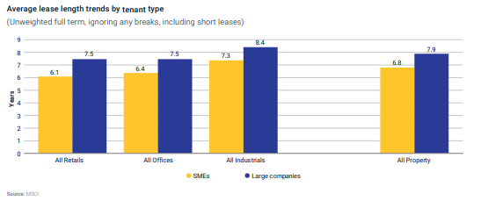
Overall, break clauses are now most common in the industrial (43.4%) and office sectors (43.8%), and notably lower in the retail sector at 29.2%.
Source: MSCI UK Lease Events Review (2019) - https://www.realestate.bnpparibas.co.uk/sites/default/files/2019-12/leaseeventsreport2019-final.pdf
Notes:
DJ

Slide 8
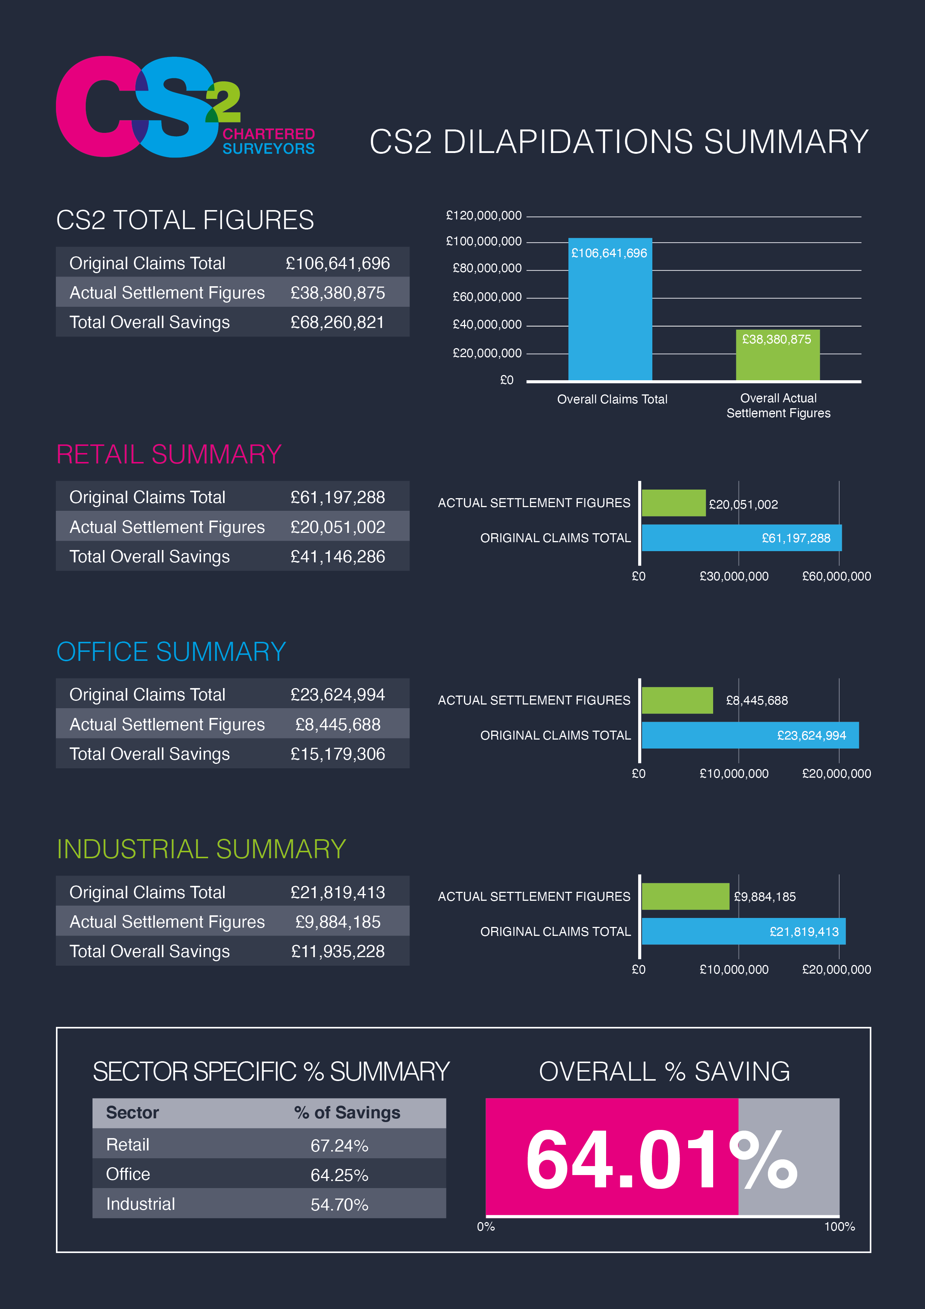
Notes:
DJ

Slide 9
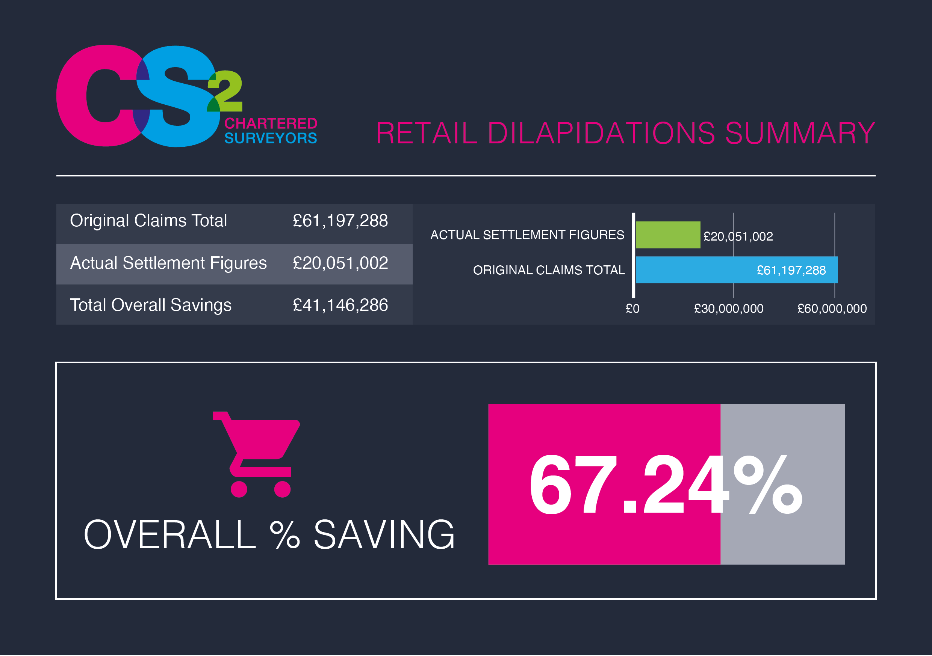
Notes:
DJ

Slide 10
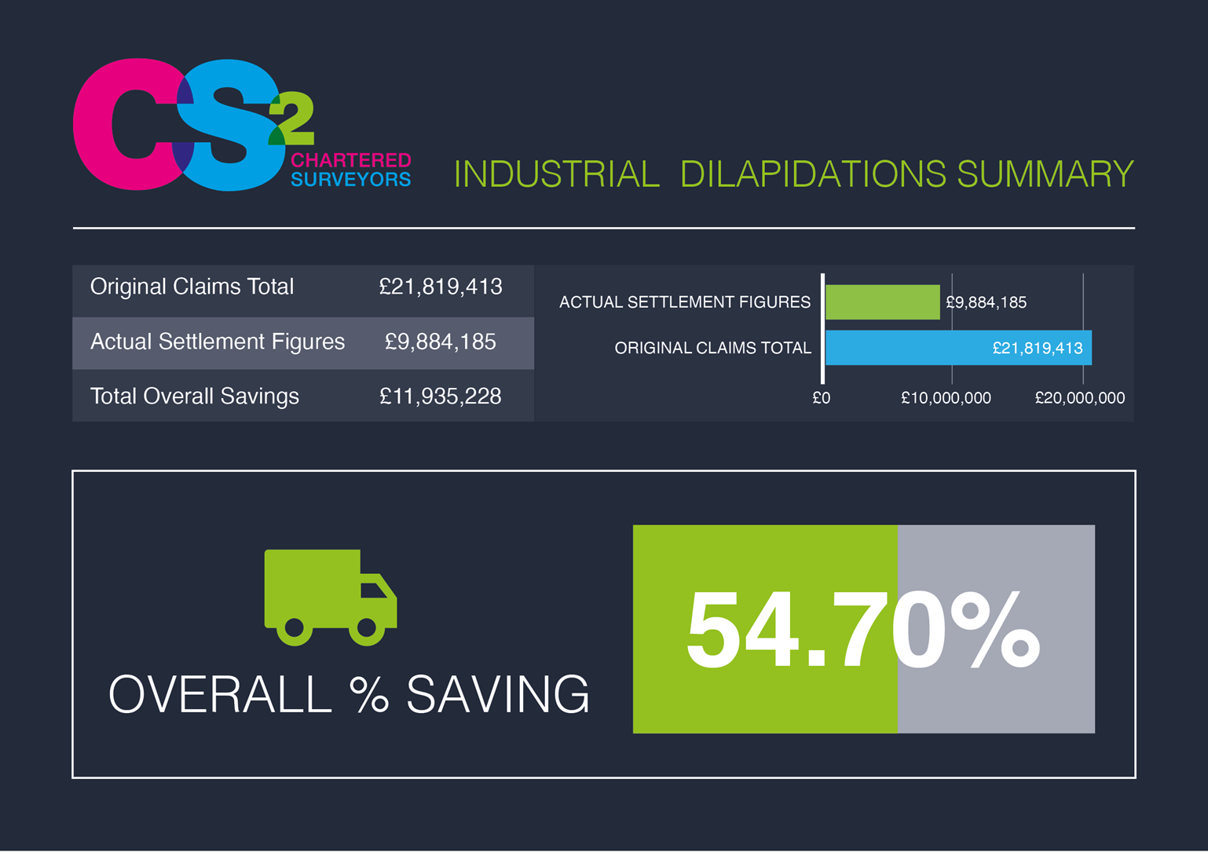
Notes:
DJ

Slide 11
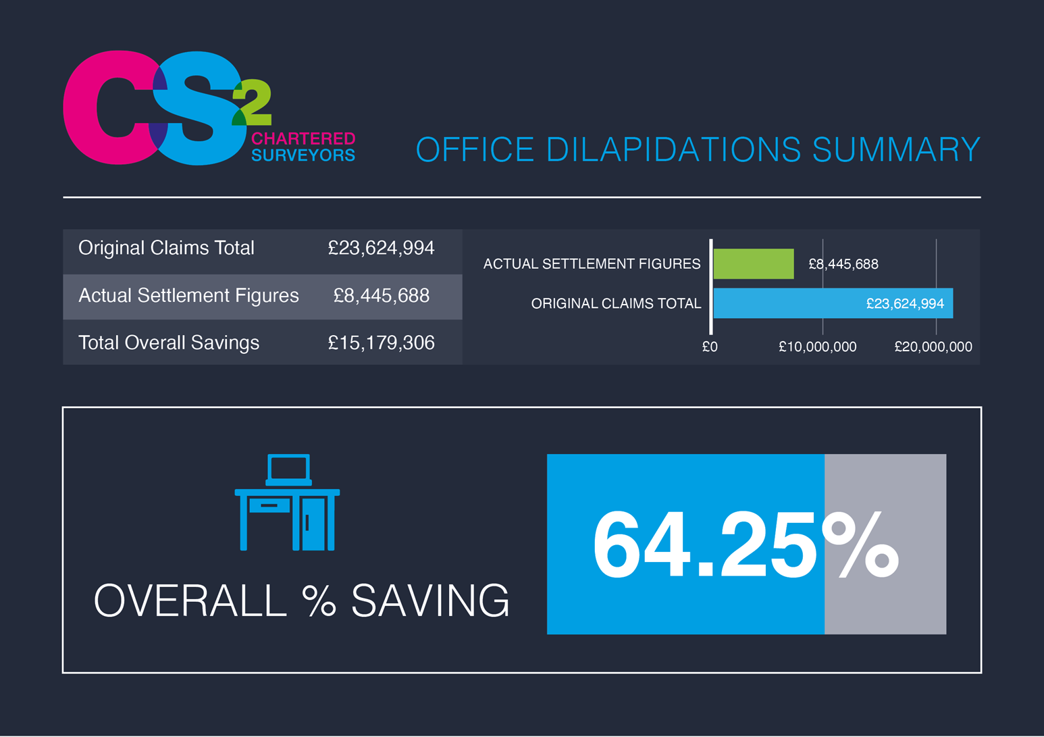
Notes:
DJ

Slide 12
CS2 Average settlement length from start to close of projects:
1 YEAR 7 MONTHS
Notes:
DJ

Slide 13
Jervis V Harris claims –
A LANDLORD alternative to lease end dilapidations
Notes:
Ben Radford

Slide 14
JERVIS V HARRIS CLAIMS (JVH) - OVERVIEW
WHAT ARE JVH CLAIMS?
A specific lease clause, which allows the landlord to formally require the tenant to undertake works during the term.
Based on historical legal case in 1995/1996 between ‘Jervis’ v ‘Harris’ which settled any uncertainty as to whether a landlord could recover the cost of repairing the property during the term after a notice to repair was issued.
Also known as a ‘Repairs Notice’ or ‘Interim Schedule of Dilapidations’.
Can only be enforced if the lease specifically contains a ‘Jervis v Harris’ clause (which most modern leases now do) and will only claim for breaches of repair & redecoration.
THREE STAGES WITHIN THE TENANTS COVENANTS
1
2
3
Landlord has right to inspect premises and issue a JVH schedule/repairs notice
Provides the tenant with a timeframe to complete or start the works identified
If tenant does not undertake the works, landlord has right to re-enter and undertake the works and recover the costs as a debt
Notes:
Ben Radford

Slide 15




Jervis v Harris CLAIMS (jvh)
HOW DO THEY DIFFER FROM REGULAR SCHEDULES?
Debt not damages
Issued during the lease term as opposed to end of lease, and therefore not subject to S(18) or Diminution Valuation cap
Limited scope for the tenant to defend works if they are reasonable in cost and were genuine breaches of covenant
Different format requirements – breaches instead of remedy or cost
Notes:
Ben Radford

Slide 16

Jervis v Harris CLAIMS (jvh)
EXAMPLE REPORT
REMEDY AND COST COLUMNS NOT INCLUDED
Notes:
Ben Radford

Slide 17
Jervis v Harris CLAIMS (jvh)
ADVANTAGES AND DISADVANTAGES
LANDLORDS
TENANTS
A way of ensuring the works are undertaken during term (either by tenant or landlord
Normally full recovery of costs for works expended
Avoids any end of lease (damages) s18 valuation or diminution cap.
Enables the property to be returned at lease end in good condition
Cost control over works if undertaken by tenant as opposed to landlord
Avoids substantial future disputes over dilapidations as the premises will now be in good repair if the works are undertaken by either tenant or landlord
Potentially helpful to have a fully repaired property if tenant is looking to extend or renew the lease going forward
ADVANTAGES
Has to forward fund the works which may be substantial
Tenant may prevent access due to breach of quiet enjoyment
Tenant undertakes only some works or also poorly
No scope to defend costs and works undertaken by way of s(18) or diminution valuation as recoverable as a debt & not damages
Disruptive to store trading & potentially a temporary store closure in worst case scenario
If undertaken towards the end of the lease the tenant has little benefit form the works being undertaken
DISADVANTAGES
Notes:
Ben Radford

Slide 18
Jervis v Harris CLAIMS (jvh)
WHAT TO DO IF YOU RECEIVE A Jvh claim?
WHAT ARE MY OPTIONS AS A TENANT?
1. Do not ignore it!
Initially try and meet with landlords surveyor to discuss claim and landlords objectives. Following this, you have three options -
2. Instruct a Building Surveyor specialising in Dilapidations
Undertake the works in full if legitimately required
Undertake the works in part if certain items are disputed
Do not undertake works
NOTE – you will run the risk of landlord trying to re-enter and undertake works with no cost control and obstruction to tenants operations
3. Check with solicitor that it was correctly served
1
2
3
Notes:
Ben Radford

Slide 19
Break clauses and vacant possession
Notes:
Ben Radford

Slide 20
BREAK CLAUSES & DILAPIDATIONS
Time/ £££ if not complied with
Legal Advice
Condition (Not dilapidations related) | Dilapidations related
1. Notice is served | 1. Vacant possession
2. Payment of Rents | 2. Material compliance
3. Penalty payment | 3. Absolute compliance
Notes:
Kate Martin

Slide 21
VACANT POSSESSION
Landlord is able to enjoy exclusive possession, occupation and control of the premises
Removal of all tenants chattels/fittings
  Riverside Park Limited v NHS Property Services Limited (2016)
  Capitol Park Leeds PLC v Global Radio Services Limited (2020)
What is the difference between Fixtures & Chattels?
- The greater the physical connection or annexation the more likely to be a fixture
- The easier it is to remove the more likely it’s a chattel
Notes:
Kate Martin

Slide 22
MATERIAL COMPLIANCE
Fitzroy House Epworth Street (No1) v The Financial Times (2005)
  FT spent over £1m on dilapidations works
  FT surveyor made reasonable efforts to meet LL surveyor to agree works
  Specification of works was sent to LL
  LL claimed break failed because approx. £40,000 of disrepair still existed
  Court rules ‘not every defect had to put into repair’
  Damage to reversion remains nil
Notes:
Kate Martin

Slide 23
ABSOLUTE COMPLIANCE
Strict compliance
Almost impossible to comply with
Client must be made aware of risk
Becoming less common
Notes:
Kate Martin

Slide 24
SUMMARY OF BREAK CLAUSES
Be wary of complexities of break clauses
Time is key. Ideally 12-24 months
Always approach landlord early to try to agree settlement
Failing a break can cost ££££
Obtain Professional Advice
Notes:
Kate Martin

Slide 25
SCHEDULES OF CONDITION
Important to mitigate liability BUT the wording in the lease is critical!!
Decorations are not always limited by the SoC – it all comes down to the wording of the specific clauses
Important to recognize it offers protection at lease end but not during. If you have a leaking roof and its in your demise you will still need to fix it to prevent ongoing water ingress.
Quality of photographs on schedules is often a problem which can impede on its value. An electronic copy of the original document should always be saved and stored on file.
A Schedule of Condition should always be considered when entering a new lease.
Notes:
Kate Martin

Slide 26
Dilapidations in scotland
Notes:
Hi I’m Simon Hottinger, Associate Director in the CS2 Edinburgh office.
I’m going to cover the differences between dilapidations in Scotland and England.

Slide 27
SCOTS LAW
Scotland has a different legal system. There is different legislation and case law applicable to dilapidations claims.
Different Legal Language and terminology.
Scotland has its own RICS Guidance note. DILAPIDATIONS IN SCOTLAND, 2ND EDITION.
Dilapidations pre-action protocol does not apply.
  No requirement for quantified demands, surveyor endorsements.
Notes:
Scots Law
When dealing with dilapidations in Scotland, its key note that there is a different legal system. Which is why we would always recommended you appoint surveyors and advisors with experience in Scotland.
There are a few key differences in Scots Law to be aware of.
One of the first things you might notice when discussing a Lease in Scotland is that there is different Legal Language.
Mostly these terms are intuitive, though not always.
If you have been involved in a Lease agreement up here you will be aware of the use of the term Conclusion of Missives, rather than Exchange of Contracts.
Tacit Relocation, is another term to be aware of. This is essentially holding over on a lease.
It’s an important point to note, and I’m sure your legal teams will be advising you, that a Lease in Scotland will not automatically expire at the Lease expiry date (ISH). Tacit Relocation occurs if neither the Landlord or Tenant serves a Termination Notice within the required period Prior to expiry of the lease.
With Tacit Relocation, if the Term of the Lease was greater than a year, then Lease will automatically continue for another year, on the same terms and conditions as the original lease.
Due to the differences in legal system, Scotland has its own RICS Guidance note. DILAPIDATIONS IN SCOTLAND, 2ND EDITION.
In principle dilapidations in Scotland, is very similar to England. The Schedule of Dilapidation’s you receive has the familiar format, identifying a Breach of lease and the remedial work required (remedy) and cost.
As the Pre-action Protocol is not applicable, there is no requirement for a Quantified Demand or an endorsed Schedule or Response.
Negotiation of the claim is handled in much the same manner. Though it is crucial you representatives are aware of differences in leases.

Slide 28
COMMON LAW REPAIR
COMMON LAW
Landlord warrants that the Leased Premises are reasonably fit for purpose at the outset of the lease.
For the duration of the Lease the Landlord has a continuing duty to keep the Premises in a wind, watertight and tenantable condition (subject to being notified of disrepair).
LIABILITY FOR REPAIR PASSED TO TENANT THROUGH EXPRESS LEASE OBLIGATIONS
The tenant accepts the premises as being in good and substantial condition and repair and in tenantable condition and in all respects fit for the purpose for which they are let.
The tenant is obliged to keep the premises in good and substantial repair and in tenantable condition at all times during the currency of the lease.
…irrespective of the cause of the damage necessitating such repair…
Notes:
Scots Law sets a different standard for repair in a commercial Lease. Under common law in Scotland the default position is that the Landlord warrants that the Leased Premises are reasonably fit for purpose at the outset of the lease.
Then, for the duration of the Lease the Landlord has a continuing duty to keep the Premises in a wind, watertight and tenant-able condition (subject to being notified of disrepair).
Unfortunately, Scotland is not a eutopia for Tenant’s.
If a Lease clause is un-am-big-uous and can be clearly interpreted, then the obligations can generally be taken as read. So essentially if you say you are going to do something the expectation is that you will.
The common law standard of repair is almost universally amended by express Lease provisions. There will almost always be clauses along the lines of those shown on the slide to do just this.
The final point on the slide in regards to repair states – irrespective of the cause of the damage necessitating such a repair. This related to whether a repair is Ordinary or Extraordinary.
An ordinary repair is more akin to the Landlord’s Common Law repairing obligation – tenantable and watertight.
Extraordinary Repairs are more substantial- such as extensive replacement or renewal required as a result of a significant defect or latent or inherent defects
Without a clause akin to this, the Tenant's liability for repair is much more limited.

Slide 29
ALTERNATIVE MEASURE OF LOSS
STATUTE
Section 18 Landlord and Tenant Act 1927 - not applicable.
No equivalent statutory provision in place.
ALTERNATIVE MEASURE OF LOSS
True measure of loss may not be cost of works
Alternative measure of loss may be applicable –Diminution in Value
Referred to in the RICS Guidance Note: Dilapidations in Scotland (2nd edition)
Case law
Notes:
In England a Tenant might be able to use the defence of the statutory cap on damaged provided by Section 18. Again, this does not apply in Scotland.
There is a common misconception that because Section 18 is not applicable in Scotland that Dim-in-ution Valuations cannot be used as a defense.
In fact, there is a precedence in Scots Case Law (Duke of Portland v Woods Trustees) that the true measure of loss – may not be the cost of works. This allows the use of alternative measures of loss through Dim-in-ution Valuations.
It is however on the tenant to prove that the alternative measure of loss is applicable. The precedence for this was established in the Prudential Assurance v James Grant [1982] - if the tenant could prove that the true loss suffered by the landlord was materially less than the cost of the works, it was open to the tenant to prove this
Surveyors acting for Landlords will often firmly argue that Dim-iin-ution values are not applicable up here. This is not the case and it is clearly referred to in the RICS guidance note.
If we feel these are to your benefit when defending a claim we will recommend them
Case Law
Duke of Portland v Woods Trustees [1926] - the true measure of loss may not be the cost of works
Prudential Assurance v James Grant [1982] - if the tenant could prove that the true loss suffered by the landlord was materially less than the cost of the works, it was open to the tenant to prove this
Mapeley v City of Edinburgh [2015] – Outer House – only cost of works that have been or are to be carried out – commercial common sense – "more akin to common law remedy"
Grove v Cape – not necessarily cost of works, may be a sum calculated in "a totally different manner"
Moor Row – Diminution in value might have been another measure of loss

Slide 30
PAYMENT CLAUSE
An express Lease Clause obligating the Tenant to PAY the landlord cost of the dilapidations claim. Irrespective of whether the works have been (or will be) undertaken.
Wording of clause essential.
Alternative measure of loss not necessarily applicable.
Tenant can still defend claim on basis of Lease obligations, quantum and value of works etc.
Notes:
There is another lease clause we look out for when reviewing a claim. This one comes with a word of warning. The Payment Clause.
What is a payment clause? It is an express Lease Clause obligating the Tenant to PAY the landlord cost of the dilapidations claim. Irrespective of whether the works have or will be undertaken. Payyment obligations oblige the tenant to pay a sum of money for dilapidations. They effectively change the landlord’s damages claim into a payment obligation, should the tenant fail to carry out its repairing obligations.
This has been tested through case law
Remembering that - if a Lease clause is unambiguous and can be clearly interpreted, then the obligations can generally be taken as read. The wording is essential.
Grove v Cape
…. to pay to the landlords the total value of the Schedule of Dilapidations prepared by the landlords in respect of the tenants’ obligations .…
The finding of Grove v Cape was that the use of the term Value put ambiguity into the intention of the clause. The value of the Schedule of Dilapidations could be interpreted as the value of the Landlords Loss and not simply the cost of works. A clause akin to this would mean that an alternative measure argument could still be applicable. Not a valid payment clause.
@SIPP
…. if the Landlord shall so desire at the expiry or sooner termination of the foregoing Lease they may call upon the Tenant, by notice in writing (in which event the Tenant shall be bound), to pay to the Landlord at the determination date (with interest thereon as provided in Clause (One) (b) hereof), a sum equal to the amount required to put the leased subjects into good and substantial repair and in good decorative condition in accordance with the obligations and conditions on the part of the Tenant herein contained in lieu of requiring the Tenant himself to carry out the work ….
@SIPP The original finding was in accordance with Grove v Cape. However following appeal this was reversed and the payment clause was found to hold. This is as the clause expressly related to the cost of works. If the clause state cost or sum equal to the works Likely to be a valid payment clause.
So, dependent on the wording, payment clauses can be enforceable and put an obligation on the Tenant to pay for the cost of works and not the value of the landlord’s actual loss. An alternative measure of loss is not applicable if there is a valid payment clause.
This does not mean there is no defense. A demand for payment under a payment clause will be issued with a Schedule of Dilapidations and an invoice. In essence this dilapidation will be negotiated as any other. So do not pay the invoice until you have sought advice from your solicitors and surveyors.

Slide 31
LOSS OF RENT CLAUSE
In addition to the Dilapidations claim for the cost of works, Landlord’s may also claim for the Loss of rent relating to the duration it takes to complete the dilapidations works.
WITHOUT LOSS OF RENT CLAUSE
Higher burden of proof on Landlord to demonstrate loss.
WITH LOSS OF RENT CLAUSE
Makes a Loss of Rent claim a contractual payment under the Lease.
Usually requires the Landlord to undertake the works.
Notes:
A further important common express lease clause is the Loss of rent clause.
A Loss of rent clause – is essentially a payment clause for the rent and often service charge for the period which it would reasonably take to completion the dilapidations works.
theTenant shall pay to the Landlord on demand as a liquidate debt a sum equal to Yearly Rent and Service Charge at the rate payable by the Tenant immediately before the end or sooner determination of this Lease for the period which it would reasonably take to bring the Premises to the state and condition in which they ought to have been if the Tenant had performed its obligations under this Lease
::
Loss of rent clauses are more likely to be upheld in Scotland. These again change the claim from that of damages damaged into a payment obligation under the lease.
If in the lease it strengthens the Landlords position when claiming for loss of rent, however the clause will usually (but not always) include a requirement that the landlord has to undertake the works before being able to claim.
It could also explain the trend in Scotland for Landlord’s to undertake the works, perhaps with them being more confident that they can recoup their loss.
It is worth being aware of these clauses prior to signing the lease and can be an important consideration in the strategy you adopt to defend the claim.

Slide 32
REPAIRS NOTICE
Claims during the lease term are very similar to those in England, though can be more readily enforceable in Scotland.
IF YOU RECEIVE A REPAIRS NOTICE
Do not ignore the Repairs Notice.
Act and appoint surveyors and solicitors to develop a strategy and defend the claim.
IF YOU DO NOT ACT THE FOLLOWING OPTIONS ARE AVAILABLE TO LANDLORD
Enter premises, undertake the works and reclaim as a debt – subject to lease clauses and notice periods.
Apply to the courts for
  Court order for value of works (would be required to subsequently undertake the works).
  Court order for tenant to undertake the works.
Notes:
Repairs notices/ interim dilapidations.
We’ve seen a number of these served over the last year, With Landlords perhaps concerned that they may not recoup sufficient funds in terminal claims to repair premises at lease expiry.
These again are very similar to in England, however they are more readily enforceable through the courts.
If you received a repairs notice do not ignore it.
These are often time critical as the Landlord may have a right under the lease to enter and undertake the works after expiry of a notice period.
The Landlord also has the options of raising court actions,
for either the value of the works,
or obtaining enforceable court orders dictating that the tenant must undertake the works.
Due to the risk and cost involved it is best to appoint legal and surveying representative early and to adopt a strategy to actively engage with the landlord

Slide 33
SUMMARY
Dilapidations in Scotland is similar but not the same as in England.
Scots Law applies.
  Use appropriate legal and surveying advice.
Diminution in value can be used as a defence (sometimes).
Leases in Scotland tend to favour Landlords. If you sign up to do something, and it can be clearly interpreted, then be prepared to do it.
  Payment Clauses.
  Loss of Rent.
Don’t ignore repairs notices.
Notes:
In summary
Scots Law applies.
Use appropriate legal and surveying advice.
Dim-in-ution in value can be used as a defence (sometimes).
Leases in Scotland tend to favour Landlords. If you sign up to do something, and it can be clearly interpreted, then be prepared to do it.
Payment Clauses.
Loss of Rent.
Don’t ignore repairs notices.
Overall, Dilapidations in Scotland is very similar to England. However, there a few potential pitfalls that we as surveyors need to be aware of.

Slide 34

OVERALL summary
We hope this webinar has enhanced your knowledge of Dilapidations and their position within the retail sector.
Overview of Industry Data and Average Savings
Exploration of Jervis V Harris Claims
Break clauses and vacant possession
Scottish Dilapidations
katemartin@cs2.co.uk
benradford@cs2.co.uk
davidjay@cs2.co.uk
simonhottinger@cs2.co.uk
THANK YOU FOR JOINING US. FLOOR NOW OPEN FOR Q&A…
Notes:
DJ

