Slide 1
2027
Annual Enrollment
October 26 – November 6

Slide 2
Today’s Topics
1
What’s New for 2027
Plan updates, new partners and higher HSA limits
KEY DATES
Oct 26
Enrollment opens; benefit sites go live
2
Save on Health Care
Programs and perks that support you and your family
Nov 4
Health & Wellness Fair
Nov 6
Enrollment closes
3
How to Enroll
Key dates, websites and your enrollment checklist
Jan 1
2027 benefits take effect
Notes:
Hello, and welcome! Thank you for taking time to join us today for an overview of your Annual Benefits Enrollment and changes for 2027! Our goal over the next several minutes is for you to learn more about your benefits and to be able to evaluate how they are a key component of your overall BMC total rewards.
[Click] This session is being recorded, and within a few days of the webinar, it will be posted on mybmcbenefits.com under Your Resources/Benefits Media Center section for future reference.
The chat is open for questions and answers during and after this presentation. We ask that you do not include any of your personal information during the Q&A. If there are questions we are unable to answer due to time or protected health information, we can reach out to you directly after today’s webinar.
The key takeaways from this webinar are:
First … What’s new for 2027
Second … A quick overview of cost savings tools you can use to save on health care
Third … When and how to enroll in the benefits that fit the needs of you and your family
A few dates to keep in mind: Annual Enrollment is through November 6th —mybmcbenefits.com and mybmcrewards.com are now open with 2027 information. Our Health & Wellness Fair is Wednesday, November 4th and your 2027 benefits take effect January 1.
Let’s begin.

Slide 3






What’s New for 2027
Redesigned website
More pharmacy choice
Caregiver support
mybmcbenefits.com has a fresh new look
Fill maintenance meds almost anywhere
Cariloop joins; backup care by the hour
Automated Roth
MyEvive benefits hub
Higher HSA limits
Set it once; conversions happen automatically
One link to your benefits and resources
Save more, tax-free, in 2027
Notes:
Let’s start with what’s new for 2027. There are six updates we’ll walk through:
• A redesigned mybmcbenefits.com website
• More flexibility in where you fill maintenance prescriptions
• Cariloop, our new caregiver support partner
• A new automated Roth in-plan conversion feature in the 401(k)
• The MyEvive benefits hub, coming in 2027
• And higher IRS contribution limits for your Health Savings Account
We’ll take each one in turn.

Slide 4
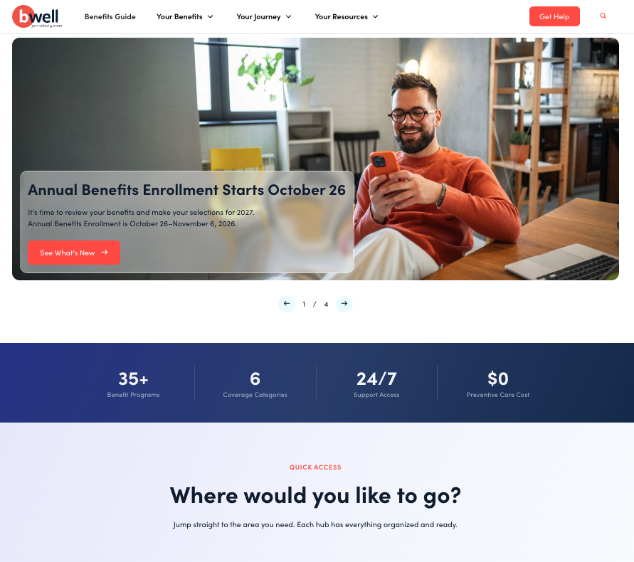




Introducing the New mybmcbenefits.com
Redesigned and live October 26
Your one-stop shop
Clear, easy-to-understand info on all of your BMC benefits
Annual Enrollment feature
What’s changing and how to get ready before you enroll
Interactive Benefits Guide
Plan details and resources at your fingertips
Presentations & contacts
Watch this session again and find who to call
Notes:
First up — mybmcbenefits.com was been completely redesigned and you can check it out now!
[Click] It’s still your one-stop shop for everything related to your BMC benefits, now with a cleaner look and easier navigation so you can find what you need faster.
[Click] During enrollment, look for the Annual Enrollment feature. It walks you through what’s changing for 2027 and helps you prepare before you log in to enroll.
[Click] The Interactive Benefits Guide puts plan details, costs and resources at your fingertips.
[Click] And it’s where you’ll find this presentation and recording, plus contact information for all of our benefit partners.
We encourage you to bookmark mybmcbenefits.com and take a few minutes to explore it before you enroll.

Slide 5




Prescription Drugs: More Pharmacy Choice
What stays the same: Prime Therapeutics continues to administer your prescription drug benefits using the Prime Broad Balanced formulary.
New for 2027: choose where you fill maintenance medications
Any participating pharmacy
Mail order
Except CVS
Pick the pharmacy that’s most convenient for you
Have maintenance medications delivered to your door
CVS pharmacies are not included for maintenance medications
Notes:
Next, an update to your prescription drug benefits.
What stays the same: Prime Therapeutics will continue to administer prescription drug benefits using the Prime Broad Balanced formulary.
What’s new: beginning in 2027, you’ll have more flexibility when filling maintenance medications — those that you take regularly for ongoing conditions.
[Click] You can use any participating pharmacy…
[Click] …or choose mail order.
[Click] The one exception is CVS — CVS pharmacies are not included for maintenance medications.
The choice is yours! Pick whatever is most convenient for you and your family.

Slide 6






Caregiver Support: Welcome, Cariloop
Bright Horizons
Cariloop
BACKUP CARE
10 days →
Find Care: search for vetted care providers or ask for help finding personalized options.
60 hours and No COPAYS
per year
Childcare
Senior care
Pet care
Household services
Use it in increments as small as one hour
…and more
Notes:
For 2027, Cariloop will replace Bright Horizons as BMC’s caregiver support partner.
[Click] Through Cariloop’s Find Care feature, you can search for vetted care providers yourself — or request help and let Cariloop find personalized options for you. That covers childcare, senior care, pet care, household services and more.
[Click] We’re also changing how backup care works. Instead of 10 days per year, you’ll have 60 hours of backup care per year. And you can use it in increments as small as one hour — so if you only need a few hours of care while your regular provider is out, you won’t use up a full day. That gives you much more flexibility when care is needed. Plus, no copays, which offers a greater benefit to you.
You’ll find more details about Cariloop on mybmcbenefits.com.

Slide 7



New: Automated Roth In-Plan Conversion
Eligible funds in your after-tax 401(k) account can convert to your plan’s Roth account automatically.
1
2
3
Call Fidelity
Review your options
Set it and forget it
800-603-4015
A Fidelity representative walks you through the options and potential tax considerations
Future conversions happen automatically, with no need to call each time
Why it matters: converting promptly may help limit taxable earnings that build up before conversion. Tax situations vary, so consider talking with a tax advisor before you enroll.
Notes:
Here’s a new feature in the BMC 401(k) plan. With this new provision, you can elect to have eligible funds you deposit into your after-tax 401(k) account automatically converted to your plan’s Roth account.
Previously, if you wanted to convert after-tax money to Roth, you had to contact Fidelity each time. With this new feature, you set it up once, and future conversions happen automatically.
Setting it up takes three steps:
[Click] First, call Fidelity at 800-603-4015.
[Click] Second, a Fidelity representative will review the available options with you, along with any potential tax considerations.
[Click] Third — that’s it. Once the feature is established, future conversions happen automatically until you decide to stop.
[Click] Why does this matter? Converting funds promptly may help limit the taxable earnings that accumulate before the conversion. Because everyone’s tax situation is different, we recommend talking with a tax advisor before enrolling.

Slide 8



Coming Soon: MyEvive Benefits Hub
One link. All your benefits.
Beginning in 2027, BCBSTX members will have an enhanced MyEvive hub: a single online destination for BMC benefits information and resources.
Health benefits
Alight
MyEvive
one link
2027
Access health benefits, Alight and work/life resources through one convenient link
Later in 2027
Single sign-on arrives, so you’ll have fewer separate logins
Work/life resources
Notes:
Coming soon: the MyEvive benefits hub.
[Click] Beginning in 2027, Blue Cross Blue Shield members will have access to an enhanced MyEvive benefits hub — a single online destination for BMC benefits information and resources. Instead of keeping track of multiple websites, you’ll be able to reach your health benefits, Alight and work/life resources all through one convenient link.
[Click] And later in 2027, single sign-on functionality will be introduced, providing a more seamless experience with fewer separate logins.
We’ll share more details, including how to access MyEvive, as we get closer to launch.

Slide 9

HSA: Higher Contribution Limits for 2027
New IRS annual maximum contribution limits
$4,500
$9,000
+$1,000
Individual coverage
All other coverage levels
Catch-up contribution
Up $100 from 2026
Up $250 from 2026
If you are age 55 or over in 2027
Limits include BMC’s contribution plus yours
No change to BMC’s contributions to HSAs
Notes:
HSA contribution limits for 2027 are increasing.
[Click] Beginning January 1, 2027, you can contribute a total of $4,500 to your HSA if you have employee-only coverage — that’s a $100 increase —
[Click] and $9,000 for all other coverage levels, a $250 increase.
[Click] IRS rules for catch-up contributions aren’t changing in 2027. If you will be age 55 or better at any time next year, you can contribute an extra $1,000 to your HSA.
[Click] To help you save, BMC matches your contribution each pay period up to a limit, depending on whether you cover only yourself or also dependents. There’s no change to BMC’s HSA contributions for 2027. Find more information by visiting mybmcbenefits.com under the HSA plan in the benefits guide.
Please remember: the annual limits include what BMC contributes and what you contribute to your account, either through payroll or directly at Fidelity. Also, if your spouse has his or her own HSA, your combined contribution totals are subject to the family contribution limit. You must contribute to your HSA through payroll to receive BMC matching contributions.
If you decide to contribute to or change your HSA elections after enrollment ends, log in to mybmcrewards.com to make the change. Changes you request are effective on the first of the month after your submission.

Slide 10

2027 Medical Plan Rates
Your paycheck contributions, per pay period, before wellness discounts
 | HSA Plan | PPO Plan | Kaiser HMO
You | $53.99 | $181.39 | $135.07
You + Spouse | $203.02 | $470.07 | $386.39
You + Child(ren) | $141.71 | $353.23 | $266.38
You + Family | $276.06 | $686.70 | $563.82
~80%
paid by BMC
BMC covers about 80% of the annual cost of health coverage
Compare 2026 and 2027 rates at mybmcbenefits.com starting October 26
Notes:
Let’s review your paycheck contributions for medical coverage. This slide shows your portion of the 2027 costs for each medical plan option before wellness discounts. Your contributions are deducted from your check each pay period before taxes. You can also review the plan rates at mybmcbenefits.com by choosing the “Resources and Contacts” tile.
If you participated in the bWell program and chose to redeem your rewards for a medical premium discount, your paycheck contributions will be lower. You’ll see your contributions with discounts online at mybmcrewards.com when you enroll.
As you can see on the right, BMC covers about 80% of the annual cost of health coverage, and you cover the remainder.
Managing healthcare costs is a shared responsibility, and we appreciate your continued efforts to take care of your health and wellbeing and to use healthcare resources wisely and cost-effectively.

Slide 11



bWell: Earn Rewards for Your Well-Being
BMC’s 2026–2027 wellness program runs through August 31, 2027
+
Biometric Screening
Health Assessment
=
100 points
Redeem for $100 off premiums, or for gift cards
Start earning at mybmcwellness.com
Notes:
You’re invited to embark on the bWell Cosmic Voyage, BMC’s 2026–2027 wellness program. This program is designed to make your journey toward well-being even more engaging and rewarding. This year’s program runs through August 31, 2027, so please visit mybmcwellness.com to start earning points and wellness rewards.
[Click] Start earning points now by completing your Biometric Screening and Health Assessment.
[Click] By completing both, you earn 100 points — which you can redeem for $100 off your next year’s premiums or for gift cards.
And remember, mybmcbenefits.com is your one-stop shop for all benefits information, and it’s where this presentation will be saved for future reference.

Slide 12

Medicare, Social Security & Your HSA
Are you enrolled in any part of Medicare, or receiving Social Security benefits?
NO
You can contribute to your HSA
YES
You can’t contribute to an HSA
You can delay Medicare and Social Security while you’re covered by the BMC HSA Plan
You can still be covered by the BMC HSA Plan
You can still spend your HSA balance tax-free on qualified medical expenses
No penalty if you enroll in Medicare within 8 months of losing coverage or stopping work
Part A is automatic with Social Security and can’t be declined
Signed up for Part A only, with no Social Security yet? You can withdraw your Part A application with the Social Security Administration.
Notes:
Let’s shift to Medicare and how it interacts with an HSA. According to the IRS and the Centers for Medicare & Medicaid Services (CMS), once you enroll in any part of Medicare, you won’t be able to contribute to your HSA.
It really comes down to one question: are you enrolled in any part of Medicare, or receiving Social Security benefits?
[Click] If the answer is NO: you can open and contribute to the HSA, and postpone applying for Social Security and Medicare until you stop working. If you would like to continue making contributions to your HSA, you can delay both Part A and Part B until you (or your spouse) stop working or lose employer coverage. You will NOT pay a penalty for delaying Medicare, as long as you enroll within eight months of losing your coverage or stopping work (whichever happens first).
[Click] If the answer is YES: you can not open or contribute to the Health Savings Account. However, you can still enroll in the HSA Medical Plan regardless of Medicare eligibility, because it is considered a Qualified High-Deductible Health Plan. And you can always withdraw money from your HSA after you enroll in Medicare to help pay for medical expenses such as deductibles, premiums, copays, or coinsurance. If you use the account for qualified medical expenses, it continues to be tax-free.
Keep in mind that you cannot decline Medicare Part A if you are receiving Social Security benefits — applying for Social Security (including for disability) automatically entitles you to Part A. If you were enrolled in Medicare Part A — either automatically or otherwise — but would rather decline it to stay HSA-eligible, you should contact the Social Security Administration.
[Click] One tip: if you’re entitled to Medicare because you signed up for Part A at age 65 or later, but have not yet applied for Social Security retirement benefits, you can withdraw your application for Part A by contacting the Social Security Administration. There are no penalties, and you are free to reapply for Part A at a future date. (However, if any claims have been paid by Medicare Part A on your behalf, you would be required to pay those back.)

Slide 13


Medicare & HSAs: Two Common Scenarios
Your spouse is enrolled in Medicare
You’re not Medicare-eligible yet, but close
HSAs are individually owned, so you can still contribute even if your spouse is on Medicare.
Keep saving: contribute up to the IRS maximum + $1,000 catch-up.
Stop contributions the month before Medicare starts (typically the month you turn 65); HSA changes take effect the 1st of the next month.
Employee-only coverage: contribute up to $4,500 (yours + BMC’s), plus $1,000 if you’re 55+.
Delaying Social Security past 65? Medicare is retroactive up to 6 months, so stop HSA contributions up to 7 months before benefits begin.
Spouse on the BMC plan and Medicare: contribute up to the $9,000 family maximum, plus $1,000 if you’re 55+.
Declining Medicare for now? Enroll later when you lose employer coverage; it’s a Qualifying Event.
Notes:
Let’s look at two common scenarios.
[Click] First, your spouse is enrolled in Medicare. Being eligible to contribute to your HSA is determined by your status as the HSA owner, not the status of your spouse or tax dependents. HSAs are individually owned, so your spouse can be covered by Medicare without disqualifying you from contributing to your HSA.
• With employee-only coverage, you can contribute up to the single maximum annual contribution for 2027: $4,500, plus an additional $1,000 if you are age 55 or above.
• If your spouse is covered under the BMC HSA Plan and by Medicare, you can contribute up to the 2027 family maximum of $9,000, plus an additional $1,000 if you are age 55 or above.
Your spouse can also use funds in your HSA to cover qualified medical expenses.
[Click] Second, you’re not Medicare-eligible yet — but close.
• You can contribute up to the IRS annual maximum plus make a $1,000 catch-up contribution.
• The month Medicare becomes effective, you must stop contributing to your HSA. Since changes to your HSA are effective the first of the following month, you’ll need to stop your contributions the month prior to your anticipated Medicare start date — typically the month you turn 65.
• If you plan to delay your application for Social Security benefits past age 65, remember that Medicare coverage will be retroactive up to six months prior to the date you become eligible for Social Security. This means you need to stop your HSA contributions up to seven months prior to receiving your Social Security benefits.
• Whether you should delay enrollment in Medicare so you can continue contributing to your HSA depends on your circumstances. If you wish to decline Medicare, you can do so and enroll later when you lose your BMC medical coverage. This is considered a Qualifying Event.
And at the time of retirement, call your local Social Security office.

Slide 14

2027
Partners for
Good Health
Notes:
Now, moving on to Partners of Good Health

Slide 15






Save on Health Care (BCBS Plans)
Health Advocacy Solutions (HAS): your personal health advocate
Help with paperwork, claims, benefits questions and coordinating care. Call the number on the back of your BCBS ID card.
Digital health programs at no cost to you. Find the one that fits your need.
NW
Learn2Live
Omada
Teladoc Health
Hinge Health
Wondr Health
Stress, anxiety, sleep and more, with online CBT
Diabetes prevention and weight loss
Blood pressure and diabetes management
Back, joint and muscle pain, plus a new pelvic health program
Weight management and metabolic health
Notes:
On this slide, I’ll be describing the programs offered through Blue Cross Blue Shield, or BCBS.
Your BCBS enrollment includes access to their Health Advocacy Solutions (HAS for short) program. HAS provides personalized support to help you and your dependents navigate complex healthcare systems, and offers assistance with decoding paperwork, managing claims, understanding benefits, and coordinating care. The program features health advocates, who can be nurses or other specialists, connecting members with community resources for social needs and helping to resolve issues related to medical bills and pre-authorizations. To contact your health advocate, call the number on the back of your BCBS ID card.
[Click] Along with HAS, BMC offers digital health programs that help you and BMC control healthcare costs and save you time. They help you identify health risks and unhealthy behaviors before they result in costly medical procedures.
Learn2Live offers customized, user-paced online programs based on cognitive behavioral therapy. It’s confidential and accessible anywhere. Help for stress, anxiety, depression, sleep problems, and substance use. To access Learn2Live, log in to bcbstx.com and click on Wellness.
For eligible employees at risk for Type 2 diabetes and heart disease, Omada is a digital lifestyle program that inspires healthy habits you can live with for the long term. This program is also open to adult family members. If eligible, you’ll be invited to participate in the Omada Program.
The Teladoc Health program makes it easier to live with high blood pressure and diabetes. When you enroll, a Welcome Kit will be mailed to your home. You’ll receive a meter, a charger, testing strips, and a blood pressure monitor at no cost. If eligible, you’ll be invited to participate in the hypertension and/or diabetes program.
Hinge Health is a coach-led digital program for chronic back, knee, hip, neck or shoulder pain using guided exercise therapy — helping conquer back or joint pain without drugs or surgery. This program is open to all, including dependents. Did you know 1 in 4 women have pelvic floor disorders? That’s why Hinge Health created a new Women’s Pelvic Health Program to help with this common yet overlooked condition. To participate, simply log in to bcbstx.com and click on Health, then Wellness.
And finally, Wondr Health is a clinically proven weight loss program to help you lose weight, sleep better, stress less, and so much more. Wondr Health teaches the behavioral science behind eating foods you love while still losing weight and improving your overall physical and mental wellbeing. There will be quarterly reminders sent throughout the year, but you may enroll at any time.

Slide 16


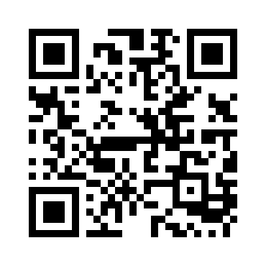
Magellan Employee Assistance Program (EAP)
Free and confidential. Nothing you share is passed on to BMC.
Virtual Therapy
Confidential virtual therapy through BetterHelp, with up to 6 pre-paid sessions per issue per year
Digital Emotional Wellbeing
Powered by NeuroFlow: Magellan’s award-winning digital cognitive behavioral therapy modules
DIGITAL CBT MODULES
ComfortAble
Chronic pain
FearFighter
Anxiety, panic and phobia
MoodCalmer
Depression
RESTORE
Insomnia
Get started
Scan the QR code or visit your member website
SHADE
Substance use disorder
ThinkHero
Anxiety, ages 6–12
ThinkWarrior
Anxiety, ages 13–17
Notes:
At some time during the course of your employment, you or a family member may experience a personal difficulty. Problems arising from illnesses, day care issues, loss of a loved one, relationship conflicts, or financial difficulties can affect your life at home and work. Through the Magellan Employee Assistance Program, or EAP, you and your immediate family members can receive counseling and referrals at no cost to you. Any help you receive is completely confidential and not shared with BMC.
[Click] Employees and their families have access to confidential virtual therapy provided by BetterHelp at no cost to you. You can benefit from up to six pre-paid counseling sessions per issue per year. Counseling is available for the entire family — individuals, couples, and teens.
Also available is Digital Emotional Wellbeing, powered by NeuroFlow.
[Click] Your family has access to enhanced versions of Magellan’s award-winning digital cognitive behavioral therapy modules, including ComfortAble® for chronic pain, FearFighter® for anxiety, panic, and phobia, MoodCalmer for depression, RESTORE for insomnia, SHADE for substance use disorder, ThinkHero for anxiety symptoms for children ages 6–12, and ThinkWarrior for anxiety symptoms for teens ages 13–17.
To get started, visit your member website or scan the QR code.

Slide 17



Work Perks
Extra support for life outside of work
NEW PARTNER
NEW PARTNER
Cariloop
Pendant Health
Formerly Arc Fertility
Milk Stork
IonTuition
Caregiver support: vetted childcare, senior care, pet care and household help, plus 60 hours of backup care a year
Family-building and fertility support, from preconception through menopause
Breast milk pumping and shipping support for working moms who travel, at no cost
Student loan management tools and college research help for your family
Learn more at mybmcbenefits.com under Work Perks
Notes:
As a reminder, we also offer several work perks — including two new partners for 2027.
[Click] Our new caregiver partner, Cariloop, provides caregiver support. Through Cariloop’s Find Care feature, you can search for vetted providers or request help finding personalized options for childcare, senior care, pet care, household services and more. Cariloop also provides your backup care benefit — 60 hours per year that you can use in increments as small as one hour when your regular care arrangements fall through.
[Click] Next, Pendant Health. Many of you know Arc Fertility, our family-building and fertility benefit partner. Arc Fertility was acquired by Pendant Health, so you’ll now see the Pendant Health name. Pendant supports family building, women’s health from preconception through menopause and men’s health. Visit mybmcbenefits.com for details on what your benefit covers and how to get started.
[Click] Moms who are getting back to work will be able to access Milk Stork at no cost while traveling on the job or on vacation. This benefit includes Milk Stork kits with breast milk storage bags, a refrigerated box for packing, and a tote if mothers choose to carry milk with them.
[Click] IonTuition can help you manage your student loans more efficiently, pay them off faster and cheaper, and live a debt-free life, as well as help research school programs for your children approaching college age.
Visit mybmcbenefits.com under the Work Perks section to learn more.

Slide 18
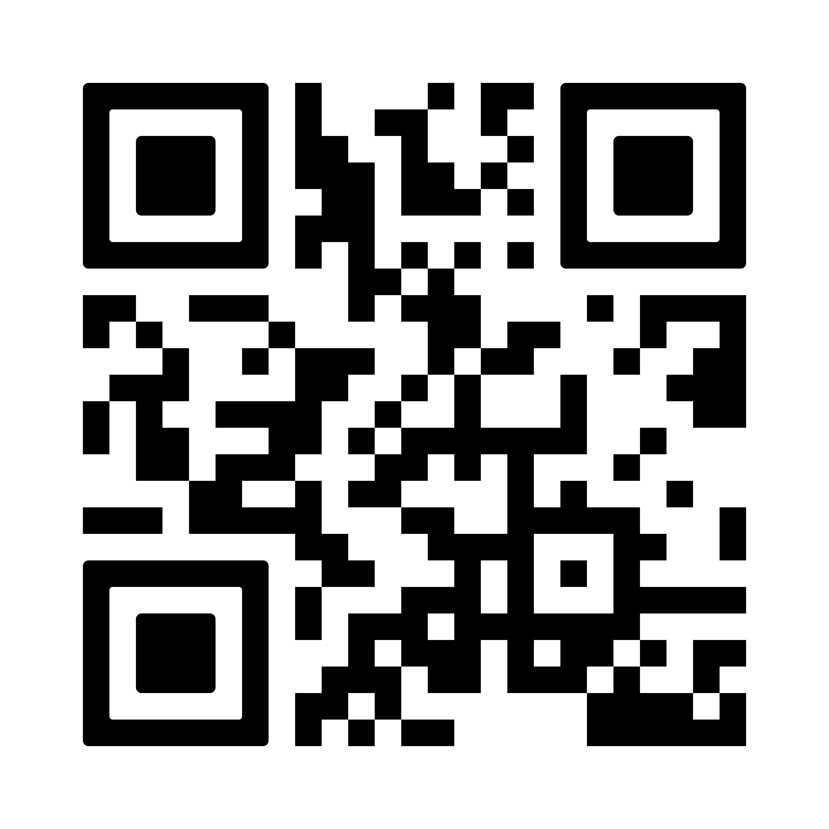

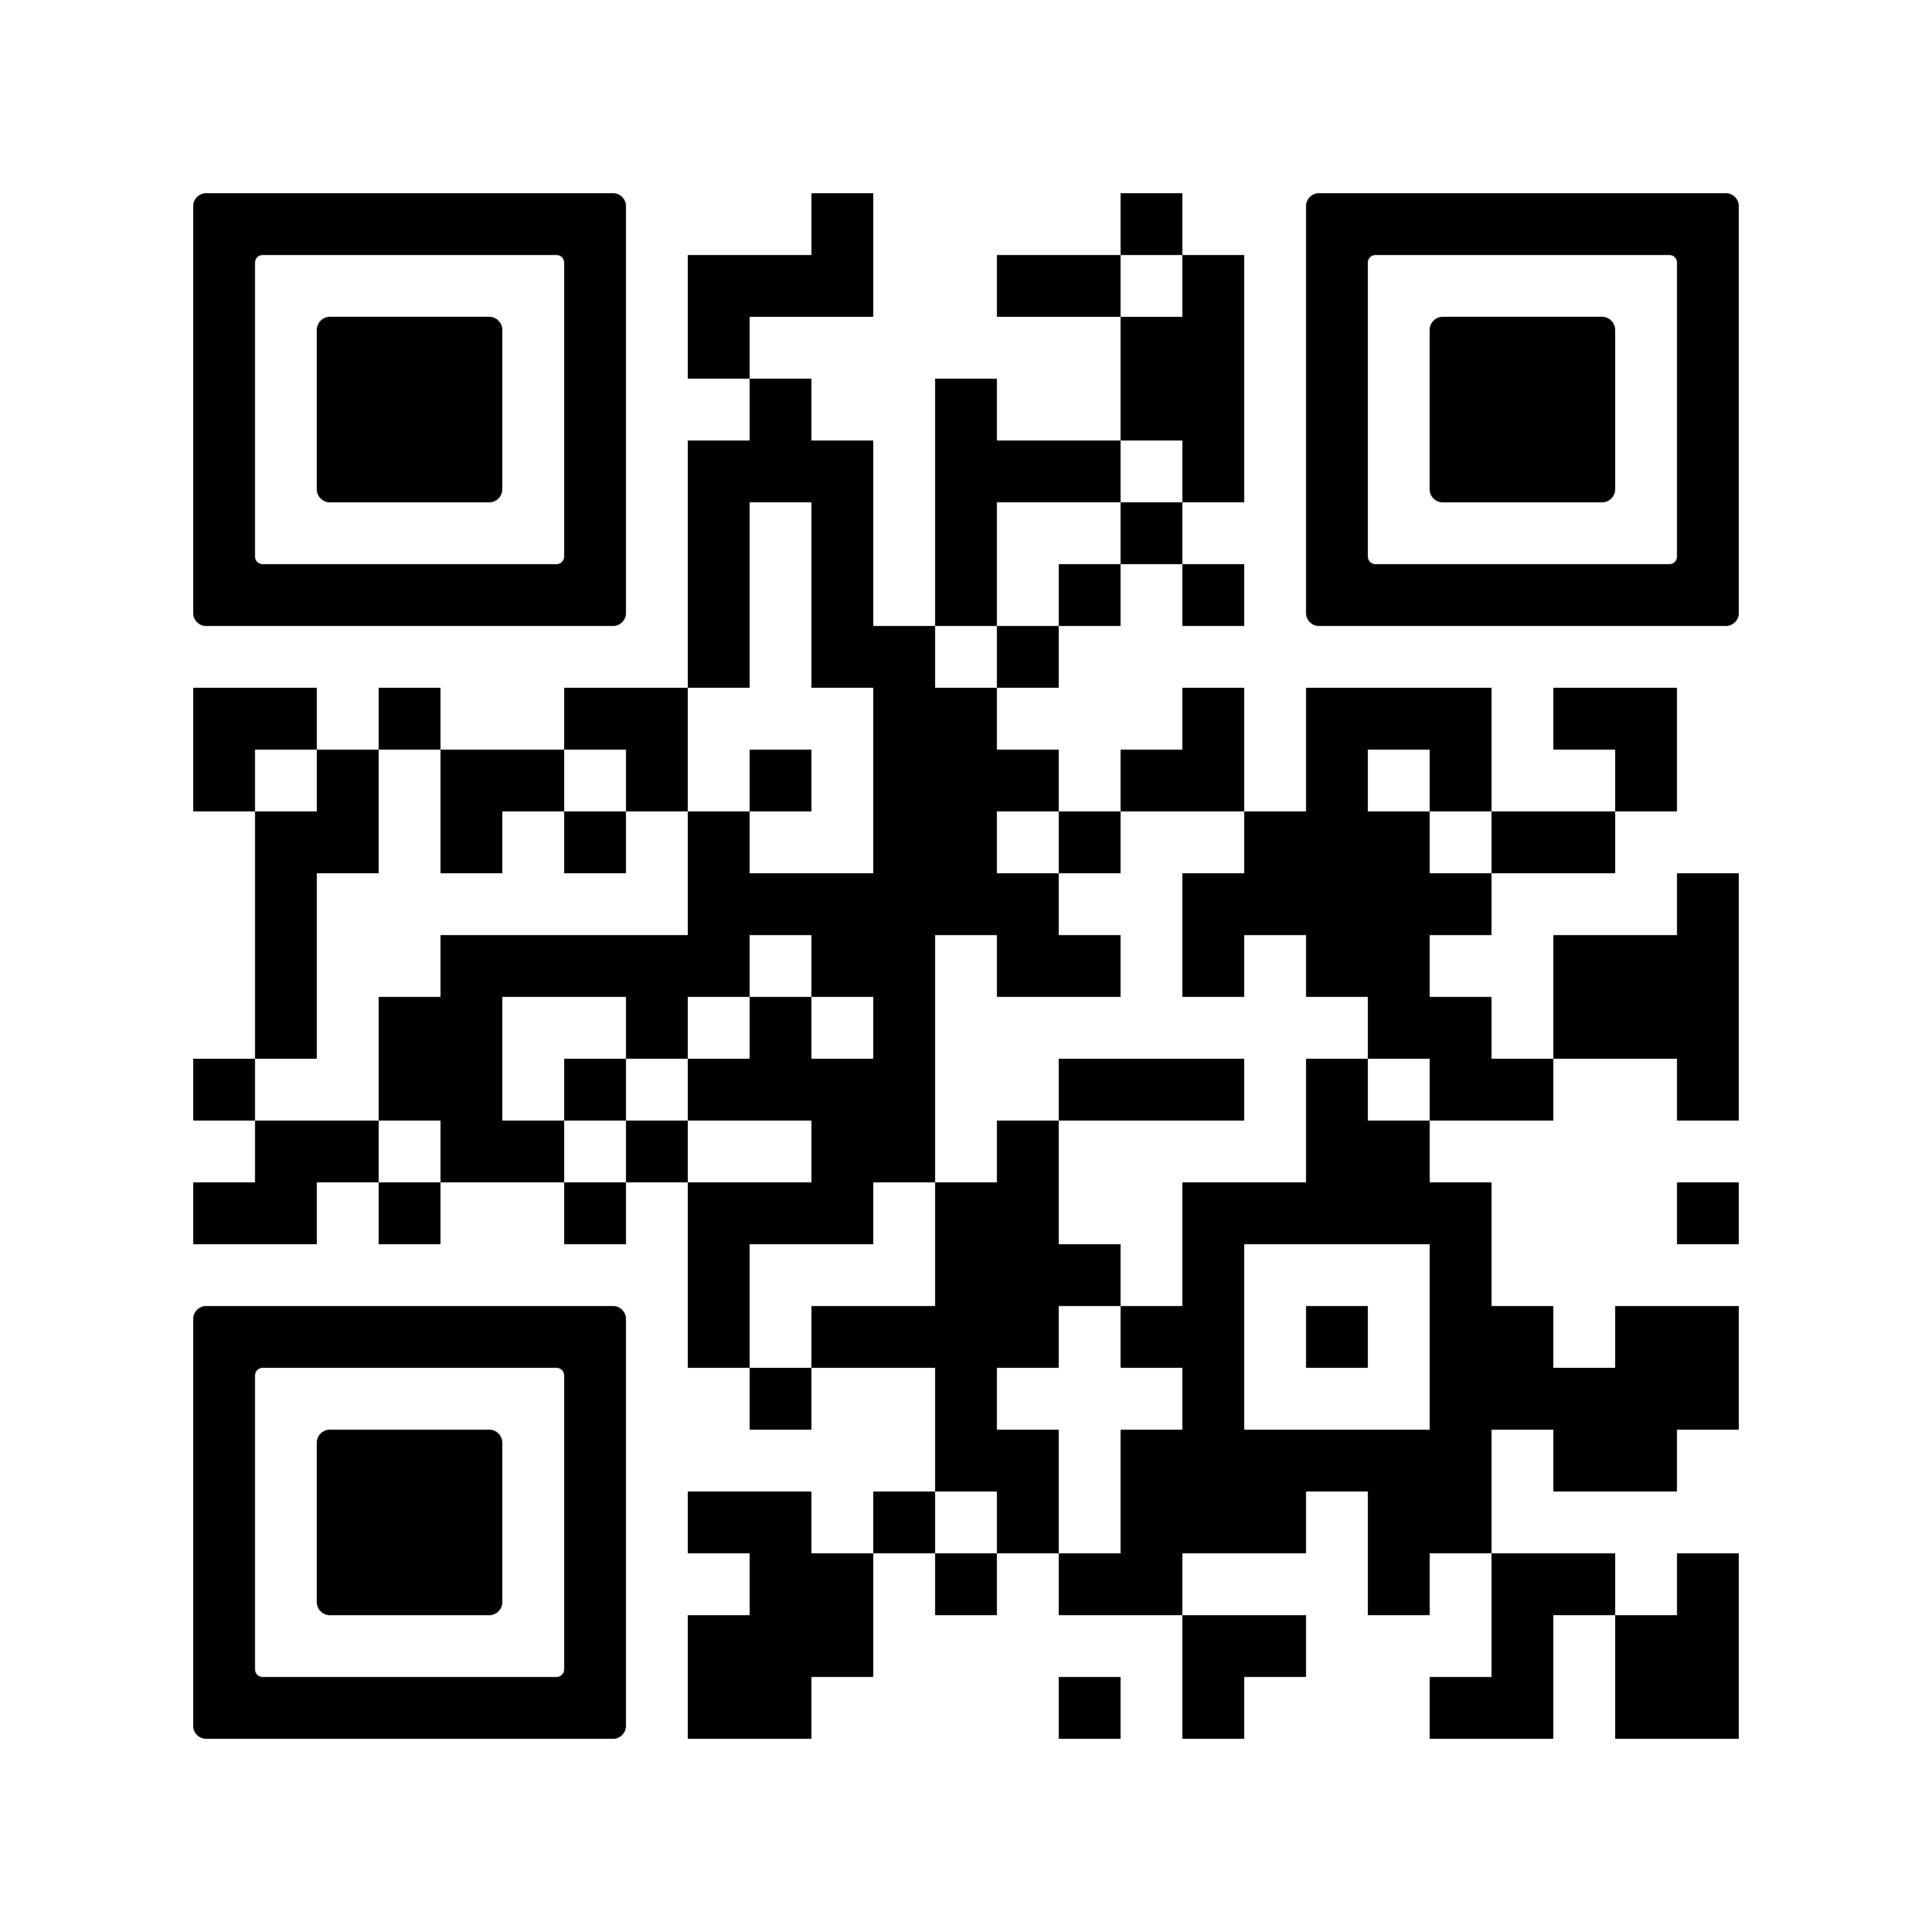

2026 Health & Wellness Fair
Wednesday, November 4
Onsite: Houston
Virtual: Everyone
Scan for
Health Fair website
Bldg. 3 Basketball Court, 7 a.m.–noon
Join from anywhere
Massage station (walk-in)
Virtual spine health evaluation (scan the Health Fair QR Code)
Spine health evaluation schedule an appointment (scan the QR Code)
Health podcast
Scan for
Spine evaluation sign-up
Biometric screening: schedule at mybmcwellness.com (Biometric Screening challenge)
Virtual fitness class
Everyone earns bWell points for joining any activity or completing a biometric screening
Notes:
We welcome you to attend our Health & Wellness Fair on Wednesday, November 4.
[Click] For those in the Houston area, the fair takes place in the Building 3 basketball court from 7 a.m. to noon. You’ll have an opportunity to complete your health screening required for the bWell program and enjoy health activities such as a spine health evaluation or a relaxing massage. To sign up for a health screening, visit mybmcwellness.com and select the Biometric Screening challenge tile and to sign up for a spine health evaluation, or scan the QR code.
[Click] Everyone can join the Virtual Engagement Center, which includes a virtual spine health evaluation, our health podcast, and a virtual fitness class. Scan the health fair QR code on the right.
Everyone will receive bWell points for participating in any activity of the health fair or by completing the biometric screening.

Slide 19


2027 Benefits Enrollment
October 26 – November 6, 2026
YOUR ENROLLMENT CHECKLIST
Make changes to your coverage
Contribute to an HSA or FSA Elections don’t roll over!
Review and update your beneficiaries
Check your home address, phone number and email
Notes:
Remember that the annual benefits enrollment period is from October 26th through November 6th.
Your new benefits will go into effect on January 1st, 2027.
You will need to enroll if you:
[Click] Want to make changes to your current coverage, or
[Click] Want to contribute to an HSA or FSA. Your 2026 HSA and FSA elections do not automatically roll over!
[Click] When you enroll, or even if you are not making changes for 2027, please take a few minutes to review and update your beneficiaries for all of your applicable benefits at mybmcrewards.com. It’s also a good idea to check your retirement-related beneficiaries, including your HSA, at Fidelity via netbenefits.com.
[Click] And finally, check that your home address is correct in HR Connect to make sure any applicable new member cards are delivered on time. While you are there, confirm your current phone number and email address.

Slide 20


Information and Resources
Both sites live October 26
STEP 1: LEARN
mybmcbenefits.com
STEP 2: ENROLL
mybmcrewards.com
Great information about all your benefits
Plan and cost information
Annual Enrollment feature
Decision tools
Interactive Benefits Guide
Enroll and update dependents and beneficiaries
Enrollment closes November 6. Bookmark both sites now.
Notes:
BMC has two key websites you’ll want to bookmark for Annual Enrollment and beyond.
[Click] First, learn at mybmcbenefits.com — It’s your go-to destination for clear, easy-to-understand information about all your benefits. You’ll find the interactive Benefits Guide, details on what’s changing for 2027, and a special Annual Enrollment feature to help you prepare before you log in to enroll.
[Click] Next, enroll at mybmcrewards.com, through November 6th. This is where you’ll go when you’re ready to take action — review plan options and costs, use the decision tools to compare coverage, and enroll or update your dependents and beneficiaries.
[Click] Together, these two sites give you everything you need to make your 2027 benefits elections. Enrollment closes November 6, so don’t wait!

Slide 21
Thank you!
Q&A
Notes:
Thank you for attending today’s session. As a reminder the slide deck and recording will be available at mybmcbenefits.com in the Benefits Media Center. We will now take live Q&A for the remainder of our time.

