Slide 1
Basketball Victoria
Professional Development
Human Resources/Return to Work Practices and Bio-Safety Officer
Presenters
Justine Salida
People and Culture Manager
Basketball Victoria
Dean Anglin
League Manager NBL1
Basketball Victoria

Slide 2
Agenda
Preparing the workplace
Consultation process
JobKeeper considerations
Process if COVID case is reported
Helpful resources
Biosafety Officer Role
Biosafety Training
Notes:
Consider: Stadium Entrance, Courts, Referee rooms, Canteens, Kitchens, Toilets and changerooms
Desks 1.5 metres apart

Slide 3
Preparing the Workplace
What is a workplace?
Duty of Care to all employees, volunteers and visitors to the workplace.
COVID Safe Plan.
Social Distancing, placement of desks, floor decals, perspex screens, signage.
Notes:
Consider: Stadium Entrance, Courts, Referee rooms, Canteens, Kitchens, Toilets and changerooms
Desks 1.5 metres apart

Slide 4
Consultation and Communication
Communicate often.
Share COVID safe plan and how the changes will be managed.
Training.
Encourage questions.
Explain steps taken to ensure a safe workplace.
Document consultation process.
Notes:
Consider: Stadium Entrance, Courts, Referee rooms, Canteens, Kitchens, Toilets and changerooms
Desks 1.5 metres apart

Slide 5
JobKeeper Considerations
Rolling back ‘Job Keeper enabled stand down’ direction.
Casual employees.
Communication and Documentation.
Notice requirements.
Notes:
Consider: Stadium Entrance, Courts, Referee rooms, Canteens, Kitchens, Toilets and changerooms
Desks 1.5 metres apart

Slide 6
Process if there is a reported COVID case
Notes:
You are not expected, and should not try, to diagnose people. However, you have a work health and safety duty to minimise the risk of workers and others in the workplace being exposed to COVID-19, so far as reasonably practicable.
If you reasonably suspect someone could have the virus, or has been exposed, this creates a health risk at your workplace, and you will need to follow the steps below.

Slide 7
Helpful Resources
Safe Work Australia
https://www.safeworkaustralia.gov.au
Fair Work Ombudsmen
https://coronavirus.fairwork.gov.au
Department of Health and Human Services
https://www.dhhs.vic.gov.au/coronavirus
Business Victoria
https://www.business.vic.gov.au

Slide 8
Any Questions?

Slide 9
Basketball Victoria
Professional Development
Bio-Safety Officer

Slide 10
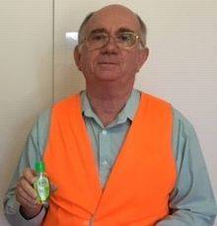
Primary Role
To monitor and record the number of people within a venue, or on/around a court at any time.
Ensure the BSO is clearly identifiable in a High Vis Vest
Notes:
Consider: Stadium Entrance, Courts, Referee rooms, Canteens, Kitchens, Toilets and changerooms
Desks 1.5 metres apart

Slide 11
Who can be a Biosafety Officer
Can be a paid or voluntary role
An adult with reasonable people skills
In smaller venues the BSO may also be the door keeper
(remember the primary role is to monitor the number of people in the venue at any time)
In larger venues this may be additional duties of the Court Supervisor or an independent person
It is NOT recommended that the BSO is also a Coach
Notes:
Consider: Stadium Entrance, Courts, Referee rooms, Canteens, Kitchens, Toilets and changerooms
Desks 1.5 metres apart

Slide 12
Duties
Monitor
  no more than four (4) courts at a time
  Record the number of people in attendance at games or training
  Ask patrons to separate, or leave the venue
Checklists
  Prior to the commencement of training or games
  During each allocated training or game timeslot
Sanitise Equipment
  in accordance with the RTS Guidelines
  Laptops, Tablets, Scoreboard Controllers and Score bench
Report
  Maintain records for a minimum 21 days
Notes:
Consider: Stadium Entrance, Courts, Referee rooms, Canteens, Kitchens, Toilets and changerooms
Desks 1.5 metres apart

Slide 13
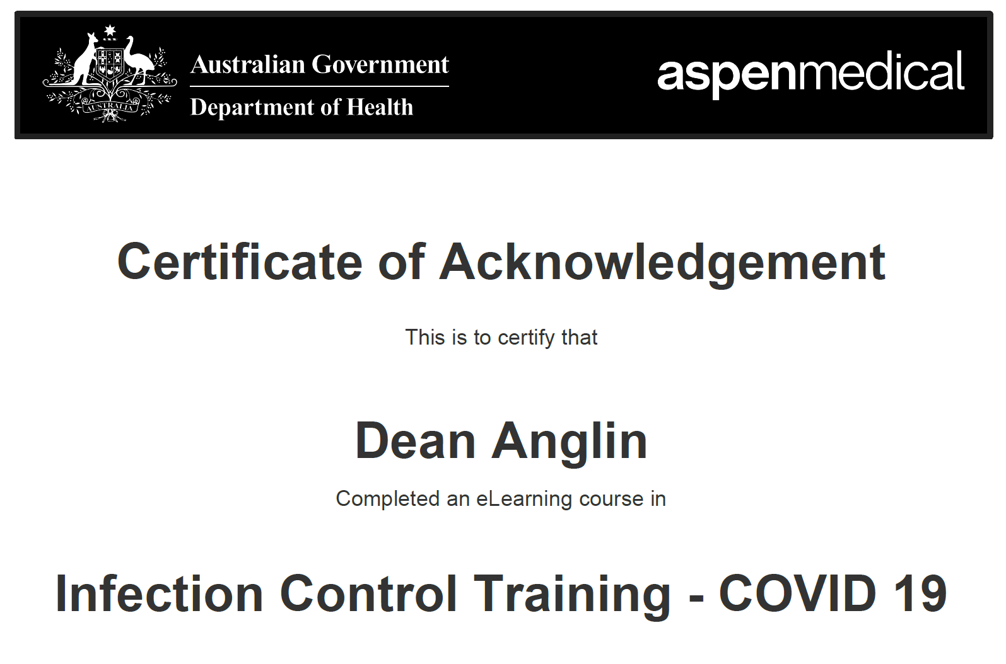
Training
BSO’s should complete the Australian Governments ‘Infection Control Training’ course.
https://www.health.gov.au/resources/apps-and-tools/covid-19-infection-control-training
Notes:
Consider: Stadium Entrance, Courts, Referee rooms, Canteens, Kitchens, Toilets and changerooms
Desks 1.5 metres apart

Slide 14
Communication
Communicate regularly with your BSO’s to ensure they have everything they need to perform the role.
Set Up a Chat Group (Facebook Messenger, Slack Channel) so issues can be raised and discussed by all BSO’s.
Notes:
Consider: Stadium Entrance, Courts, Referee rooms, Canteens, Kitchens, Toilets and changerooms
Desks 1.5 metres apart

Slide 15
Any Questions?

