Slide 1
Structuring Fund of Funds
Webinar
May 2025

Slide 2
Disclaimer
The presentation is for informational purposes only and is not intended as legal advice.

Slide 3
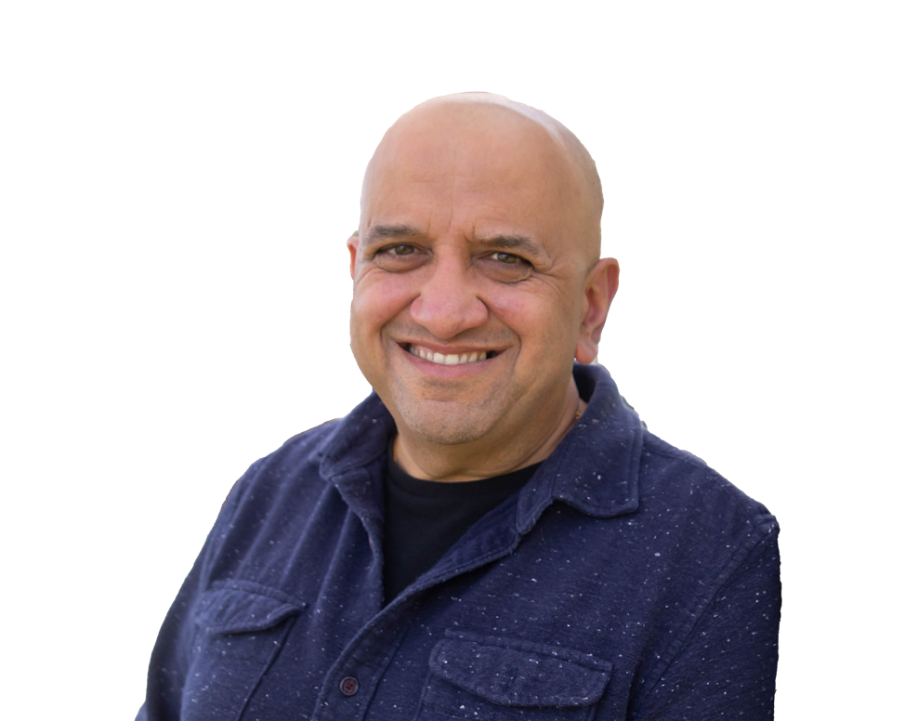
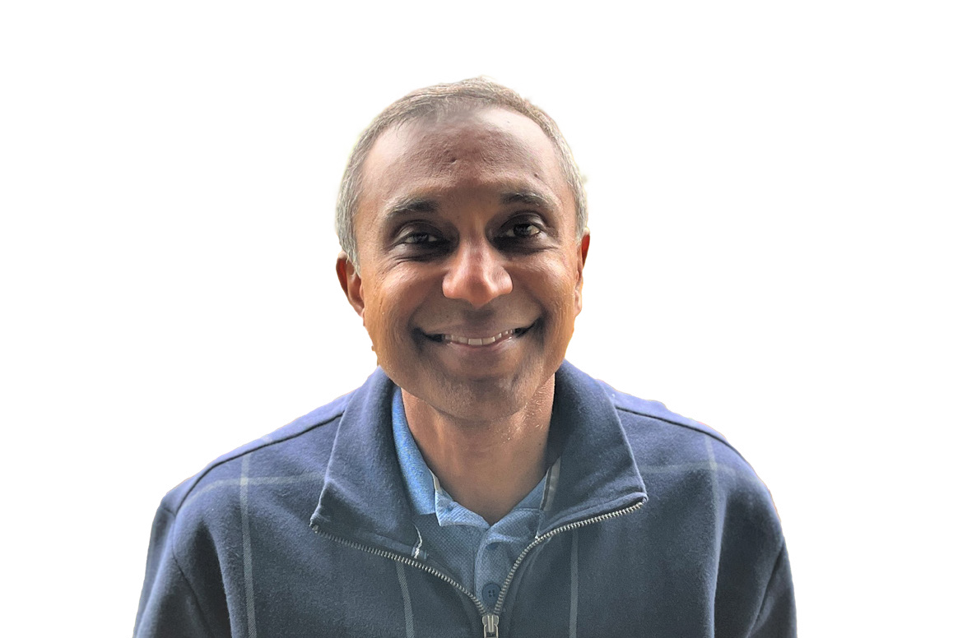

Who we are
Sanjay Vora
Avestor Co-founder/CEO
Advised over 200 funds
Avestor Ariel Fund Manager
Investing in CRE & Alternatives
20+ years in tech
Badri Malynur
Avestor Co-founder/Sales
Advised over 200 funds
15+ years multi-family real estate
Invested in multiple asset classes
20+ years in tech

Slide 4
What we will cover today
The Avestor Ecosystem
Types of Roles
Basics of a Fund of Funds Structure
Structuring Fund of Funds Partnerships

Slide 5
The Avestor Ecosystem
Short term Rentals
Single Family
RV Parks
Capital Allocators
Debt Originators
Hotels
Real
Estate
Multi-Family
Campgrounds
Offices
Conversions
Retail
Self Storage
Land
Assisted Living
Medical Offices
ADUs
Marinas
Operators
Traders
Crypto
Private
Equity
Oil &
Gas
Startups
Forex
Aviation
Private
Credit
200+ Funds across 20+ asset classes

Slide 6
Types of Roles
Operators
Purchase & active manage assets – hotels, multi-family, offices, retail, etc.
Full control of decisions – hire/fire property mgmt., buy/sell decisions, day to day operations
Raise capital to expand their portfolio
Capital Allocators
Seeking investment opportunities to build a portfolio
Focus on raising capital from investors to pool and invest together
Control investment decisions on behalf of their investor base but don’t actively manage/control assets
Debt Originators
Seeking opportunities to loan capital for either short term or long term projects
Take primary debt responsibility (replacing the traditional banks)
Focus on raising capital from investors to provide steady income generation
Traders
Pursue higher risk short term trading strategies to maximize returns for investors
Actively manage capital on a day to day basis to ensure trading profitability (automated and AI driven)
Focus on raising capital to maximize portfolio size and trading velocity

Slide 7
Partnership Opportunities via Fund of Funds Models
Significant opportunities to partner with other funds
Operators can work with Capital Allocators to raise capital for their offerings
Capital Allocators can invest in offerings from sponsors, originators, traders
Debt Originators can provide loans and bridge funding to operators
Capital allocators can partner on due diligence and capital raising
Multiple operators can JV to purchase and operate an asset together
Other partnership opportunities

Slide 8
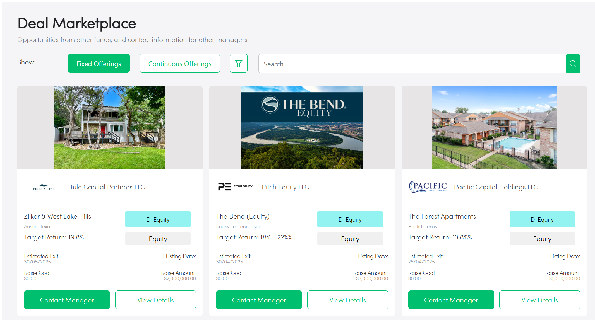
Avestor Fund Marketplace
Publish your deals to other fund managers
Managers decide which deals to put in marketplace
Managers can connect with other managers to partner on investments

Slide 9
Customizable Fund ™ of Funds Structure & Flexibility
Investors
$
$$
$$
$
$$$
Fund Entity
Equity investment
Originate
Loan
(debt interest)
Originate
Loan
(debt interest)
Equity investment
Equity investment
Debt
(debt interest)
Asset LLC
Borrower
Syndication LLC
Another fund

Slide 10
Operator – Capital Allocator Equity Deal Partnership Model

Slide 11
Operator-Capital Allocator Partnership
Fund A Investors
Fund B Investors
$
$$
$$
$
$$$
$
$$
$$
$
$$$
Capital Allocator Fund A
Fund C Investors
Capital Allocator Fund B
Preferred Terms
Preferred Terms
$
$$
$$
$
$$$
Operator Fund C
Asset LLC

Slide 12
Operator-Capital Allocator Equity Deal Structure
Operator needs to set up a minimum of 2 investment options in deal structure
  Class A: Retail investor terms
  Class B: Fund of Fund or large investor terms
Fund of Fund terms must leave sufficient room for fund manager to collect management fees for the management of their fund while still providing FOF investors better returns than going direct
Operator should NOT pay FOF managers a percentage based on capital raised – against SEC rules
Operator can provide FOF managers with fixed $ due diligence fees
Operator should provide sufficient waterfall structure to enable managers to take a service fee

Slide 13
Operator-Capital Allocator Equity Deal Partnership
Fund C Investment Options
90% to Investors (81% of total)
85% to Investors (76.5% of total)
Class A: < $500k Investment
 | Annual Return | Operator | Investor
Preferred | 8% |  | 100%
Tier 1 | >8% | 30% | 70%
10% to Manager
Capital Allocator Fund A
Capital Allocator Fund B
15% to Manager
Pref +
90% for Class B
Pref +
90% for Class B
Class B: > $500k Investment
Fund A Mgmt Entity
Fund B Mgmt Entity
Fund C Investors
 | Annual Return | Operator | Investor
Preferred | 9% |  | 100%
Tier 1 | >9% | 10% | 90%
Pref +
70% for Class A
Operator Fund C
Due
Diligence
Fee
Due
Diligence
Fee
Fund A Due Diligence fee: $20k
Fund B Due Diligence fee: $25k
Fund A Service Fee: 10% of all distributions
Fund B Service Fee: 15% of all distributions
Pref & 70% for Class A
Pref & 90% for Class B
Promote:
30% for Class A
10% for Class B
Fund C Mgmt Entity
Asset LLC

Slide 14
Capital Allocator - Debt Originator Partnership Model

Slide 15
Capital Allocator - Debt Originator Deal Structure
Debt Originator needs to provide higher interest rate option to Fund of Funds
  Class A: Retail investor terms
  Class B: Fund of Fund or large investor terms
Fund of Fund terms must leave sufficient room for fund manager to collect a portion of the interest rate for its fee
Debt Originator can provide FOF manager with a portion of the origination fees it collects from the borrower

Slide 16
Capital Allocator – Debt Originator Deal Partnership
Fund C Debt Investment:
10% to Investors
Operator collected capital from direct investors and Fund of Funds to originate loan
Direct investors: 10% interest rate
Fund of Funds: 12% interest rate
Debt Originator shares a portion of origination fee with FOF manager
Capital Allocator takes 2% of the 12%
Capital Allocator investors receive 10% interest rate
2% to Manager
Capital Allocator Fund A
Fund A Mgmt Entity
12% for Class B
Fund B Investors
10% for Class A
Debt Originator Fund B
25% of
Origination
Fee
75% of
Origination
Fee + 2%
Origination fee plus
14% return
4%
Fund B Mgmt Entity
Loan to Borrower
Fund B Mgmt Entity

Slide 17
Operator – Operator Equity Deal Partnership Model

Slide 18
Operator – Operator Partnership Model
Example 2c: Fund partnering with another fund to buy an asset
Fund A Investors
Fund B Investors
Fund A Mgmt LLC
Operator A Fund
Operator B Fund
Fund B Mgmt LLC
X%
equity
Y% equity
Pro-rata distribution
Pro-rata distribution
Manager
Income
Asset LLC
Fund A Mgmt LLC
Fund B Mgmt LLC
Notes:
Estimated Legal Fees: $4500

Slide 19
Operator - Operator Equity Deal Partnership
Asset LLC Waterfall
100% to Investors
100% to Investors
 | Annual Return | Operator | Investor (Funds)
Preferred | 8% |  | 100%
Tier 1 | >8% | 20% | 80%
Operator
Fund A
Operator
Fund B
Acquisition fee: 1% of purchase price
Disposition fee: 1% of sale price
Asset Mgmt. fee: 1% annual
Acquisition fees,
Disposition fees,
Asset Mgmt fees,
Promote
Pref +
80%
Pref +
80%
Fund A Mgmt Entity
Asset LLC
Fund B Mgmt Entity

Slide 20
Private Equity – Capital Allocator Partnership Model

Slide 21
Private Equity – Capital Allocator Partnership
Fund A Investors
$
$$
$$
$
$$$
Capital Allocator Fund A
90% invested
5% Mgmt fee reserve
5% Fund expense reserve
90/10 Promote Structure
Private Equity Fund C
85% invested
10% Mgmt fee reserve
5% Fund expense reserve
80/20 Promote Structure
Business

Slide 22
Private Equity – Capital Allocator Partnership
$1 millon Investor capital
$3,600,000
Returned
Capital Allocator Fund A
Capital Allocator Fund A
$400,000
Promote
5 years later
$900,000 invested
$50,000 mgmt fee reserve
$50,000 fund expense reserve
90/10 Promote Structure
$4,000,000
Returned
Private Equity Fund C
Private Equity Fund C
$1,000,000 Promote
$765,000 invested
$90,000 mgmt fee reserve
$45,000 fund expense reserve
80/20 Promote Structure
$5 million returned
Business
Business

Slide 23
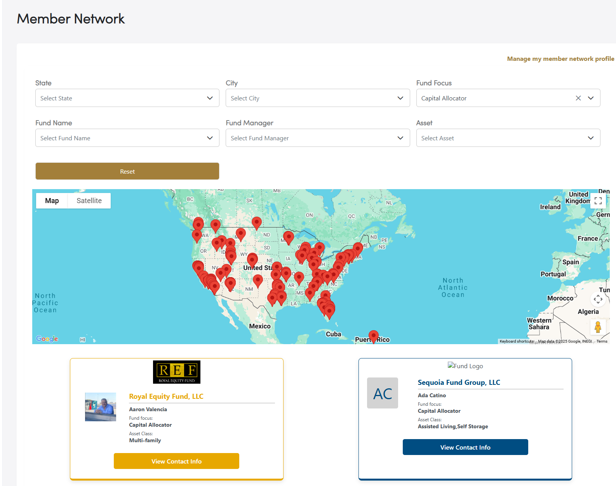
How to Establish Deals on Avestor Network
Use Deal Marketplace to publish deals if you are an operator.
Capital Allocators can use the Marketplace to find deals and contact the fund manager
  Send request via the Deal Marketplace page
  Look up Fund in the Member Network and find Fund Managers and get their contact information
Join Deal Sharing Thursdays for presentations and ask questions
Watch Deal Sharing Thursdays recorded presentations
Join Mastermind to build your network

