Slide 1

Living our vocation

Slide 2
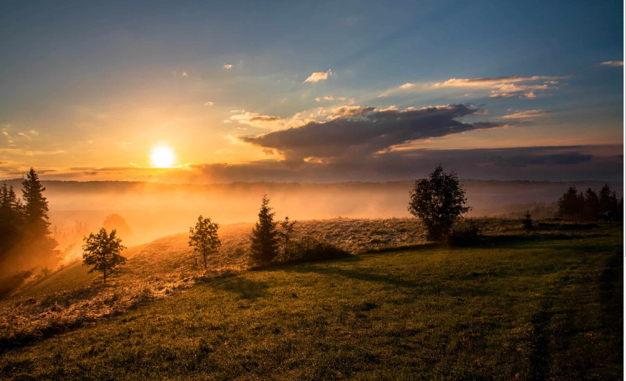
Lord God, bless our school as we enter a new year - may ours be a community of welcome and hope.
God the Father, watch over our pupils - so that they grow in understanding, faith and joy.
God the Son, encourage us - so that our service reveals your generosity and mercy.
God the Spirit, inspire the leader within us - so that our actions reveal your wisdom and justice.
Lord God, through the Trinity you teach us the importance of relationship,
help us work together to accomplish your mission:
that all your children might have life, and have it to the full. Amen.

Slide 3
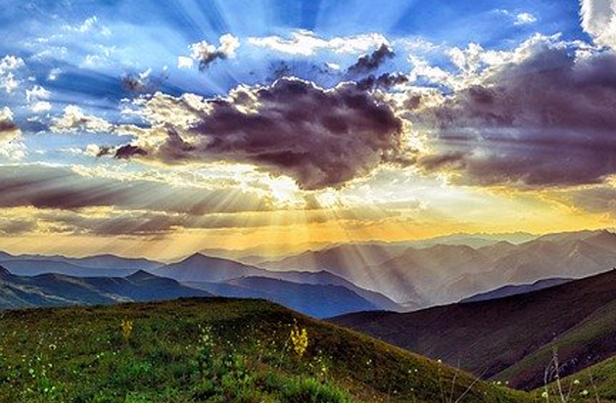
Choose a point during the next seven slides to place a candle around our altar.

Slide 4
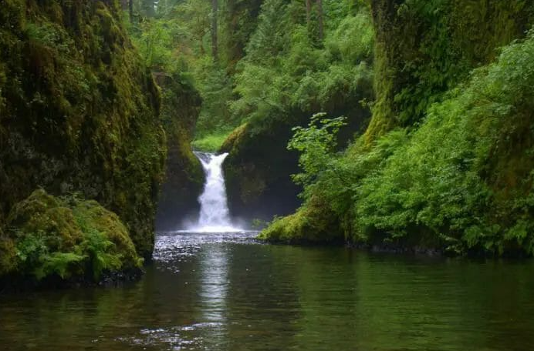

Slide 5
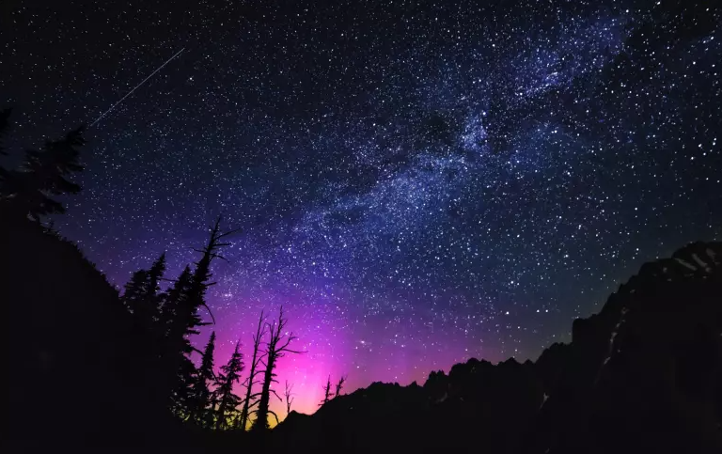

Slide 6


Slide 7
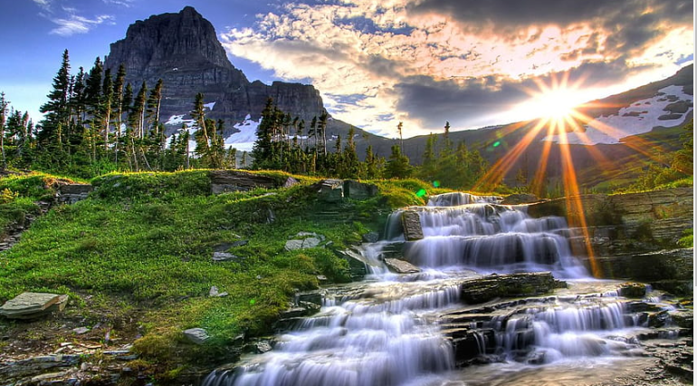

Slide 8


Slide 9


Slide 10
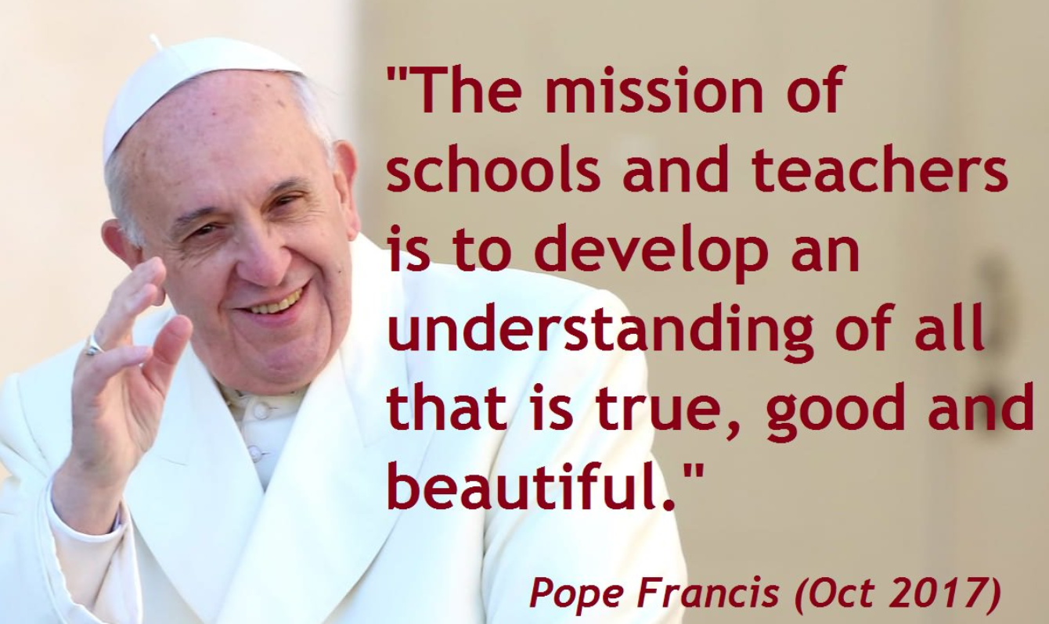

Slide 11

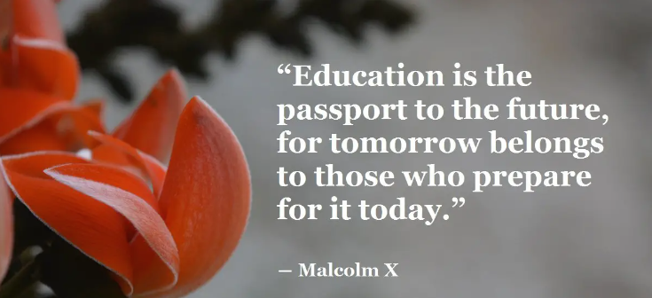

Slide 12
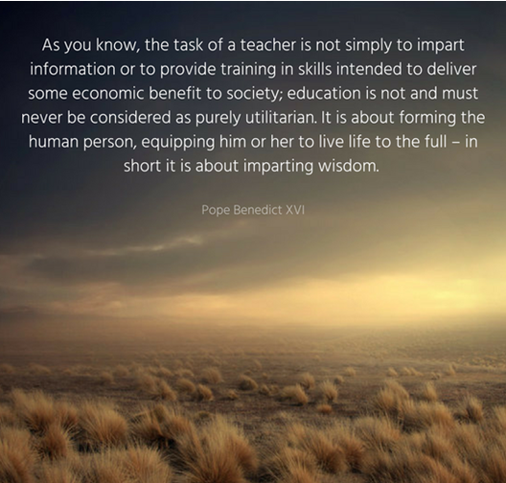

Slide 13
Let us pray
Father, please fill me with your understanding as I instruct others,
Help me to see the individual potential of every child I teach.
Father, please fill me with your patience as I teach others,
Help me to keep giving of my time and energy, especially to those who struggle the most.
Father, please give me your divine wisdom as I am with my class.
Father, help me to depend totally on You,
For You are the source of my strength, courage and peace.
Father, above all, may I love and care for each pupil I teach.
Show me how to serve as Christ serves,
Give as Christ gives.
I ask all this in the precious name of Jesus, My Saviour and friend.

