Slide 1


Legal Alert
October 2024 | www.skslegal.pl
The European Commission approves Polish
state aid schemes related to energy transition
The European Commission has approved two Polish state aid schemes related to energy transition.
Support for energy storage facilities
The European Commission has approved a EUR 1.2 billion Polish aid scheme to support investment in electricity storage to aid the transition to a net-zero emissions economy.
Projects will be selected through a call for proposals.
Aid will be provided in two forms of support: direct grants and loans. The total amount of support will not be allowed to exceed 45% of the investment costs of the supported project, although this limit can be increased to 65% for aid to small enterprises and 55% for aid to medium-sized enterprises.
The specific conditions for the provision of support will be indicated in the national regulations that are being developed. The final conditions for support are expected to be known in November.
Support for low-carbon investments
The second type of support concerns investment projects of strategic importance for the transition to a net-zero-emission economy. Its conditions are set out in Article 53 of the Law of 7 July 2023 on the preparation and implementation of investments in the National Data Processing Centre and the Ordinance of the Minister of Development and Technology of 29 September 2023 on the granting of state aid for the implementation of investment projects of strategic importance for the transition to a net-zero-emission economy.
Such a project is an investment of at least EUR 110 million, which will create at least 50 new jobs.
The investment is to consist of the production of equipment such as batteries, solar panels, wind turbines, heat pumps,
electrolysers and carbon capture and storage (CCUS) equipment or key components for the production of the above equipment. Investment in the production or recovery of related critical raw materials necessary for the production of the above devices and components will also be supported.
Eligible costs will be investment costs related to the implementation of the project - tangible and intangible assets necessary for the production or recovery of the aforementioned equipment or components.
In addition to meeting the quantitative criteria of minimum investment and an adequate number of new jobs, the investment will have to meet at least five of the fourteen supplementary conditions similar to the qualitative criteria applicable to the government grant for new investments provided under the 'Programme for the support of investments of significant importance for the Polish economy 2011-2030'.
The maximum amount of aid is calculated according to the formula:
Maximum amount of aid (PLN) = a × b × c ÷ 10
where the individual symbols stand for:
a - amount of eligible costs of the low-carbon project (PLN),
b - maximum aid intensity (%),
c - the number of points obtained for the commitment to fulfil the supplementary conditions.
The Ministry of Development and Technology is responsible for the call for proposals, which takes place on a rolling basis. Aid can be granted, and therefore grant agreements can be concluded, until 31 December 2025 at the latest. However, the call may end much earlier if the budget reserved for support is used up, so we recommend not delaying in applying for support.
This material has been prepared to inform SK&S’ clients of certain important changes in Polish law and does not constitute legal advice concerning any specific situation of any client and should not be treated by clients as advice. Should you have any questions regarding the legal issues outlined above and their possible impact on the business activities of a particular client in Poland, please contact the lawyer handling your case.

Slide 2



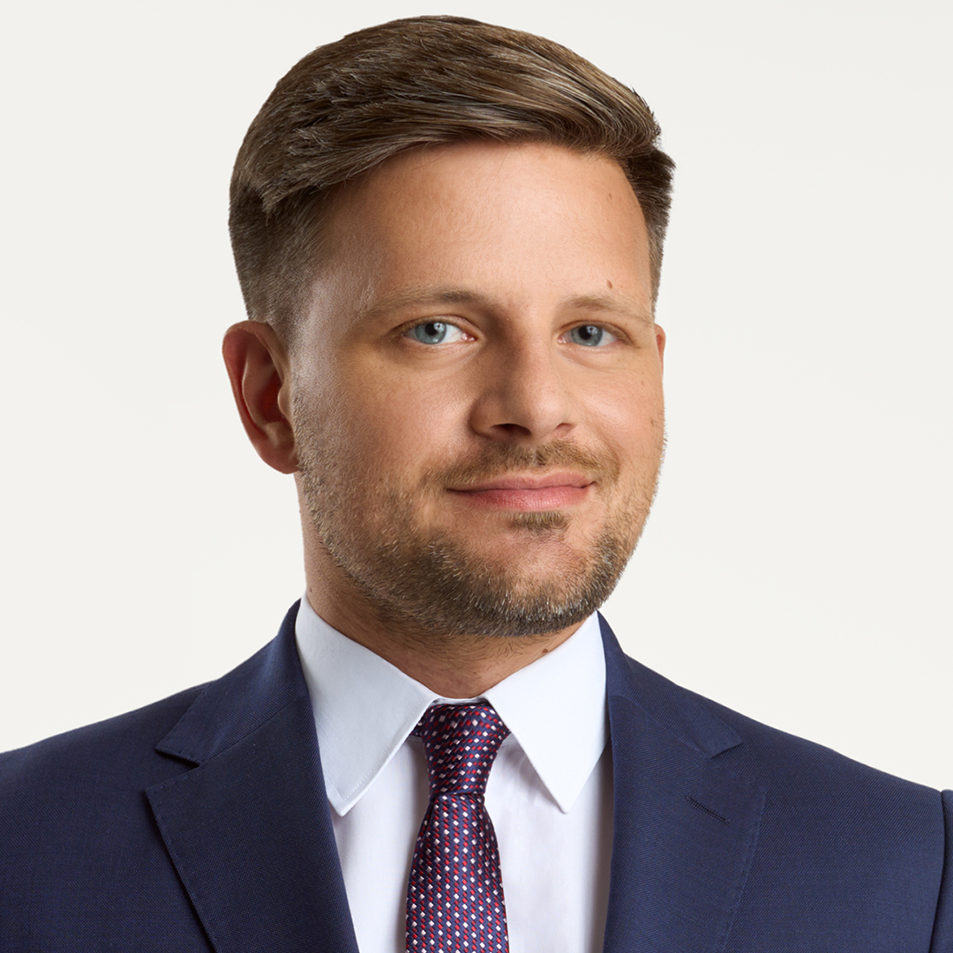
Contact us!
Warsaw
Jasna 26, 00-054 Warsaw
T +48 22 608 70 00
F +48 22 608 70 70
E office@skslegal.pl
Agata Szeliga
Partner, attorney-at-law
 +48 698 660 648
agata.szeliga@skslegal.pl
Katowice
Korfantego 138a, 40-156 Katowice
T +48 32 731 59 86
F +48 32 731 59 90
E office.katowice@skslegal.pl
Jordan Sikorski
Senior Associate, attorney-at-law
 +48 604 413 324
jordan.sikorski@skslegal.pl
Poznan
Mickiewicza 35, 60-837 Poznan
T +48 61 856 04 20
F +48 61 856 05 67
E office.poznan@skslegal.pl
www.skslegal.pl

