Slide 1
Inspiration workshop on
Democratic
companies
Can involvement and cooperation strengthen your businesssidea?

Slide 2
Can involvement and collaboration strengthen your business idea?
Inspiration workshop on democratic enterprises
Democratic enterprises are an alternative way of running a business than the "traditional" way, where it is often investors or shareholders who own and make the decisions.
In many ways, they are ordinary companies that need to make money in a market. But the fact that customers, employees, or producers are also owners has an impact on their business models and long-term strategic choices.
In this workshop, you will learn about the special characteristics of democratic enterprises so that you can assess: Om demokratisk ejerskab – eller medejerskab – kan være en mulig vej for jeres iværksættervirksomhed?
Whether democratic ownership—or co-ownership—could be a viable option for your entrepreneurial venture.
Or whether you can find inspiration for developing your business in other ways by involving (and gaining the support of) your employees, customers, and/or producers to a greater extent?

Slide 3
Inspiration workshop on
democratic companies
Workshop format
Workshopformat
Introduction to the topic: Democratic enterprises and "democratic business development"
  Presentation (10 minutter?)
Your business idea
  Group work (can be done beforehand)
Imagination exercise in groups: : What would your idea look like as a democratically owned company?
  Gruppearbejde (30 minutter?)
Presentations and discussion in plenary
  Consumer-owned companies
  Producer-owned companies
  Employee-owned companies
Summary and next steps

Slide 4


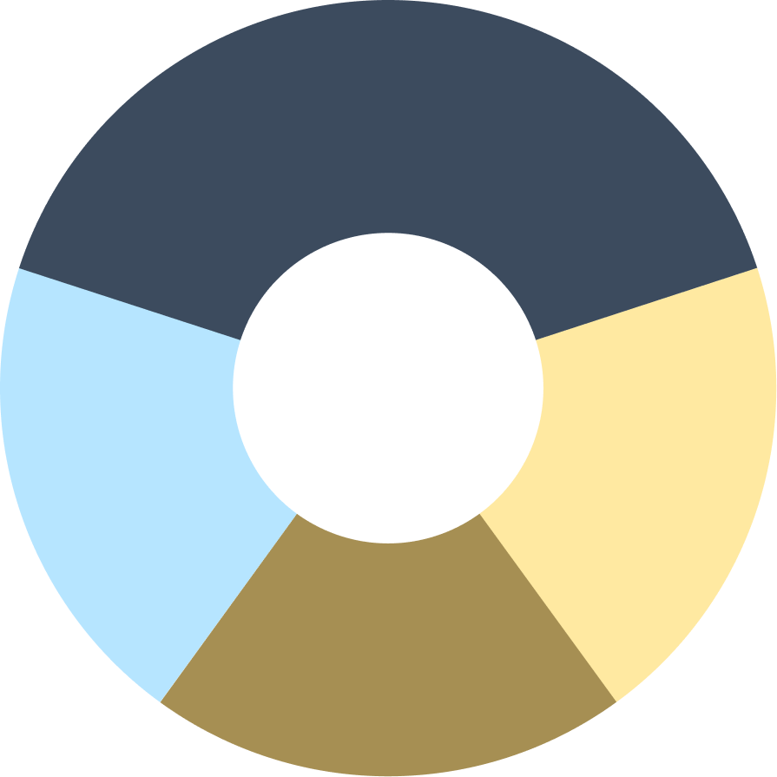
Democratic companies

Slide 5
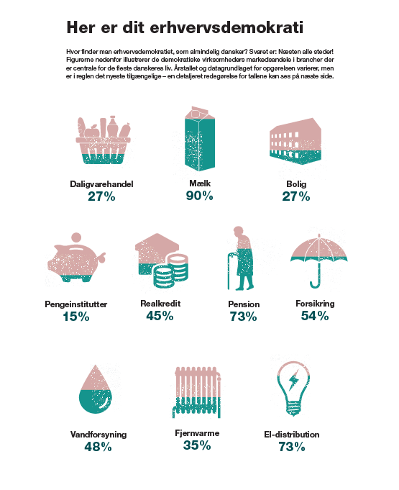
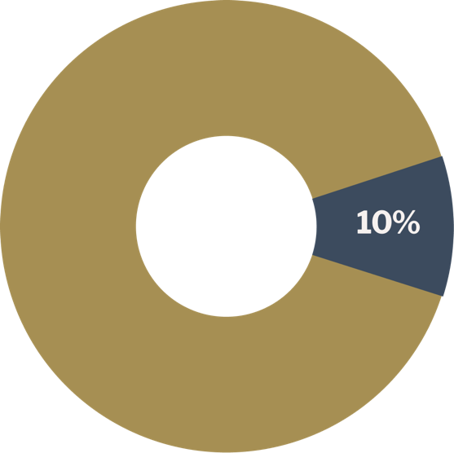
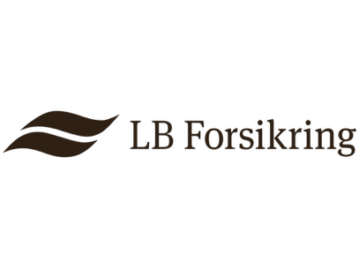
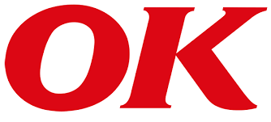

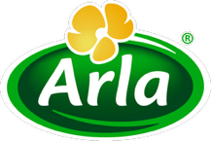
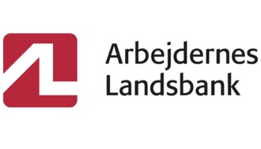
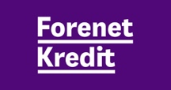
About democratic companies
Dissemination
Democratic companies stand for:
Every tenth krone earned in private Danish companies
Every tenth workplace in the world (in approx. 3 million companies) Perhaps you are familiar with them?
Maybe you know of
Notes:
Der er i vores samfund bred enighed om, at demokrati er den bedste (eller mindst dårlige) styreform. En styreform, vi vil gøre en stor indsats for at bevare.
Men vi er ikke vant til at tænke på demokrati, når det gælder virksomheder.
Alligevel tjenes ca. hver 10. kr. i dansk erhvervsliv af en demokratisk ejet virksomhed. 3 millioner virksomheder på verdensplan og ca. hver tiende arbejdsplads.
Faktisk er 98% af danskerne – svarende til 4,7 mio. - medlem af en demokratisk virksomhed

Slide 6


3 quick facts about democratic enterprises
They are also called "cooperatives" (or "cooperatives" in English)…
It could also be others, such as residents of a local community. Or a mixture. Equal shares – or according to how much they have contributed to the turnover.
In democratic enterprises, it is the employees, producers, or consumers who jointly own the enterprise.
Not necessarily for everyday operations. But for the big decisions.
They therefore also help to manage the enterprise – typically according to The principle of "one participant, one vote." And they share the profits among themselves.
Equal shares – or according to how much they have contributed to the turnover.
That is why the owners of a democratic company are often referred to as "members" or "shareholders."
Democratic ownership is often organized as a cooperative (a.m.b.a.) or a cooperative association (f.m.b.a.), which is very similar in structure to an association.

Slide 7

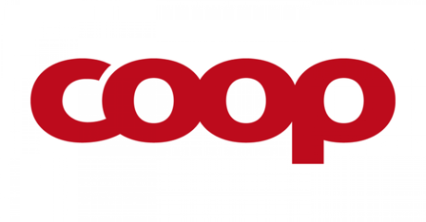
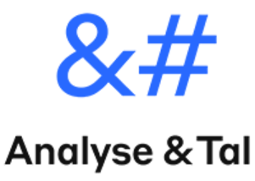

3 hurtige om demokratiske virksomheder
Forbrugereje
Producenteje
Medarbejdereje
In a consumer-owned democratic enterprise, it is the customers who own and control the enterprise.
This ensures a strong focus on meeting consumer needs and desires, for example in terms of quality.
In a producer-owned democratic enterprise, it is the suppliers who own and control the enterprise. The company acts as the producers' joint "extended arm," helping them to improve and sell their products—without too many "middlemen."
In an employee-owned democratic enterprise, the employees own and control the enterprise. They therefore have a direct influence on decisions about the company's operations and future direction – and often a strong focus on creating good workplaces.
You may be familiar with:
You may be familiar with:
You may be familiar with:

Slide 8
Hvordan fungerer en demokratisk virksomhed?
Influence
Goodbye and thank you
Membership gives voting rights at the general meeting, which determines the direction and elects the company's management.
In employee-owned companies, employees also typically have influence over decisions in day-to-day operations...
When you stop being an employee or supplier, for example, you typically also resign as a member.
When you resign, you are the right to take your deposit with you.
Entry
You become a member when you join the company. For example, when:
  An employee is hired, or has been employed for a period of time, by an employee-owned company.
  En ny leverandør underskriver en kontrakt med en producentejet virksomhed.
  A new supplier signs a contract with a producer-owned company.
Membership can be voluntary or mandatory.
Registration may be free, or you may pay a deposit to contribute to the company's finances.
Surplus
If a surplus is paid out, it is distributed among the members. Either equally or according to how much they have contributed

Slide 9

Democratic business development
Is democratic ownership good for business?
Kapital: Demokratiske virksomheder kan have sværere ved at rejse kapital, fordi de gerne vil beholde den bestemmende indflydelse hos medlemmerne.
Risikovillighed: Fokus på langsigtet værdiskabelse kan reducere risikovillighed, og derfor give lavere vækstrater.
Beslutninger: Det demokratisk ejerskab og inddragelsen af interessenter kan sænke virksomhedens beslutningshastighed.
Robusthed: Demokratiske virksomheder overlever længere end gennemsnittet. Sandsynligvis fordi de tænker og prioriterer langsigtet og tager færre risici.
Produktivitet: Særligt medarbejderejede virksomheder er mere produktive end gennemsnittet.
Opbakning: Demokratiske virksomheder scorer ofte højt i forbrugerundersøgelser.
Værdiskabelse: Demokratiske virksomheder har bedre medarbejdertrivsel og har oftere et bredere samfundsansvar skrevet ind i deres politikker.
Possible disadvantages
Possible advantages

Slide 10
Your business idea

Slide 11
Briefly describe your idea as it stands now:
What problems does it solve?
What is your solution?
What is your vision?
What do you want to achieve with it?

Slide 12
Can involvement & cooperation strengthen your business model?
The vision :
What do you want to achieve with your idea and your business?
The problem:
Describe the problems you want to solve with your business idea.
The solution:
Describe your solution and how it creates value You may also want to mention what makes you and your solution special..
Notes:
Beskriv kort jeres idé som den ser ud nu:
Hvilke problemer løser den?
Hvad er jeres løsning?
Hvad er jeres vision? Hvad vil I med det?

Slide 13

What would your idea look like as a democratically owned company?
Imagination exercise in groups

Slide 14
What would your idea look like if it were owned by the employees?
Can you outcompete the others by having the most committed employees?
What would your idea look like if it were owned by customers?
Can you involve your customers so that they come back and maybe even give you a helping hand?
How would your idea look if it were owned by the manufacturers?
Can you create the solutions the world needs by collaborating instead of competing?
Notes:
Vælg en ejerform

Slide 15
Customers
Handouts

Slide 16
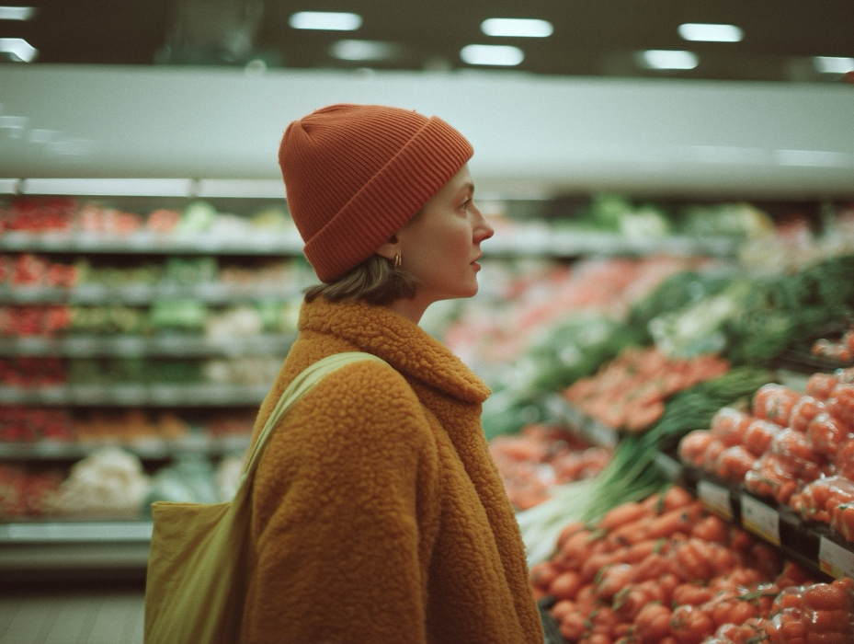
Meet:
The customers
Why are the customers important?
It is the customers who will buy your product.
Customers know best what your product needs to do to meet their needs.
But customers also talk to each other and are therefore important for your reputation and marketing.
What are your customers' interests?
To get the best possible product at the lowest possible price.
But there may also be other important things: availability, good service and purchasing experience, personalization, trust and credibility, novelty value.
What can a good customer relationship give you?
Revenue from customers who come back – again and again
Knowledge about how you can improve your product
Positive publicity and "free" marketing

Slide 17
Meet:
The customers
In consumer-owned companies, customers have a very special place
Purpose:
The companies have a statutory purpose of creating value for customers, which guides their long-term strategic decisions
Influence:
Customers are members and therefore co-owners. At a minimum, they can exert their influence by voting at the general meeting and by electing (or standing for election to) the board of directors or representative body. Often, they can also influence the company's product/service and daily operations in other ways.
Profit:
Members also have a say in what happens to the profits. If the companies make a profit, it is often paid back to customers as a "dividend," used to develop the company, or used to support good causes.
Competition:
Consumer-owned companies can enjoy very high customer loyalty, especially when they succeed in actively involving their members so that they feel they have a real influence and sense of co-ownership in the company

Slide 18
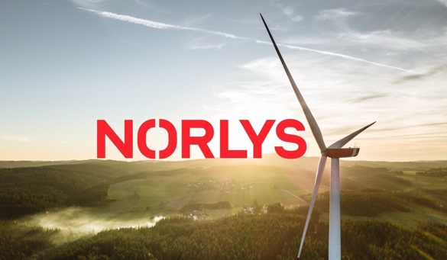
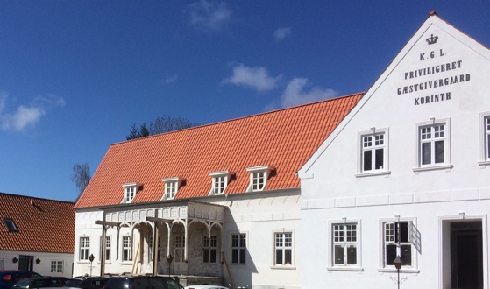
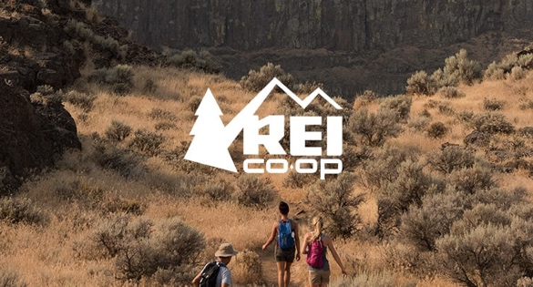
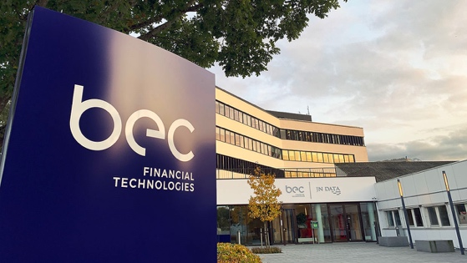
Mød:
Kunderne
I de forbrugerejede virksomheder har kunderne en helt særlig plads
Norlys is one of Denmark's largest energy companies and is owned by 800,000 shareholders. The shareholders decide how the profits are used, and they have chosen to invest in fiber networks and green transition. Today, Norlys therefore supplies energy, charging stations, internet, TV, and mobile services to Danes. When the municipality wanted to demolish the closed local inn in Korinth on Funen, the citizens resisted. They now run the place jointly as a modern hostel and community center.
Da kommunen ville nedrive den lukkede lokale kro i Korinth på Fyn, gjorde borgerne modstand.
De driver nu stedet i fællesskab som moderne vandrehjem og forsamlingshus.
REI is a large American outdoor equipment retailer with 24 million members. In addition to member benefits, the company also involves its members in the development of new products. And it facilitates a network of members who campaign politically for better conditions for outdoor recreation.
BEC Financial Technologies develops and operates IT solutions for Danish banks. The banks are the owners of BEC as customers. In collaboration, the banks and BEC can develop new solutions that meet the banks' needs.

Slide 19
Meet:
The customers
Forestillingsøvelse:
Now imagine your company and entrepreneurial idea as a consumer-owned company.
If your company were owned by your customers:
  How would that make sense?
  What would be different?
  Would it strengthen the company in any way?
  And what would the challenges be?
Answer the questions in the following sheet and prepare a
5-minute presentation.

Slide 20
Imagination exercise: What would your idea look like if it were owned by customers?
Questions | What would your idea look like if it belonged to your customers?
The name What is the name of the company—now that it is owned by the customers? (It can be the same name.)
The owners Which customer group are your members (owners)? Who are your first and most important customer members (if you were to recruit them tomorrow)?
The purpose What problem does the company solve for customers that has motivated them to join forces and own the company? What do they get out of the company and from being a member? What is the long-term vision? Is it different from the one you have now?
The solution Is anything about your solution different now that you are owned by your customers?
The advantages How does customer ownership strengthen the company?
The challenges What are the disadvantages of being owned by customers?

Slide 21
The manufactures
Handouts

Slide 22
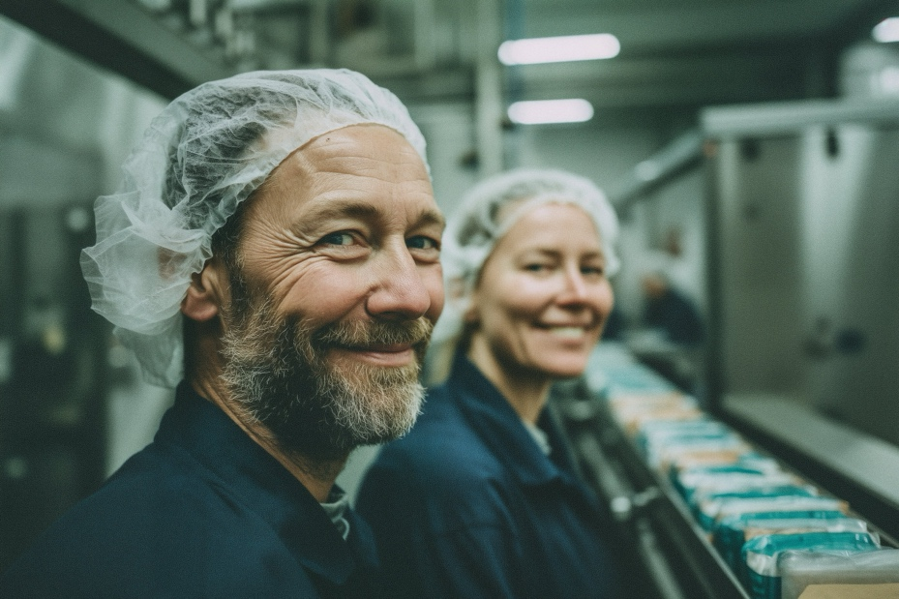
Meet:
The manufactures
Why are producers important?
In order to deliver a high-quality product or service at a good price, you depend on services from suppliers and partners.
Manufacturers have specialized knowledge and expertise in their field.
What are the manufacturers' interests?
Like all companies: to sell and get the best possible price for their product or service. But also::
Stable earnings and long-term agreements that make it easy to plan production and inventory
Predictability and low risk: Avoid complaints, returns, and cancellations
Growth and scaling
Publicity and a strong, credible brand
Fast and secure payment
What can a good manufacturer partnership offer you?
Cost efficiency through trust and shared goals
A better product through knowledge sharing and collaboration

Slide 23
Meet:
The manufactures
In manufacture-owned companies, the company is an extension of the producers
Purpose:
The companies have a statutory purpose to improve (refine) and/or sell the producers' services or products and thereby benefit the producers' finances. The purpose thus governs the entire business model of the company, where the company acts as the "producers' extended arm."
Influence:
The producers are cooperative members and therefore co-owners. At a minimum, they can exert their influence by voting at the general meeting and by electing (or standing for election to) the board of directors. Often, they can also influence the company's product/service and daily operations in other ways.
Surplus:
If a producer-owned company makes a profit, it is used for the benefit of the producers: either to further develop the producer-owned company or by giving it back to the producers. When profits are distributed, it is done according to how much each individual producer has contributed.
Competition:
When producers collaborate and pool their resources in a producer-owned company, this can give them economies of scale, access to markets, and greater bargaining power than they could achieve alone. It can also enable entirely new activities, because they can share costs and risks.

Slide 24
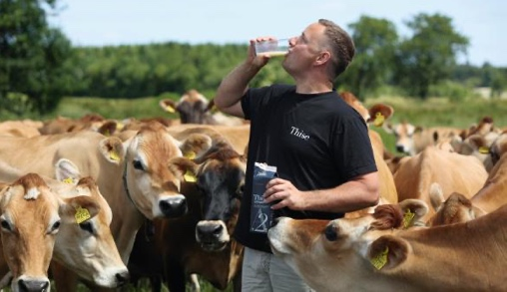

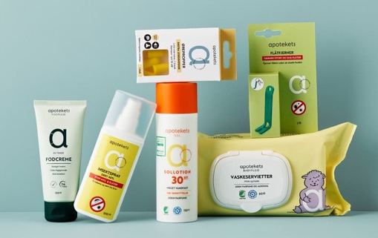
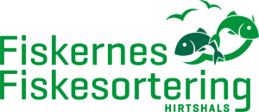
Meet:
The manufactures
In manufacture-owned companies, the company is the producers' extended arm
Thise: In 1988, a small group of organic farmers from northwestern Jutland wanted to produce organic milk and cheese, but the dairies and shops were not interested. So they got together and set up their own dairy. Today, Thise purchases 120 million kg of milk annually from its cooperative members, and the dairy's products are sold throughout the country.
KMC…
Apotekernes A.m.b.a.. is a cooperative owned by Denmark's pharmacists, through which the pharmacies collaborate on the development, purchasing, sale, and marketing of the pharmacies' own brand, Apotekets.
Fiskernes fiskesortering…

Slide 25
Meet:
The manufactures
Imagination exercise:
Now imagine your company and entrepreneurial idea as a manufacture-owned company.
If your company were owned by the manufacturers;
  How would that make sense?
  What would be different?
  Would it strengthen the company in any way?
  And what would the challenges be?
Answer the questions in the following sheet and prepare a 5-minute presentation.

Slide 26
Imagination exercise: What would your idea look like if it were owned by the producers?
Questions | What would your idea look like if it were owned by the producers (suppliers or key partners)?
The name What is the name of the company – now that it is owned by the producers? (it may be the same)
The owners Which suppliers/producers are your members (owners)? Who are your first and most important producer members (if you were to recruit them tomorrow)?
The purpose What problem does the company solve for the producers that has motivated them to join forces and own the company? What do they get out of the company and from being a member? What is the long-term vision? Is it different from the one you have now?
The solution Is anything about your solution different now that you are owned by the producers?
The advantages How does being owned by the producers strengthen the company?
The challenges What are the disadvantages of being owned by the producers?

Slide 27
The employees
Handouts

Slide 28
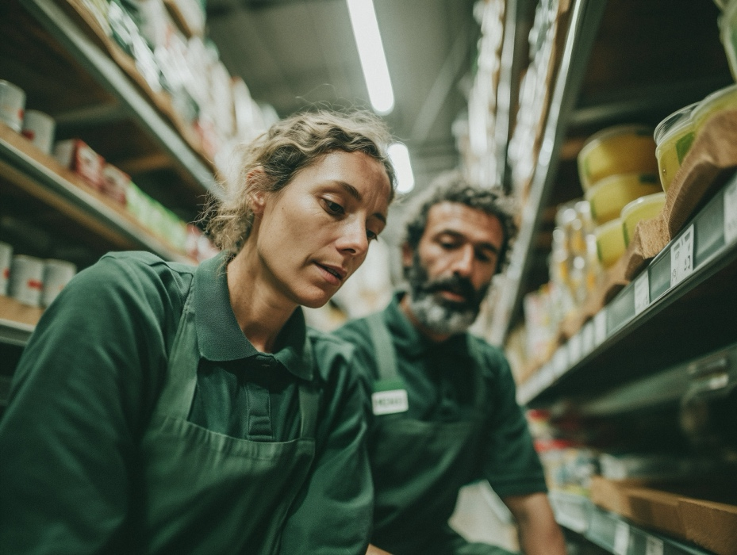
Meet:
The employees
Why are employees important?
With their skills, creativity, and commitment, employees are important for enabling you to deliver a high-quality product or service at a good price
In most companies, skilled and committed employees are essential for productive operations
What are the employees' interests?
A fair salary, good working conditions, and employment terms
Stability and security in employment
Opportunities for further training, skills development, and advancement
A healthy, safe, and positive working environment with good relationships with colleagues and management
A good work-life balance
That their work is perceived as meaningful and their efforts are valued and recognized
Being able to influence working conditions and decisions that affect their everyday lives
What can good employee cooperation give you?
High productivity and stability in task completion
An innovative company where talented employees contribute their knowledge and new ideas
Good customer service
Good reputation and brand value

Slide 29
Mød:
Medarbejderne
I producentejede virksomheder er
virksomheden producenternes forlængede arm
Purpose:
The companies have a statutory purpose of creating value for employees, which guides their long-term strategic decisions. This may involve, for example, good employee relations or sustainable job opportunities.
Influence:
Employees are members and can, at a minimum, exert their influence by voting at the general meeting and by electing (or standing for election to) the board of directors. They often also have a significant influence on decisions in day-to-day operations, for example through management structures that are less hierarchical than in other types of companies.
Profit:
In an employee-owned company, profits are typically used to strengthen the company, improve employee conditions, or distributed among the employees.
Competition:
Research consistently shows that employee-owned companies are more productive than similar companies. This may be due to greater employee motivation and loyalty, as well as decision-making structures where employees can contribute their knowledge and ideas.

Slide 30
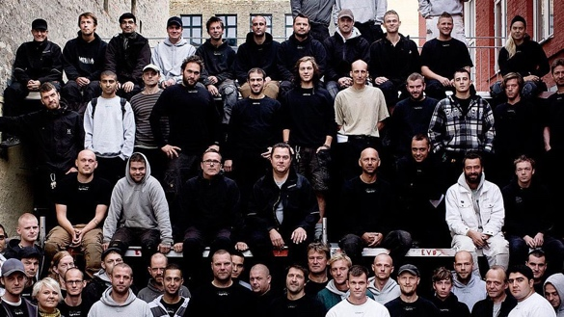
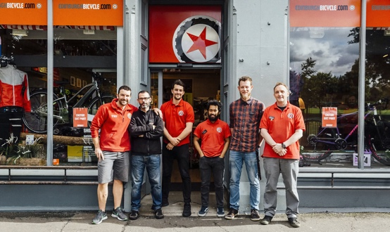
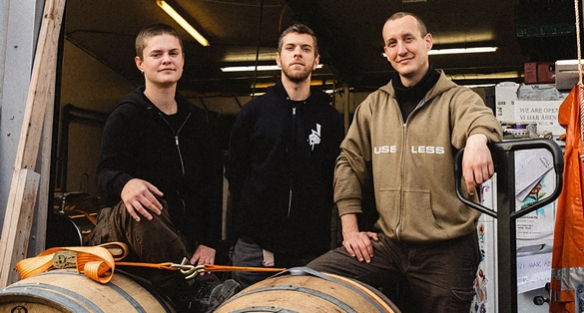
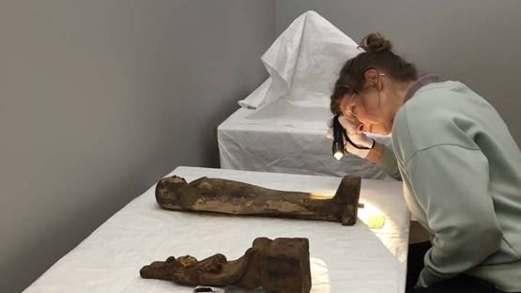
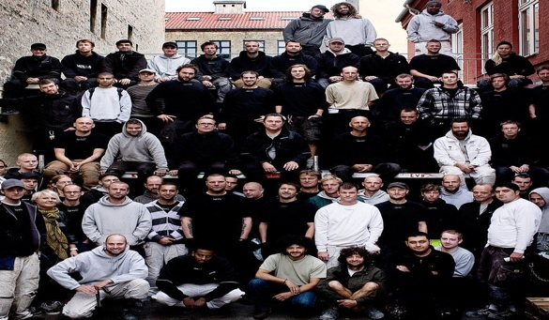
Mød:
Medarbejderne
I medarbejderejede virksomheder leverer medarbejderne ekstra værdi
Logik & Co. is a Copenhagen-based construction company that specializes in renovations and conversions with strong views on sustainability and social responsibility. They find that their values help attract customers, and they have no trouble attracting talented employees and apprentices.
Edinburgh Bicycle Cooperative is a chain of bicycle shops with stores in Scotland and England, known for its excellent customer service. Because it is employee-owned, customers are always served by staff who have a strong interest in ensuring they have a good experience.
Slowburn Brewing Co-op is an employee-owned brewery that brews specialty beers, which are sold at some of Denmark's best restaurants, among other places. They want to create a company where employees have influence and good working conditions, and which contributes to the local community. Employee ownership gives them the independence to focus on high quality and a high level of credibility among their customer base.
Komposit…

Slide 31
Meet:
The employees
Imagination exercise:
Now imagine your company and entrepreneurial idea as an employee-owned company.
If your company were to be owned by the employees;
  How would that make sense?
  What would be different?
  Would it strengthen the company in any way?
  And what would the challenges be?
Answer the questions in the following sheet and prepare a 5-minute presentation.

Slide 32
Imagination exercise: What would your idea look like if it were owned by the producers?
Questions | What would your idea look like if it were owned by the employees?
The name What is the name of the company – now that it is owned by the employees? (it can be the same)
The owners Would all or only some employees be owners? Who is your first and most important employee and co-owner/member (if you were to recruit them tomorrow)?
The purpose What will motivate employees to join forces and own the company? What do they get out of the company and from being a member? What is the long-term vision? Is it different from the one you have now?
The solution Is anything about your solution different now that you are employee-owned? How does employee ownership strengthen the company?
The advantages How does being owned by the employees strengthen the company?
The challenges What are the disadvantages of being employee-owned?

Slide 33
Presentations and discussion in plenary

Slide 34
Pitch
Present your new consumer-owned company
The name
The owners
The purpose
The solution
The benefits
The challenges

Slide 35
Reflection exercise
Do consumers ever have any say?
What do you think about giving ownership and influence to customers?
  How can this strengthen a business idea?
  What are the challenges?
Can you—inspired by consumer-owned companies—involve customers more in the business

Slide 36
Pitch
Present your new producer-owned company
The name
The owners
The purpose
The solution
The benefit
The challenges

Slide 37
Reflection exercise
Do producers ever have any say?
What do you think about giving ownership and influence to the producers?
  How can this strengthen a business idea?
  What are the challenges?
Can you—inspired by the examples of producer-owned companies—involve producers more in the business?

Slide 38
Pitch
Present your new employee-owned company
The name
The owners
The purpose
The solution
The benefits
The challenges

Slide 39
Reflection exercise
Do employees ever have any say?
What do you think about giving ownership and influence to the employees?
  How can this strengthen a business idea?
  What are the challenges?
Can you—inspired by the examples of employee-owned companies—involve employees more in the business?

Slide 40
Collective thougths

Slide 41
Inspiration workshop on
Democratic
companies
What are your takeaways?
  Name one thing that you are taking away, or that you will consider doing differently?
Do you have questions?
  Are you left with any questions about democratic companies?

Slide 42
Her kan I finde mere viden om demokratiske virksomheder
…

Slide 43
Inspiration workshop on
Democratic
companies
Can involvement and cooperation strengthen your businesssidea?

