Slide 1
Home Together Move-In Assistance Fund
Alameda County

Slide 2
About the Fund
Move In Assistance Fund
HCS Housing Deposits
Housing Assistance Fund

Slide 3
Who is eligible for funding?
Household Eligibility
Funding Limits
Currently experiencing homelessness in Alameda County with confirmed plans to move into housing OR Have exited homelessness within the last 60 days.
Maximum household income at, or below, 30% Area Median Income (AMI).
Has not previously received funding from the Home Together Move-In Assistance Fund, HCS Housing Deposits or the Home Stretch Housing Assistance Fund. Note: This requirement does not apply to applicants who are utilizing funds within their 6-month authorization period.
Eligible participants can access the Fund one time with a maximum spending amount of $5,000.
Approved participants have 6 months to utilize funding.
Providers are able to apply for an exception in the case of emergency relocations, however this funding is not guaranteed.
Requests for exceptions require additional documentation and approvals.

Slide 4
What will the fund pay for?
Home Together Move-In Assistance Fund is meant as one-time service to enable a person to secure housing and obtain basic household items.
Eligible Expense | Payment Options | Required Documentation
First Month's Rent* | Landlord/PM Only | Lease or Intent to Rent, W9 for Payee
Security Deposit | Landlord/PM Only | Lease or Intent to Rent, W9 for Payee
Utility Payments/Deposits | 3rd Party Payee only (utility company or Landlord/PM) | Utility Bill or Invoice, W9 for Payee+
Application Fees | Landlord/PM or Provider Agency reimbursement^ | Itemized receipt, W9 for Payee
*Applicants receiving long-term subsidies or transitional rent are ineligible for this support.
+Many utility vendors are already set up as payees in the request portal.
^W9s will be collected from participating Agencies as part of account set up.

Slide 5
What will the fund pay for?
Move-In Assistance Fund assistance is meant as one-time service to enable a person to secure housing and obtain basic household items.
Eligible Expense | Payment Options | Required Documentation
Health & Safety Services | Landlord/PM or Provider Agency reimbursement^ | Vendor Bill or Invoice, W9 for Payee
Medically Necessary Items for Home | Provider Agency Reimbursement^ or Abode payment to approved vendors | Order Form (Abode payment) or Invoice or Receipts (Agency reimbursement)
Essential Household Items | Provider Agency Reimbursement^ or Abode payment to approved vendors | Order Form (Abode payment) or Invoice or Receipts (Agency reimbursement)
^W9s will be collected from participating Agencies as part of account set up.

Slide 6
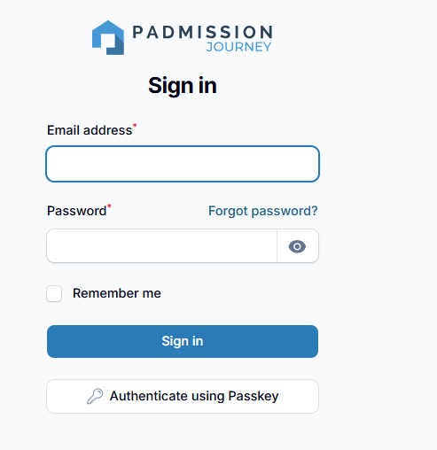
How are requests submitted?
All Home Together Move-In Assistance Fund requests will be submitted electronically through Abode Services’ request portal in Padmission Journey
Staff working for eligible providers can be granted access to submit requests to the Fund for eligible applicants.
All users must complete training and complete a user agreement before system access will be granted.

Slide 7
Submitting Requests in Padmission Journey
Steps | Action Items | Required Upload(s)
1. Project Selection | Confirm request is for the Alameda County Move In Assistance Program | None
2. Applicant Search | Search for applicant or create new Add Household Address for move in | None
3. Qualifying Information | Complete sections on current/planned qualifying living situation and housing information; Complete Case Manager agreement | - Copy of Lease or Intent to Rent - Participant Agreement

Slide 8
Submitting Requests in Padmission Journey
Steps | Action Items | Required Upload(s)
4. Funding Request | Add all requested funds – each type of expense is added separately specifying: Type of qualifying expense Amount of expense Requested payment date Who will be paid (Landlord/PM, Agency, etc.) How payment should be made (mail, priority mail or pick up from San Leandro office) | Required documents according to type of expense (see the “What will the fund pay for?” slides)
5. Review & Submit | Review all request details and “create” when complete! | None

Slide 9
What should I expect once a request is submitted?
Abode Services’ Move In Assistance Fund team will receive and review all requests within 1 business day
Abode staff will reach out for clarifications if anything in the request is unclear or if there are any issues with the submitted documentation. Providers can then resubmit requests after changes are made.
All communication with Providers outside of the Padmission Journey portal will be via acmoveinfund@abode.org. Additional information regarding requests for changes will be sent out via email and will also be visible within the request portal when users login and view the specific request.
The Fund’s goal is to process requests quickly (i.e. within 10 business days or less) - complete documentation and clear instructions is what will keep the process moving!

Slide 10
When can I submit requests?
The Home Together Move-In Assistance Fund starts on July 1, 2026
Participating Agencies will be asked to provide agency account set up information and a current W9 if they will want to set up their account for funding reimbursements.
Prior to launch on July 1, staff at participating Agencies can request a login by submitting a Move In Assistance New User form after completing a live training session.
Once live training sessions conclude in July, staff at participating Agencies can request access by emailing padmission@abode.org

Slide 11
Where do I access forms & resources?
Program webpage link: Home Together Move-in Assistance Fund — Abode
Policy & Procedures
Training Resources
Program Forms, including W9 and Checklist & Expense Guide
Planned resources:
  Move In Assistance Fund Request Job Aid
  Fund FAQ

Slide 12
Who do I contact if I need help?
If I need help with… | ...please contact:
Questions related to program exceptions or county guidance | Housing & Homelessness Services Alameda County Health Mikenya Ashby Flexible Housing Subsidy Pool Program/Financial Specialist Mikenya.Ashby@acgov.org
Issues or questions related to the program, specific requests (planned, prior or in progress) | Abode Services Home Together Move-In Assistance Fund Team Email: acmoveinfund@abode.org Phone Number: (510) 376 - 1711 Address: 545 Estudillo Ave San Leandro, CA 94577
User access or any technical issues in Padmission Journey | padmission@abode.org

