Slide 1

Medicare Seminar Educational Event
Logo
YOUR NAME – Is not connected with or endorsed by the United States government or the Federal Medicare program. For accommodations of person with special needs at meetings call [insert number] TTY: 711
We do not offer every plan available in your area. Any information we provide is limited to those plans we do offer in your area. Please contact Medicare.gov or 1-800-MEDICARE to get information on all of your options.
Notes:
PLEASE NOTE: Some statements included in this presentation are predictions and have not yet been confirmed through either the Final Rule or Carrier policy updates. All predictive statements will appear as “Bold and Underlined” throughout this presentation.

Slide 2

When do you sign up for Medicare?
Initial Enrollment Period
Special Enrollment Period
General Enrollment Period

Slide 3

How do you sign up for Medicare?
Collecting Social Security…
Enrollment in Medicare is Automatic
Card arrives in the mail about 3 or 4 months before your 65th birthday
Not Collecting Social Security…
100 Days before your birth month!
You can enroll in three different ways:
  Sign up at SSA.gov/Medicare
  Call Social Security to schedule an appointment 800.772.1213
  Visit your local Social Security office
Notes:
If you are NOT collecting Social Security you will need to take action 3 months before your 65th birthday, the month of your birthday and then 3 months after your birthday. You can enroll in Medicare 3 different ways.
1. You can sign up at Medicare.gov
2. Call Social Security at 800 772-1213 to schedule an appointment around 100 days prior to your 65th birthday.
3. Visit your Social Security office

Slide 4

Part A Hospital Care | Premium Free
First 60 days covered 100%
First 20 days of skilled nursing covered 100%
$1,736 Part A deductible for each benefit period*
* for 2026 plans
Notes:
Again, Medicare Part A is for hospital care. It covers things like your hospital room, meals, general nursing and hospital services and supplies. It does not cover private duty nursing, comfort or convenience items.
Coverage is for up to 90 days per Benefit Period and the first 60 days are covered at 100% after the Medicare Part A Deductible is met. You pay an out of pocket cost for any days after 60. There is an additional 60 days of coverage called lifetime reserve days, but it can only be used once.
It’s important to note that the deductible is $1,736 and applies to any new Benefit Period. So if you go into the hospital for a couple of days, get discharged and then return a week later – you are still in the same Benefit Period and will not be charged again for the $1,736 Part A Deductible that you incurred on the first confinement.
If you are out of the hospital and/or Skilled Nursing Facility for at least 60 days in a row, a return to the hospital would begin a new Benefit Period and you would owe the Part A Deductible.
There are usually no premiums for Part A. Questions?

Slide 5

Part B Medical Services
$202.90 monthly premium*
Covers medical services outside the hospital
Doctor visits, lab work, x-rays, ambulance, emergency room, outpatient surgery
An 80-20 plan with Medicare paying 80%
$283 annual deductible
*For 2026 the standard Part B premium amount is $202.90 (or higher depending on your income).
Notes:
Medicare Part B is optional. It covers things like doctors visits, lab work and x-rays outside a hospital stay. It is an 80 – 20 plan meaning Medicare pays 80% of the approved expenses and you are responsible for the remaining 20%. The premium for Part B starts at $185.00 per month (or higher depending on your income). There is a $283 deductible but the deductible is for the whole calendar year, not per occurrence. If you collect a Social Security check, your premium will most likely be deducted.

Slide 6


About that Part B Premium
My joint
Income is:
$218,000
or less
$218,001-
$274,000
$274,001-
$342,000
$342,001-
$410,000
$410,001-
$749,999
$750,000
and above
My monthly
Part B costs:
$202.90
$284.10
$405.80
$527.50
$649.20
$689.90
My individual
Income is:
$109,000
or less
$109,001-
$137,000
$137,001-
$171,000
$171,001-
$205,000
$205,001-
$499,999
$500,000
and above
My monthly
Part B costs:
$202.90
$284.10
$405.80
$527.50
$649.20
$689.90
*For 2026, the standard Part B premium amount is $202.90 (or higher depending on your income).
Notes:
This chart shows you that if you are a single person with an income of $109,000 or less OR a married couple with an income of $218,000 or less – the premium is $202.90 per month. That covers a lot of people, however, depending on your income, the monthly premium can go up to $689.90. That would apply only to singles making $500,000 and above and to married couples with a combined income of $750,000 and above.
Any questions on Part B premiums?

Slide 7

What you don’t get with A&B
Original Medicare doesn’t cover:
Dental
Vision
Prescription Drugs
Hearing
Help with long-term care
Notes:
Here’s a potential problem with Original Medicare. You will probably need health care beyond your hospital and doctor. For example, Parts A & B do not cover things like dental, vision, hearing and the big one…prescription drugs. We’ll address that later. For now, just remember that Parts A & B don’t cover everything.

Slide 8

When you delay Part B
If you or your spouse are working you may be able to delay enrolling in Medicare Part B, depending on the size of the employer…
If you are covered under an employer group health plan
You are covered under a spouse’s employer group health plan
No Penalties
No Loss of Options
Notes:
You can enroll in Part A but delay Medicare Part B under certain circumstances. For as long as you are covered beyond age 65 by group health insurance provided by an employer for whom either you or your spouse still actively works, and that employer has 20 or more employees, you can delay Part B enrollment.

Slide 9
Now Where Do You Go…
Medicare Supplement
Employer Group Health Plan
Medicare Advantage
Notes:
Do you enroll in Part A, Parts A & B, Medicare Advantage or even a Medicare Supplement plan or do you continue with employer group health coverage or possibly union coverage? Note: You may also have the option of retiree coverage for health care after you retire but it does not count as creditable coverage for delaying enrollment into Medicare Part B, and neither does COBRA.

Slide 10

Retiree* or Union Plan
Ask questions
Are there copays and deductibles?
Does it include a drug plan?
If I opt out, can I opt back in later?
What’s the cost?
Does it include dental and vision coverage?
Note: Retiree coverage is not creditable coverage if delaying enrollment into Medicare Part B.
Notes:
First, if you have the option of continuing on an employer group health plan, a union plan or a retiree plan, you will want to compare it to Medicare A & B. Medicare suggests that you talk with your Employee Health Benefits Administrator and ask these questions. Just remember that retiree coverage for health care after you retire does not count as creditable coverage for delaying enrollment into Medicare Part B, and neither does COBRA. (read the slide)

Slide 11
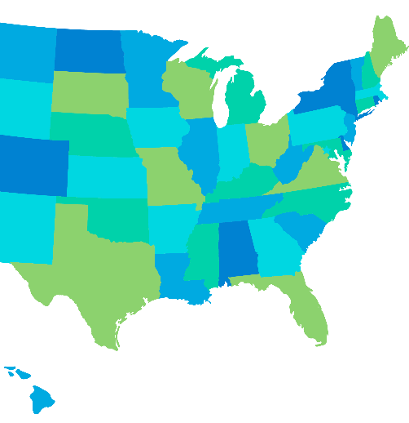
Medicare Supplement
Federally standardized Medigap plans offered in all states and DC.
8 Plans A – N offered in most states
All policies will offer the same basic benefits.
Notes:
If you want to explore Medicare Supplemental insurance or Medigap, there are lots of options. You must have Medicare Parts A and B but then purchase a Medicare Supplement policy to cover certain costs that Medicare does not. There are 8 federally standardized Medicare Supplement insurance plans that are offered in most states – Plans A through N. They are offered by many different insurance companies. Effective January 1, 2024, Plans C and F will only be available to individuals who were eligible for Medicare prior to January 1, 2020.
Here’s what’s important. All Medicare supplement plans contain the same basic benefits and all plans with the same Plan letter provide identical coverage for medical expenses no matter where you buy them. Plans have the same standardized benefits for each letter category, only the premiums may vary. Your policy may have a different cost depending on the insurance company, but still have the same coverage (although there may be a policy with an additional innovative benefit available in your area). Look at proposed plans along side each other and compare those to what you already have with Medicare A & B, then decide.

Slide 12

When it’s the best path
Want to budget medical costs
Travel and may need to see a doctor away from home
See any doctor or specialist, no referrals
Plans help pay some of the health care costs that Medicare does not pay (deductibles, coinsurance and/or copayments)
You can keep it as long as you pay premiums on time
Notes:
Medicare Supplement Insurance can help you pay for the gaps in Medicare coverage. It helps if you want to budget your medical costs or if you travel often and may need to see someone other than your hometown doctor. If you want health care coverage for things outside Parts A & B, like vision and dental, you can purchase additional insurance coverage.
Medicare Supplement policies are guaranteed renewable.

Slide 13

Medicare Advantage
Part C replaces A&B and can include Part D
PPO or HMO network of doctors
  Usually one or more plans available in a county
  Includes a Maximum Out of Pocket
Notes:
Medicare Advantage is another option. Medicare Advantage plans require that you have original Medicare Parts A & B. It provides coverage though provider networks also called HMOs, PPO, and MSAs. Medicare Advantage Part C basically replaces original Medicare Parts A and B and can include coverage for Medicare Part D. The key benefit is that Medicare Advantage plans include a maximum out of pocket feature to help you control costs.

Slide 14

When it’s the best path
Pay a lower premium
Use as a backup for VA services
Like the network of doctors
On a low-income subsidy for Medicare
Notes:
Medicare Advantage is good if you like the network of doctors in your area and want to pay a lower premium. Medicare Advantage is a good idea if you are a veteran and use VA services or if you have a low-income subsidy for Medicare.

Slide 15

Prescription Drugs
Part D
Prices vary by plan
Included with some retirement plans
Late enrollment penalties may be imposed
Vets are not required to enroll, but may choose to do so
Notes:
Now back to prescription drugs. Part D covers prescription drugs – think D for drugs. Costs vary by plan. Part D may or may not be part of employee group health plan, a union plan or retiree coverage. Veterans are not required to enroll in the coverage, but may choose to do so.

Slide 16

Changes to Drug Plans in 2025
What Medicare Recipients Need to Know

Slide 17

Changes to Medicare Part D
A newly defined standard Part D benefit design consisting of three phases: annual deductible, initial coverage, and catastrophic coverage
The sunset of the Coverage Gap
A lower annual out-of-pocket (OOP) threshold of $2,100
Gives CMS the ability to negotiate pricing with drug manufacturers – starting with 10 drugs in 2026
Capped cost of insulin at $35 per month
Notes:
The discussed bill addresses broad sectors including climate change, manufacturing, and healthcare, with a particular focus on Medicare Part D. Notable changes to the structure of Part D plans include the elimination of coverage gaps and setting maximum out-of-pocket spending limits.
Historically, Part D had a $250 deductible, which has increased to approximately $600, significantly impacting beneficiaries' financial burden at pharmacies.
Enacted proposals have introduced a $2,100 cap on out-of-pocket expenses for Medicare beneficiaries, specifically capping costs at $35 for those on insulin.
Additionally, negotiations aimed at reducing prices for ten high-cost drugs are underway, with effects expected to materialize by 2026.

Slide 18
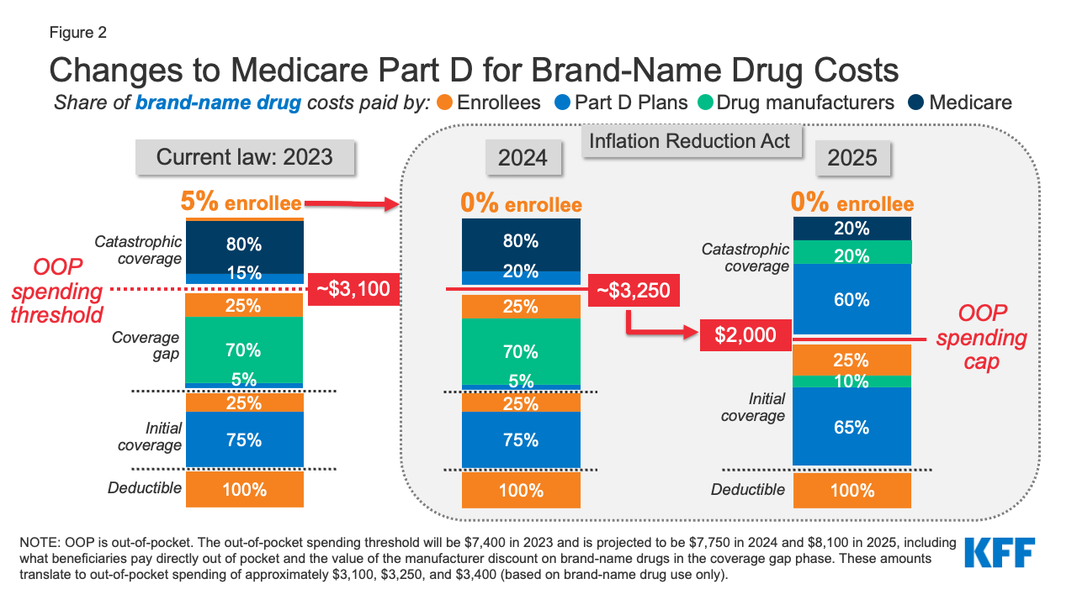
Source: https://www.kff.org/medicare/issue-brief/explaining-the-prescription-drug-provisions-in-the-inflation-reduction-act/
Notes:
Key changes to Medicare Part D are highlighted, such as the overhaul of its structure by eliminating coverage gaps and imposing maximum out-of-pocket costs. Since its introduction, the Part D deductible has increased from $250 to approximately $600, with subsequent high co-pays for beneficiaries, leading to significant pharmacy bills at the start of the year.
In 2025, the coverage gap will be eliminated. This will increase the cost-sharing burden for the carrier.
In 2024, the carrier was responsible for 20% of the drug cost in the catastrophic coverage phase and Medicare was responsible for 80%. In 2026, this shifts to the carrier being responsible for 60% and Medicare 25%.
Recent legal amendments have introduced a $2,100 cap on out-of-pocket costs for Medicare beneficiaries.
Additionally, there's a move towards negotiating drug prices, aiming to address high costs for ten specific drugs by 2026, though this benefit will not be realized immediately.
Moreover, there’s an increase in subsidies for low-income individuals, which is part of efforts to make healthcare more affordable under the Inflation Reduction Act.

Slide 19

Timeline of Cost Shifting
Part D Vaccine Coverage Expanded
No deductible or cost sharing may be charged for adult vaccines recommended by the Advisory Committee on Immunization Practices (ACIP)
Insulin Savings Program
Out of pocket costs for insulin must be capped at $35.00 per month’s supply of a covered insulin product
2023
2024
Once enrollee hits catastrophic the cost share for the remainder of the year is $0 with the plan picking up the 5% previously paid by the enrollee
2025
Setting a $2,000 annual out of pocket maximum (lowering catastrophic from $8,000 to $2,000)
Elimination of the coverage gap (Donut Hole)
Notes:
Now back to prescription drugs. Part D covers prescription drugs – think D for drugs. Costs vary by plan. Part D may or may not be part of employee group health plan, a union plan or retiree coverage. Veterans are not required to enroll in the coverage, but may choose to do so.

Slide 20
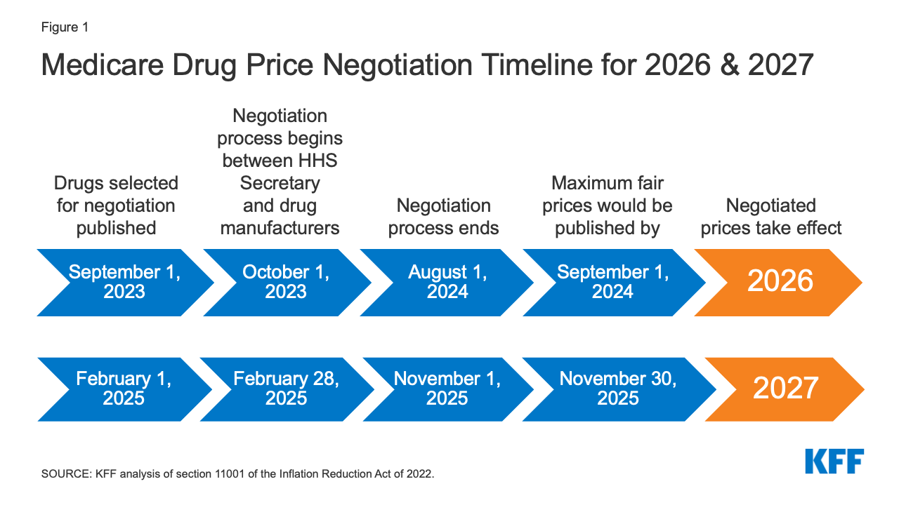
Source: https://www.kff.org/medicare/issue-brief/explaining-the-prescription-drug-provisions-in-the-inflation-reduction-act/
Notes:
Source: https://www.kff.org/medicare/issue-brief/explaining-the-prescription-drug-provisions-in-the-inflation-reduction-act/
The key points concerning the drug negotiation developments include starting with a limited set of drugs in the next year while aiming for broader implementation by 2026. Despite negotiations starting in 2023, impacts will only be palpable by 2026, marking a delayed effect.
In 2025, there will be no benefits from the negotiated drug prices, impacting seniors particularly as they notice changes in the formulary and an increase in premiums due to the Inflation Reduction Act.

Slide 21
New Part D Benefit Increases Cost to Plans
Notes:
The blue bar represents the 2020 framework regarding how the plans functioned and the impact on the members' out-of-pocket maximum. During this period, members, particularly seniors, faced significant exposure in the coverage gap. However, by 2025, this exposure for members will be eliminated, as the responsibility for managing these costs will be transferred to the insurance carriers.

Slide 22

Have questions?
The decisions you make can impact your health care coverage for a long time.

Slide 23
Firstname Lastname
Licensed Insurance Agent
PICTURE OR LOGO
Phone Number
Email@website.com

