Slide 1

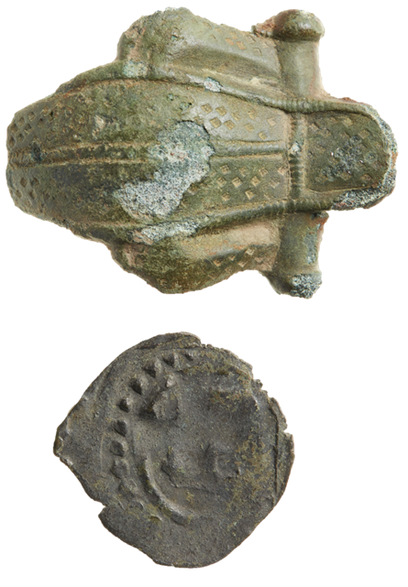
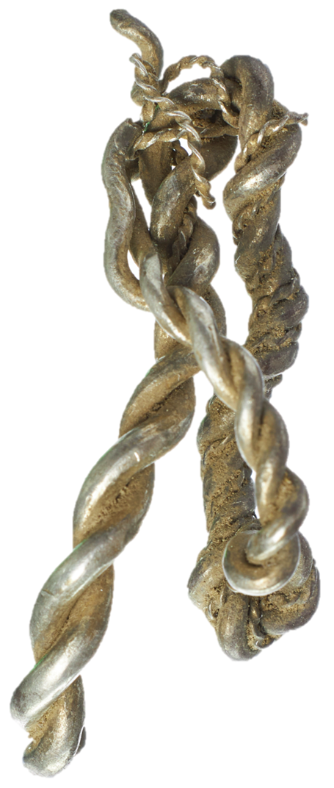

Important Points to Note:
Protected Monuments and Wrecks
An important criterion in determining the amount of Danefæ compensation is the level of care you demonstrate in handling your finds. By exercising due care, you help pre-serve their cultural and historical value.
Record the find location using GPS coordinates and share this information with the archaeological museum. The precise location is important, as it helps archaeologists understand how your discovery fits into the historical and archaeological context of the site.
It is illegal to dig below plough depth, typically 20–25 cm. If you find something – or suspect, there may be something deeper – you must immediately contact the local archaeological museum to preserve its cultural and historical value.
Objects must not be cleaned or treated. Important information that is not visible to the naked eye may be pre-sent. For example, traces of textiles may remain in the soil attached to the object.
Objects must not be damaged due to improper storage. It is important to contact the museum promptly and submit your find so that it can be stored correctly and examined by specialists
Using a metal detector is prohibited on protected ancient monuments and within two metres of them. The same applies to protected wrecks and ancient monuments located on the seabed or in lakes and watercourses.
Before using a metal detector, you are responsible for familiarising yourself with protected ancient monuments and wrecks. The prohibition applies to all visible ancient monuments, as well as certain invisible monuments, such as buried ruins.
On the seabed and in inland waters, it is prohibited to remove objects from ancient monuments, shipwrecks, or cargoes that are more than 100 years old.
Metal Detecting
in Denmark
Useful Links:
Find the museums’ archaeological areas of responsi-bility and contact details here:
https://slks.dk/omraader/kulturarv/arkaeologi-fortidsminder-og-diger/arkaeologi/ansvarsomraader-og-kontak
Learn more about what qualifies as Danefæ, how to submit Danefæ, and how compensation is paid here:
https://natmus.dk/salg-og-ydelser/museumsfaglige-ydelser/danefae
Information about protected ancient monuments can be found in the central register Fund og
Fortidsminder (Finds and Ancient Monu-ments). This information is also available in the “§ 3 Nature” app – displaying protected ancient monuments on accessible maps.
Rules and Guidelines

Slide 2
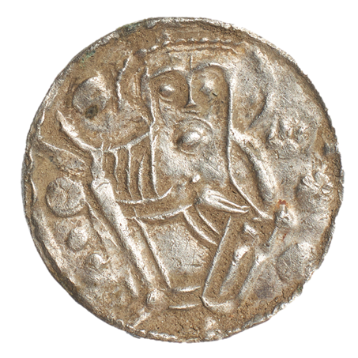
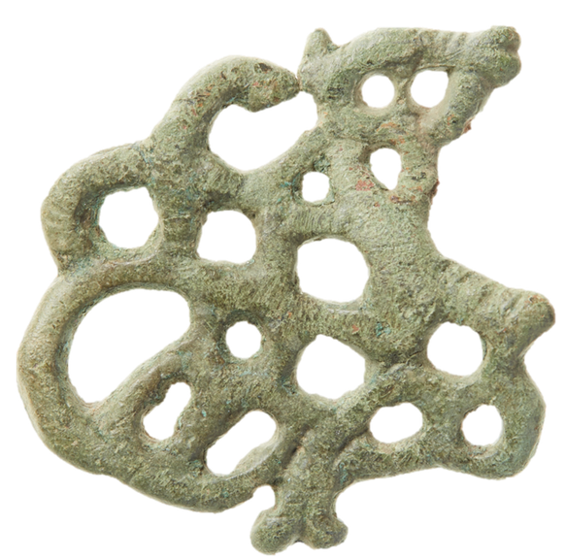
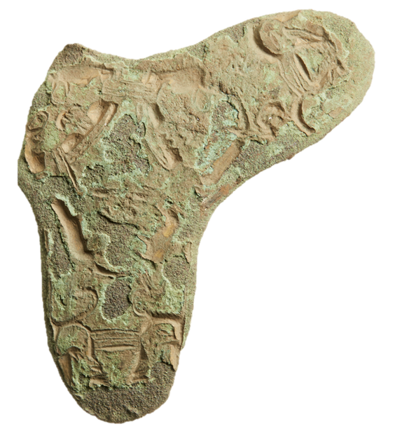
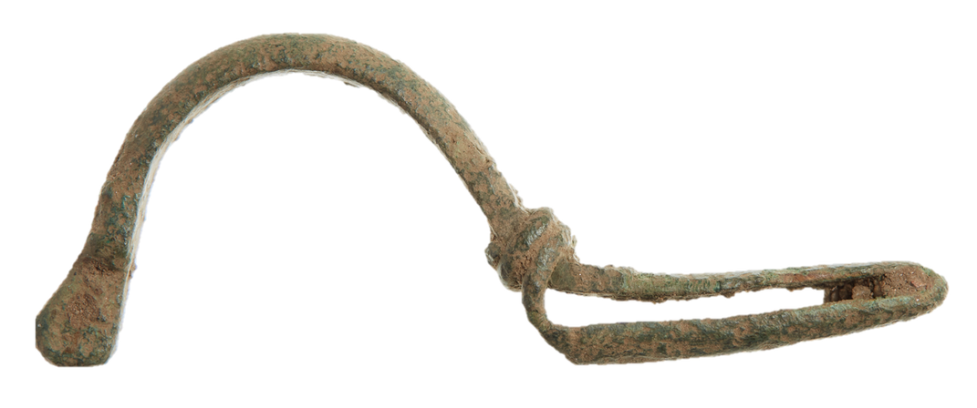
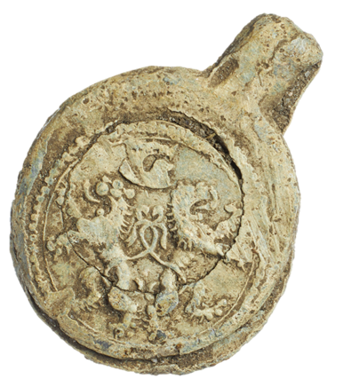
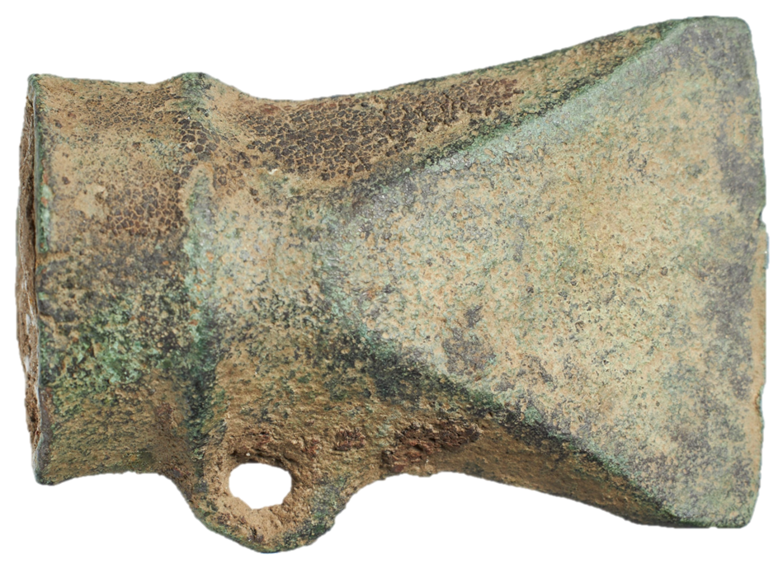
Protect Our Shared Past
Contact the Local Museum
Read here about the rules for using a
metal detector in Denmark. It is your responsibility to know and comply with the regulations that apply to both Danish and foreign citizens.
If you find Danefæ (treasure trove), it be-longs to the Danish state. Danefæ refers to objects from the past with significant cultural and historical value that have been found in the ground. These may include items made of precious metals or medieval coins.
The Danefæ legislation dates to the Middle
Ages. By reporting Danefæ, you help preserve important discoveries from Denmark’s past for future generations.
Before searching an area with a metal detector, it is advisable to contact the local archaeological museum.
The museum can advise you on handling finds and find spots, inform you about documentation requirements, and explain how to submit finds. The museum can also inform you about protected areas where metal detecting is not permitted.
If you find objects made of precious metal or
items of cultural and historical significance, they must be delivered as soon as possible
to the local museum with archaeological responsibility. The museum will assess whether the objects should be forwarded to the National Museum of Denmark for Danefæ evaluation.
Permission from the Landowner
You must obtain permission from the land-owner before searching an area with a metal detector. This applies to private land, protected natural areas, beaches, forests, as well as municipal and state-owned land.
Special permission is required to use a metal detector on state-owned land. Applications must be submitted to the authority responsible for the area. The Danish Nature Agency only grants permission if you have a formalised collaboration with a state-recognized museum.
Municipalities have their own requirements
regarding permission to use metal detectors on public areas, such as parks and beaches. You can usually obtain guidance from the municipality’s technical and environmental department.
Danefæ Compensation
What Is Danefæ?
Danefæ is not limited to gold, silver, and coins. Other objects of cultural and historical significance may qualify as Danefæ.
Contact the local archaeological museum if you are in doubt. You can also visit the National Museum of Denmark’s website to read more about what may qualify as Danefæ.
If your find is declared Danefæ, you will receive compensation from the National Museum of Denmark. The amount of compensation depends on the material value, rarity and the care with which it has been handled.
Rember to provide your contact details
when submitting your find to the local archaeological museum.

