Slide 1
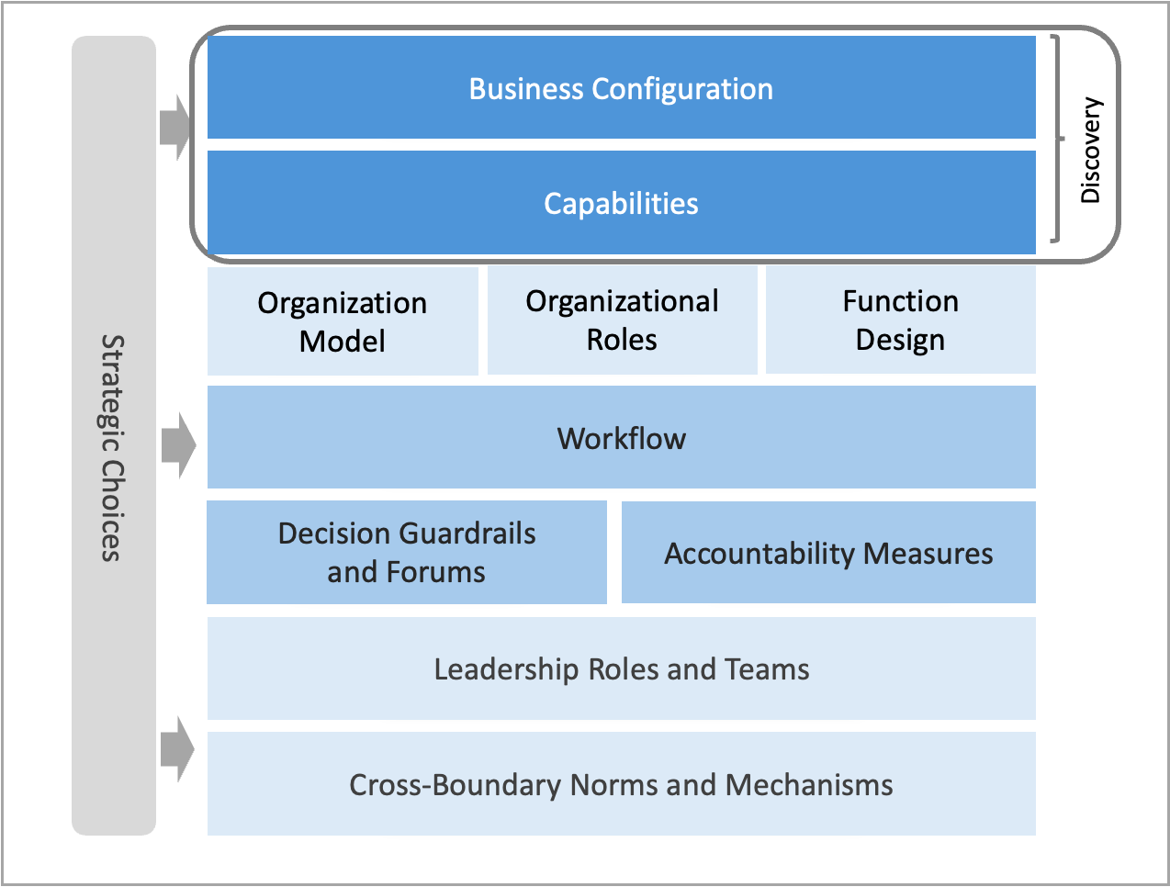
Discovery and Ambition elements of the operating model: Design outputs for Milestone One.
M1.4

