Slide 1
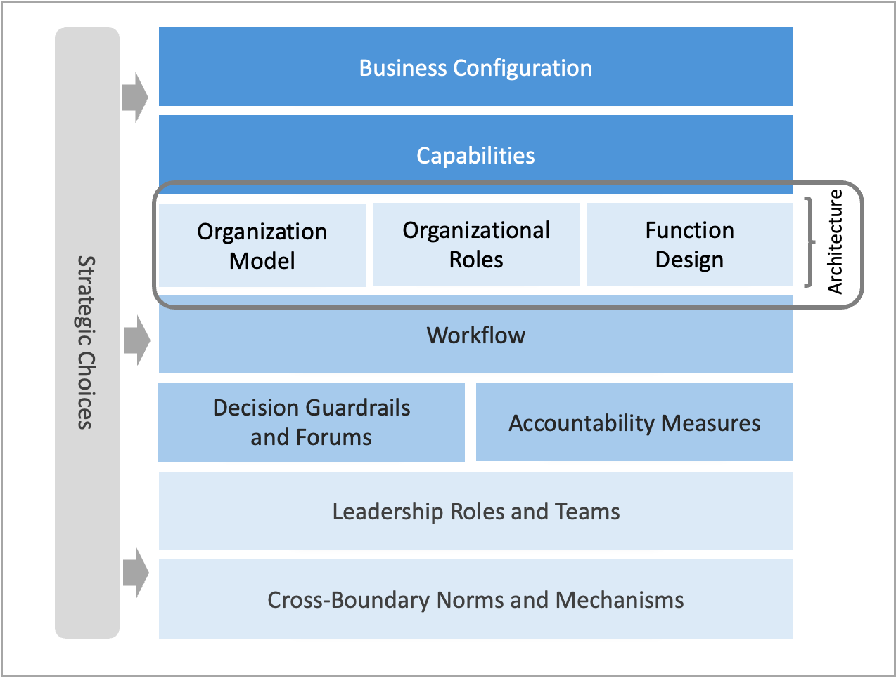
Architecture Milestone elements of the operating model: Design outputs for Milestone Two.
M2.2

