Slide 1
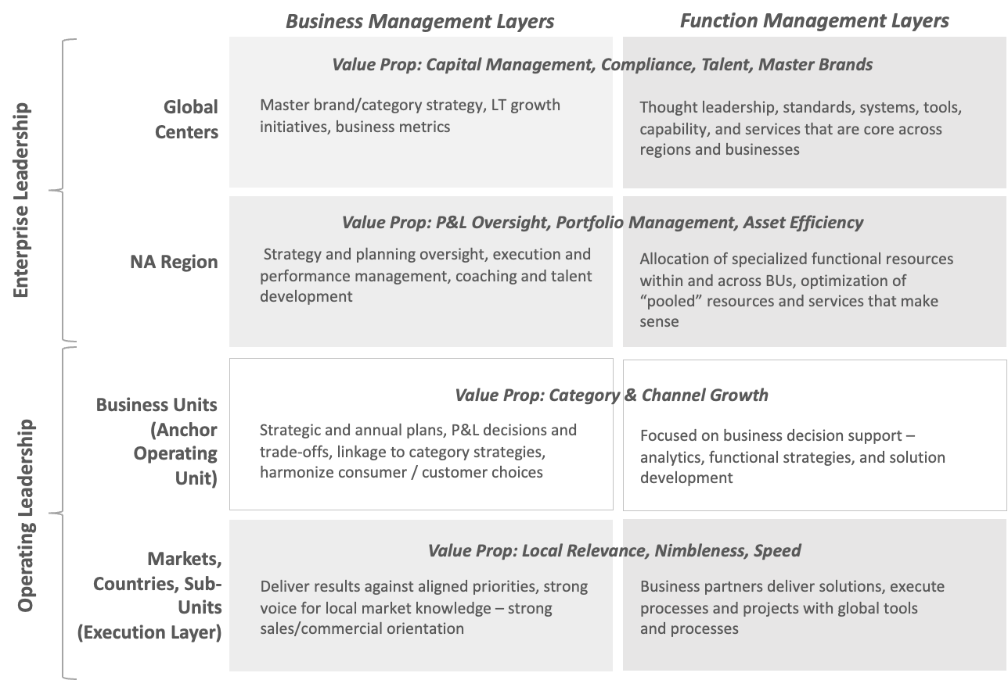
Organization roles example: Business and function units distinguished for each layer.
Strategic Layer
Portfolio Management
Integrative Layer
Operating Layer
M2.11

