Slide 1
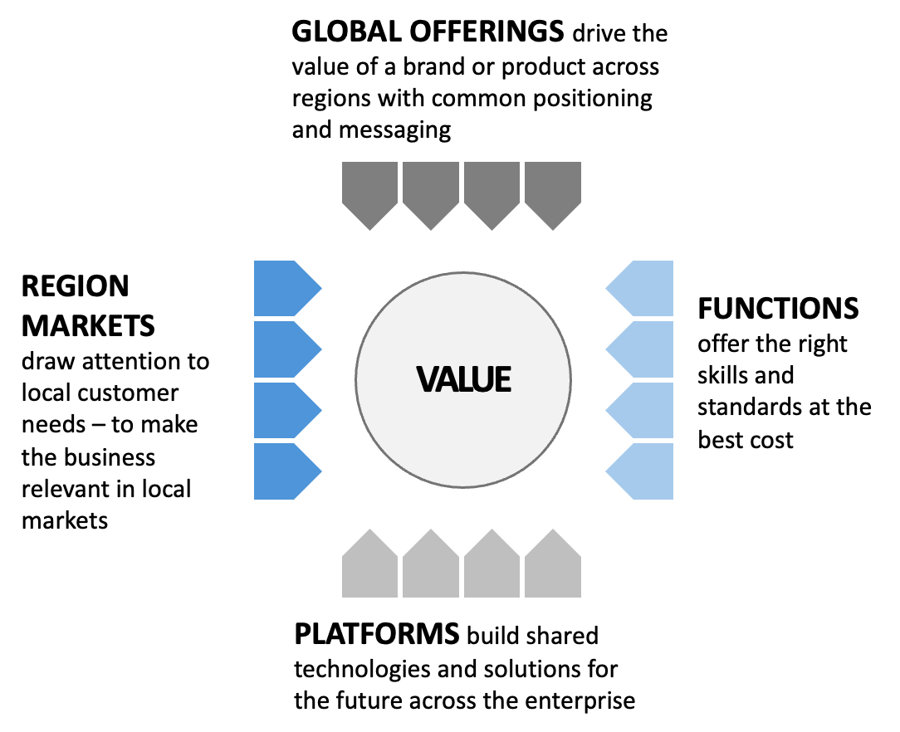
Purpose of the matrix: Multiple voices for value ”at the table” in the multi-dimensional operating model.
M3.4

