Slide 1
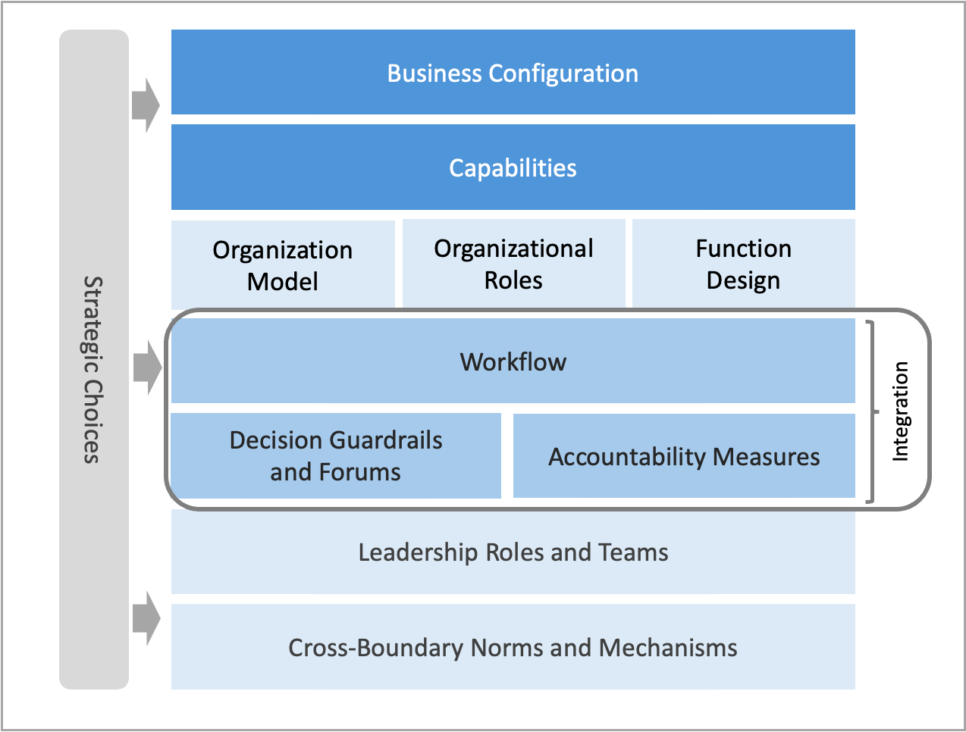
Integration Milestone elements of the operating model: Design outputs for Milestone Three.
M3.2

