Slide 1
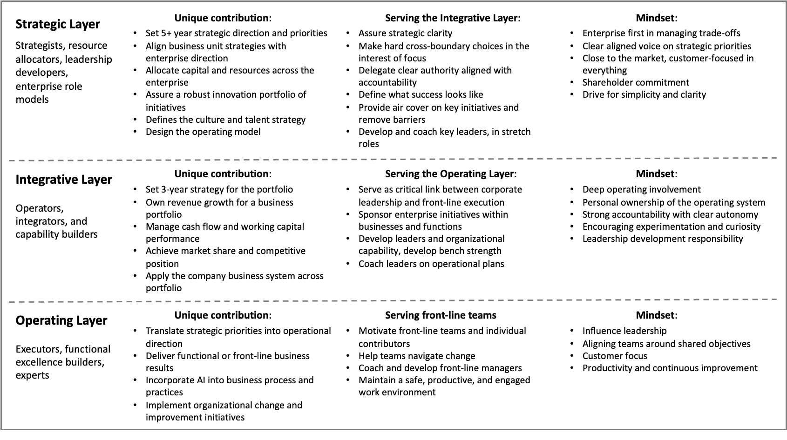
Leadership roles example for each layer: For diversified healthcare products company.
M4.5

