Slide 1
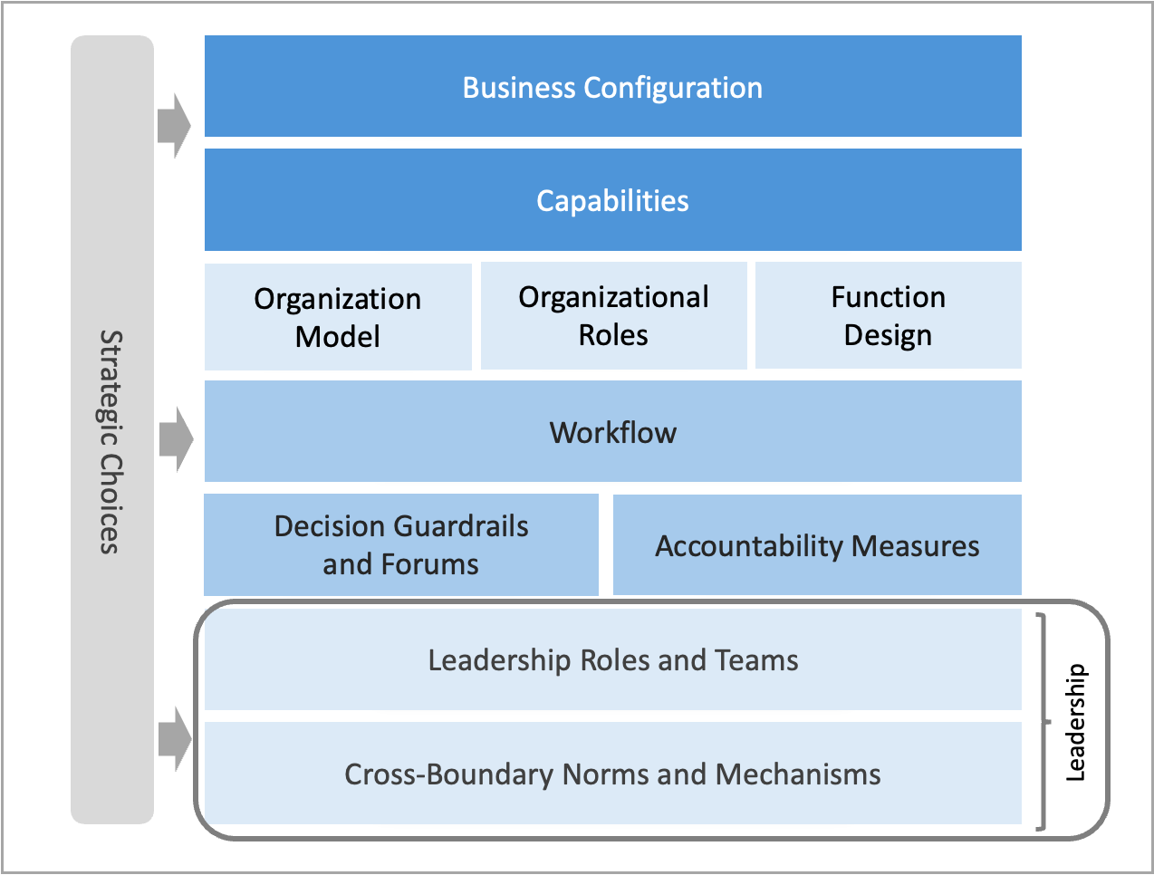
Leadership Milestone elements of the operating model: Design outputs for Milestone Four.
M4.2

