Slide 1
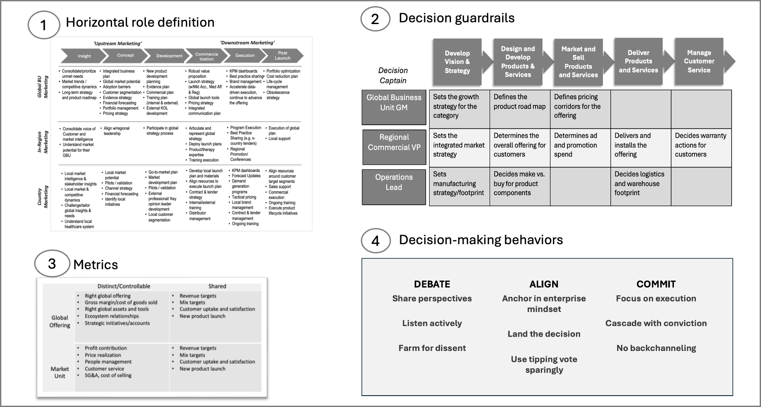
Interaction model example: With decision rights, metrics, and key behaviors for life sciences company.
1
(c) Kates and Kesler 2026
M3.19

