Slide 1
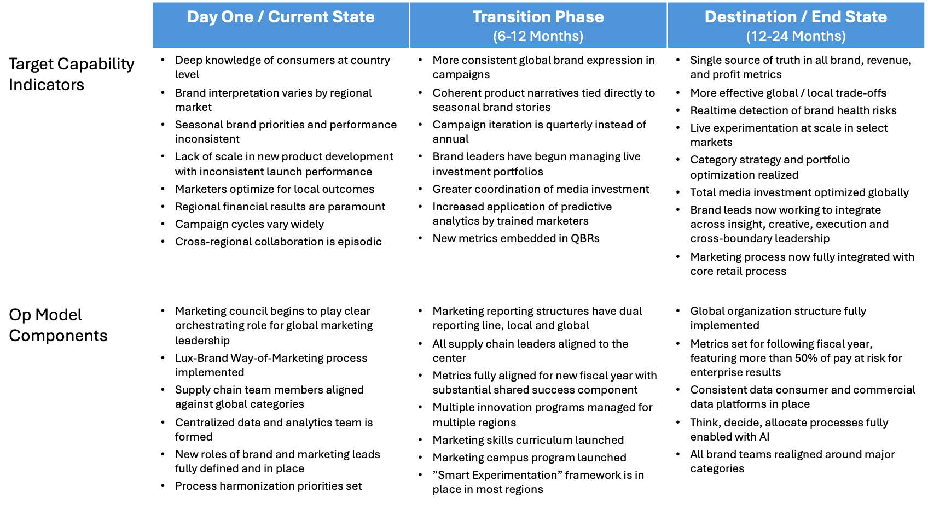
Example: Pace and sequencing indicators for a luxury brand company shifting from local to global brand management. Note the timeframes at the top of the table
M5.2

