Slide 1




Healthy Communication:
Strengthening Relationships through Gratitude
Grades 9-12

Slide 2



Say it Now is all about sharing our gratitude to others now instead of waiting.

Slide 3








Table of Contents:
*Helpful Tip: Spread these lessons out as much as you need to! Make them fit YOUR schedule.
INVESTIGATE AND LEARN
PLAN
REFLECT
TAKE ACTION
  Learn about gratitude, what it is, why it is important and how it supports healthy relationships and well-being.
  Learn about gratitude through a diverse lens by exploring various perspectives.
  Learn about healthy relationship habits and how authentic gratitude can support it.
  Identify individuals to express gratitude towards
  Explore various creative tools for expressing gratitude.
  Plan an expression of gratitude for someone special.
  Utilize a creative tool to express gratitude to someone.
  Reflect on the experience of expressing gratitude and its impact on the self and others.
Slides 2-17
Slides 18-23
Slides 24-26
Slides 27-30

Slide 4

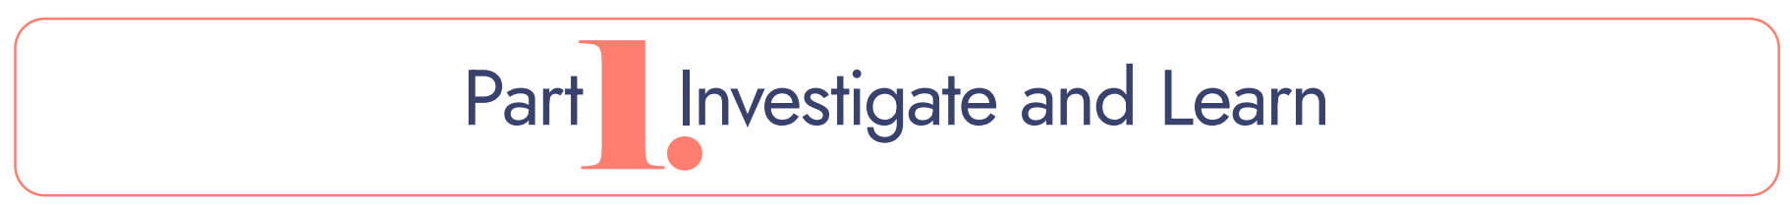


Slide 5




A Mindful Start
Mindfulness is:
being fully in the present moment.
being aware of your thoughts and feelings.
being totally engaged in what you are doing.
trying not to get distracted.
If you do get distracted, that’s okay. Just try to bring your mind back in the moment.
Notes:
3

Slide 6

A Mindful Start
Notes:
3

Slide 7

All About Gratitude
  What is gratitude? What does it look and sound like?
  How do you think gratitude is connected to well-being?
  How do you think gratitude is connected to healthy relationships?
What is gratitude?
Notes:
3

Slide 8
The Science of Gratitude
  ​Gratitude is strongly and consistently connected with greater happiness. (Harvard, 2021)
  Gratitude builds strong bridges between people, releases warmth in us, and can even change lives.
Gratitude can:
  Strengthen immune systems
  lower blood pressure
  Improve sleep
  have positive long-term benefits months later
Notes:
3

Slide 9
The Science of Gratitude
Notes:
3

Slide 10
The Science of Gratitude
Notes:
3

Slide 11
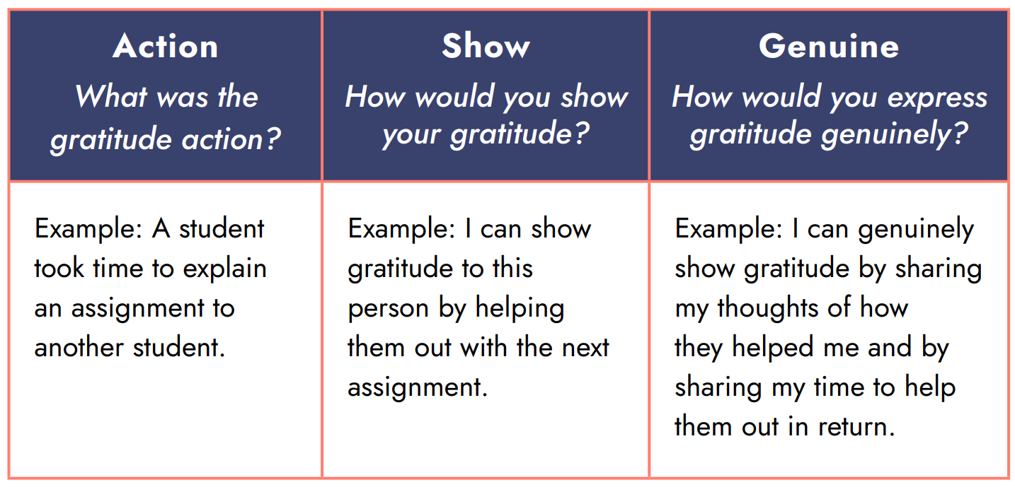

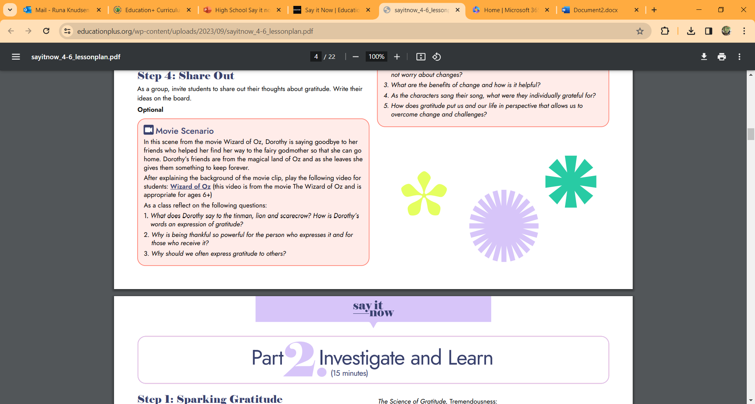
Gratitude Practice
Let’s think of a few examples…
Notes:
3

Slide 12
Gratitude Practice
A few tips on expressing “genuine” gratitude:
  Be specific about what action you appreciate
  Highlight what you value, appreciate, and care about the person
  Incorporate positive body language (smile, eye contact, etc)
  Use positive words
  Try to be authentic and honest
Notes:
3

Slide 13
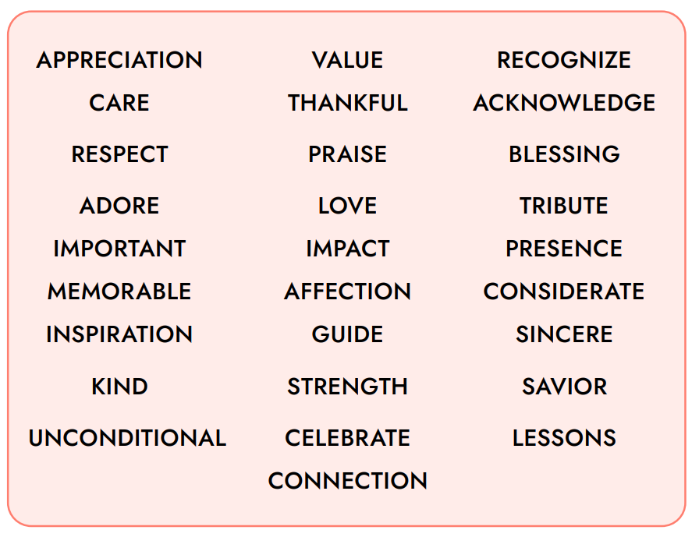
Gratitude Terminology
Small Groups: Define the words assigned to your group and come up with an example of how each of your words could connect to gratitude.
Notes:
3

Slide 14
Gratitude in Different Cultures
Notes:
3

Slide 15
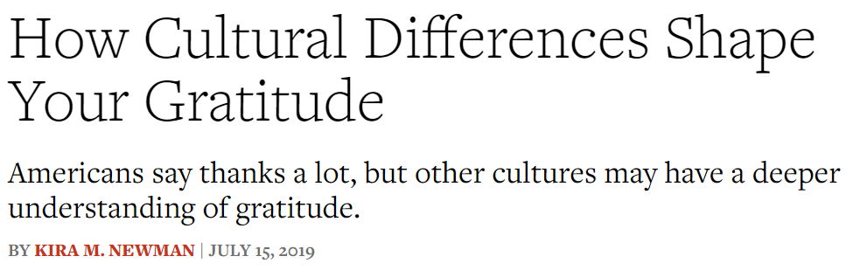
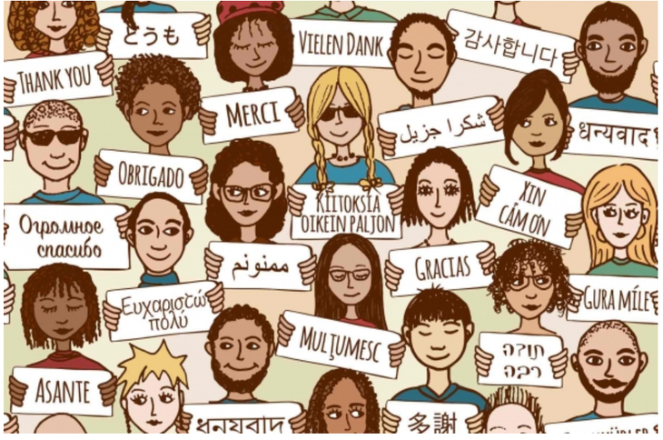
Gratitude from Different Perspectives
Let’s look at gratitude from a multicultural perspective. Read this article with your group and be ready to discuss as a class.
Notes:
3

Slide 16
Gratitude from Different Perspectives
Discussion Questions:
  What is something you learned about gratitude in different cultures?
  What categories of gratitude did you read about? What did you learn about the categories?
  Why do you think it’s important to be aware of the cultural perspectives of gratitude?
Notes:
3

Slide 17
Challenges of Gratitude
Gratitude can be tough…
  Expressing gratitude can make people uncomfortable.
  It might not be something practiced in your culture.
  You might not feel grateful each day.
  Some people may feel expressing gratitude is weak.
Can you think of any other challenges there might be?
Notes:
3

Slide 18
Challenges of Gratitude
But remember, while gratitude should never be forced…
  It’s okay express gratitude if you’re uncomfortable
  You are still strengthening your relationship
  You are boosting your well-being and their well-being
  You can choose a way that is more comfortable for you and them
Notes:
3

Slide 19

The only mistake we make about expressing gratitudie is never expressing it at all.
Walter Green

Slide 20
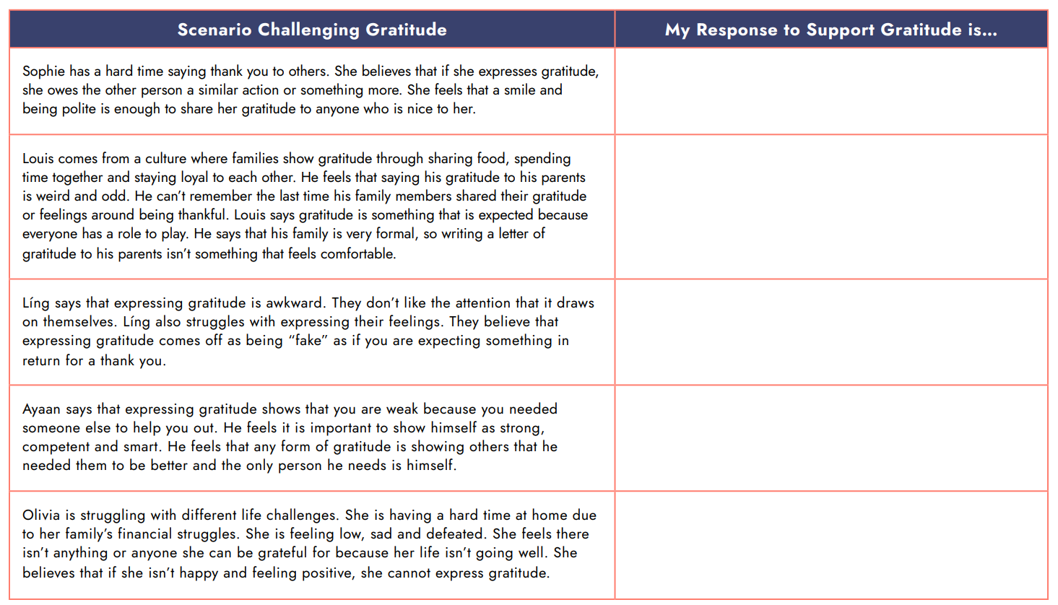
Challenges of Gratitude
Discuss possible responses to these challenges- there are no right or wrong answers!
Notes:
3

Slide 21
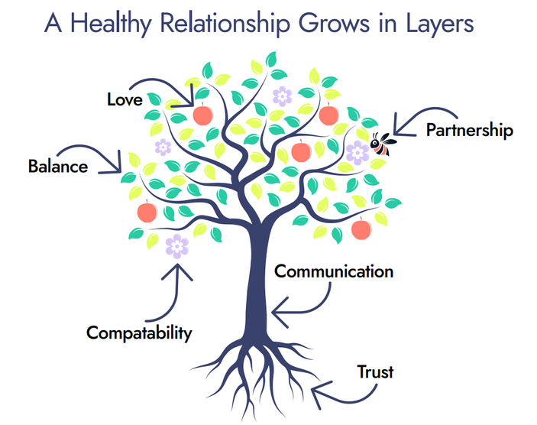
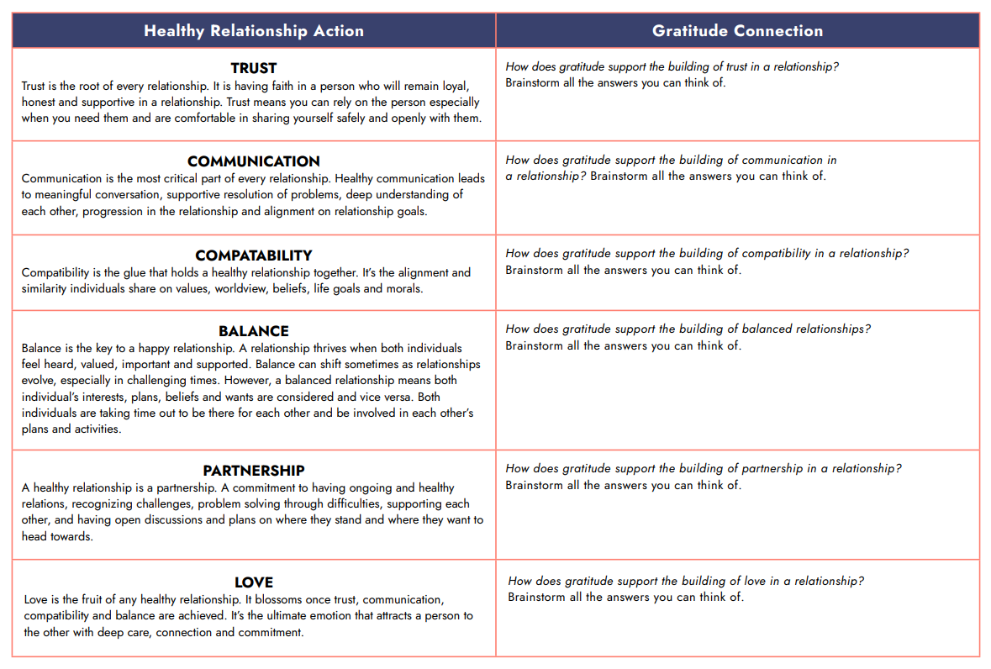
Healthy Relationship Habits
Discuss possible responses to these challenges- there are no right or wrong answers!
Notes:
3

Slide 22


Slide 23
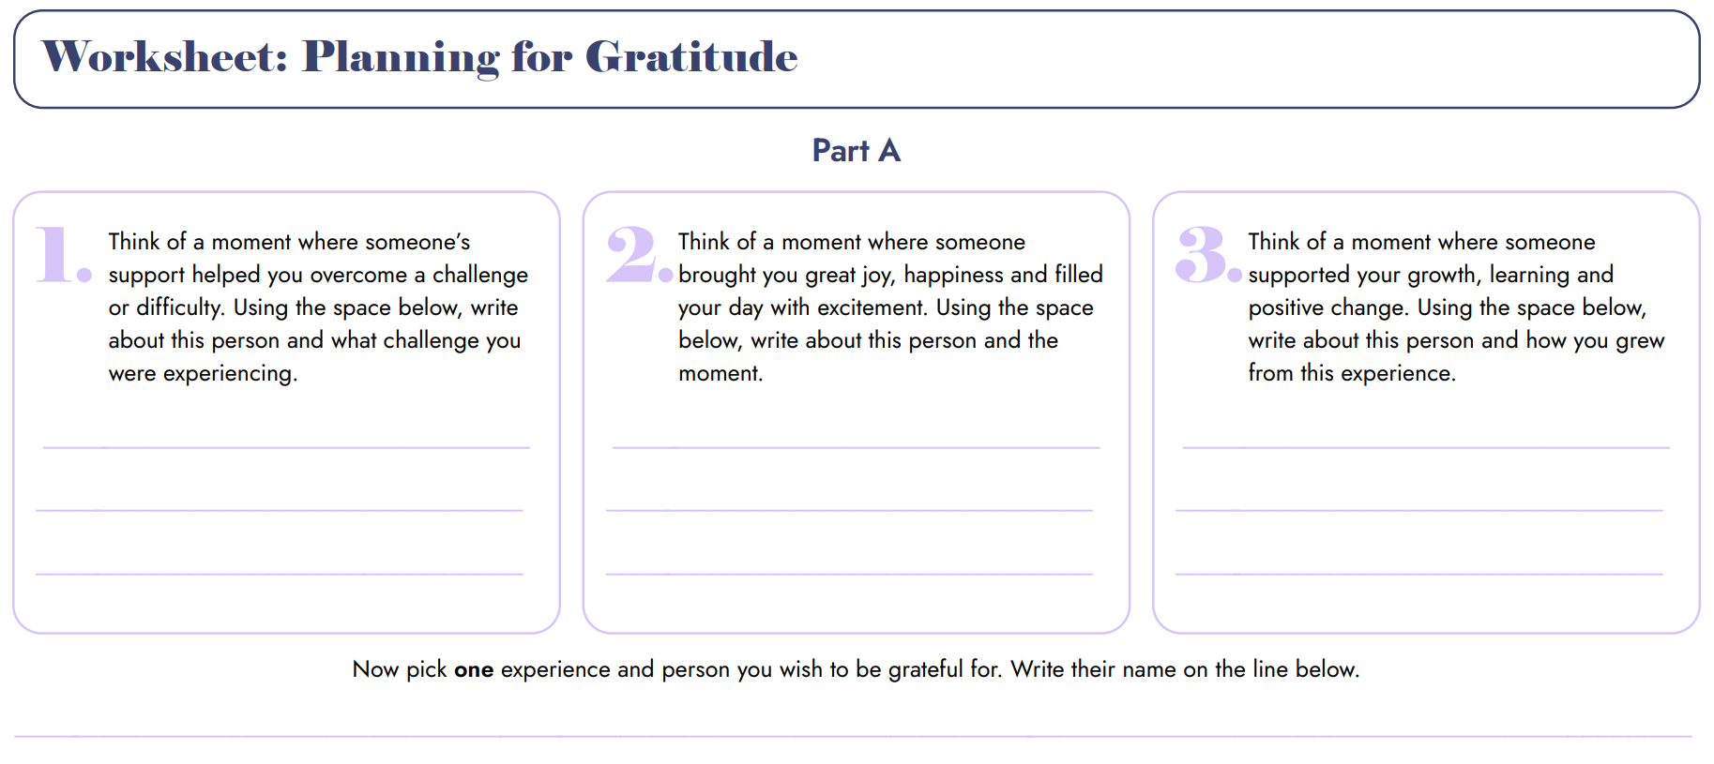
Planning Gratitude
Notes:
3

Slide 24
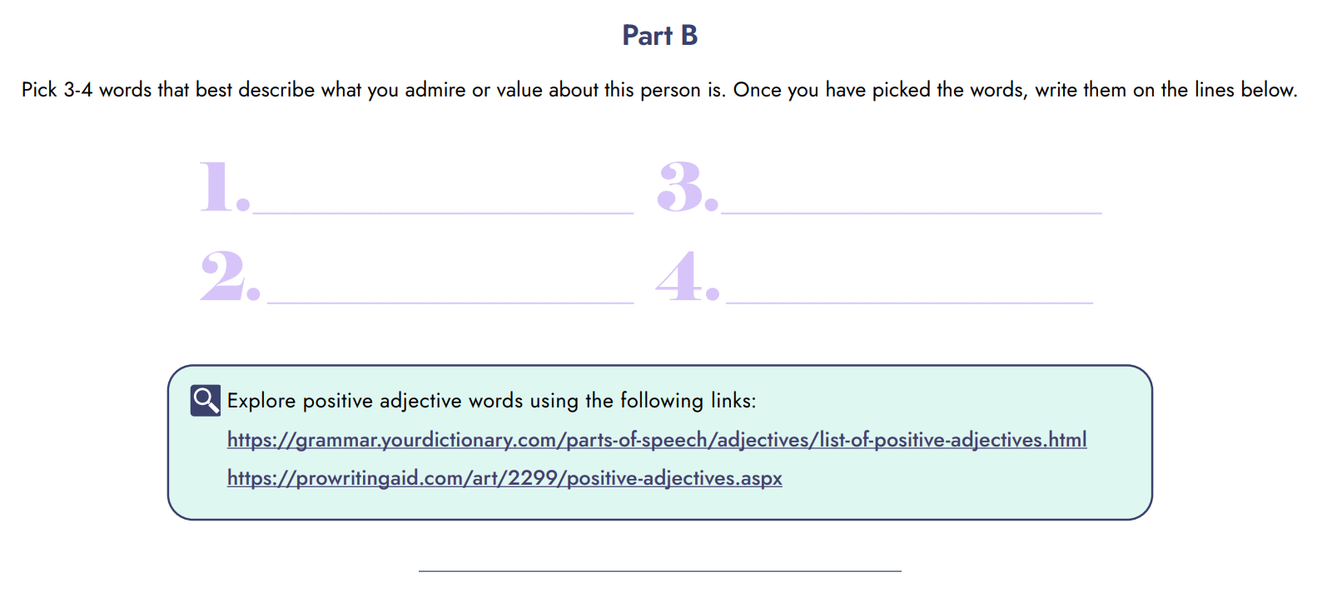
Planning Gratitude
125+ Positive Adjectives | List of Adjectives | YourDictionary
The Ultimate List of Positive Adjectives (prowritingaid.com)
Notes:
3

Slide 25
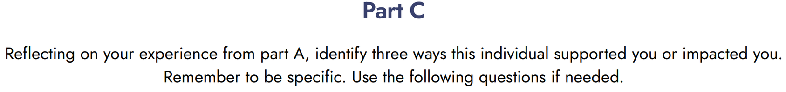
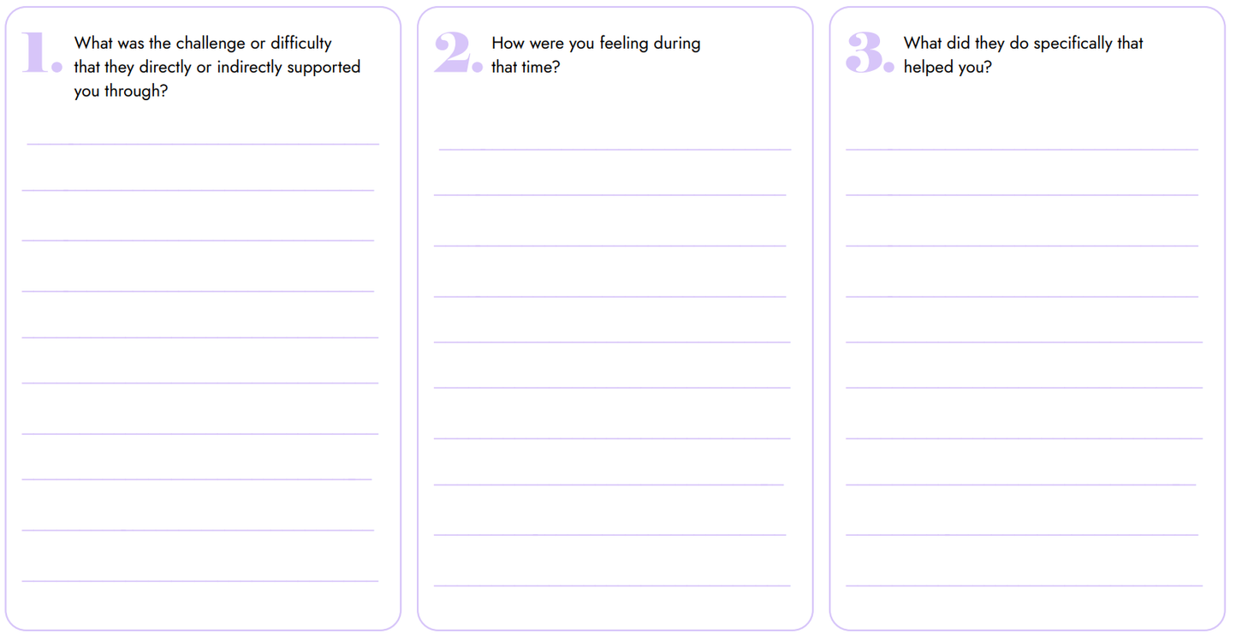
Planning Gratitude
Notes:
3

Slide 26
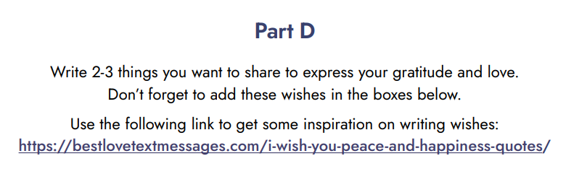
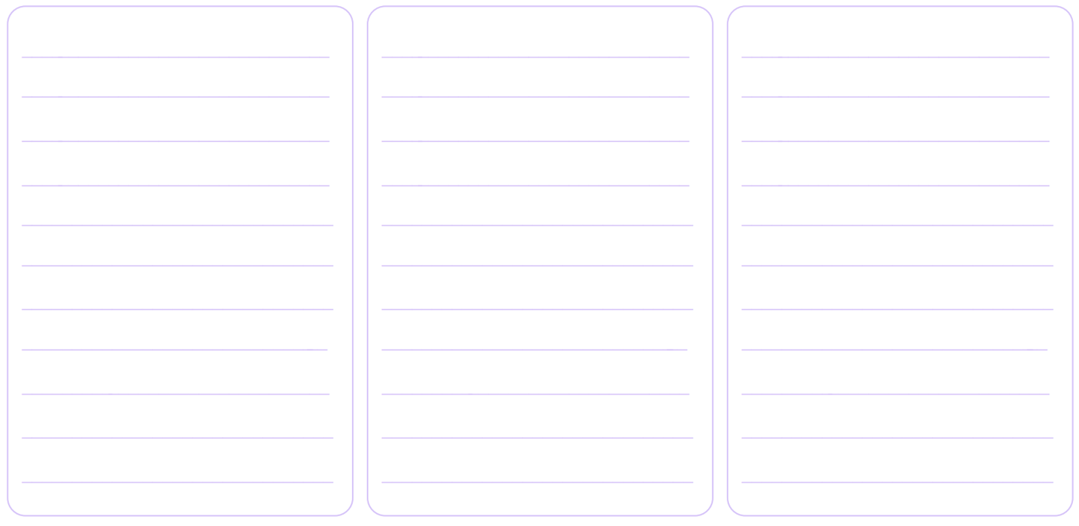
Planning Gratitude
I Wish You Peace And Happiness Quotes - Best Messages (bestlovetextmessages.com)
Notes:
3

Slide 27
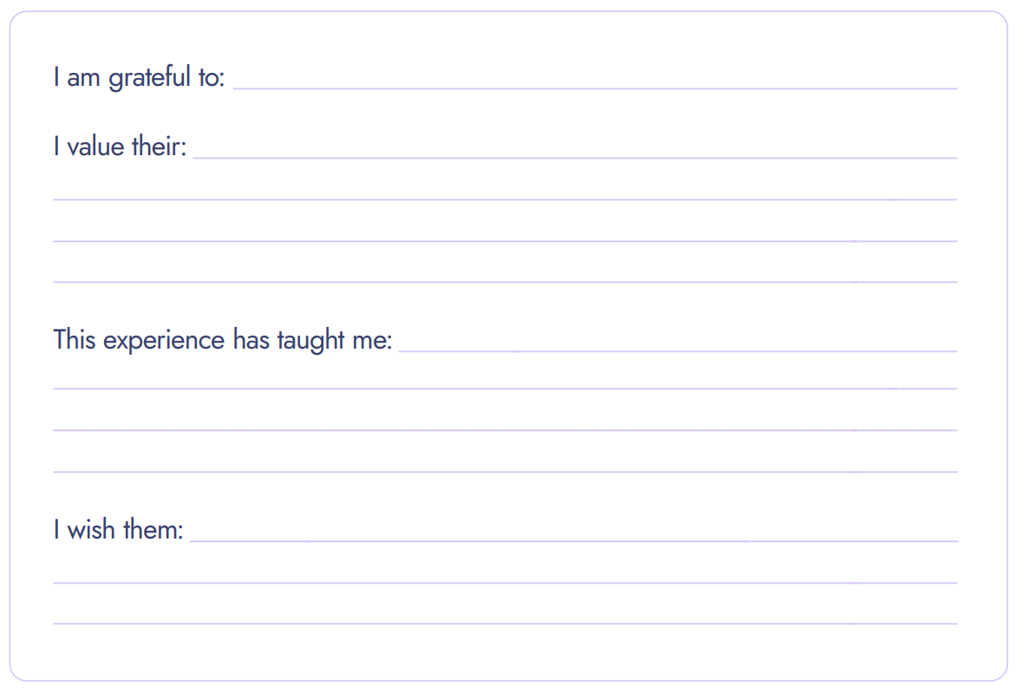
Planning Gratitude
Notes:
3

Slide 28


Slide 29

Gratitude Expressions
When deciding how to express your gratitude, take time to consider…
1.
Who are
How do you think they would like to receive gratitude?
they
Combine their personality and your personality into your expression of gratitude
2.
Who are
you
Notes:
3

Slide 30
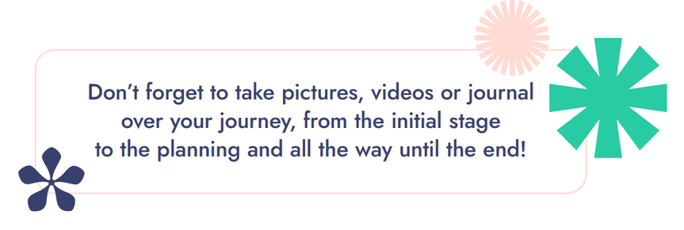

Gratitude Expressions
  In person
  Living Tribute
  Virtually
  Recording
  Letter
  Personalized gift
  Card
  Artwork
  Poem
  Music
  Collage
Notes:
3

Slide 31


Slide 32
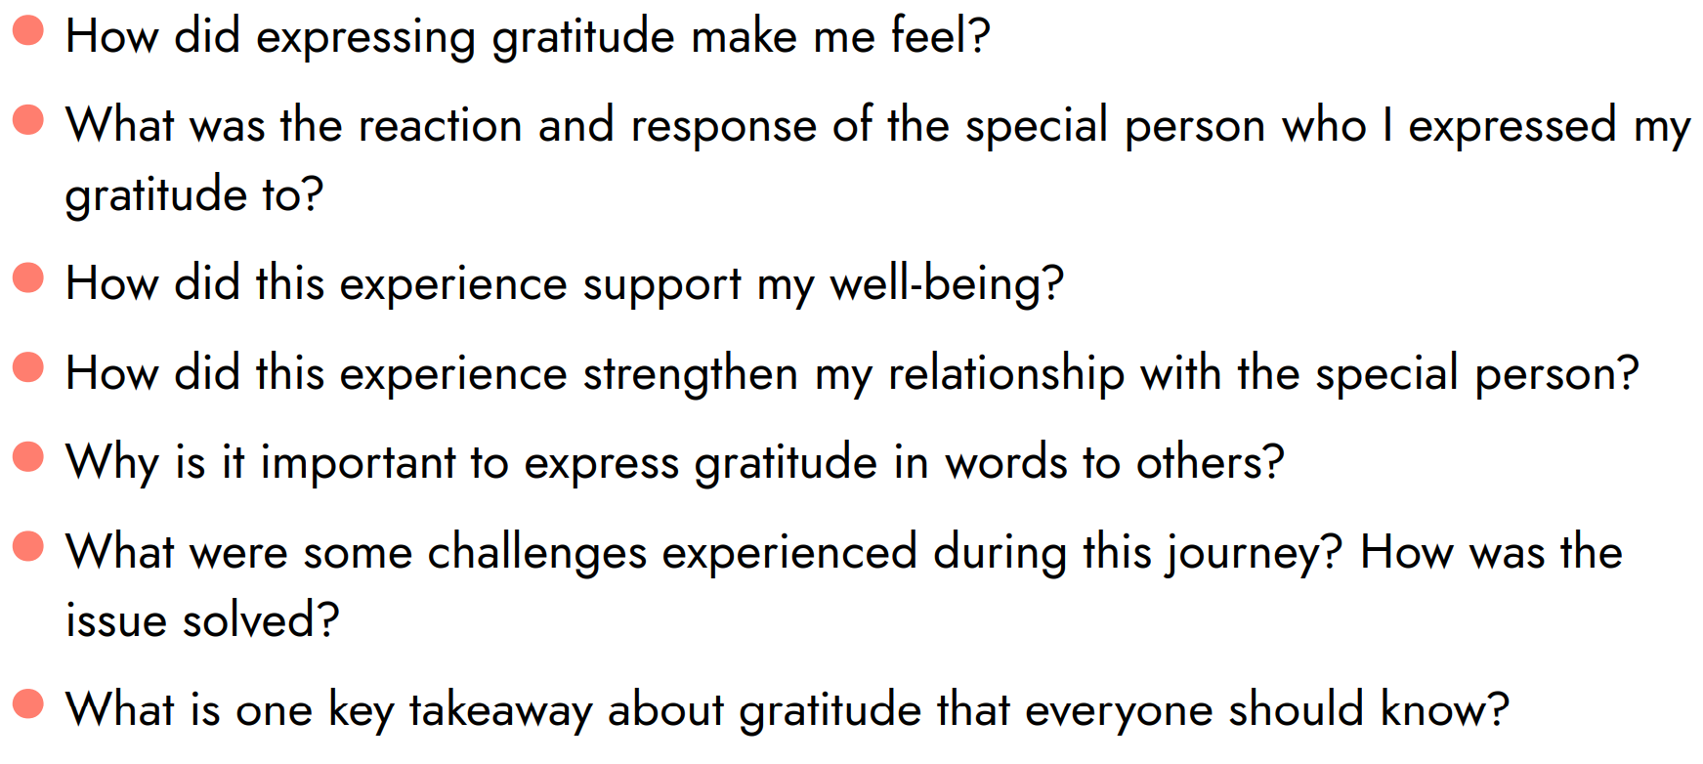
Reflection Questions
Notes:
3

Slide 33

Celebrate and Next Steps
  How could we celebrate our accomplishments?
  How could you continue spreading gratitude?
  How could you encourage others to spread gratitude?
Notes:
3

Slide 34



Your gratitude brought goodness to the world!
Teachers- please share pictures of your project with…
Notes:
30

