Slide 1




Grades 4-8

Slide 2





Table of Contents:
1.
2.
3.
Lesson
Lesson
Lesson
We Have Gratitude
Slides 3-15
We Express our Gratitude
Slides 16-24
We Reflect on and Celebrate Gratitude Slides 26-30
  Mindful Start
  Linking “thankful” to “gratitude”
  Science of Gratitude
  Discussion
  Reflection and Closing
  Gratitude quiz
  Mindful Start
  Reflecting on gratitude
  Who could we be grateful for?
  Gratitude Expressions
  We have gratitude for others
  Mindful Start
  Independent and collaborative reflection of gratitude experience
  Next Steps
  Thank you!
Slides 2-17
Slides 18-31
Slides 31-40

Slide 3




1.
Lesson
We Have Gratitude

Slide 4
A Mindful Start
Mindfulness is...
being fully in the present moment.
being aware of your thoughts and feelings.
being totally engaged in what you are doing.
trying not to get distracted.
If you do get distracted, that’s okay.
Just try to bring your mind back in the moment.

Slide 5




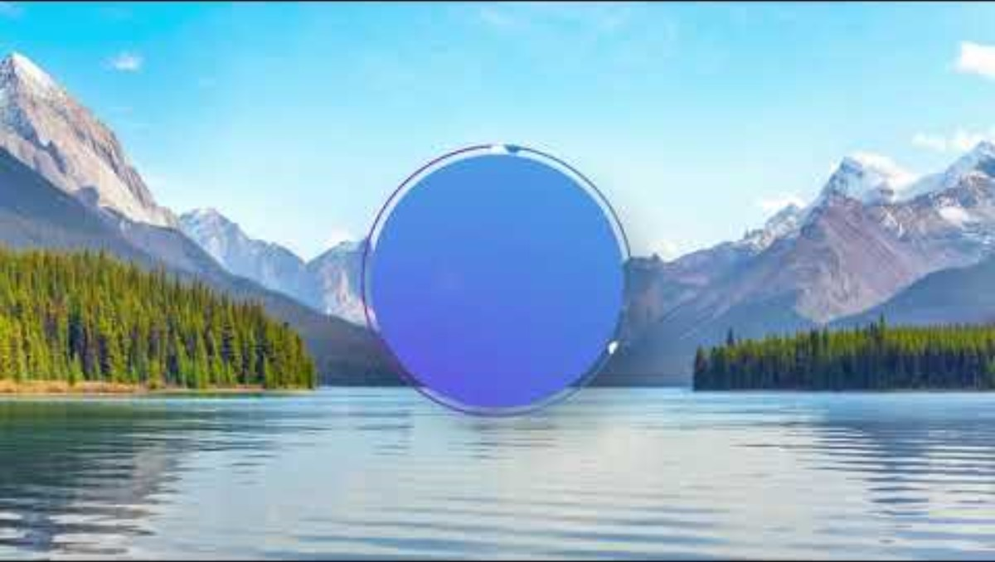

A Mindful Start

Slide 6



Experiential Learning
1.
Take a quiet moment to draw and write about something you are thankful for.
What are you thankful for?
2.
When you and your shoulder partner are done, share what you wrote, if you are comfortable sharing.

Slide 7

All About Learning
Think-Pair-Share
What is
gratitude?
How would you define gratitude?

Slide 8

All About Gratitude
Gratitude is
feeling thankful to someone for...
teaching you
playing with you
making you feel better
encouraging you
helping you
taking care of you
taking care of your community
forgiving you
protecting you
challenging you
being friendly
What else can you think of?

Slide 9

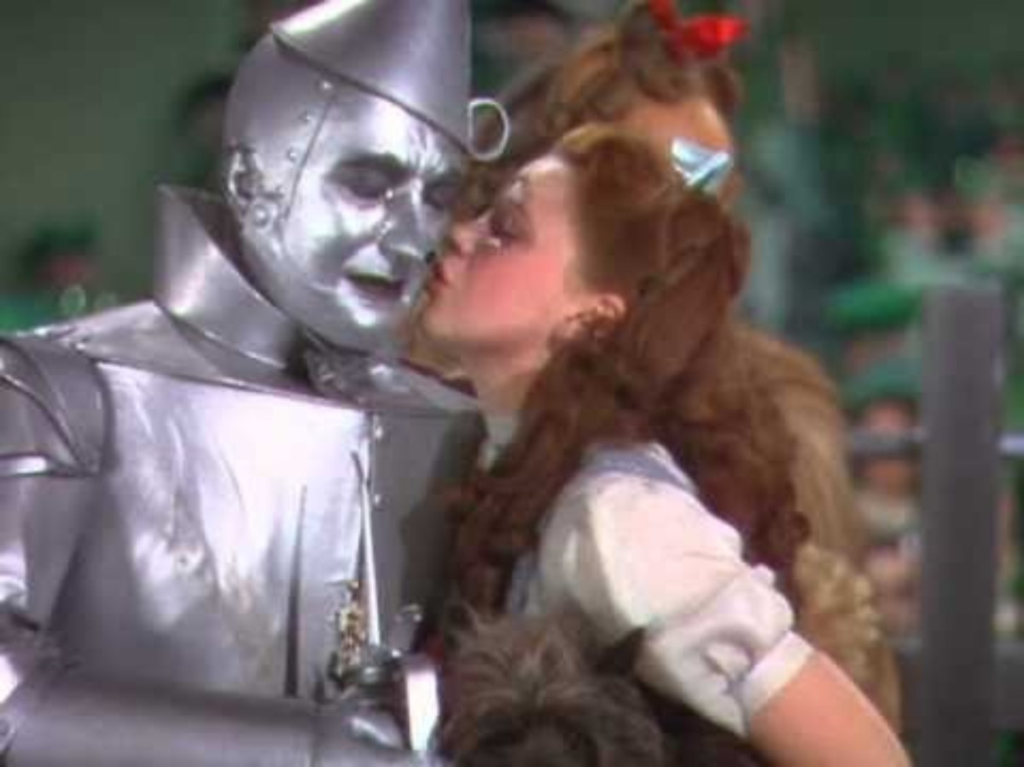
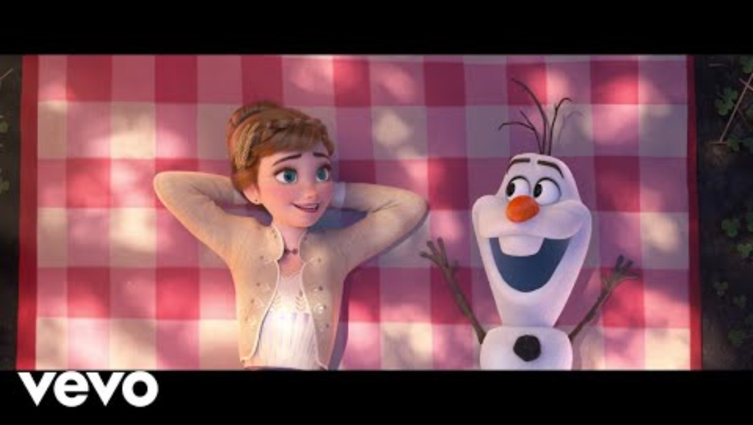
Share your gratitude
Movie Scenarios: Choose a movie clip and discuss the gratitude in the scene

Slide 10

Sparking Gratitude
Watch and listen to learn about the science of gratitude.

Slide 11
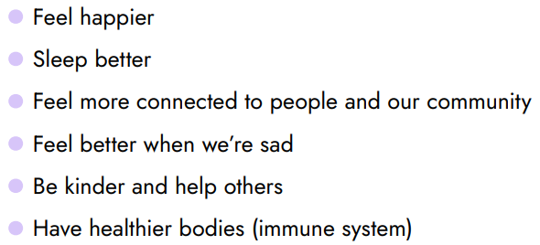
The Science of Gratitude
Studies show that gratitude can help us to…

Slide 12
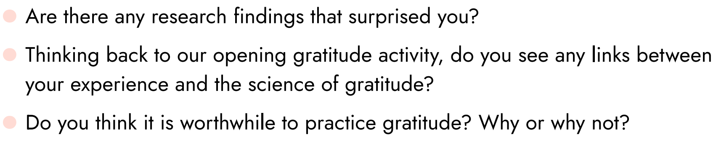
Discussion on Gratitude Science
Think-Pair-Share

Slide 13
Action Plan
.
Gratitude detectives
.
Detectives are always on the lookout for clues.
.
Over the next few days, we are going to be on the look for gratitude!
.
As a class, we will make our own gratitude jar (or journals).
Each day, watch for acts of gratitude or remember things you feel grateful for.
.
When you come back to school, write them down and we’ll share at the end of the week!

Slide 14


Reflection and Closing
Write down two things
you learned about gratitude today.
Did anything surprise you?
Write down two places
where you'll look for gratitude in the next few days.

Slide 15
Gratitude Quiz!
True or False?
1. Gratitude can make you feel happier.
2. Gratitude takes a lot of time to practice.
3. Gratitude can help you sleep better.
4. Practicing gratitude helps your body heal when you’re sick.
5. Focusing on things we own, like toys, makes us happier.
6. Gratitude can help you feel closer to people in your life.
7. Gratitude can help prevent you from getting sick.
8. Gratitude can help when you’re feeling sad.
9. Gratitude can help people become more helpful to others.
10. Gratitude can help you feel more connected to your community.
11. Expressing thanks to others can boost your happiness.
12. Gratitude can change your brain.

Slide 16





2.
Lesson
We Express our Gratitude

Slide 17
Mindful Breathing
1.
find a comfortable seat.
2.
close your eyes or pick a spot on the floor to focus on.
3.
notice what you hear around you.
4.
after you settle into your comfy spot, focus on breathing in through your nose, out through your mouth.
5.
imagine your belly is a balloon. Fill up nice and round before you exhale.
Do this for 2 minutes.

Slide 18
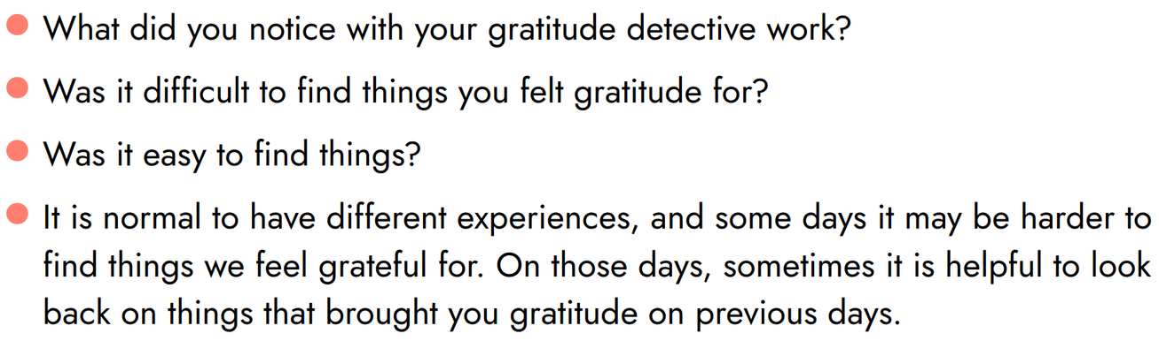
Reflecting on Gratitude
Think-Pair-Share
Have you seen any
gratitude?
You’re okay!
Some days it may be harder to find things we feel grateful for. On those days, it can be helpful to look back on things that brought you gratitude on previous days.

Slide 19


We are Grateful to Others
Who are you
Think-Pair-Share
Grateful
for?
Who is someone at school, home, or in your community that...
.
.
.
protects you
.
.
smiles at you
makes you laugh
.
.
helps you
teaches you
.
.
has forgiven you
understands you
encourages you
listens to you

Slide 20

We are Grateful to Others
Class
Huddle
Think about who we could be grateful for as a class...
.
.
Some examples might be...
.
.
medical professionals
SPCA
.
.
community leaders
first responders
.
.
non-profit organizations
veterans
.
.
school staff
senior citizens
nursing home staff
friends or family

Slide 21

We are Grateful to Others
Who are you
grateful for?
Let’s Vote!
Who should we express gratitude toward as a class?

Slide 22


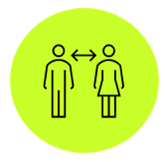

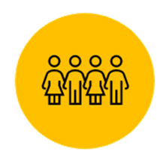
Action Plan
How can we express
There are many ways to express gratitude!
Gratitude?
In person:
•Visit them
•Meet with them
•Have a party!
From a Distance:
•Virtually
•Recording
•Personalized gift
•Letter
Get Creative!
•Artwork
•Poem
•Music
•Collage

Slide 23



Gratitude Expressions
Think-Pair-Share
How do you think we should express our gratitude?

Slide 24
We are Grateful to Others
Let’s Vote!
How should we express gratitude?

Slide 25
Take Action!
Expression of gratitude tips...
.
.
take your time and try your best!
.
don’t worry about being perfect- they will love it!
.
help each other
.
have fun!
take the time for being mindful- feel good and happy about what you’re doing!

Slide 26




3.
Lesson
We Reflect on and Celebrate Gratitude

Slide 27
Mindful Breathing
1.
find a comfortable seat.
2.
close your eyes or pick a spot on the floor to focus on.
3.
notice what you hear around you.
4.
after you settle into your comfy spot, focus on breathing in through your nose, out through your mouth.
5.
imagine your belly is a balloon. Fill up nice and round before you exhale.
Do this for 2 minutes.

Slide 28

A Walk Down Memory Lane
First, we...
Then, we...
Our
Gratitude
Steps
Next, we...
Finally, we...

Slide 29

Reflect with Each Other
How did your
Gratitude
go?
Think-Pair-Share
How do you think we made people feel through our gratitude?
How did it make you feel?

Slide 30


Shared Reflection
What’s
Next?
Think-Pair-Share
How can we continue to show gratitude towards people we are grateful for?

Slide 31
Making Connections
How did my classmates feel?
What have we learned about gratitude?
Our
Gratitude
Were there challenges?
Reflection
Was it worth it?

Slide 32


Your gratitude brought goodness to the world!
Teachers- you can share photos of your gratitude projects with

