Slide 1

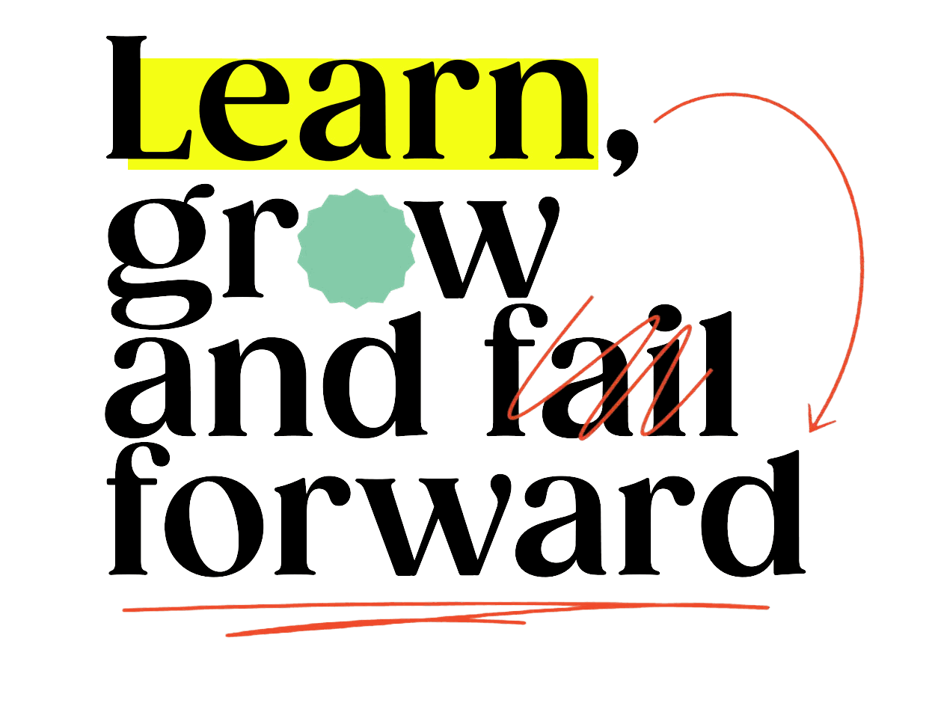
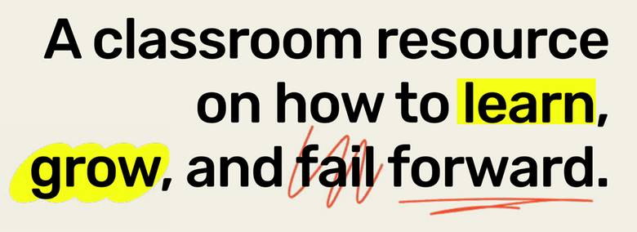


Slide 2


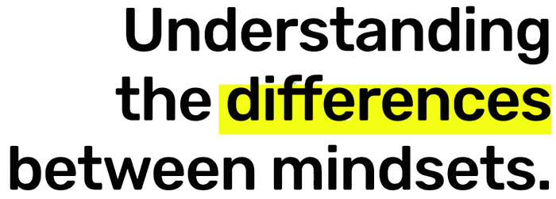

Slide 3
Learning Goals:
    Understand and articulate the differences between a “growth” and “fixed” mindset
    Reflect on how failing is an opportunity to grow and learn
    Identify times in your life where you failed and how this became an opportunity to learn

Slide 4

Use the picture to help you fold an origami swan or crane.
5 minute timer

Slide 5
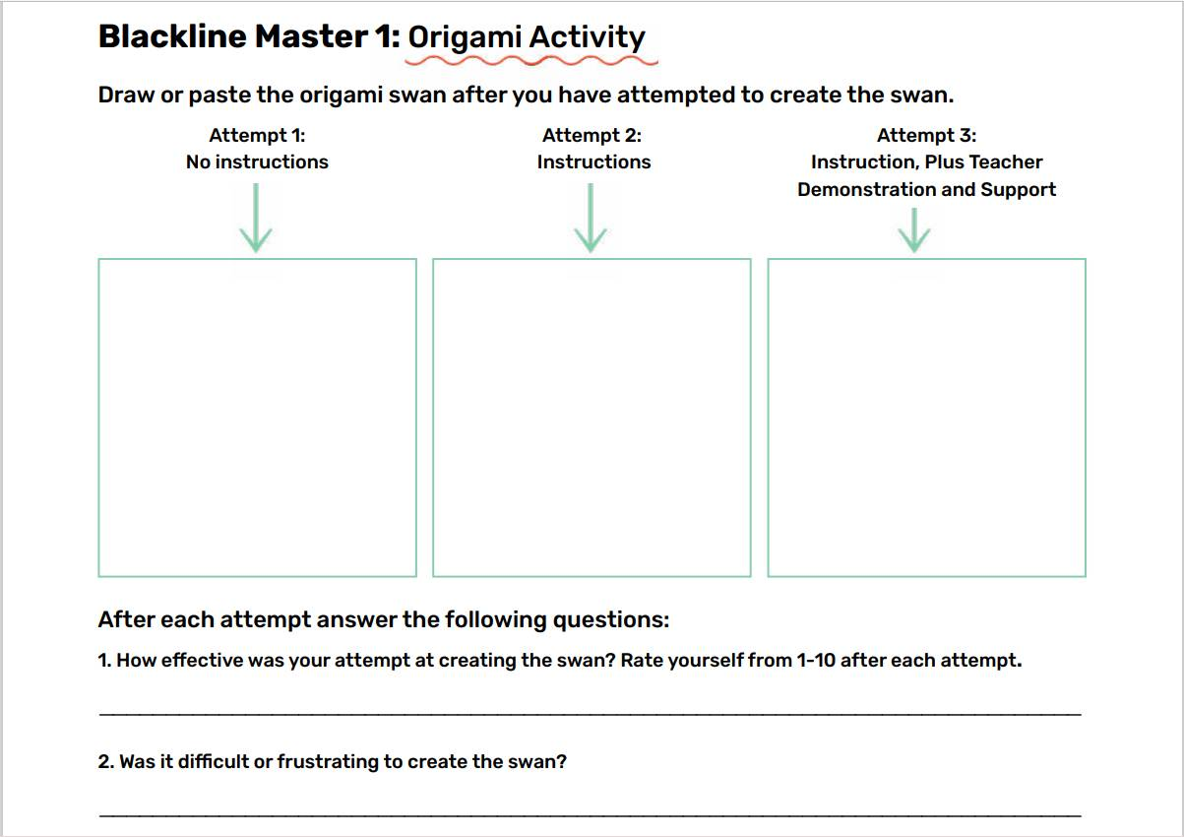

Record your first attempt.
How did you feel while trying to recreate the origami?
What could have made the process more achievable?
Ask a partner, what did they do? Was their approach different from yours? Are you willing to try their way?

Slide 6
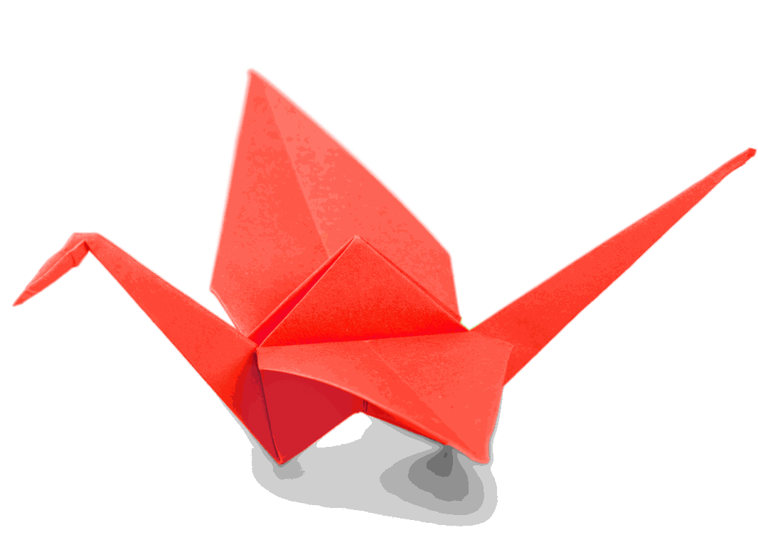
Try again!
Improve on your first design.
Try a new approach!
5 minute timer

Slide 7
Record your second attempt.
How did you feel while trying to recreate the origami?
What could have made the process more achievable?
Ask a partner, what did they do? Was their approach different from yours? Are you willing to try their way?

Slide 8
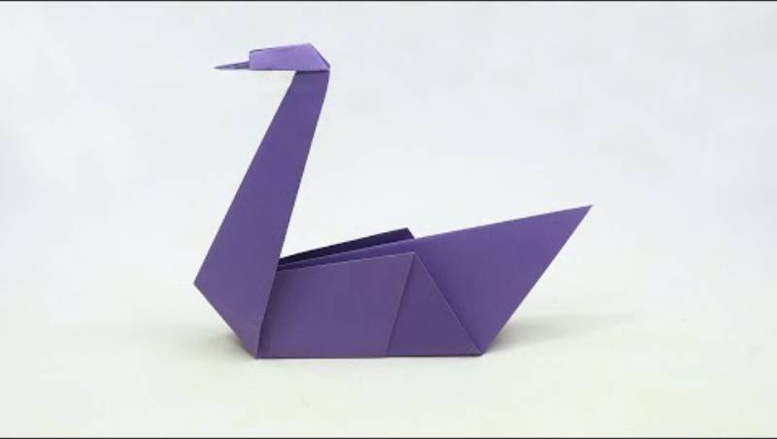
Let’s try together!
Watch the video - don’t make it yet.
We will watch it twice.
10 minute timer

Slide 9
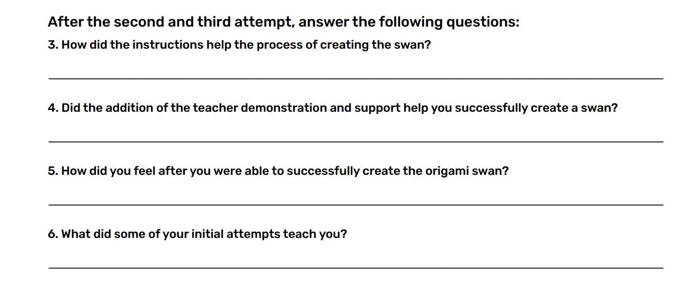
How did it go?
Answer the questions on your paper.

Slide 10

Learning to do something is a process. You have to be open to trying, even if you fail.

Slide 11
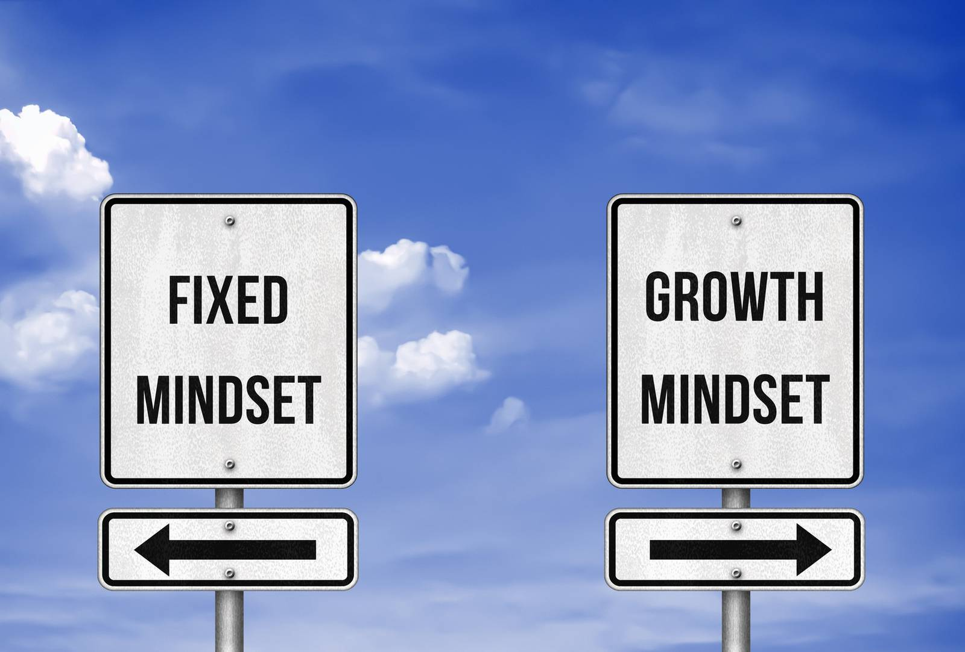
What is a mindset?

Slide 12
Mindset
a set of beliefs that shape how you make sense of the world and yourself
The mind:
    can change the way you look, move and think about the world around you
    influences how you think, feel and behave

Slide 13

What you believe about yourself impacts your success and failure.

Slide 14

Fixed Mindset
Growth Mindset
What is a fixed mindset?
What is a growth mindset?
Are there any similarities?

Slide 15
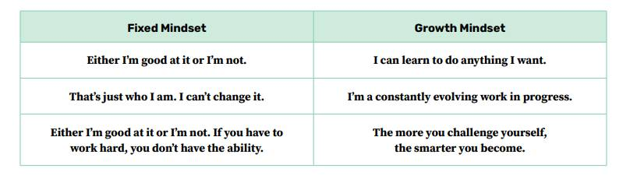
Examples

Slide 16
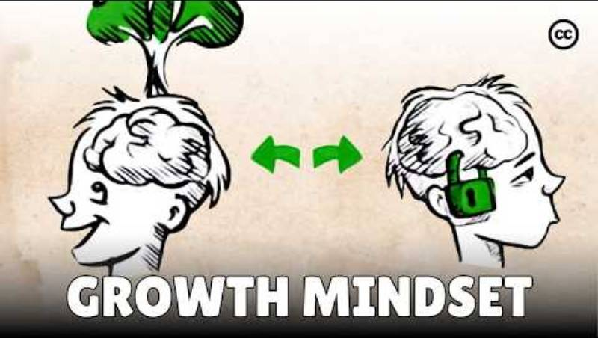
What is Growth Mindset?
As you listen, think about how you can adopt a growth mindset in your life

Slide 17
Turn and Talk
    How does one change their mindset from fixed to growth?
    How does having a growth mindset allow for continual development?
    How does embracing challenges enable learning?
    Is failure important?
    How does failing lead to learning?

Slide 18

Mindset Scenario #1
Charlie loves to play with puzzles. This time, they wanted to challenge themselves with the Rubik’s cube. They tried for an hour to figure out how to solve the cube but started getting very frustrated. They thought, “This is too difficult, maybe I should stick with puzzles that I know that I can solve.”
How can Charlie shift thinking from
a fixed mindset to a growth mindset?

Slide 19

Mindset Scenario #2
Ashraf loves to ice skate and is thinking about trying out for the school’s ice hockey team. They have never played ice hockey, so they decide to practice before the school’s tryouts. While on the ice, they realize that skating while trying to hit a puck is difficult. Ashraf thinks, “I am never going to be able to do this, so why even try.”
How can Ashraf shift thinking from
a fixed mindset to a growth mindset?

Slide 20

Mindset Scenario #3
Jessie loves to conduct experiments and is thinking of joining the science club at school. However, they know that the requirement for joining the science club is to achieve A grades in both Science and Math. Jessie has an A grade in Science but is finding it difficult to understand some parts of the math course. Jessie thinks, “I am so stupid, I will never achieve my dream of joining the science club and conducting experiments.”
How can Jessie shift thinking from
a fixed mindset to a growth mindset?

Slide 21
Think of a time in the past year that you failed or were unsuccessful at something.
    How big was the failure?
    Are you still pursuing the activity?
    If so, why did you continue and what was the outcome?
    If not, what feelings did the failure bring up that made you abandon the activity?

Slide 22
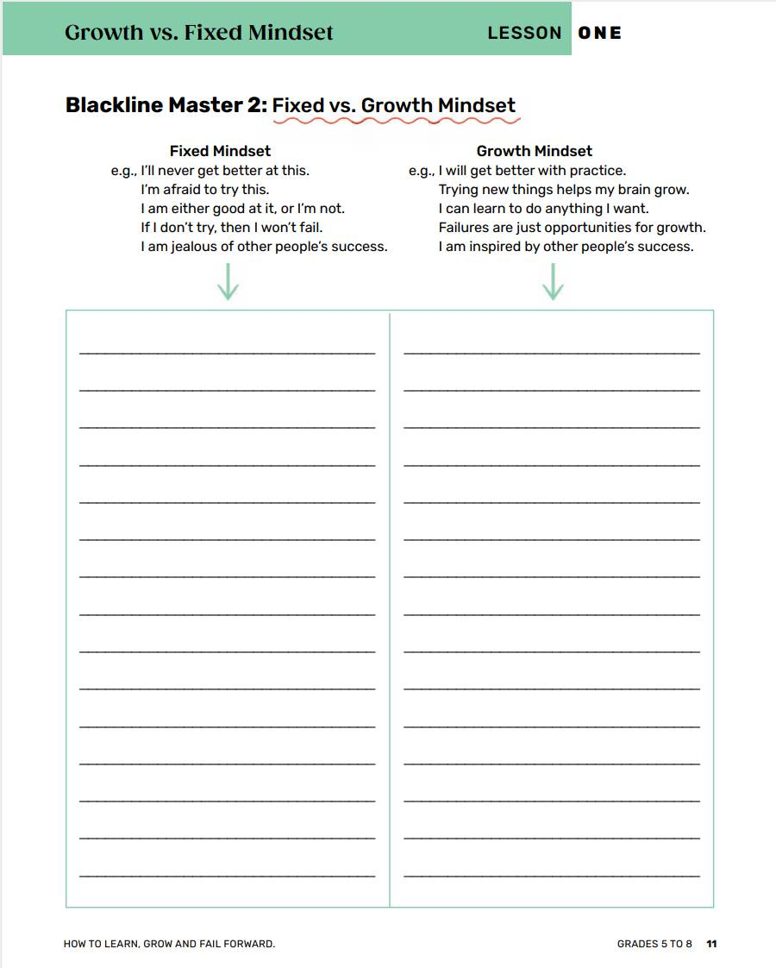
Shift your Mindset!
Think of some common phrases you use often that are a fixed mindset- and Shift them!

Slide 23

Failure can help me by.....
Add your thoughts on the sticky note and put it up on the board.

Slide 24


Canadian Connection
Connor Bedard, one of Canada’s youngest hockey superstars, faced enormous pressure and high expectations long before joining the NHL. Despite being told he was too small and not ready, he stayed focused, worked tirelessly, and turned every setback into motivation to improve.
Now a leader for the Chicago Blackhawks and a role model for young athletes, he shows that perseverance and self-belief matter as much as talent.
“You learn more from a bad game than a perfect one.”

Slide 25


“If you fail, it’s not the end. It’s just another step. You learn, and you get better.”Mr.Beast

Slide 26

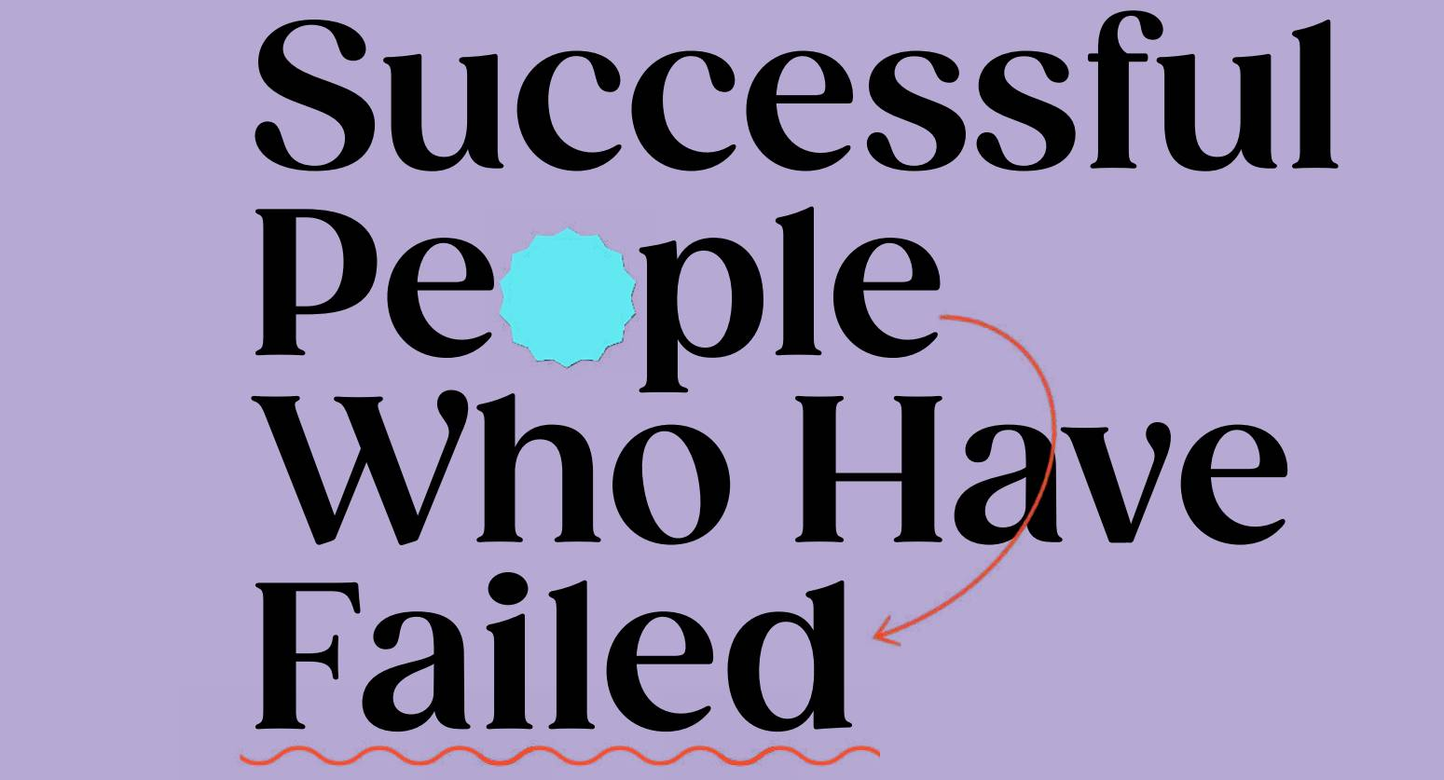
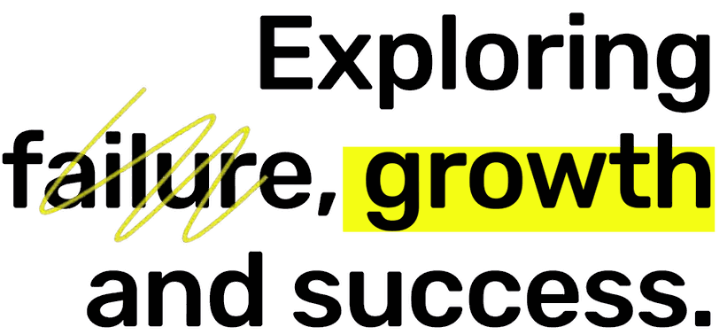

Slide 27
Learning Goals:
    Understand that failure is not a negative, but an opportunity to learn and grow.
    Explore famous personalities whose failures have led to successes and see that their failure was an opportunity to learn.

Slide 28
Exploring Failure, Growth, and Success
What does it feel like when you receive a poor grade?
How do you feel when your sports team loses a game?
When you are unsuccessful at completing a task or goal you have set, how do you feel?

Slide 29
Failure may be tied to:
Self-worth
Self-esteem
Self-acceptance
internal sense of
being good enough and worthy of loving and belonging
confidence in one’s own worth, abilities or morals -
beliefs about oneself
embracing every part of yourself - all your attributes positive
or negative
The expectation we fail to meet may be the one we created in our own mind.

Slide 30
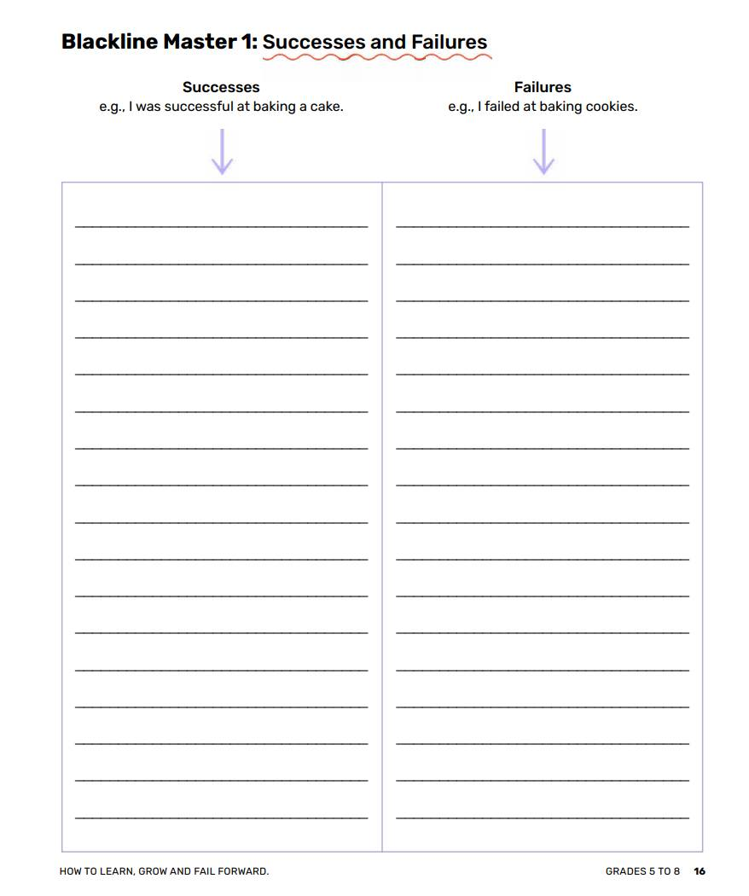
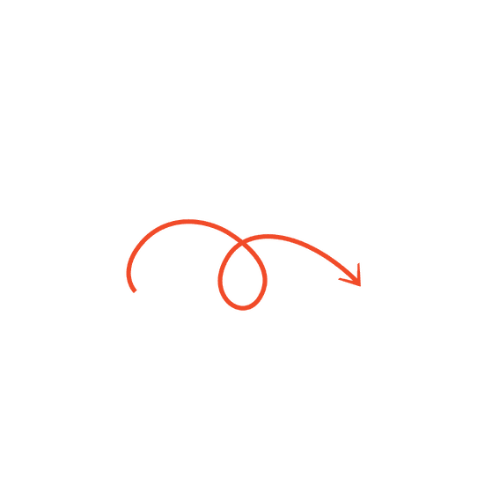
Successes and Failures
Write down all of the ways you have failed or been unsuccessful over the past week.
How does it make you feel when you write out everything you haven’t been able to achieve?

Slide 31
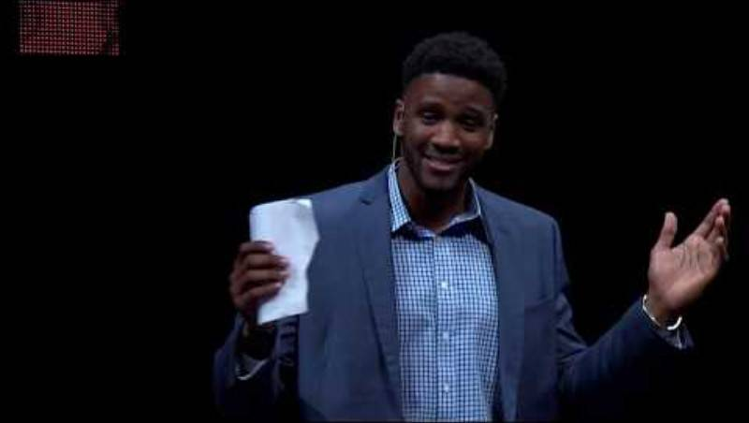
As you listen, think about how failure enables growth?

Slide 32
Turn and Talk
How did failure enable growth in the characters or person in the video?
Why is failure a necessary component to growth?
How can failure enable success?

Slide 33


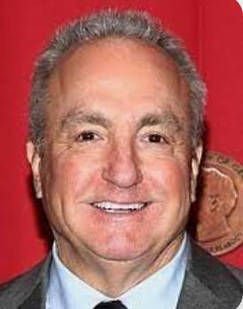

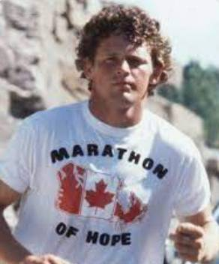

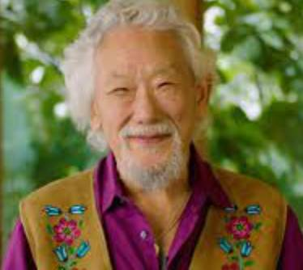
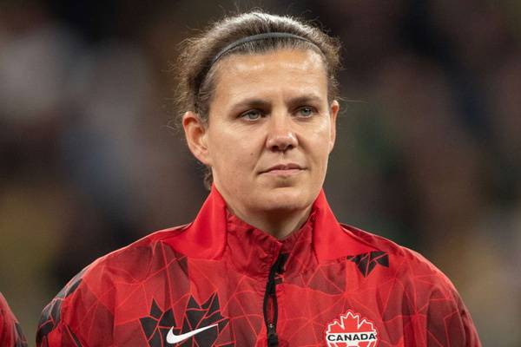
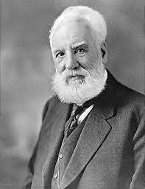
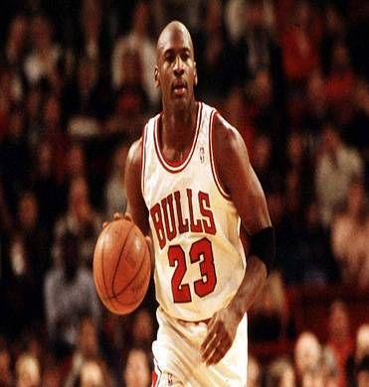
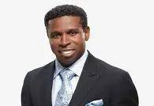


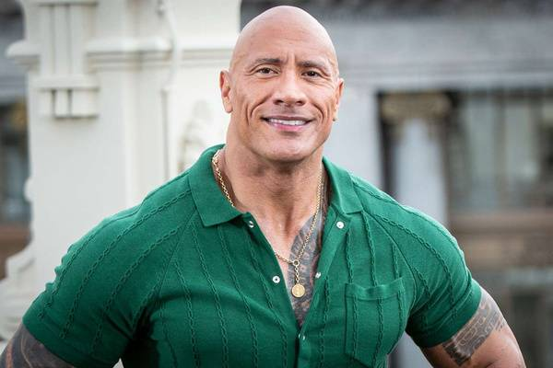


What do each of these individuals have in common?
Simu Liu
Alessia Cara
Terry Fox
Christine Sinclair
Michael Jordan
Lady Gaga
Dwayne “The Rock” Johnson
Simone Biles

Slide 34
Each of them achieved greatness in their lives through working hard and pursing their goals
Simu Liu
Alessia Cara
Terry Fox
Christine Sinclair
Michael Jordan
Lady Gaga
Dwayne “The Rock” Johnson
Simone Biles

Slide 35
Each of them have had some form of failure in their lives that they have had to work to overcome.
Simu Liu
Alessia Cara
Terry Fox
Christine Sinclair
Michael Jordan
Lady Gaga
Dwayne “The Rock” Johnson
Simone Biles

Slide 36
Time to Create!!!
Create a 3-minute presentation highlighting the stories of the famous person you researched.
    What is this person famous for achieving?
    What is this person’s story about achieving fame?
    What failures did this person encounter in their life?
    How did they overcome this failure?
    Why do you think this failure led to their eventual success?
    Put yourself in this person’s shoes: what would you have done when you encountered failure?
    What advice would you give to this person when an inevitable failure occurred?

Slide 37
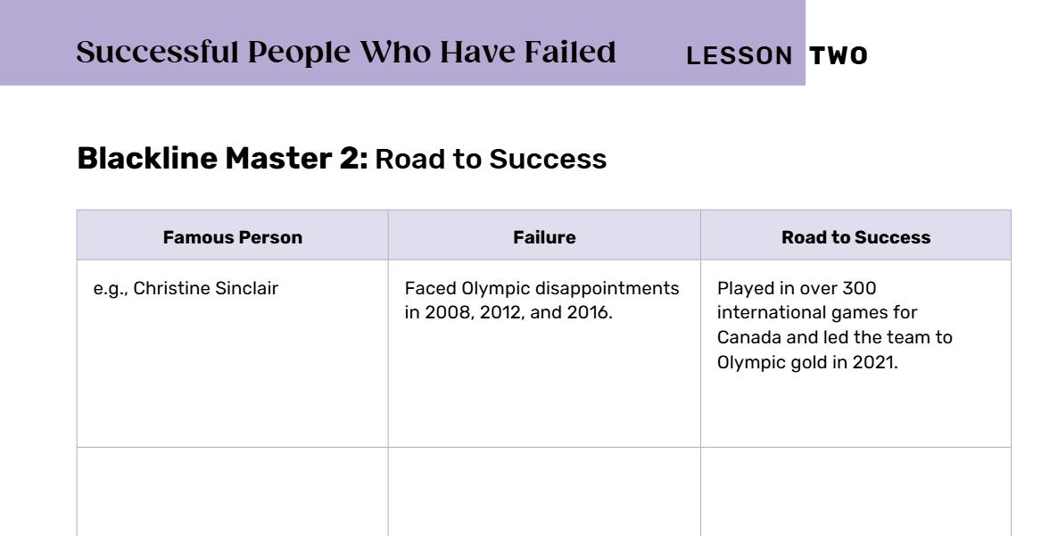
During the Presentations
Take notes and fill in the table with the failure the person encountered
and how they overcame it.
After the presentations, add yourself to the table and reflect on your own personal failures.

Slide 38
Self Reflection
How can you grow your failures into success stories?
Remember -
NO FAILURE IS TOO BIG TO GROW FROM

Slide 39

Canadian Connection
Autumn Peltier, a young Indigenous water-rights advocate from Wiikwemkoong First Nation, faced criticism and doubt but used her voice to inspire global action for clean water.
“One day I will be an ancestor, and I want my descendants to know I used my voice so they could have clean water.” – Autumn Peltier

Slide 40


“I failed a lot. I’ve made a lot of mistakes. But that’s how I learn.” Billie Eilish

Slide 41


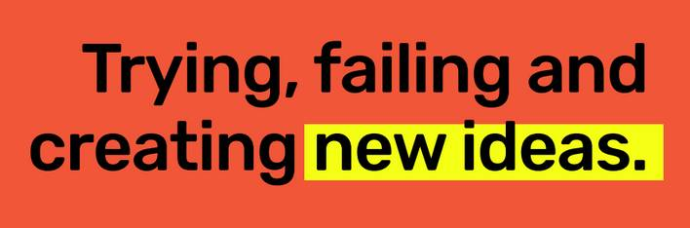

Slide 42
Learning Goals:
    Understand the concept of innovative thinking
    Reflect on how failure can lead to innovative thinking
    Demonstrate critical thinking in the design thinking process

Slide 43
Innovation is about trying new things and taking risks.
It involves making mistakes.
Many people want to embrace their innovative spirit but fear the consequences of failure.
Great ideas are sometimes
created from bad or weird ideas.

Slide 44

Usually we search for good ideas...
What do you think makes an idea for a product bad?
What would a really bad household product be?
Let’s have a creative twist
What could a really bad type of food be?
What would be some really bad games
for children?
BAD IDEAS
What would a really bad recipe be?
What would a really bad beauty product be?

Slide 45
Group Work
    Come up with a really bad idea.
    Why is this product so bad?
    Is there a group of people who may like this idea?
IT'S FINE TO CELEBRATE SUCCESS, BUT IT IS MORE IMPORTANT TO HEED THE LESSONS OF FAILURE."
Bill Gates

Slide 46
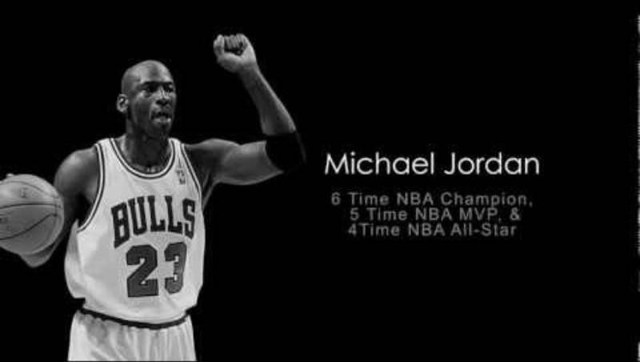
HOW FAILURE LEADS TO SUCCESS

Slide 47
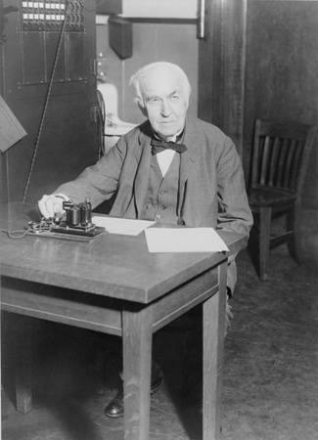
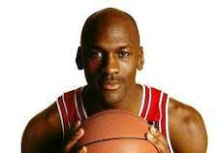

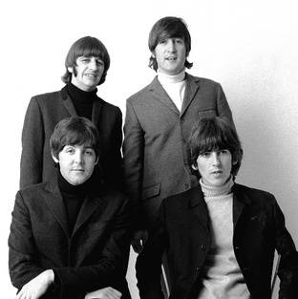


Research
Why were they considered a failure?
How did this make
them feel?
How did they move beyond their failure?
THOMAS EDISON
OPRAH
WINFREY
MICHAEL JORDAN
What was their initial step towards success?
Did they continue to gain success? How?
THE BEATLES
LEO MESSI
STEVE JOBS

Slide 48
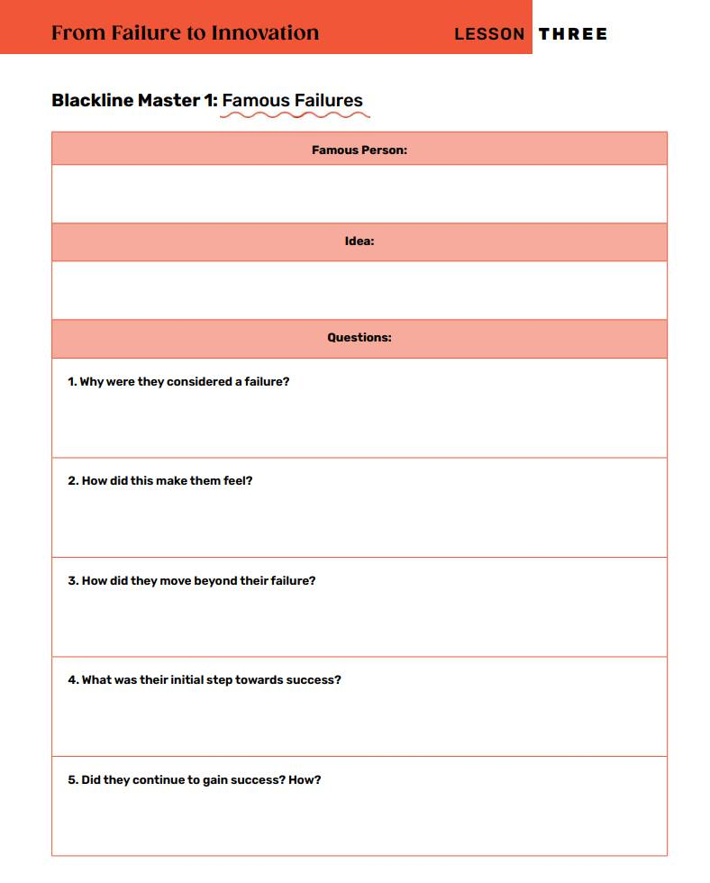
As we share our research
    What were the similarities?
    What did each person do to continue their success?

Slide 49
Each person tried and continued to create even though they encountered failure.
These famous people had different challenges that some of you may have faced before.
Each of them had an innovative
mindset.

Slide 50
Innovative Thinking/Innovative Mindset
    Involves approaching problems and opportunities with an open mind
    Seeks out new and better ways of doing things
    Uses experimentation and trial and error

Slide 51
Group Work
You’re going to be working together to build a catapult!

Slide 52
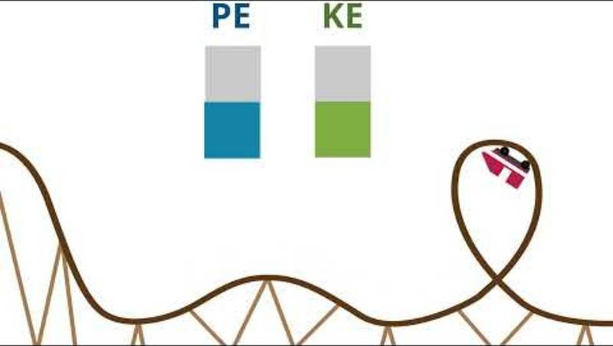
Kinetic and Potential Energy

Slide 53
Design Process
HOW WE WILL ACHIEVE THIS
OUR FIRST STEP
OUR THIRD STEP
Create your design
on paper.
Consider the distance required to launch the ball.
OUR SECOND STEP
OUR FOURTH STEP
Decide how the catapult will hold the ping pong ball?
Think about how effectively will it launch the ball?

Slide 54
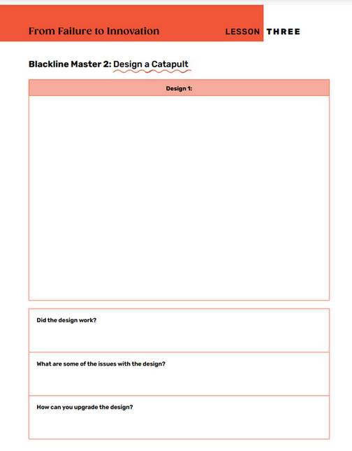
Time to Build
Use this form
Launch Again
    Which group was the most successful?
    How were the designs different?
    How many times did you try to recreate it?
    How did you enjoy the process of redesigning?
Update the Design
    Make changes on paper
    Record what changes are being made
    Why will it be
    more effective?
Create and Test
    Did the catapult work?
    Can it be improved?
    What design changes need to be made?

Slide 55
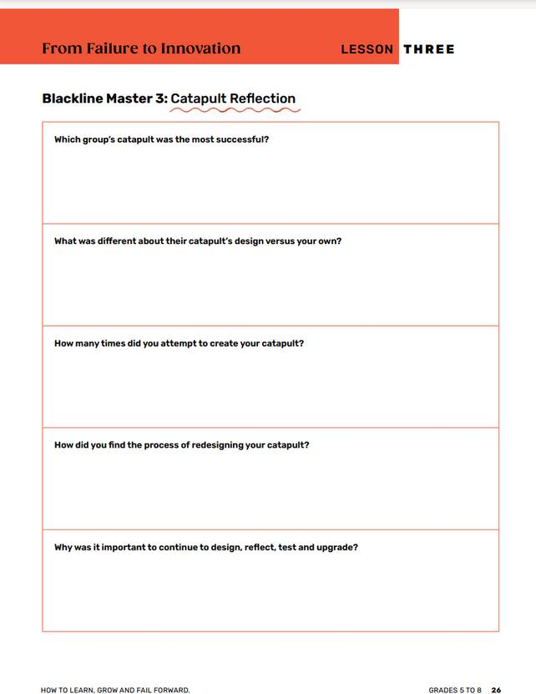
Why is it important to continue
to design, reflect, test and upgrade?

Slide 56
Each time you redesigned the catapult, you reflected on a potential issue or failure of your design.
You created and changed the design to make the best possible catapult to launch the ball.
Trying, failing and creating new ideas
That’s innovation!

Slide 57
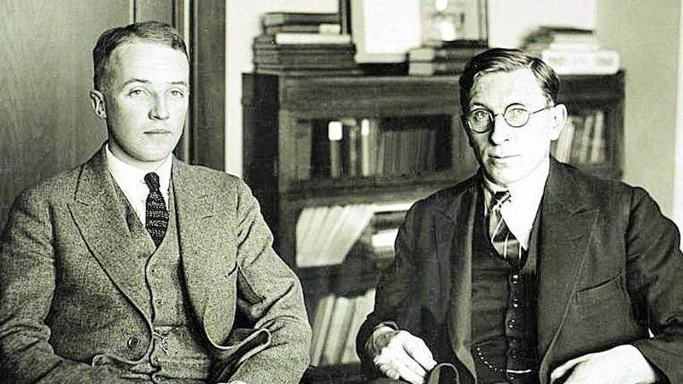
Canadian Connection
Dr. Frederick Banting and Charles Best, two Canadian scientists at the University of Toronto, set out in the early 1920s to find a treatment for diabetes — a disease that was once deadly. In July 1921, their persistence finally paid off with the discovery of insulin, a breakthrough that has saved millions of lives around the world.

Slide 58

“Every mistake is just part of getting better. You learn, you adjust, and you keep going.”
Connor McDavid

Slide 59



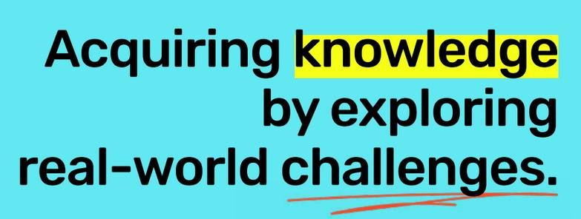
LESSON FOUR

Slide 60
Learning Goals:
    Identify a current issue/challenge within the school environment
    Create a solution for the issue/challenge
    Implement the solution
    Reflect on your failure during the implementation

Slide 61
Think about our school environment
What are some issues/challenges that we face?
Academics
Comfort
Are the classrooms the right temperature or do they have seating that allows for positive learning?
Can everyone learn in a way that works for them?
Safety
Time
Does everyone feel safe and free of violence or comfortable expressing their opinions?
Do students have time to take classes that they enjoy like music,science, PE or art?

Slide 62

The Challenge
CREATING AN ACTION PLAN
You will choose one issue/challenge currently present within your school and do your best to solve it.
Remember....it may be hard, you may be unsuccessful the first few times, but you will learn from each failure.

Slide 63
Research Process Overview
Once you have selected your issue/challenge:
Create NEED-TO-KNOW questions -
    What do you NEED TO KNOW to understand the issue in depth?
    What research do you NEED TO CONDUCT to learn more?
Try to come up with at least 5 questions.

Slide 64
Conducting Research
There are many sources you can use to help you:
    Books
    Internet
    Talking to people - both students and teachers
    Contacting experts in the field

Slide 65
Research Process
Creating an Outline:
Outline a step-by step process of how you will solve the issue/challenge
What obstacles do you think you might encounter?
Remember - you may fail the first few times you try to solve your problem,
but reflect and adapt based on what you learned.

Slide 66
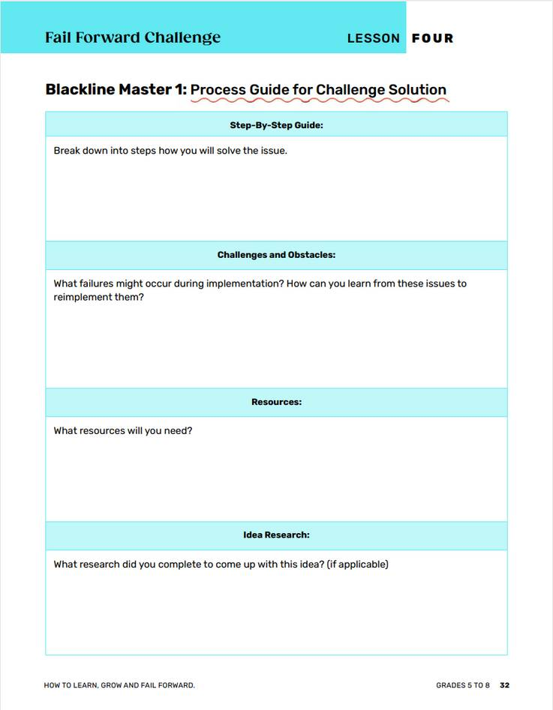
Make a Plan
Making it work
Can your solution be implemented in school? Is it realistic?

Slide 67
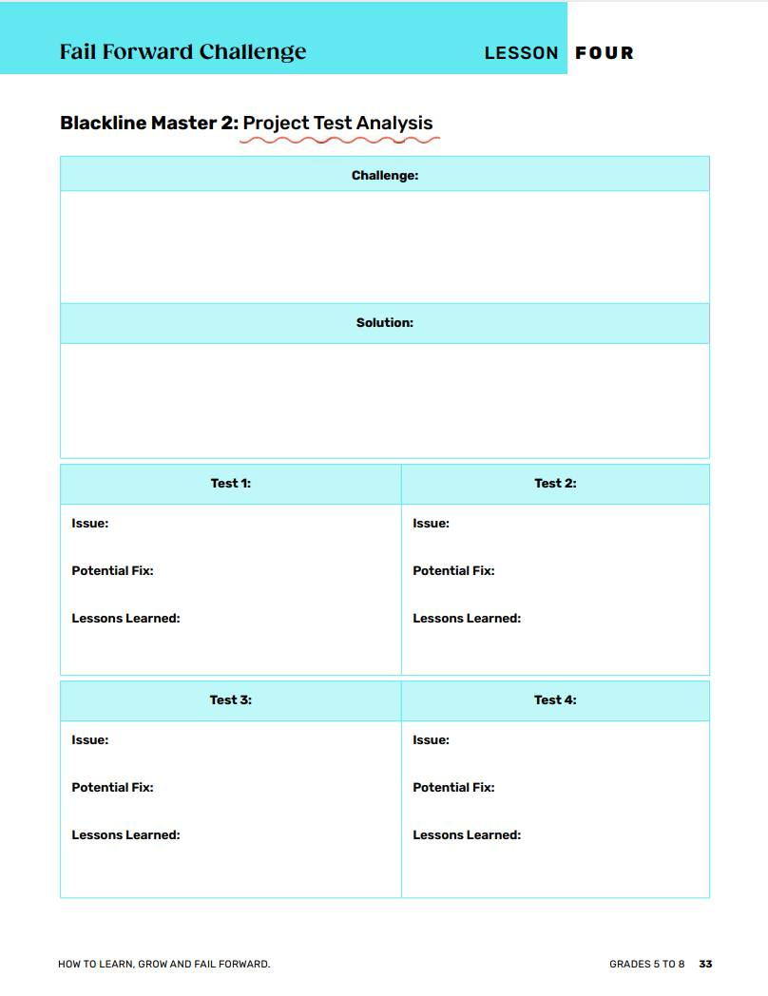
Let’s Do It!
Making it work
Are there any more resources you need? Is the result what you wanted?

Slide 68
Presenting Your Research
You will create a 5-minute presentation about your project. You can use any method that your group agrees on:
    Microsoft Power Point , Sway or Google Slides
    Prezi
    Poster
    Tik Tok video
    Blog Post
    Play, Readers Theatre or Mock Debate

Slide 69
What to Include in Your Presentation
What was the issue/challenge your group decided to solve?
What solution was created? Explain your step-by-step process.
What obstacles came up during the solution?
Did you expect these?
What did you learn each time you tried to solve the issue?
Did you update your initial solution idea after learning from each attempt?
Did the solution work the first time?
How does failing create an opportunity to grow?

Slide 70
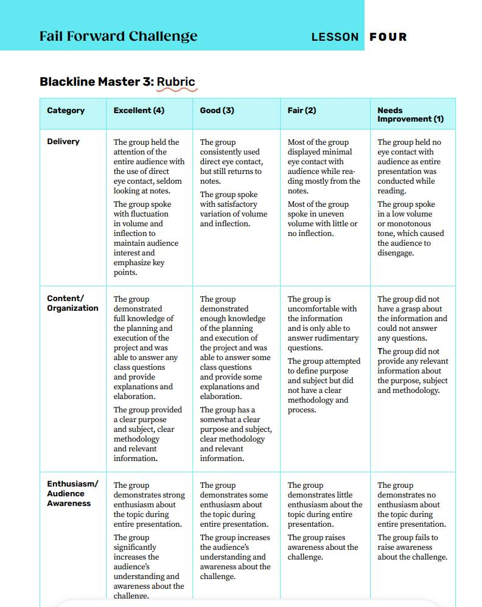
The Rubric
What makes a successful presentation:
    Delivery
    Content/organization
    Enthusiasm/audience awareness

Slide 71
Learning From Others
As you listen to the other groups present:
What did each group learn from the failure of their initial attempt?

Slide 72

Canadian Connection
Bianca Andreescu, one of Canada’s top tennis players, rose to fame after winning the U.S. Open in 2019 — but her journey hasn’t been easy. After her historic win, she faced multiple injuries and long breaks from competition that tested her confidence and patience. Bianca often speaks about how setbacks helped her grow, showing young people that success is not about avoiding failure, but learning from it.
“Every setback is a setup for a comeback”

Slide 73


“You grow the most in the uncomfortable places — the moments when things don’t go as planned.”- Sandra Oh

Slide 74

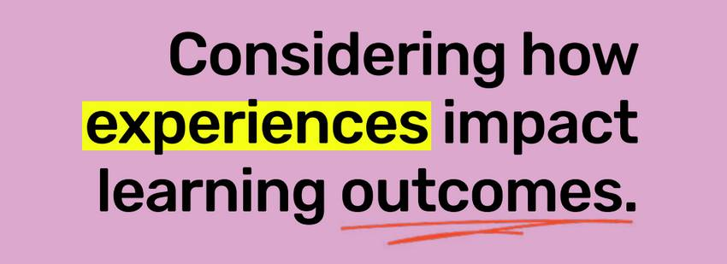
LESSON FIVE

Slide 75
Learning Goals:
    Understand that failure is not always negative
    Reflect on how your own failures can become successes
Consider how experiences impact learning outcomes.

Slide 76
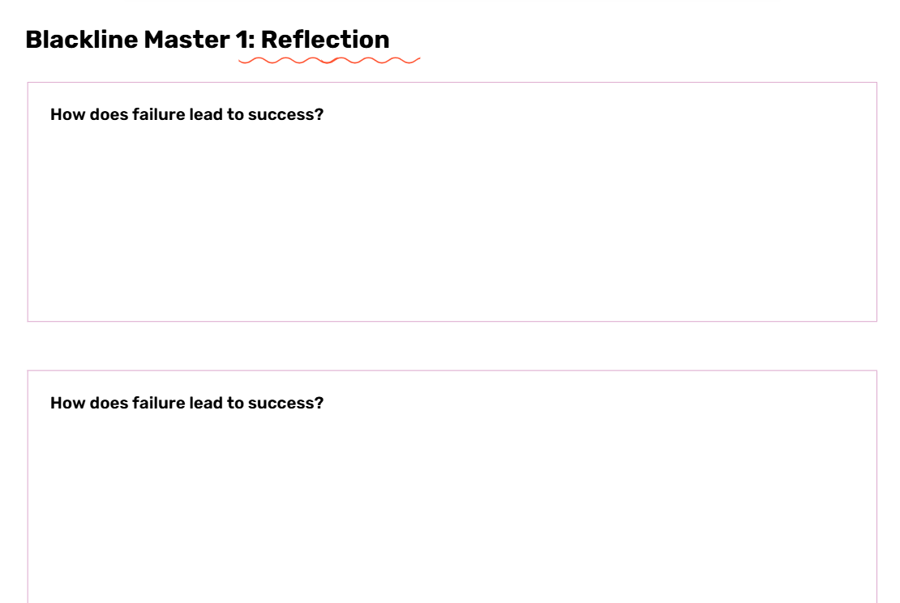
Reflection
Take a moment to think about what you have learned about failure and a growth mindset.

Slide 77
Share
    Read what you wrote in your reflection- read it exactly like you wrote it.
    As a group, come up with an answer:
        What is the process to move from failure
        to success?
        What steps do you need to take?

Slide 78


Slide 79
Discuss
    What were some of Jack Ma’s "failures?"
    How did these failures lead to Jack Ma’s success?
    How can failure lead to growth and success in your own lives?

Slide 80
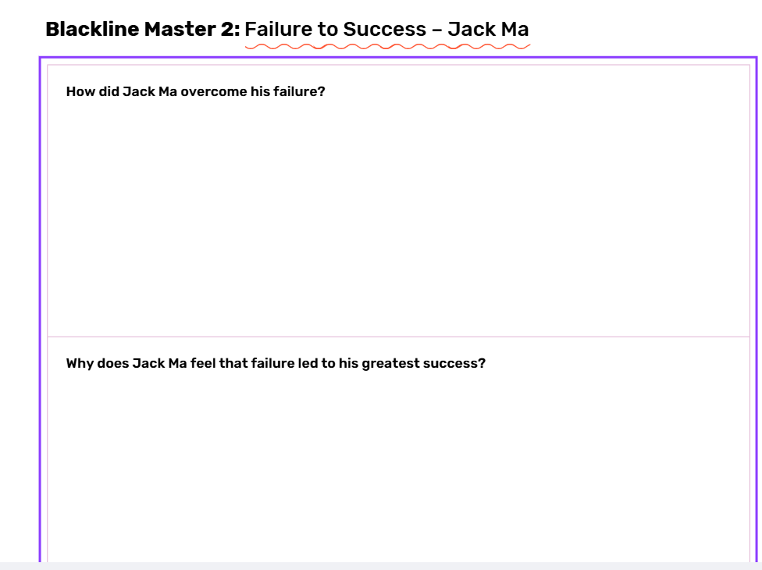
With a Partner
Think about what you just learned in the video.

Slide 81
Now let’s look at
15 Steps to Failing Forward
by
John C. Maxwell
and see how these steps can help you
change failure too success.

Slide 82
Choose 1-2 from each slide
1. Realize there is one main difference between average people and achieving people.
2. Learn a new definition of failure.
3. Remove the “you” from failure.
4. Take action and reduce your fear.
5. Change your response to failure by accepting responsibility.

Slide 83
Choose 1-2 from each slide
6. Don’t let failure from the outside get inside you.
7. Say goodbye to yesterday.
8. Change yourself and your world changes.
9. Get over yourself and start giving yourself.
10. Find the benefit of every bad experience;

Slide 84
Choose 1-2 from each slide
11. If at first you do succeed, try harder.
12. Learn from a bad experience and make it a good experience.
13. Work on the weakness that weakens you.
14. Understand there’s not much difference
between failure and success.
15. Get up, get over it, and get going.

Slide 85
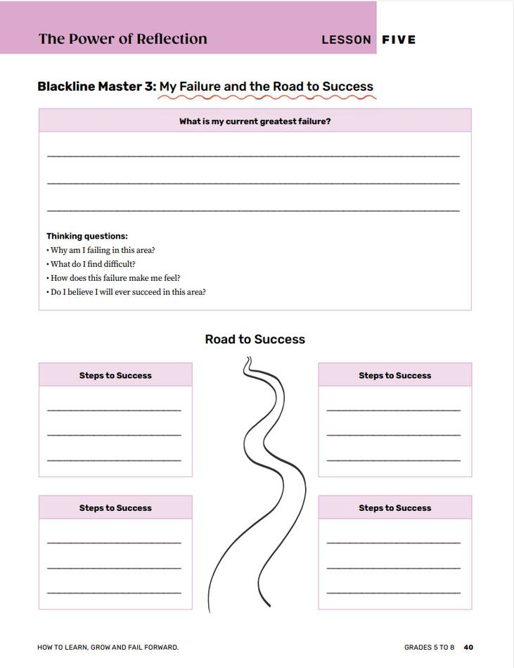
Your Turn
Select 3-5 of the Steps to Failing Forward and outline the steps you will take to change your failure into success.

Slide 86
Apply
    How can you apply the step to your own way of thinking?
    How can your failure move to a success?
    What will I need to do to grow and learn from this challenge?

Slide 87


“Failure is the key to success; each mistake teaches us something.”
- Morihei Ueshibi

Slide 88



Thank you
for learning to fail forward with us!

