Slide 1




Slide 2


F r Teachers
Use this slide deck to help you through the lesson package.
More resources are available on www.realizethedream.org
We recommend that you maintain a log of the service activities and hours along the way. Once the class is finished, you can use this form to submit the hours and your story.
Be sure to take photos and videos of students’ service—
we want to highlight their stories of service on our platforms!
Realize the Dream Service Hour & Story Form

Slide 3


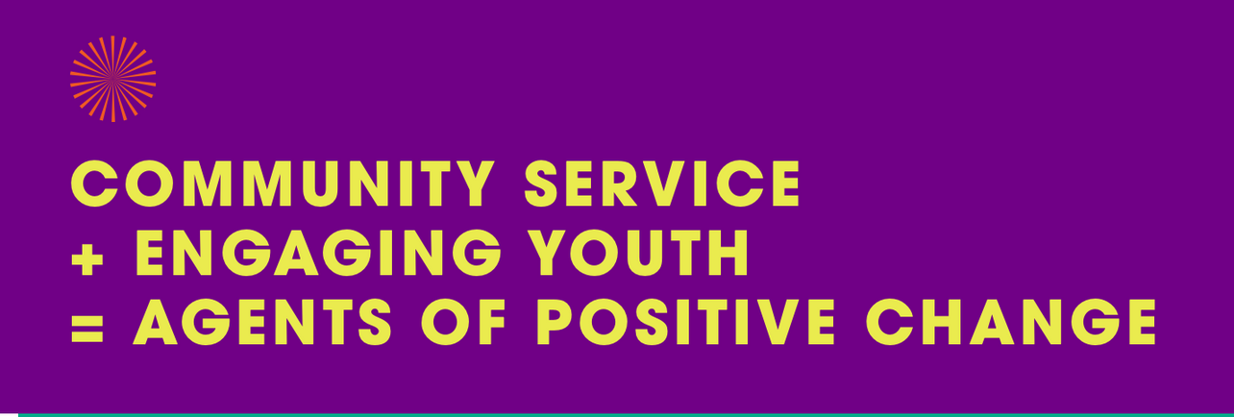
TOGETHER, LET’S CREATE A UNITED, JUST AND
EQUITABLE AMERICA THROUGH SERVICE.
Community Service is not only a great way to help make the world a better place for everyone, but it feels good too!
Encourage everyone around you to serve by sharing their time or skills. It only takes one person to take action before others are inspired to do the same.

Slide 4

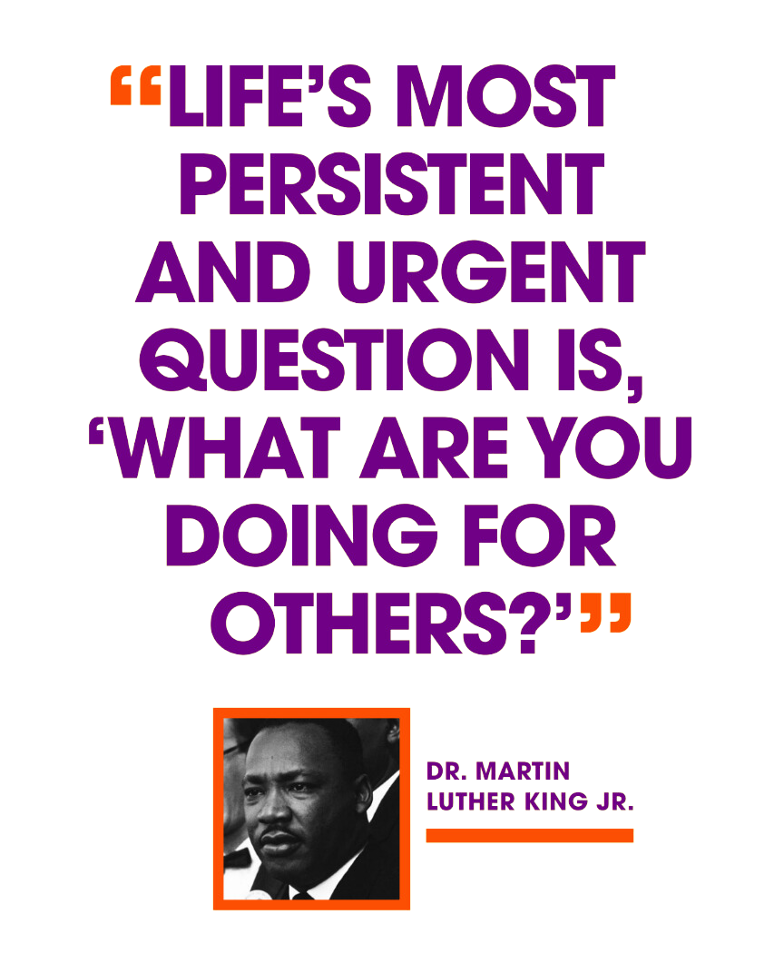

  Founded by Martin Luther King III, Arndrea Waters King and Yolanda Renee King
  Goal: 100 million hours of service by the 100th anniversary of Dr. Martin Luther King Jr.’s birth in January 2029
  5-year program with students across America
  Positive impacts on communities
Through a service-learning project, you can make a positive impact on the world around you.

Slide 5



Create a service-learning project designed to address an issue in your community.
Show us how you are carrying the vision of MLK forward.
Take pictures and make videos. We want to see your acts of service and the reactions of others towards your service.
Save samples of your work or items that you have created.
Use the hashtag #RealizetheDream to inspire and motivate others to join you in your acts of service.
Create a school service display or showcase to highlight and celebrate your acts of service!

Slide 6



Log your hours to be part of the 100M hours of service.
Go to this form or scan the QR code to track your hours.
Realize the Dream Service Hour & Story Form
Tell us about your service project.
Submit your story by sharing photos, videos and samples of your work.
Each month we’ll highlight a service story on our social media channels. Plus, there will be opportunities for exciting giveaways!
Celebrate your inspiring act of service!
Recognition letter of your service activity from your teacher/principal outlining your incredible achievement and the impact in your community.
Certificate of Recognition after completing 10+ hours of service from your school or the community-based organization.

Slide 7
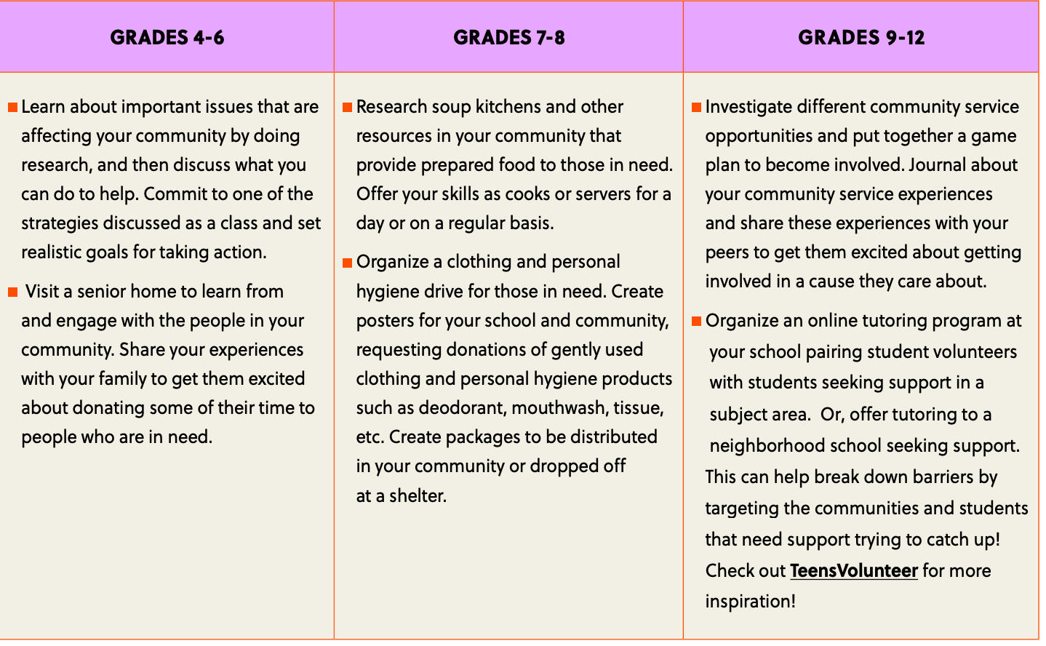
WAYS TO TAKE ACTION

Slide 8


GET DOING:
01
step
investigate and learn
What local issues are you and your group passionate about?
Before taking action, learn more about the issues you care about and research organizations where you would like to engage in community service.
Next are some other topics you may want to discuss with your group.

Slide 9
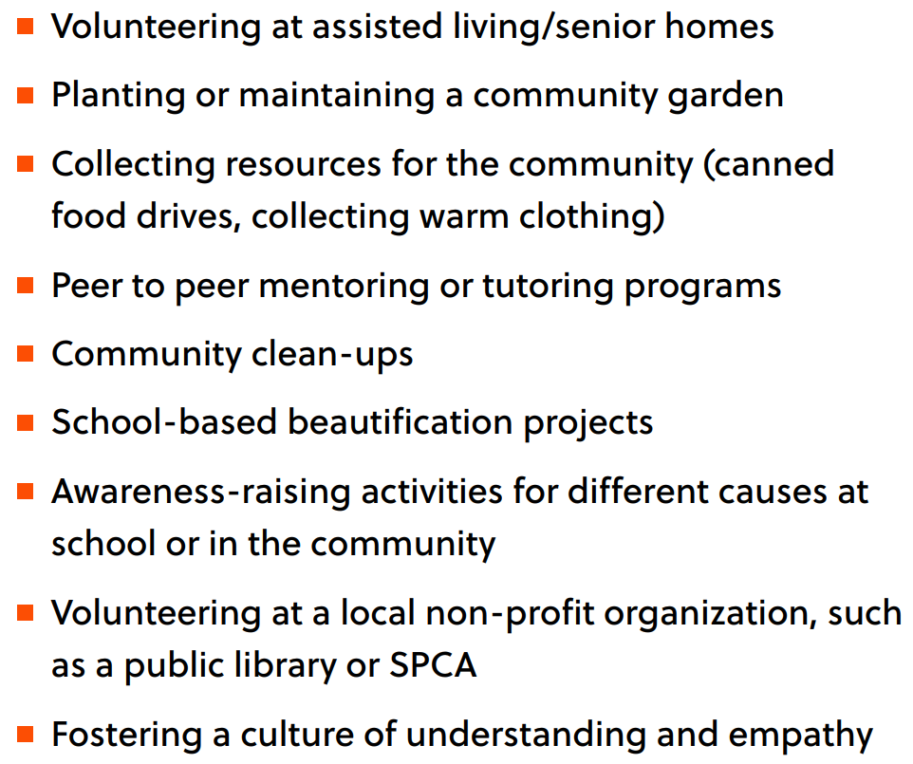
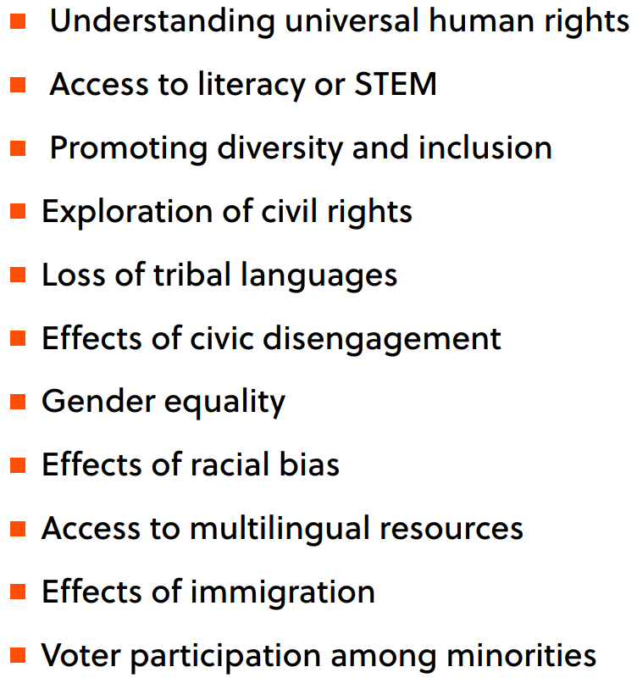
COMMUNITY SERVICE
DIVERSITY, EQUITY, AND INCLUSION

Slide 10
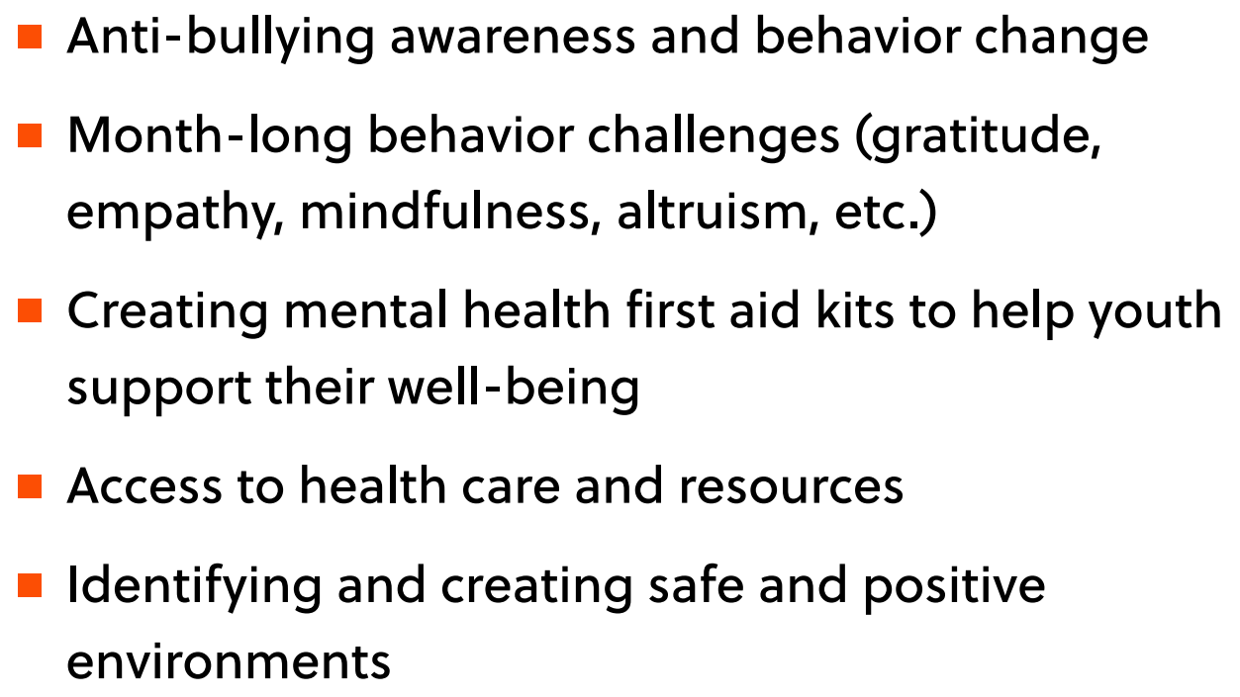
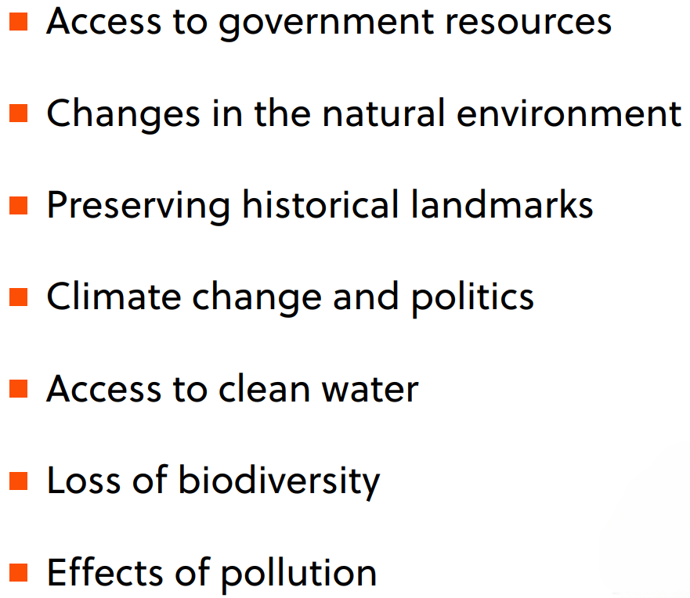

MENTAL HEALTH
ENVIRONMENTAL/CONSERVATION

Slide 11
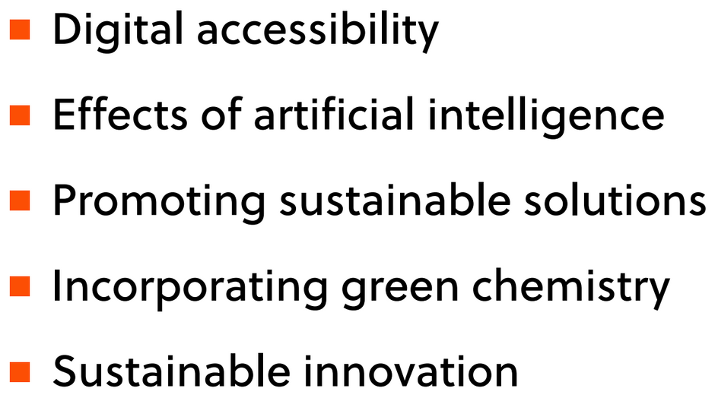
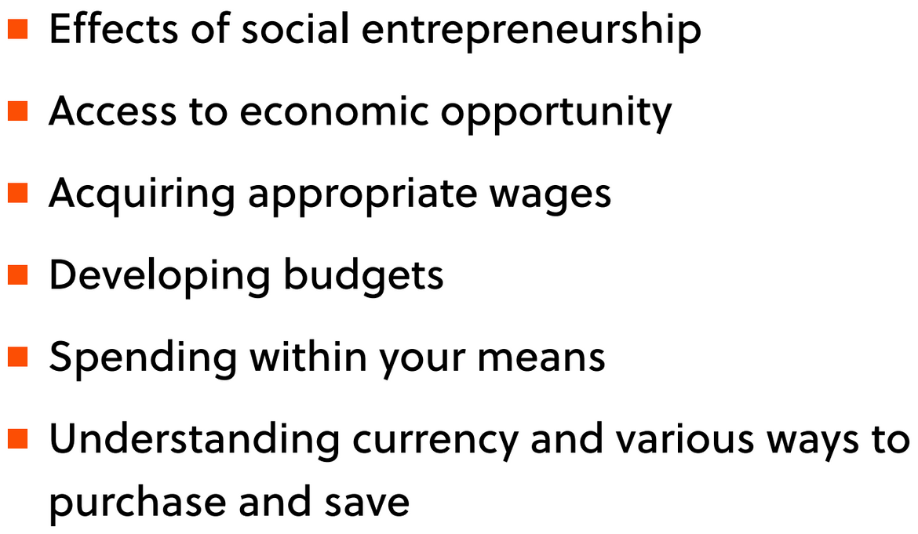
STEM AND INNOVATION
FINANCIAL LITERACY

Slide 12

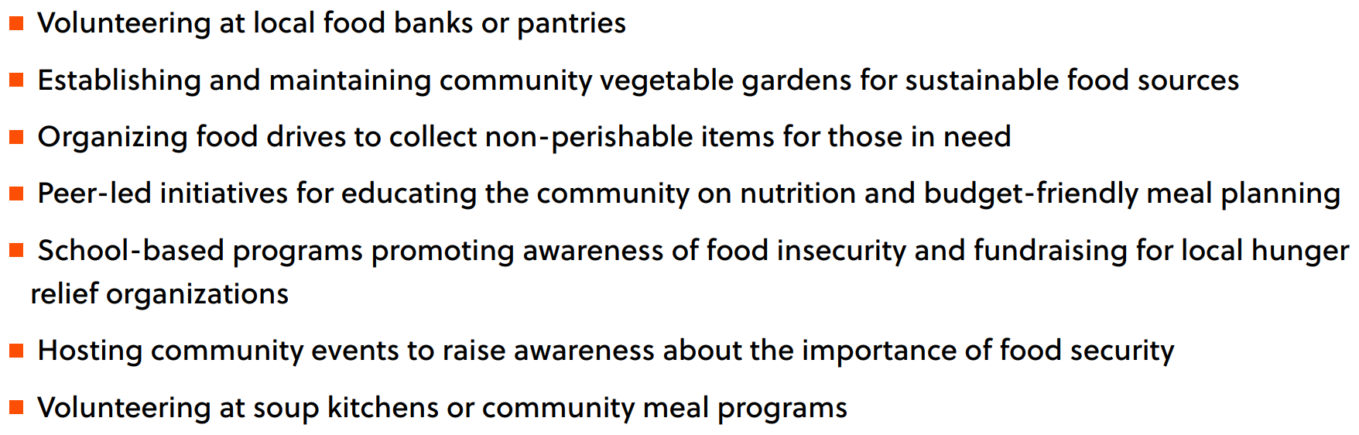
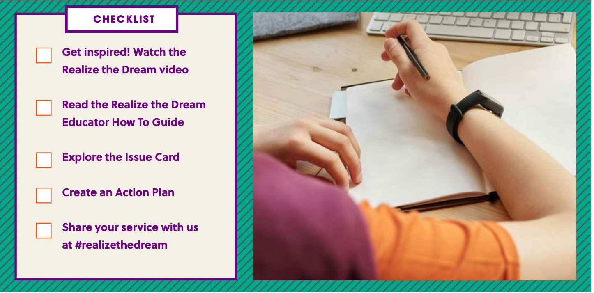


FOOD SECURITY

Slide 13
01
step
investigate and learn
WHAT DID YOU LEARN?
What local issues are you passionate about?
What local organizations would you like to volunteer for?
What value would you bring to an organization as a volunteer?

Slide 14
01
step
investigate and learn
NOW ZONE IN ON YOUR COMMUNITY!
Learn about the issues in your own backyard by taking a walk around your neighborhood and mapping out the issues.
What social issues are apparent in your community?
What issues were you most surprised by?
What organizations or businesses have been impacted the hardest by COVID-19 and how can you help?
How can you help address these issues?

Slide 15
02
step
Action Plan
SET YOUR GOAL
What will your community service be?
When will your community service take place?
How many hours of community service do you plan to do?
How will you measure your positive impact? (e.g., hours, actions, events.)
More people means more impact! How will you increase participation in your community service project?

Slide 16
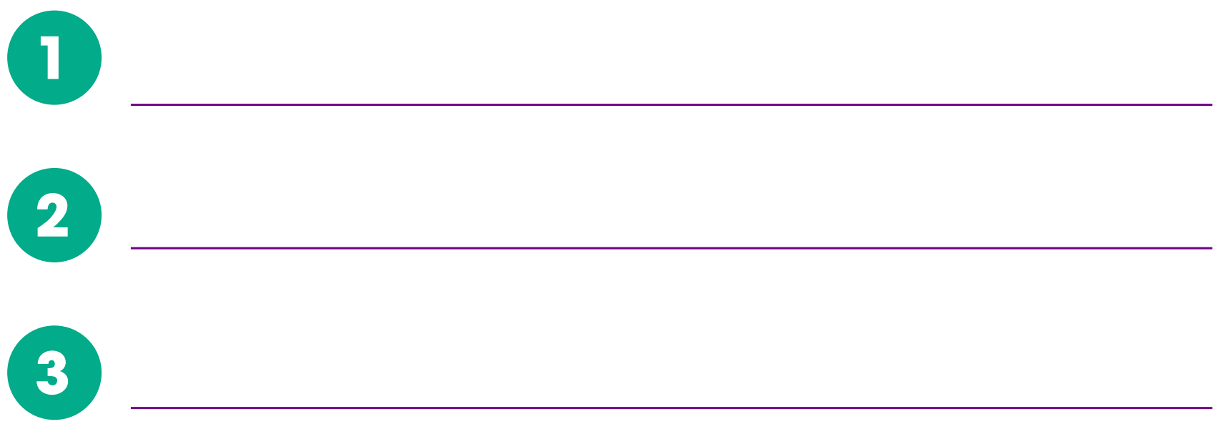
02
step
Action Plan
CREATE A TIMELINE
Create a timeline to help plan your actions! Plot the steps your group will take to gear up for your community service around the school or community, including how you will rally people together to participate.

Slide 17
02
step
Action Plan
MATERIALS
What supplies will you need?

Slide 18
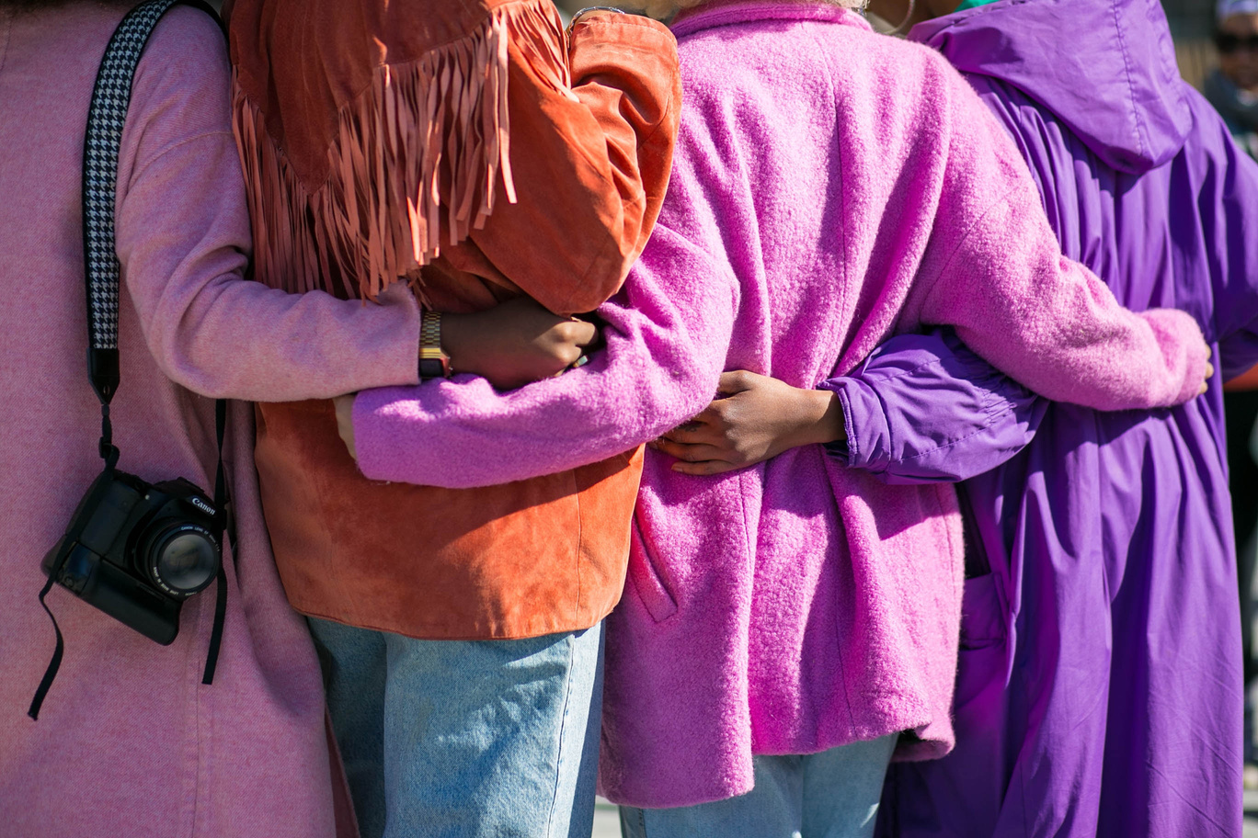
03
step
Take Action
IT’S TIME TO TAKE ACTION!
Rally your friends and community members together to become agents of change. By engaging in community service, you will be making a positive difference not just in your community but also in your own life!
TIP: GET CREATIVE AND FIND A FUN WAY TO RALLY PEOPLE TOGETHER SUCH AS MAKING A CATCHY NAME TO RAISE AWARENESS OR HOSTING AN EVENT ONLINE OR IN-PERSON!
Share your pictures, progress and community service actions on social media with #RealizetheDream.

Slide 19
03
step
Take Action
REFLECT
How did it feel to help others? Do you feel like you had an impact?
Why is it important to ask others to join you?
How will you take your community service actions further or continue your actions?

Slide 20

04
step
Report and Celebrate
SUMMARIZING YOUR COMMUNITY SERVICE IMPACT
How many different activities did you plan?
How many people did you get involved in community service actions?
How many hours, on average, did each person serve?
How have your thoughts on community service changed?

Slide 21
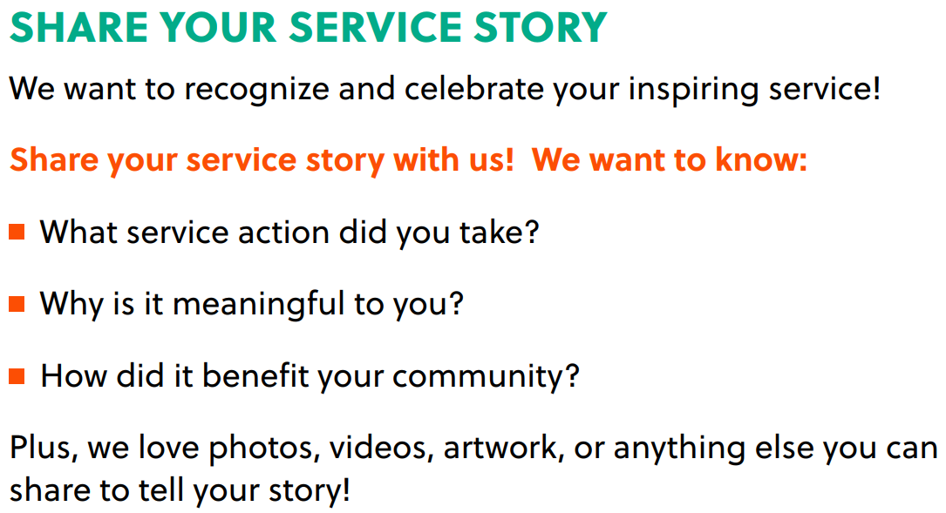
SHARE YOUR SERVICE STORY AND YOUR HOURS!
Click here or scan the QR code to share your story!
You can even receive special recognition opportunities and incentives for sharing it with us.

Slide 22




