Slide 1


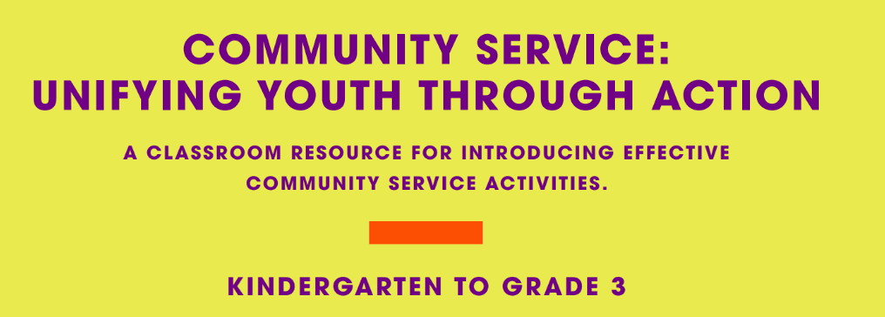

Slide 2


F r Teachers
Use this slide deck to help you through the lesson package.
More resources are available on www.realizethedream.org
We recommend that you maintain a log of the service activities and hours along the way. Once the class is finished, you can use this form to submit the hours and your story.
Be sure to take photos and videos of students’ service—
we want to highlight their stories of service on our platforms!
Realize the Dream Service Hour & Story Form

Slide 3
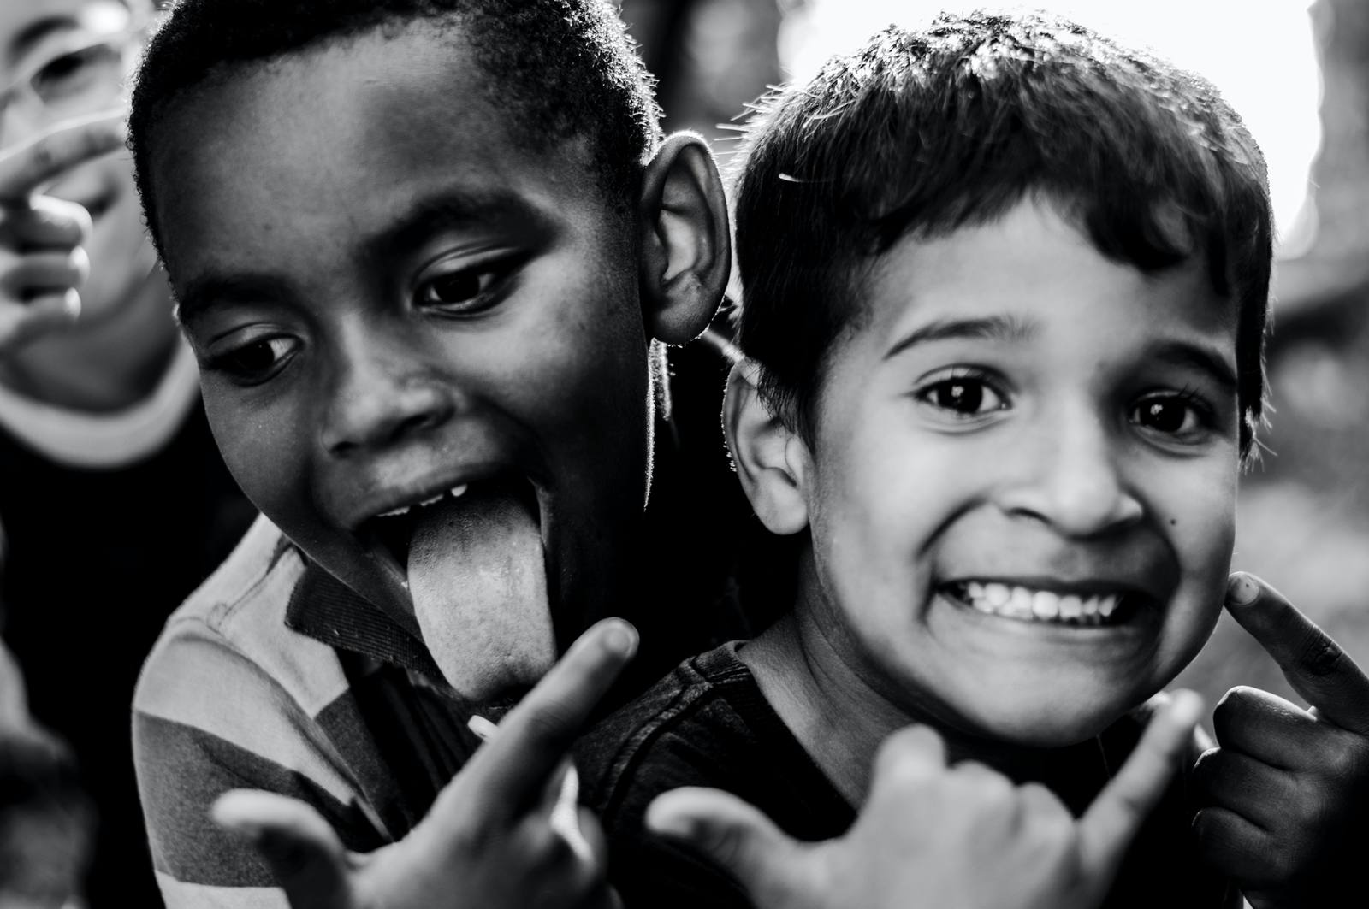


BE THE
CHANGE THAT MAKES
A DIFFERENCE.
Realize the Dream is a monumental initiative that incorporates experiential service learning in your classroom to inspire students to become engaged citizens.
Together, we’ll ignite a nation-wide movement through a bold call to action - achieving 100 million hours of service by the 100th anniversary of Dr. King’s birth in 2029.

Slide 4
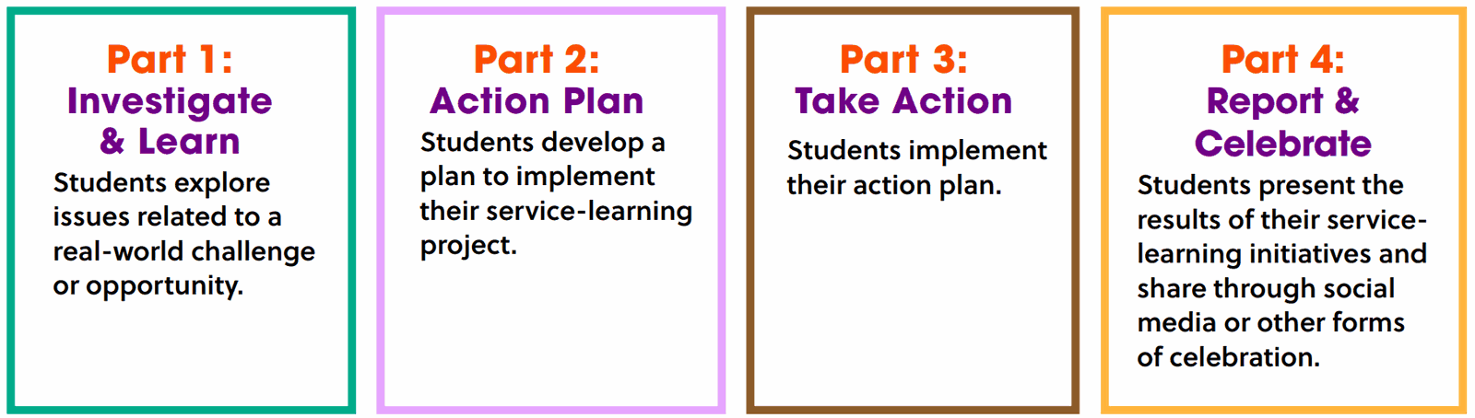


THE FOUR STEPS OF SERVICE LEARNING:

Slide 5


Slide 6

COMPLETE THE SENTENCE:
I can help (a person) by
.
TURN AND TALK:
  Do you help someone every day?
  Who do you help?
  How does helping make you feel?

Slide 7


THINK ABOUT IT...
  How does helping make you feel?
  How does it make the person you are helping feel?
CLASS DISCUSSION...
  Why do you continue to help people?
  Why is helping encouraged?

Slide 8

If video doesn’t work, click here!
As you watch, get ready to answer...
  What gave Gabriela the idea to clean the park?
  How can we help our community?

Slide 9

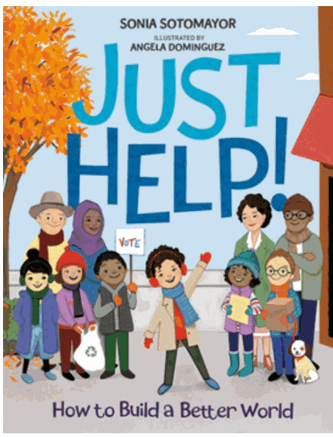
To replay, click here!
THINK-PAIR-SHARE
  What gave Gabriela the idea
to clean the park?
  How can we help
our community?

Slide 10

Discussion
  What did Sonia and her friends do to help in the community?
  How did each event lead to another form of helping by friends?
  Why is it important to help in the community?
  How did helping make Sonia and her friends feel?
  Why did Sonia’s mom ask her “how will you help today?” How did that relate to the rest of the story?

Slide 11

Reflection
Draw or Write:
  Who do you help?
  Where or how do you help?
  Why do you help?

Slide 12
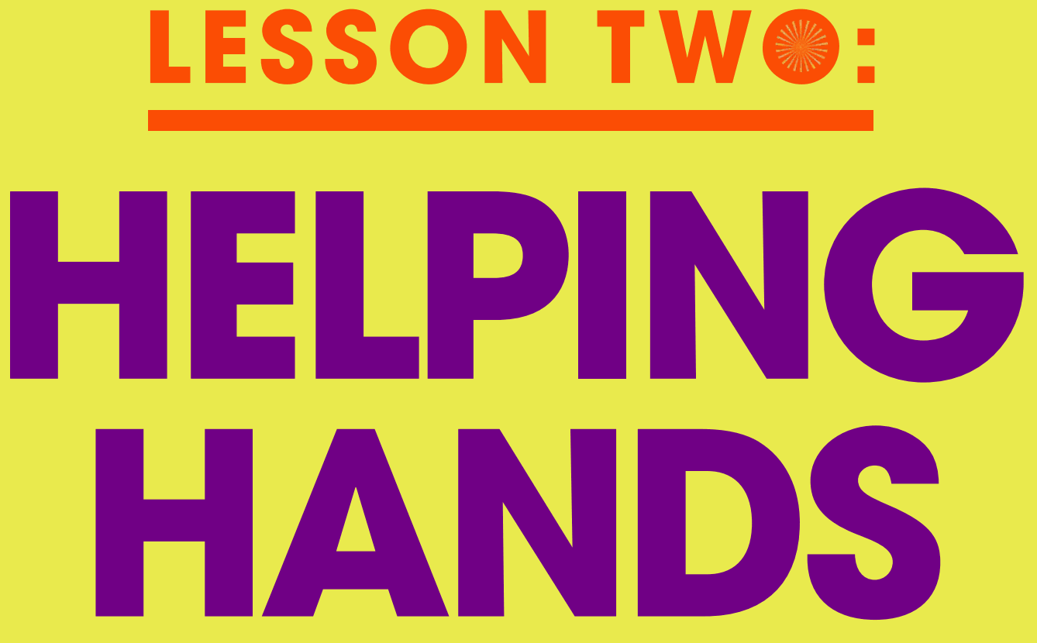

Slide 13
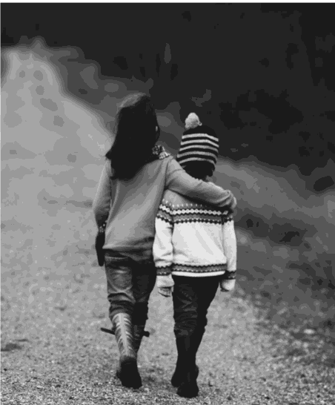

THERE ARE MANY WAYS AND OPPORTUNITIES
TO HELP OTHERS.
How can we help someone in our school or community?

Slide 14
THINK-PAIR-SHARE
  How does helping make you feel?
  How does it make the person you are helping feel?
  Why do you continue to help people?
  Why is helping encouraged?

Slide 15
If video doesn’t work, click here!
As you watch, get ready to answer...
  How did the Bears help in their community?
  How did they feel when they helped?

Slide 16
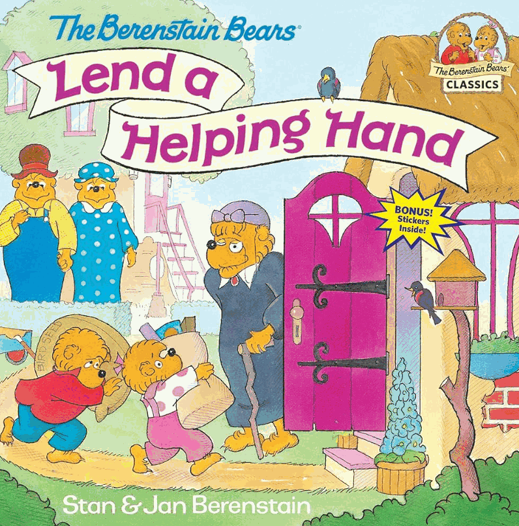
To replay, click here!
THINK-PAIR-SHARE
  How did the bears help in their community?
  How did the bears feel when they helped people?
  Why did the bears’ parents encourage them to help people in their community before they played with their friends?

Slide 17

Helping can be done
in many places.
  In Just Help, where did Sonia and her friends help in their local community?
  How can you help people in our community?

Slide 18
Kindergarten/1st grade
Complete this chart together as a class...
WAYS WE CAN HELP
School | Playground | Store

Slide 19
2nd/3rd grade
Complete this chart together as a class...
WAYS WE CAN HELP
In your group:
  Create a poster with a list of ways that you can help in your assigned area.
  Be ready to share your list with the class.
Classroom
Community
Playground
Home

Slide 20
BLACKLINE MASTER 1
HELPING HANDS
Draw two examples of how you have helped someone inside the school community and outside.
These helping hands helped by
. I felt because
.

Slide 21
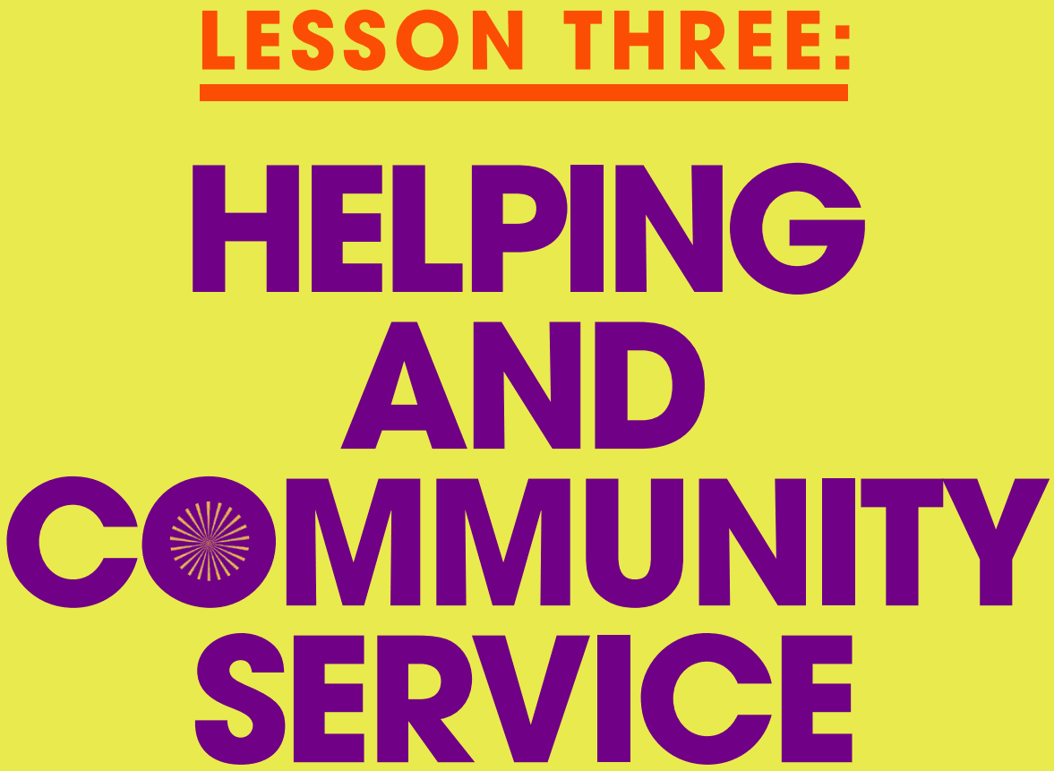

Slide 22

HELPING VS. COMMUNITY SERVICE
Help:
To make it easier or possible for somebody to do something by doing something for them or by giving them something that they need. Help often happens in the moment, not as a planned activity.
Community Service:
work helping people in the local community that somebody does without being paid. It is often organized and planned.

Slide 23
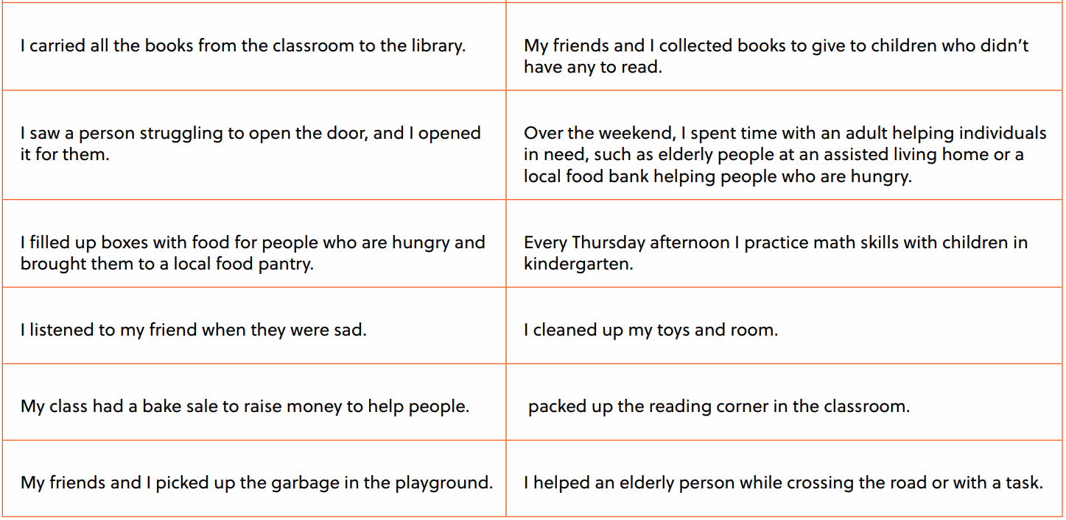
Kindergarten/1st grade
Safely move to the left side of the room if the example is “helping,”
safely move to the right side of the room if the example is “community service.”
HELPING
COMMUNITY SERVICE

Slide 24
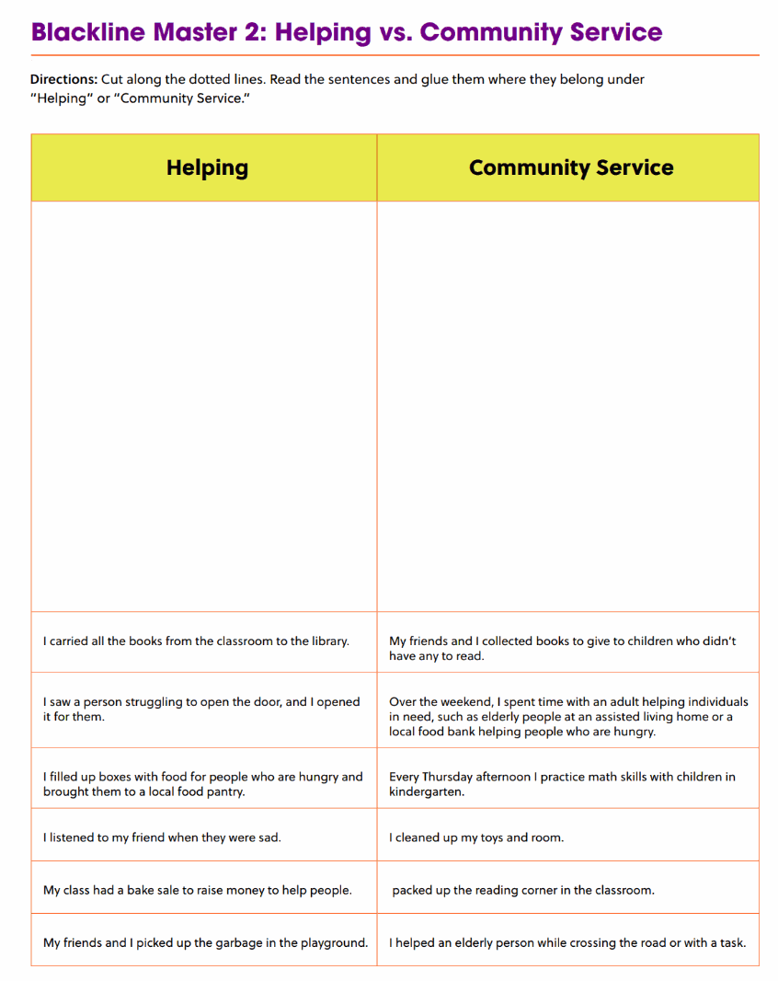
2nd/3rd grade

Slide 25

Click the picture to watch!
As you watch, get ready to answer...
  Was Arthur helping or doing community service?

Slide 26
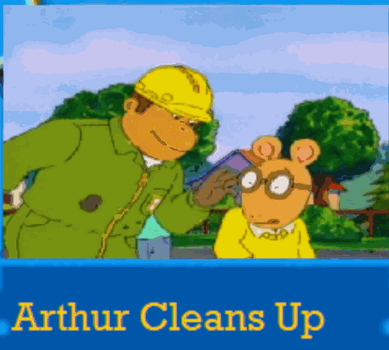
To replay, click here!
THINK-PAIR-SHARE
  What is the difference between helping or performing community service?
  Was Arthur helping or performing community service?

Slide 27
Reflection
  Why does Arthur’s dad encourage him to clean up the park?
  Are his friends supportive of the idea at first? What makes them change their mind?
  What was the process of cleaning up the park?
  Why was this an act of community service?
  Why is it important to engage in service in your local community?
  Think about the book we read The Bernstein Bears Lend a Helping Hand, how is this book and Arthur Cleans Up the same? How are they different?

Slide 28
Discussion
Look back at our chart or posters that we made about helping in our school and community.
As I read each one, think about whether they are community service or helping.

Slide 29

Kindergarten/1st grade
1
step
I Can Help
I Can Volunteer
Fold your paper in half
Draw a picture of you helping
Draw a picture of you volunteering/
performing community service.
2
step
Label the left side:
I Can Help
Label the right side
I Can Volunteer

Slide 30
2nd/3rd grade
1
I Can Help
I Can Volunteer
step
Fold your paper in half
  Write/illustrate 3 sentences explaining a way you can help.
  Why is it needed?
  How does it make someone feel?
  Write/illustrate 3 sentences explaining a way you can volunteer or do service.
  Why is it needed?
  How does it make someone feel?
2
step
Label the left side:
I Can Help
Label the right side
I Can Volunteer

Slide 31
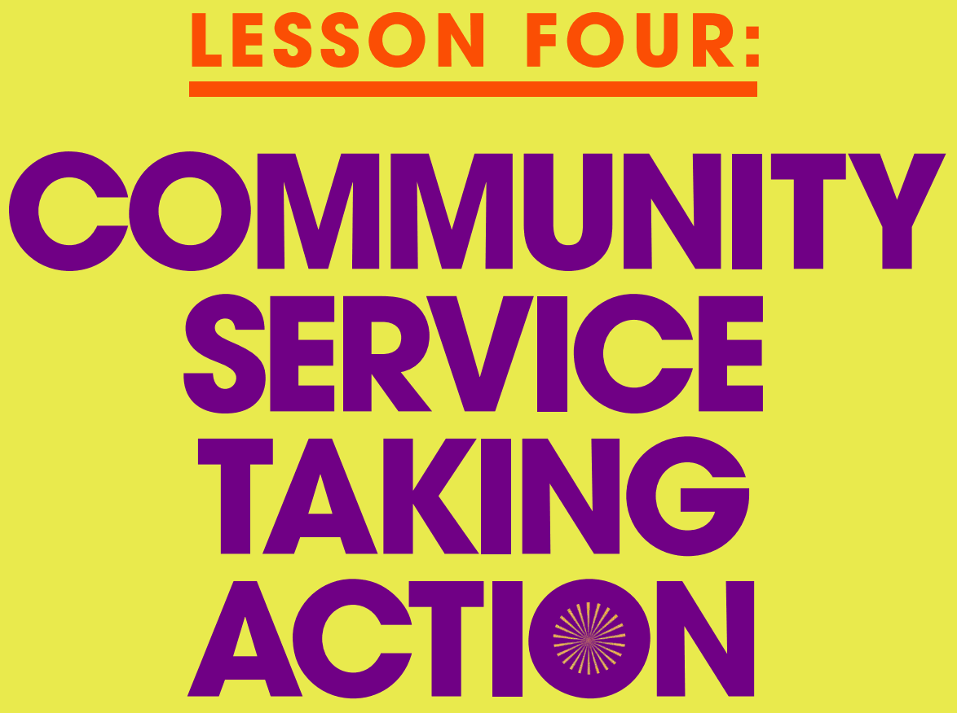

Slide 32
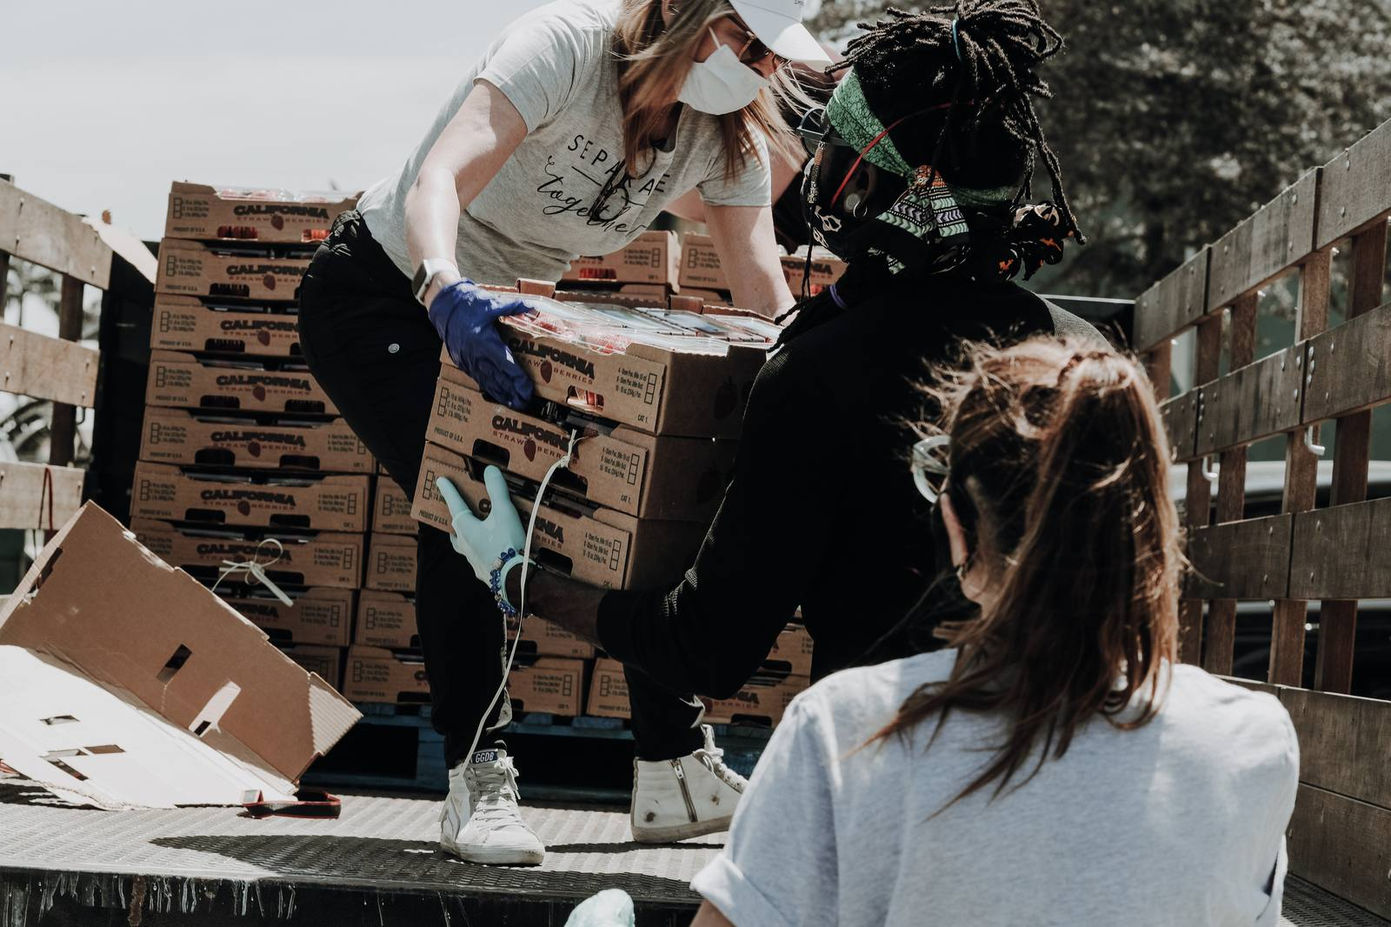

Ideas For Service
Share a community service idea you have.
Discuss...
  Why is it a good choice?
  How will it help?
  Let’s vote for our favorite.

Slide 33

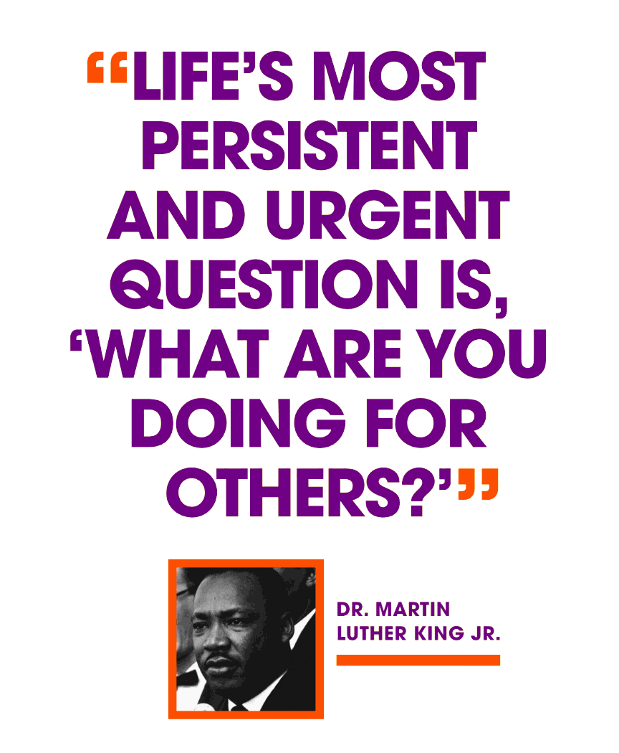
  Founded by Martin Luther King III, Arndrea Waters King and Yolanda Renee King
  Goal: 100 million hours of service by the 100th anniversary of Dr. Martin Luther King Jr.’s birth
  5-year program with students across America
  Positive impacts on communities
Through a service-learning project, you can make a positive impact on the world around you.

Slide 34
ACTION PLAN:
  How will our activity assist members of our school or community?
  How can we ensure that while we are participating in the activity, we will remember who we are trying to help?

Slide 35
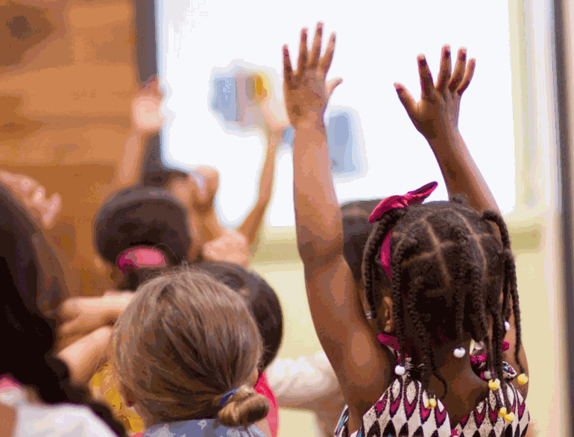
TAKE ACTION
Let’s create a list of jobs so we can make sure the project runs smoothly and our goal is met.

Slide 36
REPORT AND CELEBRATE
GROUP WORK:
  Create a video, blog or written visual reflection about the impact of the Realize the Dream initiative.
  Tell how the community service assisted our school or the local community.
  Explain how we can ensure our initiative will have a lasting impact

Slide 37
CONGRATULATIONS!
Now that you have completed the service-learning, reflect on:
  how our action raised awareness in our school about the importance of being involved in community service to help our school and community.
  how did you personally help in the community service experience.

Slide 38
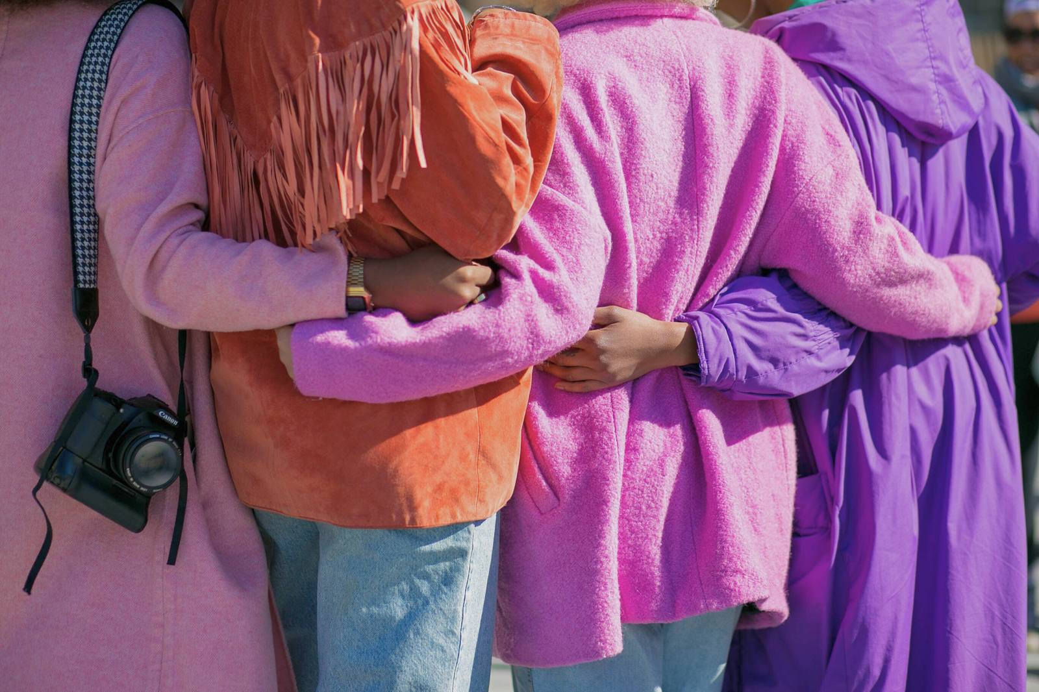


Thank you!

